Slide 1

Chobir Baksho AI
Bangladesh's First AI-Powered Creative Studio
🏆 BASIS National ICT Award (Marketing Solution) | Banglalink Incubator | ideaTHON Winner
Founder & CEO: Imtiaz Ahmed — A Maze Venture
📍 Dhaka, Bangladesh

Slide 2


The Creative Bottleneck in Bangladesh
High production cost of visuals
Foreign stock assets lacking local relevance
Slow turnaround for campaigns
Small creators & SMEs excluded from premium content tools
"Creative quality shouldn't be limited by cost or complexity."

Slide 3
AI-Powered Content Creation — In Bangla, For Bangladesh
Text → Image
Fashion Try-On
Product Photography
Bangla & English
Bangladeshi models
Automation
Festival Ad Templates
AI Video Scene Builder
Localized designs
Dynamic content
"From Idea to Ad — in Minutes."

Slide 4

Product Ecosystem
Studio
Brand Kits
Marketplace
APIs
Studio
Marketplace
Brand Kits
APIs
One-click AI creative tool
Localized AI stock & templates
Colors, fonts, and identity presets
Connect to Shopify, WooCommerce, Meta Ads

Slide 5
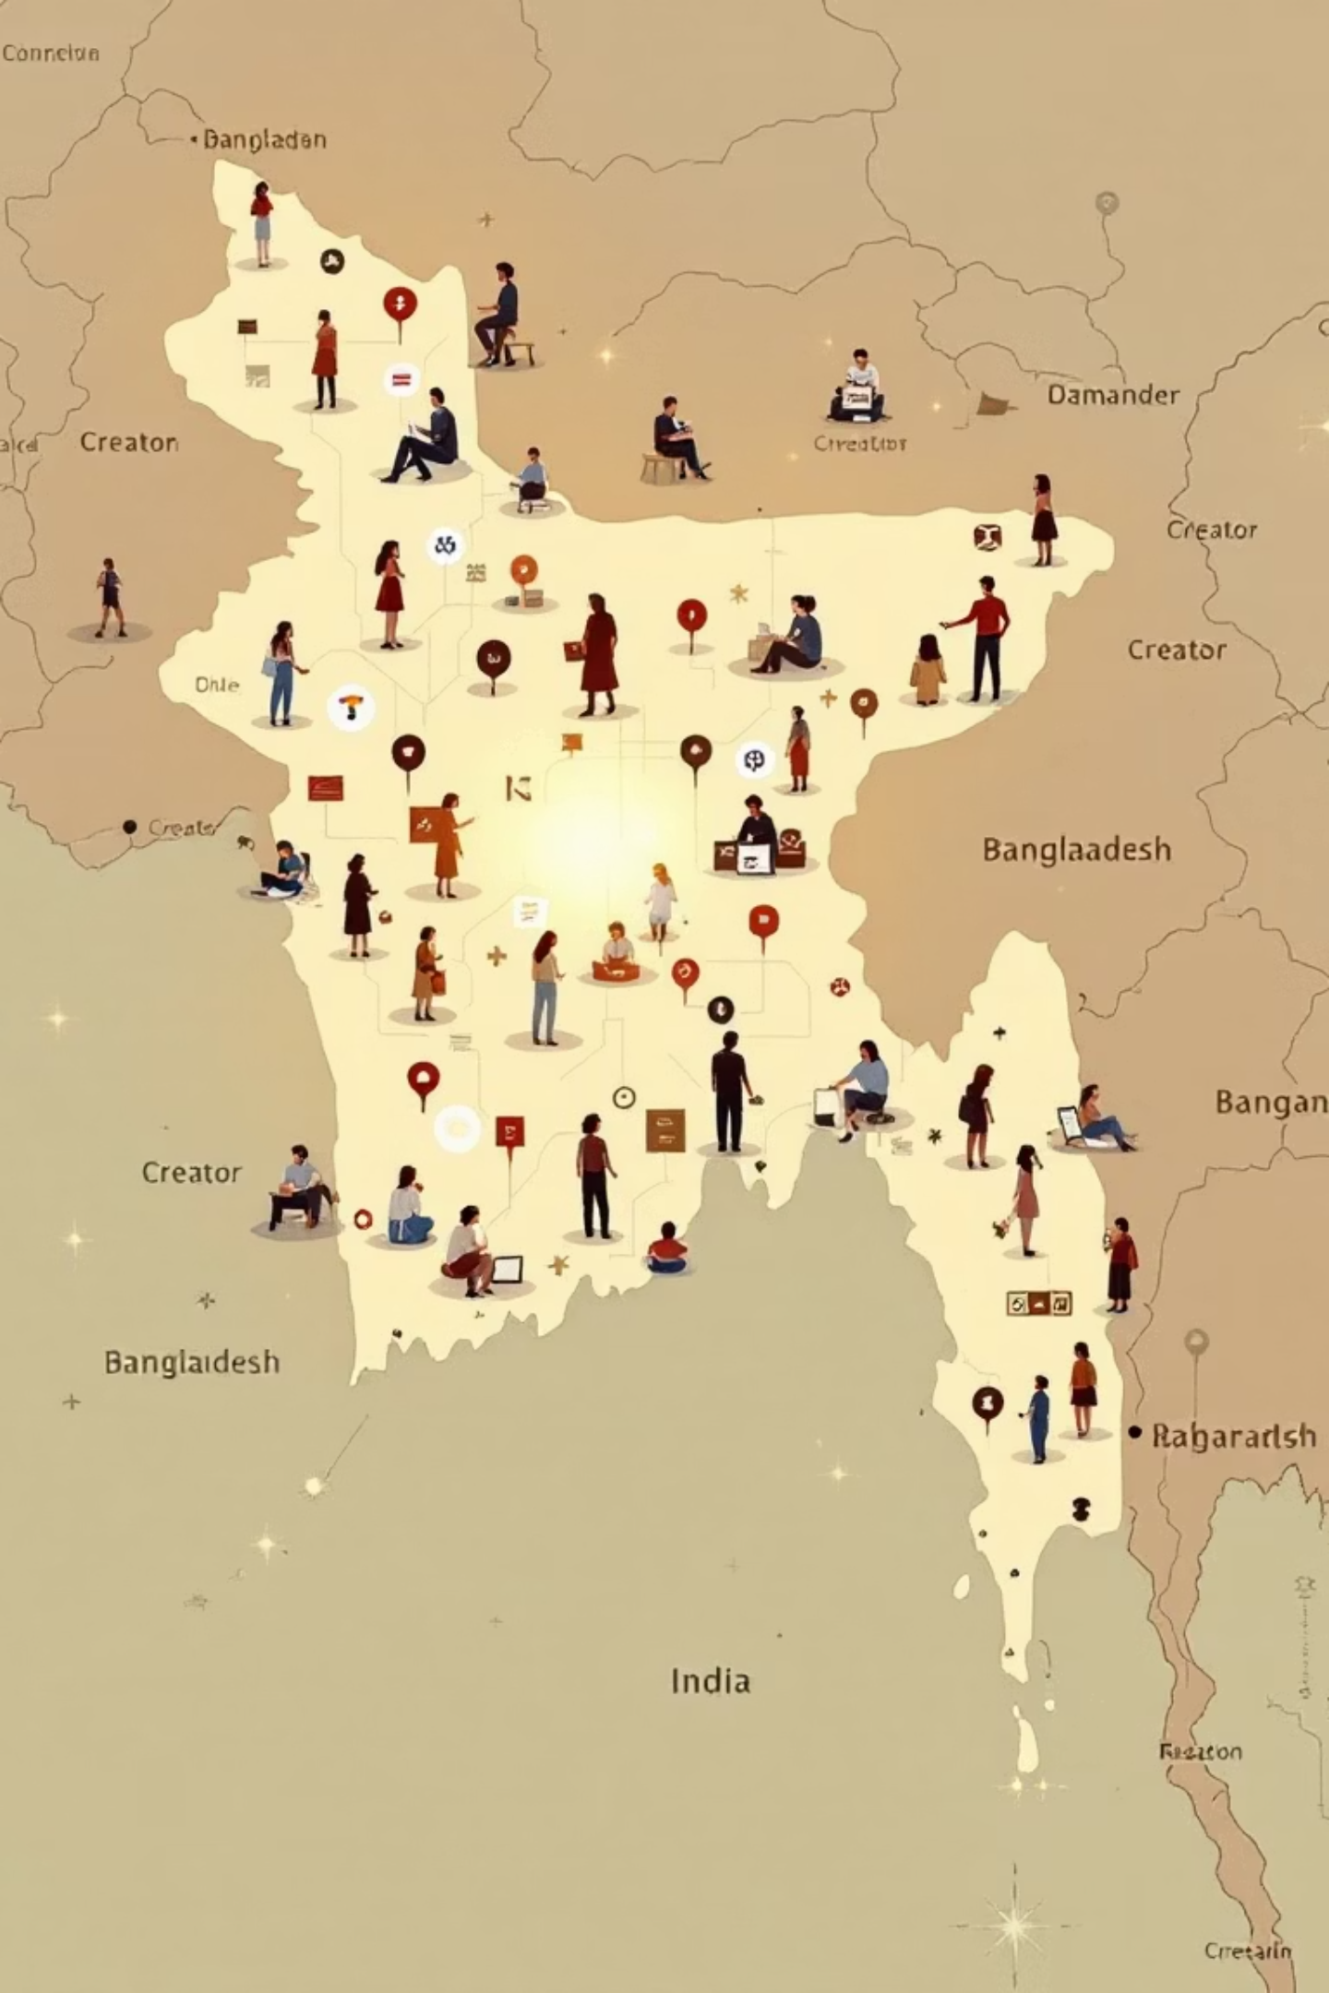
Creative Economy Ready for Disruption
$600M+
100K+
1M+
Annual ad production spend
SMEs & 30K e-commerce sellers
Active creators across TikTok, YouTube, Facebook
4
Regional expansion: Bengali diaspora in UK, MY, IN, SA

Slide 6
Technology & IP
Localized AI Models
Patented Object-Merge Engine
Bangla Tokenization
Trained on Bangladeshi visuals
Native-language support
Combines multi-image compositions
MLOps Architecture
Trust & Safety
Scalable GPUs, FastAPI backend
Watermarking, filters, provenance logs

Slide 7
Traction & Recognition
MVP Development
1
Bangla prompt support
2
15+ Presets
Localized AI scenes
Pilot MOUs
3
Ad agencies & e-commerce
4
BASIS Award
Marketing Solution
Banglalink Winner
5
Incubator Program
6
ideaTHON Winner
ICT Division & Ministry of Justice, South Korea
iDEA Project
7
Portfolio Startup, ICT Division

Slide 8
Business Model & Pricing
Tier
Price (BDT/mo)
Credits
Key Features
Starter
1,200
300
Studio + Templates
Pro
4,900
1,600
Brand Kits + API Access
Agency
19,900
8,000
Team Seats, LoRAs
Enterprise
Custom
—
Private Models, SLAs
Add-ons: Fashion Try-On (৳0.5–2/img), 360° Hosting (৳1,000/mo), Marketplace Packs (৳200–5,000)

Slide 9
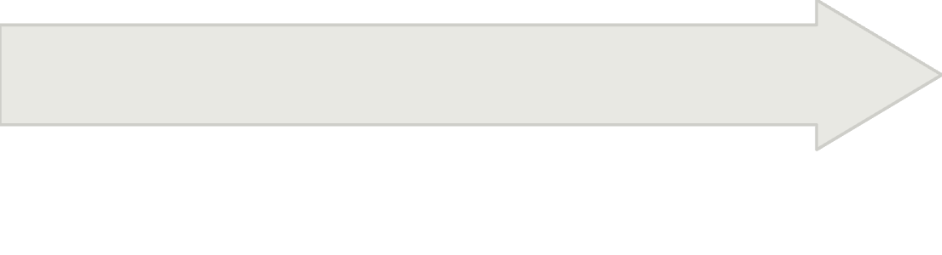
Roadmap & Metrics
Phase 3 (6–12 mo)
Phase 2 (3–6 mo)
Video AI, enterprise API, diaspora market
Phase 1 (0–3 mo)
Marketplace 1.0, Shopify/Canva plugins, Object-Merge beta
MVP, 5 agencies, 50 SMBs, 15 presets
Key Performance Indicators
70% Gross Margin
CAC payback < 2 mo
NPS ≥ 45
NRR > 110%

Slide 10

Empowering Bangladesh's Next Creative Revolution
Mission Statement: To make AI-powered creativity accessible to every Bangladeshi business, brand, and creator.
Our Ask
Strategic Partners — agencies, telecoms, accelerators
$250K Seed Round — scale GPU infra, dataset expansion, GTM
Contact
Imtiaz Ahmed
📧 info@amazeventure.com
🌐 www.amazeventure.com

