Slide 1

PRESENTER FULL NAME: SULE YILDIRIM YAYILGAN
ORGANIZATION: NORWEGIAN UNIVERSITY OF SCIENCE AND TECHNOLOGY
WORKSHOP NAME: Digital and Smart Health
E-MAIL: sule.yildirim@ntnu.no

Slide 2
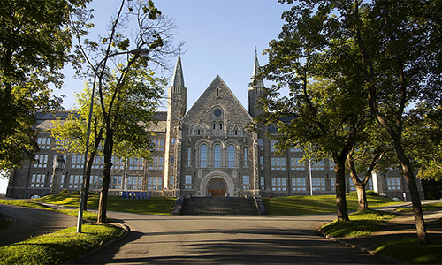
Norwegian University of Science and Technology
43 550
Students
8960
Employees
390
Study programmes
NTNU is an international oriented university with headquarters in Trondheim and campuses in Gjøvik and Ålesund.

Slide 3

Multidisciplinary Research group on Privacy and data protEcTion (MR PET)
Focuses on research related to the right to the protection of personal data. Personal data must be processed fairly for specified purposes and on the basis of the consent of the person concerned, or some other legitimate basis laid down by law (GDPR).
Expertise:
ArtificiaI Intelligence
Machine Learning
Deep Learning
Large Language Models, Cybersecurity
Privacy and Data Protection Trustworthy AI
Application Areas
Health
Energy
Education
....

Slide 4

Your Research Fields
Privacy and Data Protection in Healthcare
Blockchain technologies across land borders
Image Quality enhancement in MEDical diagnosis, monitoring and treatment
Healthcare Metaverses

Slide 5

Relevant Projects
IQ-MED: Image Quality enhancement in MEDical diagnosis, monitoring and treatment funded by the Research Council of Norway
Development of a pilot database for handling information on injured persons in alpine facilities is funded by the Regional Research Funds Norway, Inland (RFF-Inland)
Other projects in various application areas
Sule Yildirim Yayilgan - NTNU

Slide 6
Project Idea
Utilizing blockchain technologies for addressing privacy and data protection in and across European borders for emergency management
Call Topic: in the process of searching for a convenient call. Possible to join forces on an existing project proposal with similar lines of scope.
Deadline Dates:
Objectives:
- Understanding and addressing privacy and data protection challenges in cross border healthcare management especially for emergency cases using blockchain technology.
- Showcasing the benefit of blockchain technology for cross border healthcare management on a real healthcare infrastructure
Expected Results:
- A clear identification of roles in access management in emergency situations at county and international levels to secure health care services without sacrificing for privacy and data protection of healthcare data

Slide 7
Consortium – required partners
No | Expertise | Type | Country | Role in the project
01 | EHR management software developer and provider | SME | EU & Turkiye | Technical infrastructure
02 | Hospitals | Public\Private | EU & Turkiye | Healthcare emergency management knowledge and experience
03 | R&I in healthcare emergency management | University\ Research Institute | EU & Turkiye | Emergency management scenarios critical for Europe
04 | Privacy and data protection | Law institution – Public\Private | EU & Turkiye | GDPR, ethical aspects

Slide 8

PRESENTER CONTACT
DETAILS: Sule Yildirim Yayilgan
Sule.yildirim@ntnu.no
+47 466 231 72
COUNTRY: Norway

