Slide 1
PRODUCT REFERENCE • 14 COMPONENTS
F-16 / IDF
Precision Components
AI-rendered product visualizations based on supplied component photographs
Zhuyang Technology Corporation
For visual reference only • Not an engineering drawing
2026
Notes:
[Sources]
- Title and company information supplied in the conversation; no external assets used.
[/Sources]

Slide 2
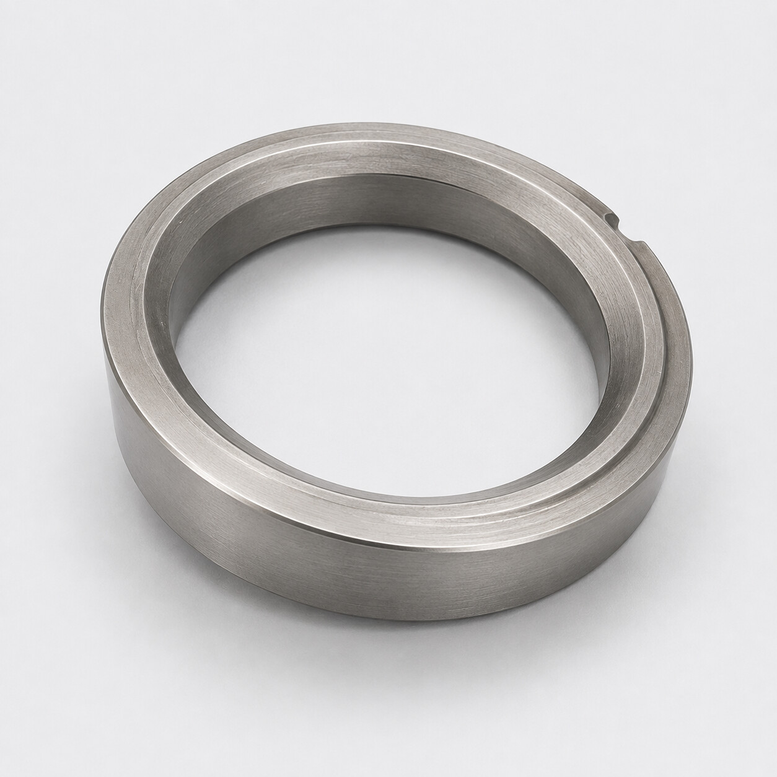
ZHUYANG TECHNOLOGY CORPORATION
FUEL CONTROL
No. 1
Lower Spacer
F-16 Fuel Flow Ratio Motor (1044)
AI-rendered visual reference based on supplied photographs • Not an engineering drawing
01 / 14
Notes:
[Sources]
- User-provided reference photograph: /workspace/scratch/d46b5ac1cbd3/upload/01-1000026844.jpg
- AI-rendered product visualization: /workspace/scratch/d46b5ac1cbd3/ppt_assets/01_4100736-1_lower_spacer.png
[/Sources]

Slide 3
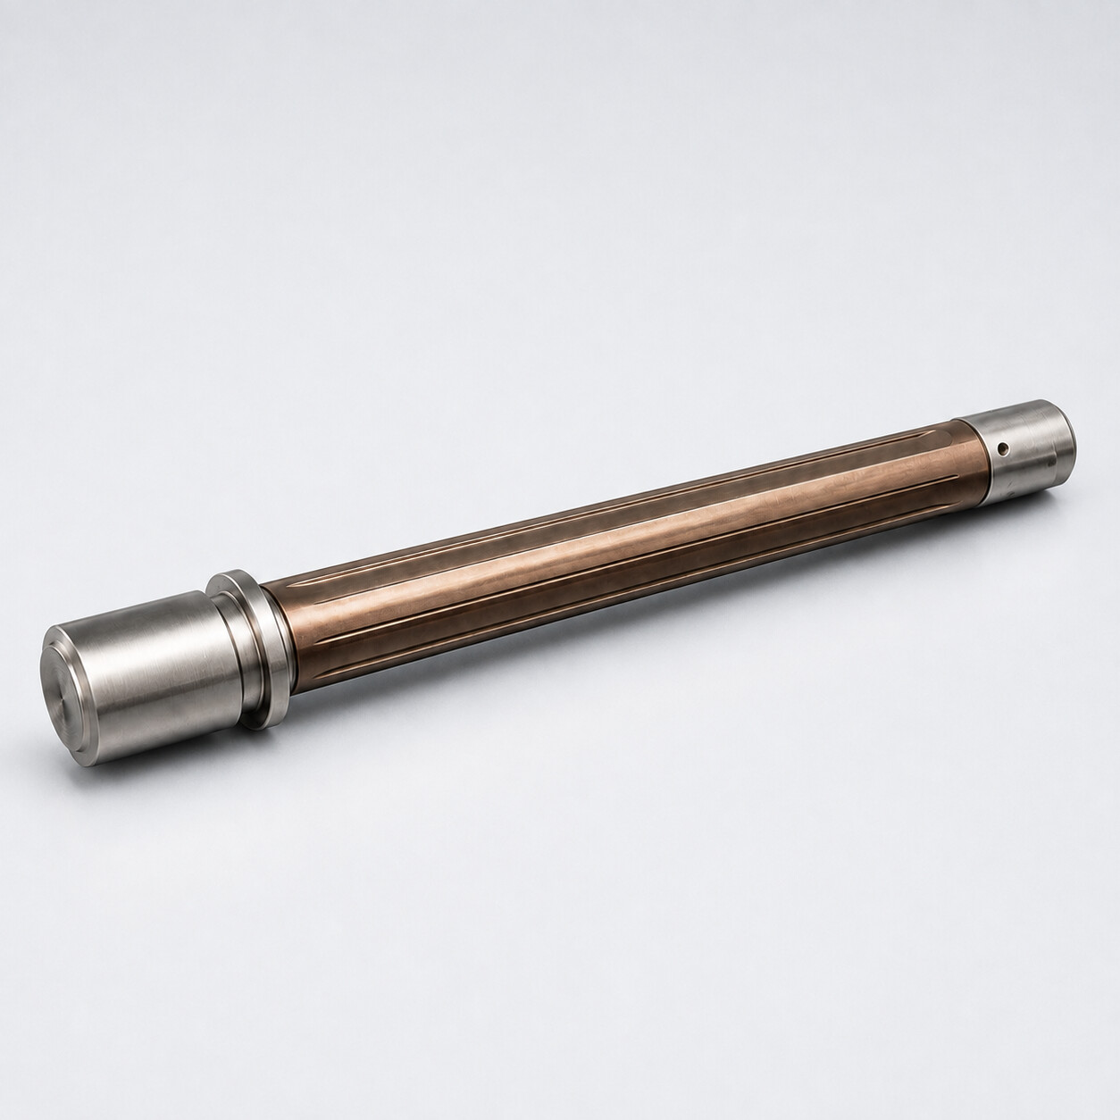
ZHUYANG TECHNOLOGY CORPORATION
HYDRAULIC SYSTEM
No. 2
Piston
F-16 Hydraulic Reservoir (800)
AI-rendered visual reference based on supplied photographs • Not an engineering drawing
02 / 14
Notes:
[Sources]
- User-provided reference photograph: /workspace/scratch/d46b5ac1cbd3/upload/01-1000026854.jpg
- AI-rendered product visualization: /workspace/scratch/d46b5ac1cbd3/ppt_assets/02_2751665-2_piston.png
[/Sources]

Slide 4
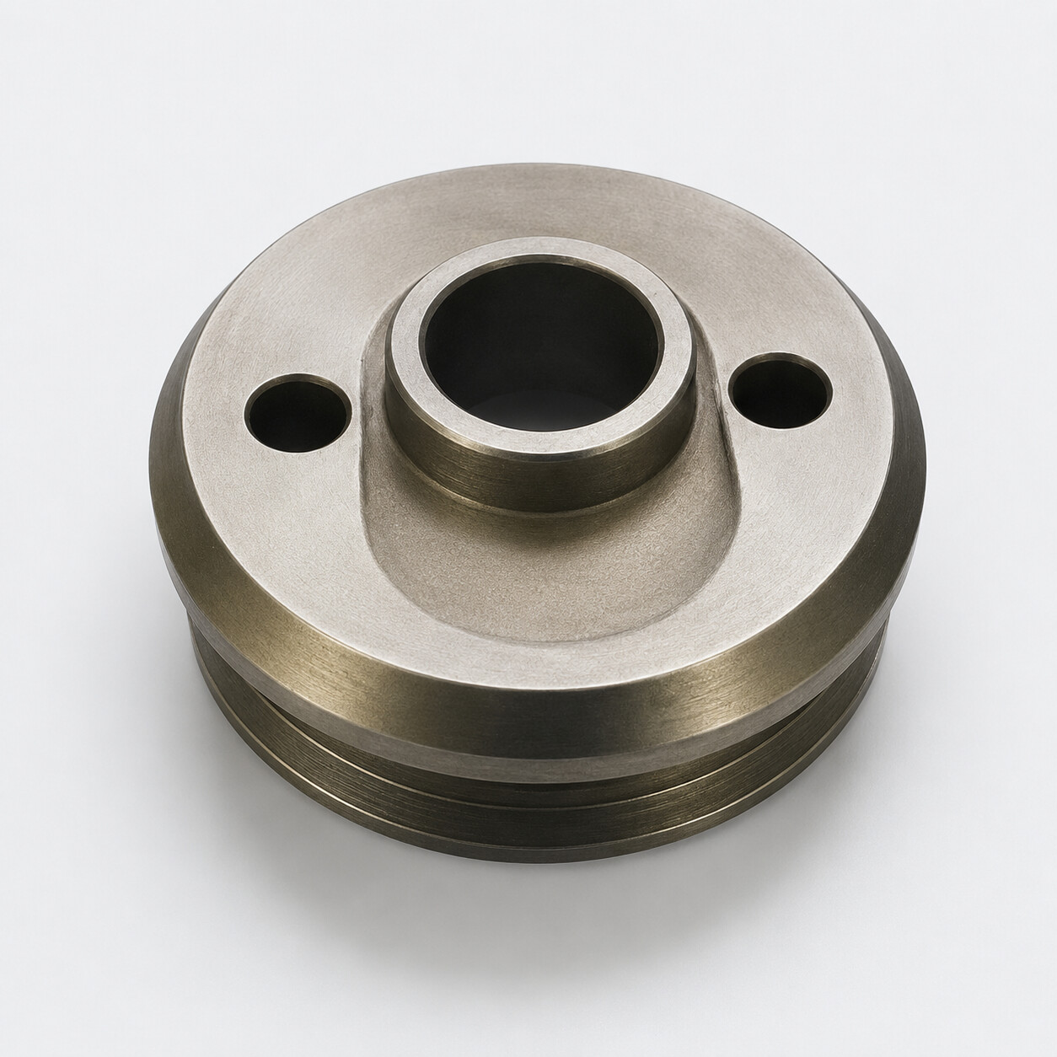
ZHUYANG TECHNOLOGY CORPORATION
NOSE LANDING GEAR
No. 3
Outer Housing
F-16 Nose Landing Gear (9655)
AI-rendered visual reference based on supplied photographs • Not an engineering drawing
03 / 14
Notes:
[Sources]
- User-provided reference photograph: /workspace/scratch/d46b5ac1cbd3/upload/02-1000026847.jpg
- AI-rendered product visualization: /workspace/scratch/d46b5ac1cbd3/ppt_assets/03_12111180-125_outer_housing.png
[/Sources]

Slide 5
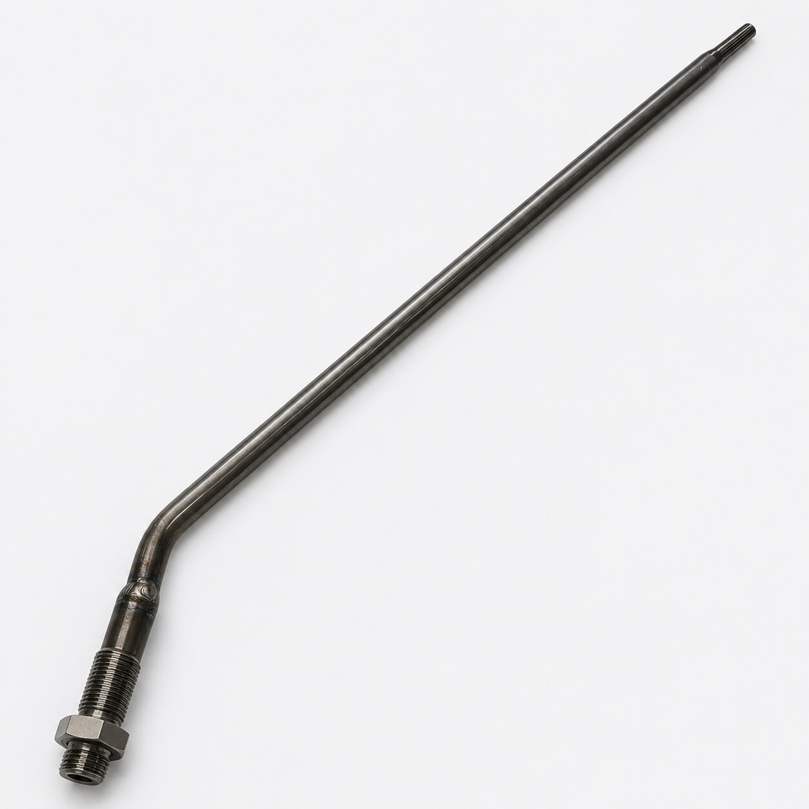
ZHUYANG TECHNOLOGY CORPORATION
NOSE LANDING GEAR
No. 4
Tube
F-16 Nose Landing Gear (9655)
AI-rendered visual reference based on supplied photographs • Not an engineering drawing
04 / 14
Notes:
[Sources]
- User-provided reference photograph: /workspace/scratch/d46b5ac1cbd3/upload/02-1000026848.jpg
- AI-rendered product visualization: /workspace/scratch/d46b5ac1cbd3/ppt_assets/04_12111180-113_tube.png
[/Sources]

Slide 6
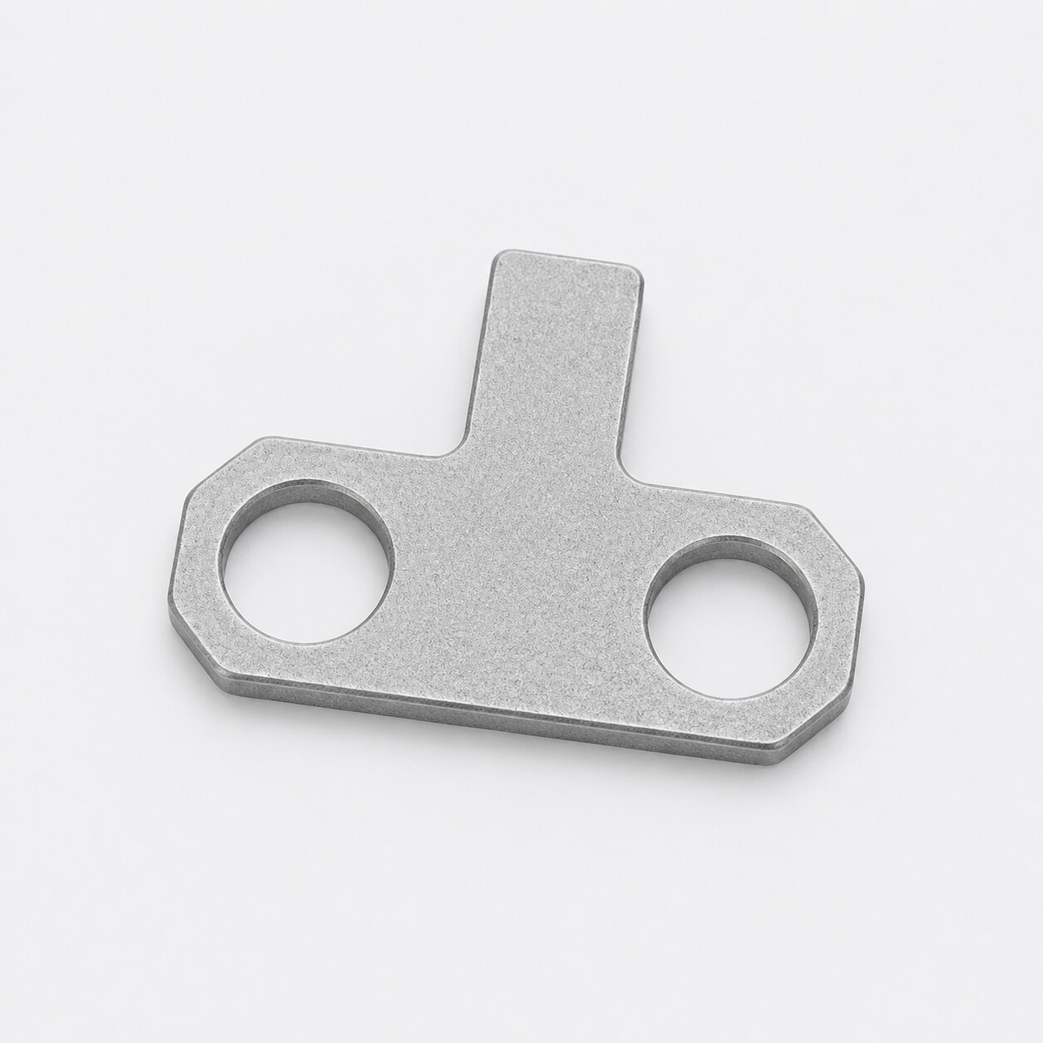
ZHUYANG TECHNOLOGY CORPORATION
NOSE LANDING GEAR
No. 5
Lock Plate
F-16V Nose Landing Gear
AI-rendered visual reference based on supplied photographs • Not an engineering drawing
05 / 14
Notes:
[Sources]
- User-provided reference photograph: /workspace/scratch/d46b5ac1cbd3/upload/03-1000026846.jpg
- AI-rendered product visualization: /workspace/scratch/d46b5ac1cbd3/ppt_assets/05_2007646-1_lock_plate.png
[/Sources]

Slide 7
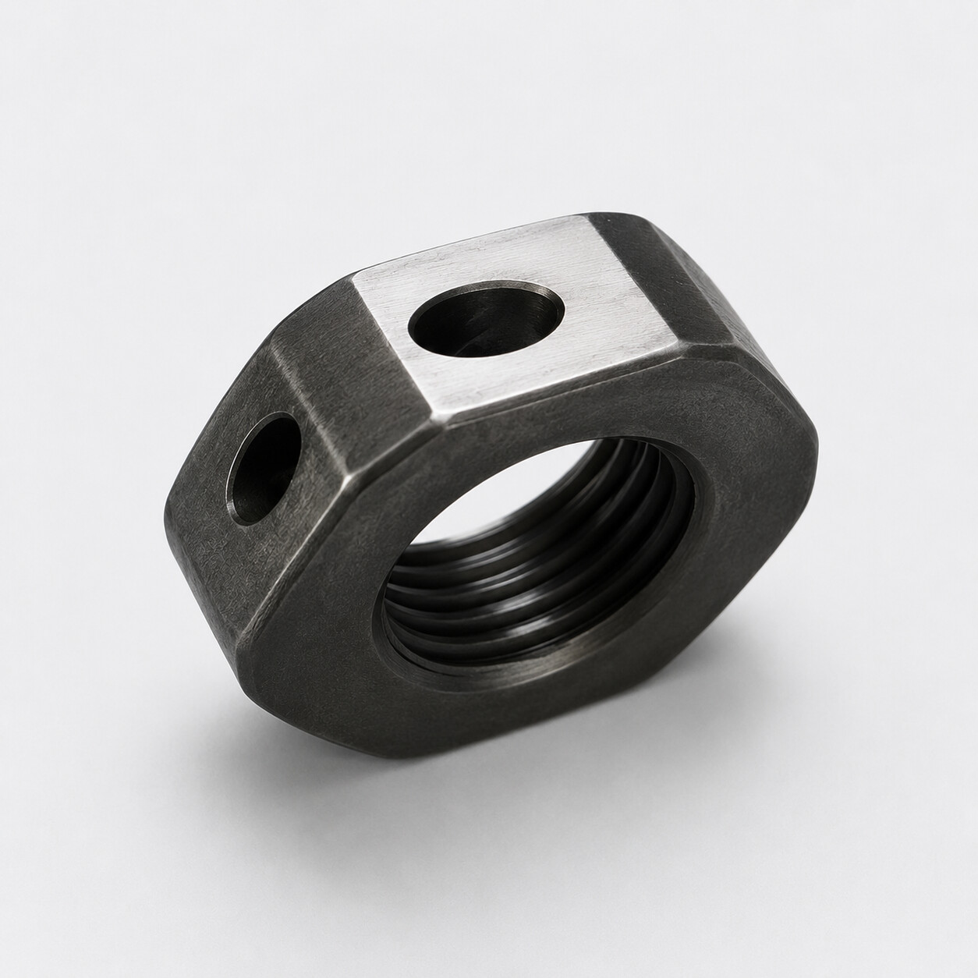
ZHUYANG TECHNOLOGY CORPORATION
NOSE LANDING GEAR
No. 6
Nut
F-16 Nose Landing Gear (9655)
AI-rendered visual reference based on supplied photographs • Not an engineering drawing
06 / 14
Notes:
[Sources]
- User-provided reference photograph: /workspace/scratch/d46b5ac1cbd3/upload/03-1000026849.jpg
- AI-rendered product visualization: /workspace/scratch/d46b5ac1cbd3/ppt_assets/06_12111180-130_nut.png
[/Sources]

Slide 8
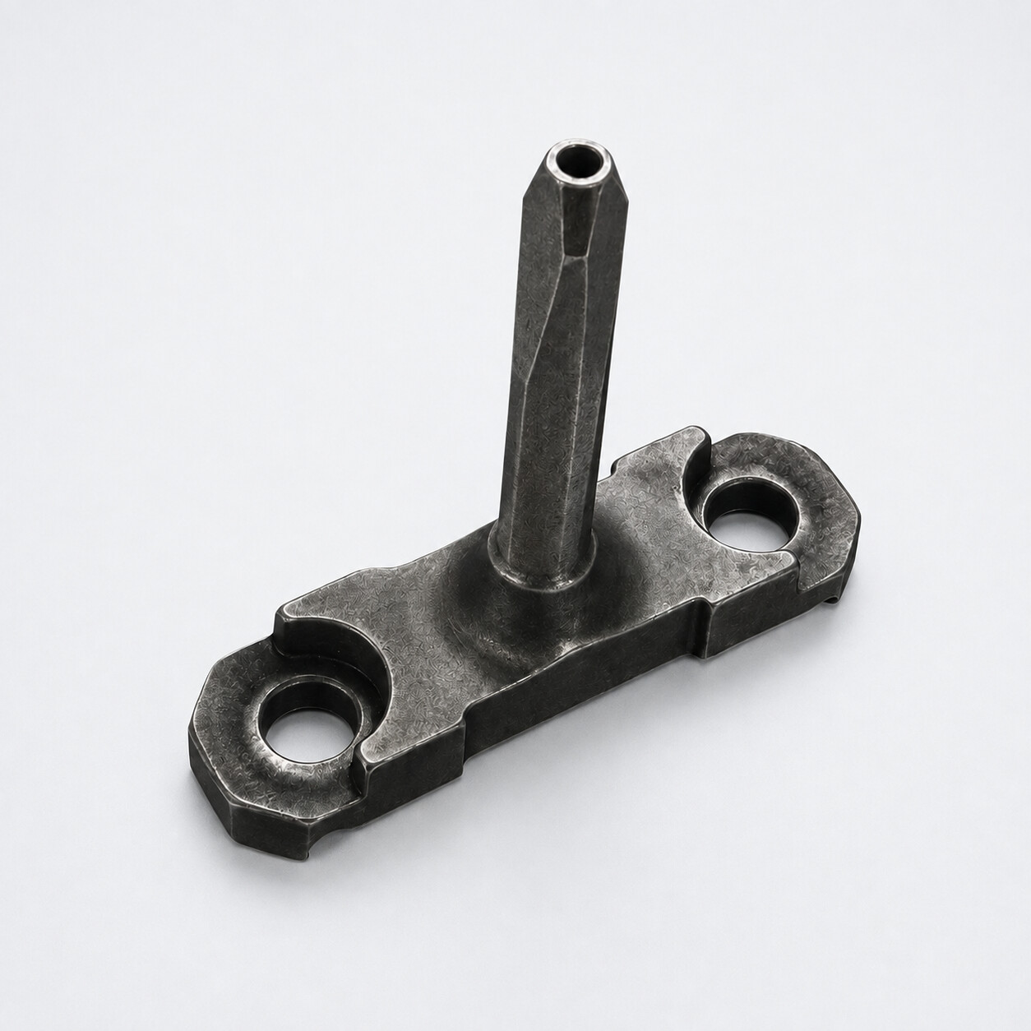
ZHUYANG TECHNOLOGY CORPORATION
NOSE LANDING GEAR
No. 7
Roller-Shaft Cover
F-16 Nose Landing Gear Brake (9655)
AI-rendered visual reference based on supplied photographs • Not an engineering drawing
07 / 14
Notes:
[Sources]
- User-provided reference photograph: /workspace/scratch/d46b5ac1cbd3/upload/04-1000026845.jpg
- AI-rendered product visualization: /workspace/scratch/d46b5ac1cbd3/ppt_assets/07_12111180-121_roller_shaft_cover.png
[/Sources]

Slide 9
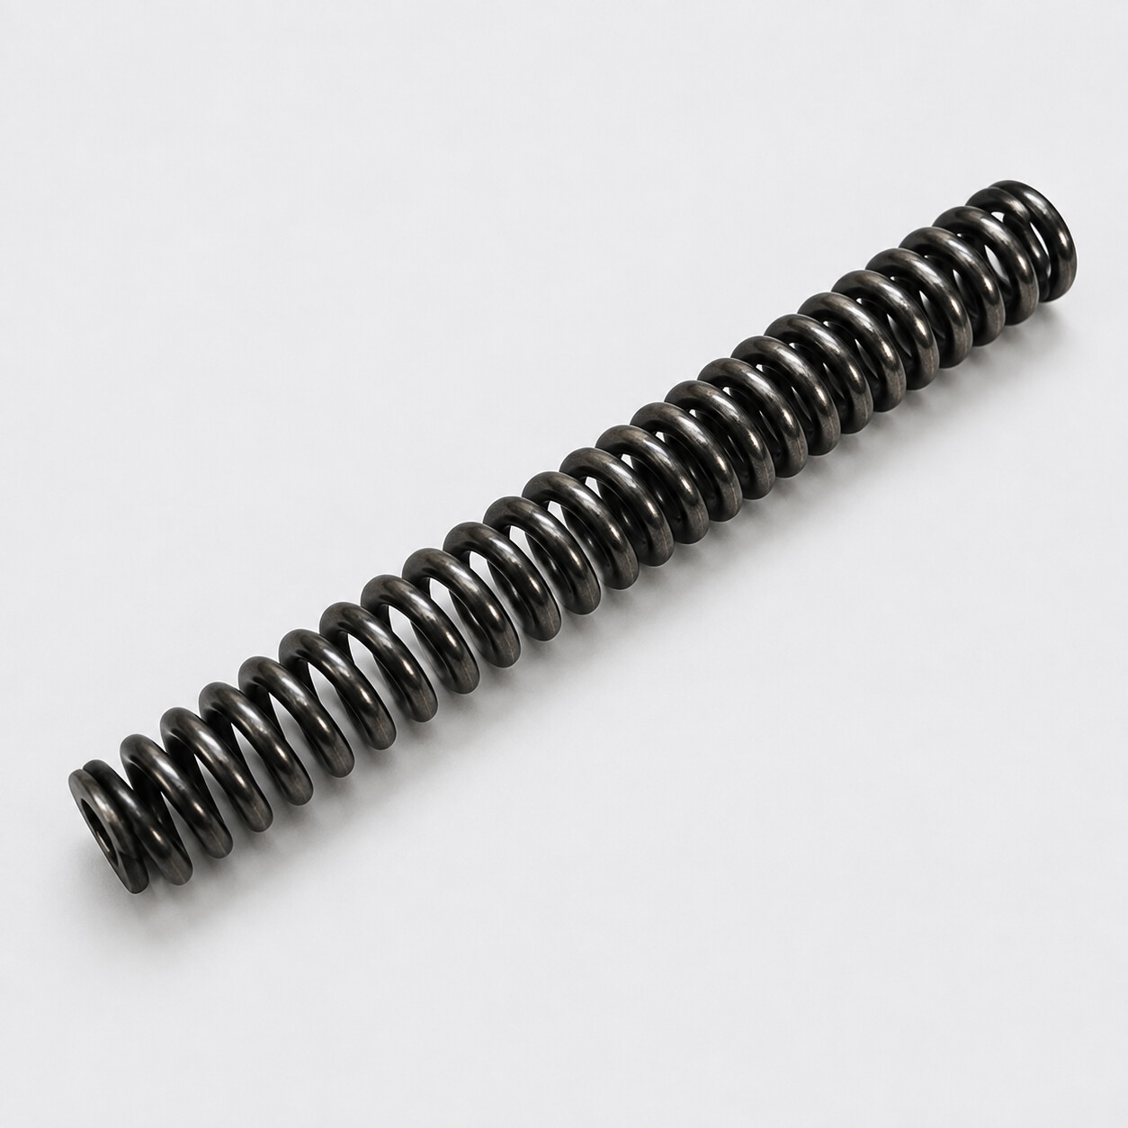
ZHUYANG TECHNOLOGY CORPORATION
NOSE LANDING GEAR
No. 8
Spring
F-16 Nose Landing Gear (9655)
AI-rendered visual reference based on supplied photographs • Not an engineering drawing
08 / 14
Notes:
[Sources]
- User-provided reference photograph: /workspace/scratch/d46b5ac1cbd3/upload/04-1000026850.jpg
- AI-rendered product visualization: /workspace/scratch/d46b5ac1cbd3/ppt_assets/08_12111179-115_spring.png
[/Sources]

Slide 10
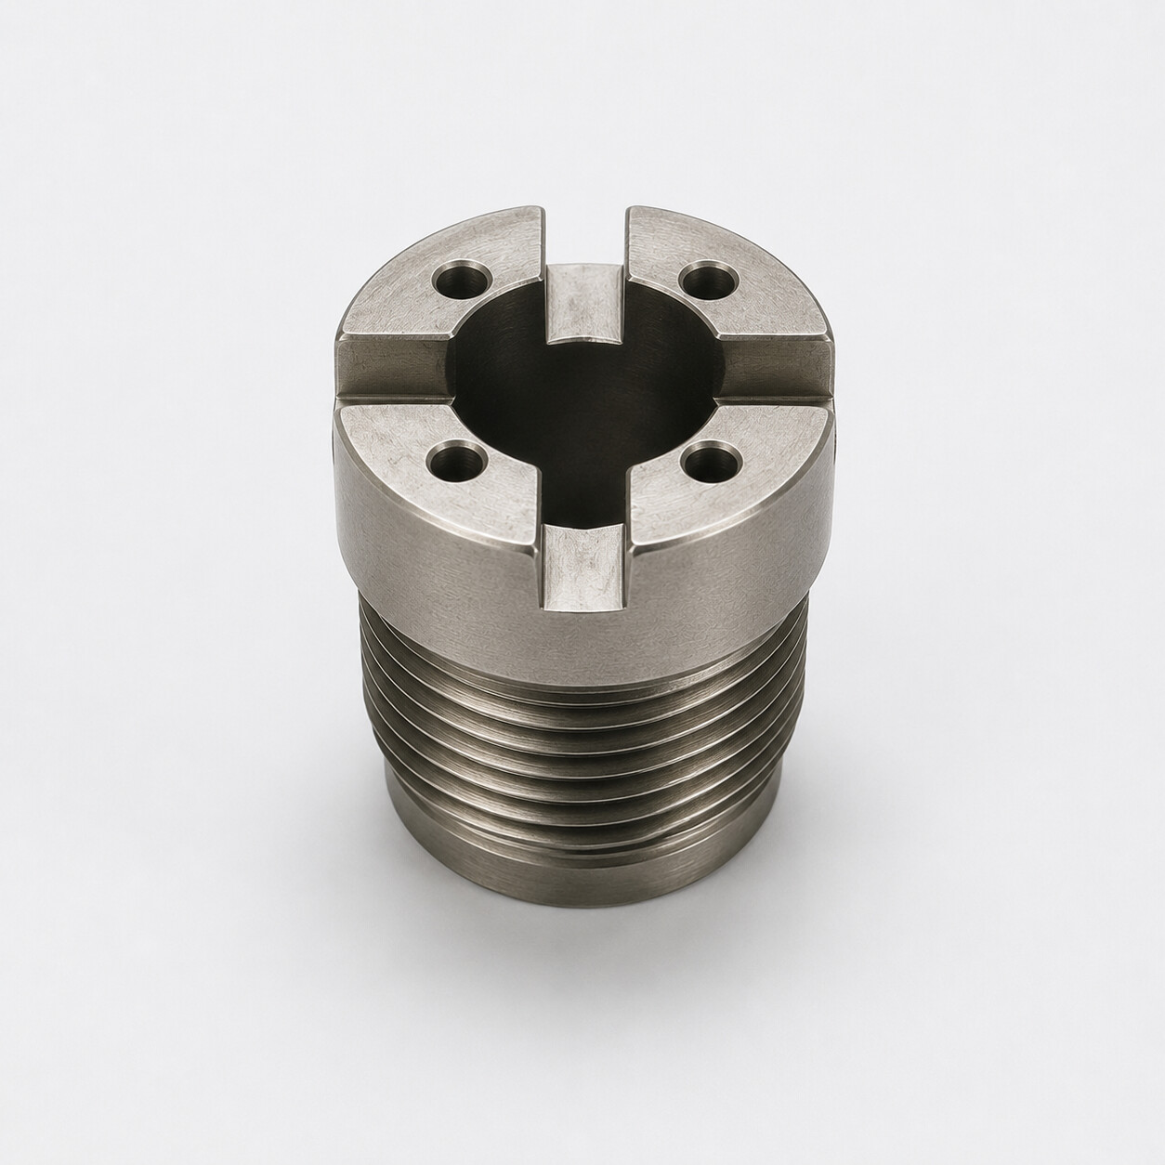
ZHUYANG TECHNOLOGY CORPORATION
NOSE LANDING GEAR
No. 9
Stop Head
F-16 Nose Landing Gear (9655)
AI-rendered visual reference based on supplied photographs • Not an engineering drawing
09 / 14
Notes:
[Sources]
- User-provided reference photograph: /workspace/scratch/d46b5ac1cbd3/upload/05-1000026852.jpg
- AI-rendered product visualization: /workspace/scratch/d46b5ac1cbd3/ppt_assets/09_12111180-128_stop_head.png
[/Sources]

Slide 11
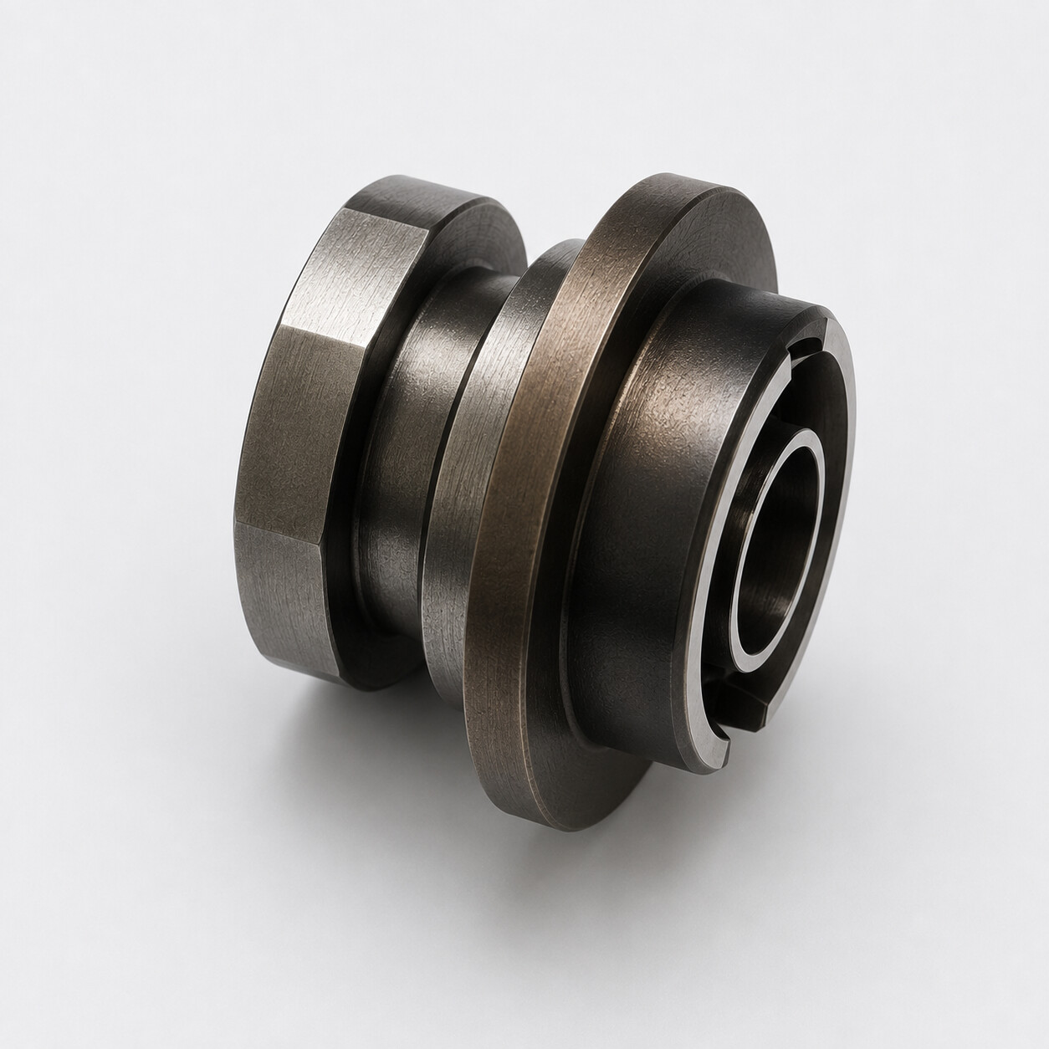
ZHUYANG TECHNOLOGY CORPORATION
NOSE LANDING GEAR
No. 10
Valve Seat
F-16 Nose Landing Gear (9655)
AI-rendered visual reference based on supplied photographs • Not an engineering drawing
10 / 14
Notes:
[Sources]
- User-provided reference photograph: /workspace/scratch/d46b5ac1cbd3/upload/06-1000026853.jpg
- AI-rendered product visualization: /workspace/scratch/d46b5ac1cbd3/ppt_assets/10_12111180-124_valve_seat.png
[/Sources]

Slide 12
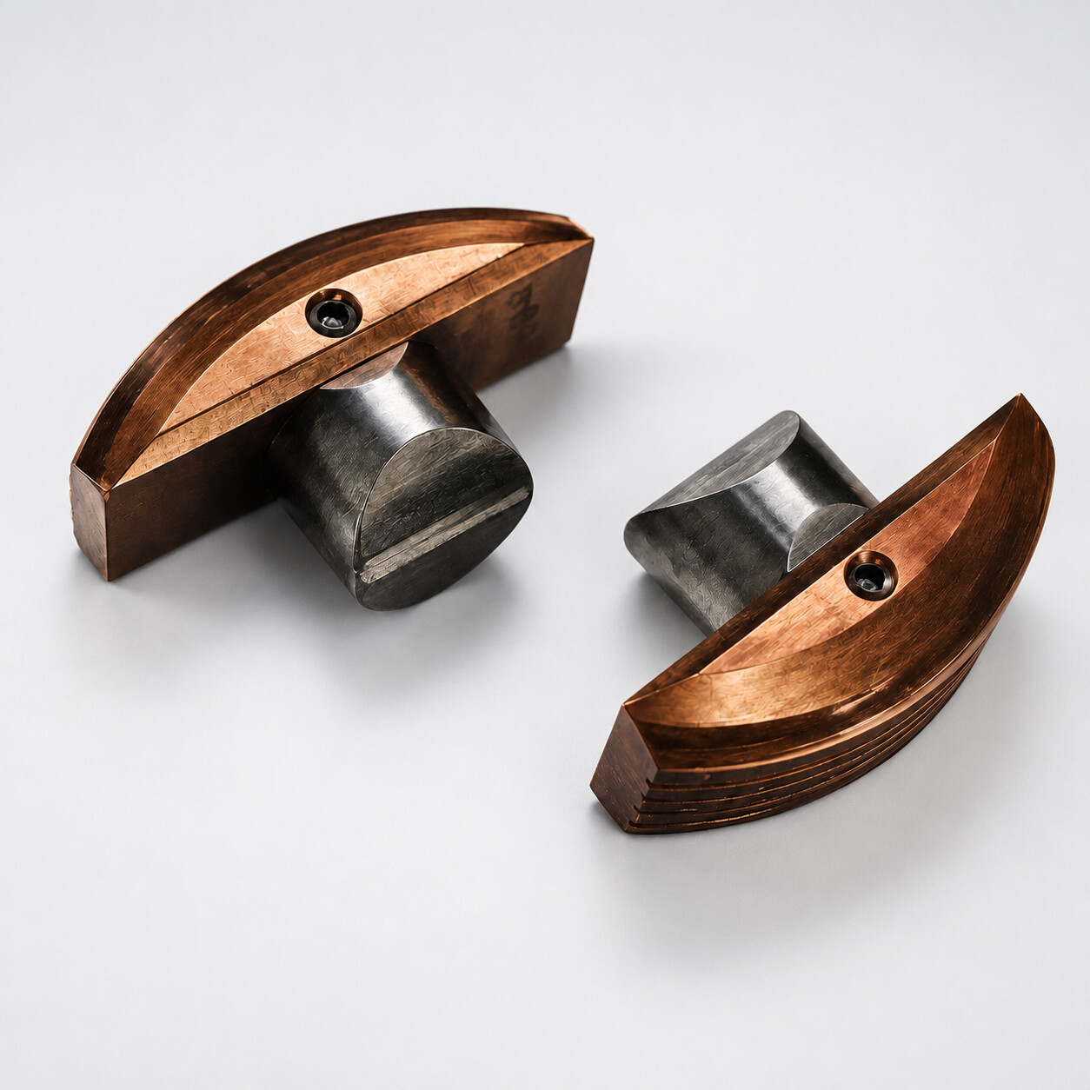
ZHUYANG TECHNOLOGY CORPORATION
NOSE LANDING GEAR
No. 11
Pawl
F-16 Nose Landing Gear (9655)
AI-rendered visual reference based on supplied photographs • Not an engineering drawing
11 / 14
Notes:
[Sources]
- User-provided reference photograph: /workspace/scratch/d46b5ac1cbd3/upload/07-1000026840.jpg
- AI-rendered product visualization: /workspace/scratch/d46b5ac1cbd3/ppt_assets/11_12-111179-106_pawl.png
[/Sources]

Slide 13
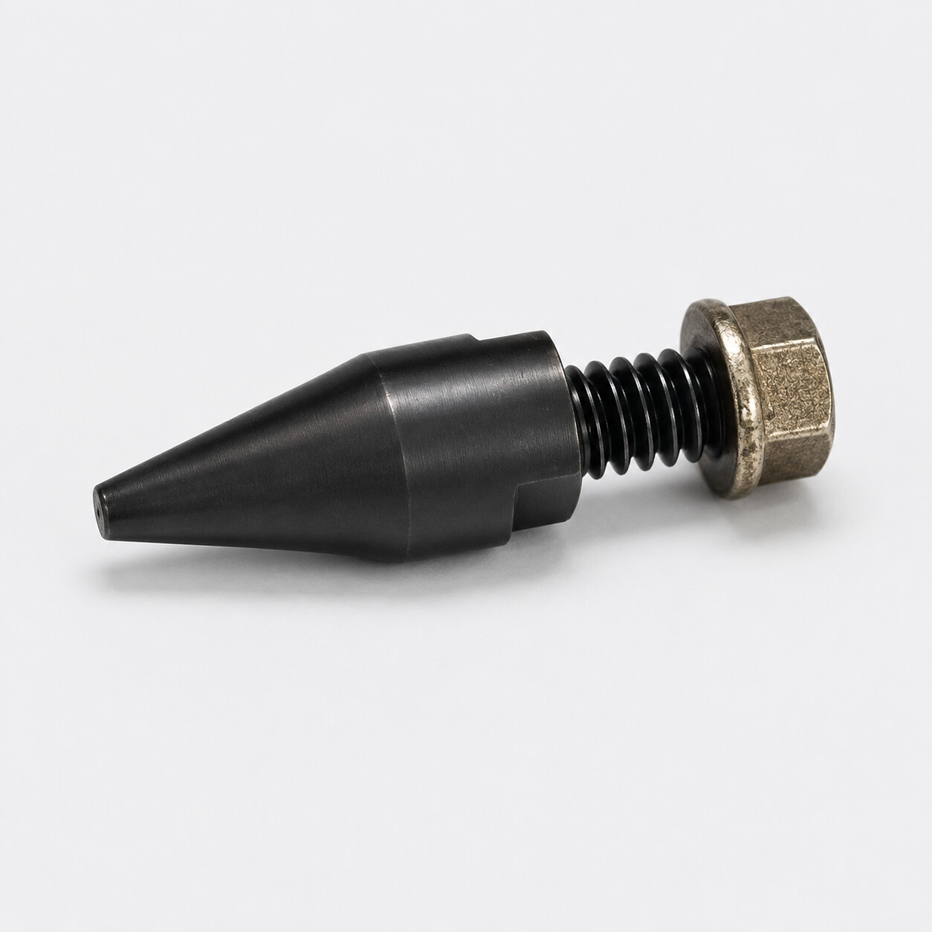
ZHUYANG TECHNOLOGY CORPORATION
NOSE LANDING GEAR
No. 12
Rod
F-16 Nose Landing Gear (9655)
AI-rendered visual reference based on supplied photographs • Not an engineering drawing
12 / 14
Notes:
[Sources]
- User-provided reference photograph: /workspace/scratch/d46b5ac1cbd3/upload/08-1000026841.jpg
- AI-rendered product visualization: /workspace/scratch/d46b5ac1cbd3/ppt_assets/12_12111180-112_rod.png
[/Sources]

Slide 14
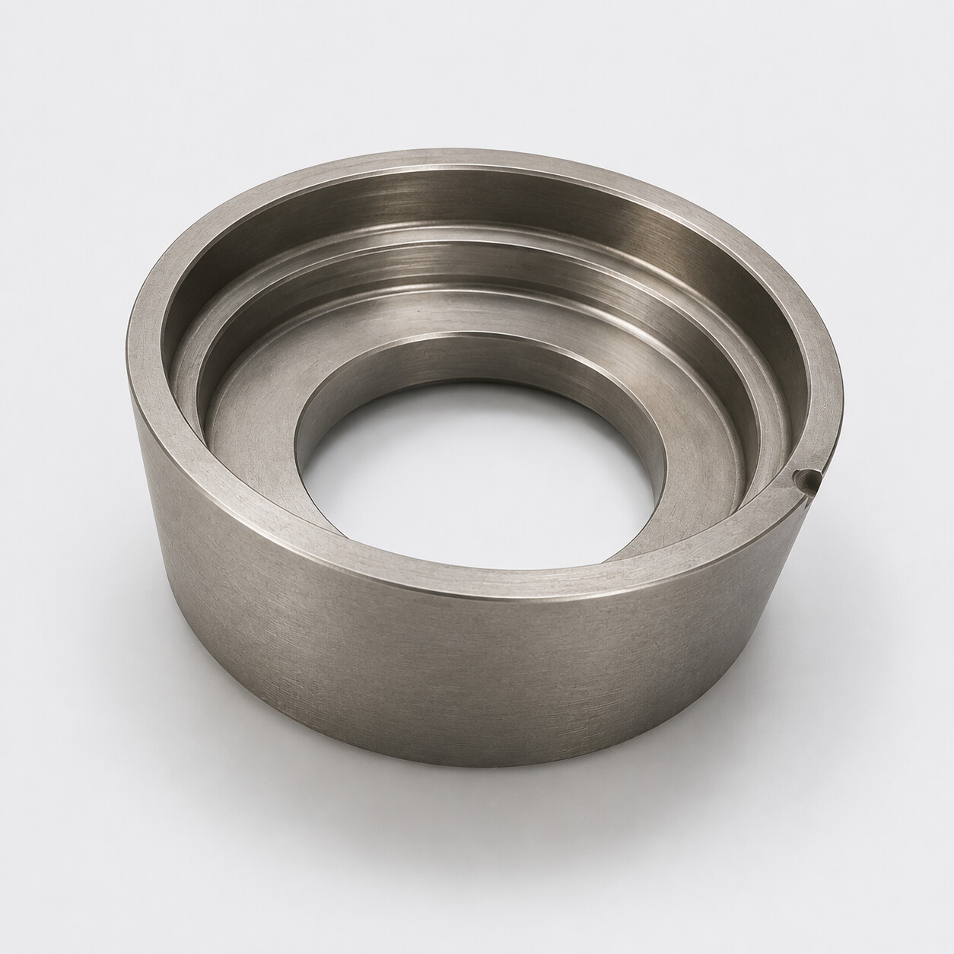
ZHUYANG TECHNOLOGY CORPORATION
FUEL CONTROL
No. 13
Retaining Ring
F-16 Fuel Flow Ratio Motor (1044)
AI-rendered visual reference based on supplied photographs • Not an engineering drawing
13 / 14
Notes:
[Sources]
- User-provided reference photograph: /workspace/scratch/d46b5ac1cbd3/upload/09-1000026843.jpg
- AI-rendered product visualization: /workspace/scratch/d46b5ac1cbd3/ppt_assets/13_4100735-1_retaining_ring.png
[/Sources]

Slide 15
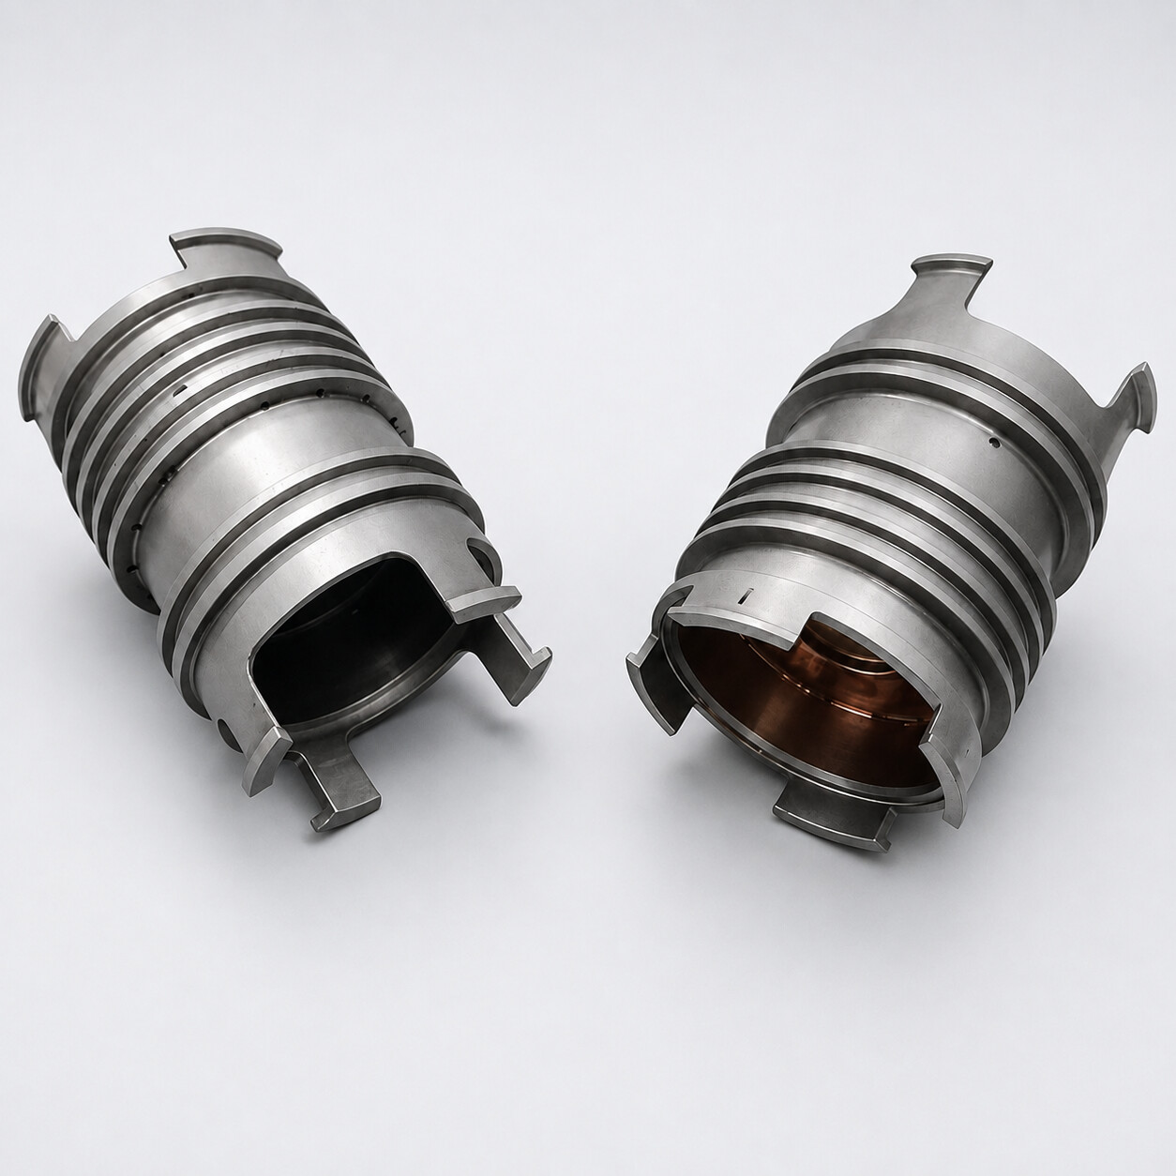
ZHUYANG TECHNOLOGY CORPORATION
FUEL PRESSURIZATION
No. 14
Guide
IDF / F-16 External Fuel Tank Pressurization Valve
AI-rendered visual reference based on supplied photographs • Not an engineering drawing
14 / 14
Notes:
[Sources]
- User-provided reference photograph: /workspace/scratch/d46b5ac1cbd3/upload/10-1000026842.jpg
- AI-rendered product visualization: /workspace/scratch/d46b5ac1cbd3/ppt_assets/14_42615A_guide.png
[/Sources]

