Slide 1

PRESENTER FULL NAME: Levente Tamas
ORGANIZATION: Technical University of Cluj-Napoca, Romania
WORKSHOP NAME: Workshop#3-Digital, Chips and 6G
E-MAIL: Levente.Tamas@aut.utcluj.ro

Slide 2

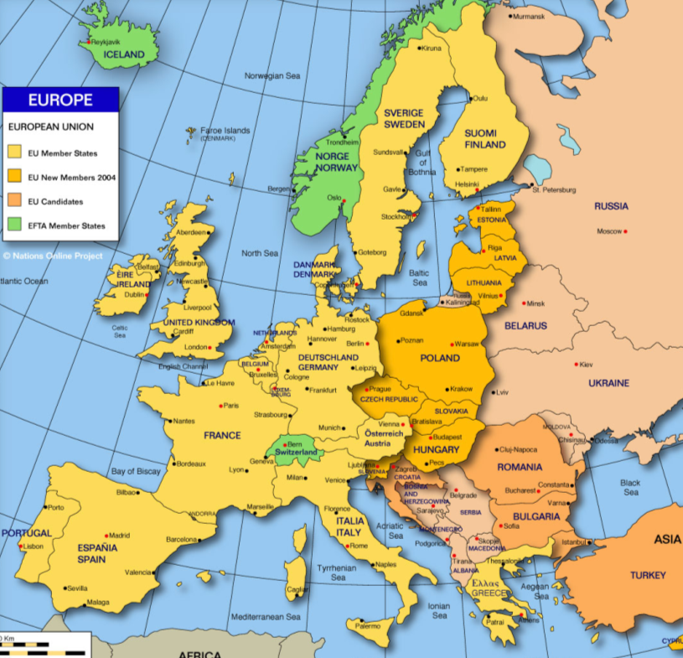
Technical University in Transylvania
Description of the Organisation
Several H2020 projects
Industrial partners

Slide 3

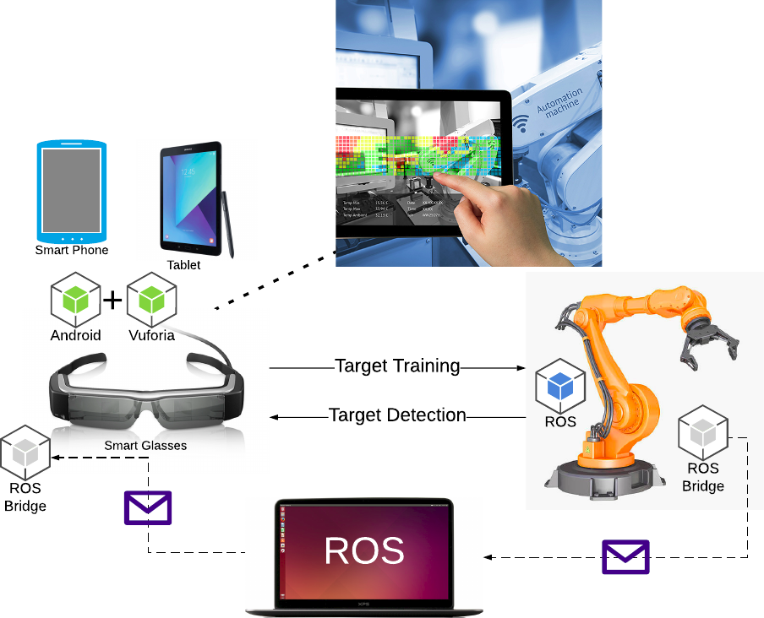
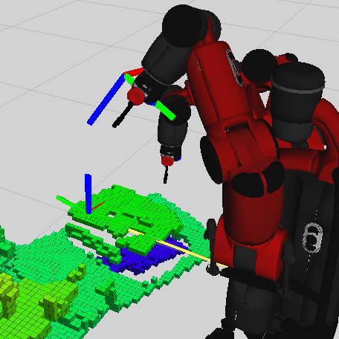
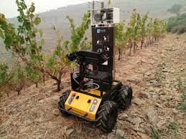
Expertise
Robotics&AI
Applied research

Slide 4

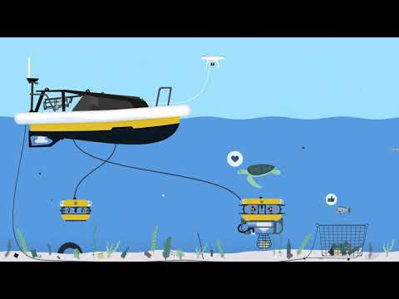
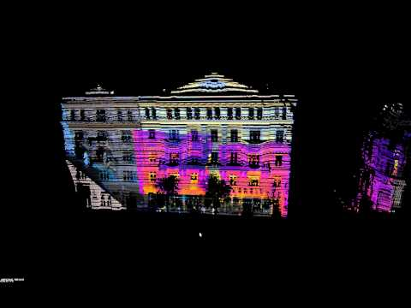
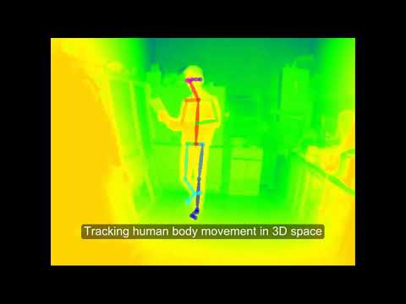
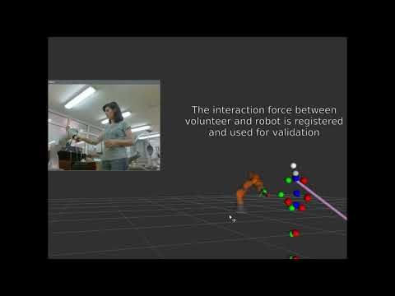
Your Research Fields
Engineering
Robotics
AI
Control

Slide 5

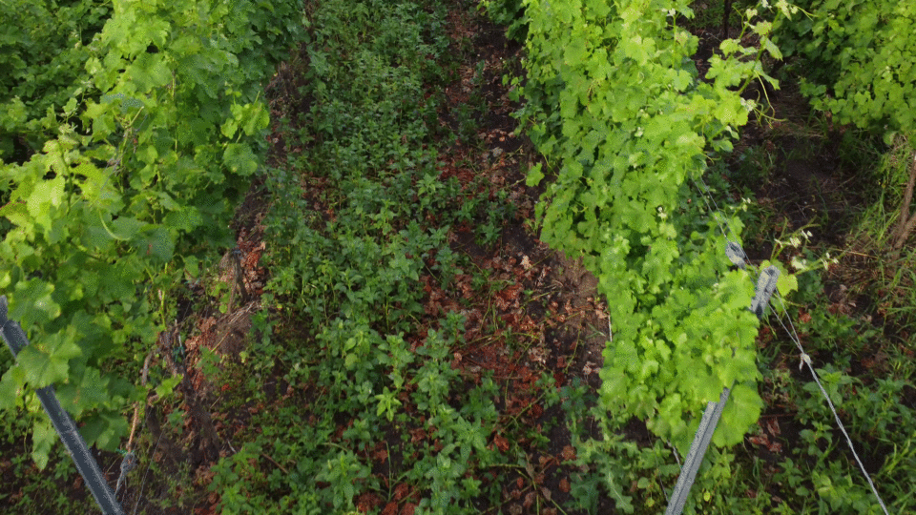
Your On-going Projects
Blue economy
Agriculture 4.0

Slide 6
Project Idea
Call Topic: Horizont - Widening
Deadline Dates: 2025
    Objectives:
      Smart farming with autonomous robots
    Expected Results:
      Integrated robotics solution for sustainable farming

Slide 7
Consortium - profile of known partners
No | Partner Name | Type | Country | Role in the Project
01 | University of Cluj | Uni | Romania | Coordination
02 | Axial | Comp | Hungary | Partner-beneficiary
03 | University of Bordeaux | Uni | France | Partner-R&D
04 | Beia | Comp | Romania | Validation
05

Slide 8
Consortium – required partners
No | Expertise | Type | Country | Role in the project
01 | IoT/IIOT |  | East Europe | Monitoring, software integration
02 | Big data |  | Turkey | Geospatial data analysis
03 | Communication |  | East Europe | Communication and public dissemniation
04

Slide 9

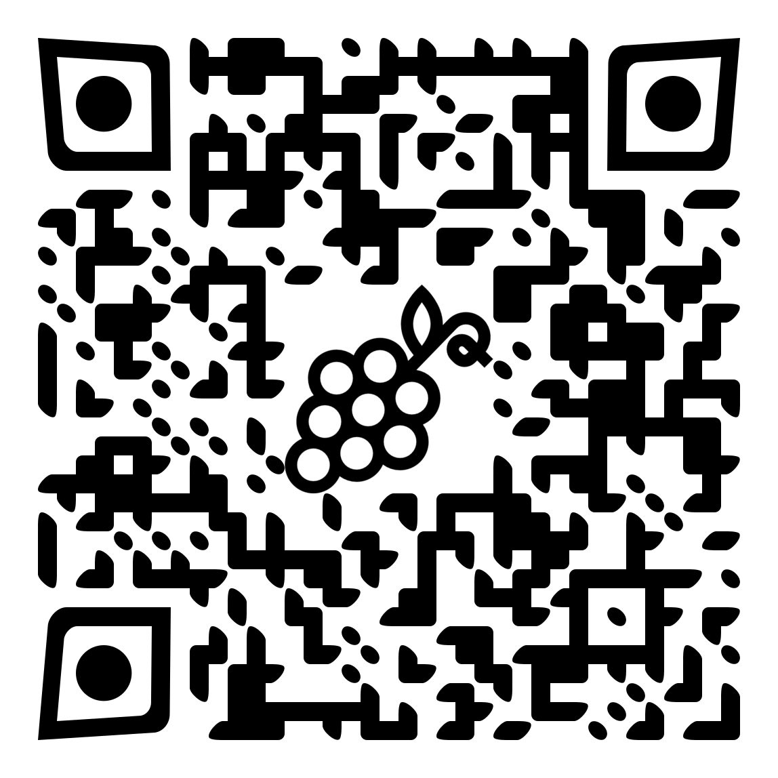
PRESENTER CONTACT
DETAILS:
COUNTRY:
Levente.Tamas@aut.utcluj.ro
http://rocon.utcluj.ro

