Slide 1
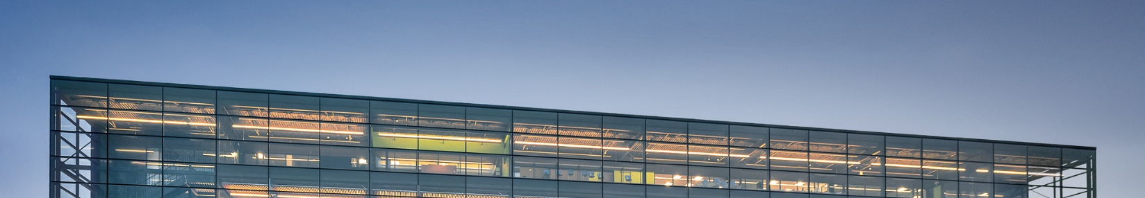

Conducting Polymer-based Electrode Matrices for Lithium-ion Batteries
Technology Details
University of Manitoba researchers have developed an alternative binder system, which is based on the combination of an electronically conductive polymer and a polyanionic binder. The researchers have shown that these new composite binders are better adhesives, show electronic conductivity, can be dispersed in water, and are film-forming upon drying. In addition, the researchers have so far explored combinations of polypyrrole and polyaniline (conducting polymers) with carboxymethyl cellulose and alginate (polyanion). The conducting polymer is a flexible electronically conducting component in the new composite binder. The polyanion acts as adhesive with strong dipolar and ionic interactions with its surroundings. By synthesizing the conducting polymer in the presence of the polyanion, the positively charge backbone of the conducting polymer interacts electrostatically with the negatively charge polyanion, forming a molecular composite of both polymers.
TECHNOLOGY LICENCING OPPORTUNITY
Applications
This binder poses as the future for lithium-ion batteries as it does not require the use of forever chemicals and can be easily dispersed in water. Hence, it can find application in batteries of any size or format.
Technology Benefits
The invented electronically conductive binder is a better adhesive and a molecular composite with flexible structure. This new binder prevents migration and agglomeration of the conductive agent in the binder, and it reduces contact loss of electroactive particles during use. The proposed method for activating conducting polymers inside the battery increases their conductivity within the electrode sufficiently to allow operation of battery electrodes with approximately 5% conducting polymer content at reasonable power output.
Development Stage
The binders have been prepared and characterized, including preparation and testing of composite electrodes with lithium cobalt oxide, graphite, and silicon. The longevity of their chemical stability is currently being assessed, as well as combinations with other active materials, in particular lithium iron phosphate and related olivines.
Patent Status:
CA National Phase (App No. 3,227,487; filed 30 January 2024).
US National Phase (App No. 18/293,536; filed 30 January 2024).
PRINCIPAL INVENTOR
Dr. Christian Kuss
Associate Professor; Department of Chemistry
University of Manitoba
CONTACT
Loren Oschipok
Technology Transfer Manager
E-mail: loren.oschipok@umanitoba.ca
Phone: (431)-777-0145

