Slide 1

BUKATECH

Slide 2
WHO ARE WE?
As BukaTech R&D Engineering and Consulting Inc., we develop innovative solutions focused on sustainability and environmental protection.
We design eco-friendly robots capable of cleaning liquid and solid pollutants on the sea surface, removing underwater mucilage, and performing underwater damage detection.
Founded with the support of TÜBİTAK 1512 Green Call, our company plays a leading role in the field of environmental technologies, combining technology and innovation to create sustainable impact.
For us, sustainability is not a choice but a responsibility.
With the purpose of preserving the balance of nature, we bring together technology and innovation to protect our planet.

Slide 3



THE BUKATECH TRİLOGY
1
Industry
BukaTech offers industrial solutions that combine environmental sustainability with high efficiency.
2
Nature
While carrying nature into the future, we build our technology on sustainability.
Artificial Intelligence
3
The artificial intelligence technology in our products maximizes efficiency and accuracy in every operation.

Slide 4

Problems

Slide 5
Problems
Pollution in the seas: Every year, millions of tons of plastic, oil, fuel, and mucilage mix into the oceans. This pollution damages the ecosystem and causes major economic losses to the fishing and tourism industries.
Safety issues of underwater structures: Structures such as dams, ports, and bridge piers cannot be inspected regularly. Damage detection processes are often costly, time-consuming, and risky.
Coastal and beach pollution: Waste accumulating on beaches reduces tourism value, while manual cleaning efforts by local authorities remain insufficient.
Operational challenges in disaster zones: During earthquakes, floods, and tsunamis, there is a lack of search and rescue robots capable of operating seamlessly across land and water. Current solutions are designed for single environments, causing time loss and operational disruption.
International competition: In Europe, environmental and disaster-response robotics technologies are rapidly advancing. In Turkey, domestic and original solutions remain limited, leading to high dependence on imports.

Slide 6
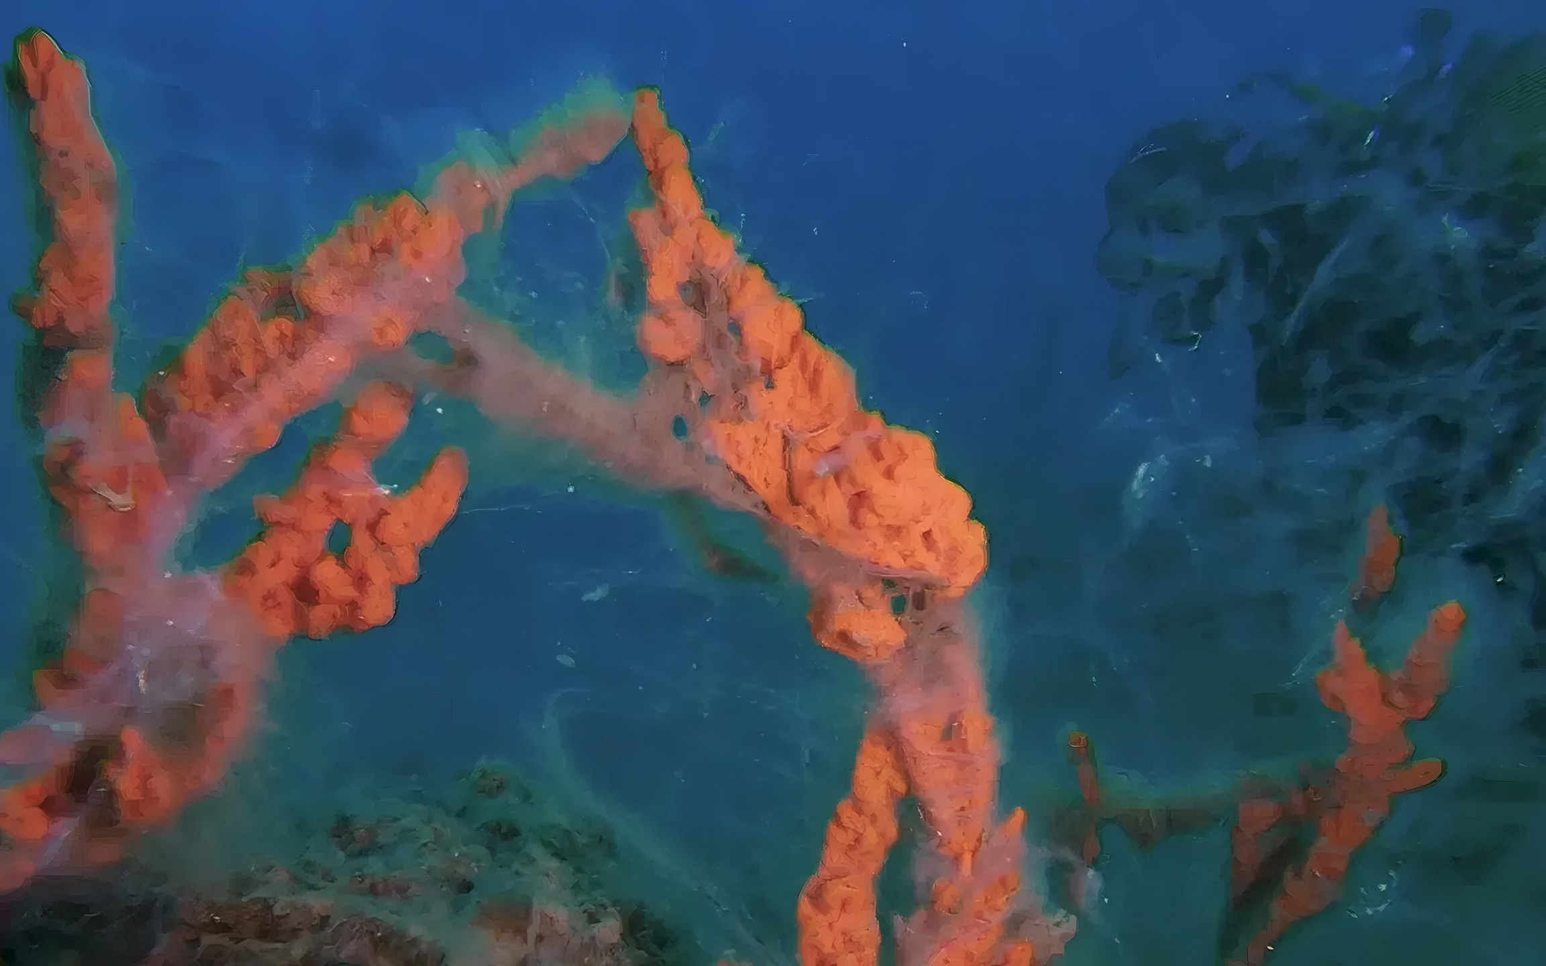
Product / Project Portfolio

Slide 7

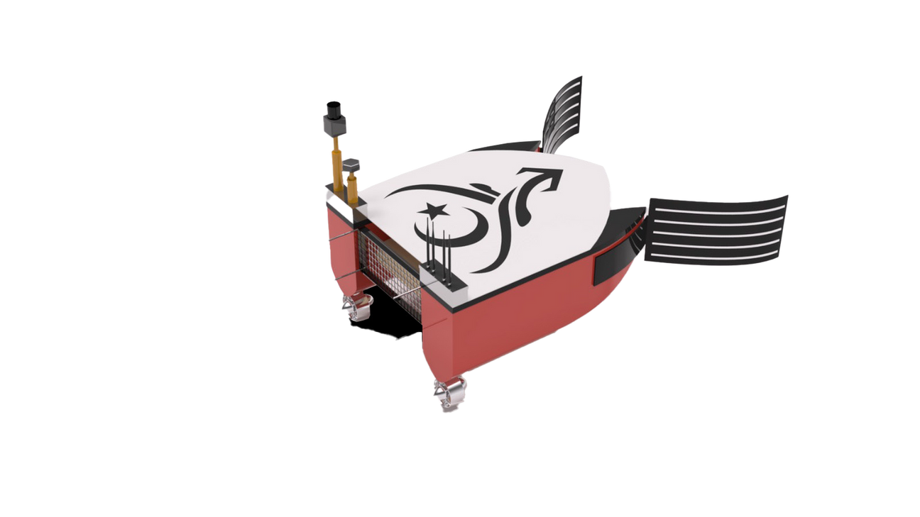
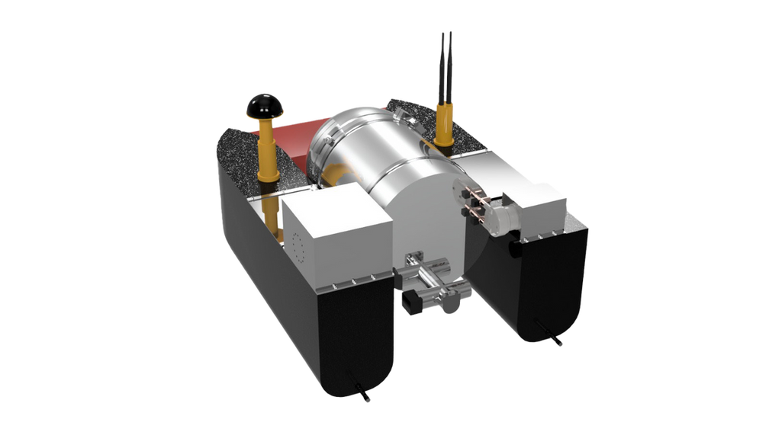


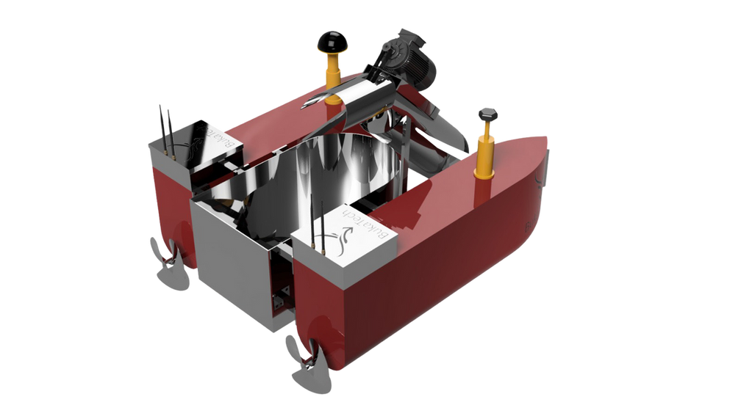


Sea Surface Cleaning Robots
TAMUK.
SEA SURFACE LIQUID-LIQUID HETEROGENEOUS MIXTURE CLEANING ROBOT
KÜNÇ.
SEA SURFACE SOLID WASTE CLEANING ROBOT
ÇOGUN.
SEA SURFACE SOLID WASTE CLEANING ROBOT

Slide 8


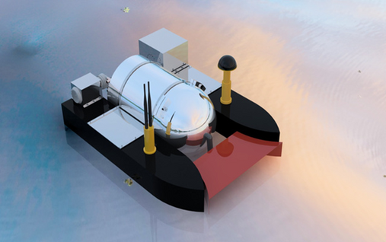
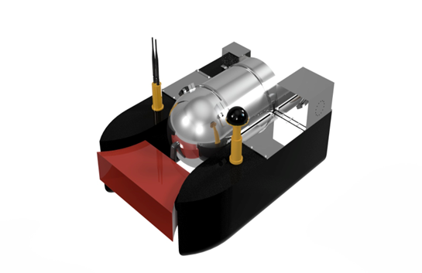
Tamuk is an ideal emergency response robot designed to quickly and effectively clean liquid pollutants (oil, fuel, petroleum, and mucilage) on the sea surface.
Operating entirely through mechanical methods, Tamuk minimizes environmental impact and accelerates the cleaning process.
Without using chemical dispersants, liquid pollutants are collected and separated efficiently inside the storage unit. The system placed within the tank provides a special environment that separates pollutants from seawater effectively.
TAMUK.
SEA SURFACE LIQUID-LIQUID HETEROGENEOUS MIXTURE CLEANING ROBOT

Slide 9



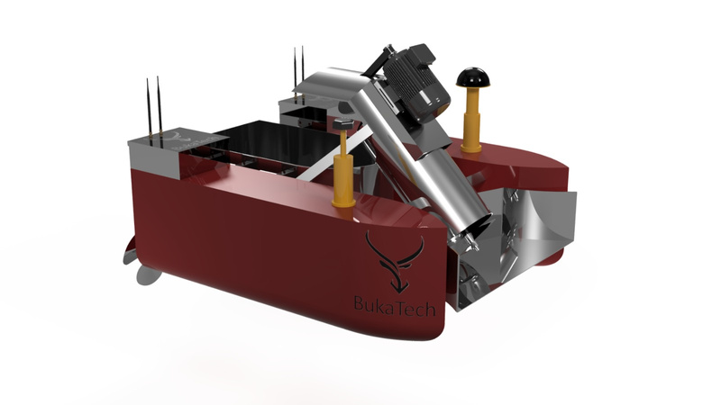
Künç is a robot designed to quickly and effectively clean solid waste (such as plastic, packaging, and wood) floating on the sea surface.
It becomes active especially in ports and coastal areas where large amounts of solid waste accumulate, helping to reduce environmental impact and accelerate the cleaning process.
Thanks to the helical conveyor system mounted on top, it can perform cleaning operations without missing small or large debris, ensuring thorough and efficient waste collection.
KÜNÇ.
SEA SURFACE SOLID WASTE CLEANING ROBOT

Slide 10

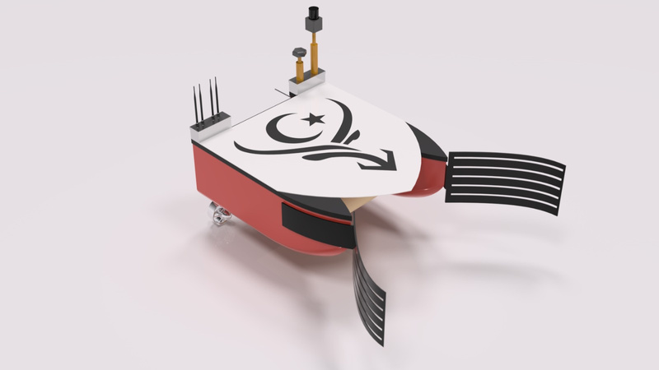
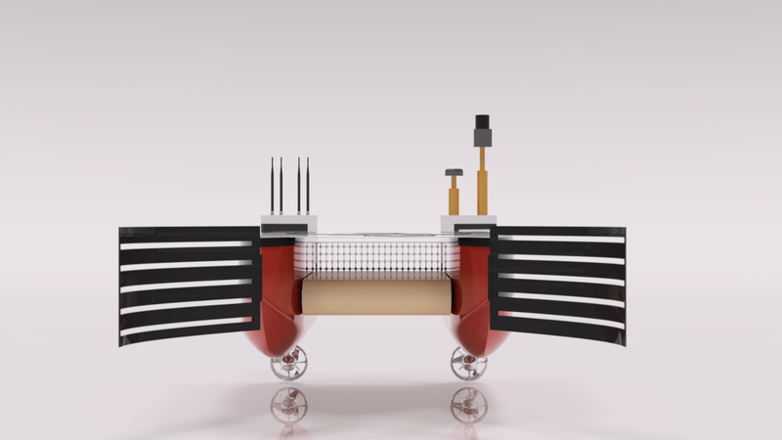
Çogun is a robot designed to quickly and efficiently clean solid pollutants (such as plastic, packaging, and wood) from the sea surface.
It becomes particularly effective in ports and coastal areas where large amounts of solid waste accumulate, helping to reduce environmental impacts and accelerate the cleaning process.
Equipped with a flat conveyor system, Çogun collects solid waste through its front intake and pushes it toward the rear section, where it is stored in a mesh-based storage unit. This system allows for effective collection and containment of waste during operation.
ÇOGUN.
SEA SURFACE SOLID WASTE CLEANING ROBOT

Slide 11
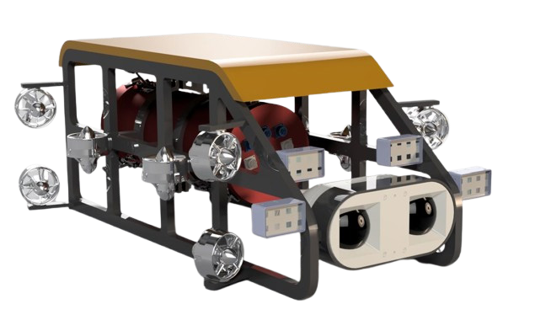

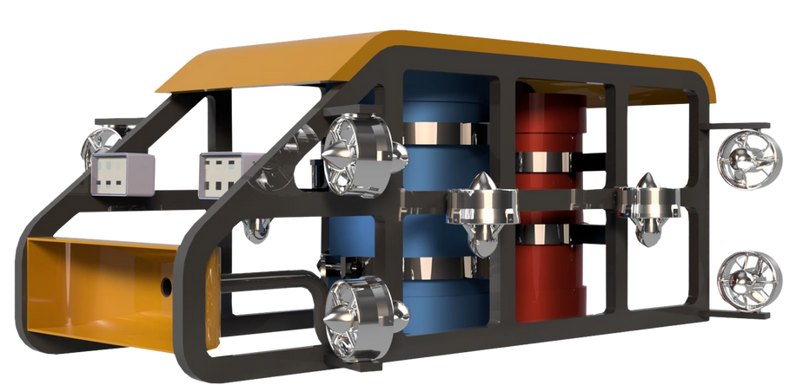


Underwater Robots
YANGA.
UNDERWATER MUCILAGE CLEANING ROBOT
ARKUT.
UNDERWATER RESEARCH AND DAMAGE DETECTION ROBOT

Slide 12
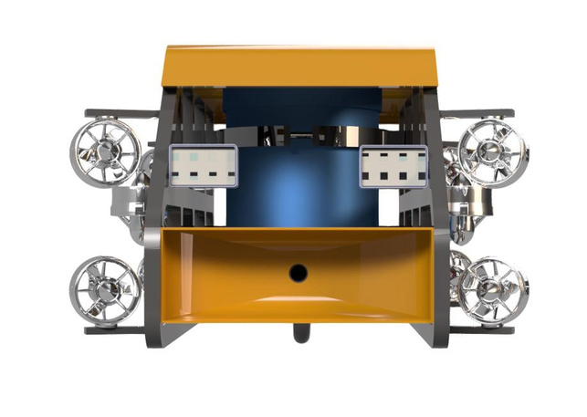


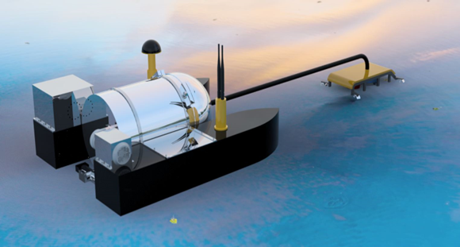
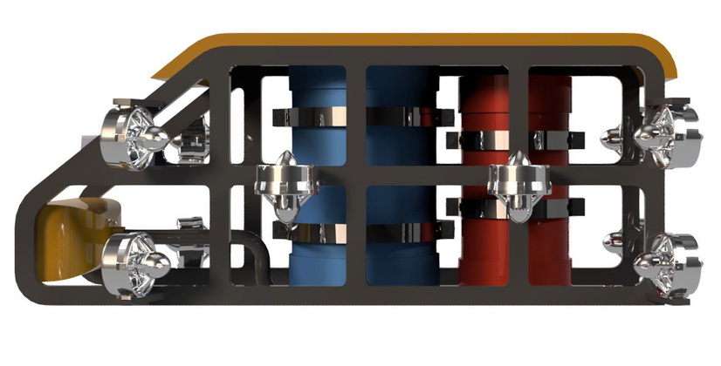
Yanga is an ideal intervention robot designed to quickly and effectively clean mucilage pollution underwater.
Operating entirely through mechanical methods, Yanga minimizes environmental impact and accelerates the cleaning process.
With its integrated swarm drone technology, it provides the ability to intervene across wide underwater areas effectively.
YANGA.
UNDERWATER MUCILAGE CLEANING ROBOT

Slide 13

Arkut is an underwater damage detection robot equipped with high-resolution 3D photogrammetry/videogrammetry and advanced sensors.
It performs detailed structural damage analysis under challenging underwater conditions, assessing the safety of underwater structures such as dams, ports, and bridge foundations.
ARKUT.
UNDERWATER RESEARCH AND DAMAGE DETECTION ROBOT

Slide 14
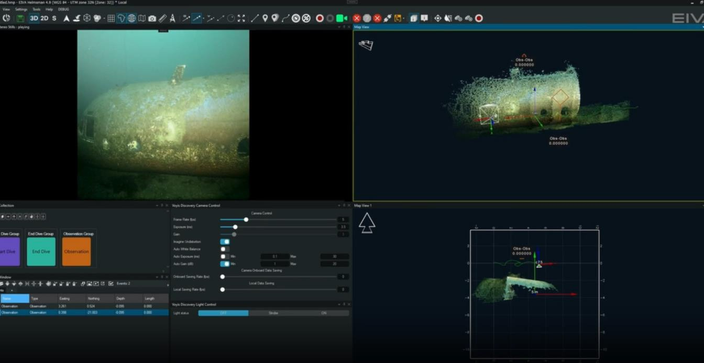

Slide 15

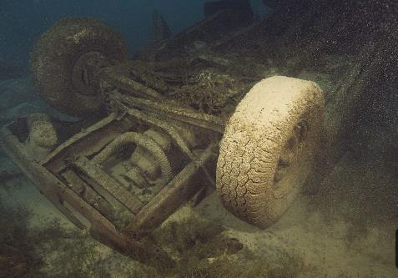
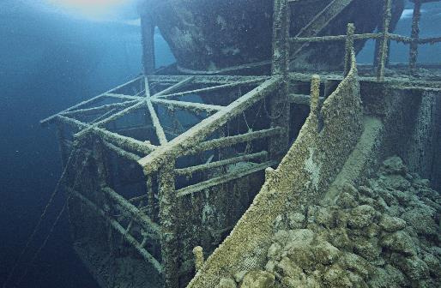

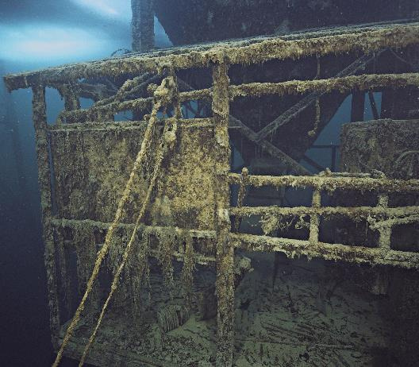
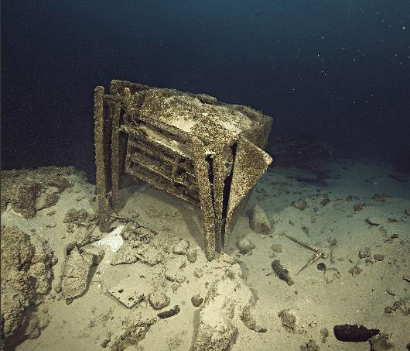



Slide 16
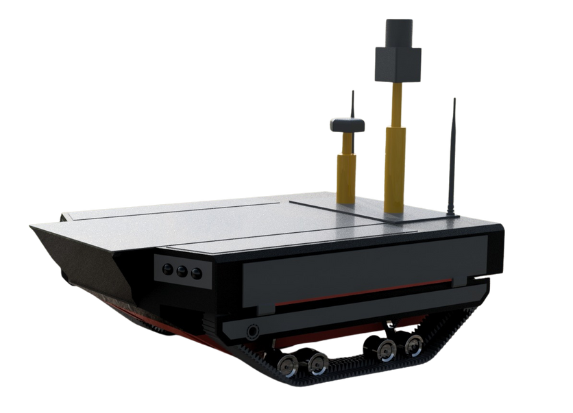
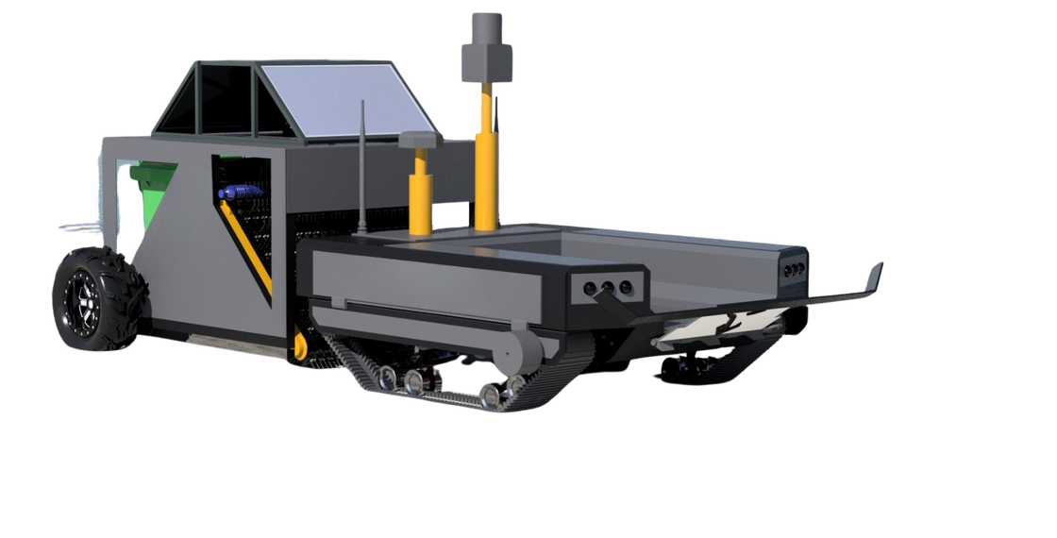
Land Robots
Beach Cleanıng Robot
Amphibious Search And Rescue Robot

Slide 17
The Beach Cleaning Robot is designed to collect plastic, glass, metal, and organic waste accumulated along coastal areas quickly and efficiently, protecting the coastal ecosystem.
With its autonomous navigation system and obstacle detection sensors, it can clean large beach areas without requiring human intervention.
Its fully mechanical collection system can reach 10–15 cm below the sand surface, removing microplastics, cigarette butts, and buried debris. Thus, it eliminates not only visible pollution but also hidden contaminants beneath the surface.
Beach Cleanıng Robot

Slide 18
Aruma is an amphibious search and rescue robot capable of operating both on land and in water, designed for high maneuverability under challenging conditions such as floods and disaster zones.
Its modular structure allows the integration of various sensors such as thermal cameras, LiDAR, and radioactive level detectors, enabling critical missions like human detection, image transmission, and risk assessment.
It can be equipped with different tools for rescue, transport, evacuation, and payload delivery tasks, minimizing human risk in emergency response operations.
ARUMA.
Amphibious Search And Rescue Robot

Slide 19

Natıonel & Intarnatıonel Project Partnershıp
BukaTech & Model Aerospace
EU-HORIZON-CL3-2025-01-DRS-03
Unmanned Platforms and Rocket Launcher Integratıon Project
EU Horızon Project Call
Consortıum Partnershıp

Slide 20
BukaTech & Model Aerospace
Model Aerospace is an innovative defense technologies startup in Turkey that designs and manufactures rockets, rocket propellants, and launch systems (launchers).
Within the scope of the joint project, the rocket and launcher systems developed by Model Aerospace are being integrated into BukaTech’s unmanned land and sea platforms.
This project aims to develop an innovative robotic system serving the defense industry, enhancing the multi-mission capabilities of BukaTech’s unmanned platforms.
Unmanned Platforms and Rocket Launcher Integratıon Project

Slide 21
EU-HORIZON-CL3-2025-01-DRS-03
This EU Horizon project, which we joined upon the invitation of a European research institute, is being carried out under an international consortium of 14 companies.
Within this consortium, BukaTech has taken on the leadership and management responsibility of a specific work package.
Due to project confidentiality agreements, details cannot be disclosed at this stage; however, the project aims to develop innovative robotic systems.
EU Horızon Project Call
Consortıum Partnershıp

Slide 22
Communıcatıon Projects
Swarm Drone Technolgy

Slide 23
Through its R&D efforts in swarm drone technologies, BukaTech develops systems that enable simultaneous communication and coordinated operations among multiple unmanned aerial, ground, and marine vehicles.
Thanks to the autonomous communication protocols developed, the vehicles can exchange data and perform dynamic task allocation among themselves without requiring a central control system.
This technology aims to ensure high efficiency and uninterrupted communication in multi-agent operations such as search and rescue missions, environmental monitoring, and defense applications.
Swarm Drone Technolgy

Slide 24
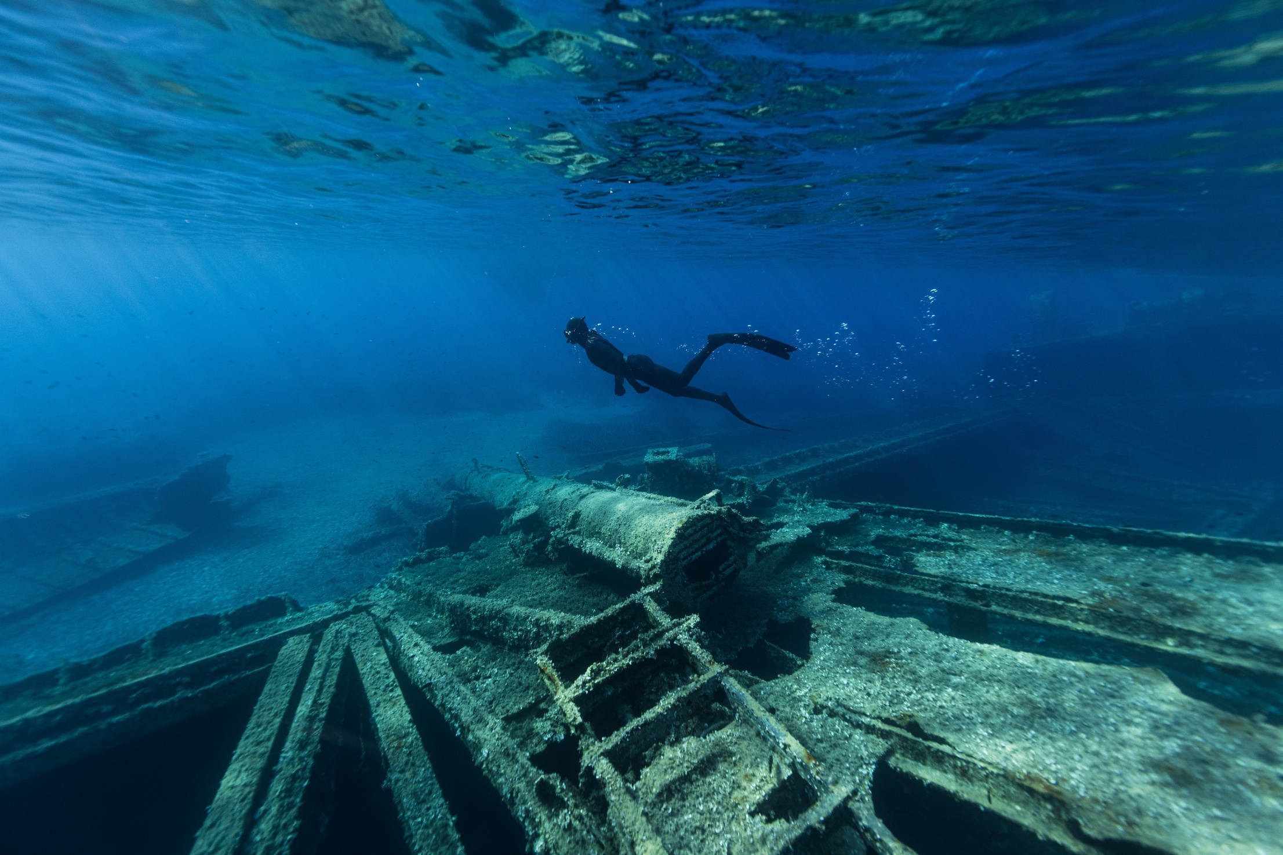
Growth Strategy and Roadmap

Slide 25
Growth Strategy and Roadmap
Short Term (0–1 Year)
Commercialization of liquid-cleaning robots to institutions responsible for marine disaster management
Active deployment of sea surface cleaning robots in municipalities and ministries
Initiation of PoC (Proof of Concept) processes for the beach cleaning robot
Medium Term (1–3 Years)
Expansion into the European market through EU-funded projects
Deployment of active and variant models of the robots across EU and Central Asian countries via established networks
Initiation of PoC processes for the project developed in collaboration with Model Aerospace under the Presidency of Defense Industries (SSB)
Long Term (3–5 Years)
Increase export volume of robots in the defense, environmental, disaster, and logistics sectors
Ensure global market impact of swarm drone technology in both environmental cleaning and defense applications

Slide 26

Contact
Tayyip ATEŞ
M. Faruk ÖZBEK
Deputy General Manager
General Manager
M: faruk@bukatech.net
M: bilgi@bukatech.net
BUKATECH.NET

Slide 27
BUKATECH

