Slide 1



Turning Waste into a Scalable Circular Value
In Latin America, millions of cardboard boxes are used once… and then discarded.
We turned that inefficiency into a scalable circular business.

Slide 2

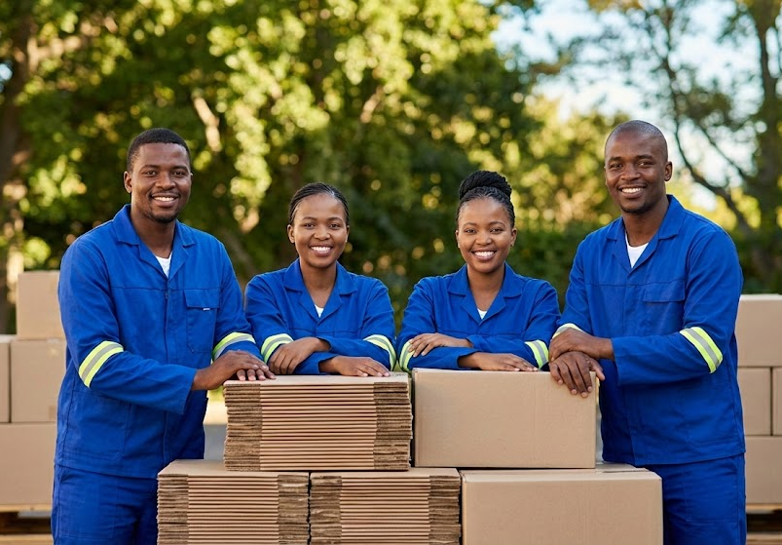
What we solve: A Broken System
Single-use industrial packaging
Rising material costs
Increasing ESG and regulatory pressure
Massive untapped reuse potential

Slide 3

How we do it: A Circular Alternative That Works
Collection of used boxes
Quality restoration under standards
Reintroduction into the same supply chain
Closed-loop circular model
We don’t recycle cardboard boxes. We extend its life

Slide 4

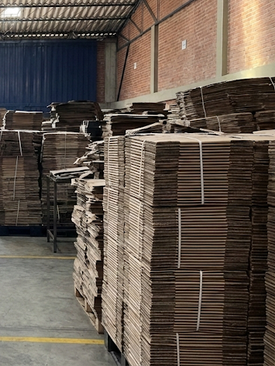



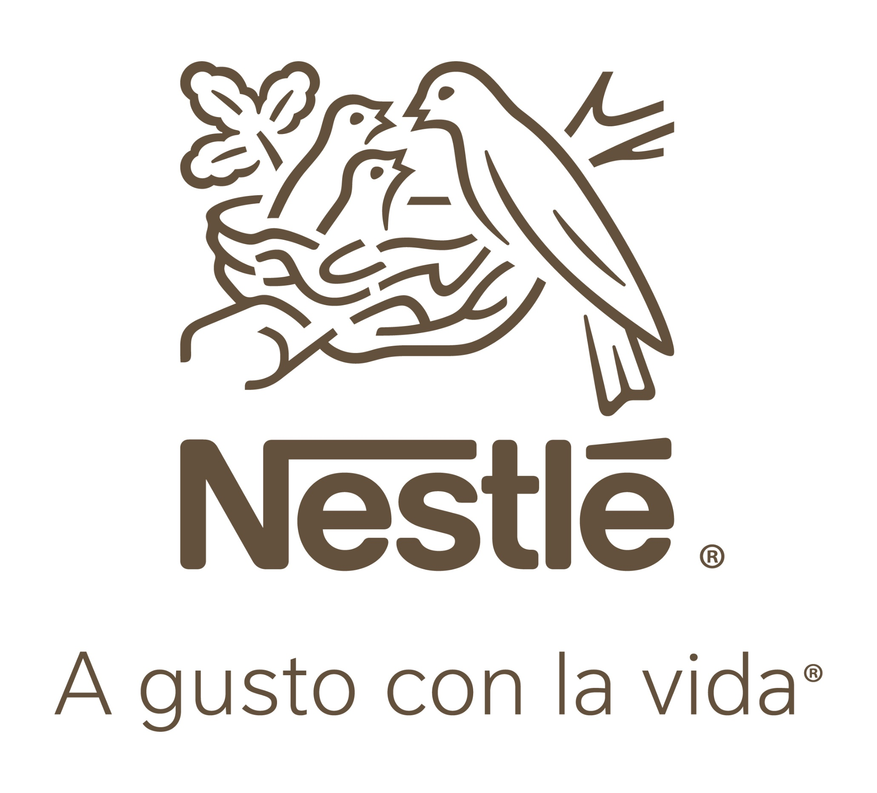

Proven Impact & Results
+ 8 M
Boxes Reintroduced
+ 100,000
Trees Saved
+ EUR 3M
Saved for Clients
Clients include multinational companies as
We are not a concept. We are an operating, proven model with measurable environmental and economic impact.

Slide 5





Recognition & Institutional support
Awarded by National Federation of Merchants (Fenalco) and Colombina, with strategic support by National Business Association of Colombia (ANDI) and institutional backing from leading organitations including The Bogota Chamber of Commerce, and Employee Benefits & Social Welfare Organizations (Comfandi and Cafam)

Slide 6
A Profitable Circular
Model
Revenue Drivers:
Sale of restored boxes
Cost savings shared with clients
Operational efficiency in reverse logistics
Value Proposition:
Up to 50% cost reduction vs new boxes
Immediate ESG impact
No change in client operations
Why It Works:,
Lower input costs (recovered materials)
High demand for cost reduction
Repeatable and scalable model

Slide 7


Technology as a scaling engine
Packaging traceability
Real-time ESG metrics
Reverse logistics optimization
Data-driven decision making
We are building the digital infrastructure for circular packaging.

Slide 8


Latin America: A High-Growth Opportunity
Large industrial base
Low circular economy penetration
Growing regulatory pressure
High cost sensitivity (perfect fit)
Latin America is not just ready — it needs this solution..

Slide 9
A Strategic Entry Point into LATAM
Partnership Options:
Equity investment
Joint ventures
Licensing model + technology
Regional representation
What Partners Gain:
Fast market entry
Proven model
Measurable ESG impact
Scalable platform

Slide 10
Let’s Scale This Together
Strategic investors
Circular economy operators
Expansion partners in LATAM
Long-term collaboration
We already proved this works in Colombia.
Now we are ready to scale across Latin America with the right partners.

Slide 11
From Local Success to Regional Scale
Proven model.
Scalable system.
Measurable impact.
This is just the beginning.
We believe circular economy needs to move from intention to execution — and we are building that bridge.
Diego A. Herrera
Tel: +57 3013544282
diego.Herrera@reusalo.co

Slide 12
