Slide 1
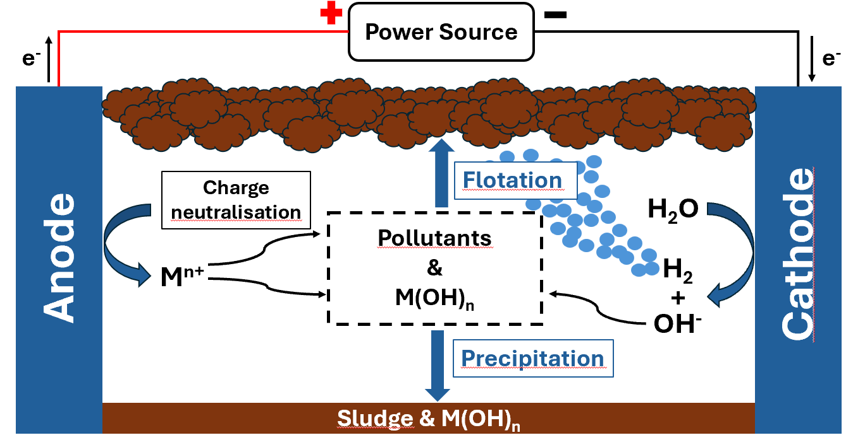
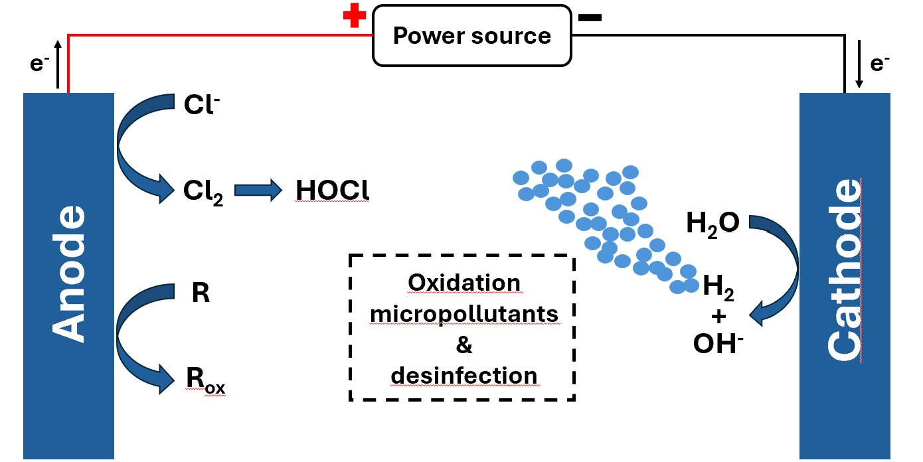
TECHNOLOGY BASICS
Tubular co-axial cell design
More homogeneous treatment
Less problems with fouling and scaling
Electro-coagulation Electro-oxidation

Slide 2
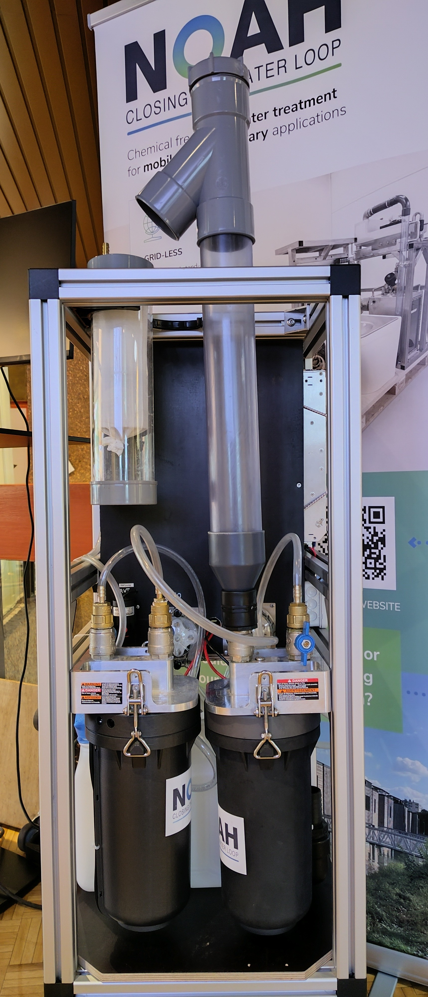


Concept micro treatment unit:
Weight emtpy: < 30 kgs
Floorspace max 50 x 50 cms x 150
24VDC power
Capacity: 300 liter/ day, redundancy 150 % (max 450 l/day)
Options for re-use of effleunt
Source of water:
      - black water (flushtoilet or vacuum toilet)
      - grey water (shower + handwash basin/sink)
      - black/grey/kitchen/laundry/dishwashe (standard domestic)
      Electro chemistry is very effective for difficult to treat industrial waters. Ask for the possibilities!
Notes:
CH4 = methaan N2O laughing gas voor GHG en NH3 amoniac
Boodschappen :
Reuslt of several years of academic research
Attention grab : shit for science
To show the development stage, to confirm it works, to confirm there is interest
Position the proximity advantages
Practical : mobile solutions, off-grid
Societal : GHG, Hygiene, enviroment

Slide 3
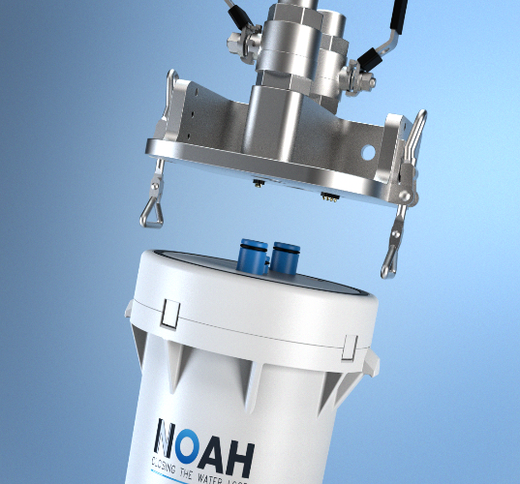
Concept micro treatment unit:
Energy:
- < 3 kWh per m3 treated
- source = domestic wastewater!
    - High concentrated water requires more energy
        - includes pumping energy
        Cartridge system
        - for easy and hygienic changing of used electrodes
        - re-usable cartridges
        Modular
        - upto 5 cels in parallel
        - capacity from 10-3000 liters/ day
        -
Notes:
CH4 = methaan N2O laughing gas voor GHG en NH3 amoniac
Boodschappen :
Reuslt of several years of academic research
Attention grab : shit for science
To show the development stage, to confirm it works, to confirm there is interest
Position the proximity advantages
Practical : mobile solutions, off-grid
Societal : GHG, Hygiene, enviroment

Slide 4
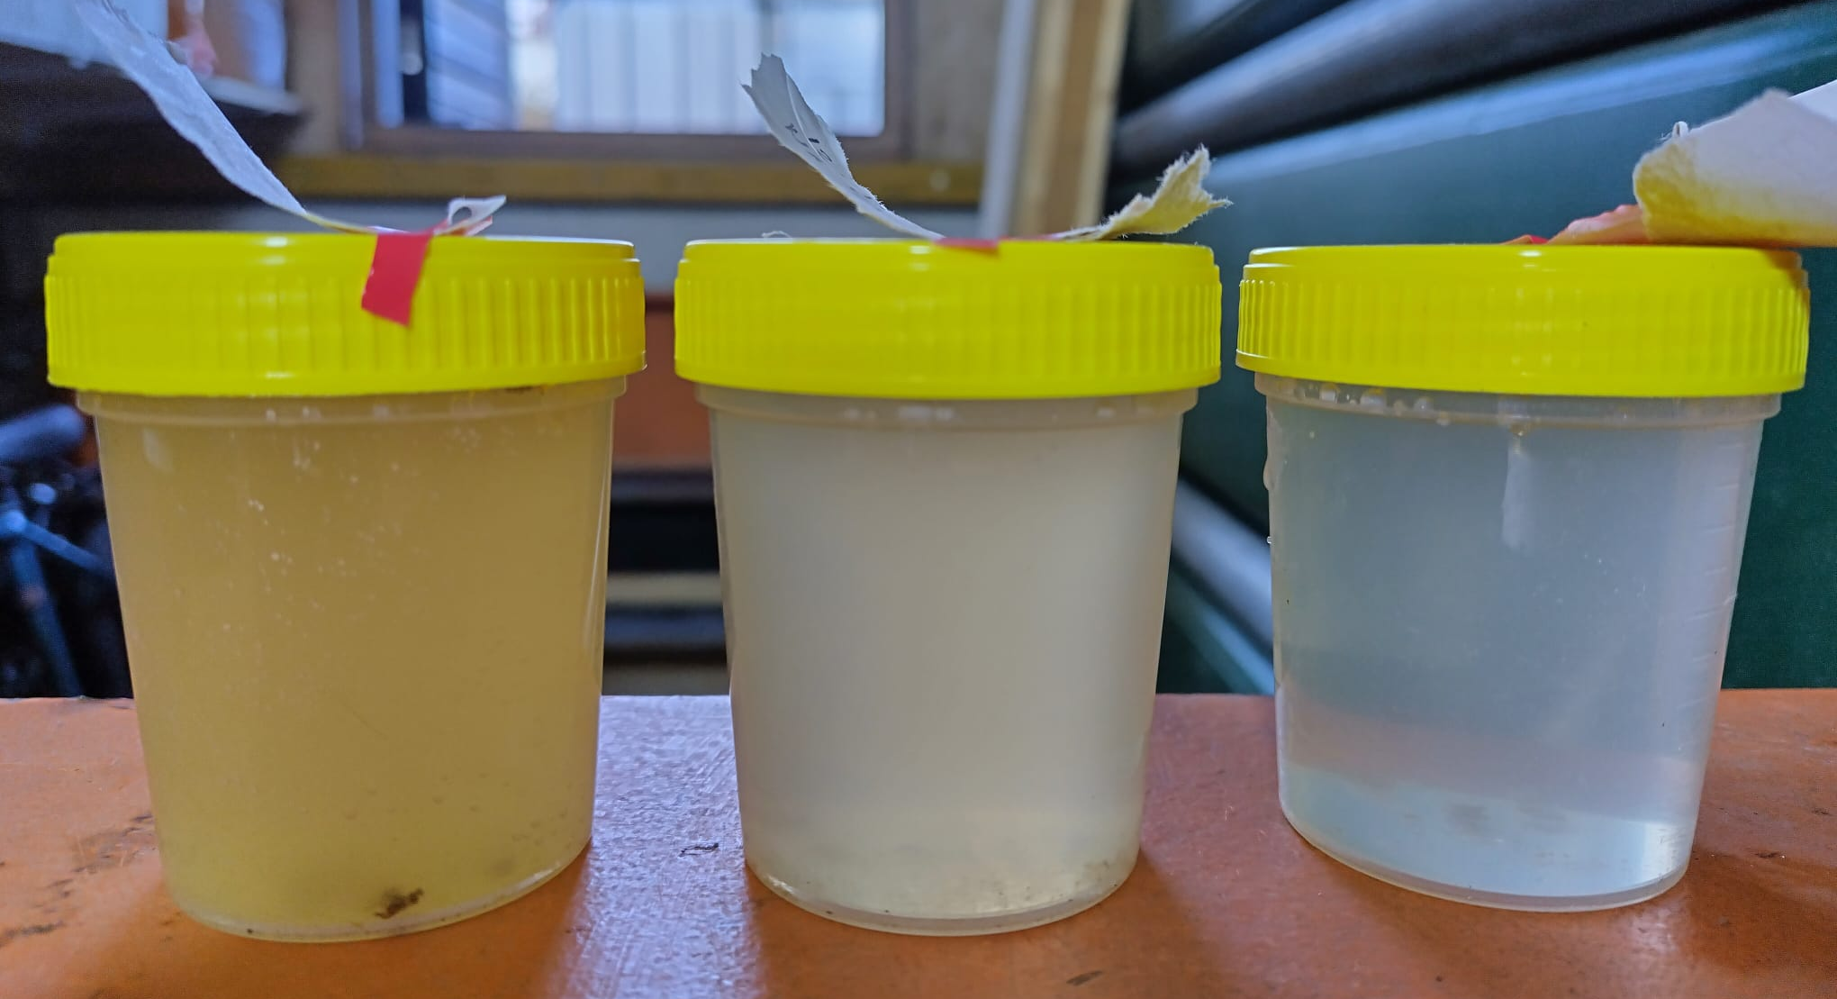
Concept micro treatment unit:
        Effluent compliant to:
        EU regulations for individual systems (land-based)
        EU-Waterways
        IMO incl. par 4.2 for P removal
        Others on demand
        ALWAYS Phosphourous removal > 95 %
        In addition:
        100% desinfection
        - eColi; Enterococci, (destroyed)
        -Helmith worms
        -Others
        heavy metal removal ( 25-90%) (in sludge)
        micro-plastics > 50% (in sludge)
        Pharmaceutical residues (25-70%) (de-composed,in sludge)
        PFAS, long C chaines, no precursor 10-60% (de-composed)
Notes:
CH4 = methaan N2O laughing gas voor GHG en NH3 amoniac
Boodschappen :
Reuslt of several years of academic research
Attention grab : shit for science
To show the development stage, to confirm it works, to confirm there is interest
Position the proximity advantages
Practical : mobile solutions, off-grid
Societal : GHG, Hygiene, enviroment

