Slide 1
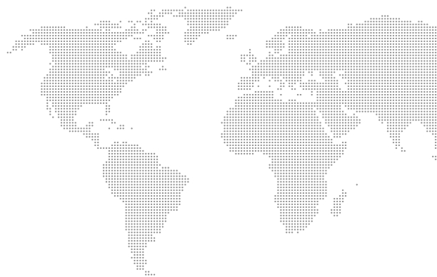


YOUR PARTNER
FOR ENTERING
FOREIGN MARKETS

Slide 2

About us
NG Shipping – is a logistics company that unites specialists with 15 years of experience in international trading and international container transportation.
By building reliable supply chains, we help Ukrainian manufacturers supply high-quality Ukrainian products to international markets: from shipping samples to transporting hundreds of containers.

Slide 3
About us
We specialize in the export of food, semiprepared products, alcoholic and non-alcoholic beverages, and organic products.
We have got extensive experience in organizing deliveries to the countries of North and South America, the Middle East and Asia.

Slide 4
Increasing the export potential
of Ukraine

Slide 5



Our values
Reliability
Our Team strives to provide services at a high level through well-coordinated professional work
Service
We provide and ensure maximum convenience and ease of interaction at every stage of our work
Technologies & Innovations
We constantly follow the trends of technologies and innovations, constantly introducing them into our business processes

Slide 6
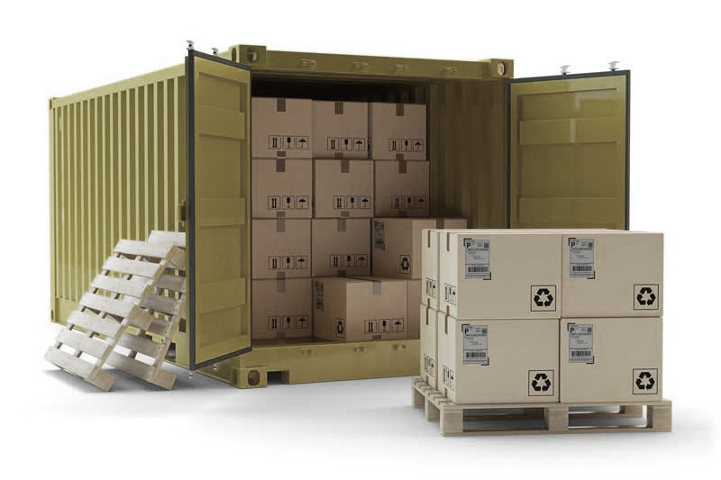
Container Transportation
Our specialists with 15 years of experience will help you develop individual schemes for international container transportation, taking into account the optimal delivery time, cargo characteristics and transportation cost.
More and more Ukrainian exporters choose container transportation for several reasons:
the possibility of combining various types of transport without reloading goods,
security - specialists of the NG Shipping company additionally seal all containers,
flexibility - the possibility of either full container load (FCL), or less than container load (LCL).

Slide 7

Export of food products
When exporting food products, it is necessary to take into account many nuances connected with product certification, obtaining various commercial and approval documents. This is a process that requires high qualifications and significant experience in foreign markets.
NG Shipping specialists will provide comprehensive advice on the export of food products and develop an optimal scheme for the international supply of your food products.
We know and strictly follow all the rules of transportation, depending on the type of food, terms and conditions of storage. Our company is used for exporting canned vegetables, fish, frozen foods, sweets, marshmallows, cookies, cereals and much more.

Slide 8
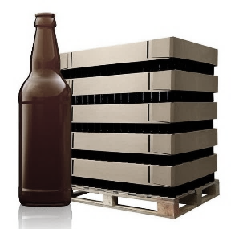
Export of alcoholic and non-alcoholic beverages
Organization of the export of alcoholic and non-alcoholic beverages is a labor-intensive process that requires high qualifications, experience in foreign markets and reliable suppliers.
NG Shipping Company has all of the above components for organizing the export of alcoholic and non-alcoholic beverages.
We know and strictly follow all the rules necessary for the international transportation of wine, beer, vodka, juices, fruit purees and concentrates.
We carefully select containers for transportation - they must be almost perfectly clean, we conduct additional sealing of containers and carry out additional control of the weight of the cargo. All this is done in order to minimize risks and improve the quality of shipping services.

Slide 9
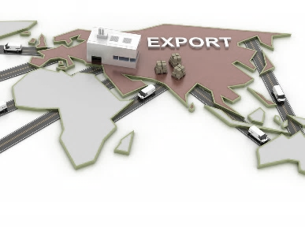
Development of export strategies
Over the past years, Ukraine has confidently conquered new foreign markets, and our country has already secured the status of a world leader in the export of agricultural products. According to viewpoint of numerous experts, there is still a lot of potential ahead.
In order to successfully enter foreign markets, exporting companies need export strategies that allow them using the company’s potential and competencies, responding in a timely manner to changes and using various trends.
Specialists of NG Shipping Company will help you develop and implement an export strategy, from analyzing potential markets, developing an optimal model for entering the market, working out branding and marketing, adapting a product, creating a communication strategy and promotion channels, and ending with providing a reliable product supply chain.

Slide 10
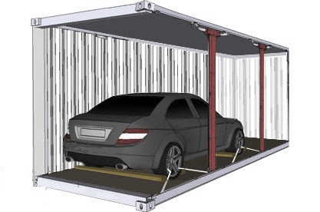
Delivery of vehicles
from the US
NG Shipping has been importing vehicles from the USA since 2016. The prices for vehicles in the USA are 30-40% lower than in Ukraine; however, in terms of their technical condition, they are superior to those sold in Ukraine.
Specialists of NG Shipping will help you choose a vehicle from the USA for the optimal budget / quality ratio. We have our suppliers in the United States; we verify the history of vehicles and work under a contract.
We have transparent pricing, and thanks to our own logistics service, we provide pleasant prices for our services.

Slide 11














Clients appreciate us for:
Transparent pricing
Flexible terms & conditions
Insurance against risks and faults
Teamwork and performance
Openness and care

Slide 12
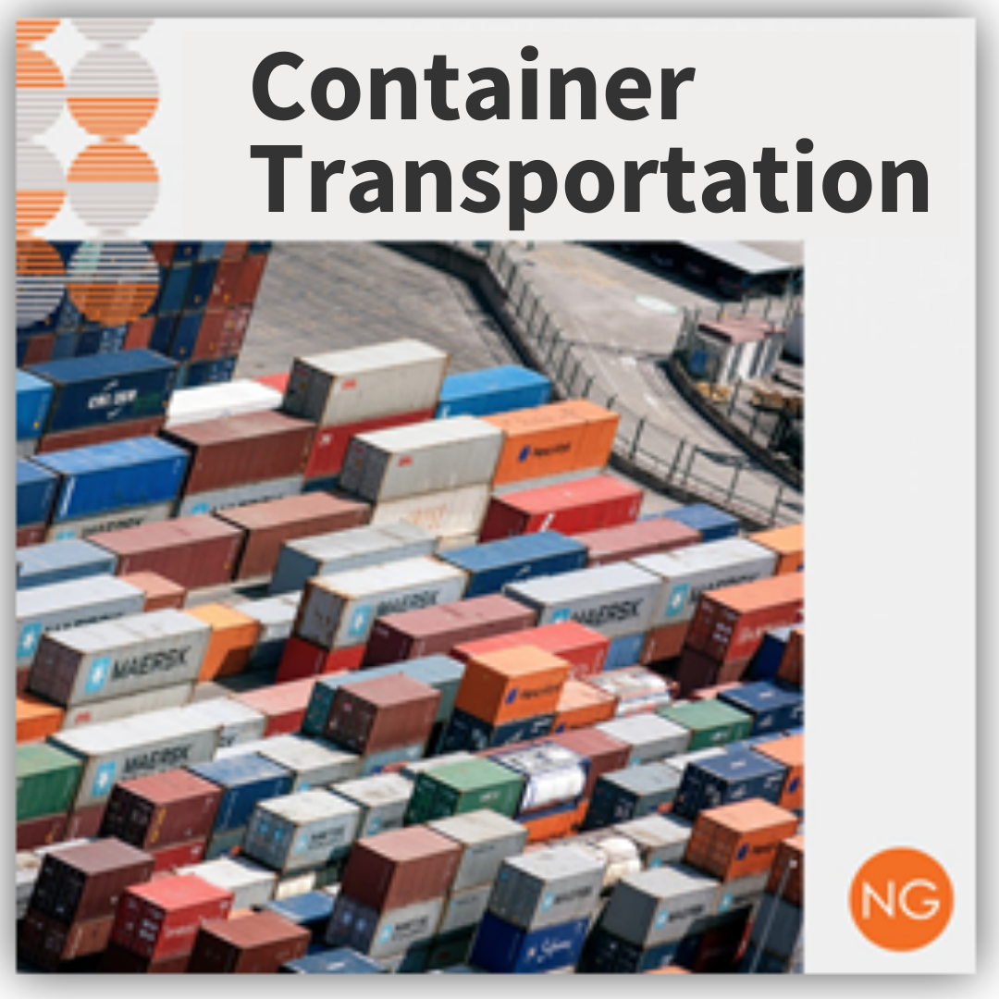
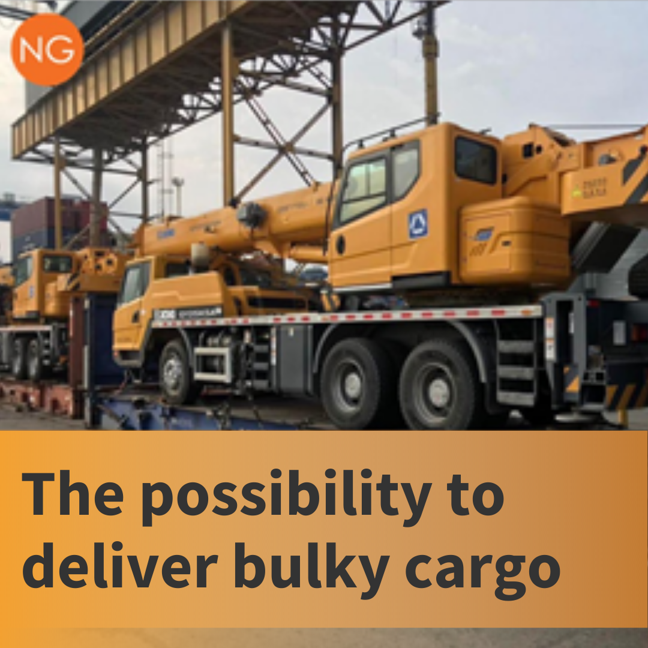
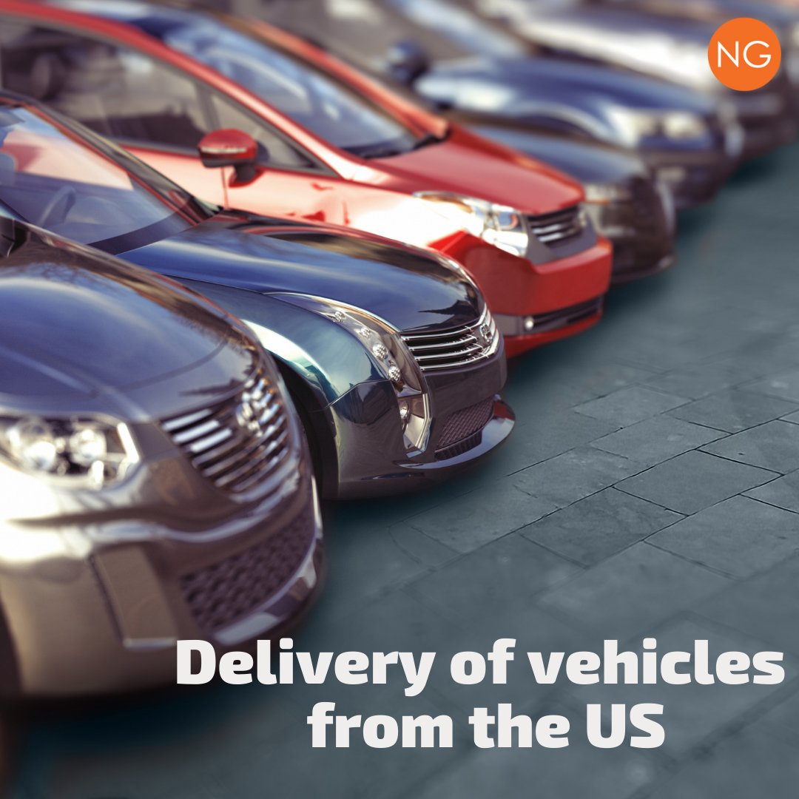
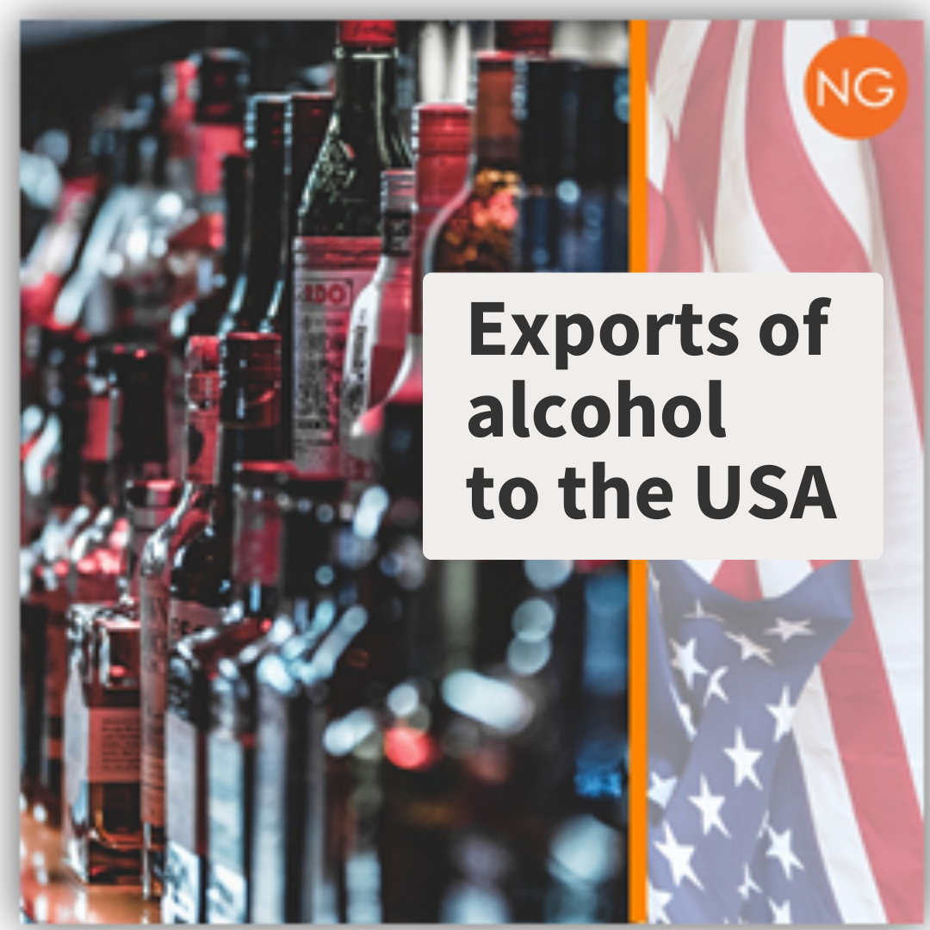
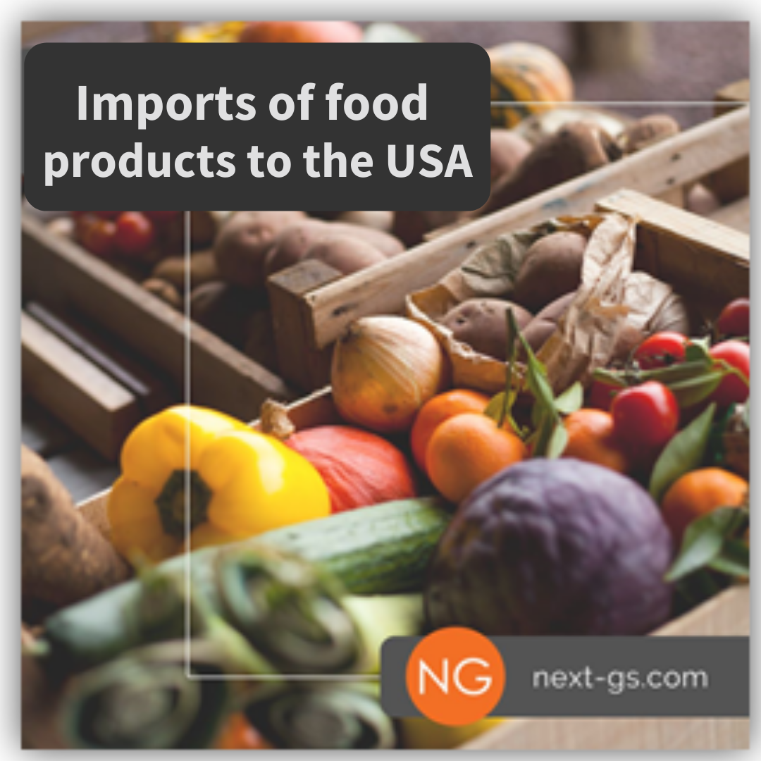
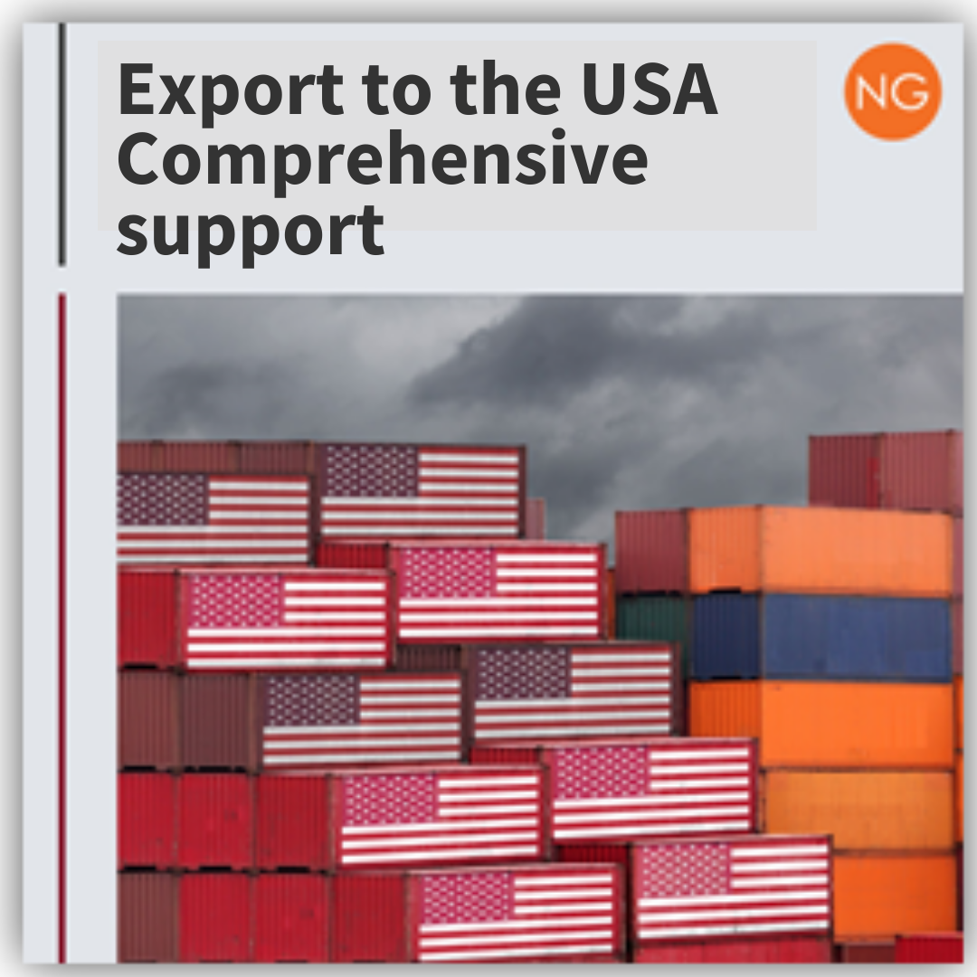
YOUR PARTNER FOR ENTERING FOREIGN MARKETS

Slide 13





We are partner of
Union of Ukrainian Entrepreneurs
REGIONAL
DEVELOPMENT
BUREAU
Центр підтримки експорту
Export Support Office

Slide 14


“OUR TEAM will provide a powerful charge of purposefulness to your business in order to achieve the set goals“
Grigoriy Cherniavskiy,
CEO NG Shipping

Slide 15





Odesa, Ukraine
YOUR PARTNER
FOR ENTERING
FOREIGN MARKETS
container@next-gs.com
www.next-gs.com
+380 (48) 704 42 89

