Slide 1



Where Austrian Companies
Can Still Thrive in the United States?
Policies for Growth
January 2026

Slide 2
Summary
The U.S. is investing heavily in three sectors with large growth:
  Data Centres and AI and components
  Advanced Biologics
  Défense capacities
Growth is accelerating
For the near-term (3 yrs), policies will support this growth
Other sectors growing substantially too.
The U.S. cannot achieve this growth without significant imports.

Slide 3
Data Centres and AI
This year 6 companies will invest Austria’s GDP (600 billion $USD) into data center construction and support.
  40 percent growth over 2025
  70 percent of centers planned for U.S.
Other large investments by component makers and suppliers.
Example: electricity generation, transmission, and distribution

Slide 4
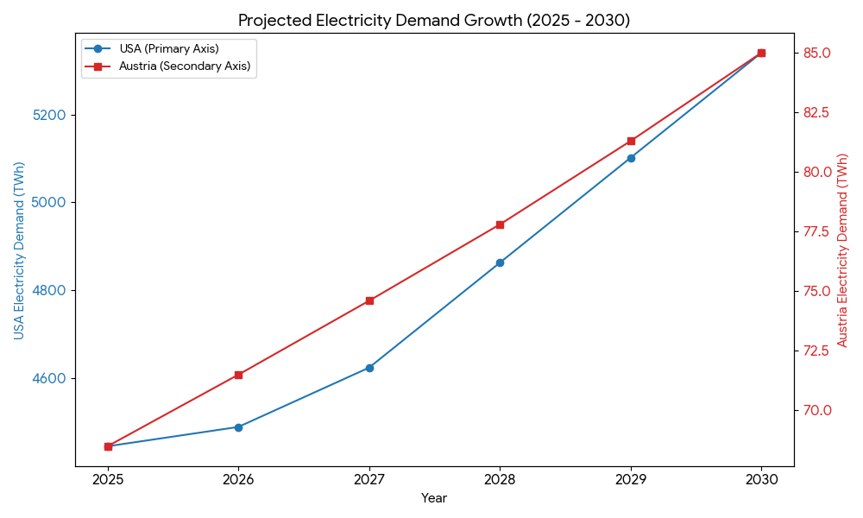
Growth in Electric Grid

Slide 5
Need New Supply and Efficiencies
The U.S. must add one Austria grid every year until 2030 and then accelerate to 1.5 Austria grids annually.
  Google recently purchased a major independent power company
  Austria has more experience managing this growth
    Energy Efficiency systems, construction, retrofit
Shift in Generation
  Existing
    Combustion turbines
    Continued organic growth in renewables
  New
    Modular nuclear reactors
    Energy efficiency

Slide 6
US Needs Everything Else
10 percent of data center spend is for cables, sensors, buildings, electrical connections, HVAC, and many other non-IT parts.
  Well over 60 Bil $USD incremental increase to these markets.
Spending by firms to use AI and to optimize corporate networks for AI
  > 100 Bil $USD /year in 2026
Inadequate global supplies.

Slide 7
Supportive Policies
The Administration is highly focused on this transition.
  2 Major E.O.s
    Blocking US states from denying power, permits
  Offering federal lands to
    Data centers
    Modular Nuclear Reactors
    Uranium enrichment
  Changing tariffs to allow imports
  Pushing hyperscalers to invest in energy supplies
Unlikely to be challenged by Congress even if Democrats have substantial gains in November.
Next President could remove this support.

Slide 8
Advanced Biologics
Demand growing at 40 percent a year
Examples:
  GLP-1 inhibitors
    Oral and targeted therapies
  Cell and Gene Therapies
    More than 50+ under FDA review
  New platforms for oncology and for CVD
Pharma Companies have 1 Trillion $USD globally to invest
Companies scaling up global production
  6 Bil $USD announced last week in US

Slide 9
Advance Biologics
Production Needs
Everything – US Supply Chain almost completely lost
Pharma investing in production plants but local suppliers do not exist
US production will increase also due to more start ups
  Pharma will buy established start ups
  Founders/VC will move to next set
  AI will allow more start up identify candidate compounds faster
    More need for small scale equipment and supplies

Slide 10
Mixed Policy Support
Supportive
  Tax bill offers R&D expensing and large deductions for US manufacturing.
  Tax credits for small companies
  Favorable M&A reviews
Discouraging
  Federal research funding cuts
  Pressure to reduce prices
  Tariff and immigration policies

Slide 11
Défense Spending
US Défense spending for RDTE and Procurement is increasing
  Nearly 385 Bil $USD
  Increase to 40% of budget from 33% in 2018.
Mostly tied up in a few major weapon systems
Recent conflicts have demonstrated new threats and new capabilities
  Low cost, saturation of drones
  Autonomous systems
  Defensive barriers

Slide 12
Recognition that Change is Necessary
General bipartisan agreement to try:
  Procure new systems faster
  Buy from companies that are not defense contractors
  Test new systems faster
  Reduce weight and give more lethality to small units
This year, 25-50 billion $USD available for these programs
  More than double two years ago
Opportunities for non-US companies to participate
  Helpful to have some US production

Slide 13
Policy Environment
Administration is slashing staff, reshaping military leadership.
Disruption may help, hurt push for change.
President proposed essentially doubling procurement budget.
  Unlike to get that much, but Congress may agree to more (100 Bil $USD) before November
Rate of spending increase would likely be reduced if Democrats win substantially in November.

Slide 14
If We Had Time….
Rapid Changes and Investment in Mobility
  EVs, AVs, micromobility, commercial AV and drones
Financial and Professional Services
  Ground zero for AI transformations
Energy and Chemicals
Consumer
  Leisure experiences and products

Slide 15


Further Information
Jonathan Gledhill
Policy Navigation Group
(703) 280-0430
jgledhill@policynavigation.com
www.policynavigation.com

