Slide 1

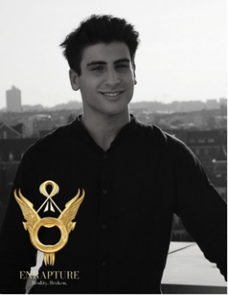
ENRAPTURE SRL
VRAR Industrial Coalition
Enrapture: Virtual-World Creators Engaging Modern Audiences through Gamification. Working towards Metaverse from the heart of Europe: Brussels.
We are a team of young, talented creators who first met inside gamified virtual worlds – the rest is history. Starting in the top 1% of Second Life creators, we have gone on to design digital assets bought by over 100,000 avatars, develop our proprietary immersive office software, and a growing Roblox studio for b2b branded Roblox games.
🚀 Bootstrapped & growing: 100% independently grown studio.
🎮 Developed Roblox games with 156K+ plays.
🛠️ Proprietary virtual-world office software used in B2B partnerships.
🤝 Collaborations with creators, brands, think tanks, media and academia.
📚 Academic track record: Our virtual-world research is published in peer-reviewed journals.
We are ready to bring our hands-on innovation, platform expertise, and co-creation approach to Horizon Europe consortia focused on digital creativity, cultural engagement, XR, and user-driven tech design.
Manuel Bolognesi
Founder & CEO
info@enrapture.world
+32 491103658

Slide 2
ENRAPTURE SRL
HORIZON CL2-2025-01-HERITAGE-04, HORIZON-CL2-2025-01-HERITAGE-05
HORIZON-CL4-2025-03-HUMAN-14, HORIZON-CL4-2025-03-HUMAN-15, HORIZON-CL4-2025-03-HUMAN-16, HORIZON-CL4-2025-03-HUMAN-17
🛠️ Enrapture’s Technical Expertise & Consortium Value (Brussels City Report Ambassador for Metaverse & Simulations):
With a deep foundation in immersive design and virtual-world systems, Enrapture offers cross-cutting expertise at the intersection of gamification, UGC, and platform engineering:
🎮 User-Generated Content (UGC) & Gamification
Experts in player engagement systems, retention mechanics, and branded experiences across gamified virtual worlds.
🧱 Game & Platform Development
  Roblox (LUA), LSL and platform-specific scripting: Custom game loops, avatar systems, monetization
  Unity: Prototyping 3D simulations, immersive software
  Close collaboration with platform companies
  Full Stack Development
🧠 Virtual-World Demand Analysis
Insights from over 100,000 avatar customers, guiding smart UX, pricing, and asset design and academic research in peer-reviewed academic journals.
🧩 3D Creation
  Asset modeling, texturing, and optimization for UGC
  3D Rigging & Animation for interactive and expressive avatars
🛍️ Marketplace & B2B Innovation
  Building Shopaverse™, a virtual-world marketplace framework
    Supporting brand-to-avatar commerce and digital storefronts
  Building MeetWork.ai, the virtual world of professionals.
We are uniquely positioned to bridge creative production, behavioral design, and system-level development — ready to lead or support technical work packages across Cluster 2 & 4 Horizon calls.
Manuel Bolognesi
Founder & CEO
info@enrapture.world
+32 491103658

