Slide 1
Data reply for
Smart Communities projects
Simonetta, Bodojra Senior Data Scientist s.bodojra@reply.it

Slide 2

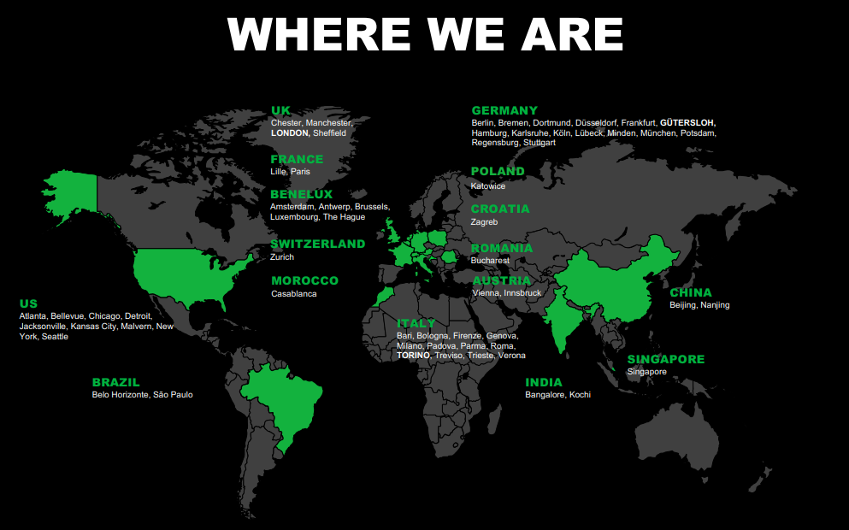

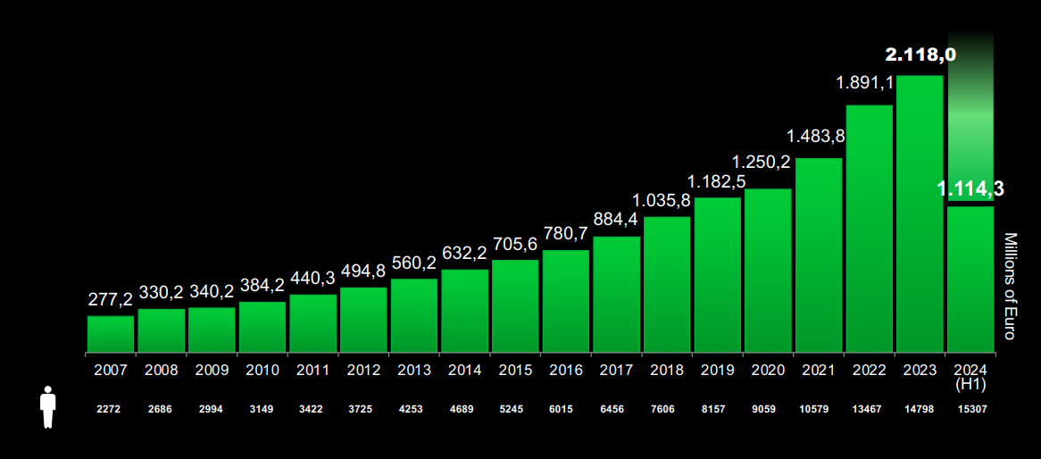

Reply is a network of companies highly specialized in technologies and industry sectors.
Our services include Consulting, System Integration and Digital Services, and we cover three main areas of competence:
Processes, Applications and Technologies.
Notes:
fatta

Slide 3
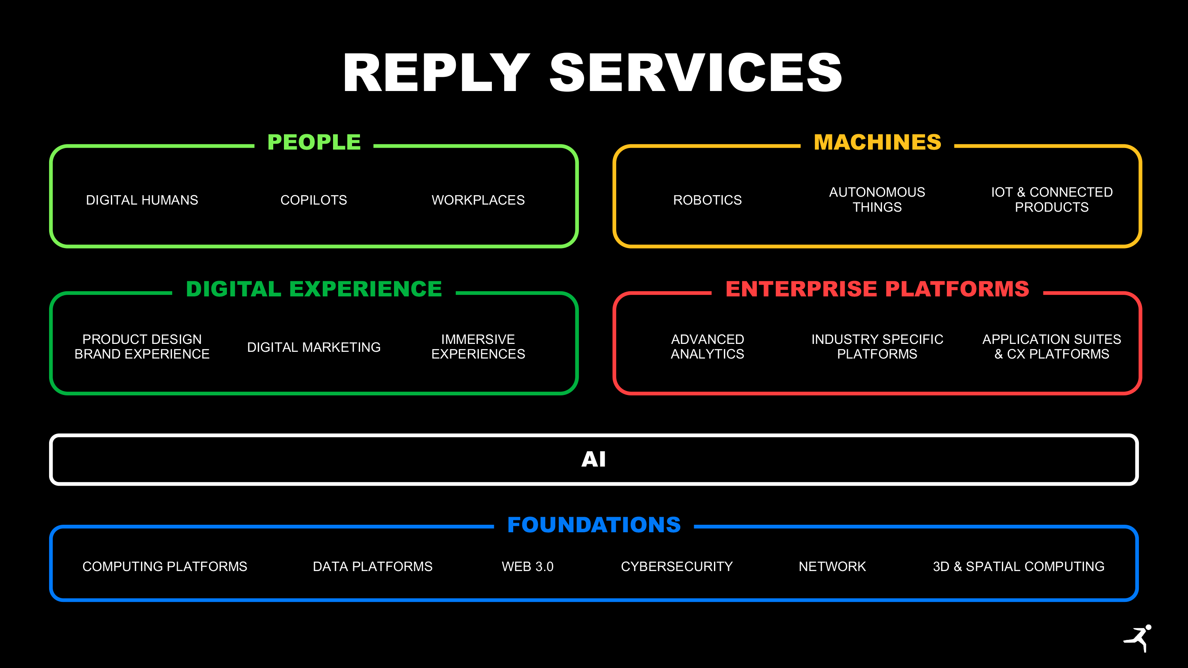
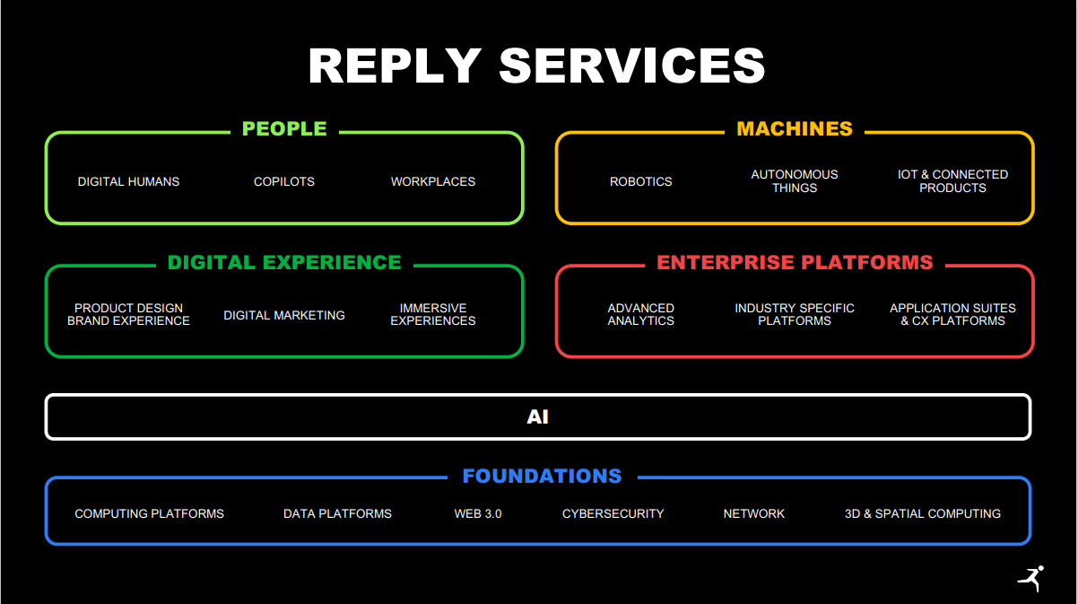
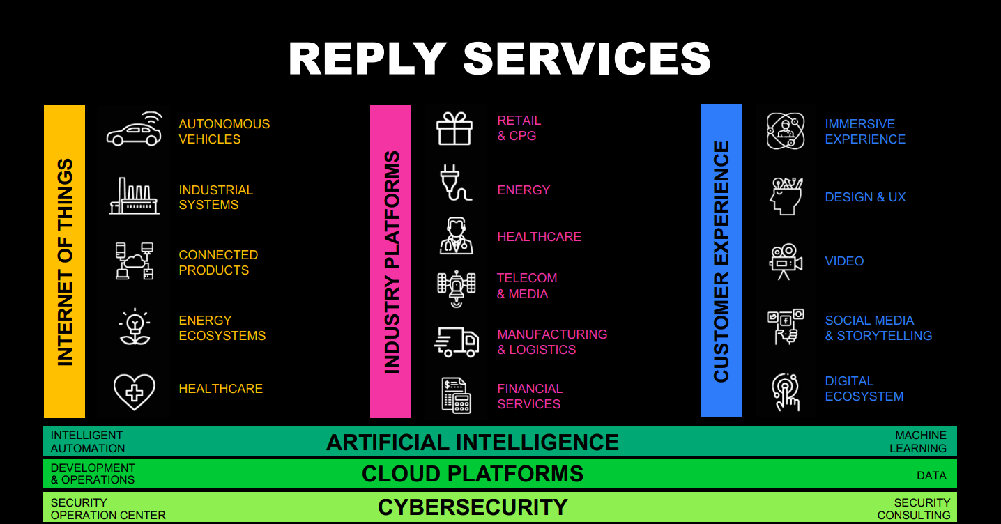
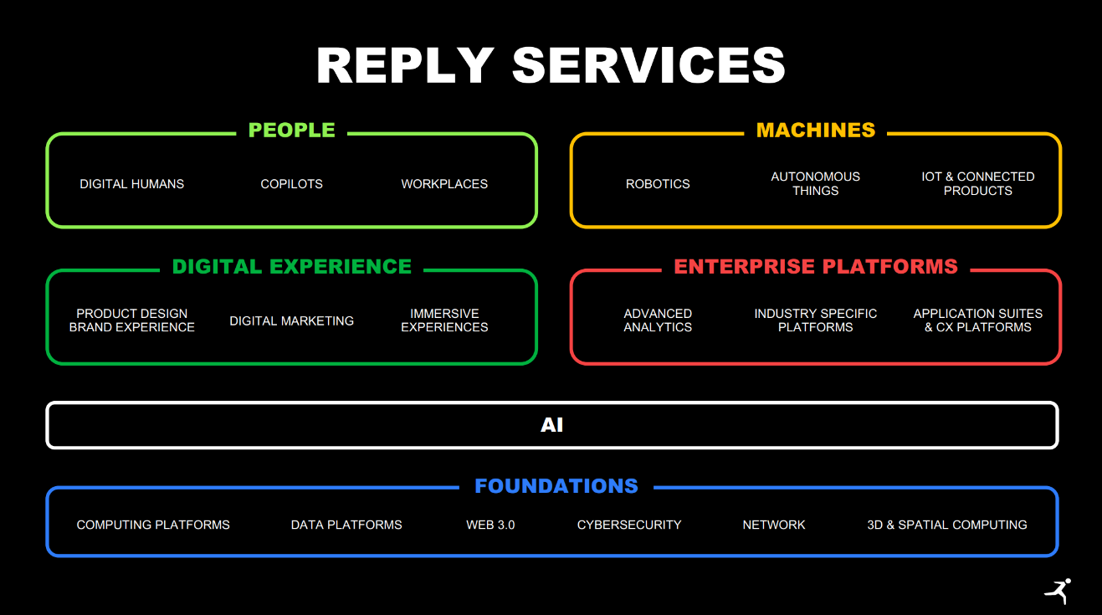
@simo verificare se disponibile nuovo file
Notes:
fatta

Slide 4
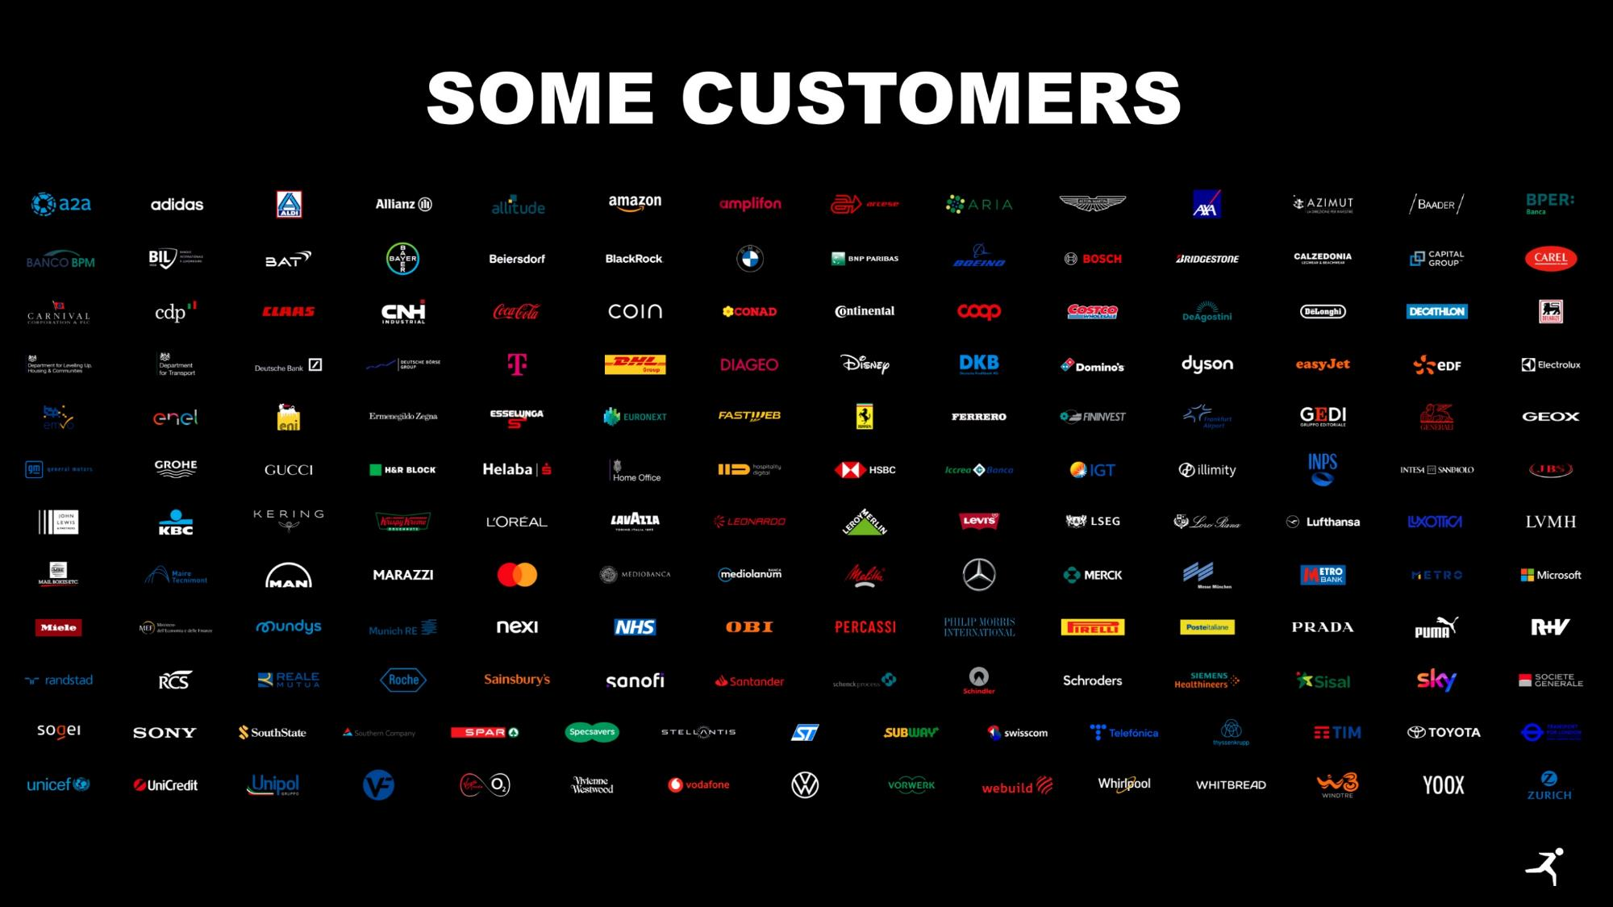
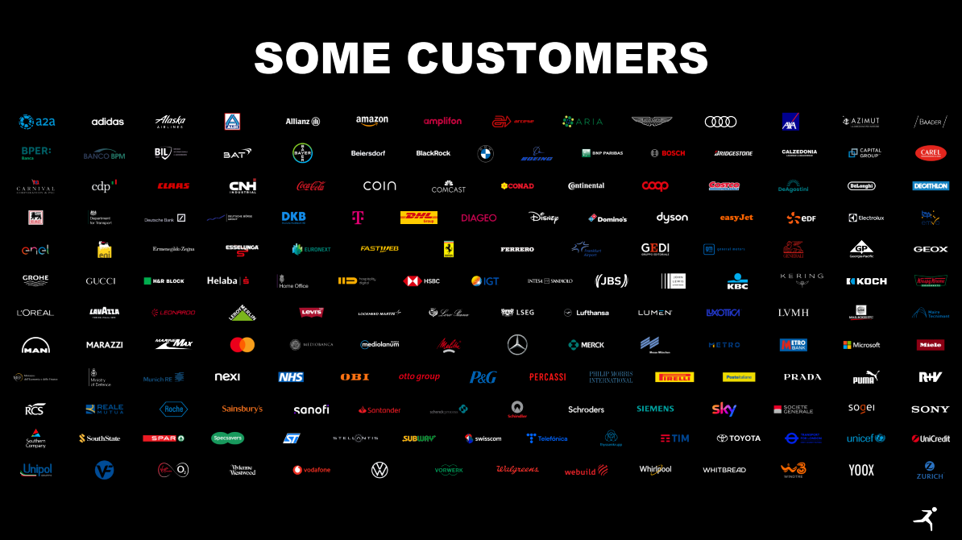
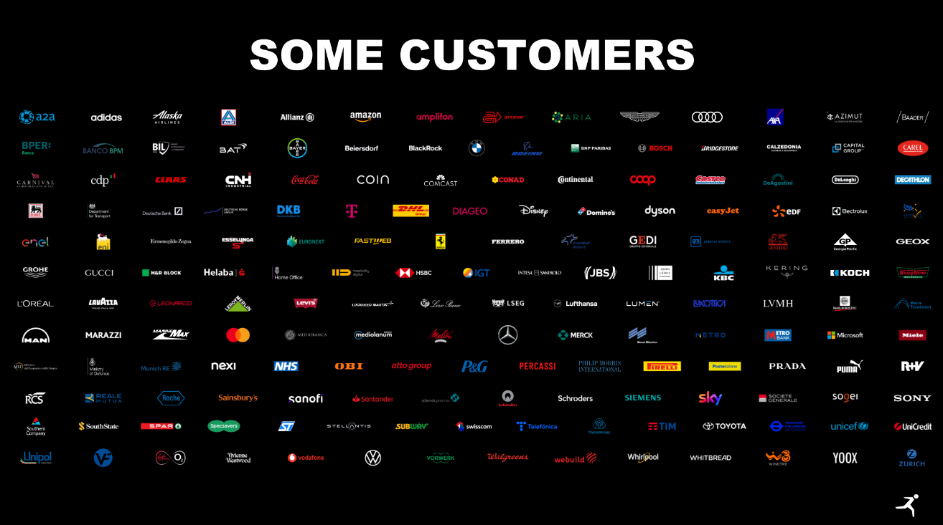
Some customer
Notes:
fatta

Slide 5


WE SUPPORT C-LEVELS TO EXTRACT VALUE FROM DATA
BIG DATA | ARTIFICIAL INTELLIGENCE | QUANTUM
In all industries and all business functions.
With more than 120 projects already delivered in production.
Confidential
Notes:
fatta

Slide 6







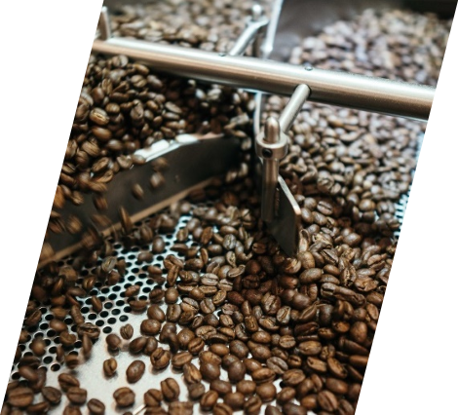


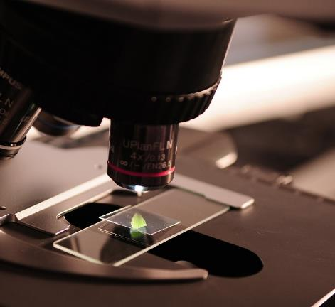
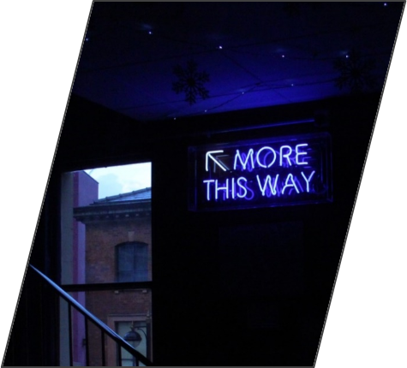
Automotive
INDUSTRIES
Travel & Logistics
Finance
Insurance
Retail & CPG
Manufacturing
Utilities
Telco/Media/Publisher
Pharma
Others
Confidential
Notes:
fatta

Slide 7

























































































Automotive
MAIN CUSTOMERS
Travel & Logistics
Finance
Insurance
Retail,Fashion & CPG
Manufacturing
Utilities
Telco/Media/Publisher
Health/Pharma
Others
Confidential
Notes:
fatta
AUTOMOTIVE → STELLANTIS AL POSTO DI FCA
FINANCE →SCHRODERS

Slide 8

Earth observation
Intelligence
Confidential

Slide 9
Earth observation intelligence
Data Science & BDA
Advanced Analytics Solutions, ML
Satellite techs
Earth Observation, Weather Services, …
Confidential

Slide 10
Digital twin for urban climate adaptation

Slide 11




Proposal context
The problem
In today's rapidly changing climate, cities are facing numerous climate-related issues that demand urgent attention and innovative solutions.
The vast availability of data has paved the way for numerous innovative services and technologies aimed at addressing urban resilience challenges.
It is essential to leverage all our capabilities, data technologies, and use cases, integrating them to extract truly actionable insights.
This approach will enable the development of explainable tools that policymakers can use to make informed decisions.
Insights
Use Cases
Maturity Level
Technology
Global Coverage Earth Data
The material of this document must be considered as property of DATA Reply s.r.l, confidential and not disclosable to any third party

Slide 12




Proposal context
A possible solution
How can we measure the impact of green spaces on air quality?
Liveable Cities
What key adaptive measures are needed for resilient urban planning?
Sustainable Cities
What are the trends in urban population growth and their impact on housing demand?
Information Factory
Where are the high-risk areas in urban mobility?
Connected Cities
What adaptive measures can enhance the resilience of urban transport systems?
The material of this document must be considered as property of DATA Reply s.r.l, confidential and not disclosable to any third party

Slide 13




Proposal context
Development framework
Satellite Tech
Digital Twin and IoT
Data will be complemented with cutting-edge technologies to extract meaningful insights.
AI
Generative
AI
The material of this document must be considered as property of DATA Reply s.r.l, confidential and not disclosable to any third party

Slide 14





Proposal context
Satellite data
A solution will be developed using Earth Observation Satellite Data as input.
Water Quality
Weather Data
Land Surface Temperature
Vegetation Status
Air Quality
The material of this document must be considered as property of DATA Reply s.r.l, confidential and not disclosable to any third party

Slide 15





Possible Use-cases
Air Pollution
Nature-based Solutions
Energy
Urban Sprawl
Actions on urban mobility
Actions to reduce heat islands
Buildings energy efficiency actions
Actions for requalification of abandoned areas
Additional ideas are welcome!
The material of this document must be considered as property of DATA Reply s.r.l, confidential and not disclosable to any third party

Slide 16





Proposal CONTEXT
Needed Competences
Project Coordinator needed
Public Authorities and Local Administrations to provide pilot cases, facilitate solution deployment, ensure real territorial impact
Jupiter
Research centers, and climate experts with experience in climate adaptation, risk assessment, and urban resilience, for technology validation, climate risk and impact assessment
Saturn
Technical Partner
NGOs, citizen associations, training providers, and dissemination experts focused on community engagement, co-creation, training, dissemination of results, and monitoring of social impact.
The material of this document must be considered as property of DATA Reply s.r.l, confidential and not disclosable to any third party

Slide 17
THANK YOU

