Slide 1

How to create your own digital badge:
1. Choose a template from below
2. Upload a photo of yourself.
Insert → Pictures → This Device → Select image → Insert
3. Save the image
File → Export → JPEG → Save
• Post it on LinkedIn or other social medias
• Done!
4. Please tag:
#VentureMatch2026
#UminovaInnovation
LinkedIn: @uminovainnovation
Instagram: @uminovainn

Slide 2
You have two options for placing your image in the template:
1. Place the image on top: Insert your photo and leave it above the template graphics. (Exempel 1)
2. Set the image as a background: Insert your photo, then right-click and choose “Send to Back”. This makes the photo a full-background image, with template graphics on top. (Exempel 2)

Slide 3

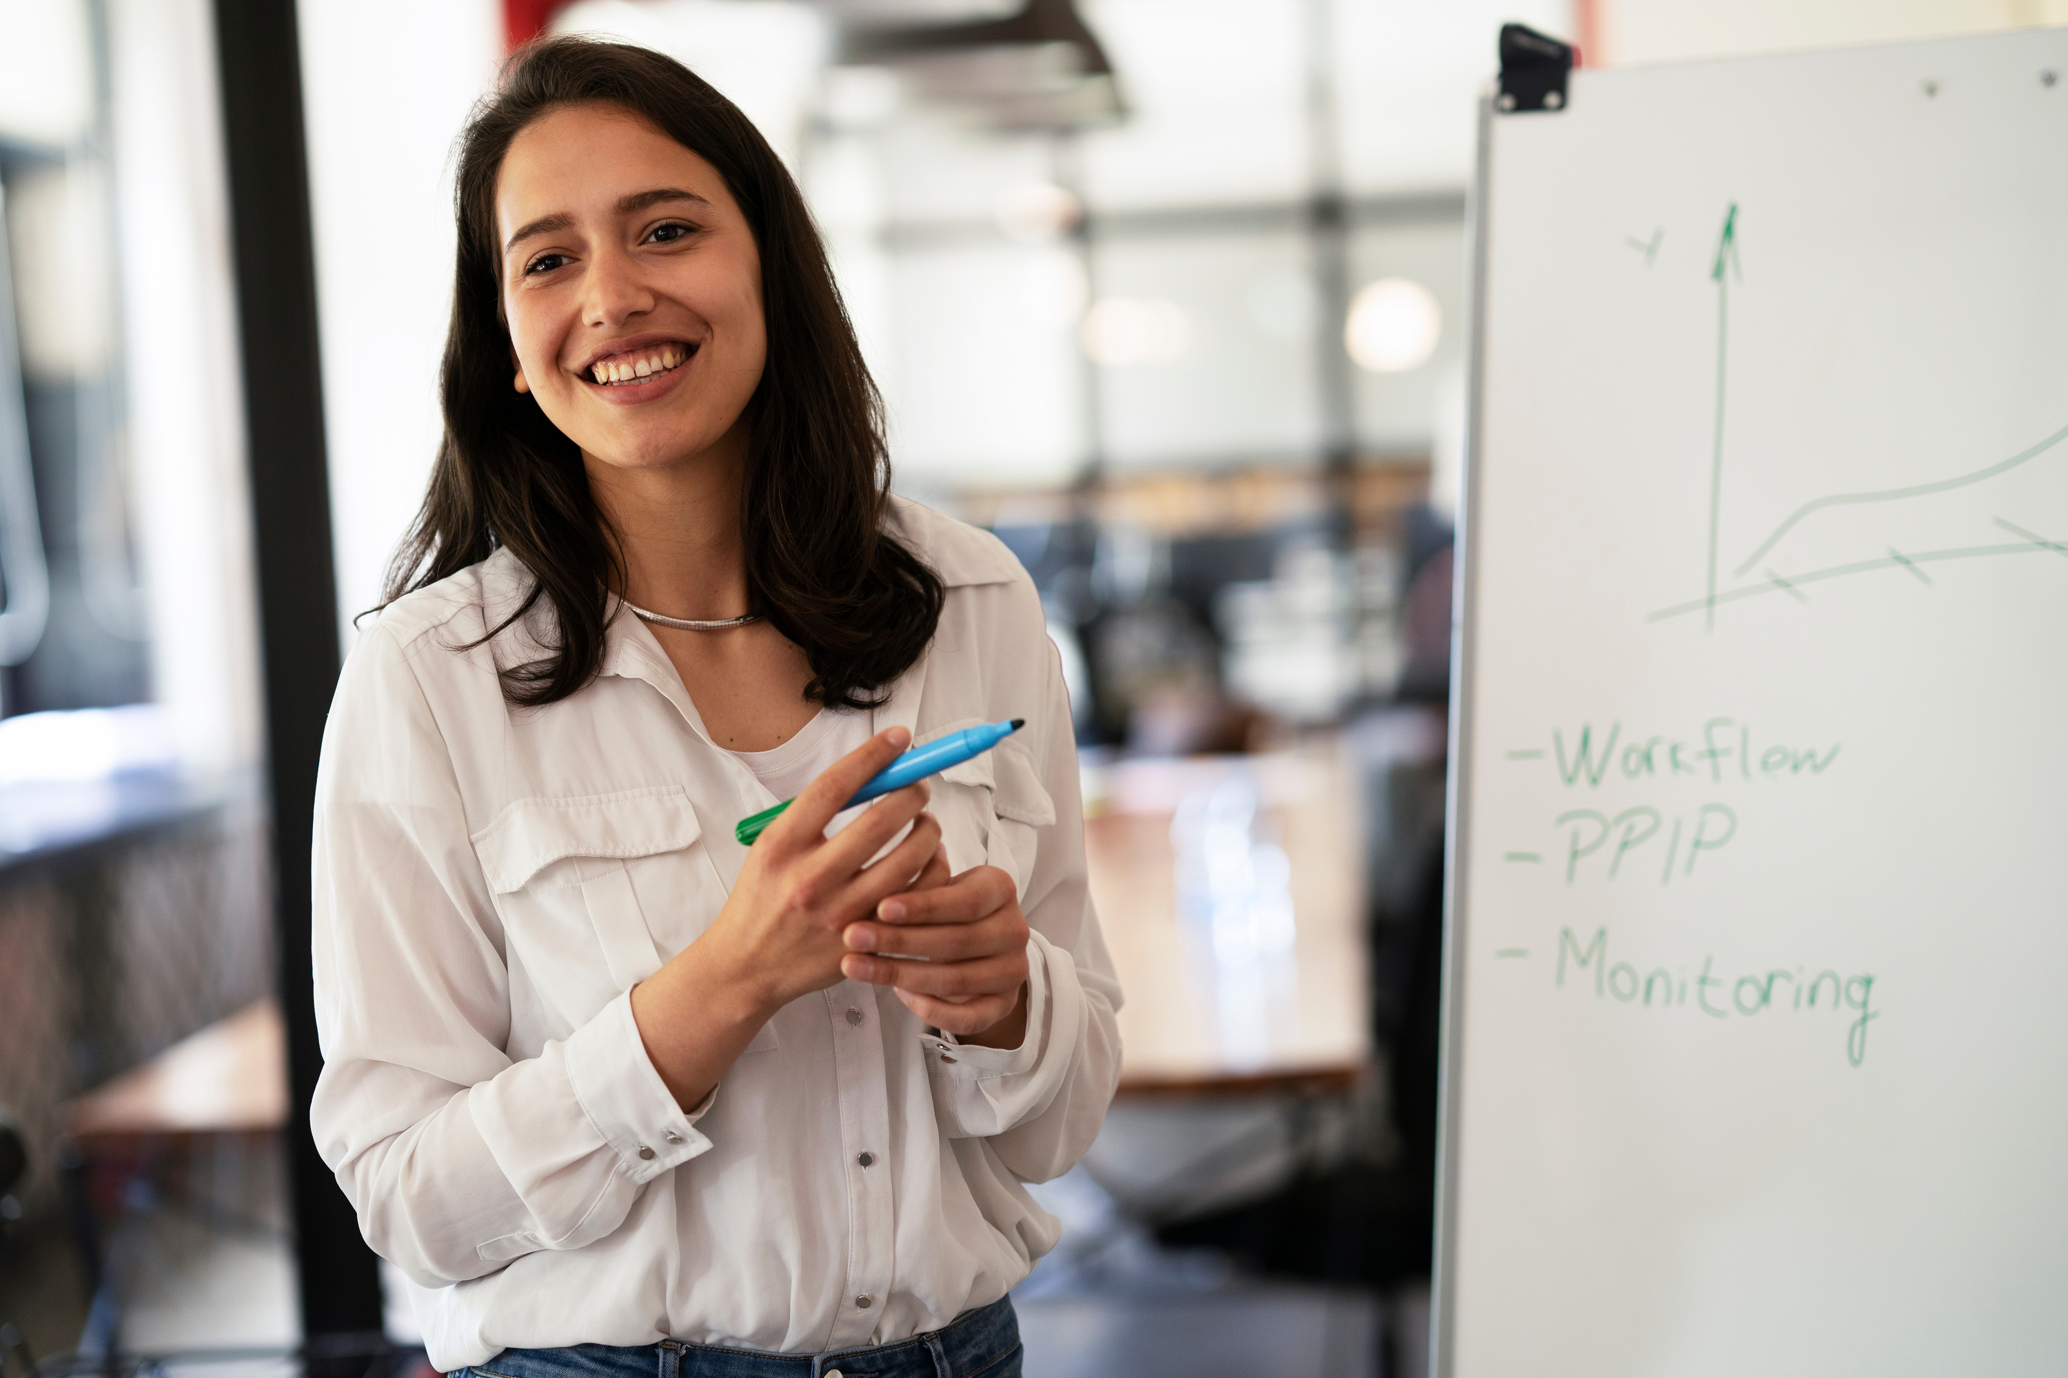








5 maj 2026 at P5, Umeå
#VentureMatch2026
#uminovainnovation
EXEMPEL 1
I’m attending!

Slide 4

5 maj 2026 at P5, Umeå
#VentureMatch2026
#uminovainnovation
I’m going to
EXEMPEL 2

Slide 5
Templates below

Slide 6
5 maj 2026 at P5, Umeå
#VentureMatch2026
#uminovainnovation
I’m attending!

Slide 7
5 maj 2026 at P5, Umeå
#VentureMatch2026
#uminovainnovation
We’ll attend

Slide 8
5 maj 2026 at P5, Umeå
#VentureMatch2026
#uminovainnovation
I’m going to

