Slide 1
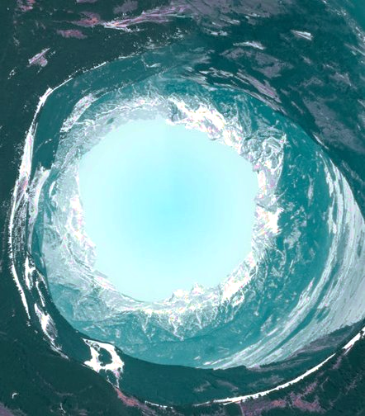
Circular Industry
We transform wasteful and harmful value chains into sustainable and circular industrial ecosystems, inspired by nature’s regenerative principles.

Slide 2
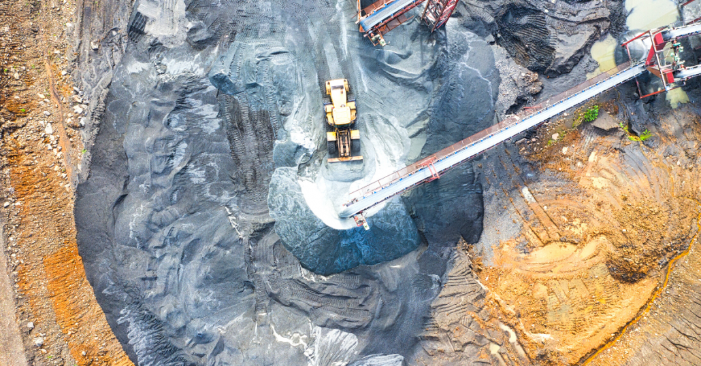
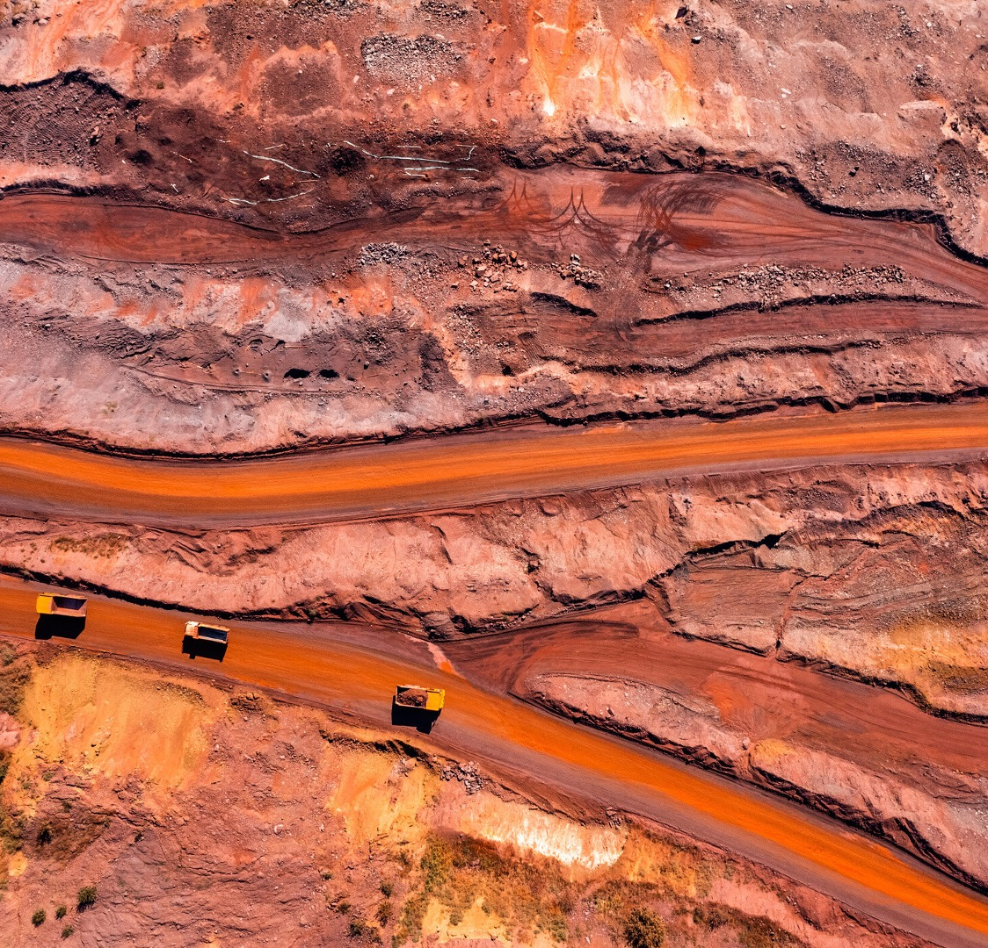
Why does it matter?
Our take-make-dispose system is bad for people, planet & (future) business
Raw material processing and extraction:
  ca. 50% of global GHG emissions,
  >90% of global water stress and land-use-related biodiversity loss.
Adverse human rights issues or unequal distribution of resources are linked to many value chains.
The EU generates 2.1 bn tonnes of waste annually and spends €55 bn on its disposal or treatment.
We need a swift and complex industrial transformation to secure a thriving future for the living world.
Notes:
Suggestion: Describe in 2-4 bullet points what you’re trying to solve and why are this is important for society. No more than 35 words per bullet.
What kind of economic transformation do we need to secure a thriving future for humanity and the rest of the living world?

Slide 3
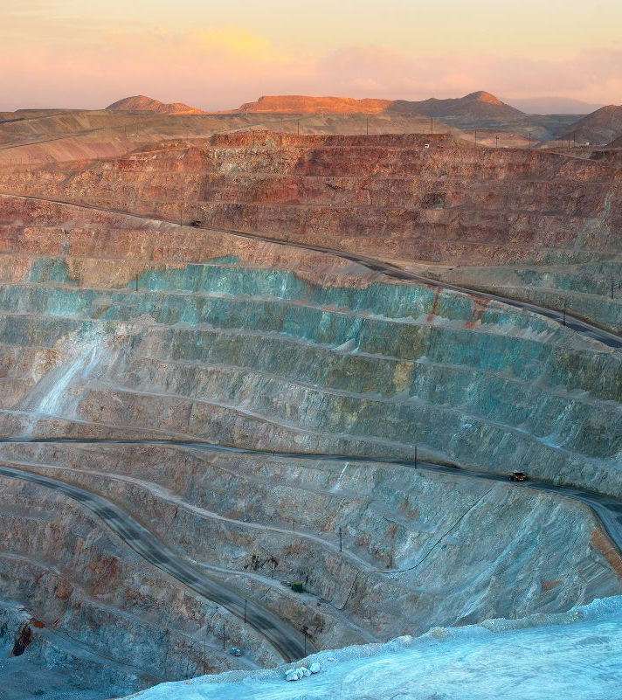
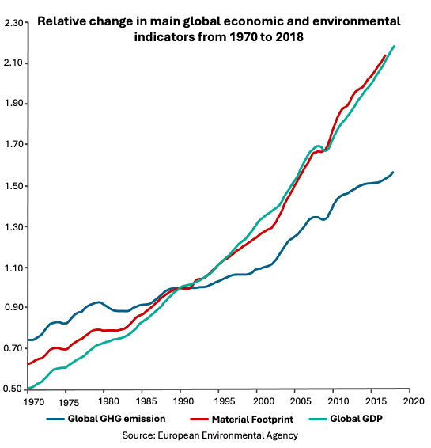
It’s not only about GHG emissions
Decoupling economic growth from GHG emissions is just one part of the story…
We just consume too much materials most of which are finite.
Supply of critical raw materials is at risk!

Slide 4
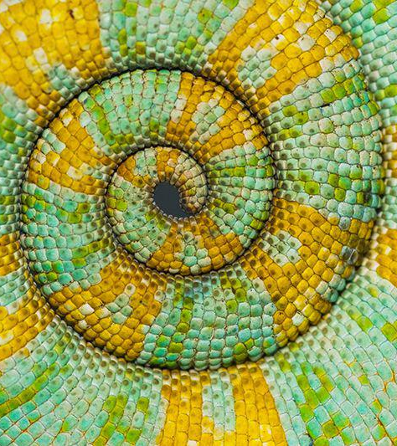
Our Vision
An Industry Inspired by Nature
The natural world reproduces, grows and consumes while maintaining balance. Everything is a source: A perfectly circular system.
How would this future look like?
Materials and products are circular by design and are sourced from secondary sources.
The value during the product lifetime is maximised, following circular strategies: repair, refurbish, repurpose and recycle.
The end-of-use is a business opportunity not a challenge.
Strong collaborations along and across value chains generate shared value for people, planet and business.
Notes:
Suggestion: Describe the alternative to your problem - what is the potential here? Help the client see what a better future could be.

Slide 5
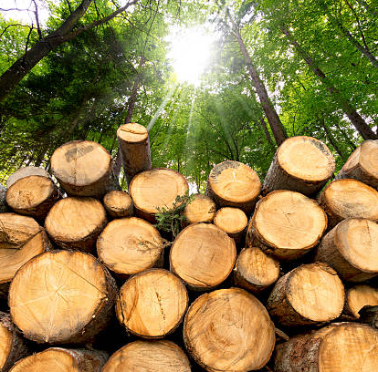
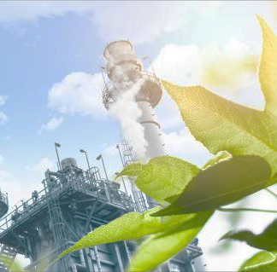
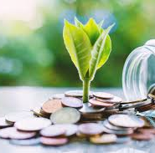
Our Approach
Circular economy (design) strategies
Circular Value Chain Creation
Circular Business Models & Financing
We support you to understand opportunities in the circular economy and develop and assess circular (design) strategies.
We support you to engage with your value chain partners and to create synergies with other industries to create shared value across a product’s lifecycle.
We support you to develop the right business model and find your way to private or public money to make your circular ideas reality.

Slide 6







Innovating in the Technosphere
Technical materials
Mining/materials manufacturing
We capitalise on our expertise, network and reputation in industrial circularity and ecosystem creation.
We support:
Research and development activities for circular materials, products, and processes
The implementation of circular strategies and business models in companies or across a value chain
The creation of new industrial or innovation partnerships
The access to funding
MATERIAL / PARTS MANUFACTERER
PRODUCT MANUFACTURER
Recycle
Refurbish/
remanufacture
RETAIL / SERVICE PROVIDER
Reuse/
redistribute
Maintain
User
Collection
DISPOSAL

Slide 7







Innovating in the Biosphere
Biological materials
Farming/ collection
We capitalise on our expertise, network and projects in biomaterial innovation and biowaste/wastewater valorisation.
We support:
Research and development activities for biomaterials, products, and processes
The assessment of bio-circularity levels and tailored business models for the bioeconomy
The creation of innovation partnership and access to funding
MATERIAL / PARTS MANUFACTERER
Soil restoration
PRODUCT MANUFACTERER
RETAIL / SERVICE PROVIDER
Cascades
Biogas
Consumer
Collection
Anaerobic digestion/
composting
DISPOSAL
Extraction of
Biochemical
feedstock

Slide 8
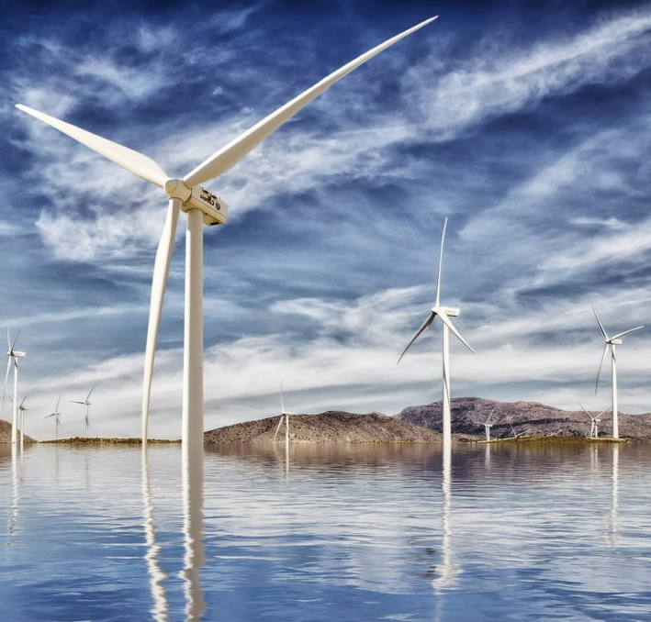
Circular design and value chain engagement
Design of a circular offshore wind project
Circular challenges in Offshore Wind Projects include:
Data availability and quality for circularity assessments (competitive risks)
Commercial availability of circular solutions
bax supported with:
Supplier engagement
Definition of circular strategies and specific measures
Impact qualification

Slide 9
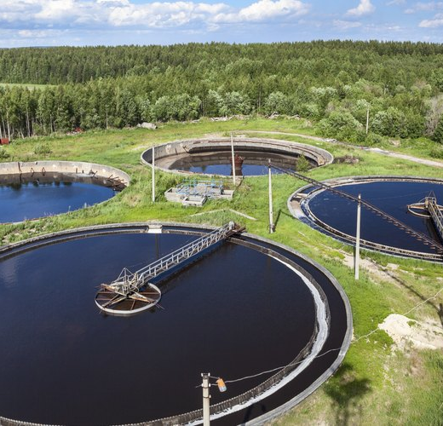
From waste to thriving circular urban bioeconomies
Organic Waste & Waste-water Sludge Valorisation
Biobased projects and businesses are challenged with:
Technical, legal and administrative barriers
Scaling and financing issues, perceived high risks of bioeconomy projects
bax supported with:
Project development assistance
Development of financial tools and bio-circularity assessments
Facilitation of strategic partnerships and matchmaking
Find here more info on the HOOP project

Slide 10
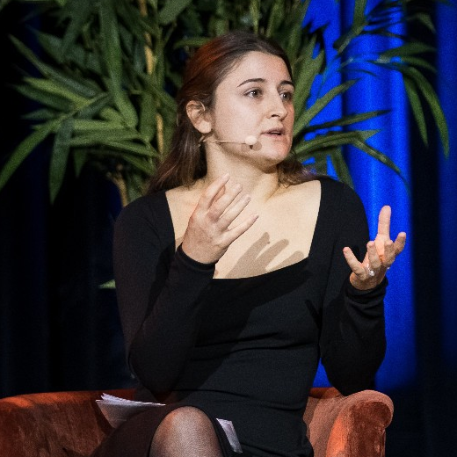
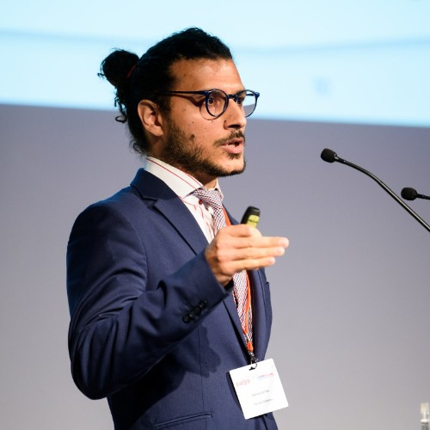
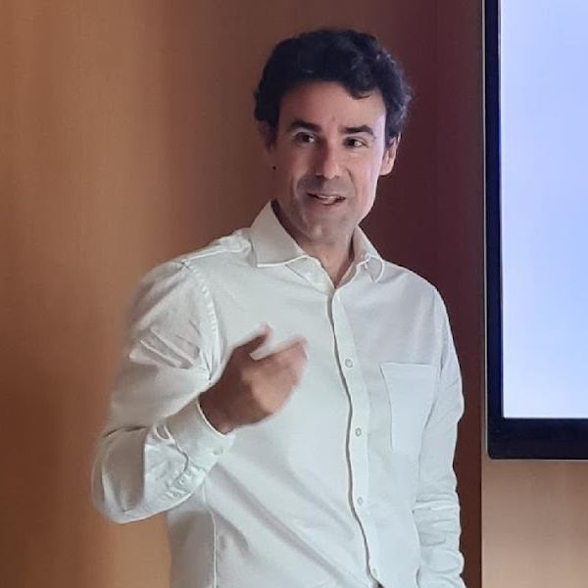
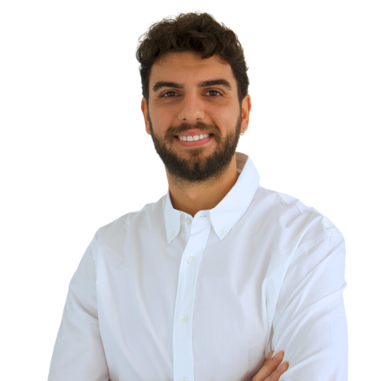
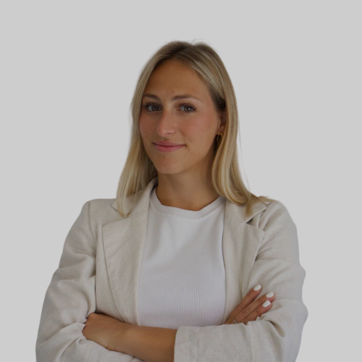
Our Team
Combining technical and business innovation expertise, our team is in the best position to help implement novel solutions and partnerships.
Biobased Sciences
Material Sciences
Chemical Engineering
Mechanical Engineering
Circular Business Models
Strategic Design and Management
Corporate Sustainability
Johanna Reiland
Innovation Manager
(Expert in Materials & Processes, Business Models)
Marcos Ierides
Innovation Manager
(Expert in Materials &
Processes, Business Models)
Aitor Hornes
Innovation Manager
(Expert in Materials &
Processes, Bioeconomy)
Alaa Mostapha
Innovation Consultant
(Chemistry, Materials)
Mafalda di Palma
Innovation Consultant
(Regulations, Materials)
Notes:
Suggestion: Imagine you’re describing to a potential client why your team is the perfect one to take on this problem. Why are you the ideal team to meet your clients needs? How does Bax & Company support your ability to deliver?

Slide 11
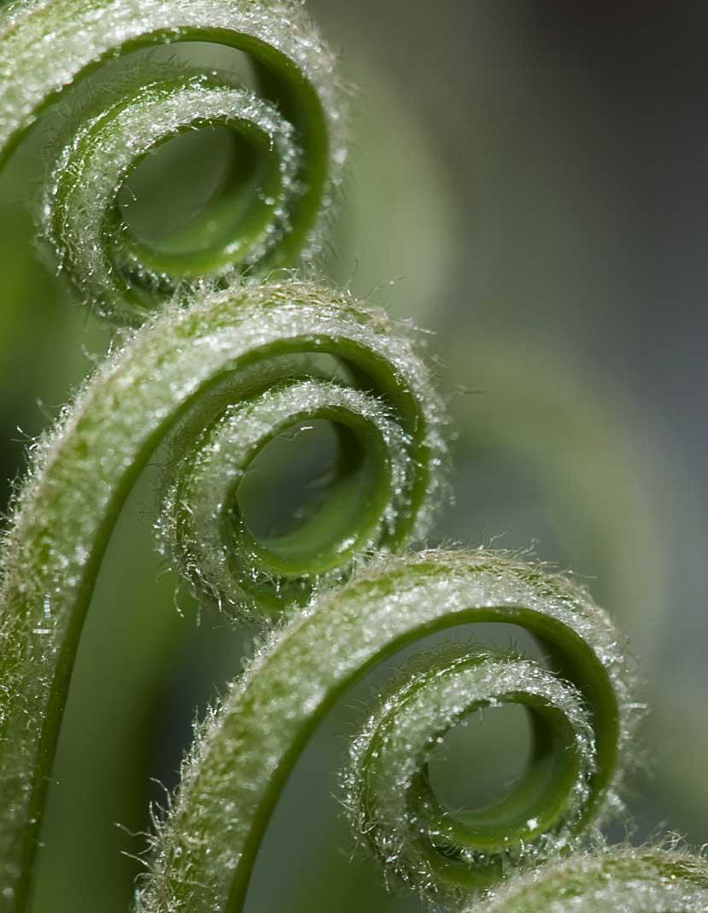
GET IN TOUCH
baxcompany.com
linkedin.com/company/bax-makeideashappen/mycompany/
Carrer Casp 118, 08013 Barcelona, Spain
Johanna Reiland
j.reiland@baxcompany.com
Marcos Ierides
m.ierides@baxcompany.com

