Slide 1
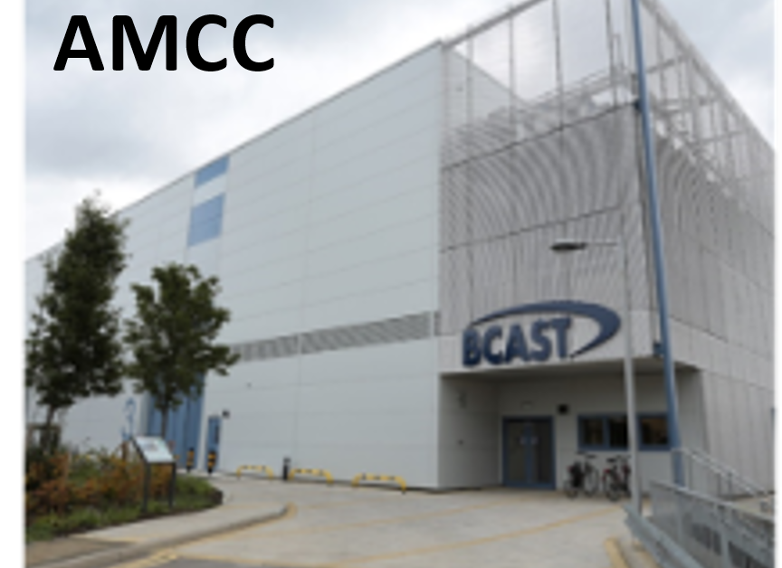
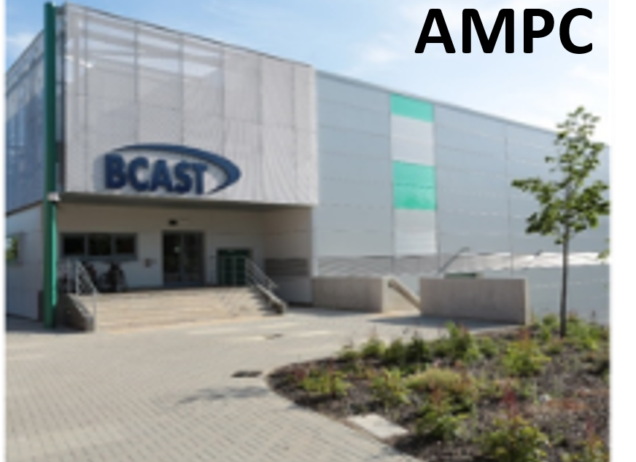
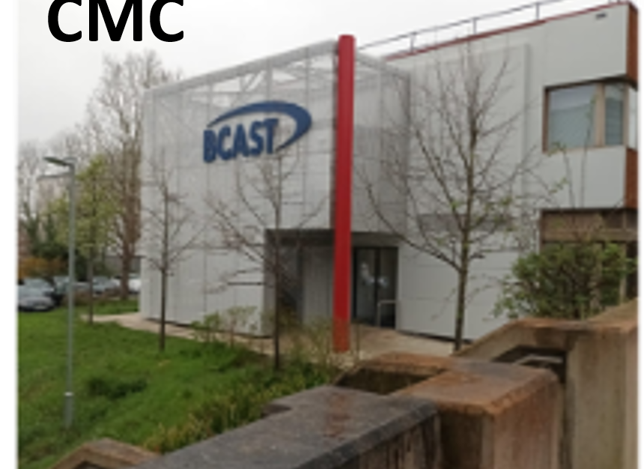
Brunel University of London
BCAST
Brunel University London, located in West London, has over 12,500 students, including 2,500 international students, and more than 1,400 academic staff.
BCAST is a world-leading research centre focused on fundamental and applied research in solidification and downstream processing of metallic materials, particularly light metals (e.g. aluminium and magnesium alloys), as well as sustainable solutions for waste management.
BCAST hosts the Advanced Metal Casting Centre (AMCC), Advanced Metal Processing Centre (AMPC), and Centre for Materials Characterisationn(CMC), offering casting, extrusion, and joining equipment, advanced microstructural characterisation tools (TEM, SEM, OM, XRD, XCT, AFM), thermal analysis instruments (DSC, FlashDSC), mechanical testing (nano/microhardness, tensile, fatigue, Gleeble thermal physical simulator). It also has high-performance computational resources (FEA, CFD, CALPHAD) for process modelling and microstructure prediction
Project idea/ Field of expertise - Ideas: (a) Lightweight high entropy alloys & (b) electropulsing repair technology
Expertise: physical & process metallurgy
Organisation name – Brunel University London
Addressed topic - 1. HORIZON-CL4-INDUSTRY-2025-01-MATERIALS-61: Technologies for critical raw materials and strategic raw materials from end-of-life products (IA)
2. HORIZON-CL4-INDUSTRY-2025-01-TWIN-TRANSITION-05: Advanced manufacturing technologies for leadership of EU manufacturers in products for the netzero industry (Made in Europe Partnership) (IA)
3. Also looking to target Advanced Material (eg lightweighting high entropy alloys)
Advanced alloy development
Extend service-life of critical metallic components.
Recovery of manufacturing-induced microstructural defects
Project ideas:
Lightweight High Entropy Alloys
Existing high entropy alloys are multicomponent systems composed of transition and refractory metals with large atomic weights and exhibit exceptional mechanical properties. This project aims to use computational alloy design to develop lightweight high entropy alloys by replacing these elements with metals of lower atomic mass, while maintaining the entropy-stabilized single-phase microstructure.
Electropulsing Treatment for Repairing Critical Metallic Components
This project aims to apply electropulsing treatment to extend the lifetime of critical metallic components by using high-current-density electrical pulses to induce localized heating and compressive stresses, which promote recrystallization and heal defects (e.g., microcracks and pores) caused by service or manufacturing.
Expertise offered:
Solidification and downstream processing, as well as joining of hybrid metallic materials using electromagnetic pulse technology.
Advanced microstructural, thermal, and mechanical characterisation and testing.
High-performance computational materials and process modelling
Contact person | Professor Isaac Chang
Organisation | BCAST, Brunel University London
Address | Kingston Lane. Uxbridge UB8 3PH
Phone | +44 01895268491
E-mail | Isaac.chang@brunel.ac.uk
B2Match profile | Hitesh Patel | KETs 2025 I EU Brokerage Event
LinkedIn/Twitter

