Slide 1

After the Shock, Navigating the “What Next”

Slide 2
Agenda for Presentation – How to Navigate the Current Environment
Why: Outlook for the US markets in 2026
How: What does America First Mean?
    Tariffs and value chains
      What’s coming in 2026
    Export controls
    Investment
    Critical Minerals
What: What Can You Do?

Slide 3
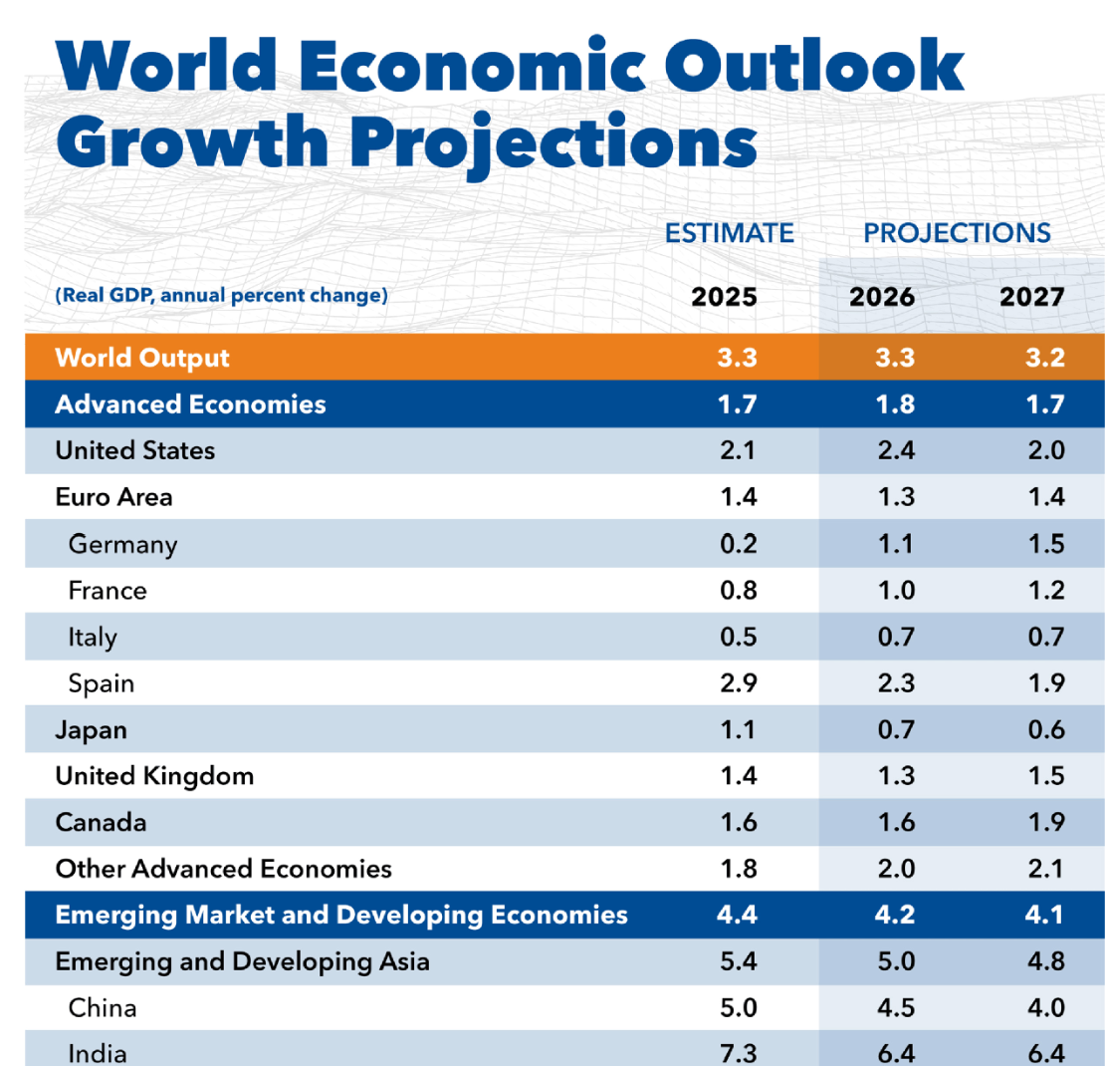
Global Economic Outlook

Slide 4
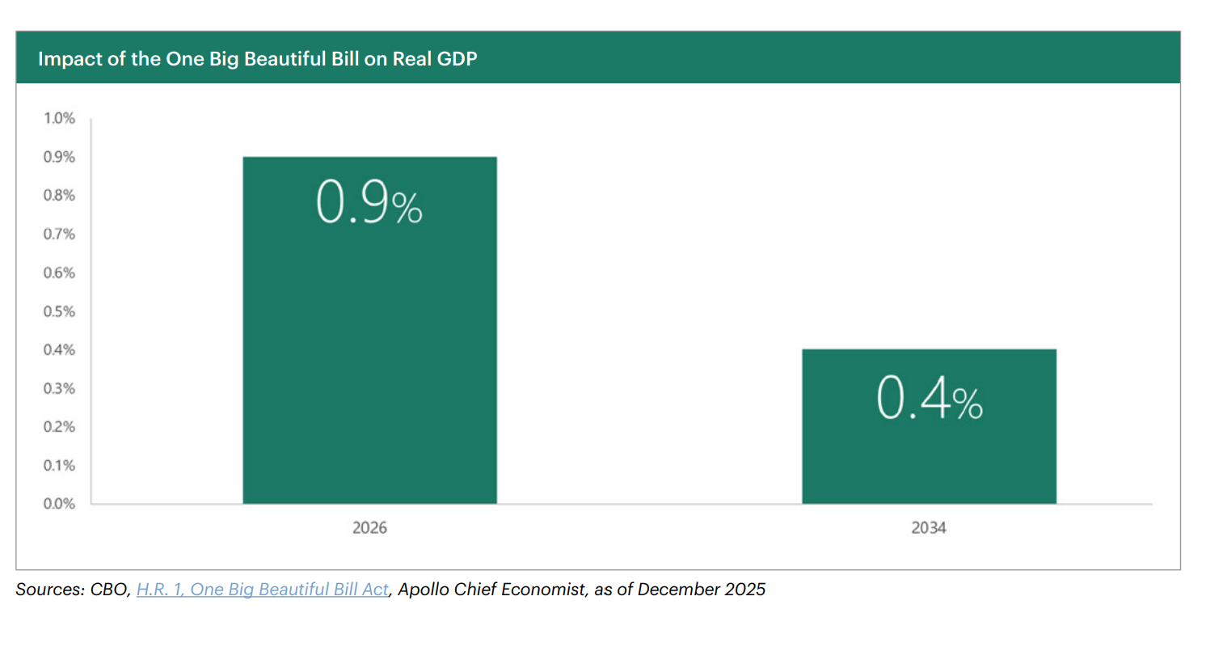

Slide 5
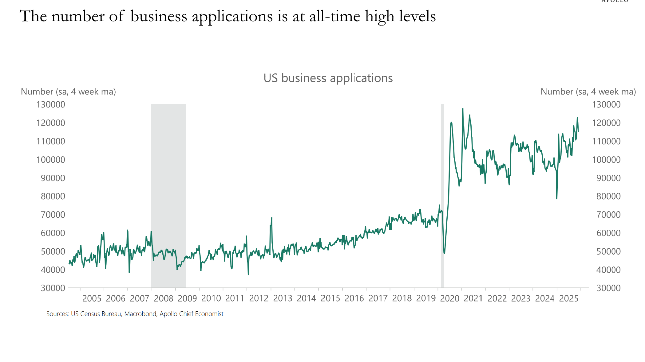

Slide 6
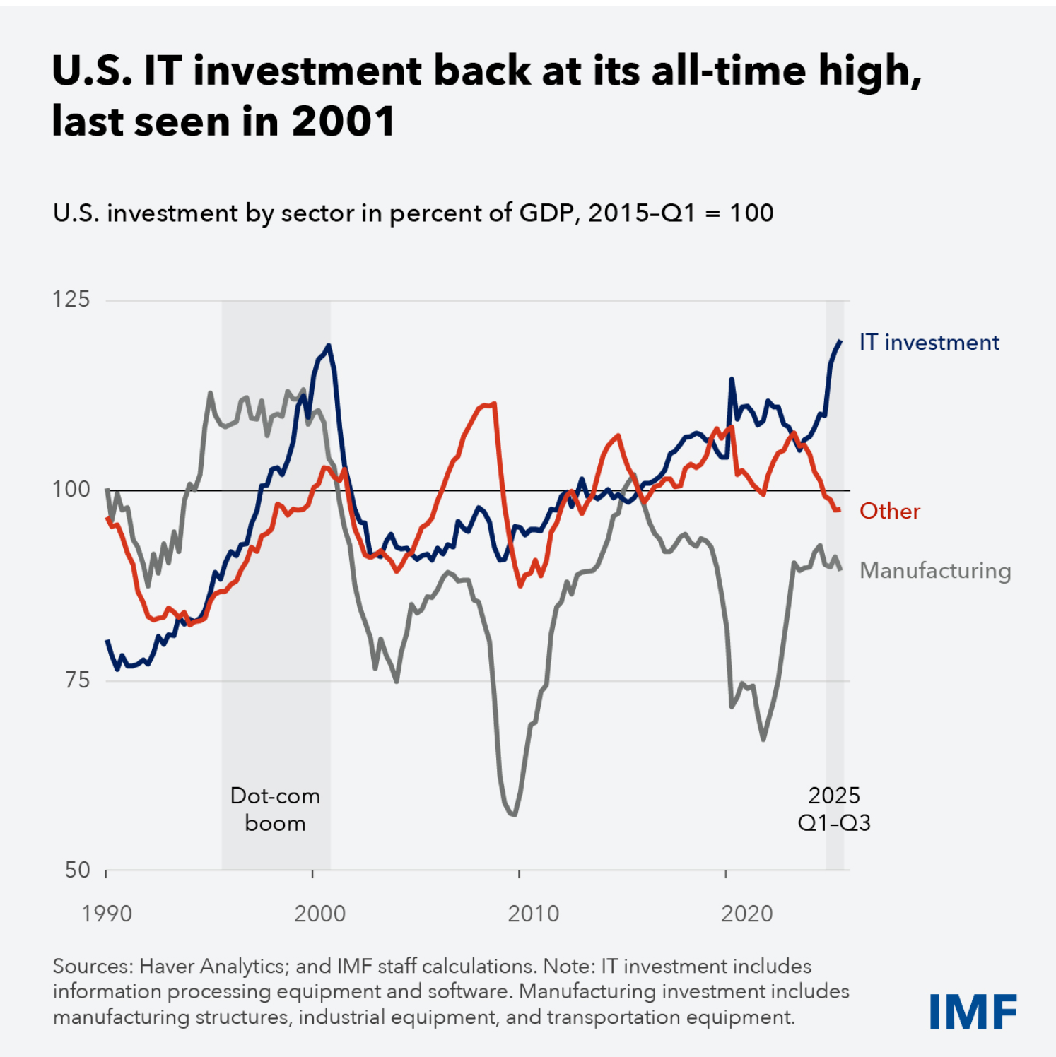
IT Investment Driving US Growth

Slide 7
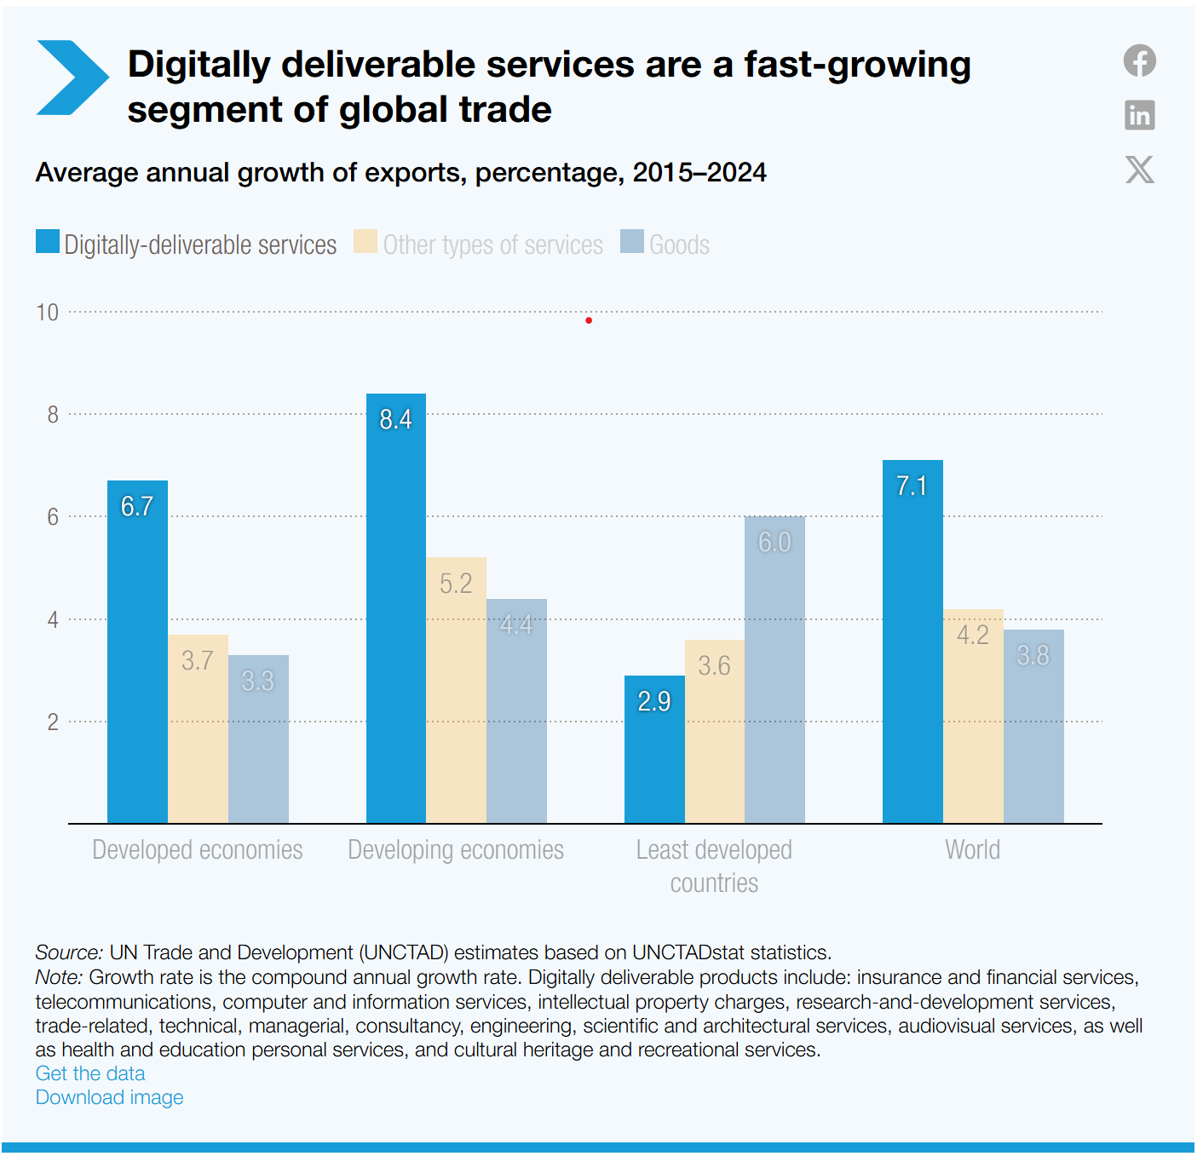
Services
Not covered by tariffs
Services continue to outperform.

Slide 8
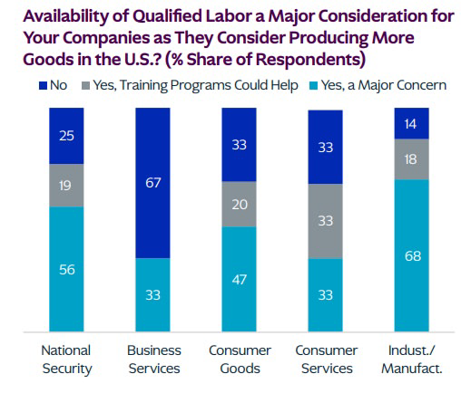
Bottlenecks
Labor and energy are two limiting factors on U.S. investment

Slide 9


Slide 10
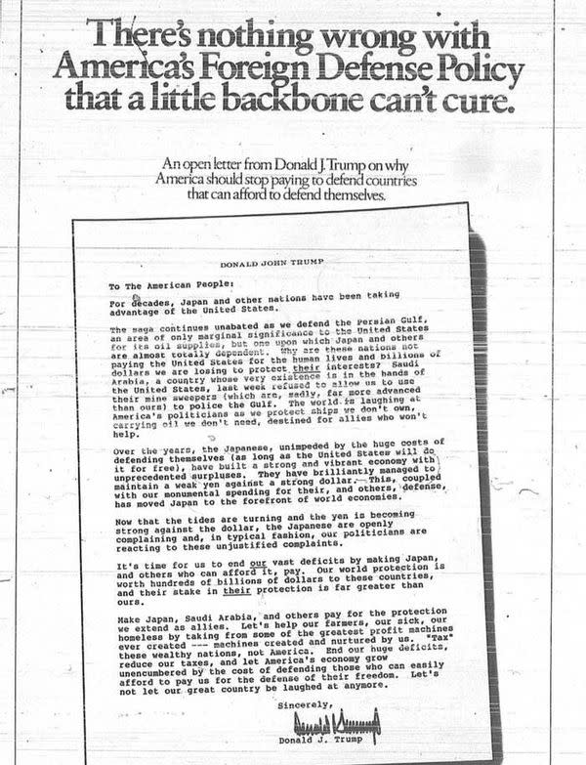
President Trump’s Long Held Views
From September 2, 1987:
“Taking advantage of the United States”
“Pay their fair share”
“”Tax” these wealthy nations – not America.”
Economic and investment policy is foreign policy.

Slide 11
“America First” Trade Policy
Goal: New investment, increase construction of new factories and facilities, secure critical raw materials, and more U.S. manufacturing jobs
Key elements:
Aggressive Use of Tariffs as Primary Economic Instrument
Linking Market Access to Domestic Investment
National Security As an Economic Filter
Restructuring Trade Through Bilateral Pressure, Not Multilateral Rules
Prioritizing Domestic Supply Chains and US Workers Over Efficiency
Securing Sufficient Raw Materials and Other Natural Endowments via Bilateral Agreements

Slide 12
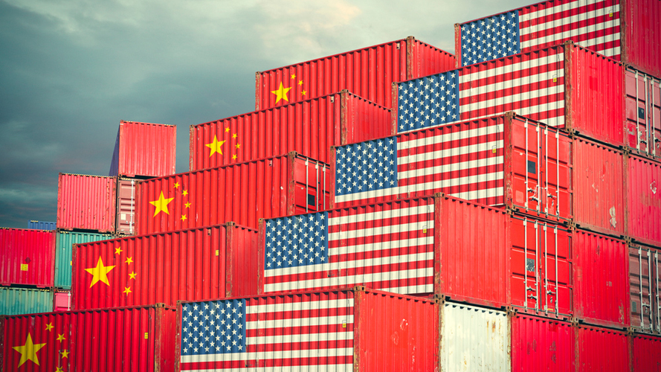

Slide 13
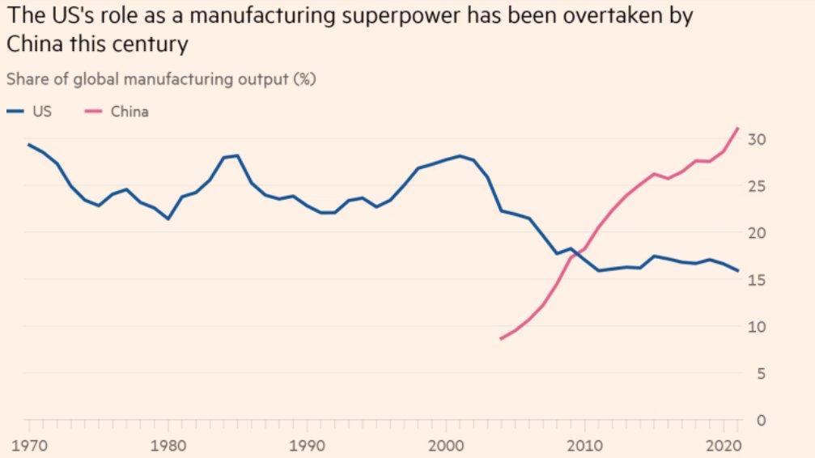

Slide 14


What is a tariff to President Trump?
Rebalancing: Financial instruments with the power to sculpt economic landscapes.
Reshoring: Tools to change the course of industries and economies alike.
Leverage: Economic levers reflecting wider geopolitical strategies and national interests.
Revenue: Tax on the import or export of goods between countries.

Slide 15
Executive Authority On Trade
IEEPA
International Emergency Economic Powers Act
301
Section 301 of the 1974 Trade Act allows tariffs if discriminatory or unreasonable practices restrict U.S. commerce.
232
Section 232 of the 1962 Trade Act allows tariffs if certain products threaten to impair U.S. national security.

Slide 16
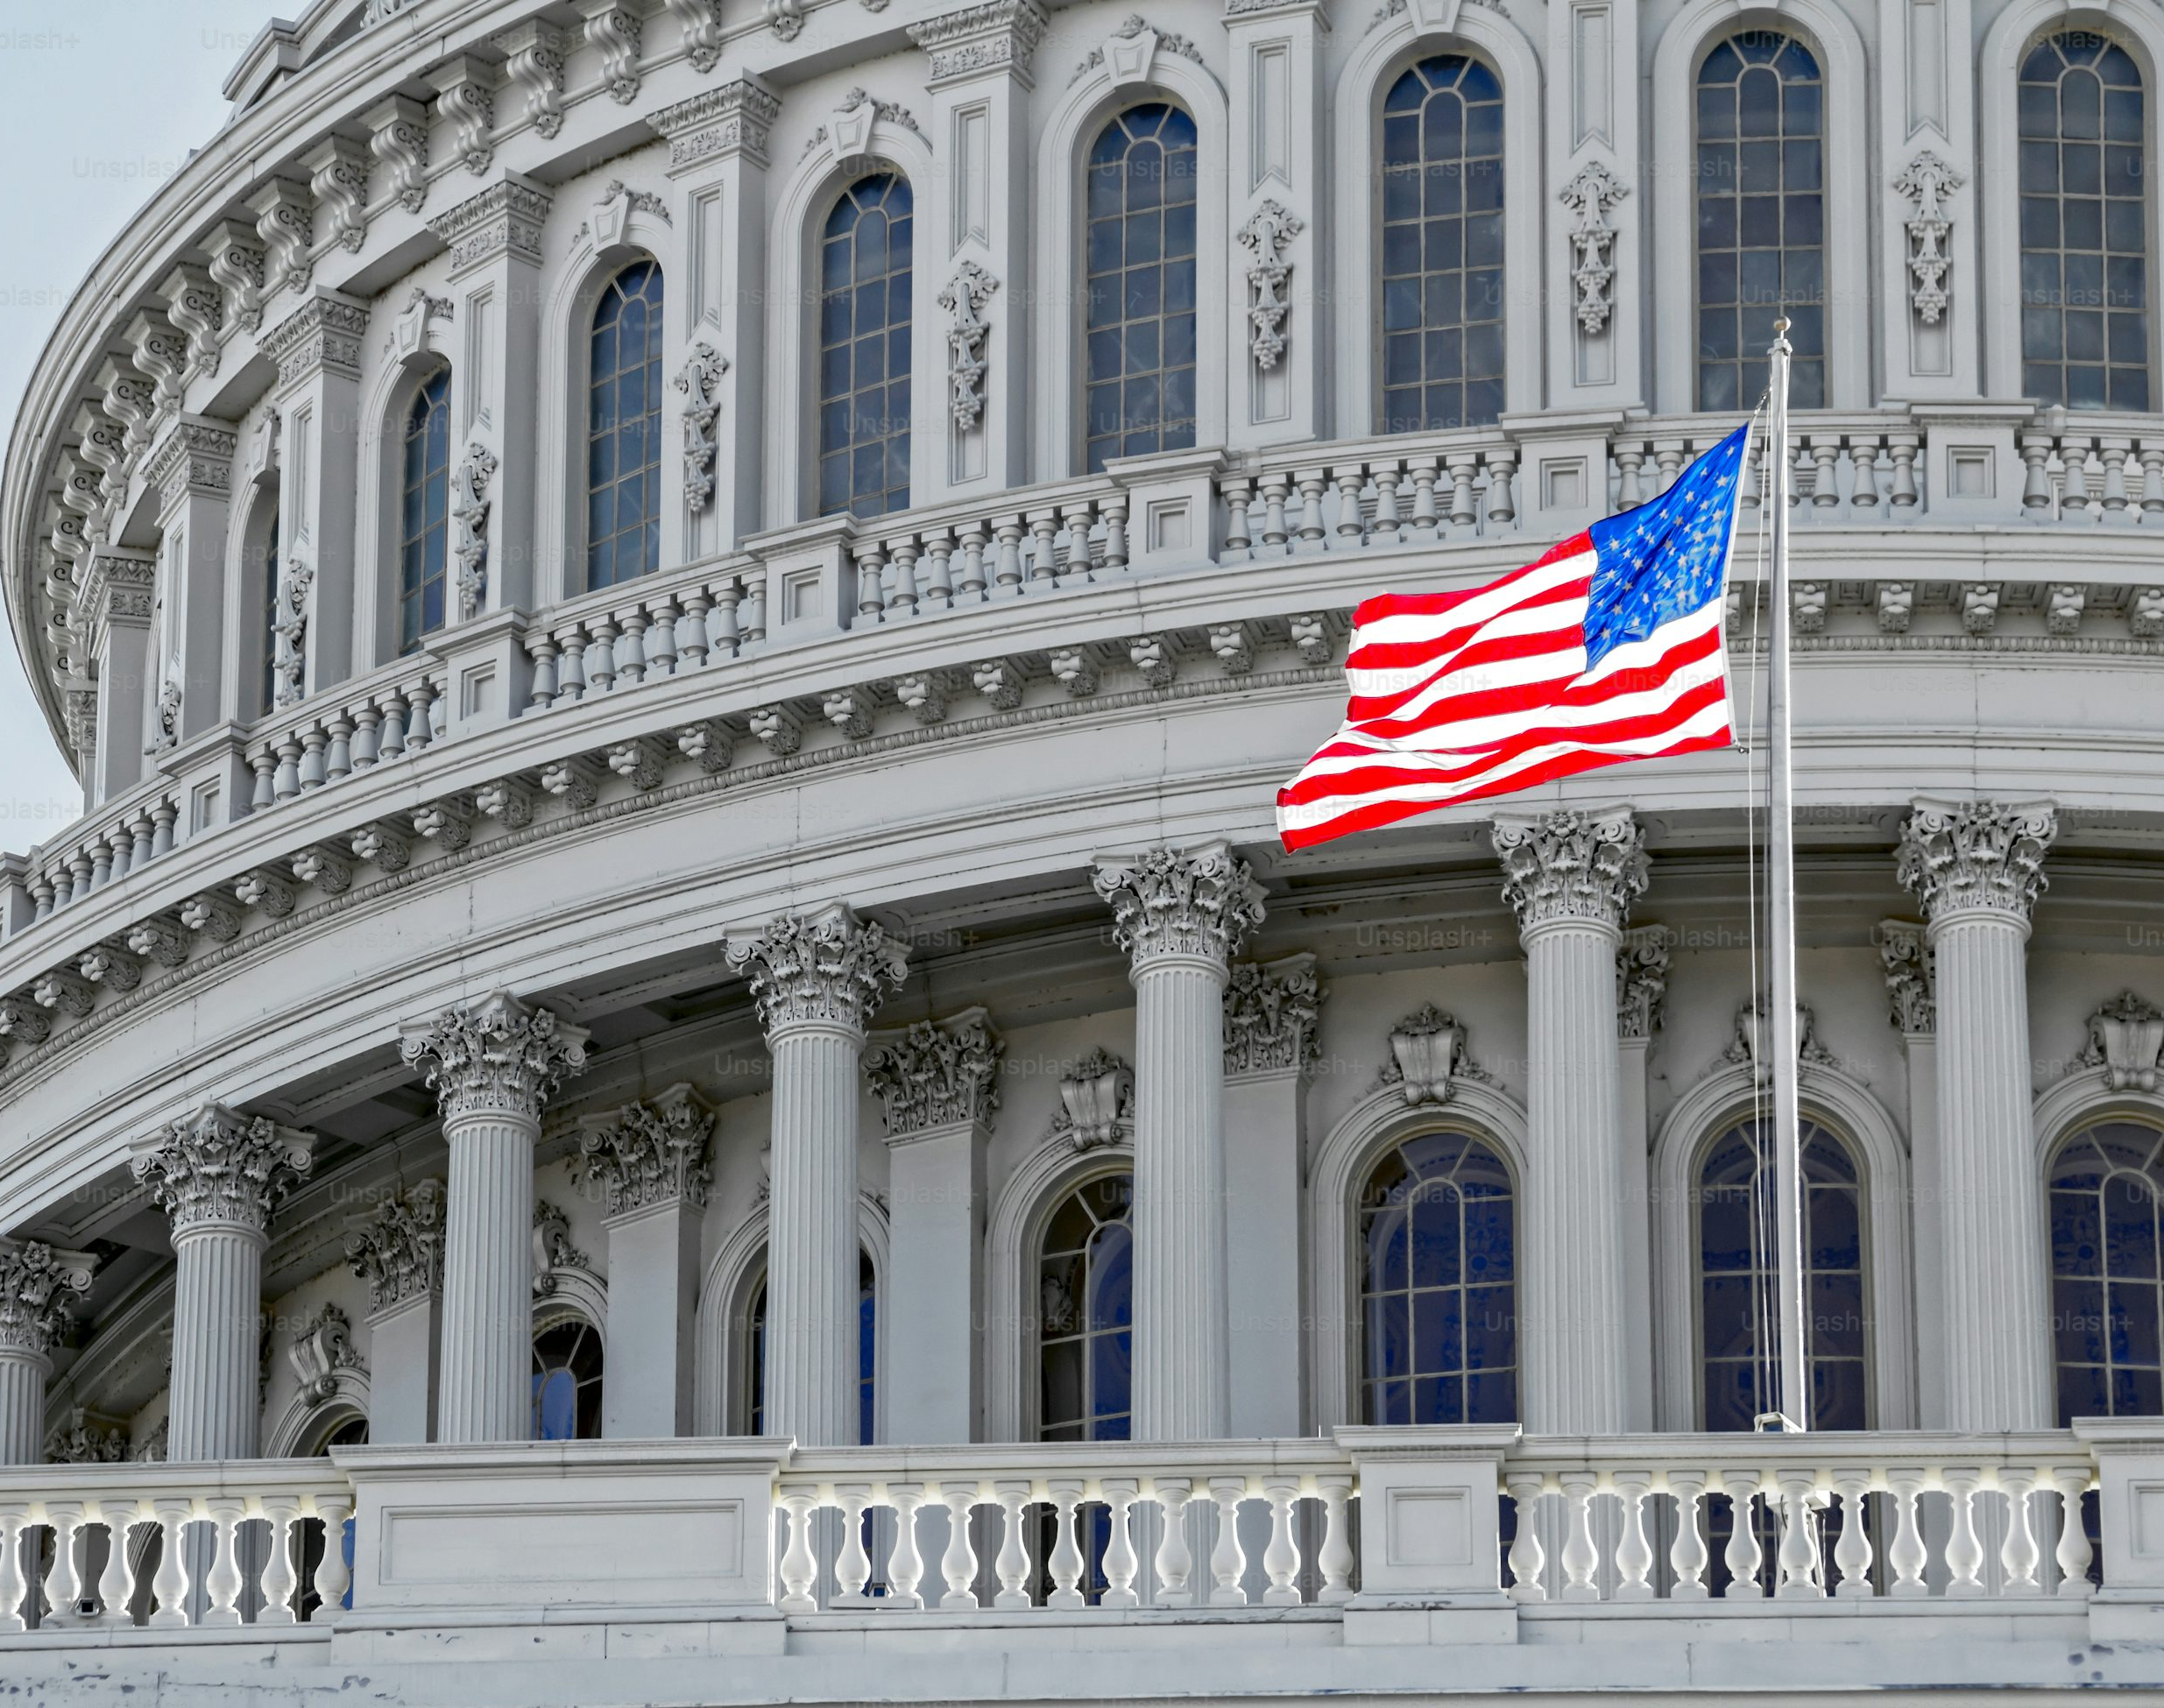
Role of Congress in Trade
U.S. Constitution, Art 1, Sec 8
The Congress shall have Power
To lay and collect Taxes, Duties, Imposts and Excises, to pay the Debts and provide for the common Defence and general Welfare of the United States; but all Duties, Imposts and Excises shall be uniform throughout the United States;…
To regulate Commerce with foreign Nations, and among the several States, and with the Indian Tribes;

Slide 17
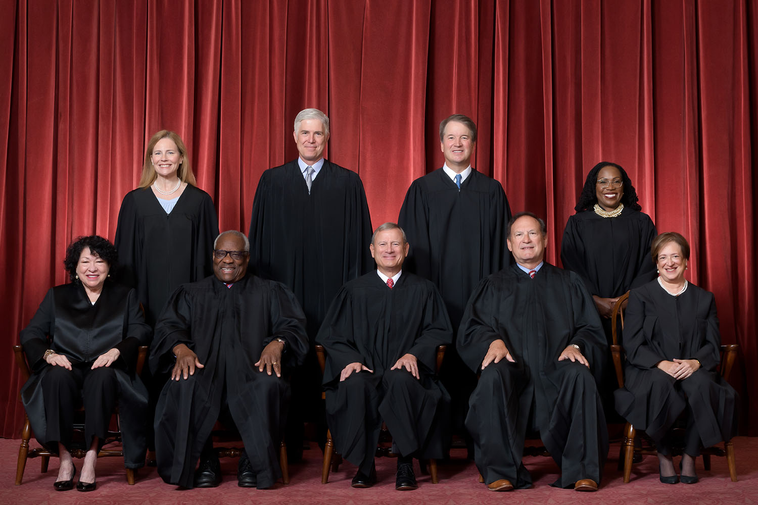

Slide 18


Slide 19
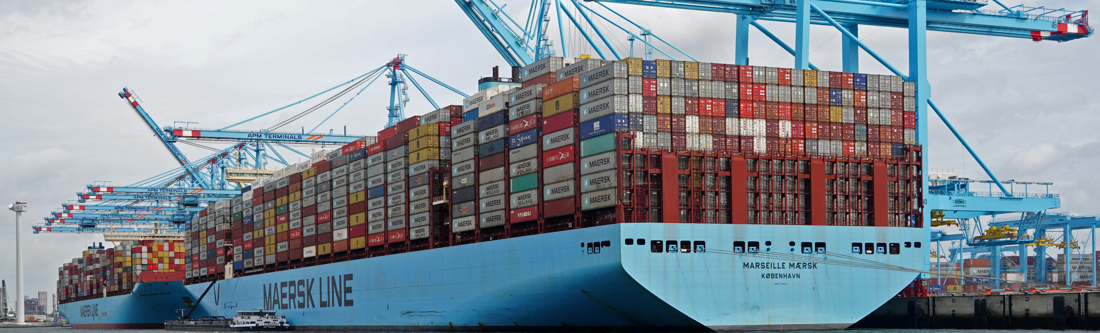
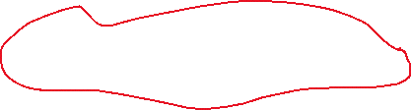
Elements of the “deal”
Tariffs
Non-tariffs barriers
Digital Regulation and Taxation
Economic Security
Rules of Origin, Intellectual Property, and Labor/Environment Standards
Investments or purchases

Slide 20
Announced Investments
Investor​ | Amount​ | Sector​ | Focus​
UAE​ | $1.4 T​rillion | Manufacturing & Industry​ | Technology, aerospace, energy​
Qatar​ | $1.2 T​rillion | Manufacturing & Industry​ | Technology and manufacturing​
Japan​ | $1Trillion​ | Manufacturing & Industry​ | Auto plants, U.S. steel​
EU Firms (Trade Deal) | $600 Billion | Various sectors | General investment
Taiwan | $500 B​illion | Technology & AI​ | Semiconductors, AI ​
South Korea (Foreign Investment) | $450 Billion | Energy & Environment | U.S. energy products
* Investments – The White House

Slide 21
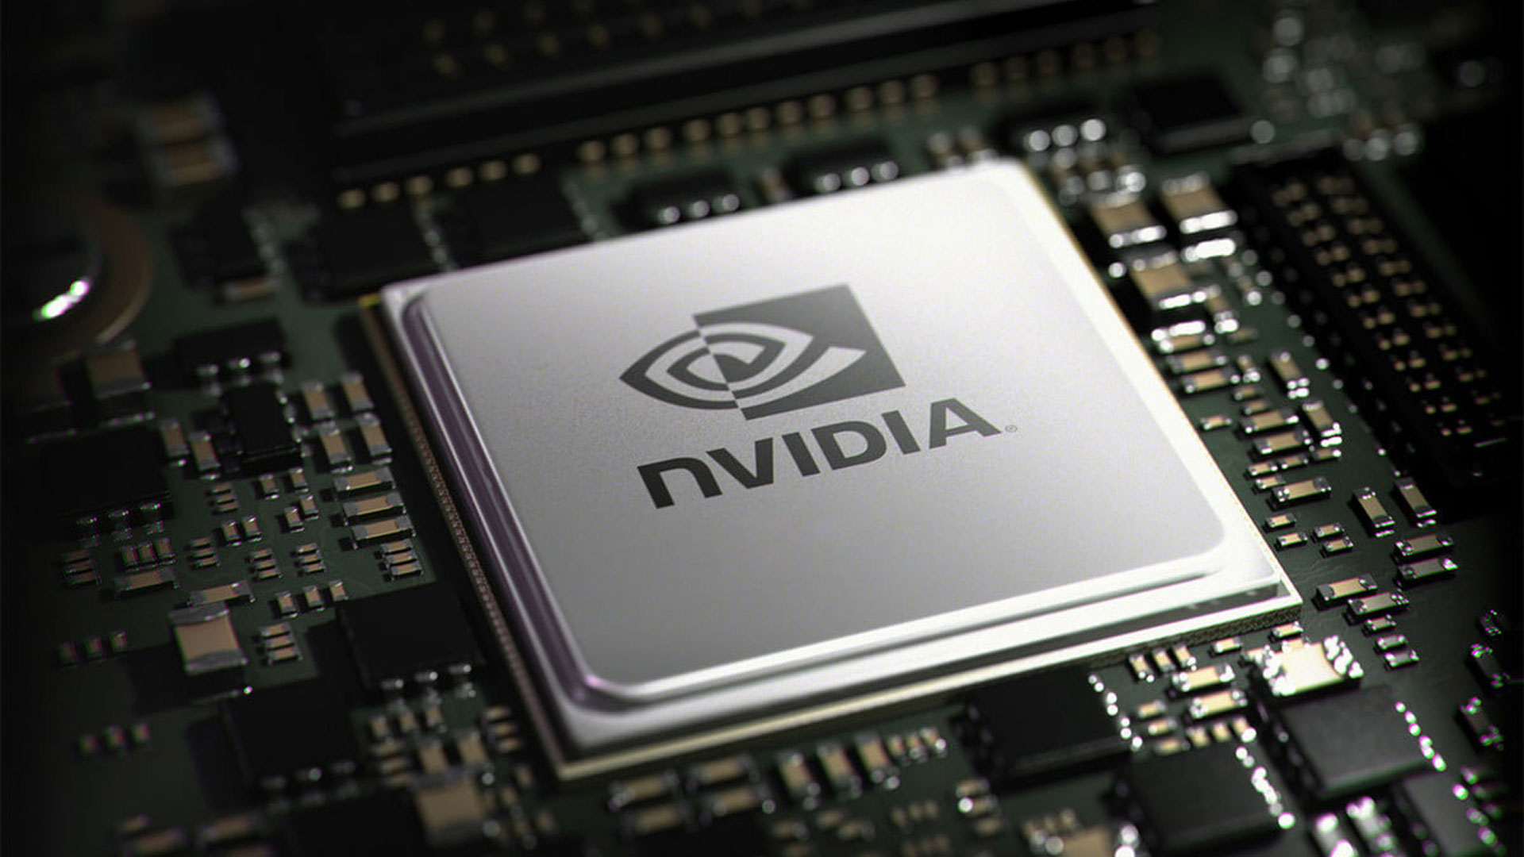

Slide 22
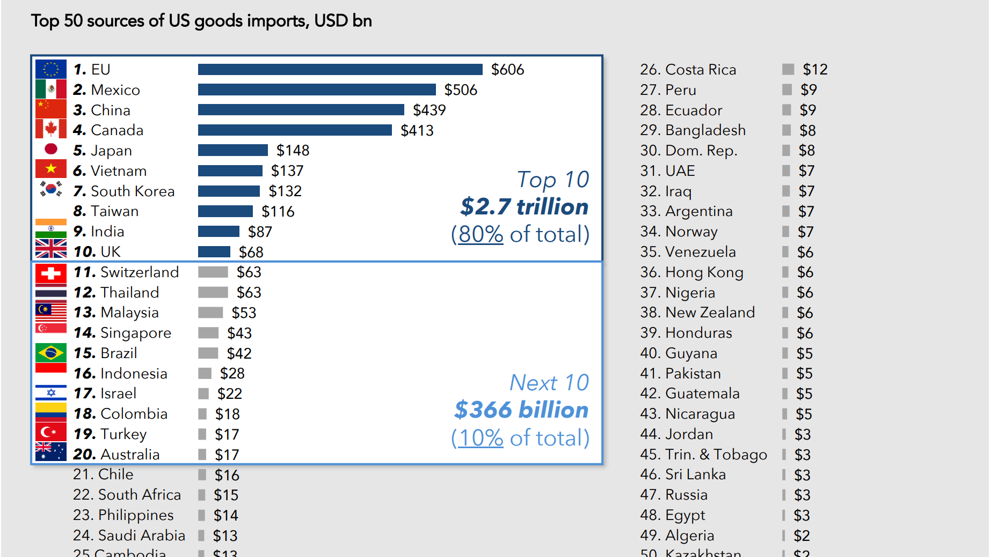

Slide 23
Economic Security Overtaking Efficency and Growth
Ability to protect or advance economic interests in the face of adverse circumstances.
Export Controls
Investment Screening
Sanctions
Tariffs

Slide 24
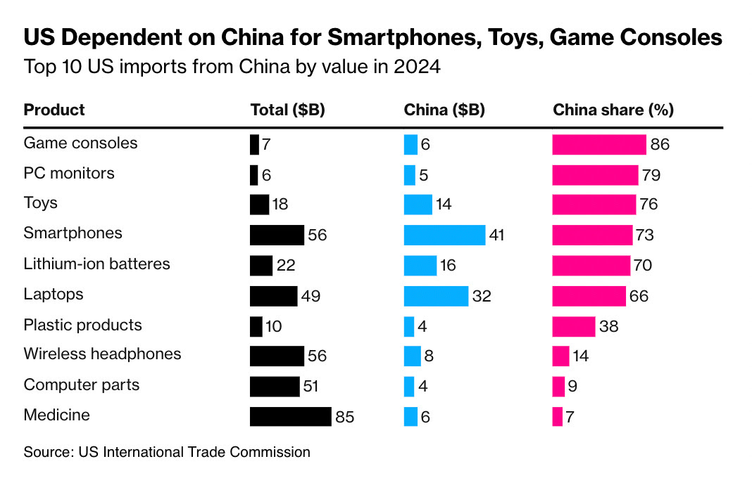
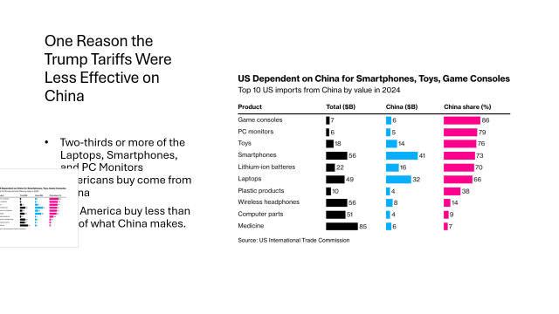
One Reason the Trump Tariffs Were Less Effective on China
Two-thirds or more of the Laptops, Smartphones, and PC Monitors Americans buy come from China
But America buy less than 5% of what China makes.

Slide 25
Rare Earth vs Critical Minerals
What are rare earth elements (REE)?
  Not rare, but hard to mine and process
  Light REEs, Heavy REEs
Subset of Critical Minerals: Essential mineral that faces considerable supply chain vulnerabilities.
  EU - 34 critical minerals
  US - 54 critical minerals
Mining vs. Processing
  90% of REEs processed in China
Used in smartphones, computers, defense, electric vehicles and wind turbines.
  Magnets, flat screen TVs, fighter jets, missile systems rely on REEs
Scandium
Yttrium
Lanthanum
Cerium
Praseodymium Neodymium Promethium
Samarium
Europium
Gadolinium
Terbium
Dysprosium
Holmium
Erbium
Thulium
Ytterbium
Lutetium

Slide 26
Chokepoints
Why does China have so much power?
China monopoly:
~85-90% of global REE processing; 92% magnet production; almost 100% heavy REEs.
Monopoly power and pricing used to keep competitors out of the market.
New REE Export Controls
License required for exporting REEs.
Any products containing more than 0.1% of Chinese-sourced rare earths regardless where made.
Mining, processing, magnet-making technologies, and bans military-linked uses.
Country | 1994 | 2004 | 2014 | 2024
China | 30,600 | 95,000 | 105,000 | 270,000
US | 20,700 | 0 | 5,400 | 45,855
Myanmar | 0 | 0 | 0 | 36,125
Australia | 3,300 | 0 | 8,000 | 13,000
Total | 64,500 | 102,000 | 123,000 | 399,930

Slide 27


Slide 28

Decoupling, derisking, deglobalizing?
Decoupling – Not yet
Derisking – Not yet
Deglobalizing – No, but shifting
*2/3 of trade is in global value chains.

Slide 29
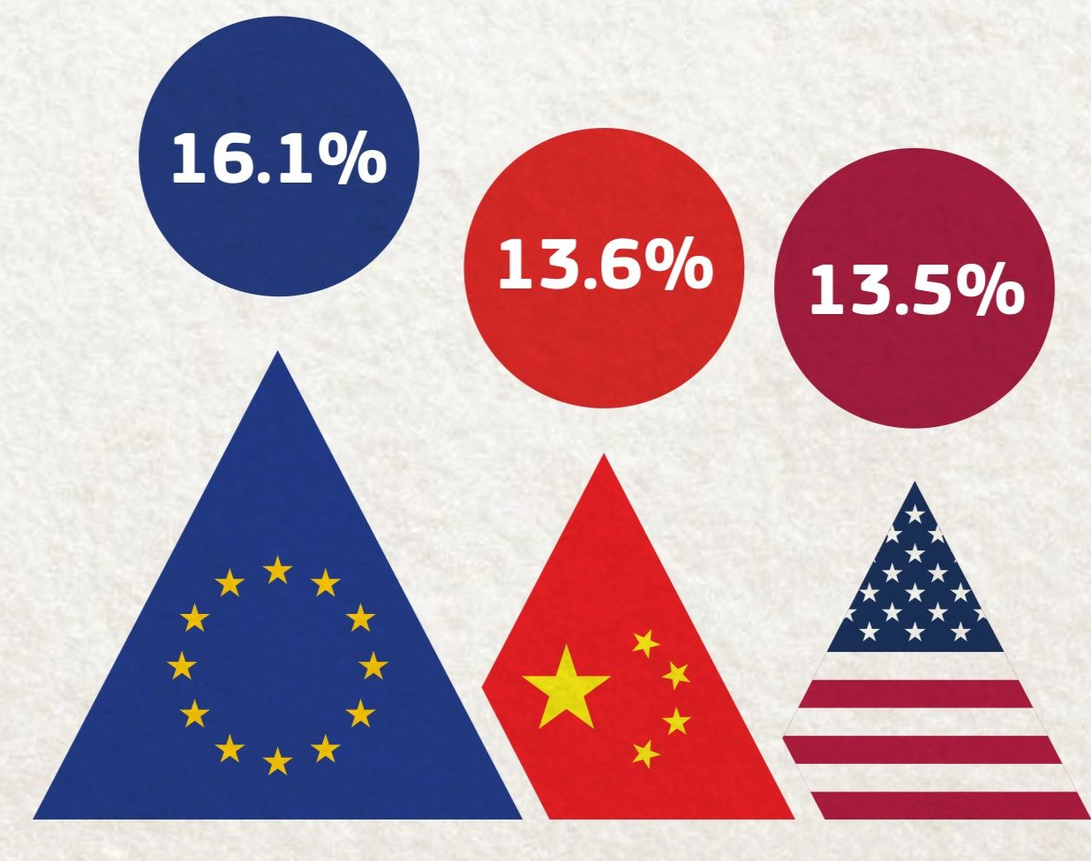
Share of Global Trade
We are not in a hyper-globalized world.
Just 20% of all goods and services are exported.
Foreign FDI accounted for only 5% of gross fixed capital formation.
18% of traffic to online news websites came from abroad.
And just shy of 4% of people lived outside of the countries where they were born.
*DHL Connectedness Index

Slide 30
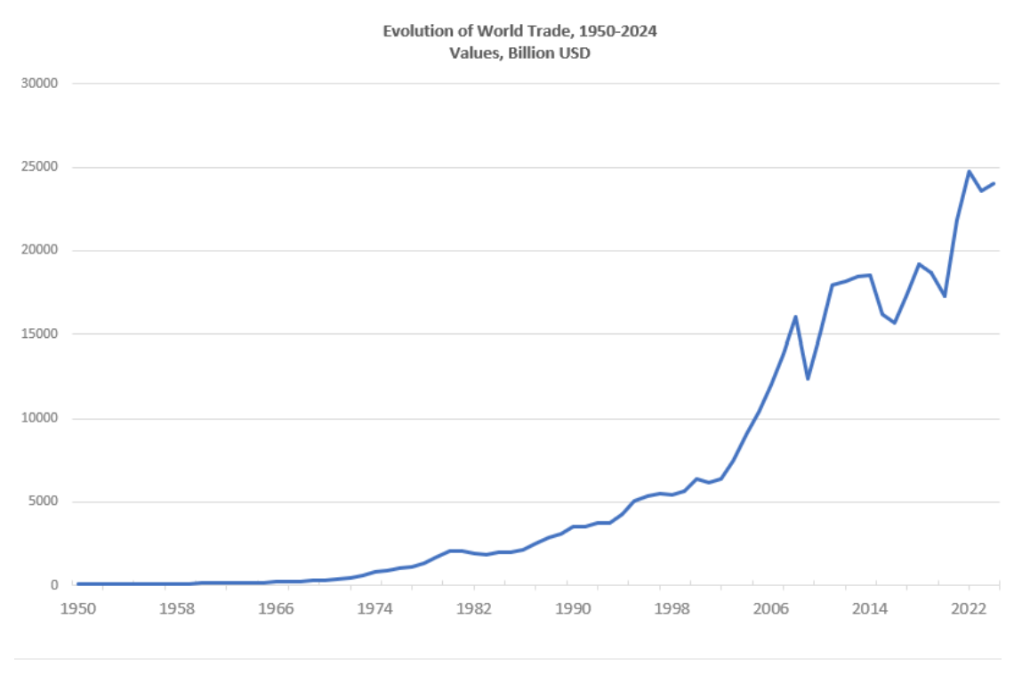
Global Trade Continues to Grow

Slide 31


Slide 32
What Can You Do?

Slide 33
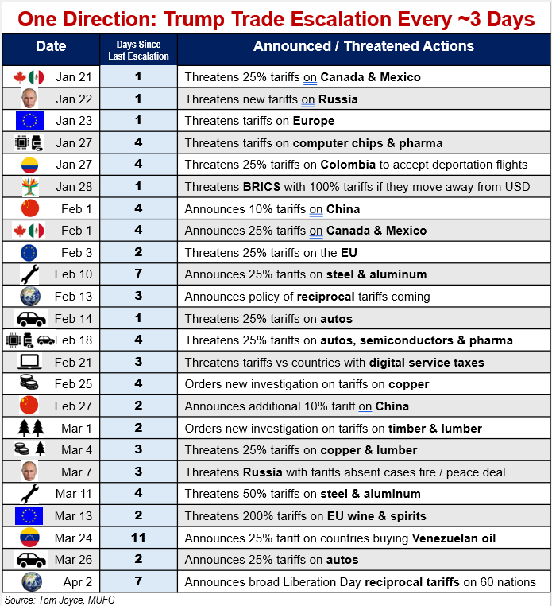
Overwhelming the System
  Change is the point.
  Lack of certainty, grit in the gears of trade
  Creating incentive to invest in the US

Slide 34

Living in a time of flux – Maximize your cards
Advocate and ask
Flexible, agile
Analytical muscle
Compliance
Mitigate risks
Seek opportunities

Slide 35


Washington | Ankara | Belgrade | Berlin | Brussels | Bucharest | Paris | Warsaw

