Slide 1

AI-enhanced
Low-Code Platform
Easy, fast, and budget-friendly way of software development
February 2025

Slide 2
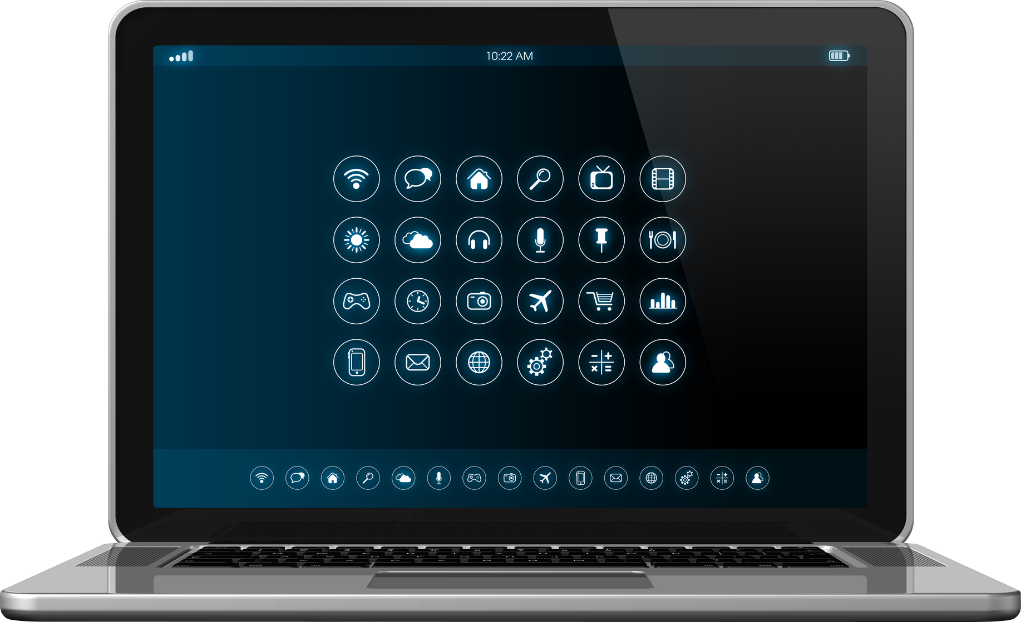
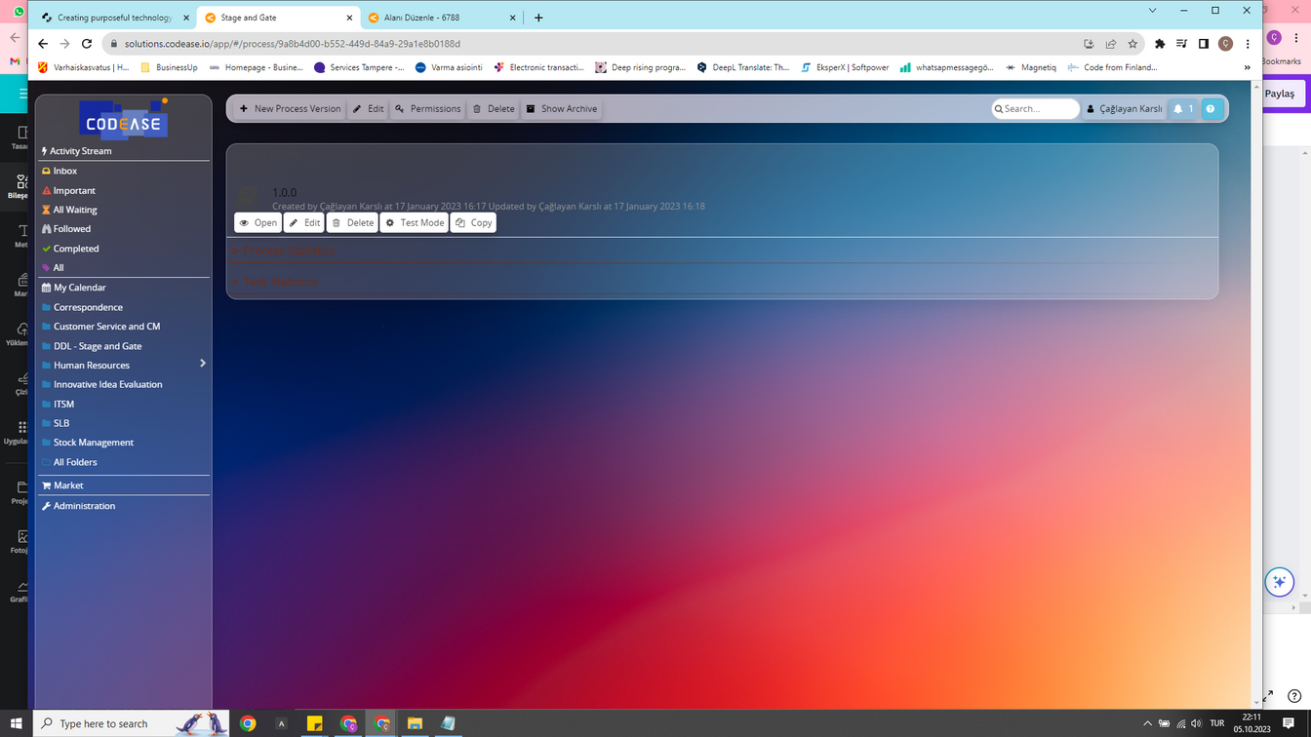

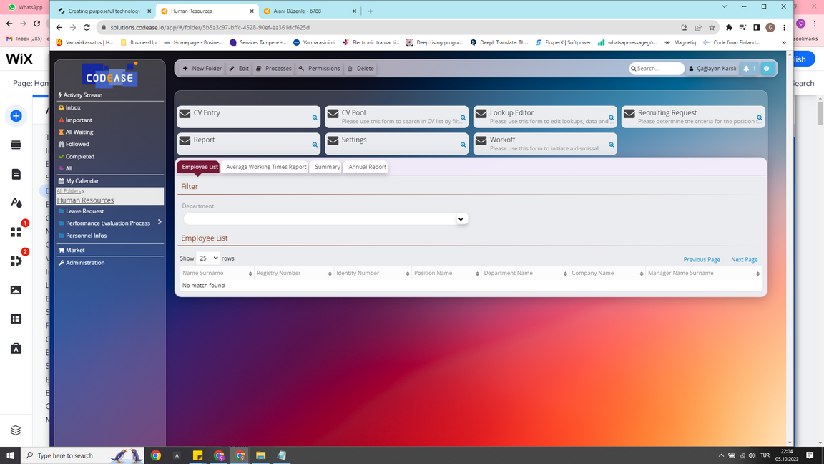

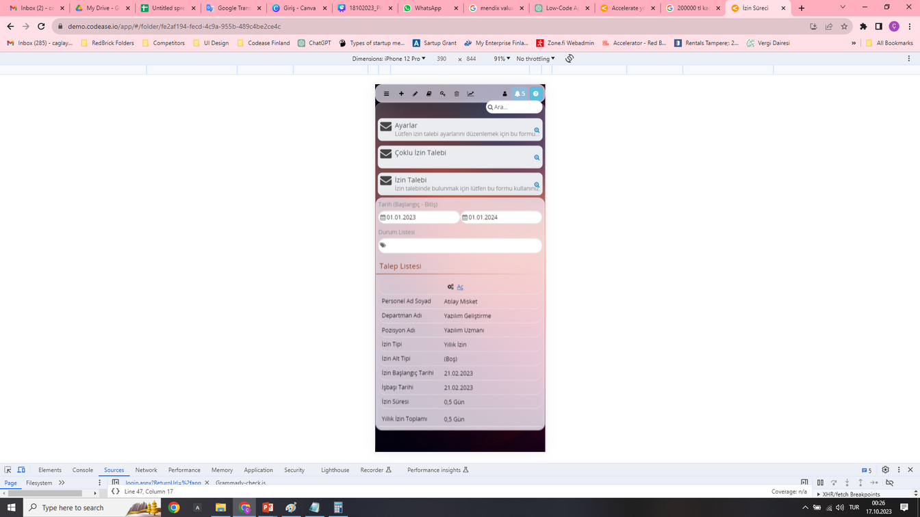

Introduction
Business : Deep Tech / Software / Digital Transformation / AI
Location : Turkiye (Headquarter), Finland (Europe Office)
Partners : NDC Technology (10 Dealer), FNF1 Technology, Rhisos, SSID Global, Prova, Sooce (UK), Hepapi (UK), Codefirst, Padran…
Customers : Agricultural Credit Holding (Technology & Supermarket), Bereket Insurance Group, EMAA Insurance, Infotron, IQVIA, Innovex, Farplas, Armor Broker, Artıdoksan, Gateway Holding…
www.codease.io

Slide 3

The Idea Origin of Story
2020
Company established
Istanbul /Turkey
2021
2 Partners
7 Customer acquisition (4 On-Prem, 3 Cloud)
2022
First international sales
Release of the 4th version of the platform
2023
First global partner
Distribution channel in Turkey
Lead generation automatization
2024…
Finland Office established
* In 2018, this platform, which started to be developed (Bootstrapping Phase), took its place in the market with the visionof becoming a global brand under the name CodEase.
www.codease.io

Slide 4
Future Roadmap
4
2025
Pre-Series A round
Solution partner network attached to the Finland Office in each Nordic countries.
Release of the AI-enabled version
UAE Office – Gulf Countries Partner Community
2026-2027
Citizen Development Community - User Guides, Virtual Library, Digital Courses
Series A round ($75M valuation)
London Office – Europe, Partner Community
2028-2029
Gamification for developers and end-users
Series B round ($200M valuation)
Singapore Office –Asia Partner Community
Series C round ($500M valuation)
2030
USA Office-Headquarter
Exit ($1B valuation)
www.codease.io

Slide 5


Our Vision
Our Mission
We aim for a world where humans analyze and machines develop software.
To be one of the leaders in low-code technology, provide advanced solutions, and promote AI software development with cost & time efficiency.
www.codease.io

Slide 6

Our Target Clients
In-house Software Developers
              Corporate Firms
        SMEs
        State Institutions
System Integrators
Software Vendors
Citizen Developers
www.codease.io

Slide 7

Client Problems
Complexity and time consumption in software development
High costs of human resources and application development processes
The challenges of managing too many applications and their suppliers
Low quality of maintenance and upkeep work
Failure to ensure technological continuity and organizational memory
www.codease.io

Slide 8
Confirmation of the problem
Many businesses still rely on inefficient and high-cost traditional software solutions, resulting in increased operational costs and reduced productivity.
www.codease.io

Slide 9
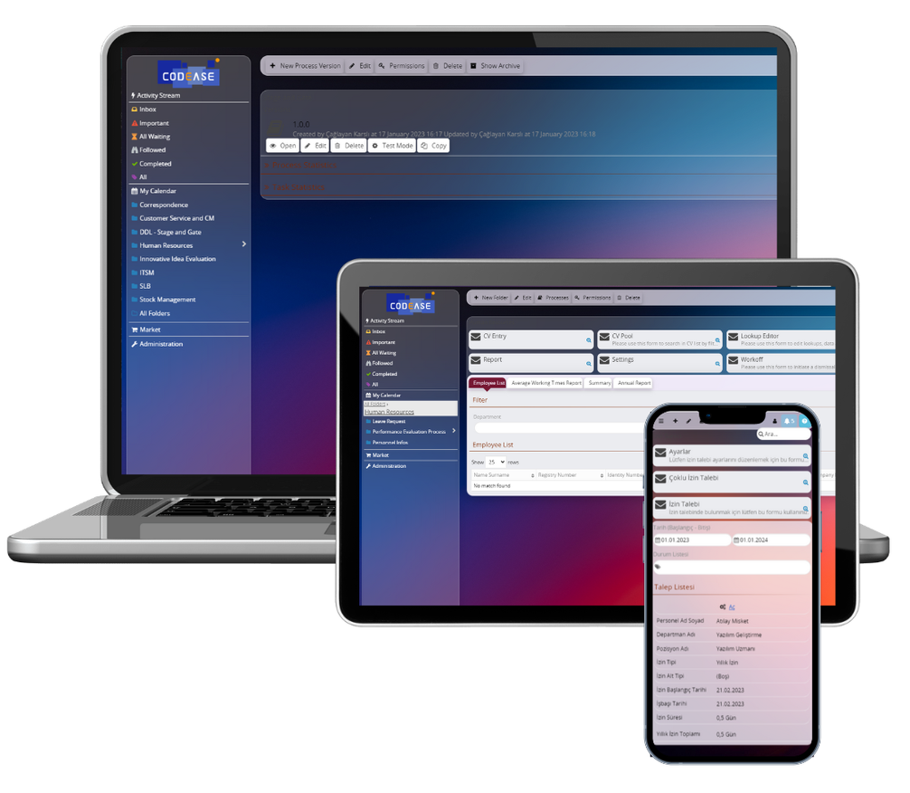
Solution
CodEase enables low-code development, reducing programming time by 90% and costs by over 60%
All applications can be managed on a single platform
Maximizes productivity and increases agility by improving customer and employee experiences and increasing collaboration between business and IT.
Democratizes software development by enabling citizen developers to build applications.
www.codease.io

Slide 10
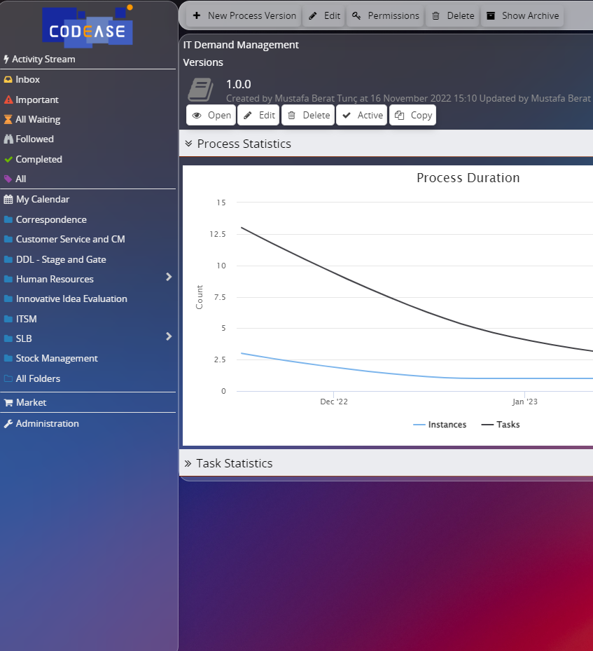
Our Technology
  Advanced drag-and-drop application and form design
  Wizard structure automatically generates scripts
  PAAS Architecture with multi-tenancy structure
  Fault-tolerant and scalable Business Process Management Engine
  ChatGPT integration for designing applications by AI
  Responsive running on all devices (PC, mobile, etc.)
  Scripting and rule management provide a development standard
  Integration management
www.codease.io

Slide 11
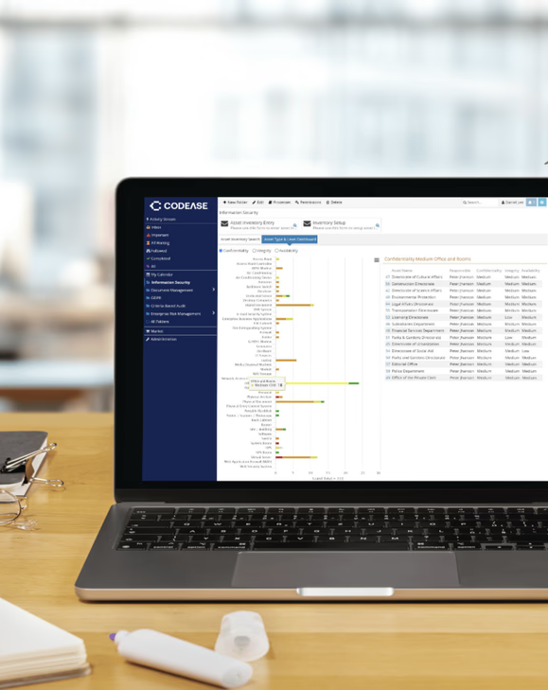
How does it work?
  CodEase seamlessly operates on-premises and in the cloud, eliminating the need for separate deployment, development, and testing environments. It also features a multi-tenant architecture.
  Applications developed on CodEase can be sold both in its own market and in other markets (Microsoft, Amazon, Google, etc.).
www.codease.io

Slide 12

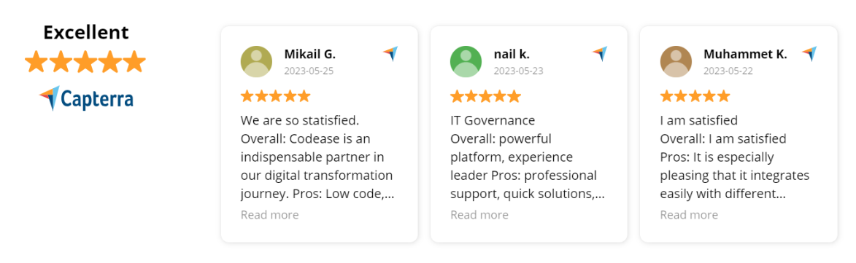
Value for clients
Low-code platforms as Codease play a pivotal role in our digital transformation journey. They help us modernize our financial processes, streamline workflows, and improve overall efficiency, which is crucial for remaining competitive in our industry.
İrem Ö. - Finance Director
www.codease.io

Slide 13
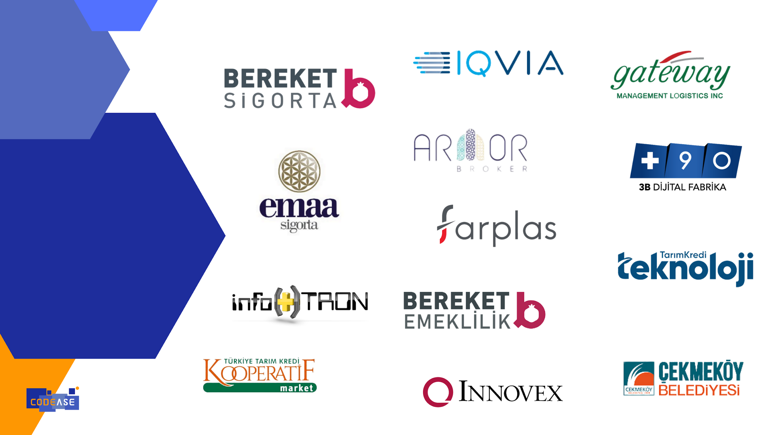








Value for Clients
Reference
Value Delivered
Reference
Value Delivered
Achieved end-to-end management of over 40 business processes, improved customer and agent management, and ensured sustainable, uninterrupted service through rapid development and seamless integration
Document Management has facilitated handling all internal documents, including contracts, proposals, quality records, and corporate papers. Integrating various systems has established a CRM system, which has successfully increased policy sales.
All business processes that were unmanageable by core insurance ERP have been quickly developed and integrated into the platform. Ten applications were successfully launched within a six-month timeframe. Additionally, customer complaints have been efficiently handled using email listeners.
Design changes, production errors, and related requests for each manufactured part have been compiled, digitizing the R&D and engineering workflows and creating an advanced Knowledge Base. With portal design and language support, this has been made accessible to internal users at overseas factories.
Employee leave, advance, and expense processes have been digitalized through cloud services and fully integrated with LOGO TIGER, achieving end-to-end digitalization. This has resulted in reduced paper usage and significant savings in staff labor.
Multiple integrations have ensured the seamless operation of all systems. The platform has facilitated forms requiring e-signatures for banking communications. Instead of the costly JIRA application, a Helpdesk application has been developed.
Over 2,500 markets have been regularly and effectively supervised, ensuring standardization and enhancing the quality of services and products. A balanced scorecard for the stores has been created, and the efficiency of the inspectors' work has been increased by displaying their performance charts.
Employee leave, cash advance, and expense processes have been digitized using cloud services and fully integrated with LOGO TIGER, resulting in end-to-end digitalization. This has led to reduced paper usage and significant labor savings for staff.
Integration with invoice integrators has ensured a consistent flow of e-invoices into the system. Additionally, the processes for invoice approval, dispute resolution, and payment steps have been enhanced. This has streamlined all invoicing activities with suppliers and resulted in significant labor savings for staff.
Fault, maintenance, and installation services provided at over 4,000 locations across 81 provinces and districts have been digitized in just five months and are now operated 24/7. Paper service forms have been eliminated, and with stock and invoice integration, losses and leaks have been resolved.
Integrating with invoice integrators has established a consistent flow of e-invoices into the system. Additionally, improvements have been made to invoice approval, dispute resolution, and payment processes. As a result, invoicing with suppliers has been streamlined, leading to significant staff labor savings.
In public relations, the policies for holding, storing, and destroying personal data, as well as retention and access policies, have been digitized, eliminating the reliance on Excel and reducing human workload. A data inventory has been created, fulfilling all legal requirements.
www.codease.io

Slide 14
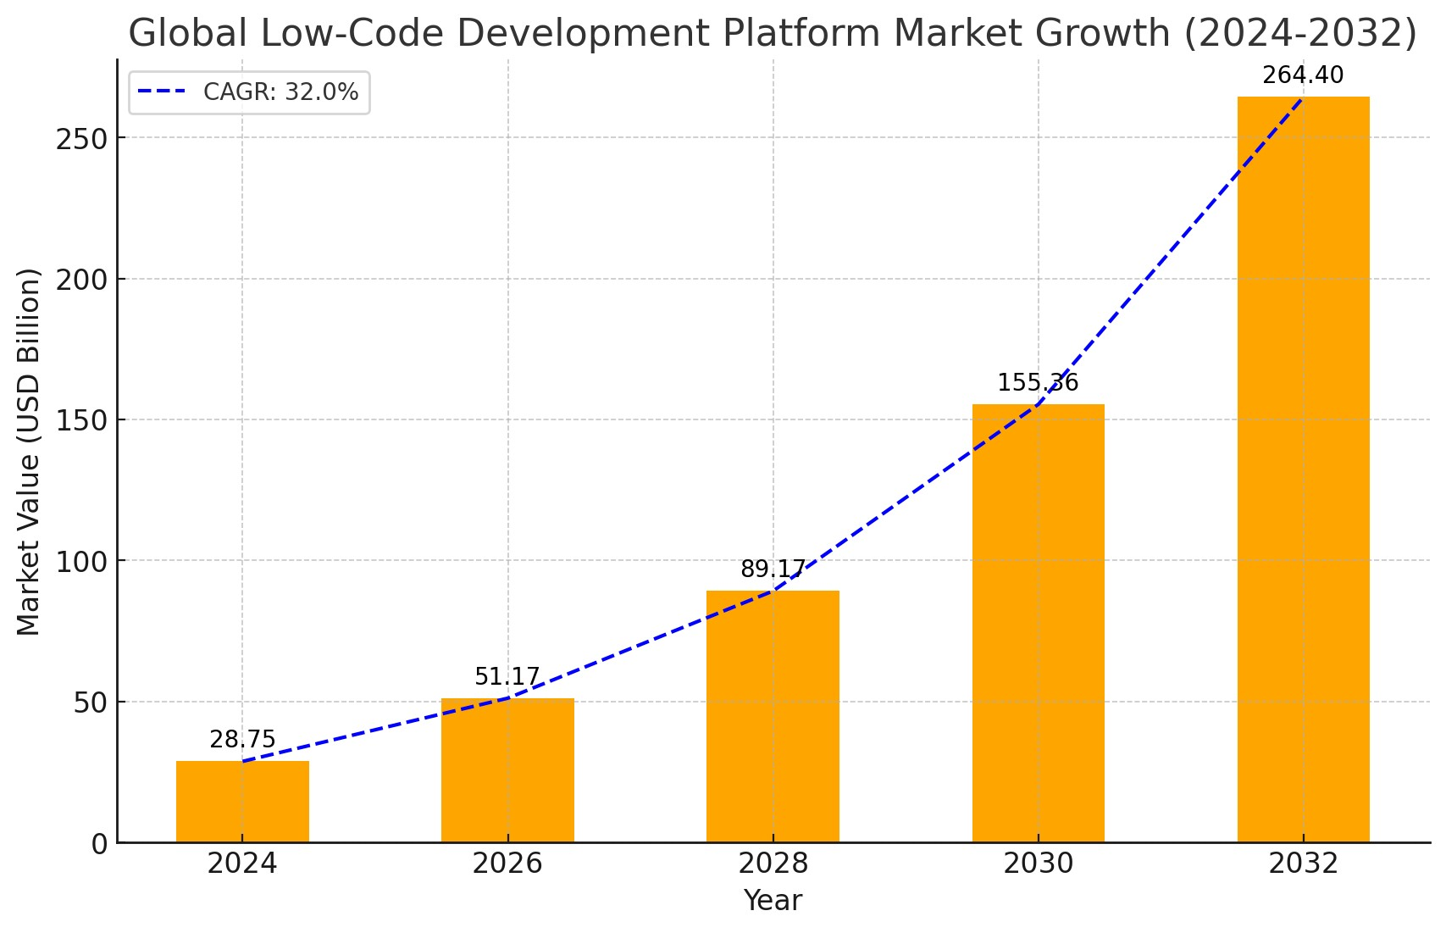
Market Strategy
The global low-code development platform market was valued at $28.75 billion in 2024, and is projected to reach $264.4 billion by 2032, growing at a CAGR of 32.0% from 2024 to 2032.
The key growth strategies for Codease include product portfolio expansion, partnership, collaboration and community management.
https://www.fortunebusinessinsights.com/low-code-development-platform-market-102972
www.codease.io

Slide 15
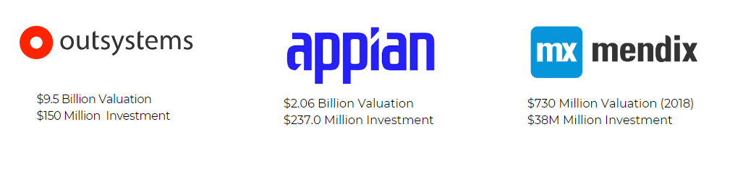
Competitors
www.codease.io

Slide 16

The weakness of our competitors
$9.5 Billion Valuation
$150 Million Investment
$2.06 Billion Valuation
$237.0 Million Investment
$730 Million Valuation (2018)
$38M Million Investment
Complexity
Integration
Code Management
UI / UX
Easy Development
Cost
www.codease.io

Slide 17
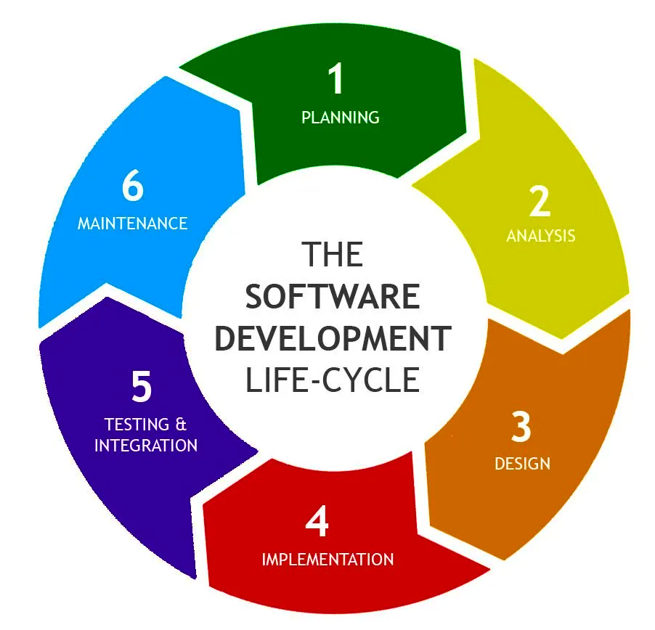
Our value Proposition
CODEASE provides organizations and companies with a digital transformation platform on which they can transform their entire businesses into business applications with full SDLC support.
www.codease.io

Slide 18
Our Advantages
  Codease offers not only software development but also a methodology (from design to maintenance and support) and guarantees the quality of every application developed, regardless of the designer.
  It handles complex processes, allows simultaneous use and bug fixing thanks to potent version management.
  It has the ability to easily integrate with AI due to its architectural infrastructure suitability.
  Performance is consistent across devices, including mobile platforms. Plus, it houses its own app market.
  Codease differs from its competitors with its installation-free structure.
www.codease.io

Slide 19

What client pays for and Business Model
  On-prem platform license (User base)
  Cloud platform license (Usage base)
  Applications on CodEase market
  Project development on CodEase platform
  Platform maintenance
  Application maintenance
www.codease.io

Slide 20
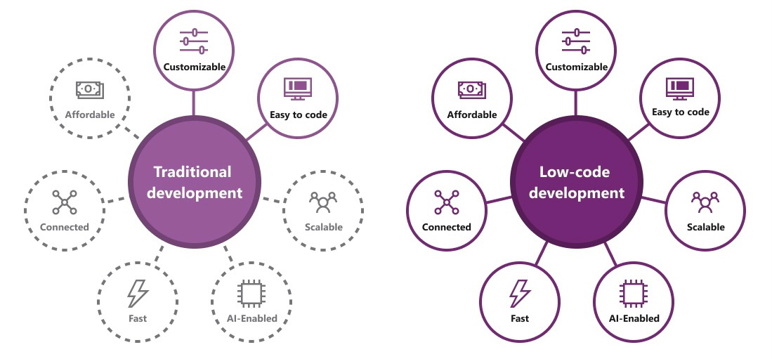
Why now?
  Low-Code and AI have been a very trendy technologies in recent years and is rapidly becoming mainstream. (Banks, Insurance Companies, Holdings etc.)
  Limited resources will continue to plague the world more and more.
  Sustainability is one of the biggest concerns of organizations and investments in this issue are increasing significantly.
www.codease.io

Slide 21

Why CodEase?
  Possibility to grow anywhere in the world, independent of geography and culture, with similar parameters
  A highly mature product developed according to the requirements of the field
  Numerically few competitors in a very large volume market
  Opportunity to become a partner in a company with high potential to become a global technology giant in a short time
www.codease.io

Slide 22

Our growth plan
Increase our footprint in Nordics
Widen Our Partner Network
Fast-tracking the growth in the Finland office and team to support the expanding client base in Nordic countries
In order to expend our sales channels and support the growth, identify and engage with solid long-term both sales and implementation partners
Expand to Europe & Middle East
Position as Top-Tier Solution
Adding our 3rd and 4th offices to the United Arab Emirates, United Kingdom to increase our global presence.
Increase our presence in analyst reports, benchmarks, and studies while supporting our product with more international acceptance.
www.codease.io

Slide 23
Raising Investment
Currently, we are raising investments $ 1.500.000
Estimated post-investment valuation of the company is $ 15.000.000
PRE-SERIES A
www.codease.io

Slide 24
Investment Goals
We plan to invest this funds in the following:
60%
Growth & Sales
Global Sales Operation, Marketing, Channel Management
25%
Product Development
AI, Gamification, Lower-Code
15%
OPEX
This money will be enough for 12 months
www.codease.io

Slide 25


Cap Table
Mustafa Teber
Strategic Execution
Growth & Branding
Finance and Investment Process
Veysel Karsli
Chief of Staff
Technical Leader
System Architect
Technology Development
www.codease.io

Slide 26




Our Team
Doruk Sardag
Chief Growth Advisor
Leader in business development, marketing, and sales
Advisor to the board
Caglayan Yilmaz
Project Management
Leader of the development team
Gathering and analysing feedback about the product
Ekrem Kupeli
Business Dev. Manager
Partner Ecosystem
Corporate Solution Network
Hulya Karsli
Product Manager
Researching the product, competitors and market, product strategy
Developing multi-year roadmaps for products and services
www.codease.io

Slide 27
Thank You!
Mustafa Teber
Managing Partner
mustafa.teber@codease.io
🇹🇷 Technology Development Zone / Bilisim Vadisi
Gebze
🇹🇷 Nida Kule, Barbaros Mahallesi, Begonya Sk.
No:1, Ataşehir, İstanbul
🇫🇮 Finland Office
Platform6 Åkerlundinkatu 8, 33100 Tampere
www.codease.io

