Slide 1

PRESENTER FULL NAME: HALİL AKGÜL
ORGANIZATION: PRESSURA / FLOTEKS
WORKSHOP NAME:
E-MAIL: hakgul@floteks.com.tr

Slide 2

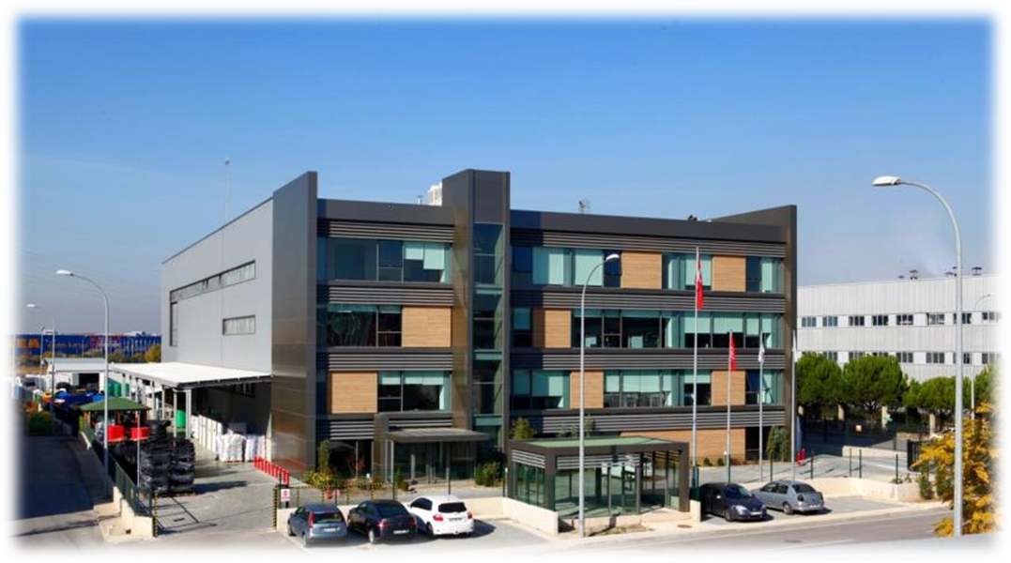
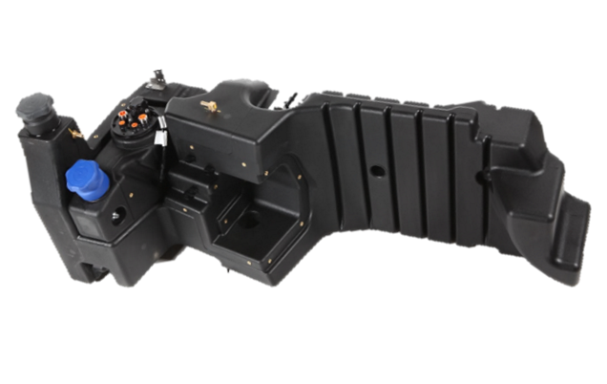
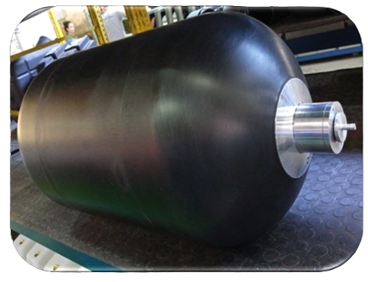
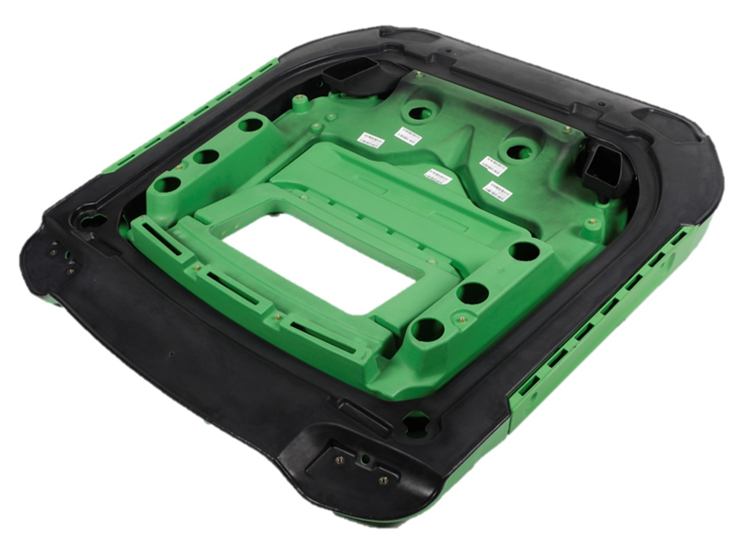
FLOTEKS
Floteks manufactures plastic parts using rotational moulding technology.
Establishment year: 1977
Production area: 30.000 m2
Main customers: Bus, Truck, Tractor and Construction machinery manufacturers.
Main product: Diesel and Adblue tanks
Company Type: SME

Slide 3
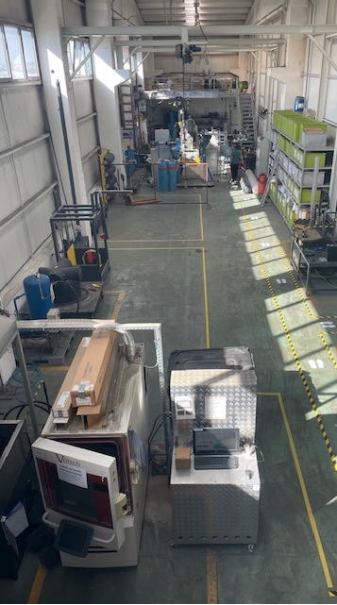
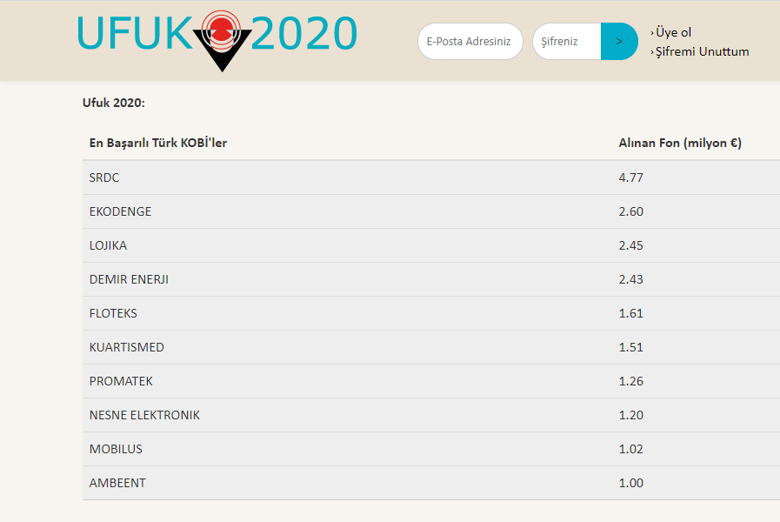
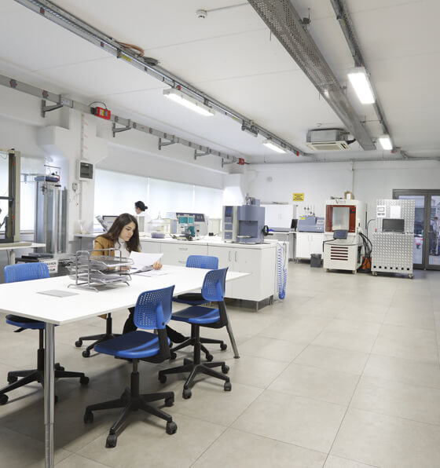
R&D
Floteks possesses a strong R&D culture and expertise.
Floteks R&D Center is certified by the Ministery of Technology and Industry.
Floteks has been most successful industrial enterprise, in the SME scale, in European Union Horizon 2020 programs.

Slide 4





FLOTEKS SUCCESS IN EU PROJECTS
In 2012 Floteks started doing EU funded projects in cooperation with many partners in EU.
Total 12.627.535 €

Slide 5
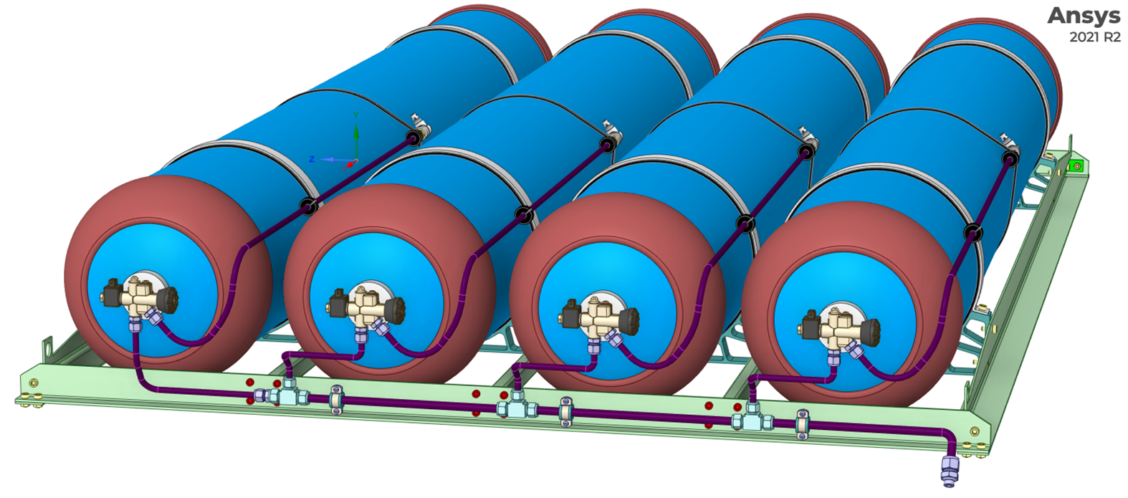
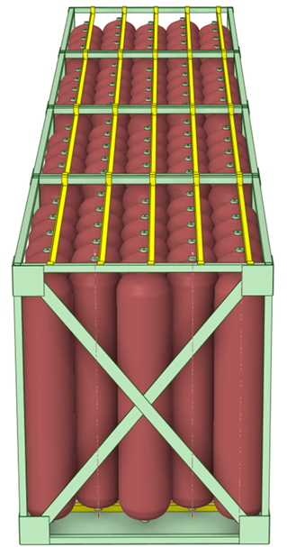
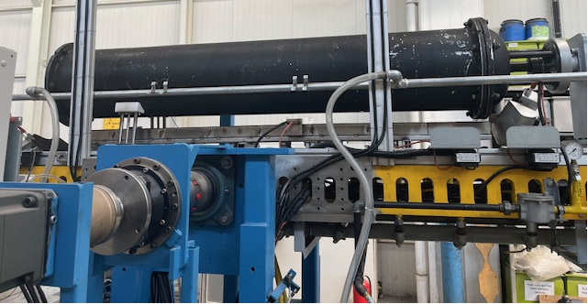
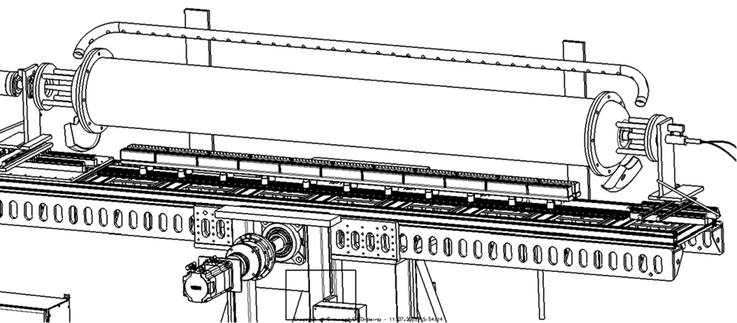
R&D PROJECTS SUPPORTED BY TUBITAK
CNG Tank set for buses . Working Pressure 200 bar
Start: April 2021 End: April 2023
2. TYPE 4 TANK FOR H2. Working Pressure 350 bar
Start: Sept 2022 End : June 2024
3. H2 Tanks for Gas Transportation Working Pressure 380 bar
Start : 1.4.2024 End: 31.12.2025
Development of Rotational Moulding Technology to Produce Liner.
Start : 1.4 24 End : 30.6.25

Slide 6
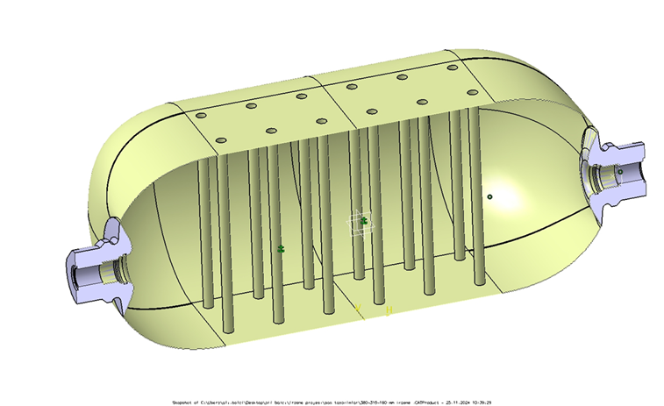
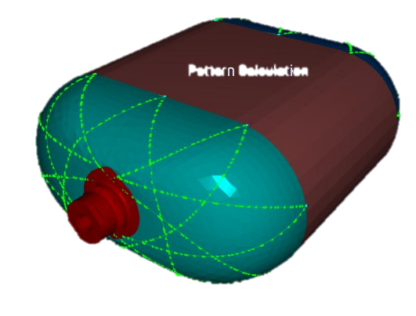
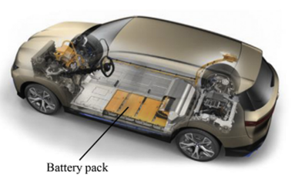
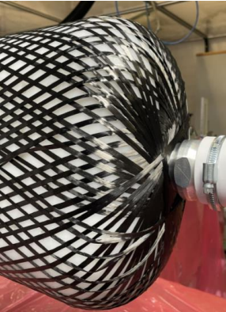
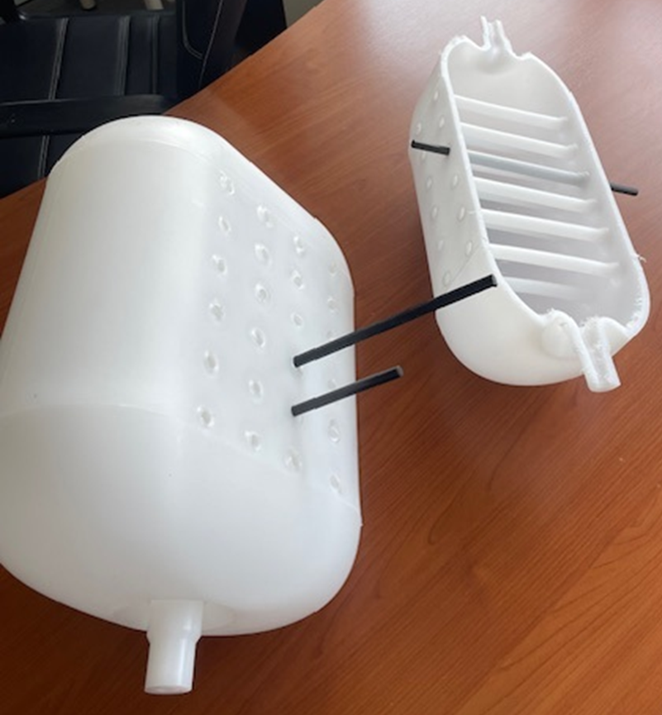
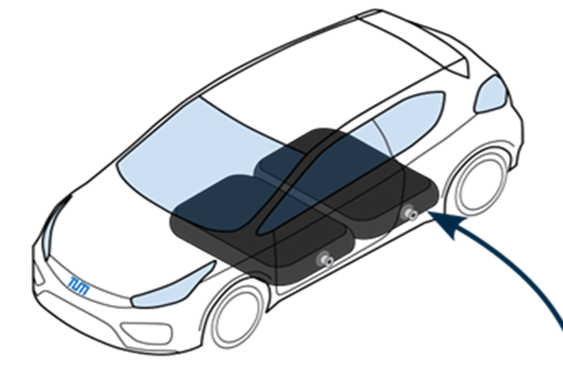

R&D PROJECT SUPPORTED BY EU: ADAPT-H2 TANK
IRASME Project Supported by EU: Adaptive Design for Advanced Performance of Type 4 H2 Tanks
Start : 1.2.2024 End: 30.06.2026
Working Pressure: 700 bar
Project Partners: Technical University of Munich (TUM), Mefex Germany, Floteks Türkiye
Target: Design and production of a hydrogen fuel tank suitable for the rectangular prism-shaped volume that appears when the battery pack is removed.

Slide 7
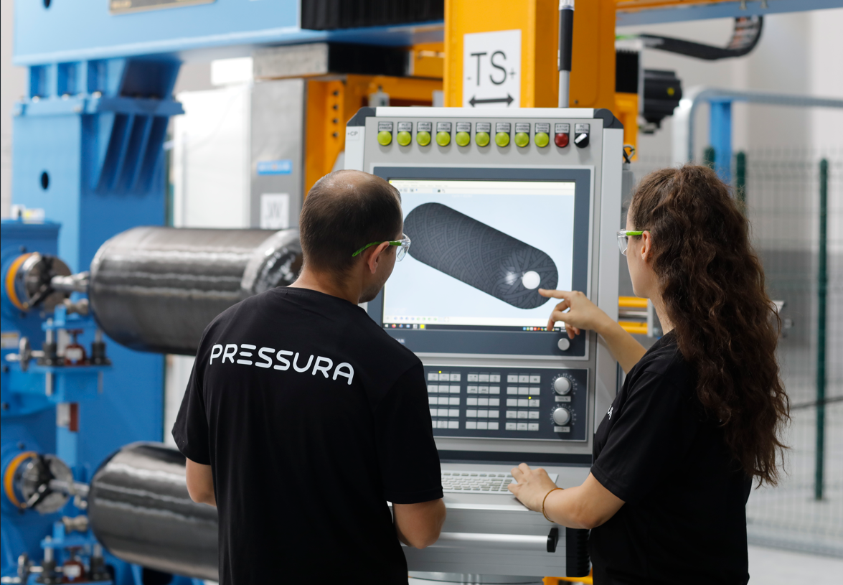
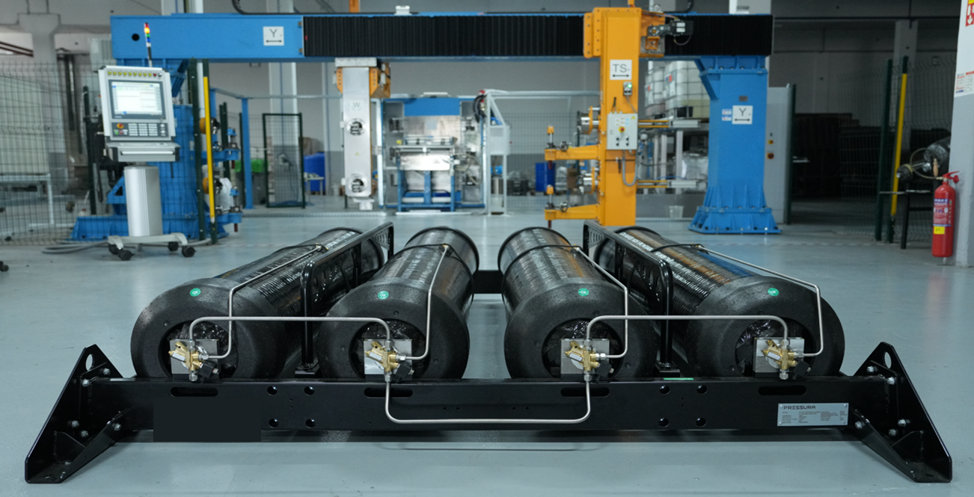
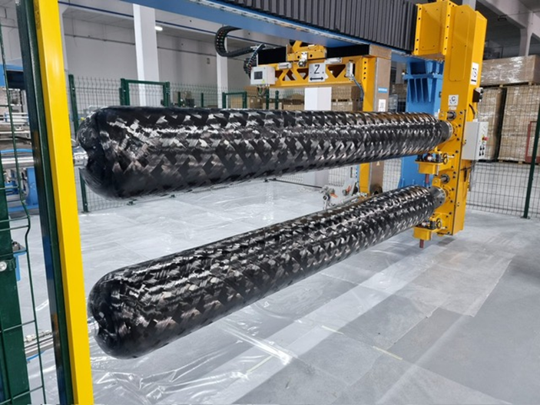
SPİN-OFF COMPANY
Pressura is a spin-off company established by Floteks with a strategic focus on the design, manufacturing and testing of Type IV composite pressure vessels.
Establishment year: 2024
Production area: 4.000 m2
Main product: Type 4 Pressure Vessel

Slide 8
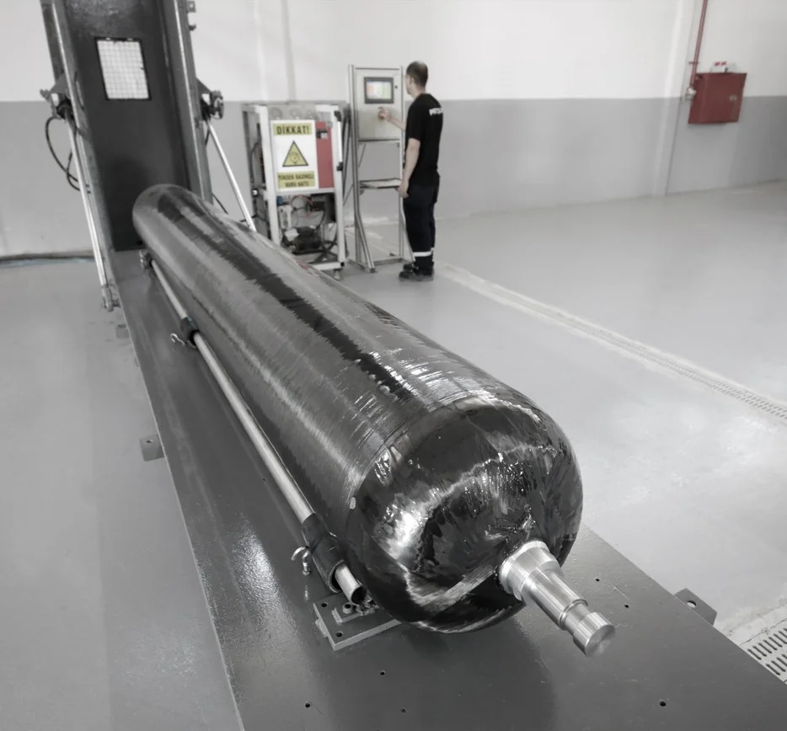
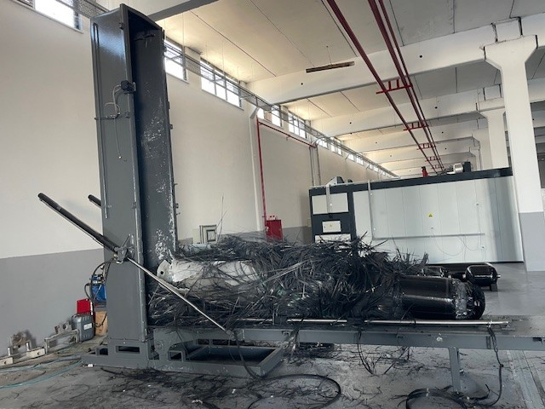
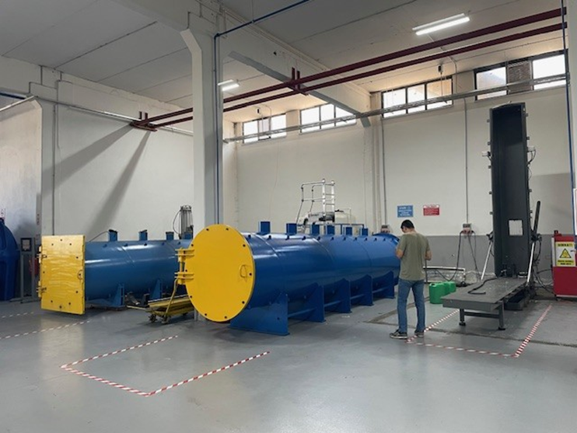
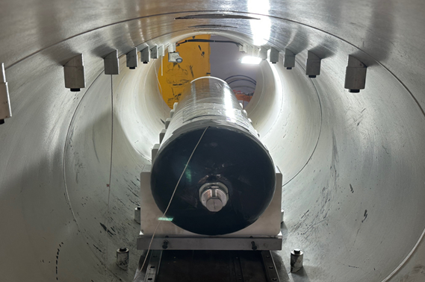
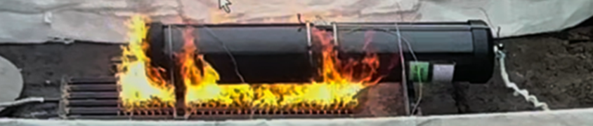
TESTING CAPACİTY
In house:
Proof pressure test
Hydrostatic burst pressure test up to 1200 bar
Pressure Cycle Test
Gas leak test: up to 700 bar
Accelerated Stress Rupture test
Drop test
External Lab:
Gas Cycle
Extreme Temperature cycle test
Gun fire test
Bonfire Test

Slide 9
PROJECT PARTNERSHIP
Project Ideas:
Type 4 pressure vessels for different gas storage applications:
  Space
  Drones
  Marine
  Railways
  Health
  H2 buses
  CNG trucks
Rotational molding parts for different applications.
  Marine
  Environment
  Water purification
  Rainwater storage
  Automotive
  Construction machinery
  Hybrid products: Plastic + Composite
Products produced by filament winding method
  Composite shafts
  Sleeves

Slide 10

PRESENTER CONTACT
DETAILS: hakgul@floteks.com.tr
COUNTRY: TÜRKİYE

