Slide 1
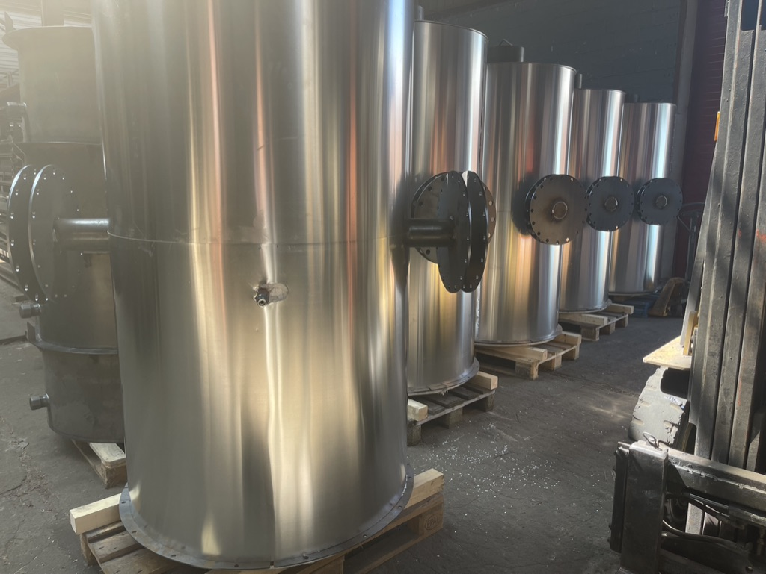
Notes:
Hello, my name is Marc Moons from Viktor Goes Green. We build installations for the production of biochar and take the initiative to set up our own productions. This can range from small installations of 50 kg per batch to industrial projects of several tons per hour. Today I would like to introduce you to two projects related to biochar production.

Slide 2

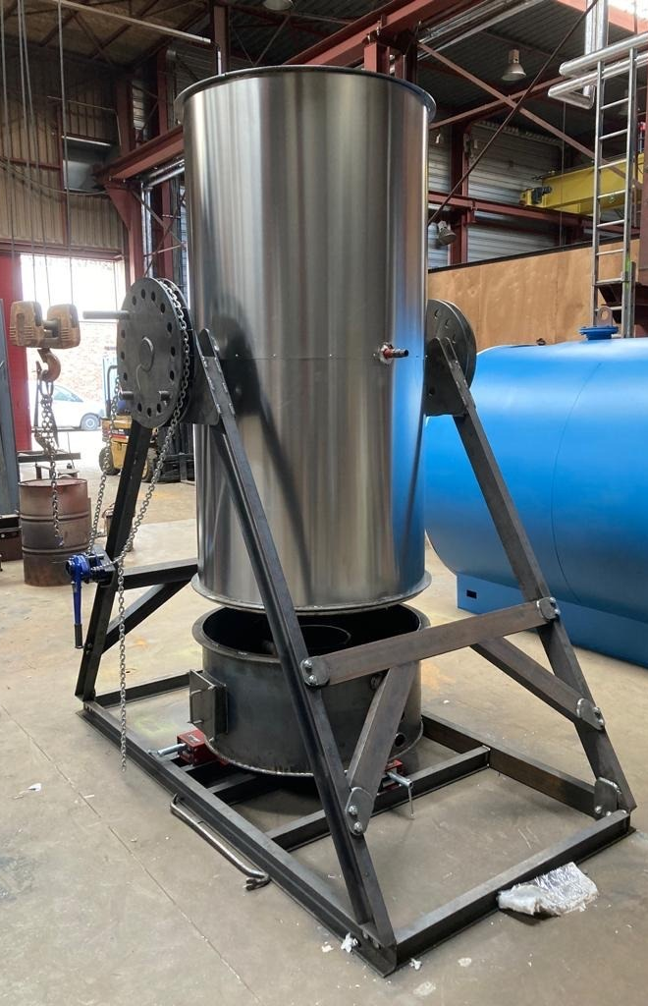
Conversion of residual wood into charcoal and biochar with a high-efficiency reactor to preserve more forests.
innovation project
Notes:
In our workshops in Ghent, Belgium, we developed a simple but very efficient device to produce charcoal or high-quality biochar. The device has been specially developed for the African market. During our visits to Benin in Africa we saw the traditional production methods for the production of charcoal. And then we started tinkering with a design to produce the same amount of charcoal with less wood and fewer greenhouse gas emissions.
When the demand came for biochar to be used in pineapple cultivation from the benin agricultur deveolpment agency, we decided to build some installations.

Slide 3
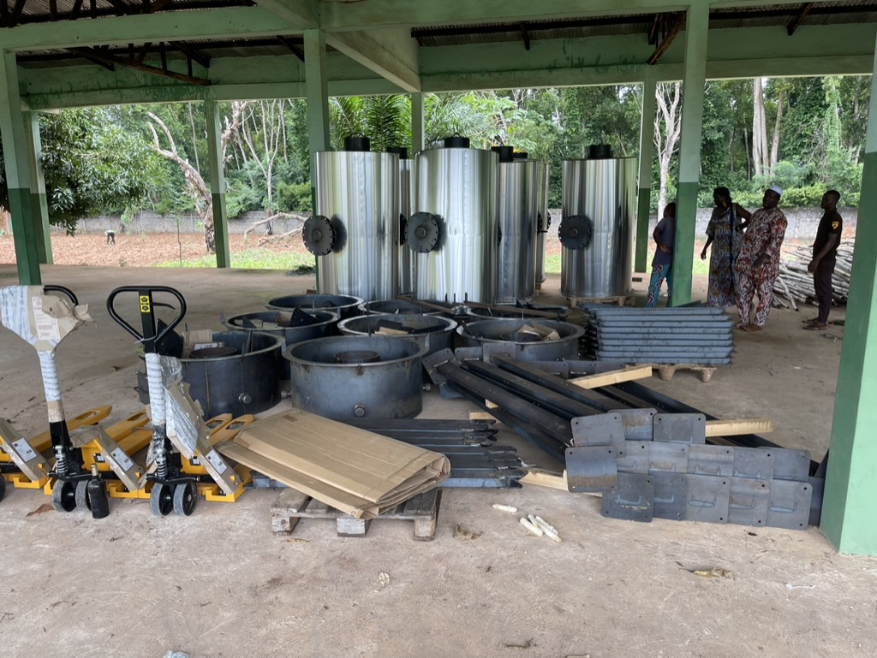

This project is supported by the Belgian government by Minister for Foreign Trade and Development Cooperation,
Minister Hadja Lahbib, and is a gift from Belgium via Finexpo to Benin
Notes:
With the support of the Belgian government, we have succeeded in building the first 20 installations for Benin. These 20 installations are a gift from the Belgian government to Benin and are being set up at various locations as a demo project. Some of them as biochar production. The biochar will be used in pineapple cultivation.

Slide 4
Notes:
The design of the reactor is simply an inverted barrel with a chimney through the middle. The barrel is open at the bottom and you turn the reactor in an horizontal position to fil it. The combustion chamber is at the bottom. The fire to heat the reactor is only in the combustion chamber. The heat from the fire passes through the chimney in the midle and heats the reactor. In the reactor you get a circulation of the produced gases. So the temperatur is almost the same on every place in the reactor. The gases can only leave the reactor by passing the combustion chamber and inflame. This fire drives the temperature of the reactor to more than 400 degrees. Once gas production stops and the fire goes out, the charcoal or biochar is ready and of very good quality.

Slide 5
Technical data
Operating temperature: >400°
Reactor capacity: 1.4 m3
Reactor time: 3-4 hours
No electronics are involved.
No fan, no pump
Manual filling and emptying
Easy to use
All repairs can be done locally
Notes:
Some technical information
The capacity 1,4 cubic meters
There are no electronics on the installation, no controls. It is an autonomously running process

Slide 6
The result
- The conversion factor is 3.5/1 compared to 8-10/1 of current traditional technology.
- Improved working conditions
- High quality coal with a carbon content of more than 90% (Biochar quality)
Processing time.
  Traditionally, the process takes from one to several weeks
  Our recator can be filled and emptied daily or twice a day.
Notes:
Compared to traditional methods, our installation only uses 1/2 to 1/3 of the wood for the same amount of charcoal.
The production time and working conditions are much better.

Slide 7
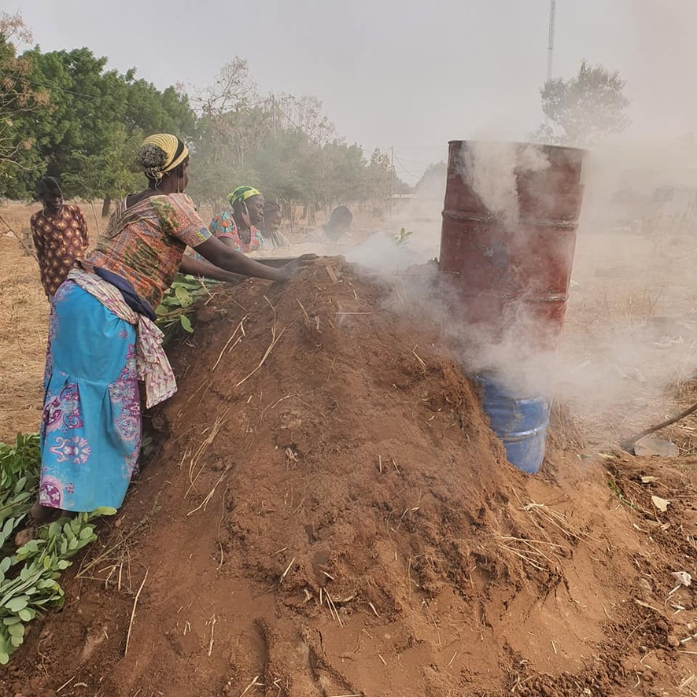
Climate and Environmental benefits
Less wood for the same result means less wood consumption
Forest Conservation
Strong climate emissions reduction
  Less CO2 emissions
  No CH4
  No CO
Notes:
On the left you see a photo of a traditional method that is used almost everywhere in Africa.
The process takes several days to sometimes 2 weeks
The gases leave the covered pile without burning. These contain high concentrations of greenhouse gases

Slide 8
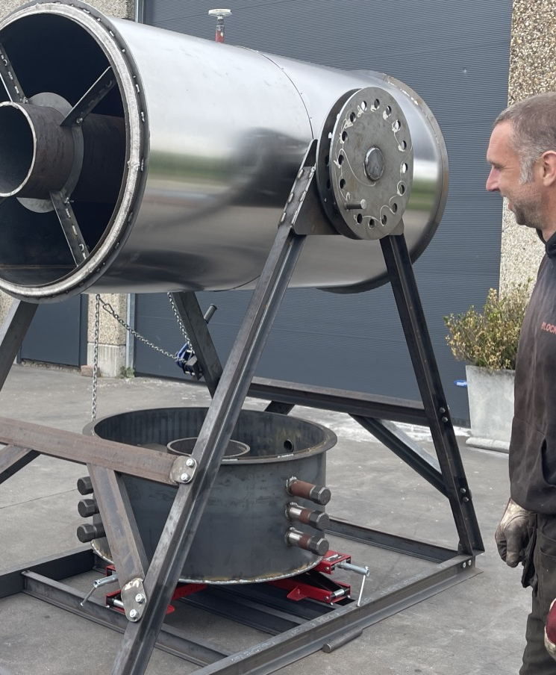
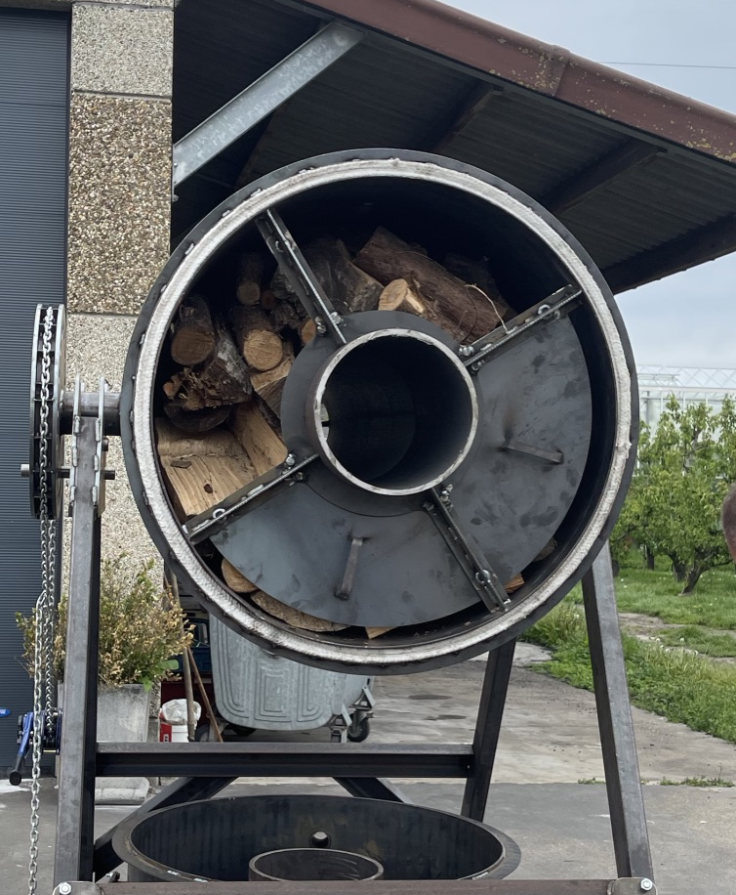
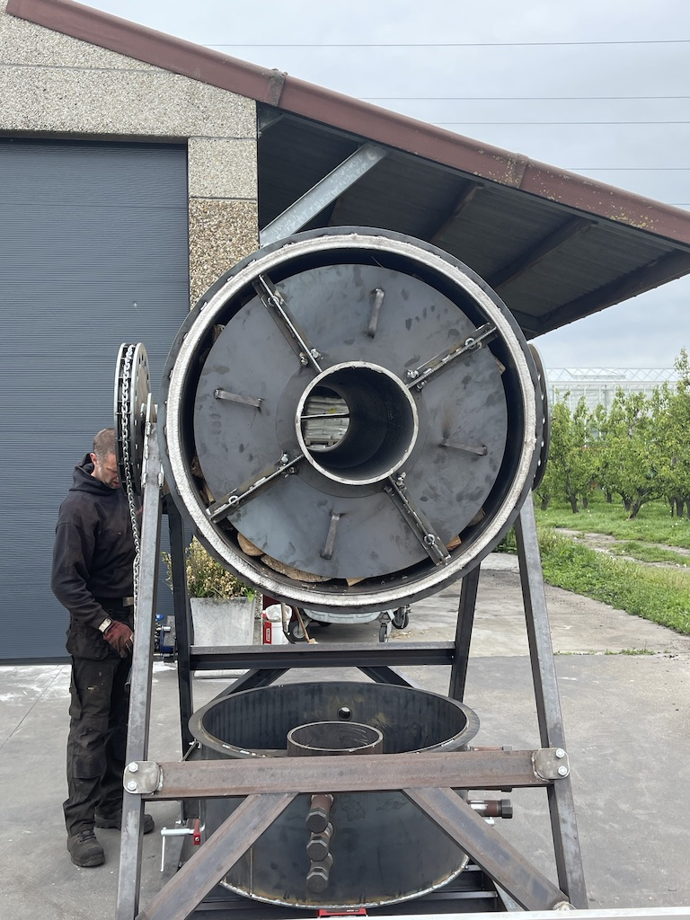
User Manual 1
Place the reactor in a horizontal position for filling.
Fill the reactor with pieces of wood or bamboo
Close the reactor with the lids provided
Fill the fireplace with logs
Notes:
I also include the instructions for use.
It is a very simple installation to use.
In the horizontal position you fill the reactor.
In these photos you can also see the fireplace in the middle, the closing covers to keep the wood in place in a vertical position and the combustion chamber below.

Slide 9
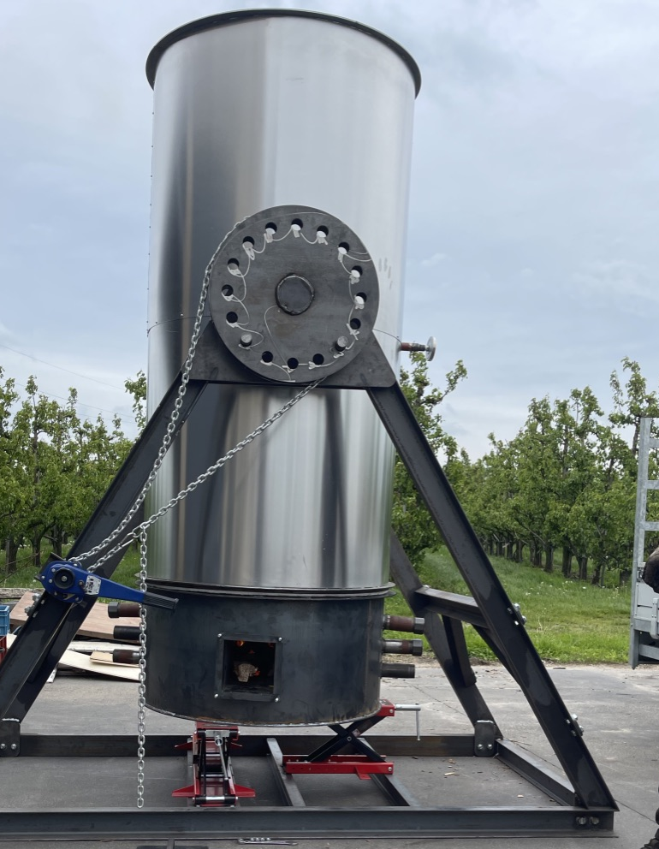
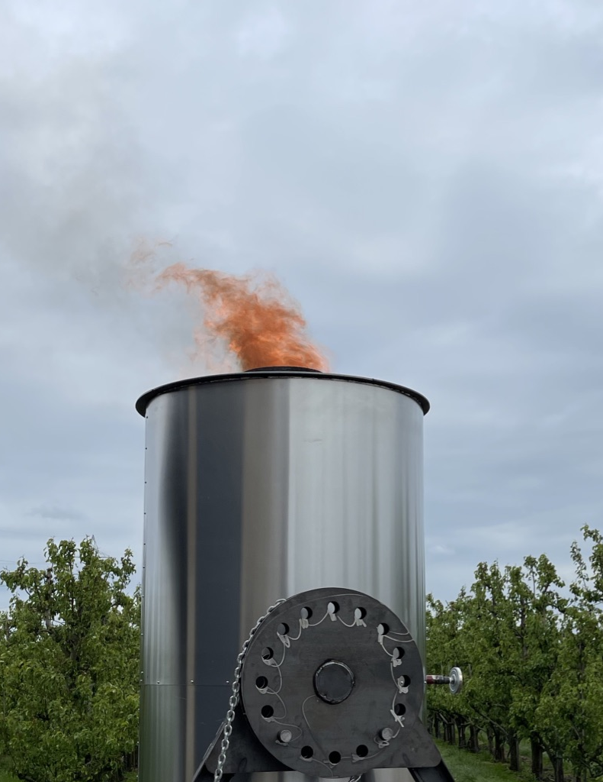
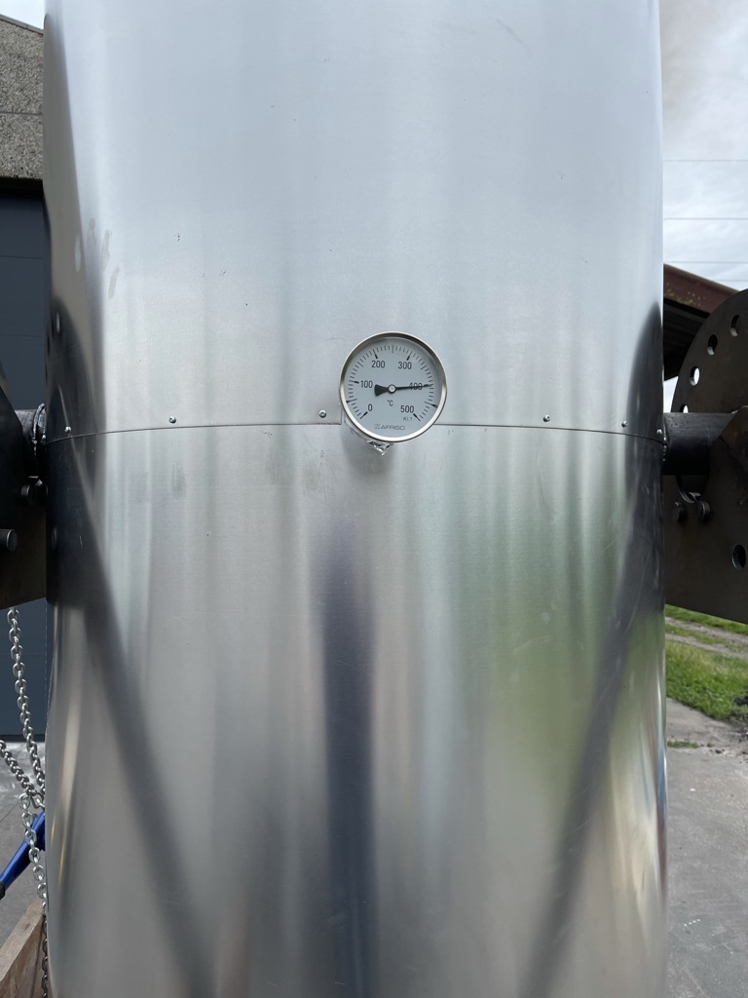
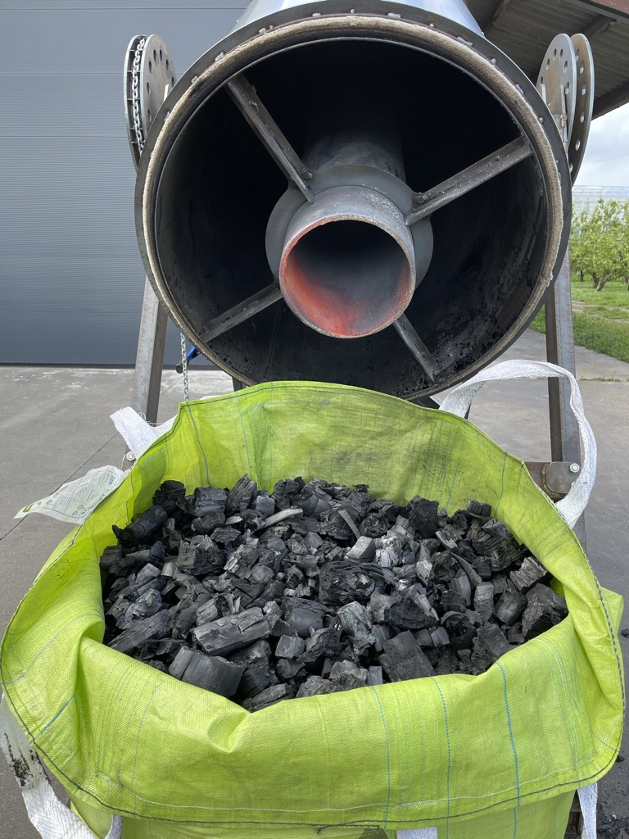
User Manual 2
Light the fire, place the reactor horizontally and close the reactor with the combustion chamber .
If necessary, fill the combustion chamber with wood until you can see the wood gas burning
Due to the production of wood gas in the reactor, the reaction is now self-sufficient.
The jacket temperature automatically rises above 400°C. Visible on the thermometer.
After about an hour, a flame is visible. The reactor is now running at full speed. The flame goes out after one hour of combustion. the production of wood gas decreases and stops. Close all air vents. And let the reactor cool.
Leave the reactor to cool and put (when cool) it in a horizontal position to empty it. If necessary, cool the material further with water.
Notes:
In the vertical position the combustion chamber is closed with the reactor.
The fire is only started in the combustion chamber.
Once the reactor is above 200 degrees, the gases in the wood are released and these must pass through the combustion chamber. This causes the gases to ignite.
From now on it is an autonomous process. The burning gases further increase the temperature of the reactor to 400 degrees.
When the gases have burned out, the reaction is complete and you have to wait for cooling.
The result is a high-quality biochar with a carbon content higher than 90%.

Slide 10
What's next?
Free use for local producers
With local parties, for follow-up and registration
  NGOs
  Agencies attached to ministries
Combination with forest planting and a good management plan
CO₂ certificates
Notes:
We are currently developing a system so that local producers of charcoal and biochar can use the installations free of charge.
An installation easily costs between 13 and 16,000 euros. Depending on the transport costs. It is still cheaper for a local producer to use the traditional method.
We want to set up a concept with local parties that can demonstrate how much less greenhouse gases are released into the atmosphere and how much extra CO2 is stored. It can be used for both biochar production and charcoal production. Local parties can be NGOs or agencies.

Slide 11
Contact
Marc Moons
+32 497 45 21 44
marc@viktorgoesgreen.be

Slide 12

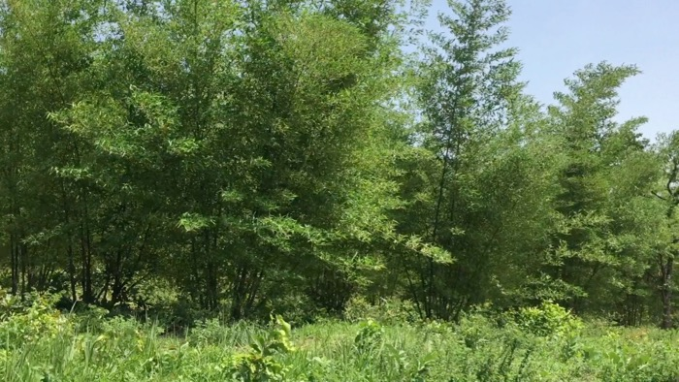

Bamboochar
Project summary
Notes:
The second project I would like to present is our bamboo to bambochar project.

Slide 13

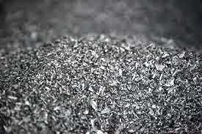
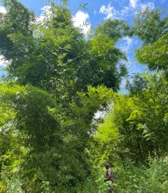

BamboO
Bamboochar
Green energy
Local economy
12 Novembre 2022
Notes:
Our bamboo project is located in Benin, where we want to turn our own bamboo production into bamboochar. Bamboo char is natural biochar made from bamboo.

Slide 14
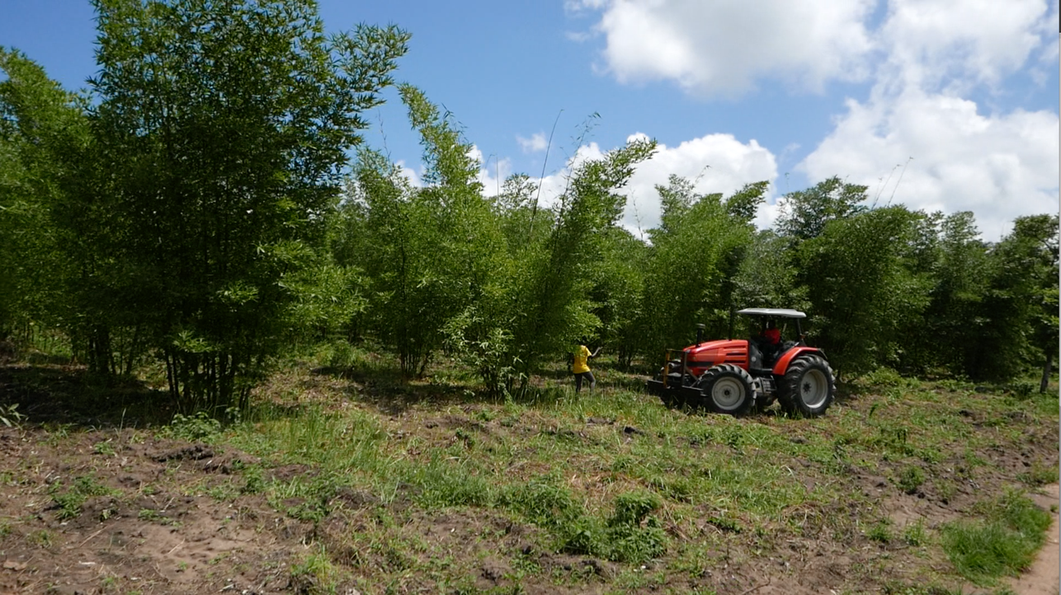
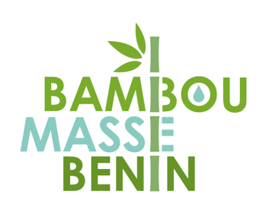
Biomass From our own sustainable production
Notes:
We have planted our own bamboo forest in Benin.

Slide 15
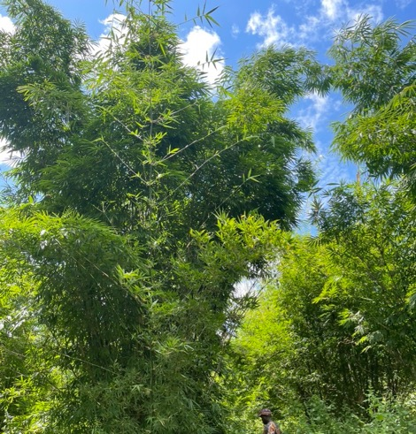
BamboO
Bamboo is the only type of grass that can diversify in a forest.
Bamboo is a type of grass. Does not therefore belong to the category of trees. But it can produce wood and turn into a forest on larger areas.
Notes:
When we talk about biomass production, bamboo is a great crop.

Slide 16

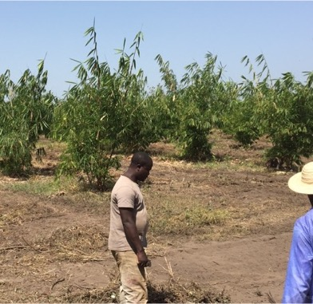
Project history
Started in 2014
As a company registered in Benin
350 ha planted
  Planted in phases from 2014 to 2017
Plantation unique
  When the bamboo is harvested, it does not need to be replanted. Plants immediately give new shoots. After two years, these become a complete forest again.
Cycle de 3-4 ans
  Depending on growth, harvesting can take place every three to four years.
no irrigation
  Only after planting young plants, a small amount of water is given manually. The same during the next dry season. After that, the plants are developed enough to find water themselves, at great depths.
no chemistry
  bamboo has few natural enemies, so chemical control is not necessary.
Notes:
The planting started in 2014. We planted parts in 2014, 15, 16 and 17
About 350-400 hectares have been planted. There is room for much more.
The first plantings are now maturing and can be harvested.
The big advantage of bamboo is that it can be harvested every three to four years once the plants are mature.
We use no irrigation and no chemicals. We only mow the undergrowing vegetation once a year

Slide 17




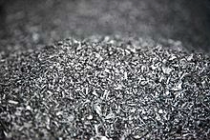
Biochar process and green energy
Raw material | Transformation | Production | Use
Bamboo Sustainable local production | Gasifier & Cogeneration | Electricity | →Local electrical network →Business for local use
 |  | Heat | →Business for local use - Drying of fruits, nuts, rice,...
 |  | Bamboochar | →raw material for industry →CO2 storage →Soil improver
Notes:
This is a schematic representation of what we want to do with the bamboo.
We want to sell the better stems directly. The rest is chipped and goes into the installation as feedstock.
This installation is a continuous installation with a gasifier and a cogeneration. The installation uses approximately 1 ton of dried bamboo per hour. This produces approximately 700 kilowatts of electricity and 250kg of bamboo char. The rest is heat. We are looking at using these locally for drying fruit, nuts, rice, ...

Slide 18
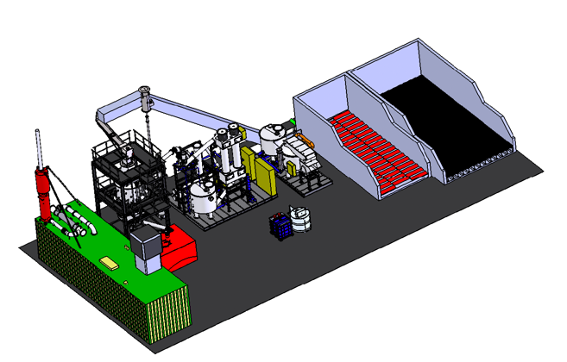
Notes:
Here's a better view of our gasifier.
The red tube at the bottom is the place where the bamboo char comes out of the installation.
On the right you see a complete setup. From storage bunkers to cogeneration.
the total investment of this setup is 2-2.5 million euros.

Slide 19



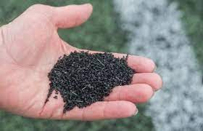

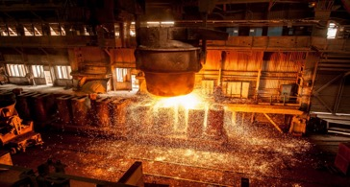
Bamboochar
Industrial markets
CO2-neutral raw material for the metal industry
CO2 negative feedstock for bioplastics
Chemical industrie
SAF-Production
Long-term CO2 storage
Soil amendment as peat substitute
Notes:
The electricity and heat are valorized locally. We are currently negotiating with major industrial customers for the sale of the biochar.

Slide 20

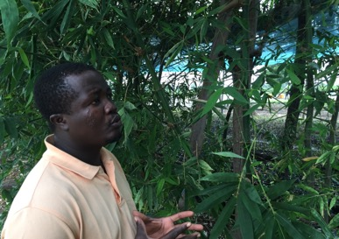
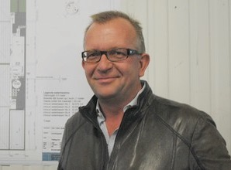

The partners
Chamsdine OUOROU BARE
‭+229 97 87 4178‬
Raliyatou BIO BANGANA
‭+229 90 61 4142‬
Marc Moons
+32 497 45 21 44
marc@viktorgoesgreen.be
Notes:
And then there are the contact details and photos of both our local partners.

