Slide 1
F6S Innovation

Slide 2

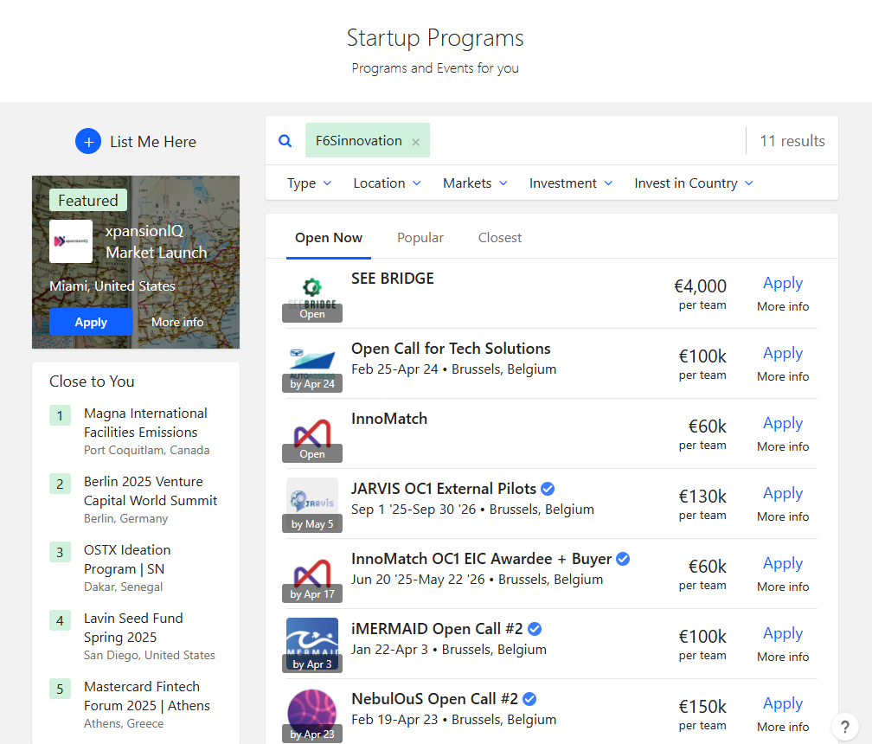
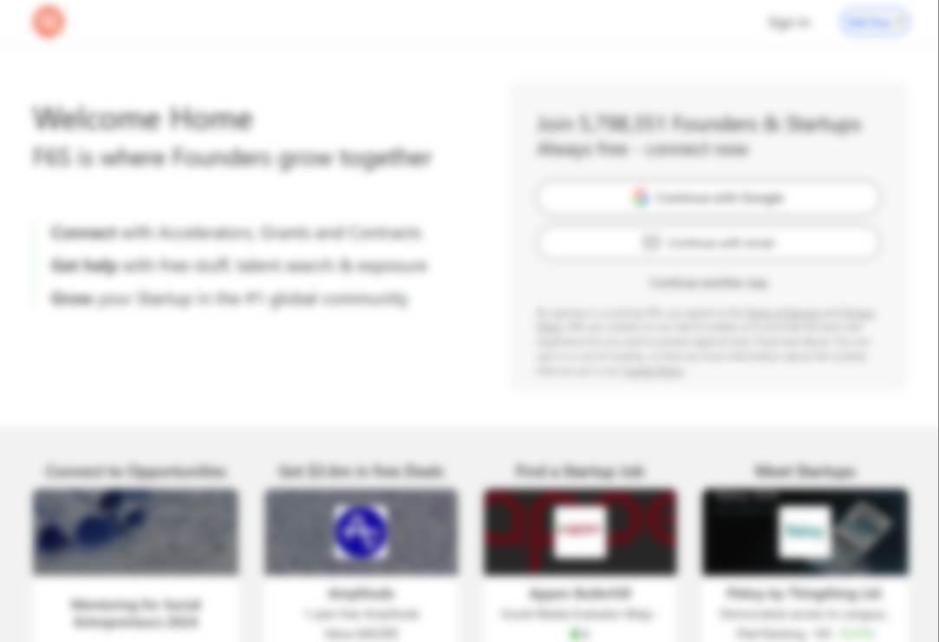
Mission
F6S helps founders and startups grow
to solve the world's pressing social, economic, environmental, sustainability and innovation problems.
The world’s largest Corporate Innovation Community, connecting 5.5m+ users.
[founders & startups, corporates, RTOs, researchers…]

Slide 3
An Innovation
Leader
300+
20K
250K
Sectors tracked
Dedicated Analyst
& Research teams
Partners on F6S
Accelerators, VC’s, Corporates & Universities
Companies <> Corporates
Connections made
F6S framework powers 1.6M+ tech startups and 4,000+ corporates, enabling successful partnerships, investments, and M&A.

Slide 4
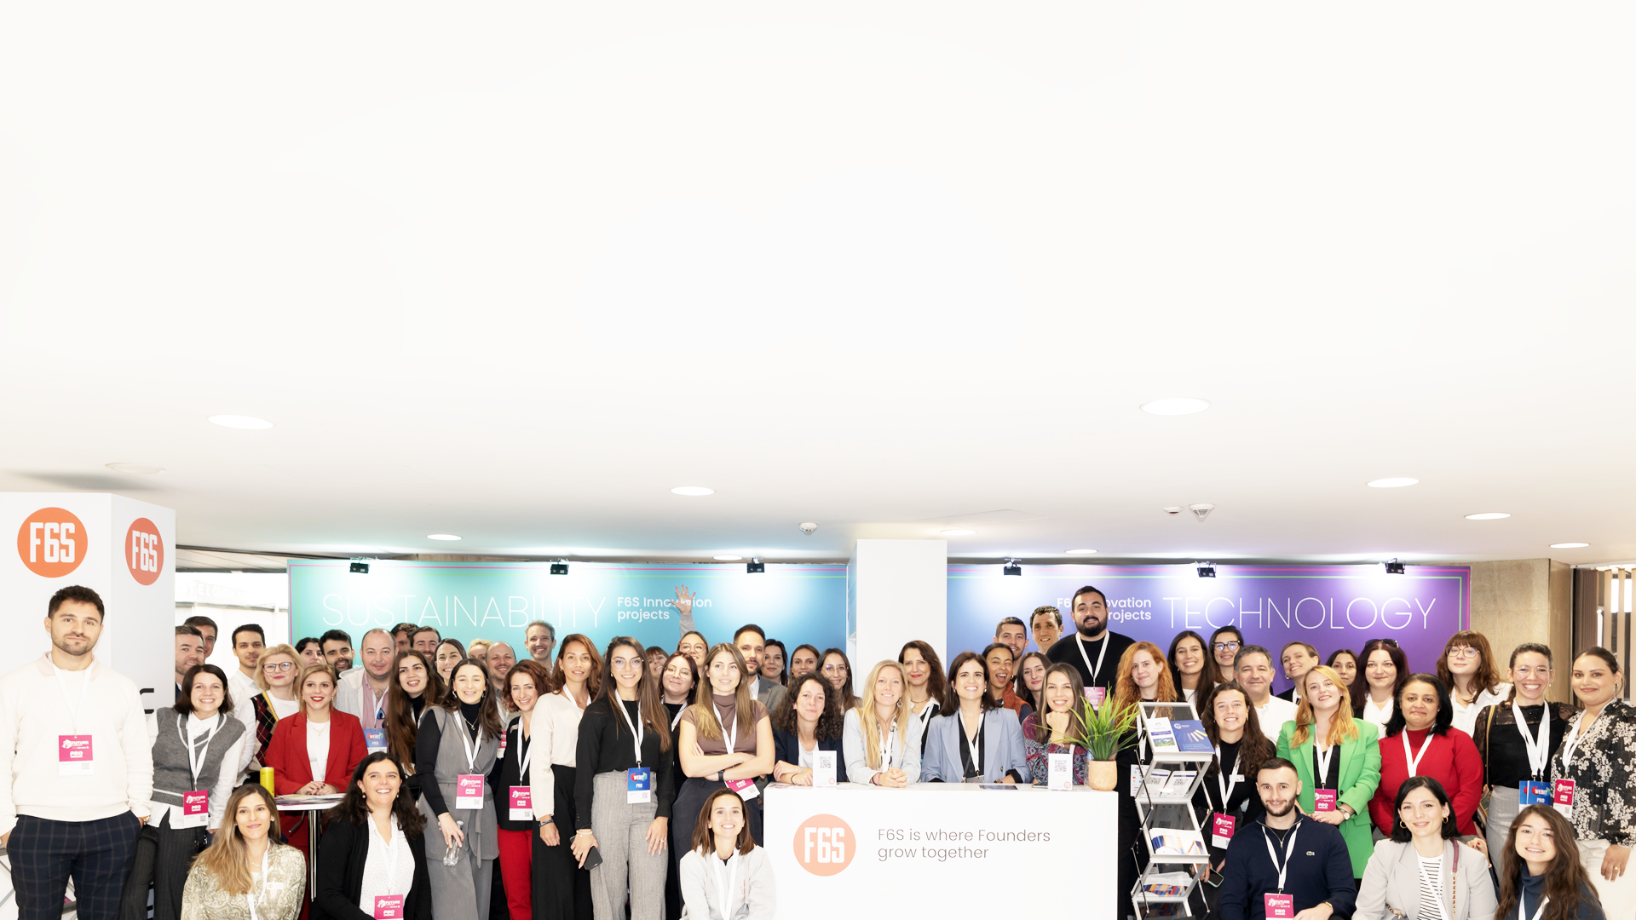
What makes F6S different?
Largest startup
& corporate innovation community.
Proven track
record in funding
& project execution.
Expertise in commercialisation
& ecosystem growth.
Seamless integration
of funding, networking,
and corporate partnerships.

Slide 5
















4,000+ Corporates use F6S for Innovation
F6S framework powers 1.6M+ tech startups and 4,000+ corporates, enabling successful partnerships, investments, and M&A.

Slide 6
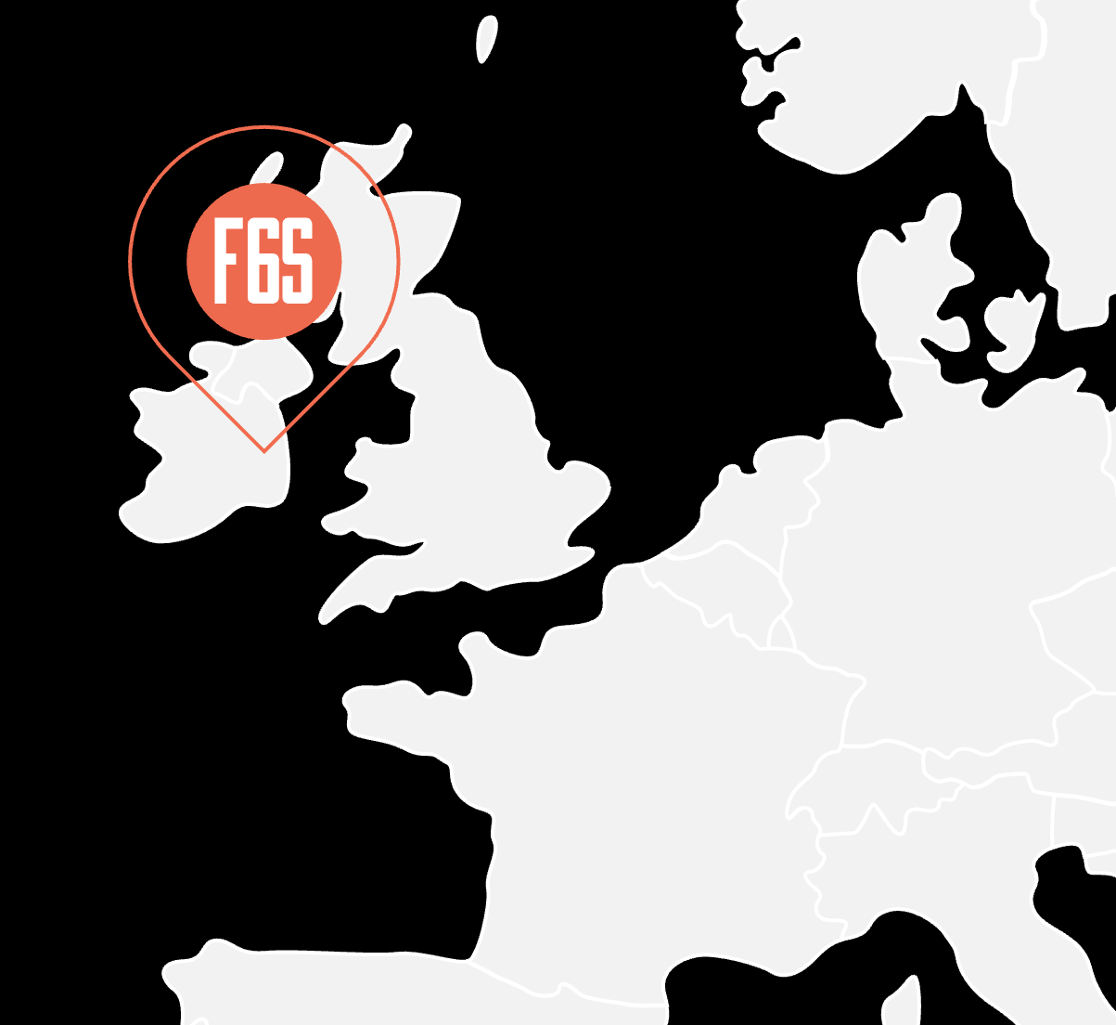
F6S Innovation
Driving Technology growth through public funding programmes
Ireland Headquarters
SME
F6S Innovation is part of F6S Network group
We partner with European entities to deliver
high quality and impactful projects.
F6S assets:
+85
experienced professionals
+160 projects
within the
last 8 years
Team experience & knowledge
F6S platform & community
EU partnership & international networks
Sector driven synergy/cluster channels
1 stop shop to build EU projects
branding and communication campaigns
Experience with EU workgroups
and events
13 as project Coordinator
10y
experience
in EU projects
INTERNATIONAL PARTNERSHIPS

Slide 7
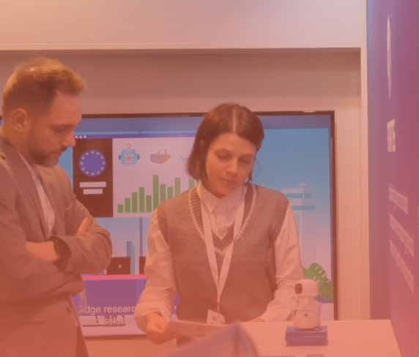
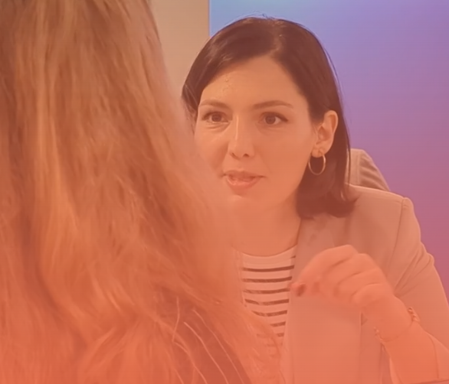
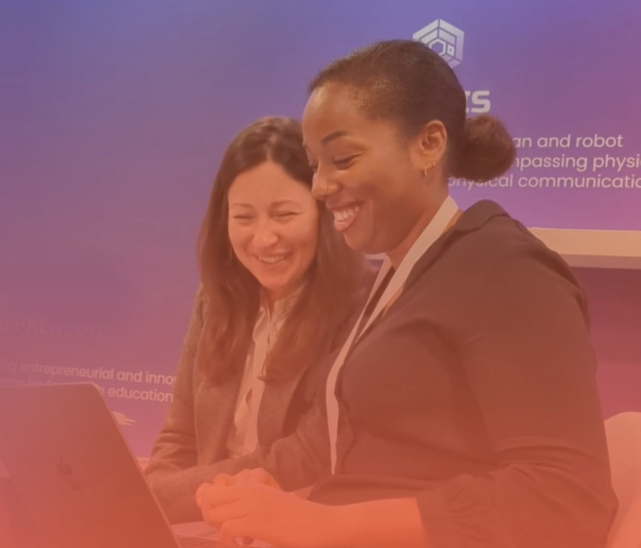
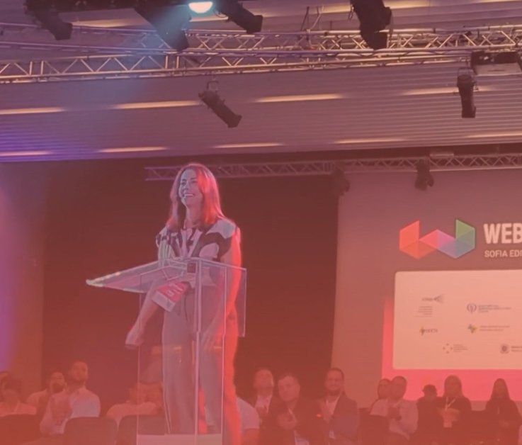
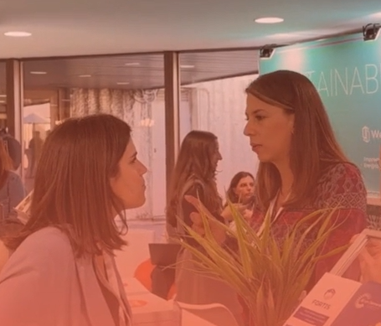





F6S Innovation
Our roles in EU projects
Open Calls Management
Stakeholder engagement
& Community building
Exploitation, sustainability & impact
Communication
& Dissemination
Coordination

Slide 8







OUR ROLE IN PROJECTS
Open Calls Management
(Cascade Funding / FSTP)
The F6S accelerator network enhances reach and attracts high-quality applicants across sectors.
We design open calls to maximise project value, ensuring alignment with strategic goals.
We expertly manage end-to-end processes, from dissemination and applicant evaluation to contracting and monitoring.
+140m
FSTP fund managed
+230
Open calls
+5100
Awarded projects/ entities
Notes:
services:
Application platform & evaluation management
Process monitoring & reporting

Slide 9







OUR ROLE IN PROJECTS
Stakeholder Engagement
& Community Building
F6S drives stakeholder engagement through high-impact campaigns, global community building, and interactive co-design workshops.
We implement an efficient multi-actor approach, fostering synergies and clustering activities among projects and EU initiatives.
Customised stakeholder engagement strategy
Training delivery & Workshops facilitation
Joint International events/ conferences participation

Slide 10
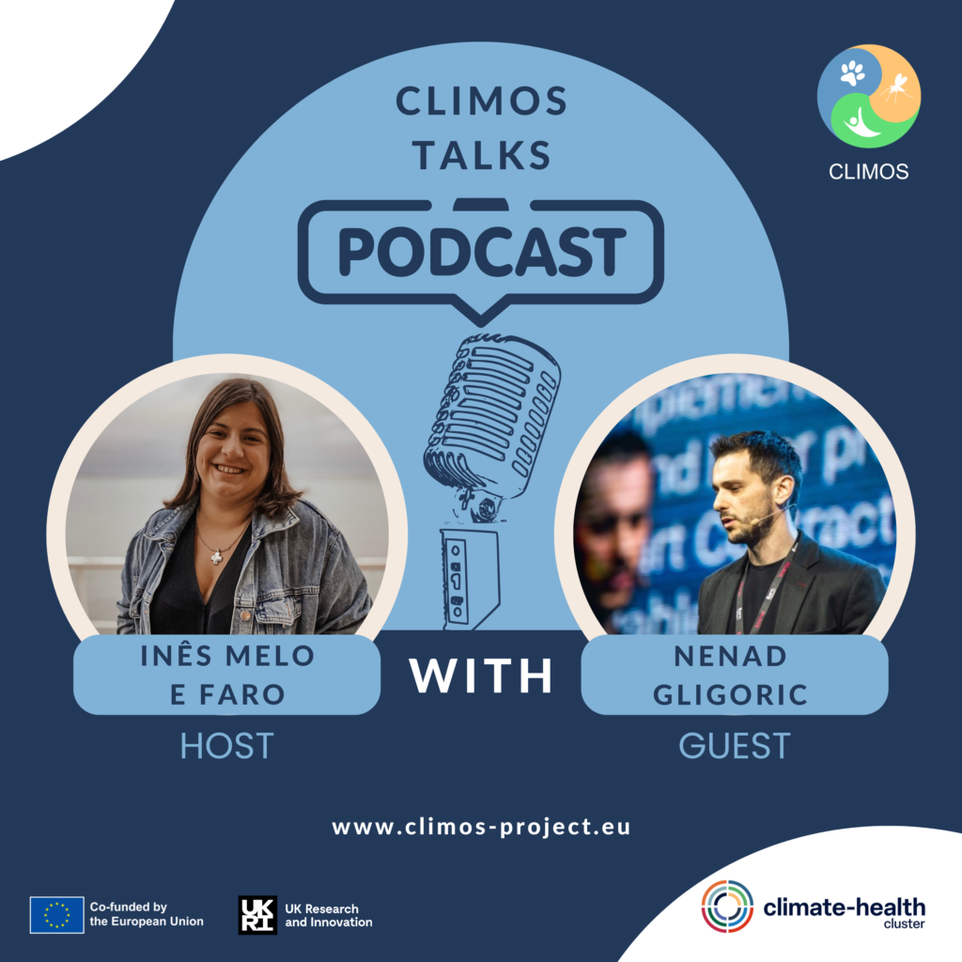
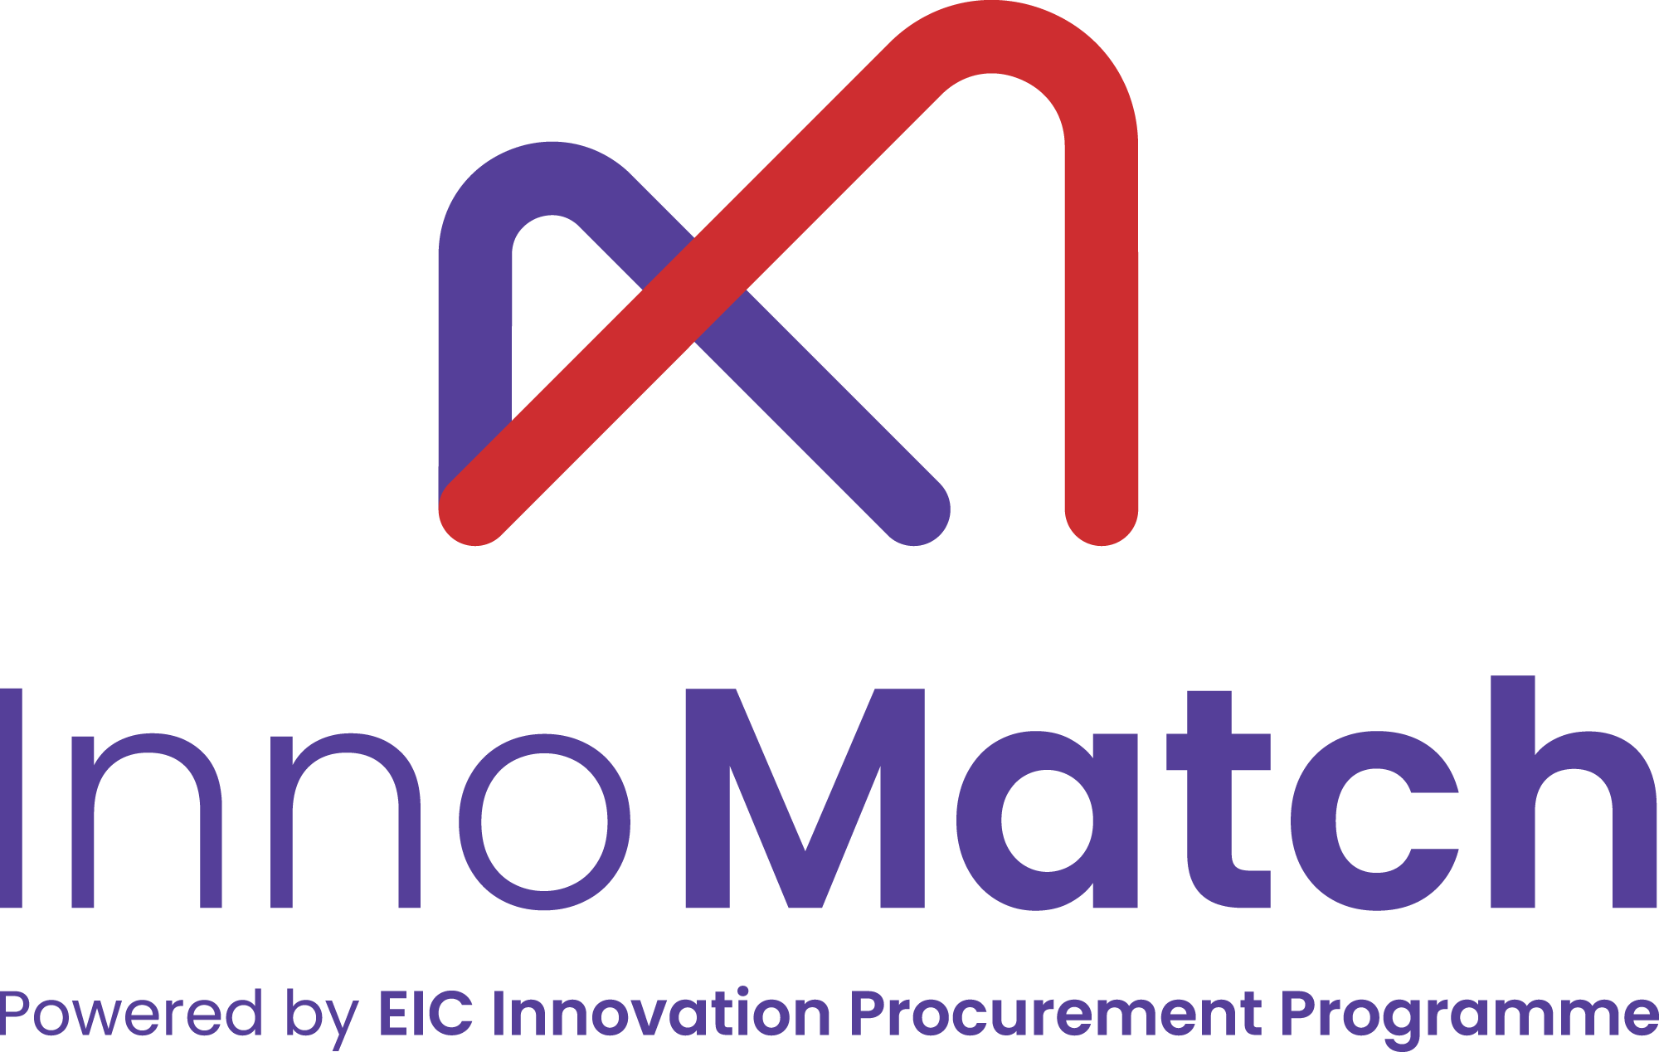

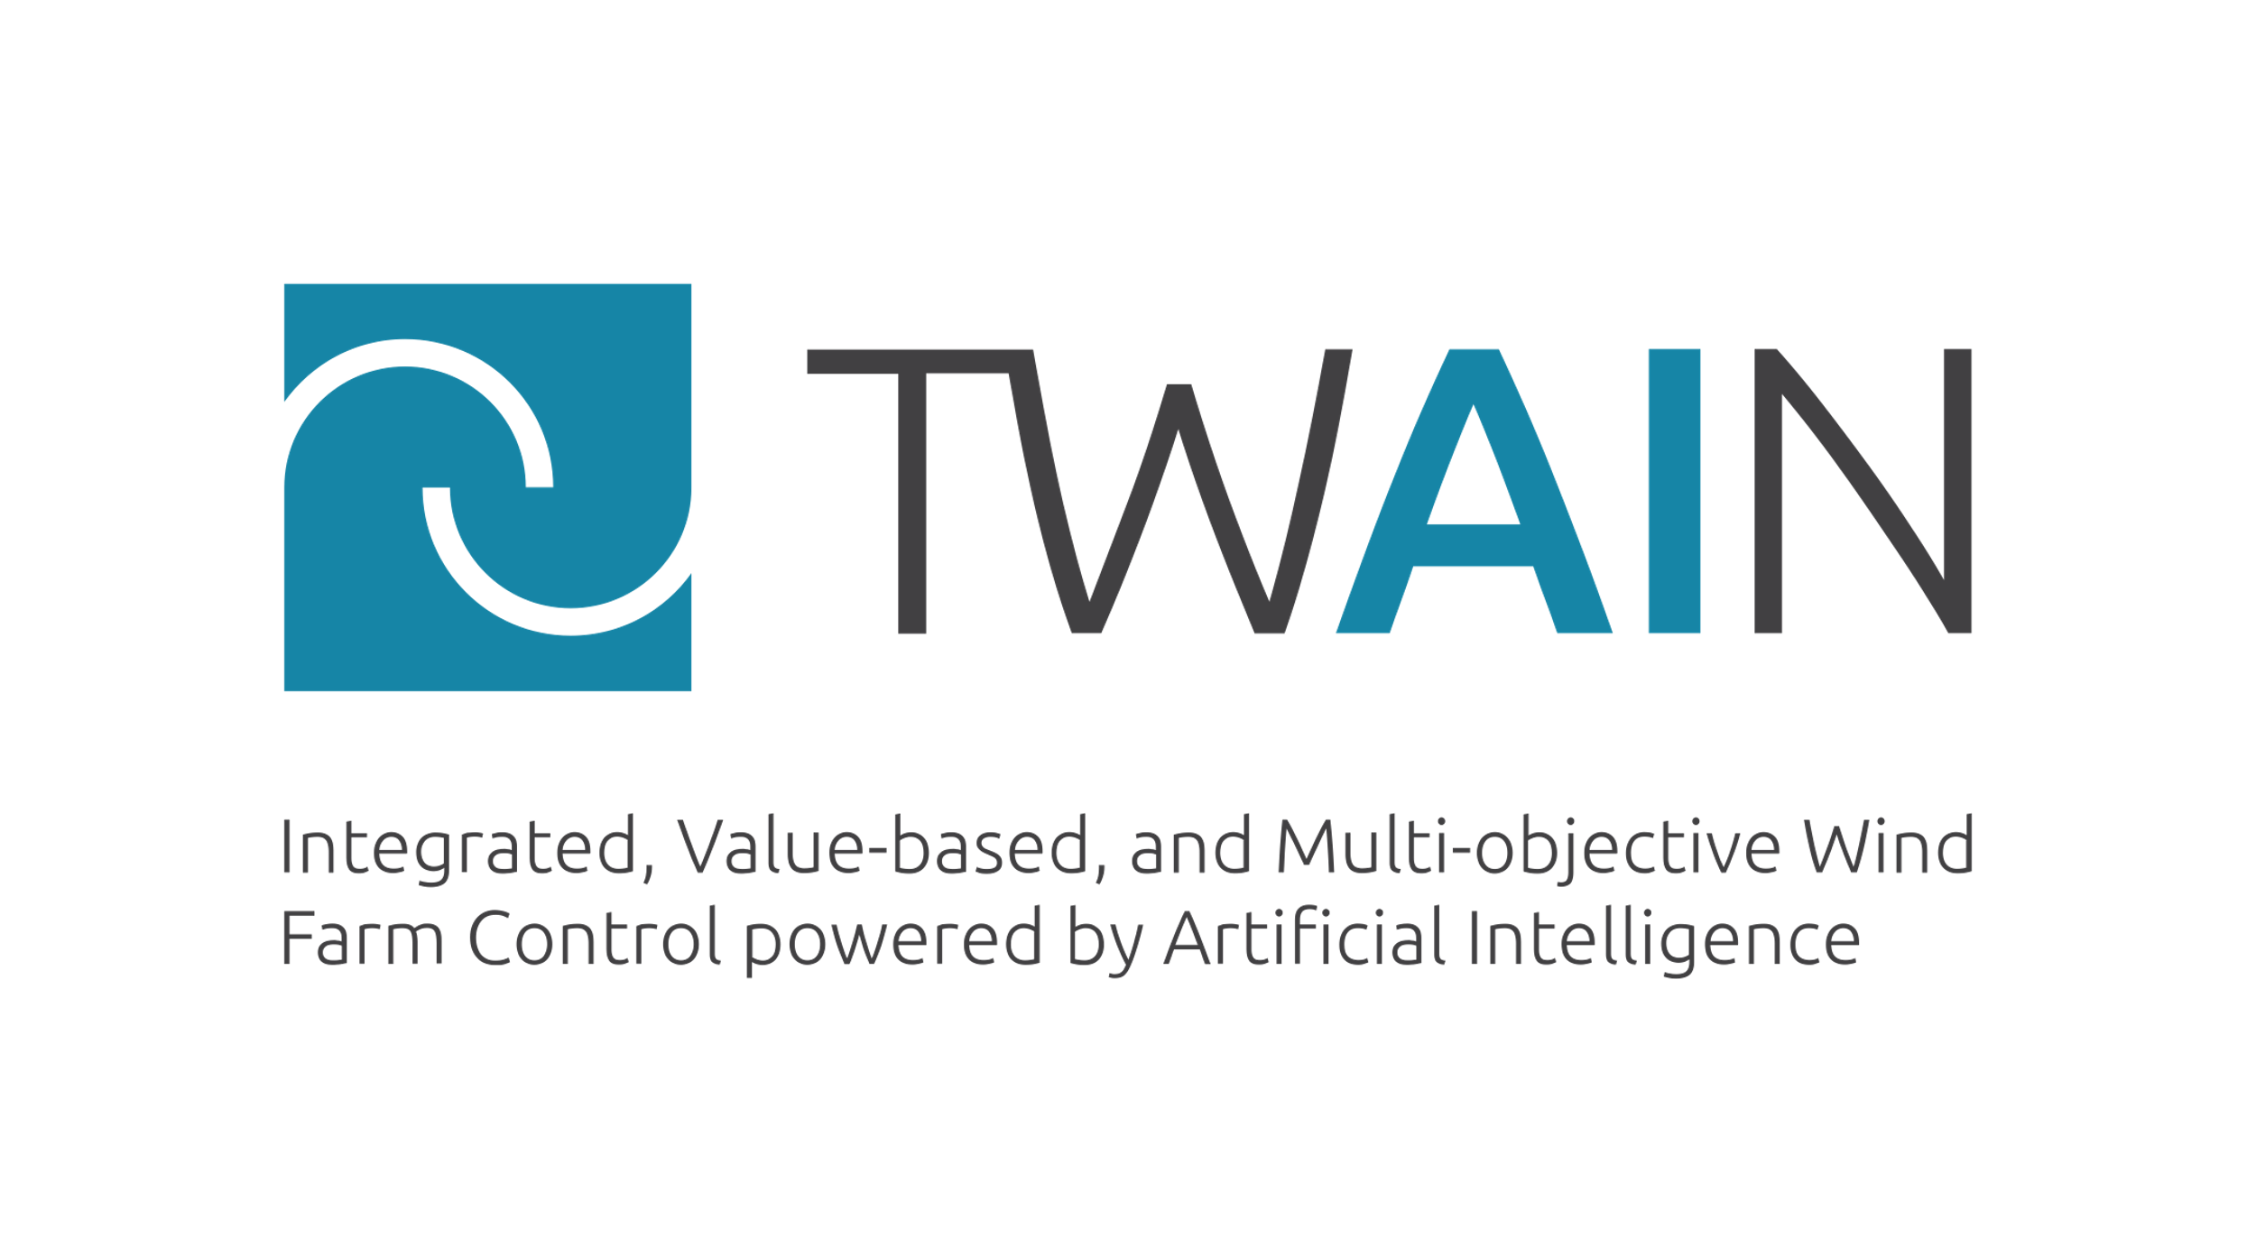

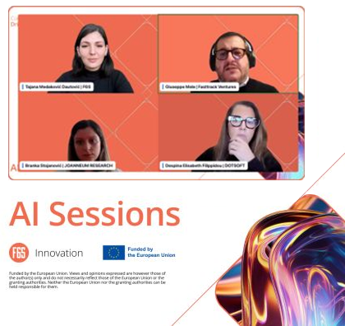



OUR ROLE IN PROJECTS
Communication
& Dissemination
We integrate innovative outreach methods like social media, webinars and podcasts to amplify impact.
F6S develops/executes high-impact promotion and dissemination strategies tailored to project needs.
We organise engaging events that foster meaningful connections and elevate project visibility.
Unique & powerful project branding
Targeted & growth
focused campaigns
Engaging & authentic
social media

Slide 11







OUR ROLE IN PROJECTS
Exploitation, Sustainability
& Impact
We help identify and articulate the most
promising exploitable results for market success.
F6S accelerates project teams' market readiness through tailored business strategies.
We guide pathways for Key Exploitable Results, including commercial, policy, and standardisation opportunities.
Commercialisation
& Business planning
Policy workshops
& white papers
Project representation in tech fairs

Slide 12





OUR ROLE IN PROJECTS
Coordination
F6S leads European multi-partner projects with a results driven coordination approach, ensuring strategic alignment and streamlined processes.
We cultivate strong partnerships to ensure seamless communication and cooperation among stakeholders.
We drive proactive risk management to anticipate challenges and efficiently deliver project milestones.
Inclusive & diverse team
Partners satisfaction
survey 4,8/5
Proactive risk mgt & milestone delivery
All with review report:
”Fully achieved”

Slide 13











Innovation Projects
Blue Economy
Bioeconomy
Big Data
AI
Edtech
Energy Efficiency
Greentech
Health
Manufacturing
Media
XR

Slide 14




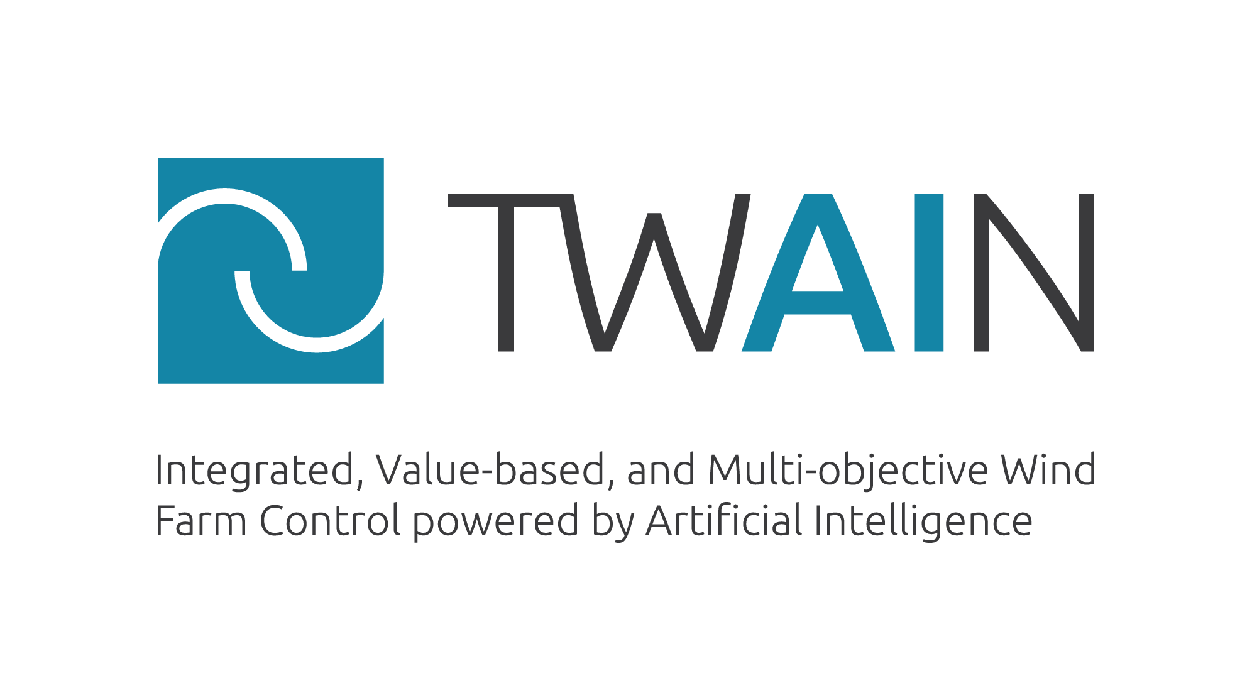






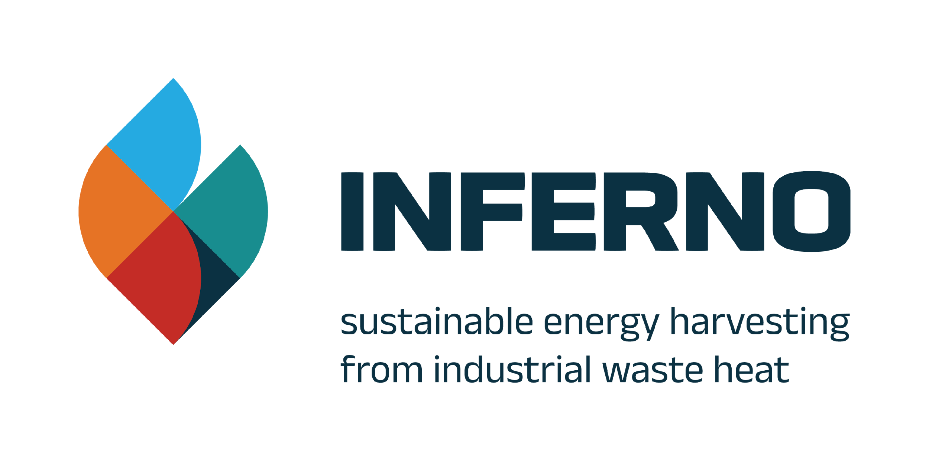






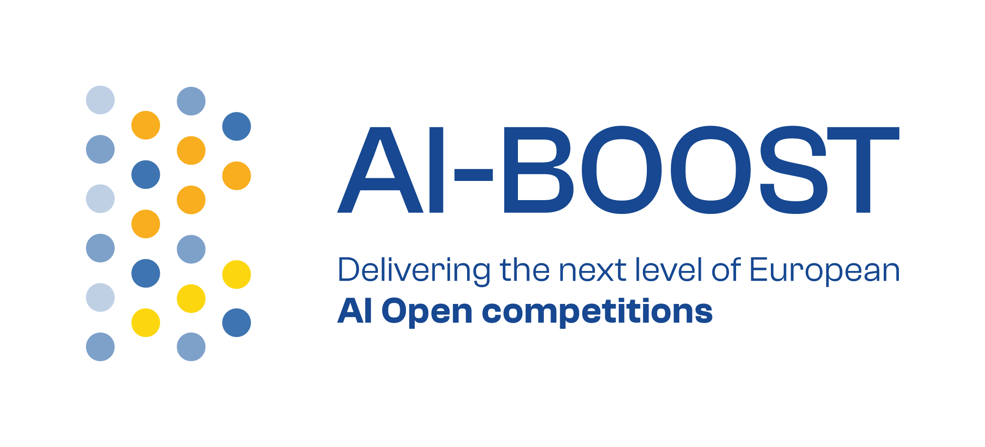













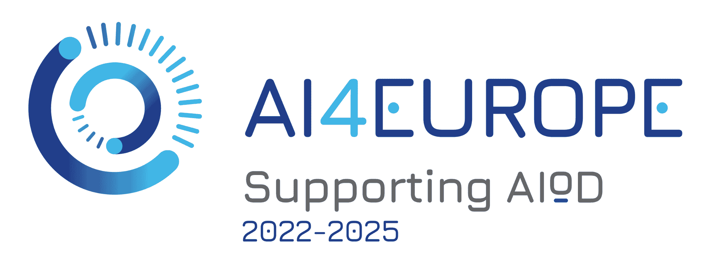








Project Synergies
Big Data,
AI and NGI
Greentech
Blue
Economy

Slide 15
Let’s Innovate Together
Get in touch!
Robert Carroll:robert@f6s.com
EU Projects Development Manager F6S Network Ireland

