Slide 1
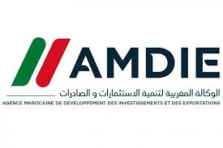
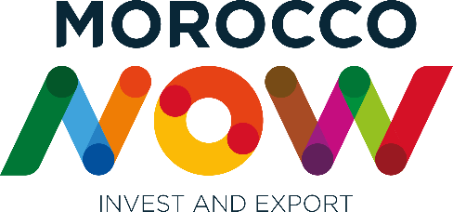
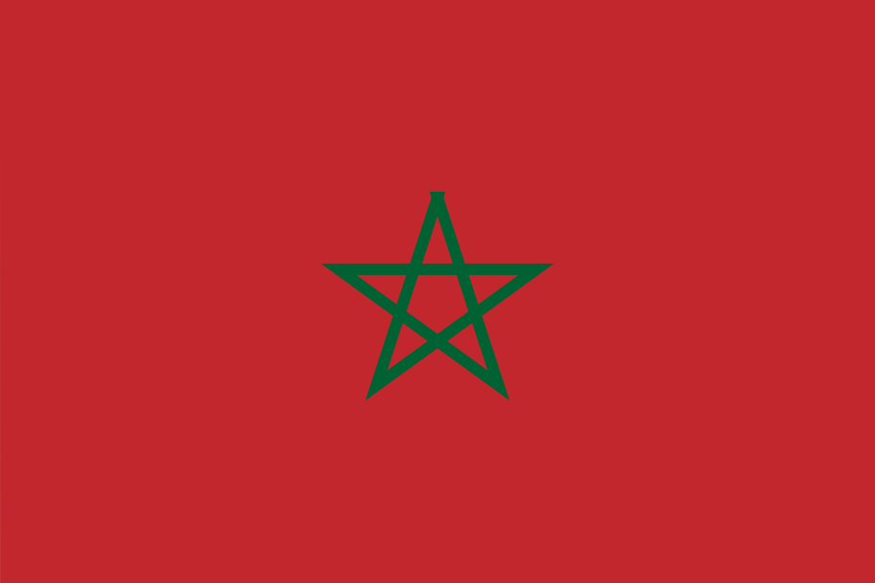
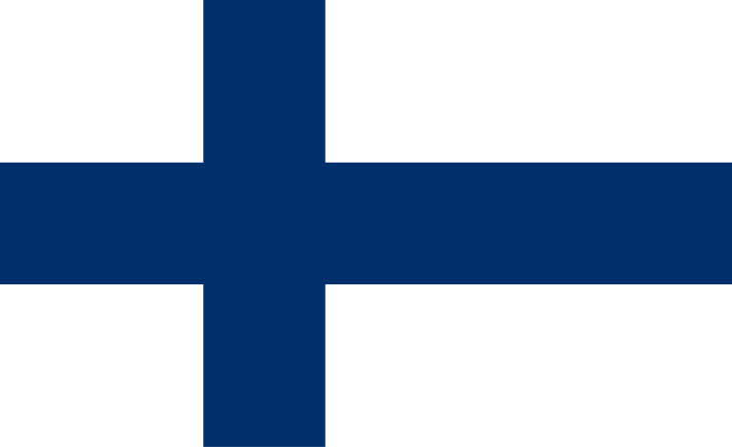
FINNPARTNERSHIP SEMINAR
DOING BUSINESS WITH FINLAND
February 20th, 2025 - Casablanca

Slide 2
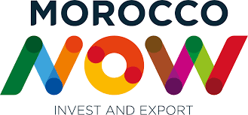
WHAT IS MOROCCO NOW?

Slide 3
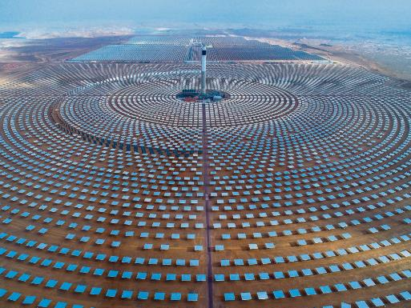
Your world class hub for sustainable investment and trade
Stable Environment
Young, Diverse and Motivated
Human Capital
World class infrastructures and Ecosystems
Leader in Energy Transition
Swift Access to a 2,5 bn Consumer Market
Execution Driven
2

Slide 4
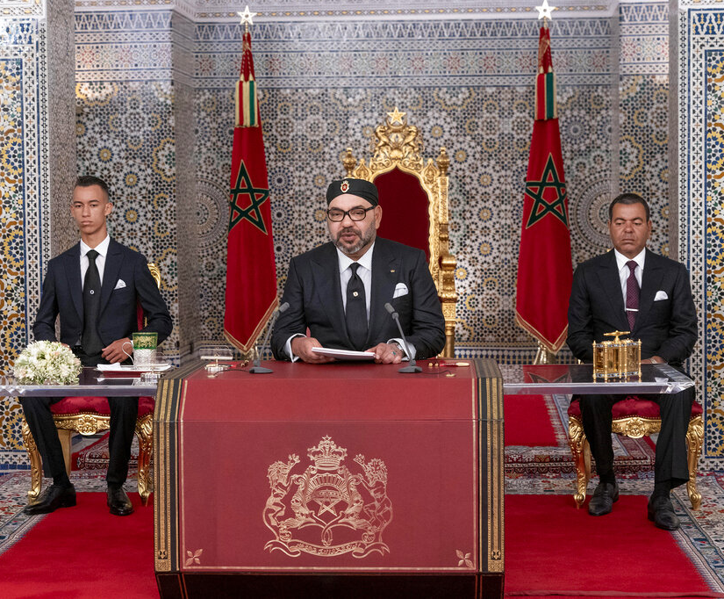
A Stable Country with a Vision
A stable political, economic, and social environment driven by the commitment to build an open, diverse and equitable society
Stability rooted in history and in continuous reforms in favor of a more egalitarian and democratic society
Sizeable investments in the service of sustainable and inclusive development : Education, Health, Transportation and Renewable Energy Infrastructures
Solid macro-economic fundamentals : Inflation < 2% from 2009 to 2021
Long time commitment to trade openness and foreign investment : 50 non double taxation agreements, no restrictions on capital and profit repatriation for non-residents
4

Slide 5
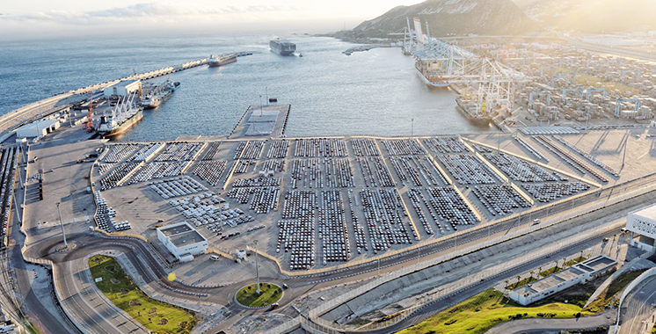
A World Class Hub
Infrastructures built to the highest international standards
1st
High speed train in Africa
Tangier-Casablanca
18
TANGER MED PORT,
#1 TRANSSHIPMENT PLATFORM IN THE MEDITERRANEAN AND AFRICA
International airports
130
destinations
#19
19 th of 500
containers port
#4
4th of 328
port efficiency
9M
9 million containers per year
1800
Km of highways
Source : UNCTAD, Lloyd’s list 2021
7

Slide 6
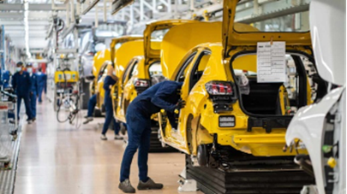
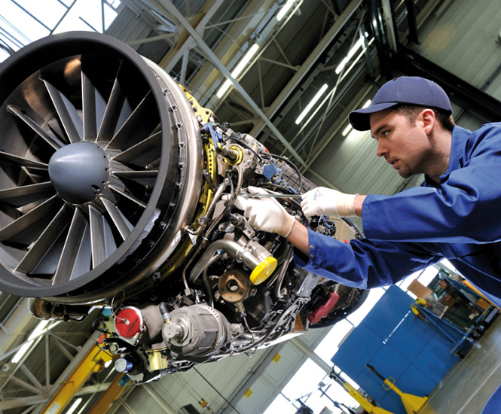
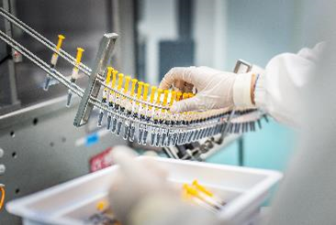
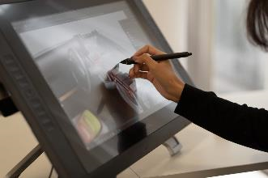
A World Class Hub
Innovative ecosystems in cutting-edge sectors
Sub-assemblies for aircrafts and engines for OEMs including Airbus and Boeing
#1 passenger car producer in Africa
#1 industrial aerospace hub in Africa,
#2 pharmaceutical producer in Africa,
Classified as a European Zone by World Health Organization
Leading engeneering platform, with growing design and engineering capabilities
2 global manufacturers,
250 tier 1 and 2 subcontractors,
integration in the EV value chain
9

Slide 7
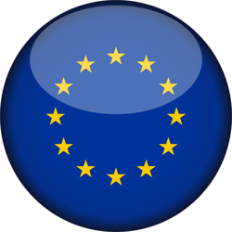
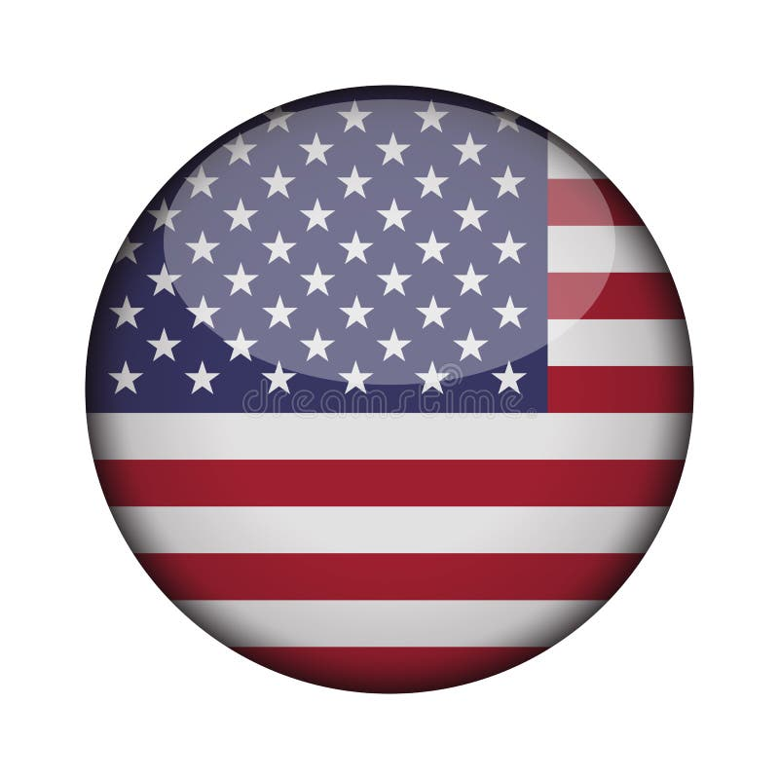
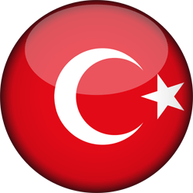



Swift Access to a 2,5 Billion Consumer Market
Free Trade Agreements with nearly 50 countries offering duty-free access to a market of 2,5 billion consumers
Association Agreement with the European Union (1996)
Advanced status granted in 2008
FTA with EFTA
Agreement with USA (2005)
Agreement with Turkey (2003)
Unique FTA with the US in Africa
Agadir Agreement with Egypt, Jordan, and Tunisia (2004)
United Arab Emirates Agreement (2003)
Arab League Agreement (1998)
Morocco to become member of the Economic Community of West African States (ECOWAS)
Africa Continental Free Trade Agreement (AfCFTA) (2018)
Source: Institutional websites
6

Slide 8
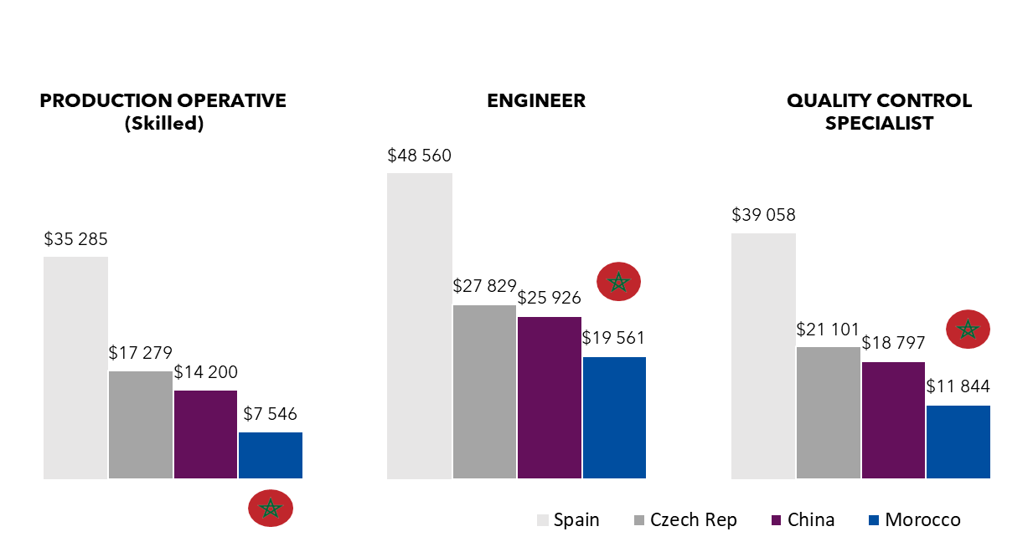
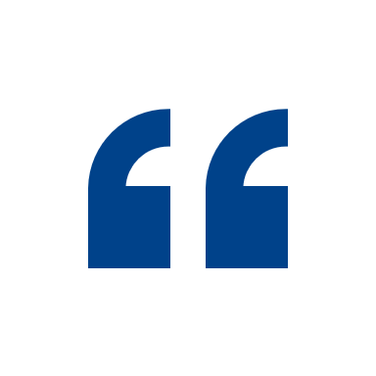
Young Diverse and Motivated Human Capital
A young, skilled, committed, enthusiastic and competitive talent pool
Competitive Labor Costs
(Annual Total Compensation Costs)
The can-do attitude, the education, the willingness and the enthusiasm of Moroccans will mean that Morocco continues to grow significantly
29
180 K
19 K
55 K
42 %
Median age (US : 38.5, EU : 44)
University graduates / year
Engineering graduates / year
Technicians / year
Women engineers
10

Slide 9
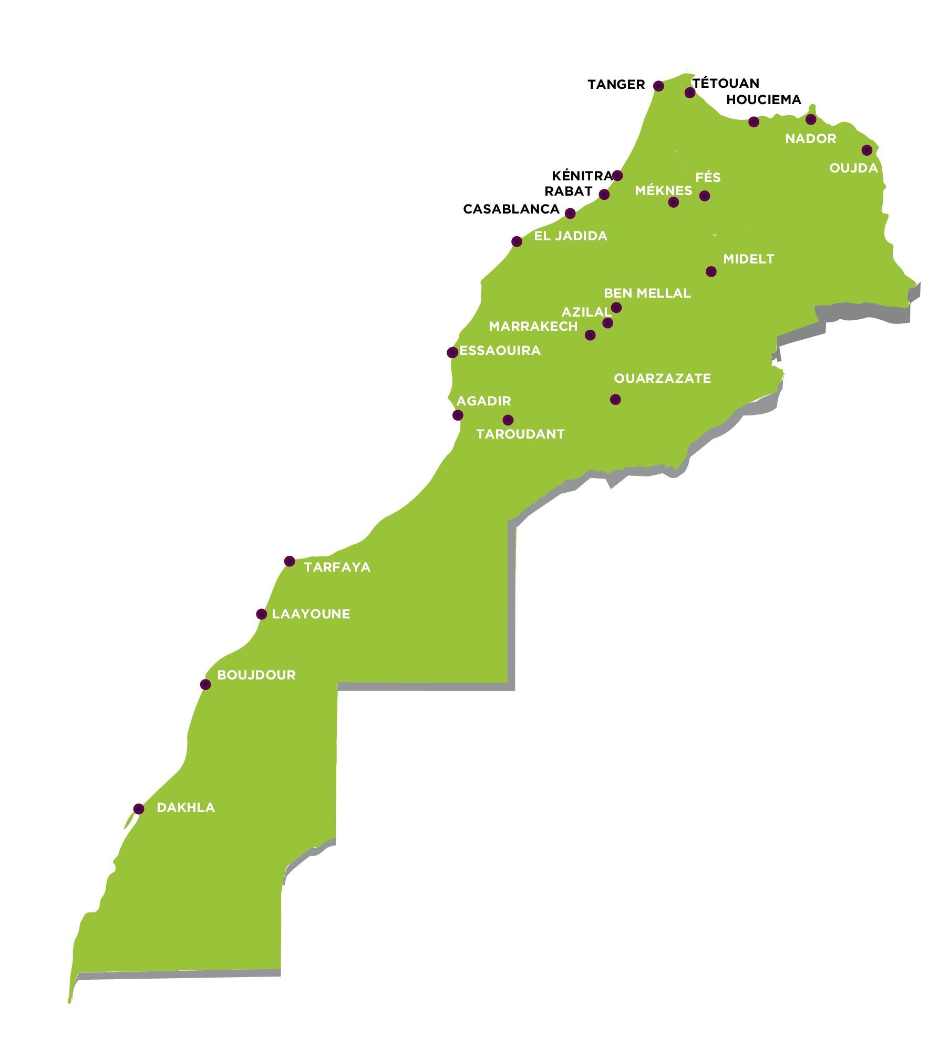
Leader in Energy Transition
Competitive renewable energies to support the decarbonization of industries
45%
Production capacity from renewable sources in 2024
TANGER
TETOUAN
AL HOCEIMA
KENITRA
52%
Forecast target for 2030
TAFILALET
4,500MW
Renewable capacity in 2022
700MW
Developed by private players
and several own power generation projects
<0,06€
per KW/h
40,000GW
Estimated technical solar potential
NOOR, LARGEST SOLAR PLANT IN THE WORLD
TARFAYA, ONE OF THE LARGEST WINDFARMS IN AFRICA
6,000GW
Estimated technical wind potential
Sources : Masen, Ministry of Energy Transition and Sustainable Development, AMDIE
10

Slide 10
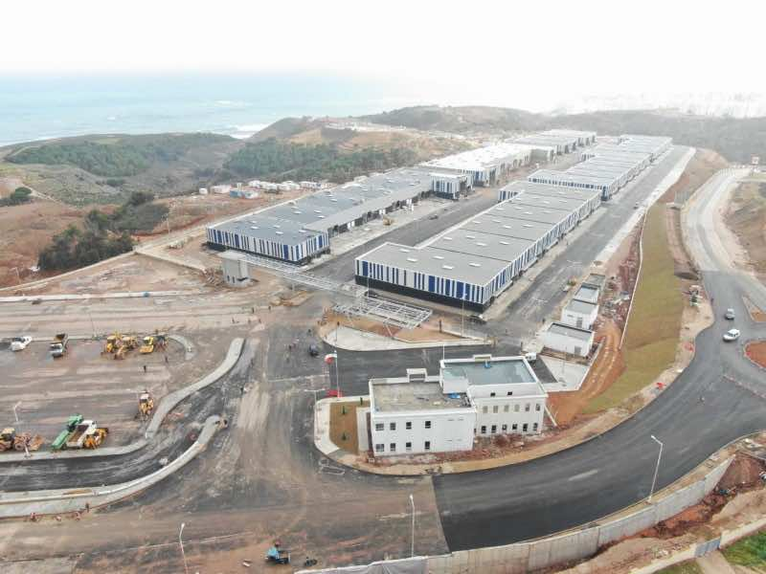
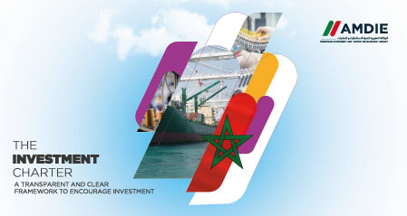
Execution Driven
Investment friendly environment
Special Economic Zones to facilitate installation and operations
• One-stop shop and accelerated procedure : 2 weeks for a building permit
• 5 years corporate tax exemption (followed by 20%)
• Commercial operations in the investor's currency of choice
• Exemption from VAT and customs duties
• Dedicated training institutes and recruitment support
A New Investment Charter (2022)
• Incentives of up to 30% CAPEX for projects exceeding $5m in investment or creating more than 150 jobs
• A tailor-made government support package for strategic projects with capital expenditures above $200 m, aligned with Morocco's priorities.
11

Slide 11
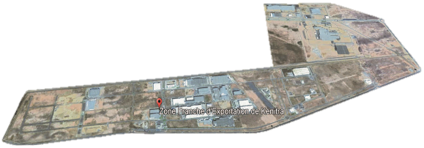
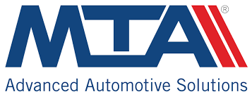

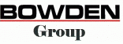
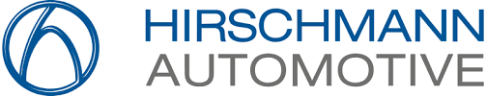


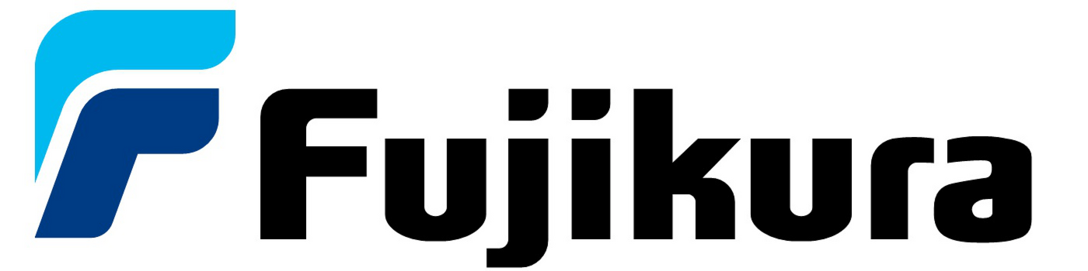
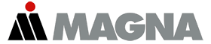
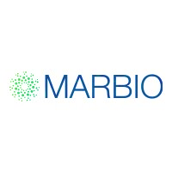
Execution Driven
Fast project delivery
First block of a Regional Bio Tech Hub
20K+ m² greenfield aseptic fill and finish facility built within 12 months
Stellantis Ecosystem signed in 2015, operational with 60+ international companies in 2019 at the Atlantic Free Zone in Kenitra
4

Slide 12
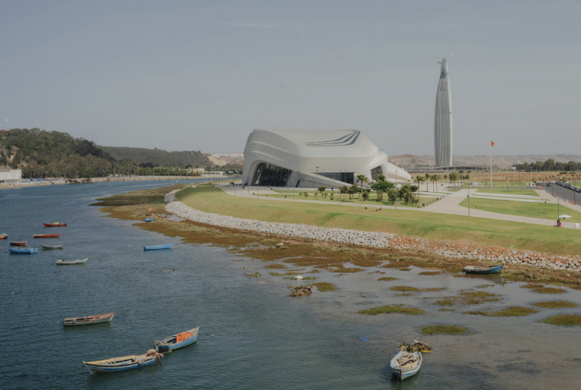
THE NEW CHARTER OF INVESTMENT
The new Investment Charter aims to drive economic growth in Morocco through targeted investment support, job creation, regional equity, and sustainability.
2

Slide 13
