Slide 1
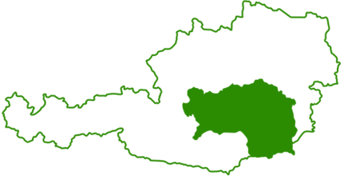
➔ Steirische Wirtschaftsförderungsgesellschaft m.b.H. / Styrian Business Promotion Agency (SFG)
The Styrian Business Promotion Agency is 100 % owned by the Province of Styria, acts on behalf of Barbara Eibinger-Miedl (Minister of Economic Affairs) and positions itself as
an initiator
a supporter
and a promoter
of the more than 60.000 companies in the province.
The portfolio of activities includes
funding and financing programs
location and theme development
company settlements
networking between science and industry.
Economic strategy 2030: New growth, new opportunities, new quality.

Slide 2
➔ Your specific competence
Area Entrepreneurship and startups
Styria is the second largest startup location in Austria (well networked startup community, high quality of universities and research institutions, access to talent, incubators ect.)
The Styrian Startup Ecosystem has a lot of players which offer different services for innovative entrepreneurs such as workshops, business plan competitions and networking events.
Good portfolio of funding and financing programs for startups (especially in the early stages)
Infrastructure: Technology, startup and business parks with thematic focus areas, incubators ect.
Lead project Startupmark - Aim: Improving and strengthening the Styrian startup ecosystem through proactive collaboration - Three pillars: Clusters, Incubators and Competence Centers - Projects: Green Startupmark, Startup Mission Europe ect. - Next Goals: Developing the startup-ecosystem into a scaleup-ecosystem, Internationalization
https://www.sfg.at/gruenden-und-starten/startupmark/

