Slide 2
About us
ICONS boosts research impacts on society via public communication, social and business innovation
ICONS is a key strategic partner in EU-funded Research & Innovation projects. We specialize in designing and implementing communication, dissemination, social and business innovation strategies, while measuring their impact through innovative indicators.
Since our founding in 1999, we have successfully contributed to over 130 EU-funded projects and various service contracts for the European Commission, among them the Horizon Results Booster, the EU flagship initiative by DG Research, acknowledging ICONS’ long-lasting experience.
ICONS also supports philanthropic projects actively promoting the creation of a new cultural development model involving citizens, companies, public authorities and society at large.

Slide 3


Our expertise

Slide 4
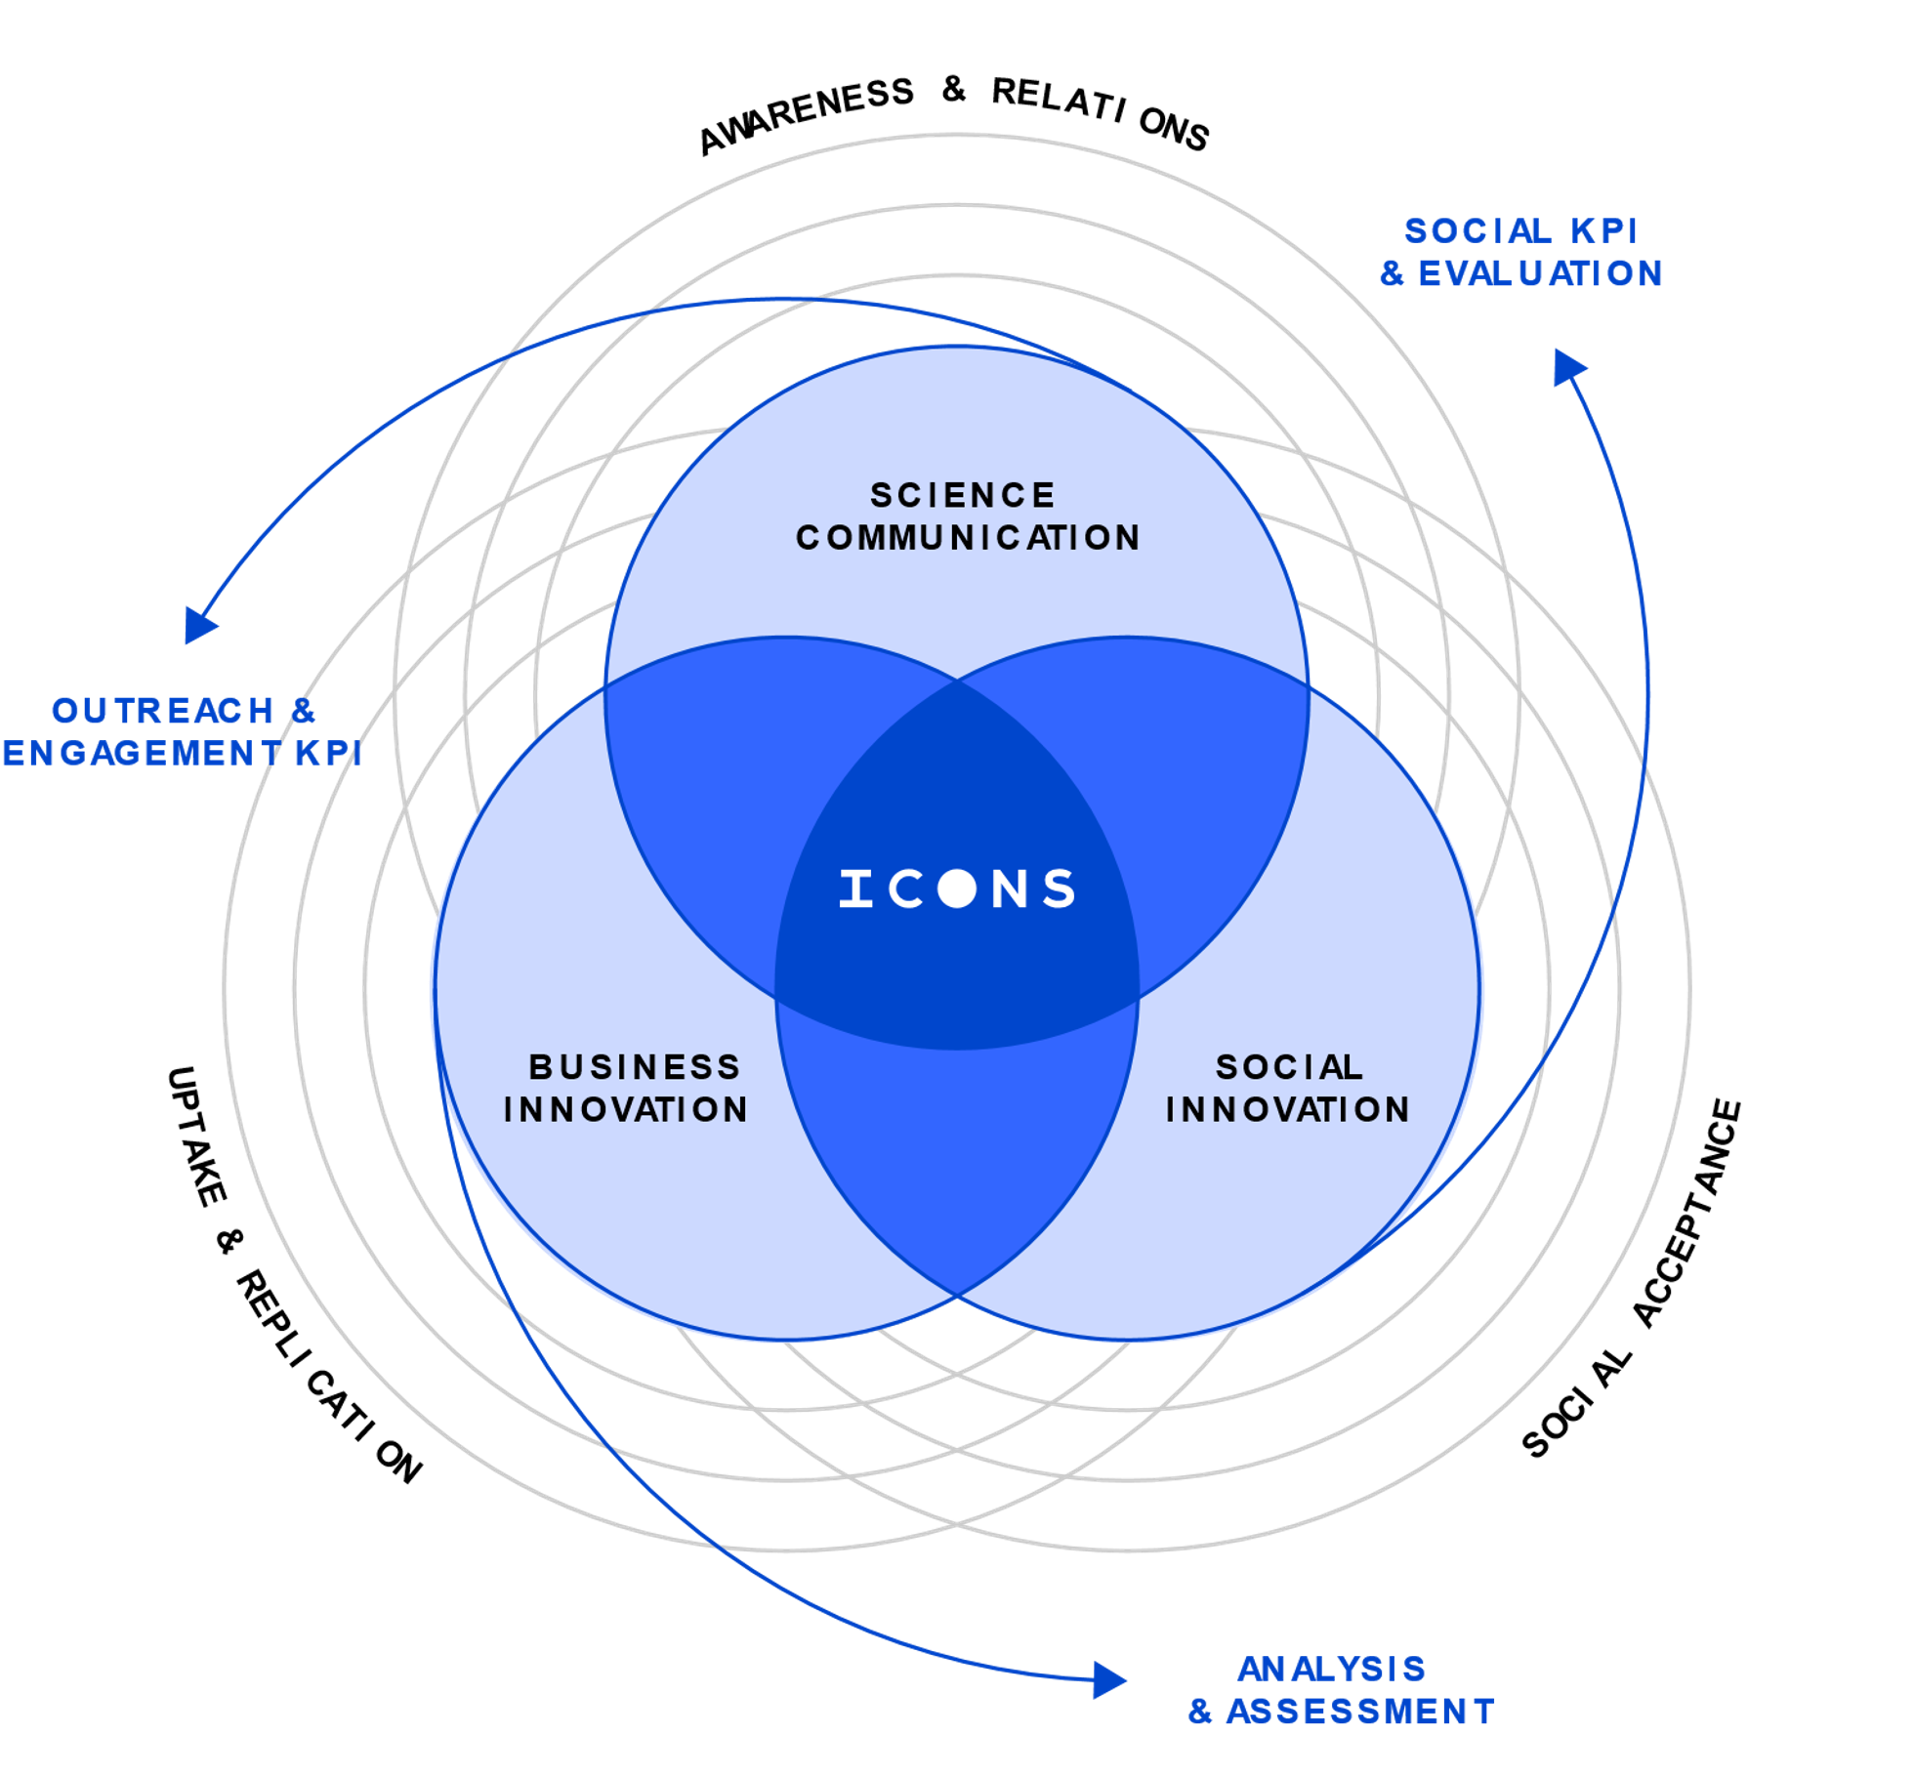
Our expertise
We enhance research impact, driving benefits for society, the economy and a more sustainable future
With other 25 years of expertise, ICONS is a key player in public science communication, social innovation and
business innovation.
We adopt an innovative model to turn research results into impacts, working together with researchers, companies, public institutions and other players involved in R&I projects.
Through an integrated, impact-driven and measurable approach, we create awareness, foster public engagement, raise social acceptance and facilitate uptake and replication of the results of European research.

Slide 5
Our added value

Slide 6
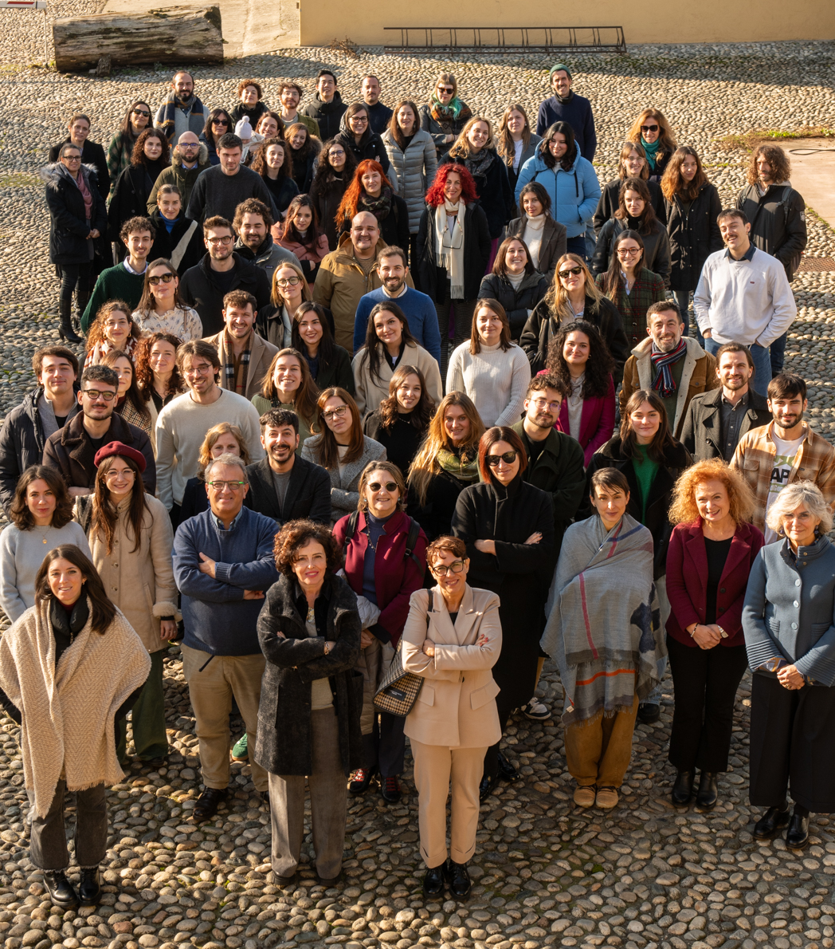
A one-stop-shop for research & innovation projects
We provide solutions for the whole lifecycle of a Research & Innovation project
from the set-up of its visual identity and communication channels, to the creation and distribution of contents,
from the analysis of user needs and requirements to the involvement of stakeholders in participatory processes,
from the strategic positioning of research results in the market to the design of tailored exploitation pathways and sustainable business plans
integrated into a unique approach that seamlessly combines diverse solutions into a streamlined process, ultimately driving meaningful impact and excellence

Slide 7
Our solutions

Slide 8
Science Communication
Maximize the outreach through accessible and inclusive communication
Enhance your project visibility
Raise awareness
Increase know-how and understanding
of your project results
Develop contents tailored to your targets
Build up communities of interest and long-lasting relations with enablers and users
Objectives
> OUR EXPERTISE > SCIENCE COMMUNICATION
We design and develop innovative solutions to communicate the results of research projects
With decades of experience in communication for research and society, we have developed a comprehensive range of cutting-edge products, processes, and methodologies that are now being implemented in numerous European research projects.
Our solutions bridge the gap between science and society by raising awareness, strengthening stakeholder relations, and building consensus – all with the goal of fostering innovation.

Slide 9

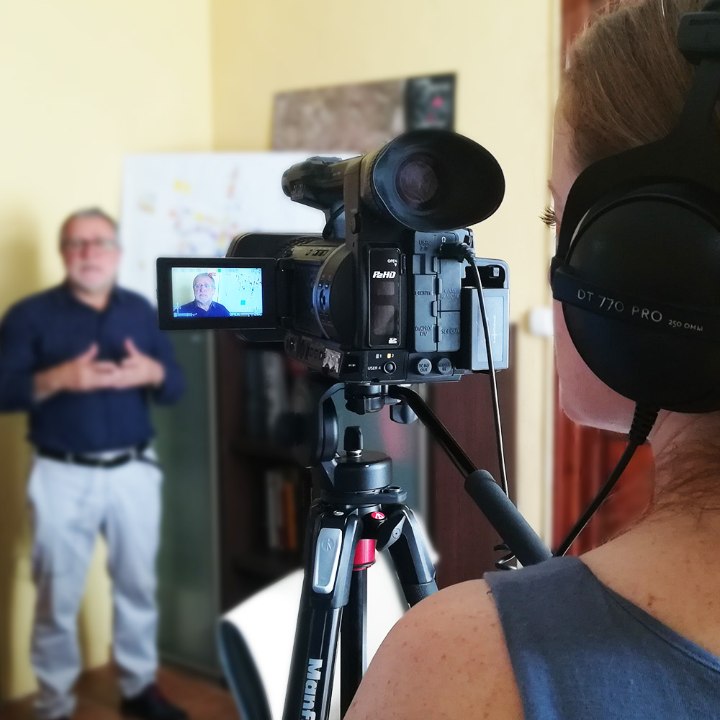
What we do
> OUR EXPERTISE > SCIENCE COMMUNICATION
Public Communication
We raise visibility on research results
Visual and content identity
Communication materials
Web design
Social media management and ADV
Journalism
Multimedia storytelling
Video production, podcasts
Media distribution
Dissemination & Engagement
We design and execute customized knowledge transfer strategies
Stakeholder identification
Targeted content creation
Actionable knowledge tools: technical briefs, results-packs, policy briefs, handbooks, info-graphics
Networking with stakeholders
Events, capacity building, workshops
Impact Assessment
We measure outreach and engagement impacts
Measurement and optimization of science communication impacts on society through CEI (Community Engagement Index)
Stakeholders’ perception

Slide 10
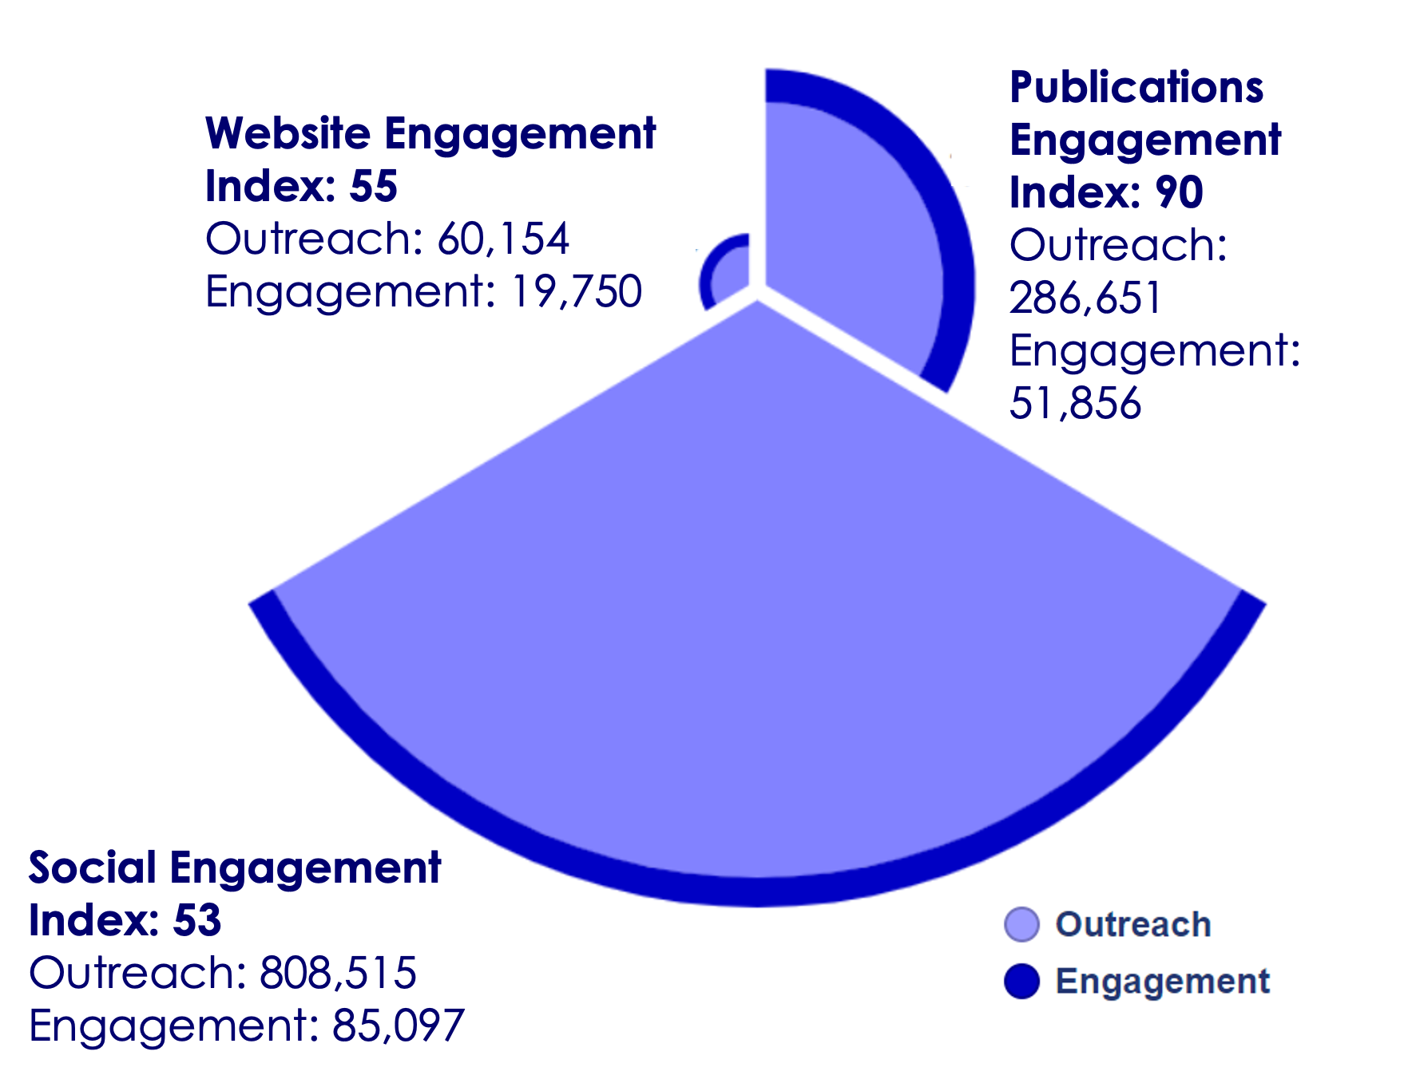
Measurement and optimization of science communication impact
> OUR EXPERTISE > SCIENCE COMMUNICATION
CEI
70
ICONS uses a powerful, proprietary methodology to measure science communication impacts on society.
Going far beyond standard KPIs, ICONS has created an innovative indicator, the Community Engagement Index (CEI), which measures the actual stakeholders’ engagement with the project’s communication.
Through an in-depth analysis of the CEI, actions are taken, corrections are made, and communication plans are periodically reviewed against benchmarks to optimize and maximize communication impact.
Our indicator is widely used in EU-funded research and has been applied to over 100 Horizon 2020 and Horizon Europe projects, recognized as a distinctive feature and a major asset.
Total Outreach: 1,155,320
Total Engagement: 156,703
Example of the CEI calculation from a EU-funded R&I project

Slide 11
Social Innovation
Integrate human-centric frameworks in Research & Innovation projects
Support citizen and stakeholder engagement & dialogue
Facilitate co-design and co-creation
Measure and evaluate social acceptance and impacts via social KPIs
> OUR EXPERTISE > SOCIAL INNOVATION
Objectives
We develop social innovation strategies tailored to different social contexts for each research initiative
Innovation cannot take place without engaging with society.
Co-designing research with stakeholders drives innovation based on real needs and fosters social acceptance.
Understanding social impact of research and developing effective engagement methods and tools are key to driving meaningful innovation.
We provide guidance, training and support in implementing these strategies.

Slide 12

What we do
> OUR EXPERTISE > SOCIAL INNOVATION
Social Innovation Strategies
We develop social innovation strategies through:
Context analysis and deep dives into
stakeholder needs and user requirements
Participatory Design and Co-creation Models
Tailored engagement roadmaps
Training on the implementation of social
innovation strategies
Engagement tools and methods; facilitation
of participatory workshops
Living Labs
Policy Design
Applied Social Research
We integrate human-centric frameworks in R&I through:
Human centred design
Design thinking
Theory of Change (ToC)
Quantitative/Qualitative/Mix methods based on research needs
Data Analysis
Evaluation Research
We measure the social impact of research on society through:
Measurement frameworks for knowledge valorisation (e.g. engagement of stakeholders, policy uptake)
Indicators and metrics of social impact
Social impact models (i.e. Logic Model)
Social Acceptance (i.e. TAM, UTAUT) and behavioural change analysis

Slide 13
Business Innovation
Objectives
> OUR EXPERTISE > BUSINESS INNOVATION
We support R&I projects, organisations and researchers in the valorisation of their knowledge and research outcomes
Assess innovation potential and develop frameworks for knowledge valorisation, IPR management, and economic feasibility.
Analyse market, sector, and policy dynamics to support strategic decision-making.
Design sustainability strategies, replication, and commercialization roadmaps.
Provide evidence-based recommendations, capacity building, and strategic guidance for innovation adoption.
Business innovation is about transforming research results into impactful solutions, whether as new products and services in the market, as policy insights for decision-makers, or as scientific advancements that drive further research and development.
Our experts bring extensive experience in business consulting and strategic advisory supporting industries, SMEs, start-ups, policymakers, and the public sector across the EU.
In EU-funded projects, we provide tailored, impact-driven strategies to maximize the uptake, scalability, replication, and sustainability of research outcomes.

Slide 14

What we do
> OUR EXPERTISE > BUSINESS INNOVATION
Innovation management & market uptake
We turn innovations into economic, scientific and societal value through:
Key Exploitable Results (KERs) & Innovation Potential
Knowledge and IPR Management
Market & ecosystem Analysis, value chain mechanisms
Regulatory Analysis & Identification of opportunities & barriers
Go-To-Market Strategy and Innovation Adoption Roadmap
Business modelling, scalability & replication
We ensure the long-term viability of innovation through:
Business Models & scenario analysis
Business planning
Funding and Financing Schemes
Economic Impact models
Replicability Schemes and Sustainability Frameworks
Strategic consulting & capacity building
We strengthen business and accelerate market success through
Evidence-based Recommendations for Business Improvement & policy-makers
Optimization of Business and Communication Processes
Strategic support to private and public organisations
Capacity building, trainings & upskilling

Slide 15
Cultural Philanthropy
Act as a cultural amplifier at an international scale, empowering a multifaceted community
Create culture where there was none before: Promote musical heritage of the baroque and classical era
Valorise the talent of young professional musicians
> OUR EXPERTISE > Culture
Objectives
We emphasize the importance of philanthropy in our society, creating and supporting projects for young people to improve their skills in music, arts and humanities
The most tangible outcome of ICONS' philanthropic cultural initiatives is the management of two leading international orchestras for young professional musicians, both specialised in historically informed performance and playing period instruments: Theresia Orchestra and the European Union Baroque Orchestra.
Through this commitment, ICONS stands out as a key player in the musical landscape, leading large-scale cultural initiatives that preserve and promote the artistic heritage of the Baroque and Classical periods while fostering intercultural dialogue.

Slide 16
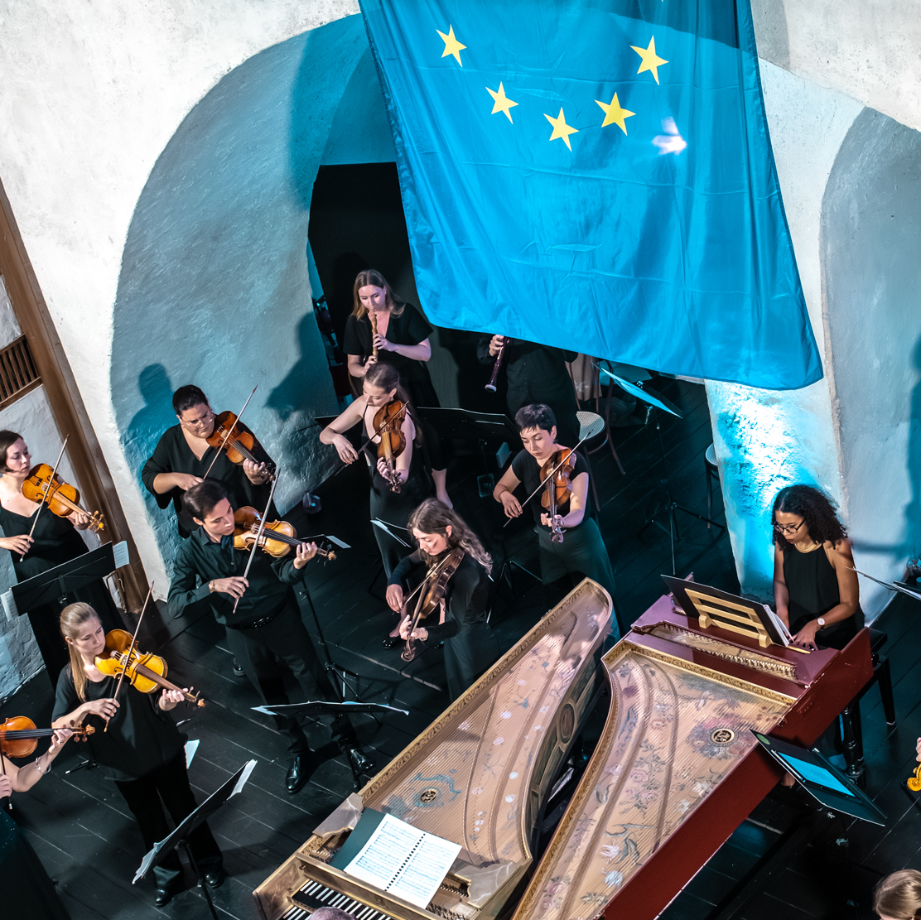
What we do
OUR EXPERTISE > Culture
Musical residencies, Concerts, Recordings, Auditions
In collaboration with partner institutions, we organise Europe-wide:
Auditions
Musical residencies: rehearsal periods lasting 5 to 10 days
Concert tours in most prestigious venues and festivals, concluding the musical residencies
Recordings: high quality CD and Video productions
Capacity building
We provide online training for early career musicians in the fields of:
Musicological and historic in-depth knowledge about the classical era
Economic, organisational and
managerial skills - business planning
Online and offline communication
Mental coaching, concentration
techniques and well-being
Environmental sustainability
Ambassadorship
We empower our musicians to develop
their own and new projects
Co-creative workshop to work on core concept
Digital promotion and strategy development for cultural heritage
Events organisation for new and young audiences in unusual venues, to bring them in contact with early music, historic instruments and musical heritage

Slide 17
References

Slide 18
Why ICONS?
Over 130 EU funded projects (from FP4 to Horizon Europe)
40 H2020 projects; 77 Horizon Europe projects
strategic consultancy for different EC DGs and EU Agencies
strategic advisory partner for innovation management and knowledge valorisation
contracting partner of the Horizon Results Booster and the Booster (DG RTD)
responsible partner for the communication and dissemination activities and technical social innovation expert of the BRIDGE and ETIP SNET Secretariat (DG ENER/CINEA)
communication support to more than 600 EU funded projects through the public communication platform youris.com set up in 2004
a unique network of more than 600 partner organisations
Official Partner of the New European Bauhaus and Associate Partner of EIT Culture & Creativity
Board member of REMA EEMN, European Early Music Network - Member of European Mozartways, Cultural Route of the Council of Europe

Slide 19

Booster
> REFERENCES
ICONS is a contracting partner of the Booster, the flagship initiative from the European Commission aimed at boosting impacts from EU funded projects
BOOSTER provides a set of services to EU-funded projects, free-of-charge, to help navigate the complexities of dissemination and exploitation.
ICONS experts deliver mentoring and continuous guidance to beneficiaries of EU funded Horizon Europe, H2020, FP7 projects and other co-funded initiatives within the EC’s R&I Framework Programmes (such as Joint Undertakings, Partnerships, EIT KICs) throughout the BOOSTER pathway, offering support in project communication, dissemination and exploitation strategies. Additionally, ICONS develops tailored cluster dissemination strategy portfolios and creates high-quality audiovisual materials
www.horizonresultsbooster.eu

Slide 20














Research domains covered by ICONS
Cities & Communities
Society
Circular economy
Energy & renewables
Built environment
Industry
Batteries
Emerging technologies
& robotics
Transport
Agri and food
Bioeconomy
Environment &
climate
Security
Health
https://www.icons.it/references/

Slide 21







Cities & Communities
> REFERENCES
NBSINFRA
City nature-based solutions integration to local urban infrastructure protection for a climate resilient society
2023-2026 | www.nbsinfra.eu | HORIZON-CL3-2022-INFRA-01-01
SMART ERA
SMART community-led transition for Europe's Rural Areas
2023-2027 | www.smartera-project.eu | HORIZON-CL6-2022-COMMUNITIES-02-01
DriVe2X
Delivering Renewal and Innovation to mass Vehicle Electrification enabled by V2X technologies
2023-2026 | https://drive2x.eu/ | HORIZON-CL5-2021-D5-01-03
NEUTRALPATH
Pathway towards Climate-Neutrality through low risky and fully replicable Positive Clean Energy Districts Framework
2023-2027 | www.neutralpath.eu | H2020-MISS-2021-CIT-02-04
EHHUR
EYES HEARTS HANDS Urban Revolution
2022-2025 | https://eyesheartshands.eu/ | HORIZON-MISS-2021-NEB-01-01
dRural
The service marketplace for European rural areas
2021-2024 | www.drural.eu | H2020-DT-ICT-09-2020

Slide 22







Cities & Communities
> REFERENCES
POCITYF
A Positive Energy City Transformation Framework
2019-2024 | www.pocityf.eu | H2020-SCC-01-2019
STARDUST
Holistic and Integrated Urban Model for Smart Cities
2017-2022 | www.stardustproject.eu | H2020-SCC-01-2016
MAtchUP
MAximizing the UPscaling and replication potential of high level urban transformation strategies
2017-2022 | www.matchup-project.eu | H2020-SCC-01-2016
URBAN GreenUP
New Strategy for Re-Naturing Cities through Nature-Based Solutions
2017-2022 | www.urbangreenup.eu | H2020-SCC-02-2016
REMOURBAN
Regeneration Model for accelerating the Smart URBAN transformation
2015-2019 | www.remourban.eu | H2020-SCC-01-2014
CITyFiED
Replicable and Innovative Future Efficient Districts and cities
2014-2019 | www.cityfied.eu | FP7-ENERGY-2013-8.8.1
R2CITIES
Renovation of Residential urban spaces: Towards nearly zero energy CITIES
2013-2018 | www.r2cities.eu | FP7-EeB.ENERGY.2012

Slide 23





Society and sustainability
> REFERENCES
widerAdvanceFacility
The Dissemination and Exploitation Facility for Widening Projects
2025-2028 | HORIZON-WIDERA-202—ACCESS-05-01
SCALEDEM
Scaling Democratic Innovations
2024-2028 | www.scaledem.eu | HORIZON-CL2-2024-DEMOCRACY-01-12
PREFIGURE
Prototypes for addressing the housing-energy-nexus
2024-2027 | www.prefigure.eu | HORIZON-CL2-2023-TRANSFORMATIONS-01-09
Fair Muse
Promoting Fairness of the Music Ecosystem in a Platform-Dominated and Post-Pandemic Europe
2023-2026 | www.fairmuse.eu | HORIZON-CL2-2022-HERITAGE-01-05
TExTOUR
Social Innovation and Technologies for sustainable growth through participative Cultural Tourism
2021-2024 | www.textour-project.eu |
H2020-SC6-TRANSFORMATIONS-2020
SITRANS
Governance and Social Impact of Coal Regions under Transition
2022-2025 | www.sitrans-project.eu | LIFE-2021-CET-COALREGIONS

Slide 24



Circular Economy
> REFERENCES
ANIPH
Avoiding the negative impacts produced by plastic materials in humanitarian contexts
2025-2028 | HORIZON-CL6-2024-CIRCBIO-01-5
CIRCLE
Avoiding the negative impacts produced by plastic materials in humanitarian contexts
2024-2028 | HORIZON-JU-CBE – 2023 –IAFlag-02
K-CCRI
Increasing the impact of the Circular Cities and Regions Initiative
2024-2026 | https://viss-project.eu | HORIZON-CL6-2022-CIRCBIO-02-03-two-stage
ViSS
Viable, safe and sustainable PHBV value chain for food packaging applications
2023-2027 | https://viss-project.eu | HORIZON-CL6-2022-CIRCBIO-02-03-two-stage
Plastice
New technologies to integrate PLASTIC waste in the Circular Economy
2022-2026 | www.plastice.eu
HORIZON-CL4-2021-TWIN-TRANSITION-01-17
Agro2Circular
Territorial Circular Systemic Solution for the
Upcycling of Residues from the Agrifood Sectors
2021-2024 | www.agro2circular.eu |
H2020-LC-GD-3-2-2020

Slide 25




Circular Economy in construction
> REFERENCES
TIMBERHAUS
Climate-smart, circular, and sustainable solutions for use of wood in the construction sector
2024-2028 | www.timberhaus.eu | HORIZON-CL6-2024-CLIMATE-01-5
RECONSTRUCT
A Territorial Construction System for a Circular Low-Carbon Built Environment
2023-2027 | https://reconstruct-project.eu/ | HORIZON-CL6-2022-CIRCBIO-02-01-two-stage
WOODCIRCLES
Integrated, circular, and digitally supported sustainable solutions for waste minimization and carbon capture in buildings and the construction sector
2023-2027 | https://woodcircles.eu/ | HORIZON-CL6-2022-CIRCBIO-02-01-two-stage
HOUSEFUL
Innovative circular solutions and services for new business opportunities in the EU housing sector
2018-2022 | www.houseful.eu | H2020-CIRC-2017

Slide 26






Energy efficiency – built environment
> REFERENCES
RETIME
Urban Adaptation and Alert Solutions for a TIMEly (re)Actionock
2024-2028 | www.retime-project.eu | HORIZON-CL5-2023-D4-02-02
iEPB
Upgrade the energy performance of the EU’s building stock
2023-2026 | www.iepb-project.eu | LIFE-2022-CET-BUILDPERFORM
RENplusHOMES
Renewable ENergy-based Positive Homes
2023-2027 | https://renplushomes.eu/ HORIZON-CL5-2022-D4-01-02
GINNGER
Regeneration of neighborhoods and built environments
2023-2027 | www.ginnger-project.eu | HORIZON-CL5-2022-D4-02-02
BUILDON
Affordable and digital solutions to Build the next generatiON of smart EU buildings
2023-2026 | https://buildon-project.eu/ | HORIZON-CL5-2022-D4-01-03
INHERIT
Systematic methodology towards sustainable and inclusive Cultural Heritage solutions
2023-2027 | https://inheritproject.eu/ | HORIZON-CL5-2022-D4-02-03

Slide 27






Energy efficiency – built environment
> REFERENCES
DEDALUS
Data-driven Residential Energy Carrier-agnostic Demand Response Tools and Multi-value Services
2023-2026 | https://dedalus-horizon.eu/ | HORIZON-CL5-2022-D4-01-01
SUPERSHINE
2022-2024 | HORIZON-CL4-2021-RESILIENCE-02-32
Smart Upgraded asset-values and quality of life Public Private Partnership Extended Energy Efficiency Renewables triggered by the project Social Housing Investment Net Zero European
SUPER-I
Extended Public-Private Partnership for Investment in Smart Energy Efficiency Projects in a Social Housing context
2021-2024 | https://super-i-project.eu/ | H2020-LC-SC3-2020
eTEACHER
End-users tools to empower and raise awareness of behavioural change towards energy efficiency
2017-2021 | www.eteacher-project.eu | H2020-EE-2017-IA
BuildHEAT
Standardized approaches and products for the systemic retrofit of residential Buildings, focusing on HEATing and cooling consumptions attenuation
2015-2019 | www.buildheat.eu | H2020-EeB-08-2015
BRICKER
Total Renovation Strategies for Energy Reduction in Public Building Stock
2013-2017 | www.bricker-project.com | FP7-2013-NMP-ENV-EeB

Slide 28
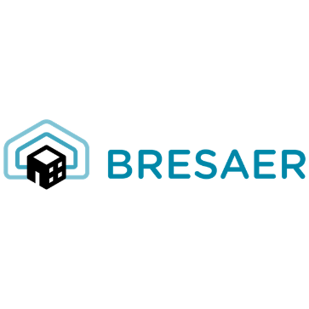



Energy efficiency – built environment
> REFERENCES
BRESAER
BREakthrough Solutions for Adaptable Envelopes in building Refurbishments
2015-2019 | www.bresaer.eu | H2020-EeB-02-2014
MeeFS
Multifunctional Energy Efficiency Façade System for Building Retrofitting
2012-2016 | www.meefs-retrofitting.eu |
FP7-2011-NMP-ENV-ENERGY-ICT-EeB
DIRECTION
Demonstration at European Level of Innovative
and Replicable Effective Solutions for very Low
Energy new Buildings
2012-2015 | www.direction-fp7.eu | FP7-EeB.ENERGY.2011.8.1-1
3ENCULT
Efficient Energy for EU Cultural Heritage
2010-2014 | www.3encult.eu | FP7-EeB.ENV.2010.3.2.4-1

Slide 29







Energy efficiency - renewables
> REFERENCES
DTWO
Federated Digital Twins for Wind-Offshore
2024-2027 | HORIZON-CL5-2023-D3-02-14
TAILWIND
Sustainable station-keeping systems for floating wind
2024-2027 | HORIZON-CL5-2023-D3-01-05
AIR4NRG
Air isothermal compression technology for long term energy storage
2024-2026 | https://air4nrg.eu | HORIZON-CL5-2023-D3-01-13
SUDOCO
Sustainable resilient data-enabled offshore wind farm and control co-design
2023-2027 | HORIZON-CL5-2022-D3-03-04
CRETE VALLEY
Crete Renewable Energy Valley
2023-2028 | https://cretevalley.eu | HORIZON-CL5-2023-D3-01-01
MERIDIONAL
Multiscale modelling for wind farm design, performance assessment and loading
2022-2026 | https://meridional.eu/ | HORIZON-CL5-2021-D3-03-04
MOPO
Comprehensive, fast, user-friendly and thoroughly validated open-source energy system planning framework
2023-2026 | https://www.tools-for-energy-system-modelling.org/ | HORIZON-CL5-2021-D3-03-04

Slide 30

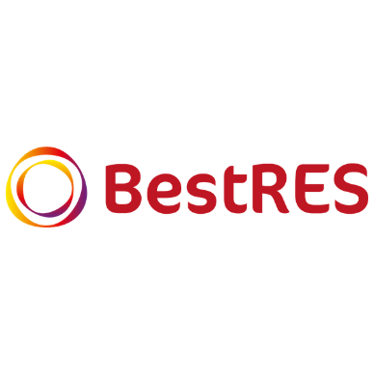
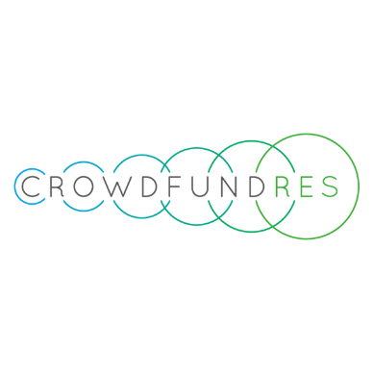

Energy efficiency - renewables
> REFERENCES
SocialRES
Fostering socially innovative and inclusive strategies for empowering citizens in the renewable energy market of the future
2019-2022 | www.socialres.eu | LC-SC3-CC-1-2018
BestRES
Best practices and implementation of innovative business models for Renewable Energy aggregatorS
2016-2019 | www.bestres.eu | H2020-LCE-2015-3
CroudFundRES
Unleashing the potential of Crowdfunding for Financing Renewable Energy Projects
2015-2017 | www.crowdfundres.eu | H2020-LCE-04-2014
WINDTRUST
Demonstration of more reliable innovative designs on a 2 MW Wind turbine
2013-2016 | www.windtrust.eu | FP7-ENERGY-2012-2

Slide 31





Smart energy systems
> REFERENCES
InterSCADA
Towards Intelligent DC-based hybrid Grids Optimizing the network performance
2024-2027 | www.interscada.eu | LC-SC3-ES-10-2020
SSTAR
Innovative HV Solid-State TrAnsformer for maximizing Renewable energy
penetration in energy distribution and transmission systems
2022-2025 | https://sstar-project.eu/ | HORIZON-CL5-2021-D2-01-08
eNeuron
GreeN Energy HUbs for Local IntegRated Energy COmmunities optimisatioN
2020-2024 | www.eneuron.eu | LC-SC3-ES-3-2020
TIGON
Towards Intelligent DC-based hybrid Grids Optimizing the network performance
2020-2024 | www.tigon-project.eu | LC-SC3-ES-10-2020
BEST-PATHS
BEyond State-of-the-art Technologies for rePower Ac corridors and multi-Terminal HVDC Systems
2014-2018 | www.bestpaths-project.eu | FP7-ENERGY-2013-7.2.3

Slide 32


Energy - Hydrogen
> REFERENCES
CARMA-H2
Carbon-negative pressurized hydrogen production from waste using an energy efficient protonic membrane
2024-2028 | www.carma-h2.eu | HORIZON-JTI-CLEANH2-2023-01-05
SINGLE
Electrified Single Stage Ammonia Cracking to Compressed Hydrogen
2023-2026 | https://singleh2.eu/ | HORIZON-JTI-CLEANH2-2022-02-04
OVERLEAF
Novel Low-pressure Cryogenic Liquid Hydrogen
Storage For Aviation 2022-2025
www.overleaf-project.eu | HORIZON-CL5-2021-D5-01-05

Slide 33





Energy–industries and manufacturing
> REFERENCES
ELITHE
Electrification of ceramic industries high temperature heating equipment
2024-2027 | https://elithe.eu | HORIZON-CL4-2023-TWIN-TRANSITION-01-33
ZHYRON
Valorisation of iron-rich & Zinc-containing steelmaking by-products via HYdrogen-based ReductiON
2024-2026 | https://zhyron.eu | HORIZON-CL4-2023-TWIN-TRANSITION-01-45
FLEXINDUSTRIES
Digitally-enabled FLEXible Industries for reliable energy grids under high penetration of Variable Renewable Energy Sources
2022-2026 | https://flexindustries.eu/ | HORIZON-CL4-2021-TWIN-TRANSITION-01-21
BAMBOO
Boosting new Approaches for flexibility Management By Optimizing process Off-gas and waste use
2018-2022 | www.bambooproject.eu | CE-SPIRE-03-2018
REEMAIN
Resource and Energy Efficient Manufacturing
2013-2017 | www.reemain.eu | FP7-FoF.NMP.2013-1

Slide 34
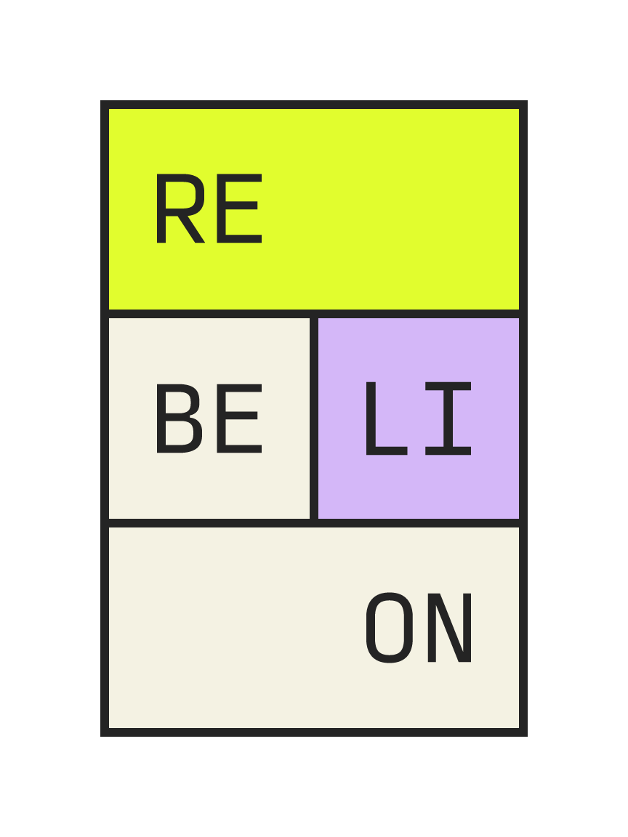

Energy - Batteries
> REFERENCES
ATHENA +
Advanced technology for stationary energy storage in NA-ion
2025-2028 | HORIZON-CL5-2024-D2-01-02
REBORN
Renewable battery module and management system development for reliable second life
2025-2028 | HORIZON-CL5-2023-D2-01-04
GIGABAT
Sustainable and digitalized GIGAfactory for BATtery production with made-in-Europe machinery
2023-2026 | www.gigabat-project.eu | HORIZON-CL5-2022-D2-01-04
REBELION
Research and development of a highly automated and safe streamlined process for increased Lithium-ionbattery repurposing and recycling
2023-2027 | https://rebelion-project.eu/ | HORIZON-CL5-2022-D2-01-10

Slide 35

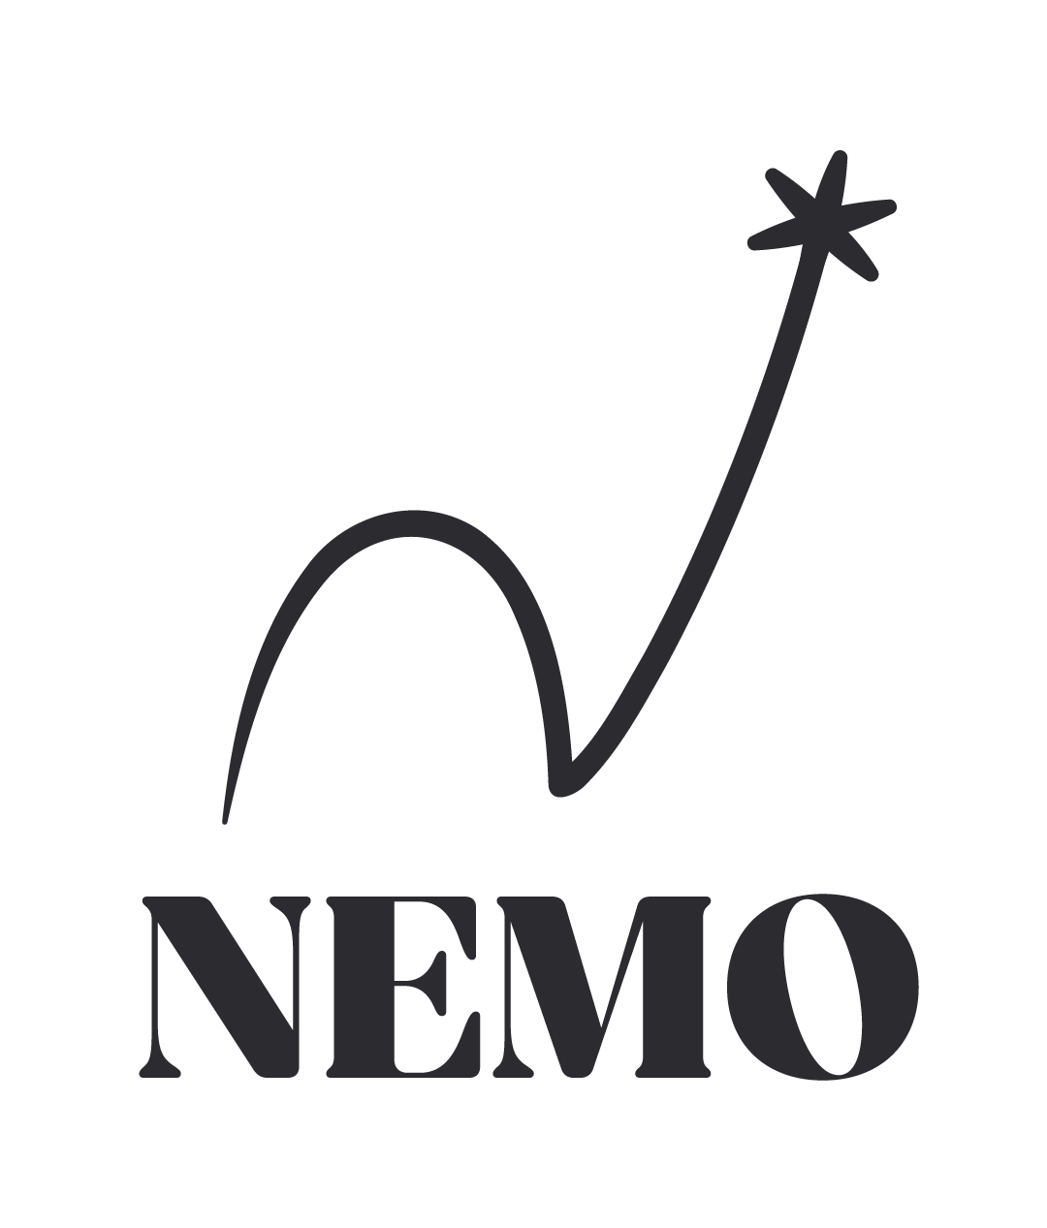


Energy - Batteries
> REFERENCES
THOR
Innovative methodology for battery testing
2023-2027 | https://thorbatteries.eu/ | HORIZON-CL5-2022-D2-01-07
NEMO
NExt-generation MOdels for advanced battery electronics framework
2023-2026 | https://nemoproject.eu/ | HORIZON-CL5-2022-D2-01-09
GR4FITE3
Graphite Resilience For lithium-Ion baTtery anodes through a sustainable European End-to-End supply chain framework
2023-2027 | https://gr4fite3.eu/ | HORIZON-CL5-2022-D2-01-01
ASTRABAT
All Solid-sTate Reliable BATtery for 2025
2020-2023 | www.astrabat.eu | LC-BAT-1-2019

Slide 36


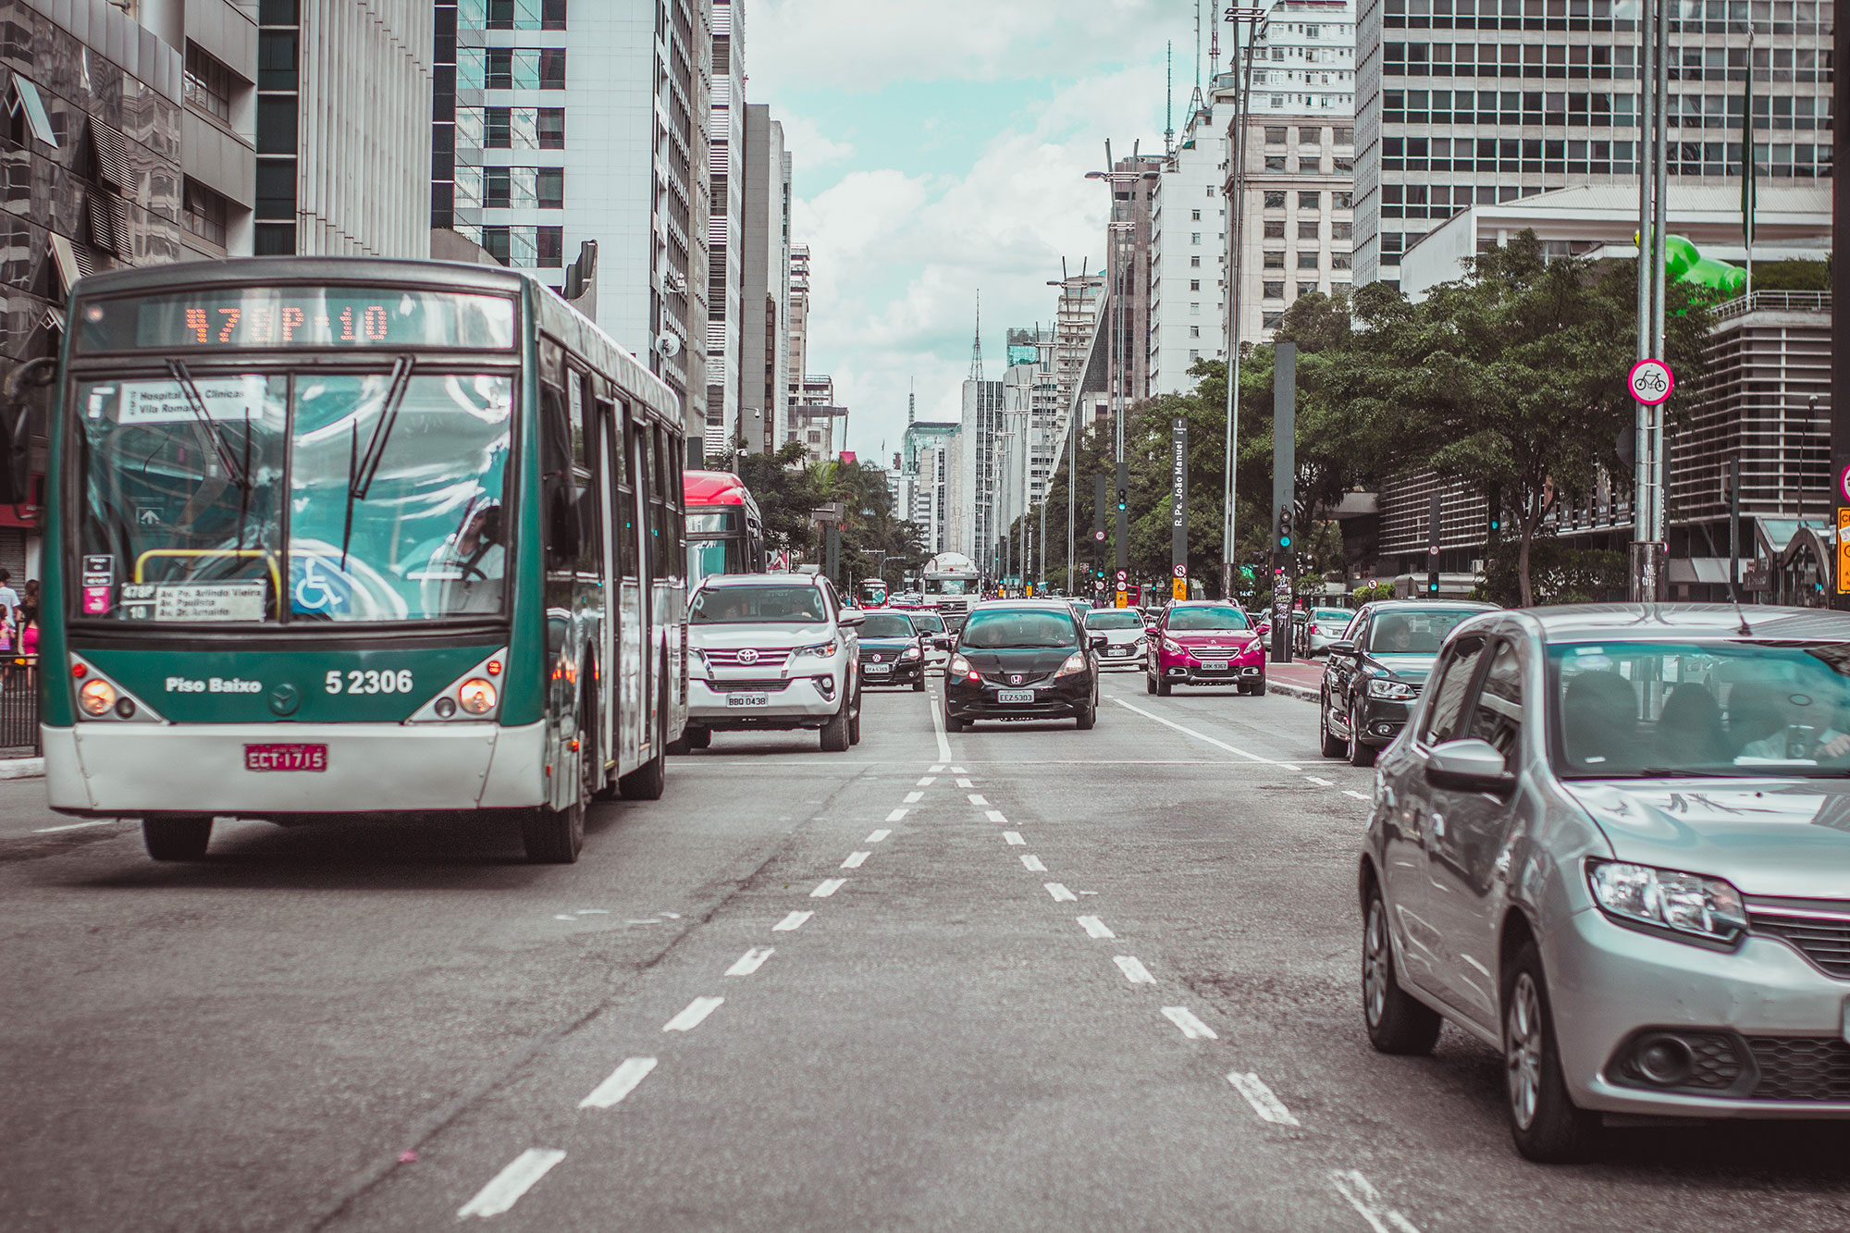
Transport and infrastructures
> REFERENCES
CompSTLar
Boosting the digital transformation of aviation supply chains for advanced composite aerostructures
2025-2029 | HORIZON-CL5-2024-D5-01-08
LIAISON
Lowering transport envIronmentAl Impact along the whole life cycle of the future tranSpOrt iNfrastructure
2023-2026 | https://liaison-transport.eu/ HORIZON-CL5-2022-D6-02-06
OVERLEAF
Novel Low-pressure Cryogenic Liquid Hydrogen
Storage For Aviation 2022-2025
www.overleaf-project.eu | HORIZON-CL5-2021-D5-01-05
DRIVEMODE
Integrated Modular Distributed Drivetrain for Electric & Hybrid Vehicles
2017-2021 | www.drivemode-h2020.eu | H2020-GV-2017
GREENTRANSPORT-TV
Development of 12 TV-reportages on the major results and discoveries in the sustainable transport area
2009-2010 | www.youris.com/mobility/greentransporttv/ | European Commission, DG RTD

Slide 37





Agriculture and food
> REFERENCES
SPOON
Food Systems in transition – ParticipatOry, Open citizen research for sustainable Nutrition
2024-2028 | HORIZON-CL6-2024-FARM2FORK-01-6
DARWIN
Fair, healthy, safe and environmentally friendly food system
2024-2027 | HORIZON-CL6-2023-FARM2FORK-01-11
ARAGORN
Achieving Remediation And GOverning Restoration of contaminated soils Now
2023-2027 | HORIZON-MISS-2022-SOIL-01-04
CULTIVATE
Co-designing food sharing innovation for resilience 2023-2026 | https://cultivate-project.eu/ | HORIZON-CL6-2022-COMMUNITIES-01-04
MRV4SOC
Monitoring, Reporting and Verification of Soil Organic Carbon and Greenhouse Gas Balance
2023-2026 | https://mrv4soc.eu/ | HORIZON-MISS-2022-SOIL-01-05
GUARDIANS
Smart solutions to empower small- and medium-sized farms as guardians of the territory
2023-2027 | HORIZON-CL6-2022-FARM2FORK-02-04-two-stage

Slide 38








Agriculture and food
> REFERENCES
PLANEAT
Food systems transformation towards healthy and sustainable dietary Behaviour
2022-2026 | https://planeat-project.eu/ | HORIZON-CL6-2021-FARM2FORK-01-15
CLEVERFOOD
Connected Labs for Empowering Versatile Engagement in Radical Food system transformation
2023-2026 | https://food2030.eu/projects/cleverfood/ | HORIZON-CL6-2022-GOVERNANCE-01-01
CoreNET
Connecting advisOrs towaRds a European NETwork for consumer-producer chains
2022-2027 | https://shortfoodchain.eu/ | HORIZON-CL6-2021-GOVERNANCE-01-27
B-FERST
Bio-based FERtilising products as the best practice for agricultural management SusTainability
2019-2024 | www.bferst.eu | H2020-BBI.2018.SO3.D4
EFFECT
Environmental public goods From Farming through Effective Contract Targeting
2019-2023 | www.project-effect.eu | H2020-RUR-03-2018
WalNUT
Closing waste water cycles for nutrient recovery
2021-2025 | www.walnutproject.eu | H2020-RUR-2020-2
HIPSTER
Deployment of high pressure and temperature food processing for sustainable, safe and nutritious foods with fresh-like quality
2015-2017 | www.hipster-project.eu | H2020-SFS-17-2014
SKIN
Short Supply Chain Knowledge & Innovation Network
2016-2019 | www.shortfoodchain.eu | H2020-RUR10.2016

Slide 39

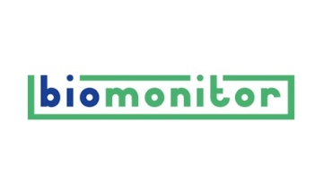






Bioeconomy
> REFERENCES
Allthings.bioPRO
Game changer for the bio-based economy
2020-2022 | www.allthingsbio.eu | H2020-BBI-JTI-2019
BioMonitor
Monitoring the Bioeconomy
2018-2022 | www.biomonitor.eu | H2020-BB-2017-2
BioCannDo
Bioeconomy Awareness and Discourse
2016-2019 | www.allthingsbio.eu | H2020-BBI.S2-2015
ISO-BIO
Development and Demonstration of Highly Insulating, Construction Materials from Bio-derived Aggregates
2015-2019 | www.isobioproject.com | H2020-EeB-01-2014
ProBio
Professional support to the uptake of bioeconomy RD results towards market, research and policy 2015-2017 | www.probio-project.eu | H2020-ISIB-2014-1
greenXpo
Maintaining all Green and Ecoinnovation Results
in a Living Portal
2013-2015 | www.innovationseeds.eu | FP7-ENV.2013
ECO-PRO
Professional promotion of eco-innovative research results through a new media integrated platform for SMEs, research and the public
2011-2013 | www.innovationseeds.eu |
FP7-ENV.2011
CommFABnet
Communication of Food, Fisheries, Agriculture and Biotechnologies research – a network to support EU-funded research projects
2012-2014 | www.commnet.eu | KBBE-2011-4.03

Slide 40





Environment & Climate
> REFERENCES
FORWARDS
The ForestWard Observatory to Secure Resilience of European Forests
2022-2027 | https://forwards-project.eu/ | HORIZON-CL6-2022-CLIMATE-01-05
Biovalue
Biodiversity value in spatial policy and planning leveraging multi-level and transformative change
2022-2025 | https://biovalue-horizon.eu/ | HORIZON-CL6-2021-BIODIV-01-17
Distender
DevelopIng STratEgies by integrating mitigatioN, aDaptation and participation to climate changE Risks
2022-2026 | www.distender.eu | HORIZON-CL5-2021-D1-01-05
WADI
Water-tightness Airborne Detection Implementation
2016-2020 | www.waditech.eu | H2020-Water-1b-2015
IMETLAND
A new generation of Microbial Electrochemical Wetland for effective decentralized wastewater treatment
2015-2018 | www.imetland.eu | H2020-Water-1a-2014

Slide 41




Emerging technologies/ ICT & Digital
Robotics
> REFERENCES
TALOS
Robotics and artificial intelligence living labs improving operations in PV scenarios
2023-2026 | talosproject.eu/ | HORIZON-CL4-2022-DIGITAL-EMERGING-02-07
MOZART
Morphing Computerized mats with Embodied Sensing and Artificial Intelligence
2022-2026 | https://mozart-robotics.eu/ | HORIZON-CL4-2021-DIGITAL-EMERGING-01-11
EIC Communities
Building synergies and communities around EIC Portfolios to raise impact of the EIC deep tech research
2023-2026 | https://deepsync.eu/ | HORIZON-EIC-2022-COMMUNITIES-01-01
BEEYONDERS
Breakthrough European tEchnologies Yielding cOnstruction sovereigNty,
Diversity & Efficiency of ResourceS
2022-2026 | www.beeyonders.eu
HORIZON-CL4-2021-TWIN-TRANSITION-01-12

Slide 42




Digital & Emerging technologies
> REFERENCES
EIC-Communities
Stimulating effects of Future and Emerging Technologies through communication and outreach
2023-2026 | www.deepsync.eu | HORIZON-EIC-2022-COMMUNITIES-01-01
FETFX
Stimulating effects of Future and Emerging Technologies through communication and outreach
2019-2021 | www.fetfx.eu | H2020-FETOPEN-02-2018
EFFECT
Creating effects through communication and engagement in FET
2017-2018 | www.fetfx.eu | H2020-FETOPEN-02-2016
ICONS coordinator
FEAT
Future and Emerging Art and Technology
2015-2017 | www.featart.eu | H2020-FETOPEN-2015-CSA
COFET
Conferences for the Future of FET
2012-2014 | DG Connect

Slide 43





Health
> REFERENCES
PAIR
Pandemic Information to Support Rapid Response 2024-2028 | www.pairproject.eu | HORIZON-HLTH-2023-TOOL-05-08
KitNewCare
Developing a framework/model to environmentally sustainable and climate neutral health and care systems using the Kidney care pathway
2024-2027 | www.kitnewcare.eu | HORIZON-HLTH-2023-CARE-04-03
POINT
Preventing non-communicable diseases caused by the post-acute phase of cOvid-19 INfecTion
2024-2027 | www.point-health.eu | HORIZON-HLTH-2023-DISEASE-03-07
CYMEDSEC
Innovations in Cybersecurity for the Future of Healthcare
2023-2027 | www.cymedsec.eu | HORIZON-HLTH-2022-IND-13-01
FLAVIVACCINE
Development and characterization of a pan-flavivirus vaccine candidate
2024-2027 | www.flavivaccine.eu HORIZON-HLTH-2023-DISEASE-03-18

Slide 44



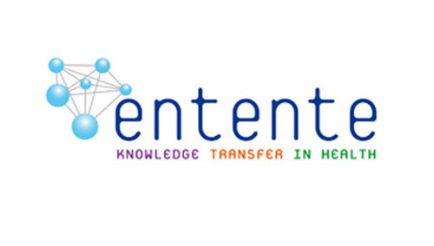


Health
> REFERENCES
GEMSTONE
Genetically Engineering Experimental Models: Enhancement of Scientific and Technological excellence and innOvation potential to study
NEurodevelopmental diseases
2022-2025 | HORIZON-WIDERA-2021-ACCESS-03-01
CoronaDX
Three rapid diagnostic tests (Point-of-Care) for COVID-19
2020-2023 | www.coronadx-project.eu |
H2020-SC1-PHE-CORONAVIRUS-2020
ULISES
Immunological incompatibility as a basis for cancer curing and vaccination
2020-2023 | www.ulises-project.eu | H2020-FETOPEN-01-2019
ENTENTE
European Network of Knowledge Transfer in Health
2012-2015 | HEALTH.2012-4.1-1
HIGHLIGHT
Highlighting EU-funded Health research results via TV media and the Internet
2012-2014 | www.youris.com/health/ | HEALTH.2012-4.1-4
HEALTH-TV
Development of 15 TV-reportages on the major results and discoveries in the Health area
2008-2009 | www.youris.com/health/healthtv/ |
European Commission, DG RTD

Slide 45




Security
> REFERENCES
The Hut
The Human-Tech Nexus - Building a Safe Haven to cope with Climate Extremes
2022-2026 | https://thehut-nexus.eu/ | HORIZON-CL3-2021-DRS-01-02
RAIN
Risk Analysis of Infrastructure Networks in response to extreme weather
2014-2017 | www.rain-project.eu | FP7-SEC-2013-1
CITYCoP
Citizen Interaction Technologies Yield Community Policing
2015-2018 | www.citycop.eu | H2020-FCT-2014
PROTON
Modelling the Processes Leading to Organised Crime and Terrorist Networks
2016-2019 | www.projectproton.eu | H2020-FCT16-2015

Slide 46



Culture
> REFERENCES
EMPOWER
Empowering the Theresia Orchestral System
2022-2025 | CREA-CULT-2021-PECE
ICONS coordinator
European Union Baroque Orchestra
Cultural Ambassador for the European Union
ICONS management since 2022

Slide 47
Our awards

Slide 48
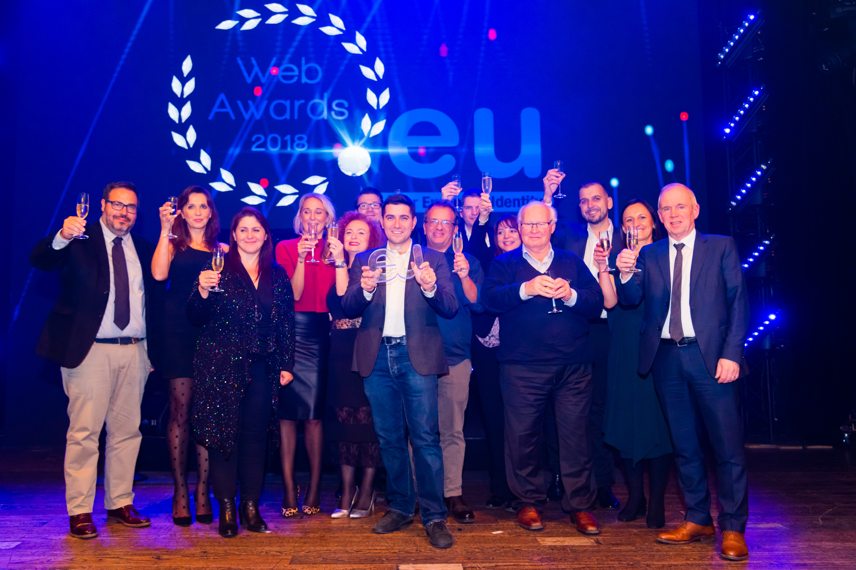


.eu Web Awards
> OUR AWARDS
2023 .eu Web Award - “Better World” Category
This category is reserved to websites that represent green initiatives and environmentally-friendly organizations. ICONS won this award with the POCITYF website: www.pocityf.eu
2018 .eu Web Award - “Better World” Category
This category is reserved to websites that represent green initiatives and environmentally-friendly organizations. ICONS won this award with the STARDUST website: www.stardustproject.eu
Great visuals, consistent and intuitive navigation. Good adaptation of design and images for alternative media. Impressive progress for such a new project. [Jury statement]
Very professional and modern website, consistent visual design, great use of tagging for content (one of the best we have seen for years). Very rich multimedia content, engaging stories and inspiring projects which bring a potentially dry, scientific subject matter to life. [Jury statement]
2018.eu Web Award - “Laurels” category
This category is reserved to websites that represent educational institutions, charitable organisations and pan European projects. ICONS won this award with the FETFX website: www.fetfx.eu
The .eu Web Awards, organised by EURid, is an online competition held every year since 2014 acknowledging the best websites with .eu extensions. The objective of the award is to enhance the visibility of beautiful and impactful .eu websites. EURid is the registry manager of the .eu country code top-level domains upon appointment of the European Commission in 2003.

Slide 49
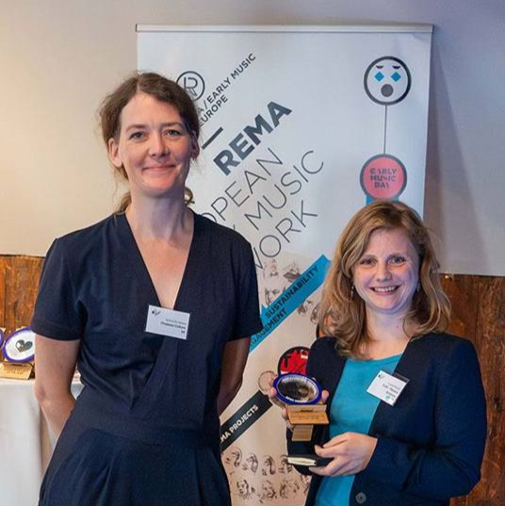
REMA Award
> OUR AWARDS
Business Innovator of the year 2024
The REMA Awards, attributed by REMA EEMN (European Early Music Network), aim to strengthen the Early Music sector by increasing its visibility, supporting sustainability, and recognizing excellence in performance and research. REMA prioritizes relevance over subjective artistic judgment and reward innovative approaches to 1000 years of musical heritage.
In 2024, ICONS won the Business innovator of the year award for the management of two leading international orchestras for early career musicians playing on period instruments:
EUBO (www.eubo.eu) and Theresia Orchestra (www.Theresia.online)
The Business Innovator of the Year award for financial stability in the sector and its economic model was given to the nonprofit organization ICONS, which manages the European Union Baroque Orchestra and Theresia Orchestra. ICONS operates under an ethical model inspired by a philanthropic vision, aimed at supporting and promoting young musicians on an international scale. [Il Giornale della Musica]
The Business innovator of the year rewarding goes to an organization that contributes in a significant way to the financial stability of the sector, by providing a new economic model, a best practice, proposal made to peers or funding organizations. [Gramophone]
Every two years, REMA – the European Early Music Network - puts under the spotlight the projects that reflect the vision and versatility of today’s Early Music sector. More information: www.rema-eemn.net/projects/rema-awards/

Slide 50
Get in contact: icons@icons.it | www.icons.it

