Slide 1


Micro Clean NexGen
Revolutionizing Cleaning: A Clean Tech Innovation Beyond Sustainability -
Presented by W Sanjeewa Amarasinghe, Founder & CEO
Investor Deck | Aug 2025
Contact: Sanjeewa@microcleannexgen.com | www.microcleannexgen.com
Steam Imagination

Slide 2

Why Our Vision is Different: Seeing the World Through a New Lens
"We fuse clean tech with inclusive and resilient economics to unlock scalable, sustainable change."
Innovation
Inclusion
Reimagining cleaning systems from the ground up
Creating accessible solutions for all communities
Resilience
Building adaptable systems for long-term sustainability

Slide 3


The Problem - The Triple Challenge
Traditional cleaning creates multiple pressure points & kills our Earth
Daily Environmental Impact
Technological
Energy & Water Waste
2.9B
Decarbonatization
Liters
Carbon Emission
Daily Water waste
Social
Disease risk
100
Harmful chemicals
Tons
Clean & Hygiene
Daily Chemical waste
Economic
Cost burden – Consumers / Businesses
79000
Manufacturing inefficiencies
Sustainable But Not Scalable
kWh
Daily electricity consumption
Sources:
Municipal Solid Waste Report 2023, GV Official Sectoral Energy Statistics 2023, Chemical Waste Treatment Centre Report 2024, Drainage Sewage Services Department 2023

Slide 4

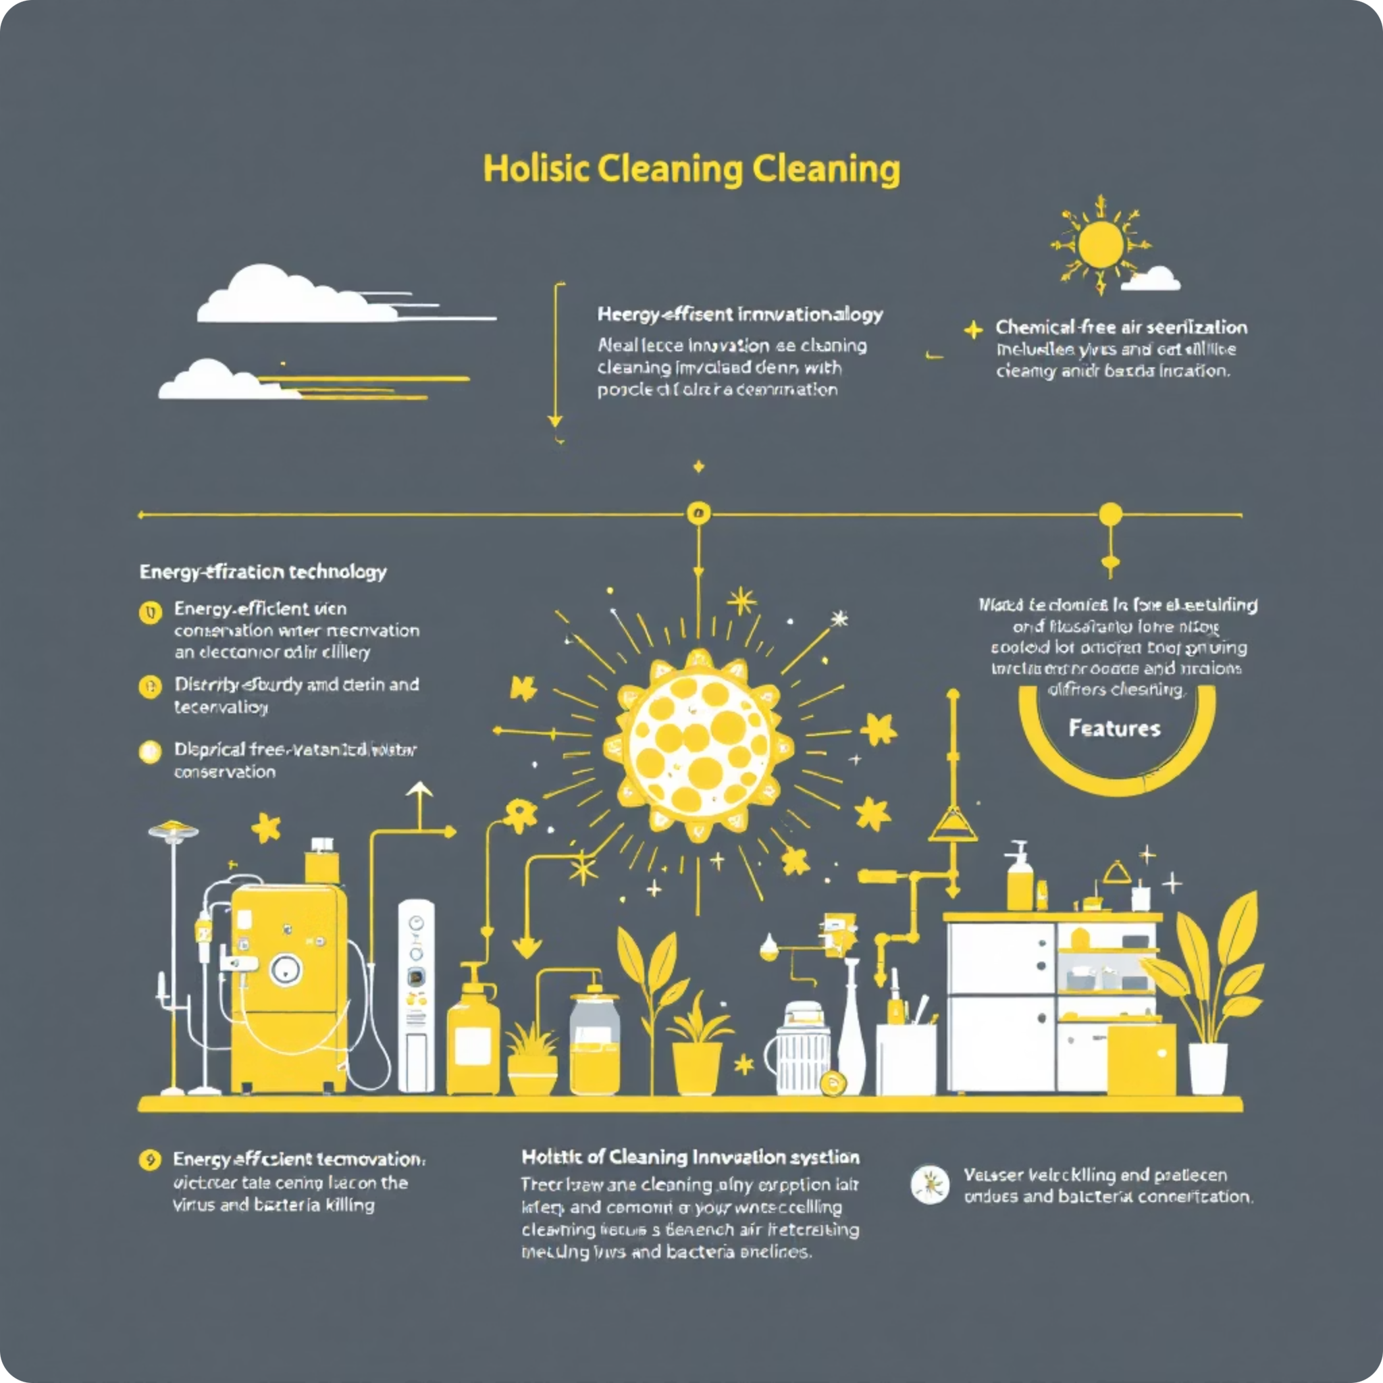
The Solutions
A Holistic & Disruptive Cleaning Innovation Built for the Future — Creating a Circular Economic Cleaning System
Clean Tech Innovation
100% Energy Efficient
Water Conservation
Clean Environment Initiative
Chemical Free & Air Sterilization
Zero Carbon Emission
Affordability
30% Cost Reduction Businesses /Consumers
30% Cost Reduction Businesses /Consumers
Disease Prevention
Virus & Bacteria Free with 99% Germ Killing Efficiency
"We bring the Clean, not the Carbon"
Clean & Hygiene , Health & Environment

Slide 5

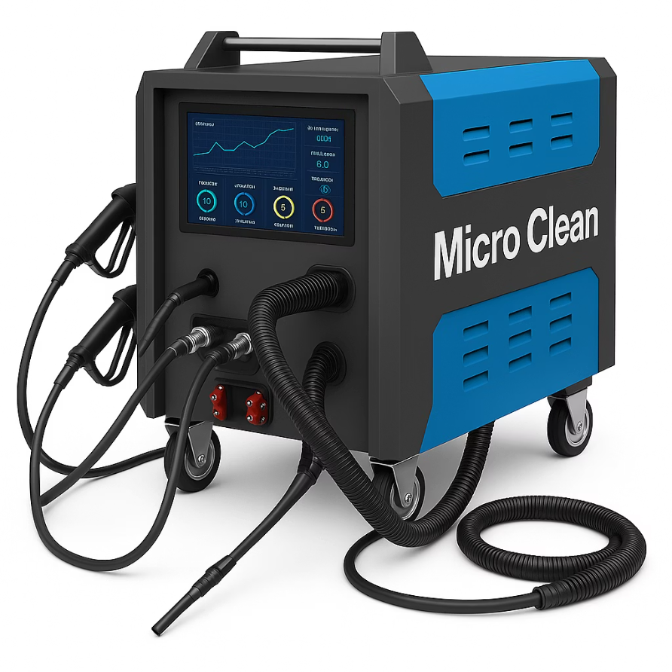




Meet MCN Ultra Steamer
Infinite Efficiency Through Unified Innovation
Secret Source
Product Features
Core Innovation
Triple-Powered Tech
Hydrogen Cell Powered
Hydrogen Power, Lithium Battery, Solar chip
Lithium Battery Powered
Solar Chip Powered
Ozone Generator
Technology Partnership
Air sterilization capabilities
Arrow Lab - HKSTP
Wurth Electronics
Endoscope Camera
HKPC
360-degree cleaning visibility
03 Patents Products
SmartQuad Technology
MCN Ultra - Hydro Cell
Performs 4 tasks simultaneously
MCN Ultra - Lithium
MCN Ultra - Solar Chip
Atomized Steam Jet
Water-saving technology
"We bring the Clean, not the Carbon"
Triple Spirit
Zero Carbon
Zero Chemicals
Smart, sustainable, and scalable facility management through intelligent operations
Sost Effective

Slide 6
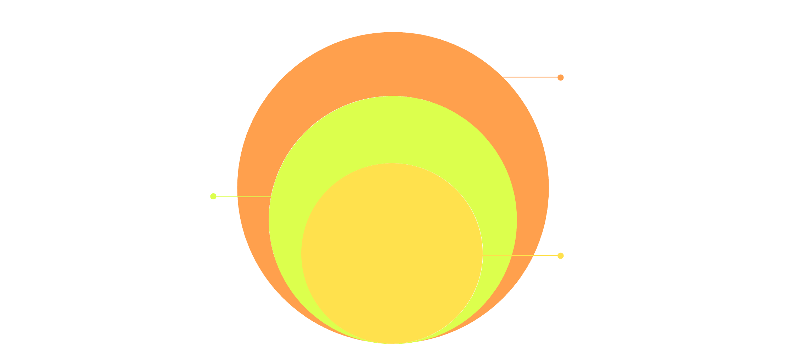
Market Opportunity
Expanding Green Horizons
Target Customers
Property Management
Public housing estates
TAM
USD 148 Billion
office buildings
2019-2024
shopping malls
CAGR 6.8%
hotels, and retirement homes
SAM
USD 11 Billion
2019-2024
GV Properties
CAGR 6.2%
SOM
USD 18 Million
School & Universities
2026-2029
Community Centers, Municipality
MICRO Clean NexGen
GV Premises
Defense & Security Premises
Healthcare Facilities
Public
Automotive Sector
Hospitals,
MTR platforms, railways
Individual car owners
assisted living homes
Buus, Ferry, Air Terminals
fleet operators,
clinics and medical centers
Construction Sites, Other
parking facilities

Slide 7
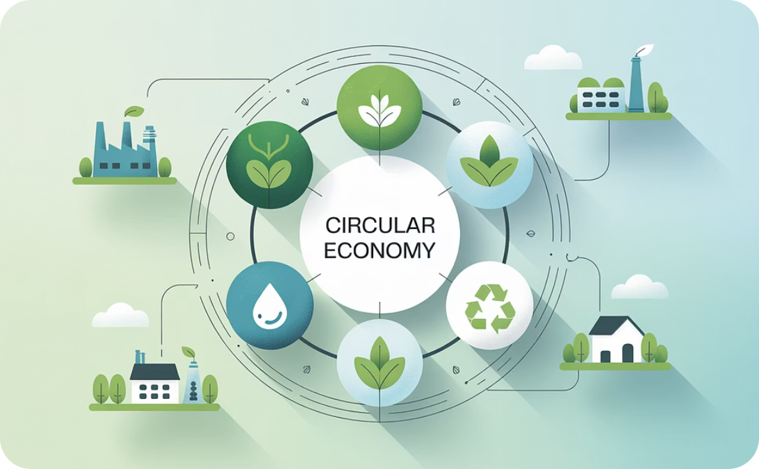
Business Model
SteamNiche – 07 Niche Market opportunities, 07 Revenue Streams
Phase One Operations
Phase Two Operations
18 Months Kick Start
18 Months Acceleration
2025-2027
2027-2029
Steam Cleaning
Retail Chain
Tenders & Contracts
Local Sales
$600,000
Rental Facility
CIC Collaboration
Steam Car Detailing
E-Commerce
Car Detailing center
On-Line Selling
$300,000
Manufacturing
Industrial Grade 4.0
Franchise Module
Global Presence
Pre-Revenue Streams with 25-30% Gross Margin
03 Years Break-Even | Monthly SaaS-style

Slide 8
Traction
Substantial Funding & Contract Commitments
Opportunities Realized
Public Sector Validation
Public Sector Trial Scheme
MTR Corporation
CIC Zero Carbon Park
7Mhkd
1.29Mhkd
1Mhkd
CITF Funding
HKSTP Incubation
ITF Fund
Government Tenders
Upon Validation
HKD secured
In Process
MTR ,GLD, FEHD, GPA
Business Partnerships/Collaborations
CITF Machine Rental Collaboration for the Construction Industry
HKSTP TECXHANGE Business Opportunities
Our robust traction demonstrates strong market validation from both public and private sectors, confirming the economic and environmental value proposition of our technology.

Slide 9



Competition
Standing out in a crowded field, Built to win in a competitive market
Brand Feature
Comparison
Go Beyond
Micro Clean
Johnson &
Johnson
Magic Clean
Shell Car
Detailing
✅
❌
❌
❌
Key Competitor
VS
Defensibility
30% Cost Reduction
Johnson & Johnson
Micro Clean NexGen
100% Energy Saving
✅
❌
❌
❌
Lead with Pure Steam Cleaning
Rely on Deep Cleaning
90% Water Saving
✅
✅
✅
✅
Extensive Energy
100% Energy Saving
Chemical-Free / Air Sterilization
✅
❌
❌
❌
Toxic Chemicals
Zero Chemicals
Triple-powered Cutting Edge Tech
✅
❌
❌
❌
Servicing for Residential/Commercial
Diverse Sectors Including
GV Subsidies
Not Sustainable
Sustainable
✅
❌
❌
❌
Affordable HKD 2.6/SQFT
Expensive HKD 3.6/SQFT
AI ESG Excellence
✅
❌
❌
❌
Users pay full price—no incentives
Gov’t-backed user subsidies
User-Friendly
✅
✅
✅
✅
ESG ONE GREEN MEMBERSHIP - HKPC
HONG KONG ENVIRONMENTAL & EXCELLENCE AWARD APPRECIATION
HONG KONG GREEN INNOVATION AWARD APPRECIATION

Slide 10
Our Path to Market Dominance
- Strategic Road Map
Go-To-Market - - Public Sector Trial Scheme
Short-Term Growth - - Revenue Diversification / Tenders, contracts
Long-Term Growth - - Scalable Expansion Manufacturing Industrial 4.0
The Quantum Jump
Our Four-Pillar Approach
Innovation
Being Attractive
Customer Service
Keeping Customers
Product Development
Staying Competitive
Sales & Marketing
Acquiring Customers

Slide 11







We Ask For Collaboration
$1M
$10M
$3MN
Investment
Pre Money Valuation
3 Year Revenue Target
Use Of Proceeds
Sales & Biz Dev 20%
Mobile App & E-Com 5%
Proto Development & Compliance 20%
Administration & Wages 30%
Import Machinery 15%
Safety Wallet 10%

Slide 12
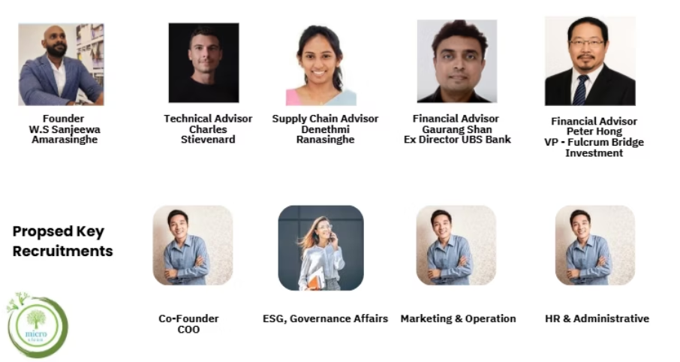
Our Team
Leadership Team:
Charles Stevenard – CTO
(Surface Plant Manager & Tender Team Leader) DRAGAGES HONG KONG LIMITED)
Gaurau Shan – Financial Advisor
(Executive Director – UBS Bank HK)
Peter Hong – Financial Advisor
(Vice President – Fulcrum Bridge Investment HK)
W. Sanjeewa Amarasinghe
Denethmi Ranasinghe – Supply Chain
(Ex Supply Chain – Andromeda International Limited)
Founder/CEO
Advisor – Global ESG Leadership Organization UK
Consultant / Entrepreneurship – Time Auction HK
EX Founder/CEO – Andromeda International Limited

Slide 13

Huge Market
Significant growth potential in clean technology sector
Powerful Team
Industry experts with proven track records
Proven Product
Validated technology with demonstrated results
Public Sector Trust
Strong relationships with government entities
Scalable Revenue
It’s About Success
Business model designed for exponential growth

