Slide 1

2022
Transport and Logistics
Everything is possible !

Slide 2
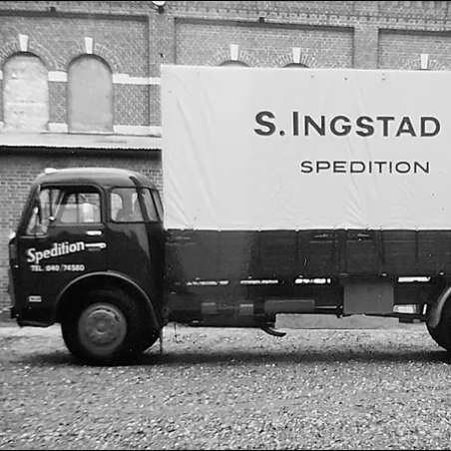
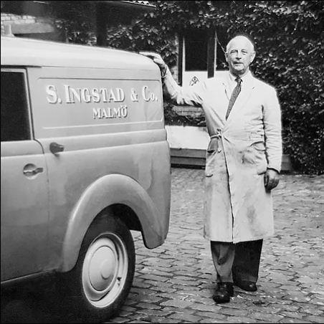
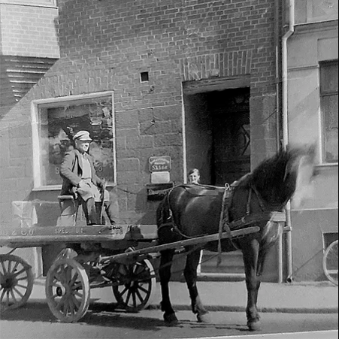
Ingstad & Co was founded by the Ingstad family in 1873, Sweden. The business started from home delivery services.
In the Ingstad family 150 years of experience in logistics business is being successfully transferred from generation to generation.
Ingstad & Co expanded their activity in 1998, Lithuania and after 10 years a third office has been established in China. Thanks to strong values and high service quality standards we are able to operate successfully and grow till these days.

Slide 3
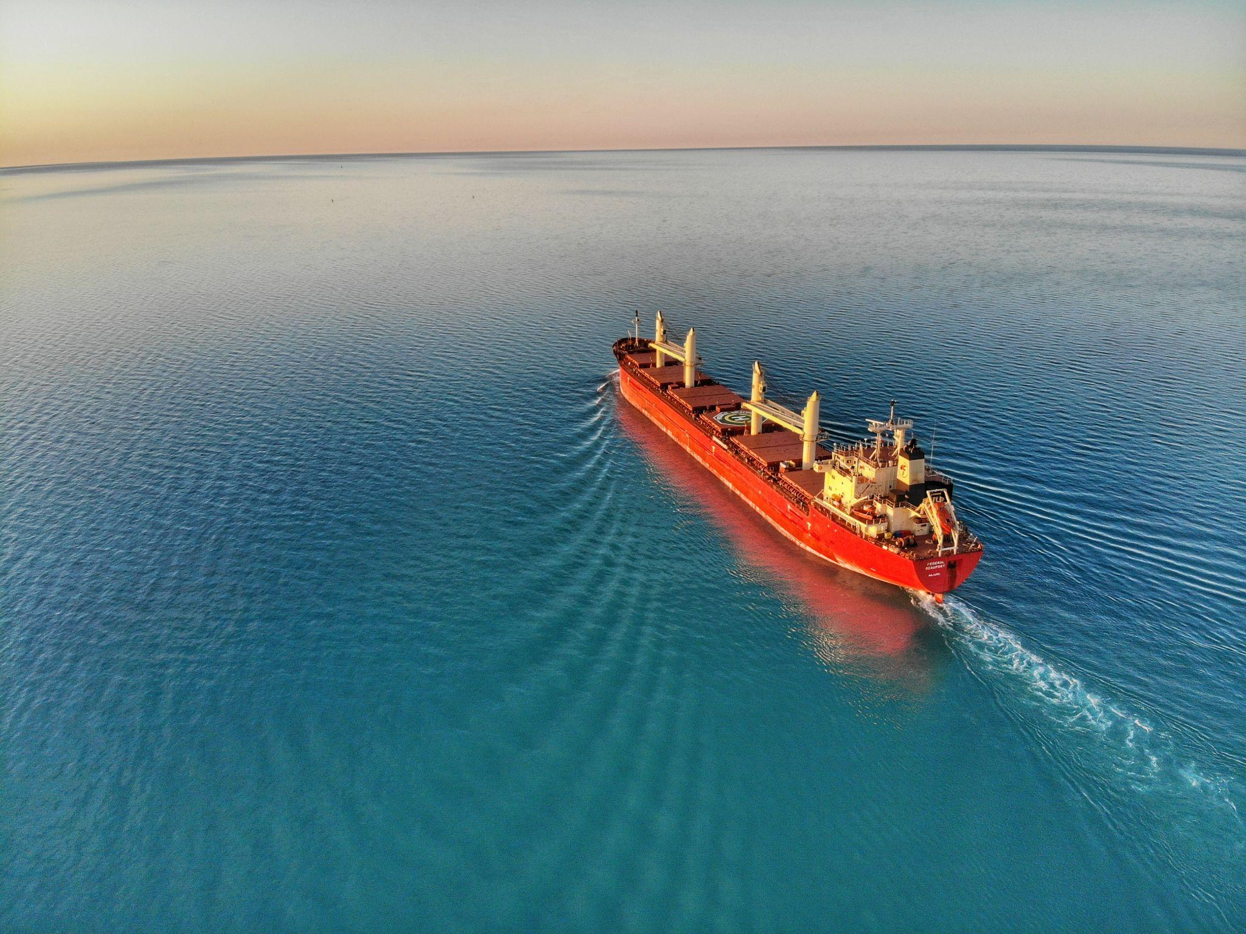
— About us
Vision
to be a competitive Scandinavian origin logistics company providing a wide range of logistics services
Mission
constantly strive to improve and offer our customers quality transport and logistics services

Slide 4

— Services
Road transport
Sea transport
Air transport
Railway transport
regular routes for full and partial loads in the following main directions: Western Europe - Lithuania - Western Europe; Scandinavia - Lithuania - Scandinavia.
sea transport in all directions FCL - full and LCL - partially loaded containers.
we provide various cargo transportation services by air from/to all countries of the world to/from Lithuania.
transportation of full loads by railway (EU, Baltic countries, Central Asia); Multimodal transports in the EU.

Slide 5
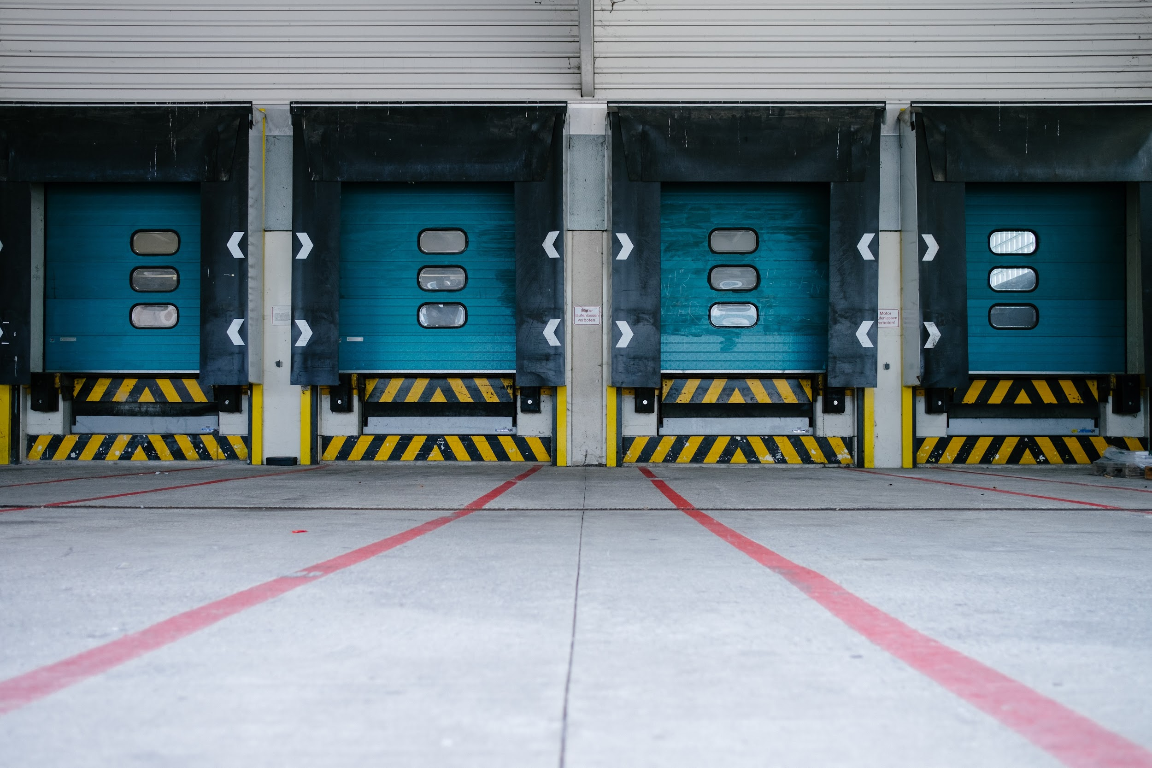
Ingstad work experience
150 years
Cargo delivered
80 000 +
Number of partners in the world
Ingstad & Co.'s values are personal attention to the client and a wide range of logistics services.
We listen carefully to the needs of our customers and allocate
necessary efforts, time to find the best
solution.
3 000 +

Slide 6
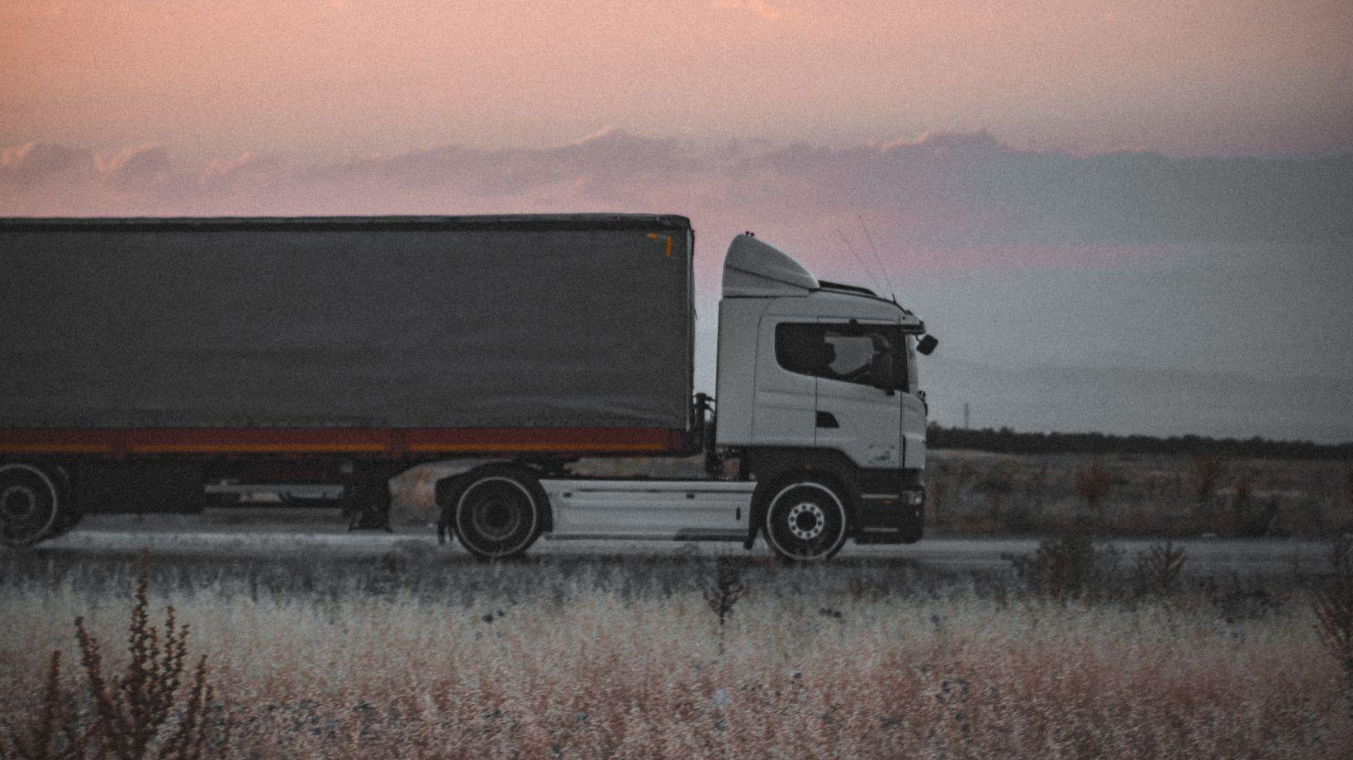
— Contacts
Our office address
Eigulių str. 21, Vilnius, Lithuania, LT-03150
Phone and email
+37052136834
sales@ingstad.lt
www.ingstad.lt

