Slide 1

Tracing Fresh Produce

Slide 2
The aim
Monitor production points, estimate and monitor yield
Trace the product downstream and upstream (quantities per location)
Track fraud practices
Run custom data analytics
Check environmental conditions during cultivation/packing/transportation (optional)
Receive feedback from consumers (optional)

Slide 3
The steps
Describe standard template products for specific areas [once]
(Use GS1’s GPC and attach DNA and Isotopic profile)
Register the farms + packing houses + assign products [once + update]
Create production periods – estimate yield [annual cycle]
Record events on the supply chain using EPCIS (farm → packing → distribution → retailer) – Check inventory level per LOT number and place [real time]
Monitor harvested quantities per farm [cumulative]

Slide 4
The steps
Describe standard template products for specific areas [once]
(Use GS1’s GPC and attach DNA and Isotopic profile)
Register the farms + packing houses + assign products [once + update]
Create production periods – estimate yield [annual cycle]
Record events on the supply chain using EPCIS (farm → packing → distribution → retailer) – Check inventory level per LOT number and place [real time]
Monitor harvested quantities per farm [cumulative]

Slide 5
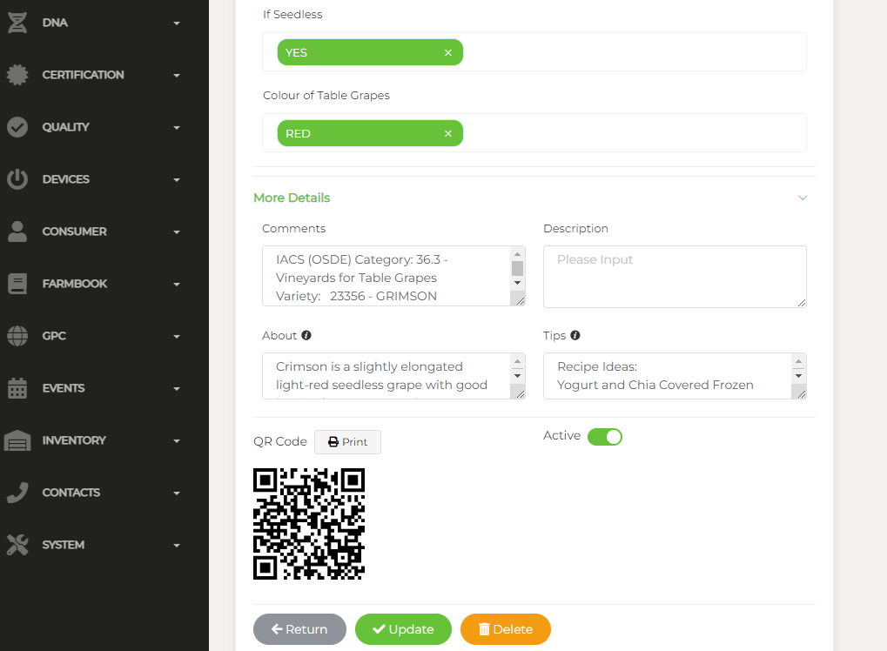
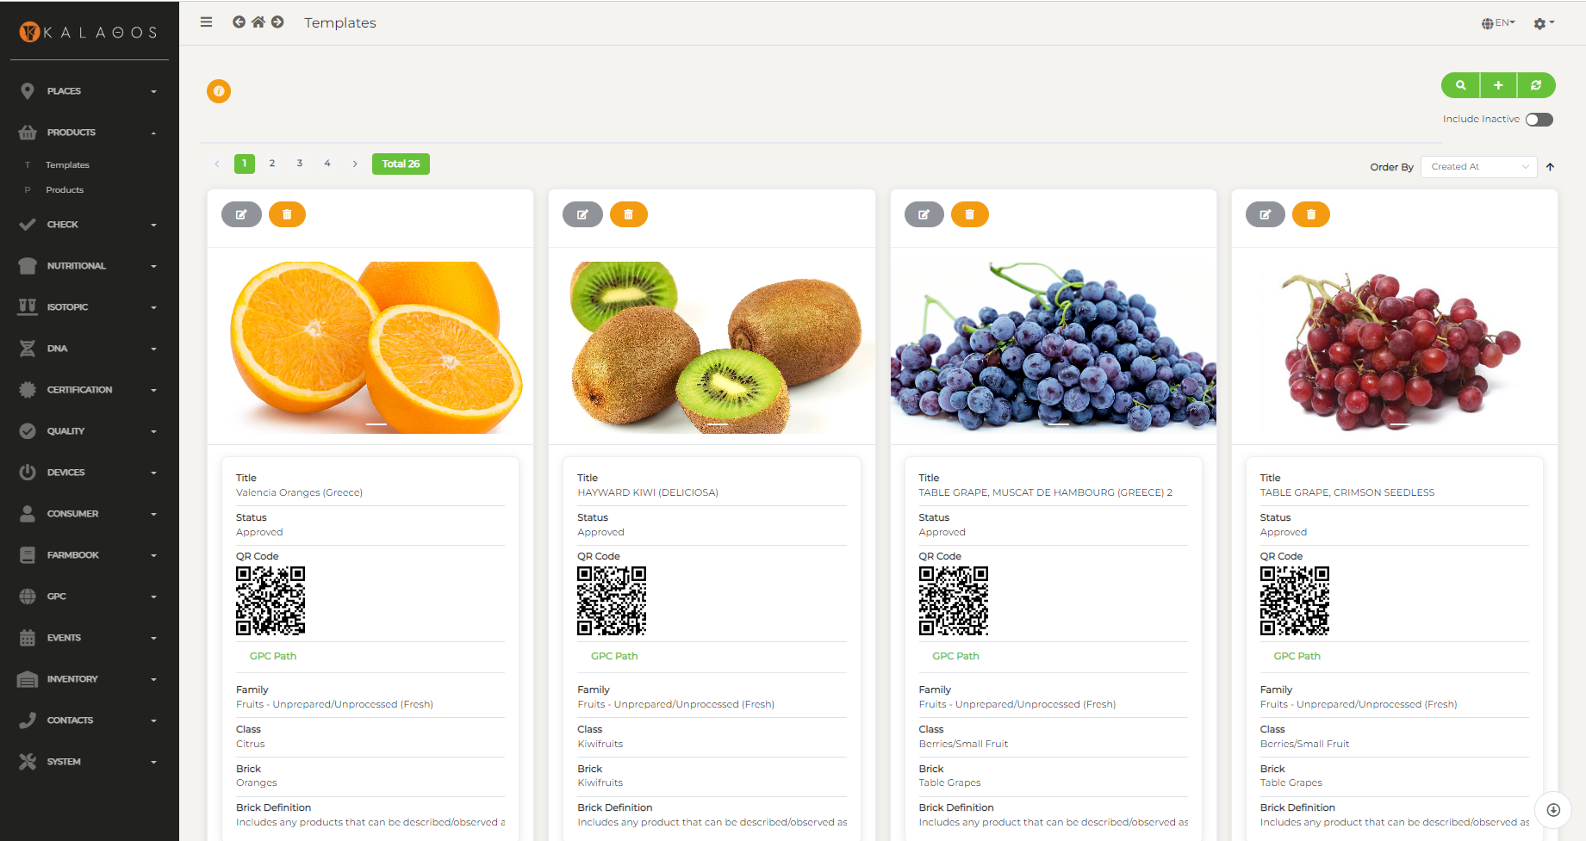
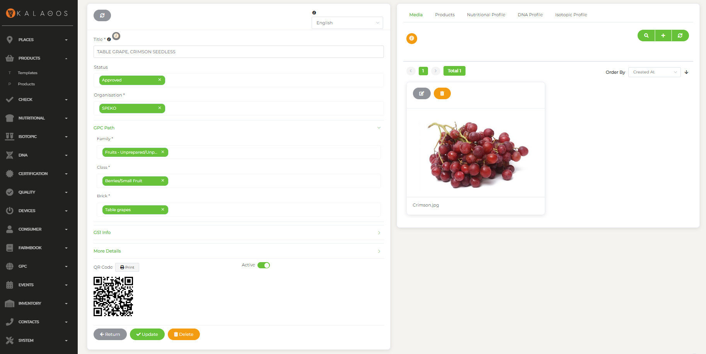
Template Product

Slide 6
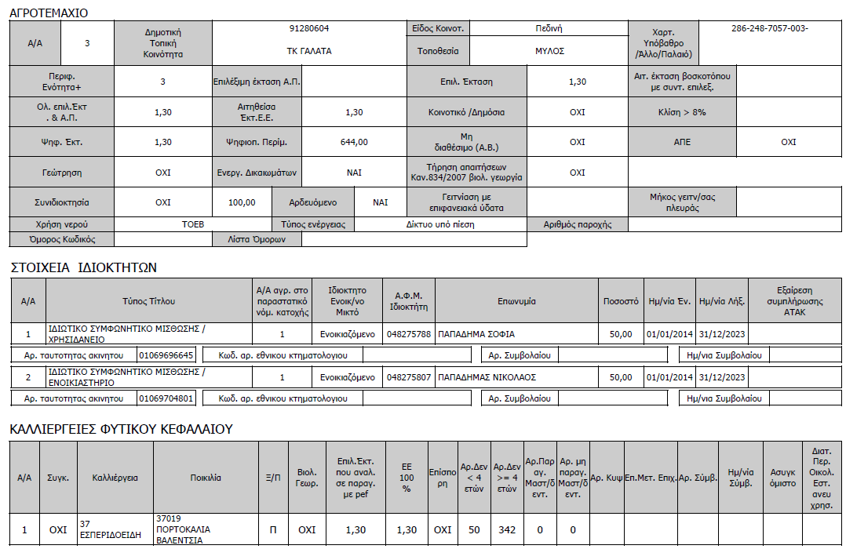
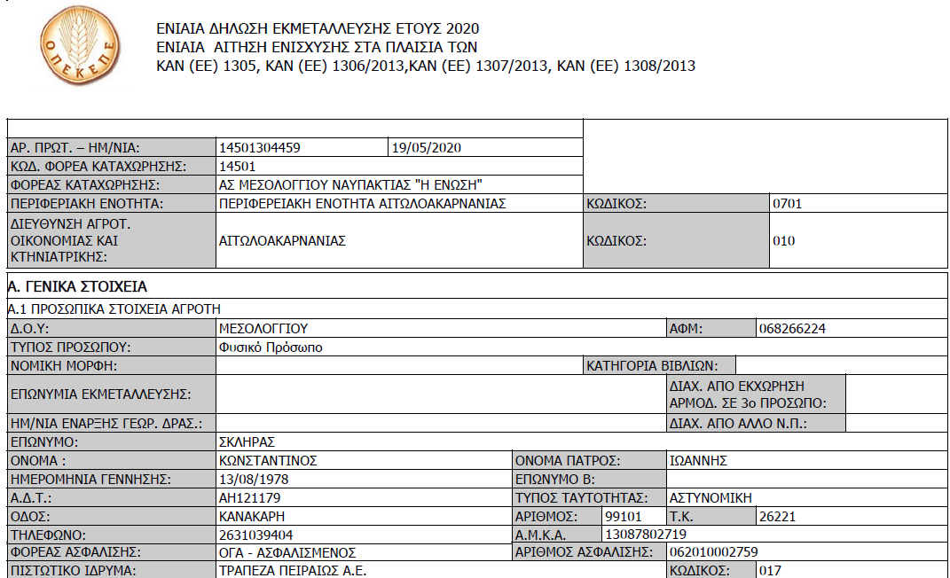
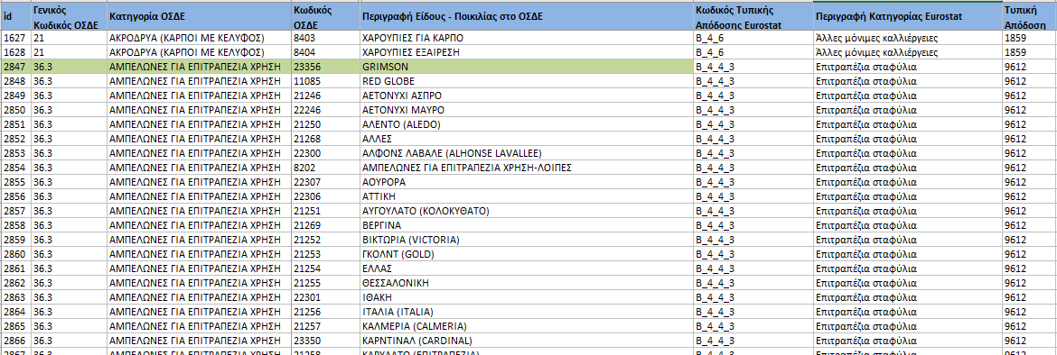
IACS Declarations
IACS: Integrated Administration and Control System
Every farmer is obliged to declare each year all agricultural holdings in IACS. These declarations include the hectares and the cultivated product of each holding.
For each product a unique category id and variety id is being declared.

Slide 7
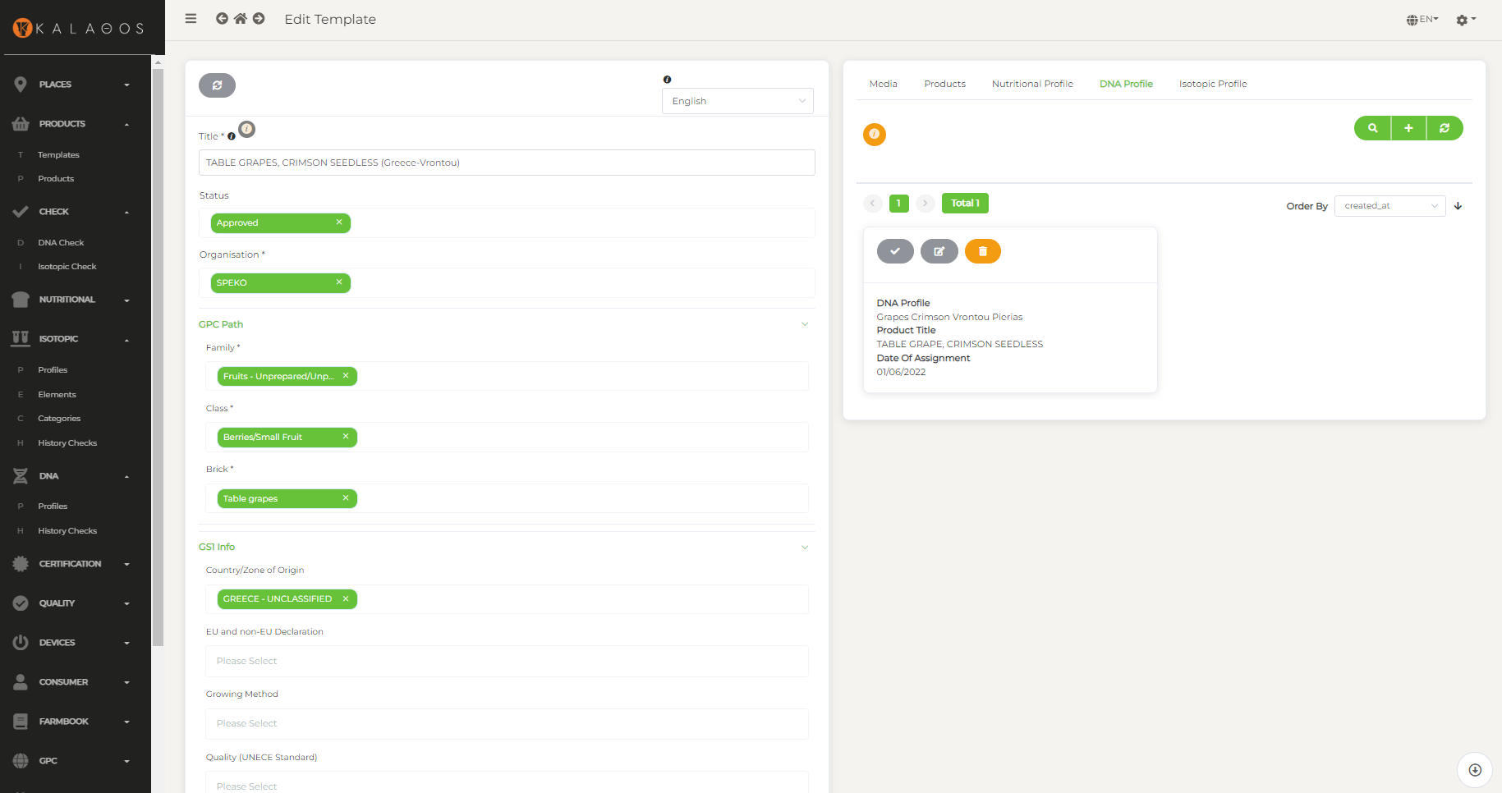
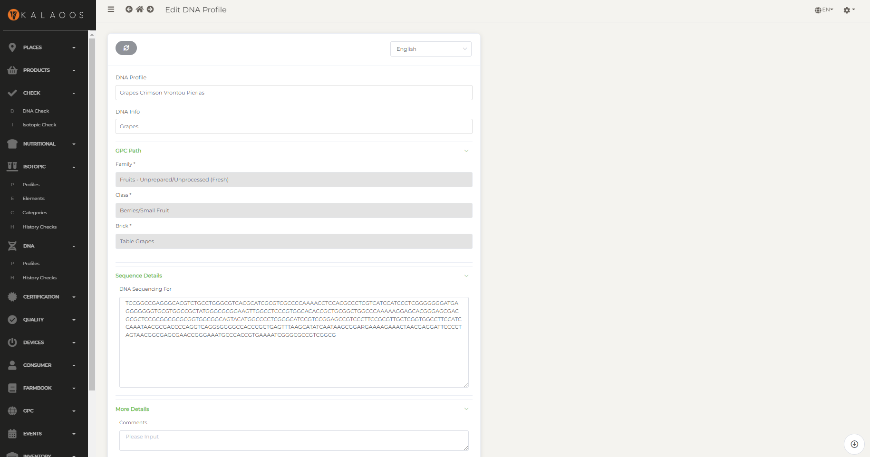
DNA Profile

Slide 8
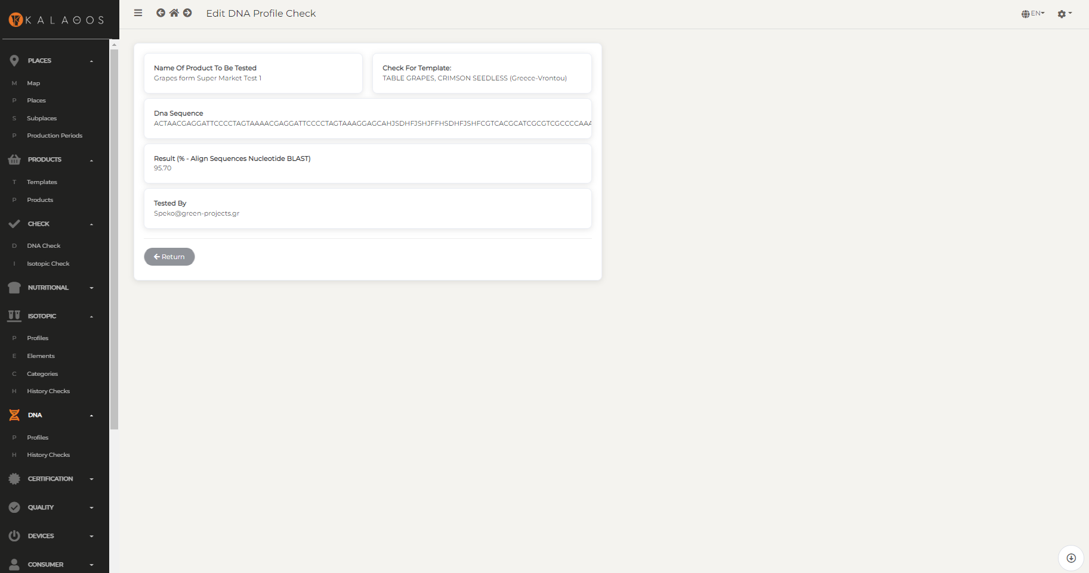
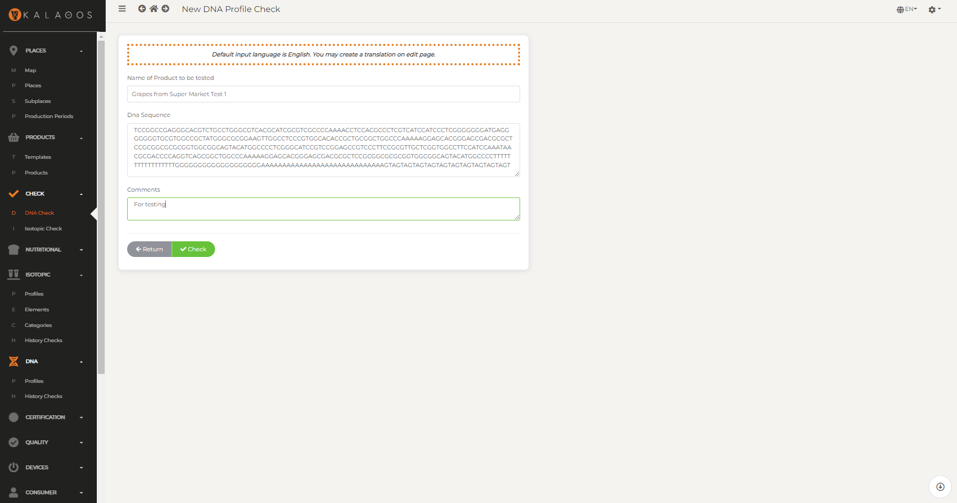
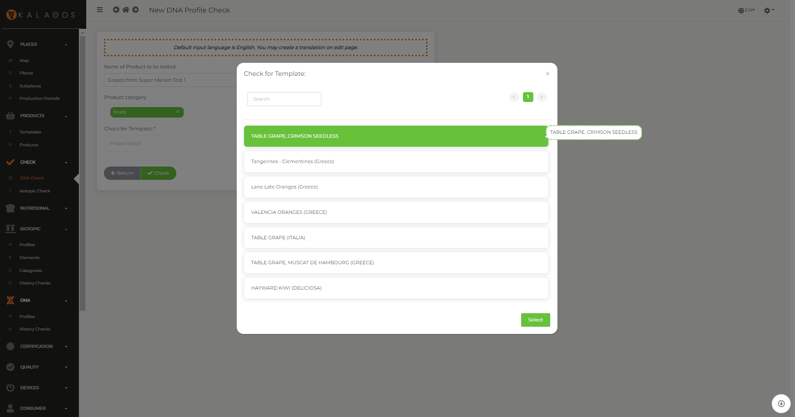
Check DNA Profile

Slide 9
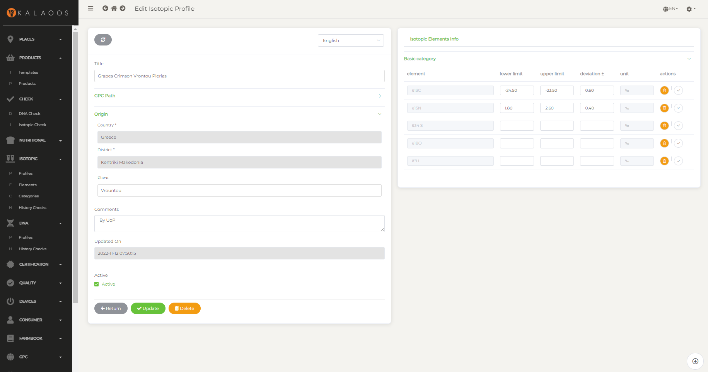
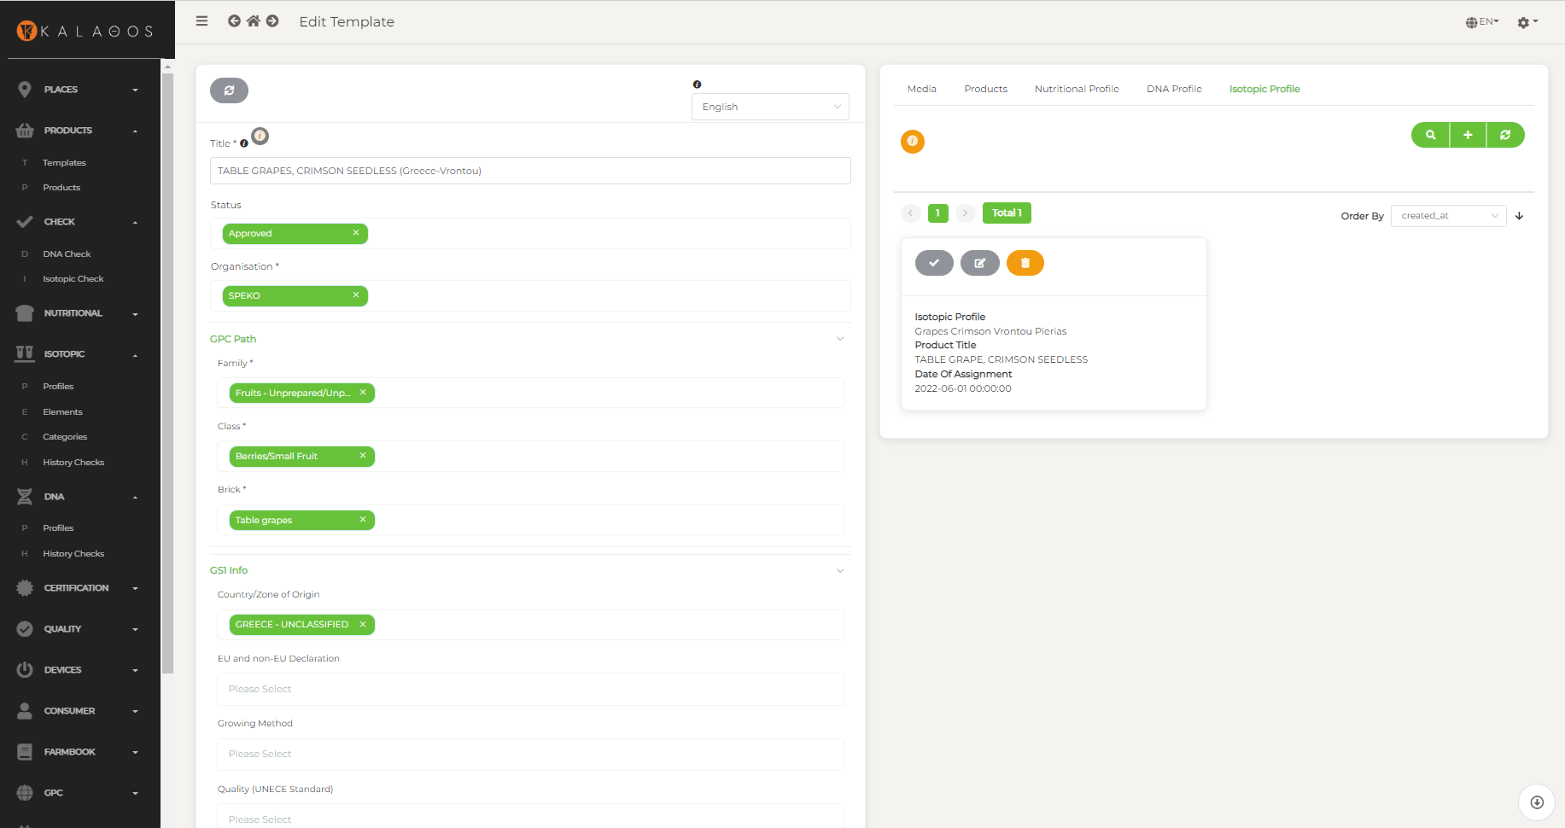
Isotopic Profile
Delta values δ (‰) are used, which indicate the composition of the sample to be tested in constant isotopes.

Slide 10
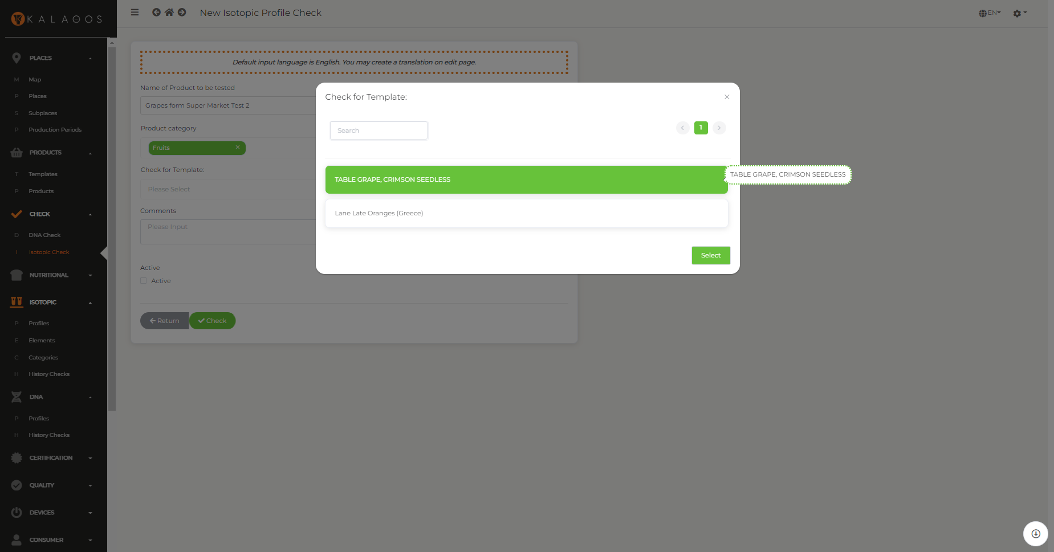
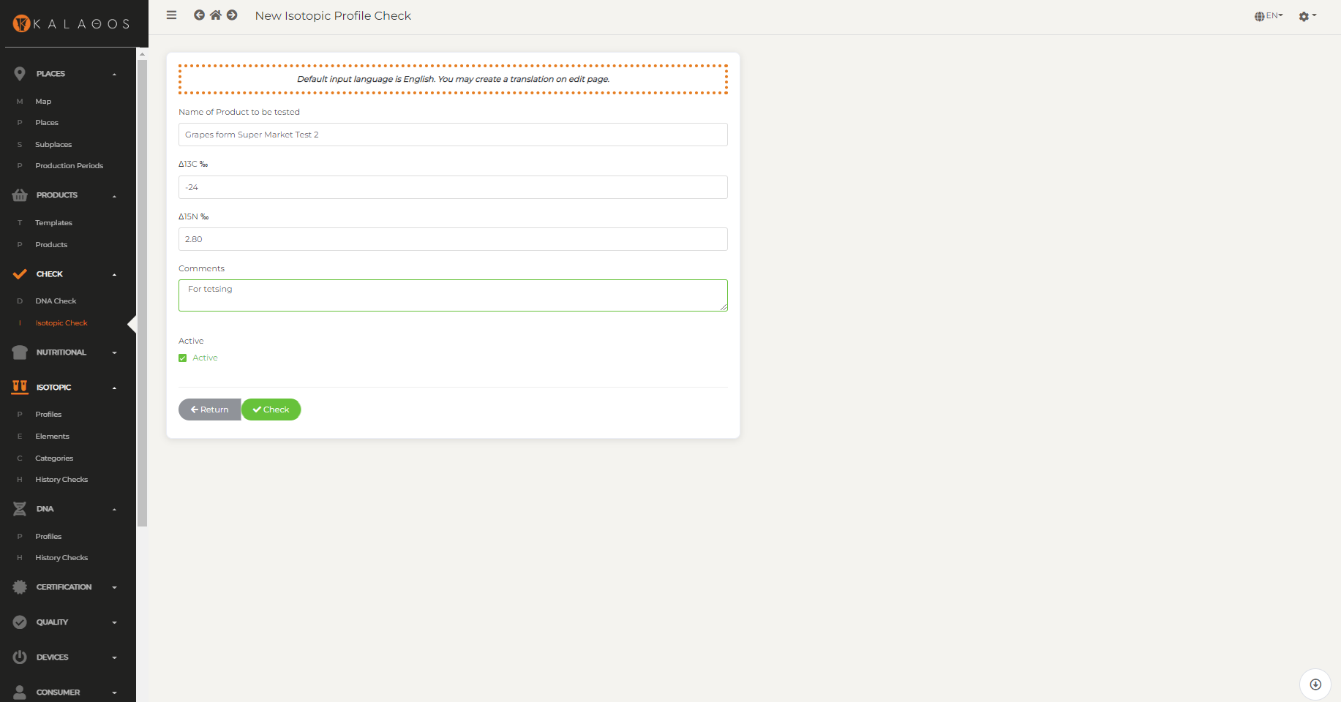
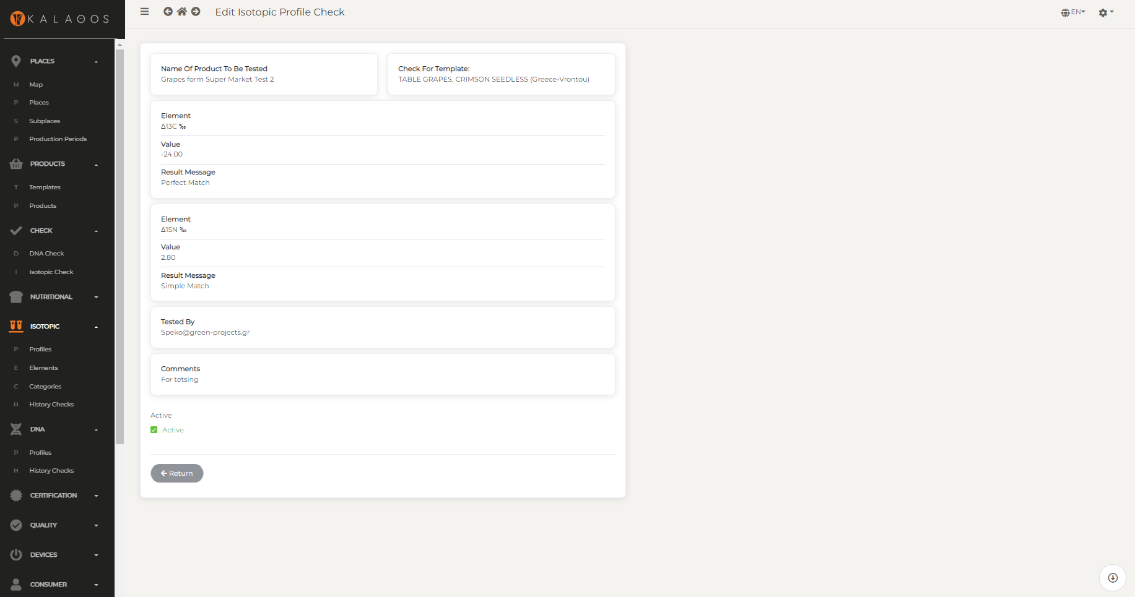
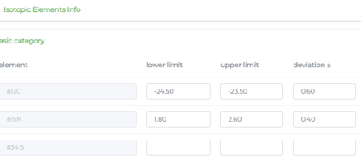
Check Isotopic Profile

Slide 11
The steps
Describe standard template products for specific areas [once]
(Use GS1’s GPC and attach DNA and Isotopic profile)
Register the farms + packing houses + assign products [once + update]
Create production periods – estimate yield [annual cycle]
Record events on the supply chain using EPCIS (farm → packing → distribution → retailer) – Check inventory level per LOT number and place [real time]
Monitor harvested quantities per farm [cumulative]

Slide 12
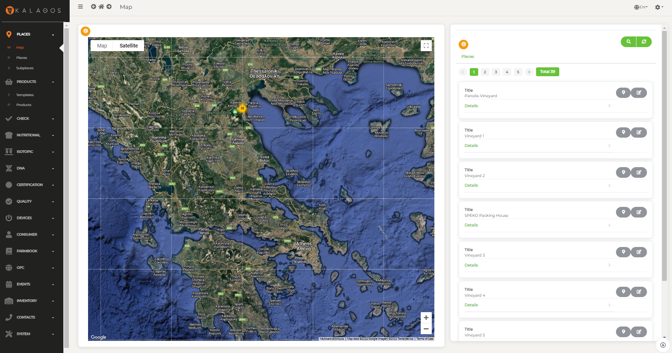
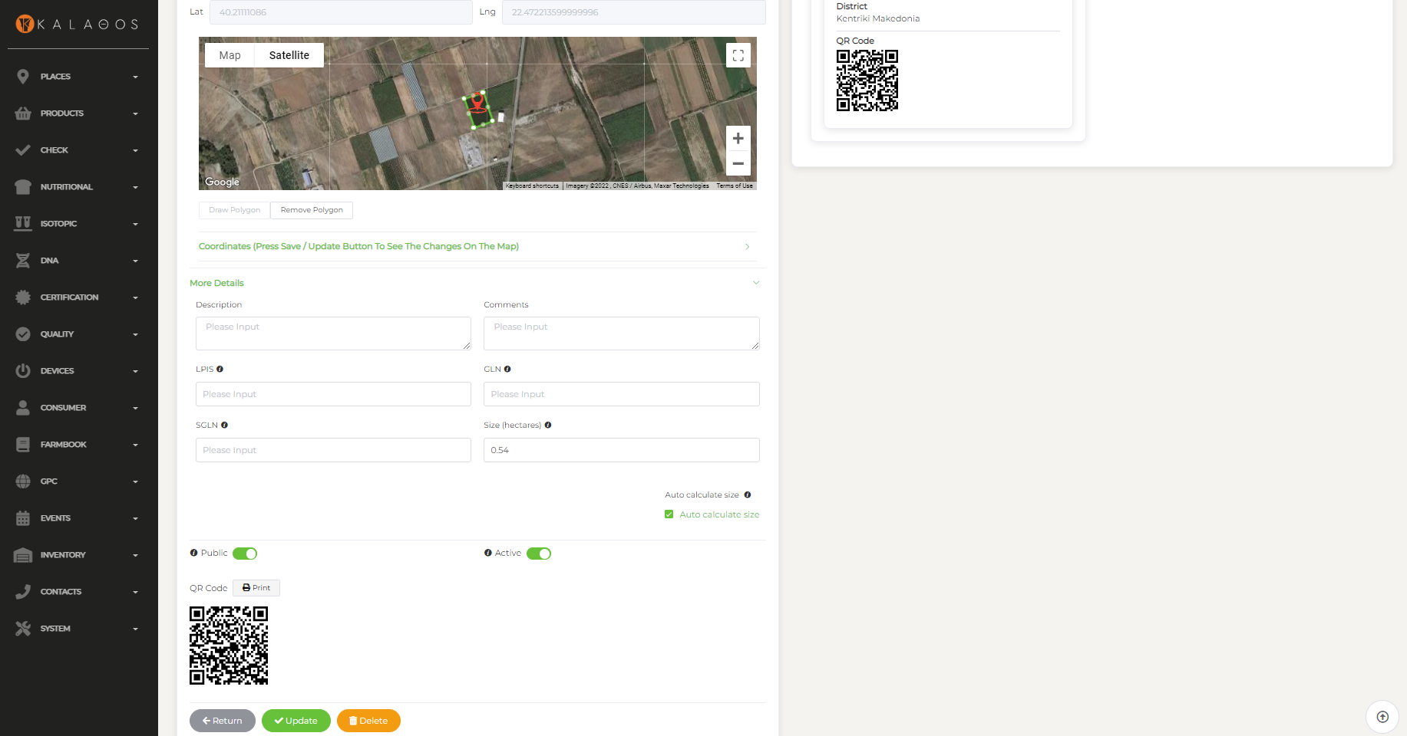
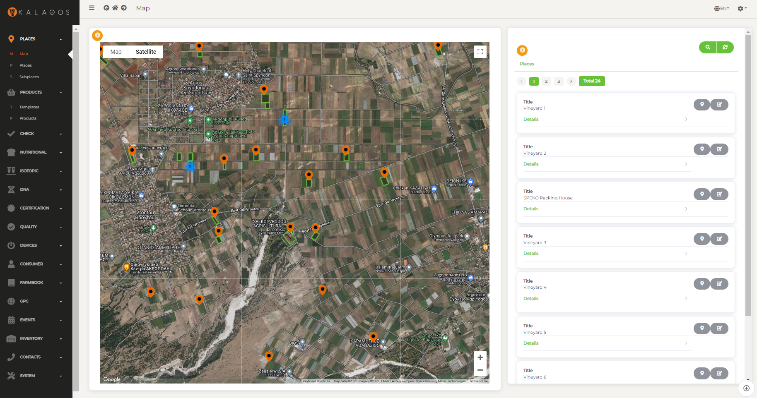
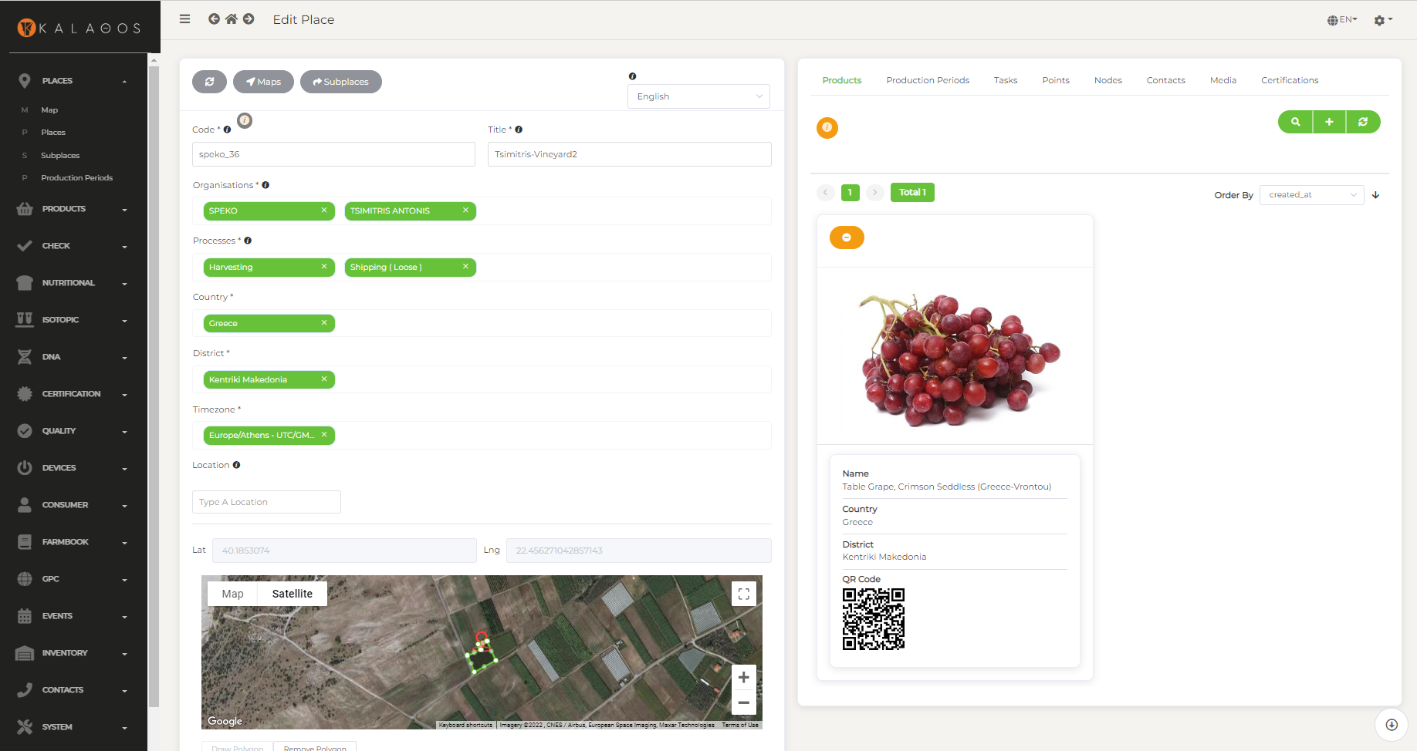
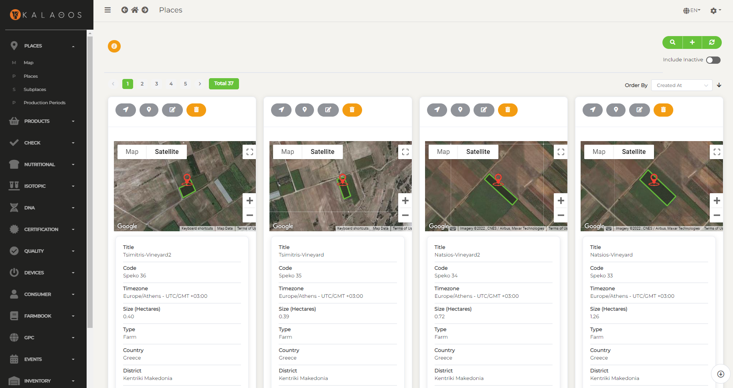
Farm Registration

Slide 13
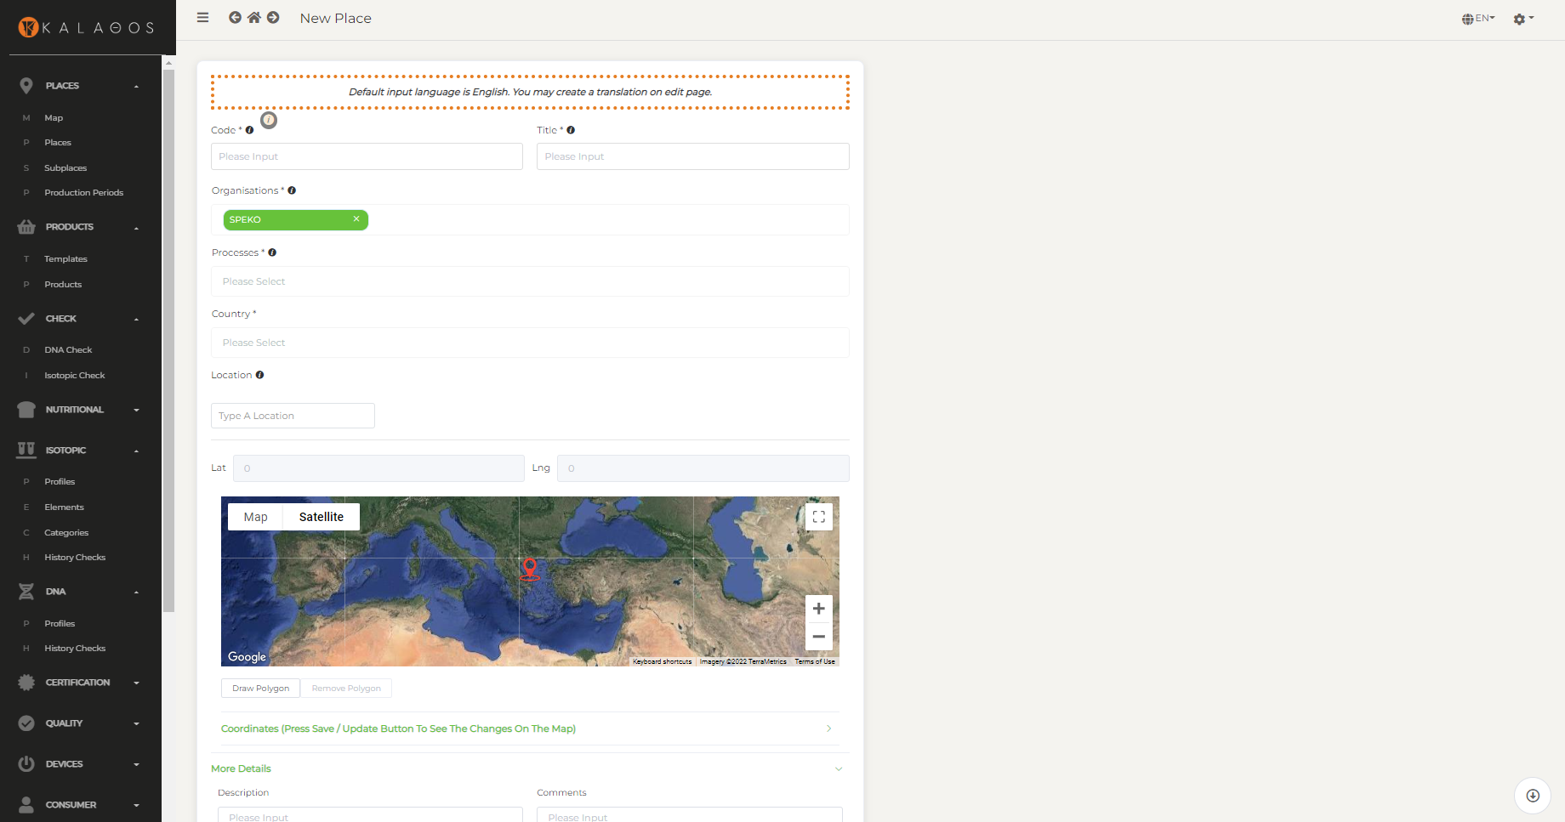
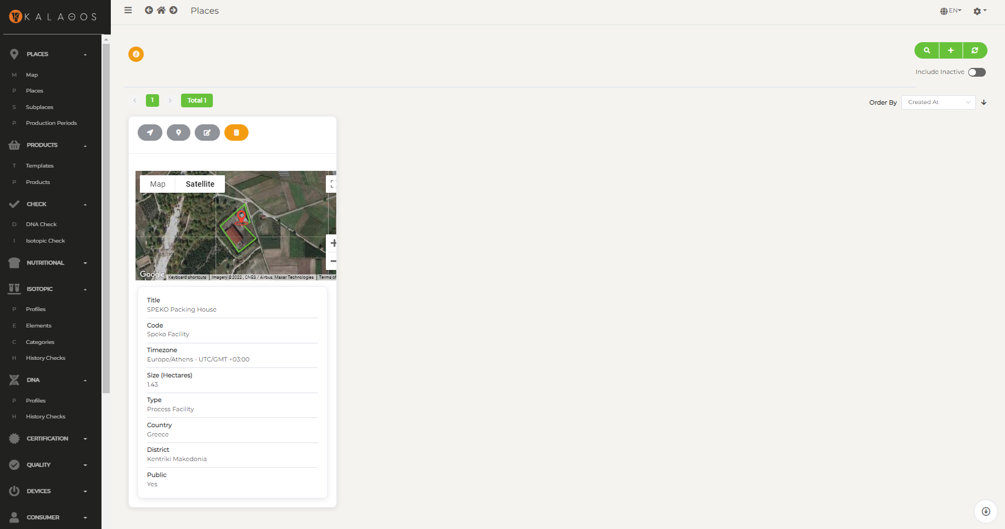
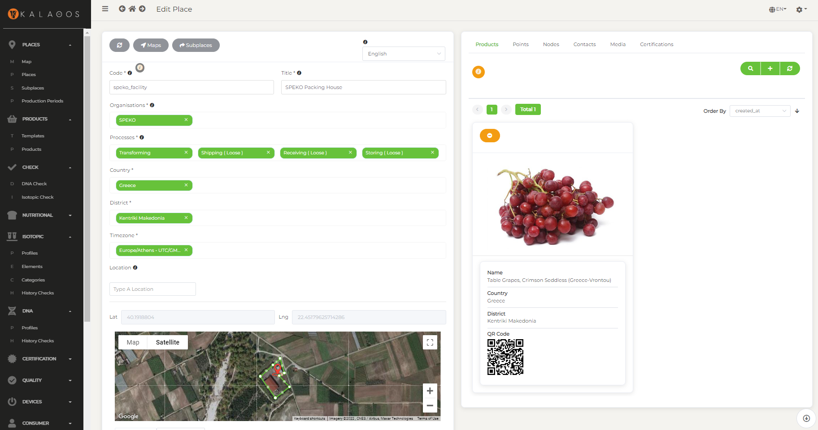
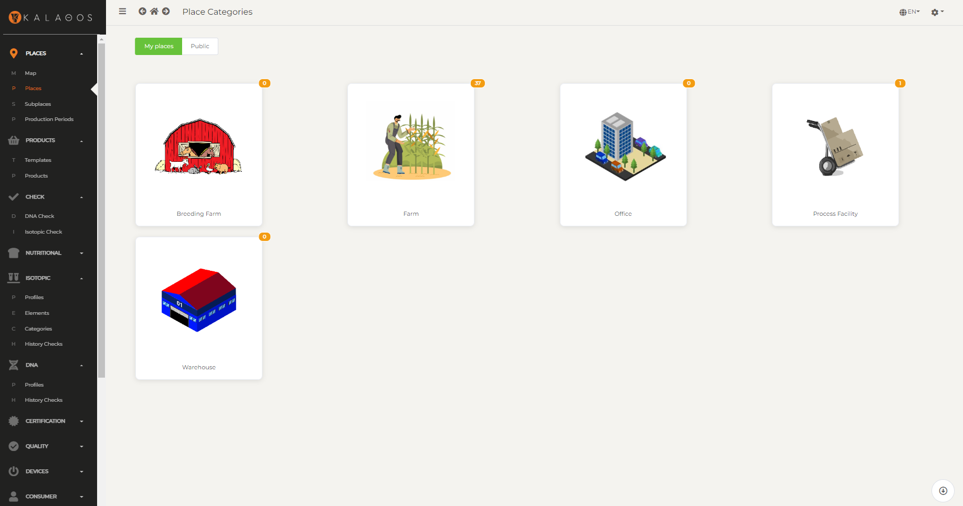
Packing House Registration

Slide 14
The steps
Describe standard template products for specific areas [once]
(Use GS1’s GPC and attach DNA and Isotopic profile)
Register the farms + packing houses + assign products [once + update]
Create production periods – estimate yield [annual cycle]
Record events on the supply chain using EPCIS (farm → packing → distribution → retailer) – Check inventory level per LOT number and place [real time]
Monitor harvested quantities per farm [cumulative]

Slide 15
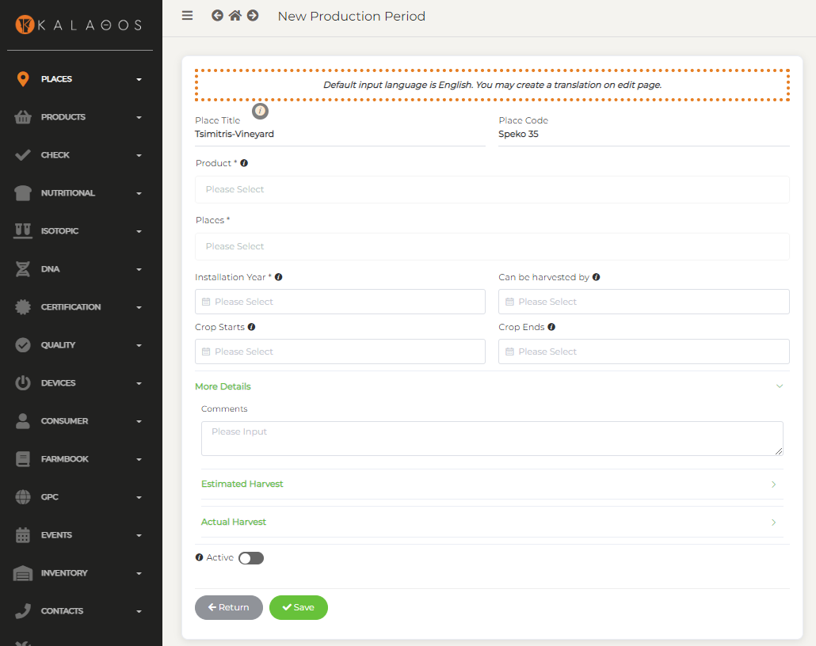
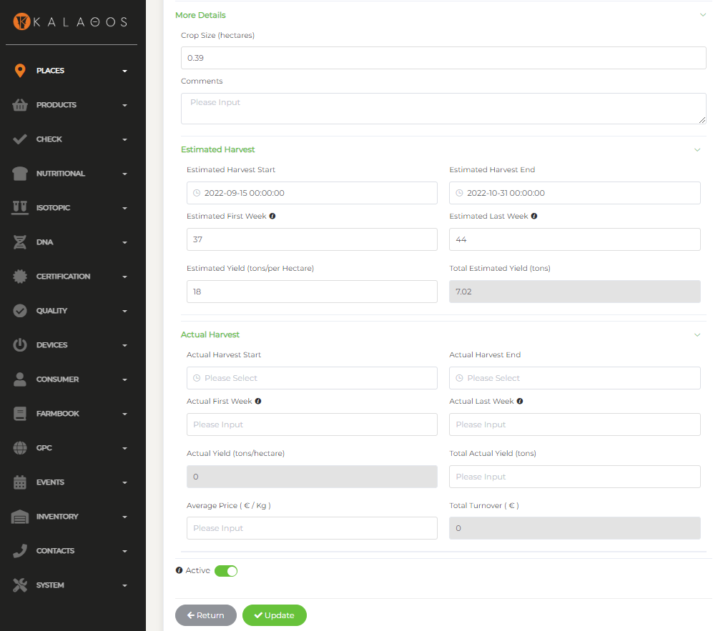
Production Periods

Slide 16
The steps
Describe standard template products for specific areas [once]
(Use GS1’s GPC and attach DNA and Isotopic profile)
Register the farms + packing houses + assign products [once + update]
Create production periods – estimate yield [annual cycle]
Record events on the supply chain using EPCIS (farm → packing → distribution → retailer) – Check inventory level per LOT number and place [real time]
Monitor harvested quantities per farm [cumulative]

Slide 17
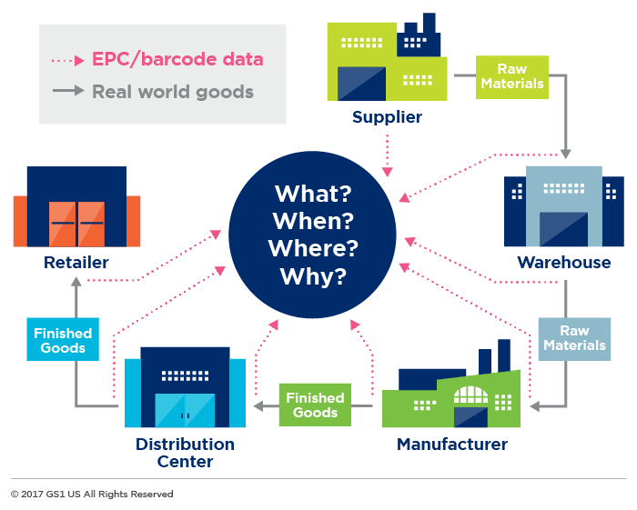
EPCIS by GS1

Slide 18
EPCIS by GS1
Farm
Harvesting
Shipping (loose)
Packing House
Receiving (loose)
Storing (loose)
Transformation
Packing
Storing
Shipping
Warehouse
Receiving
Storing
Shipping
Retailer
Receiving
Unpacking
Placing

Slide 19
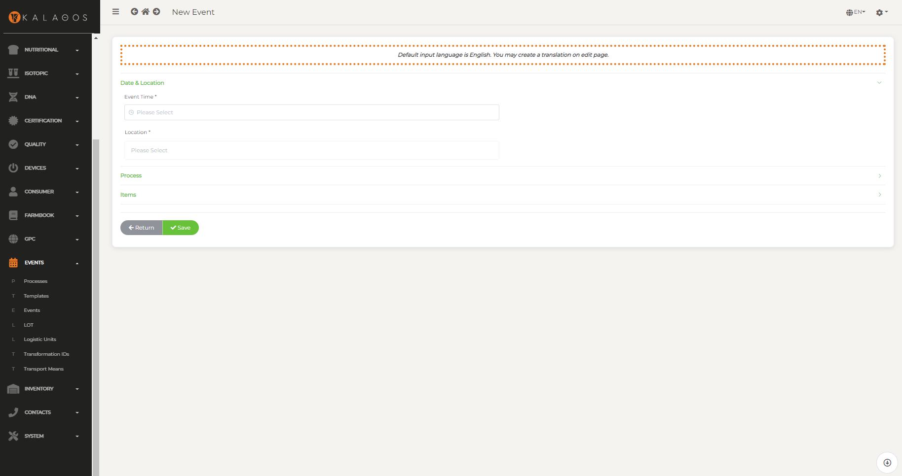
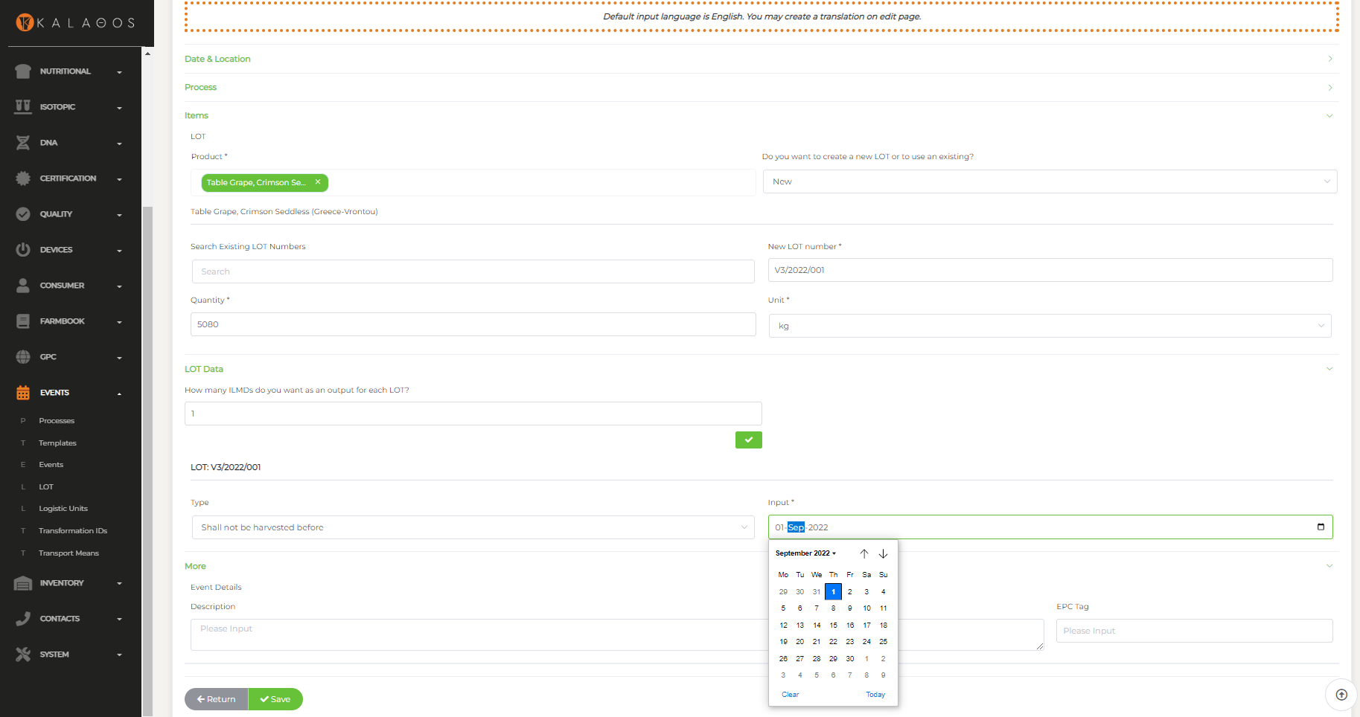
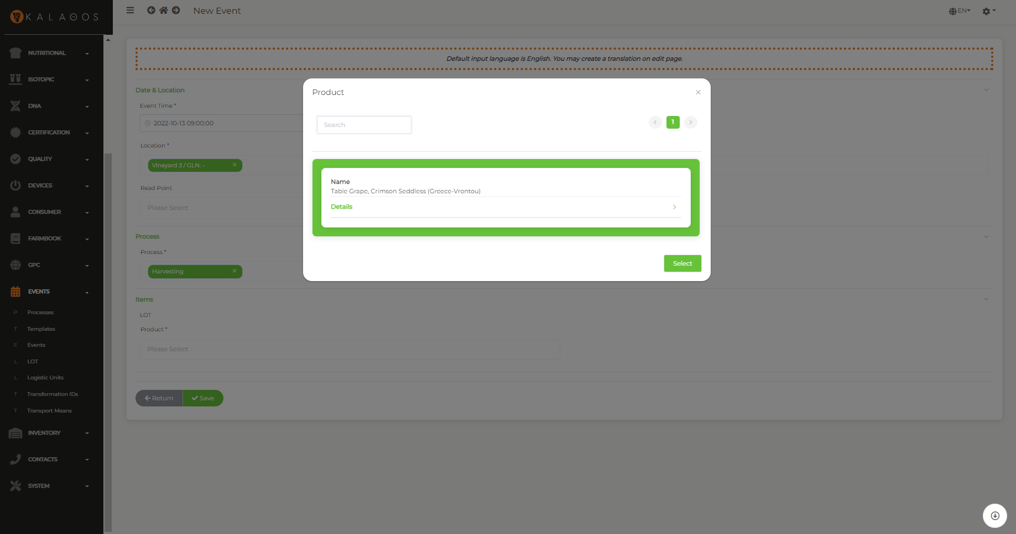
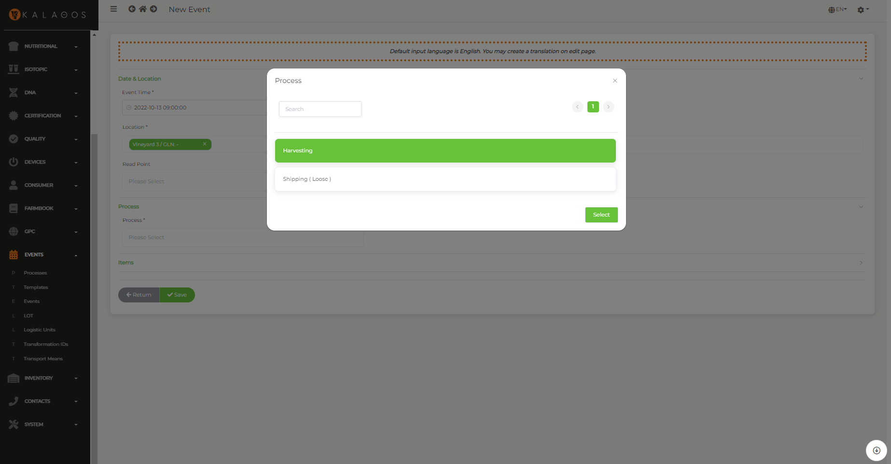
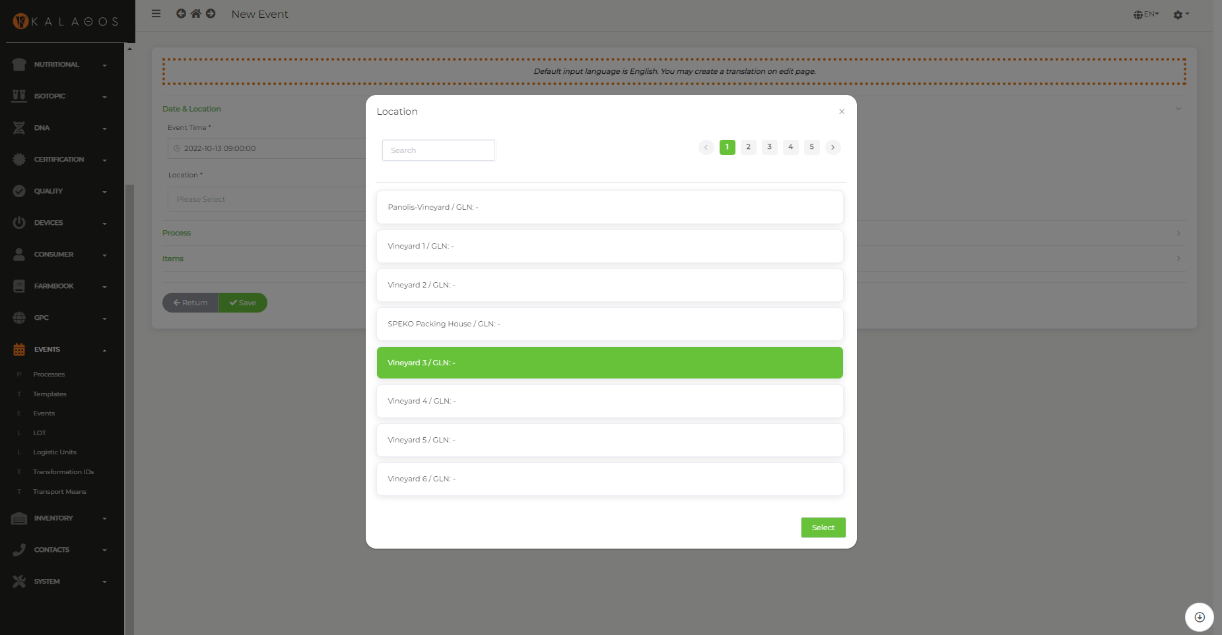
Record Events (EPCIS)

Slide 20
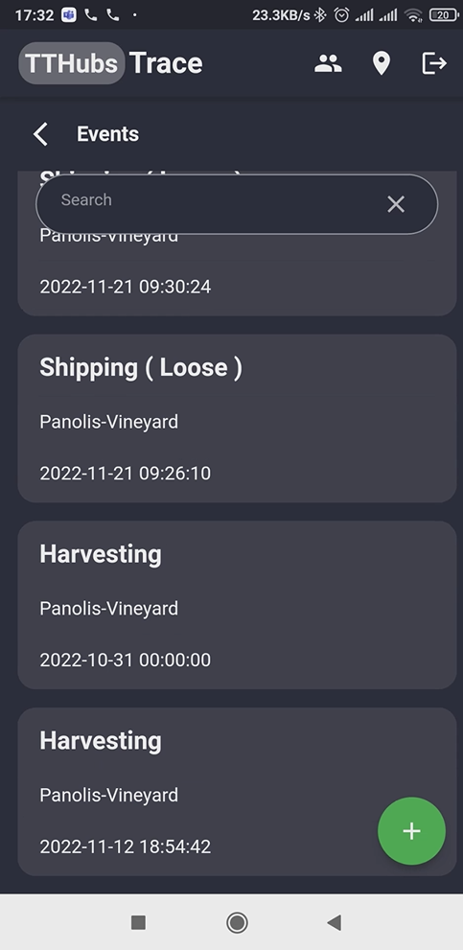
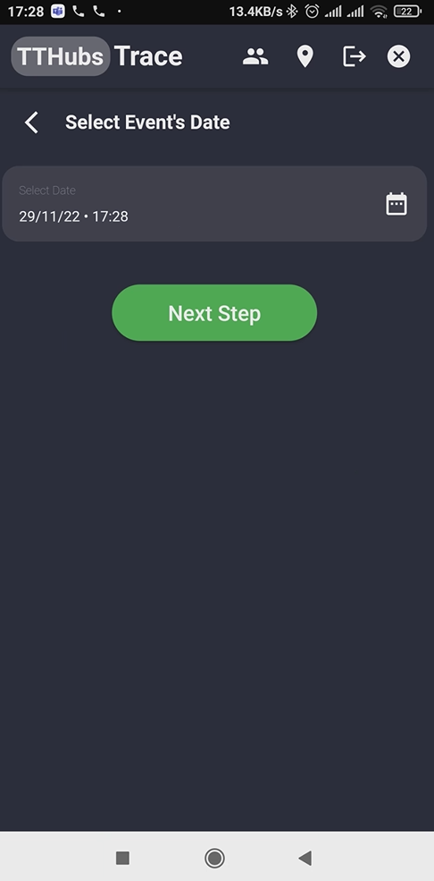
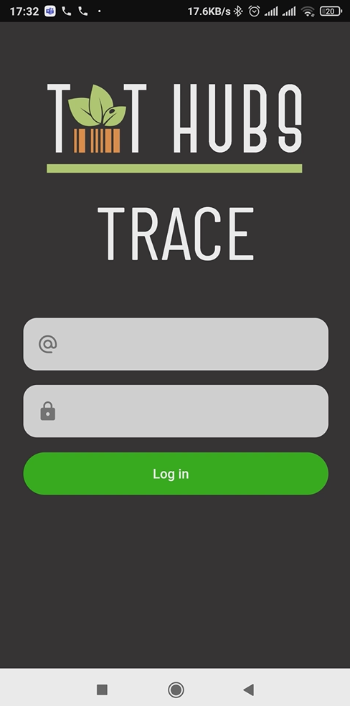
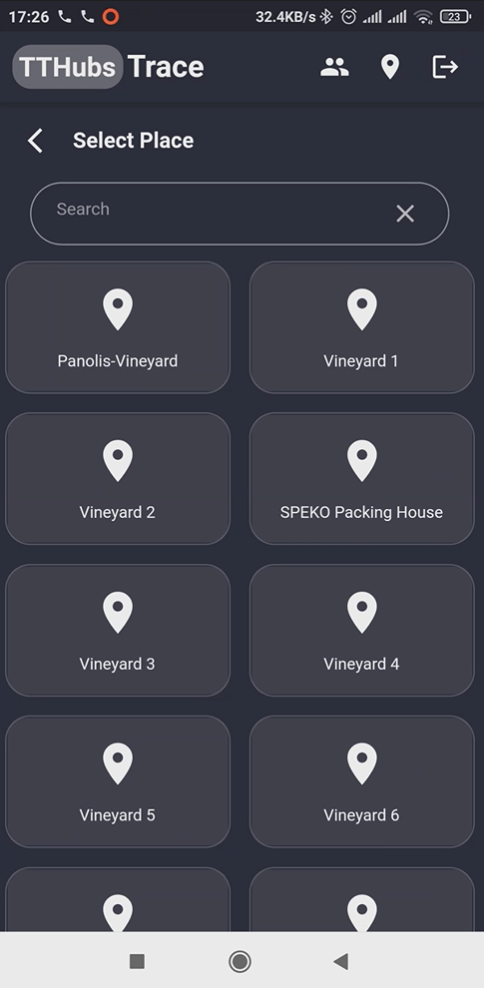
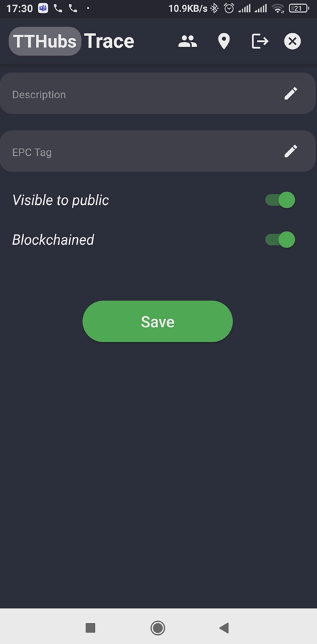
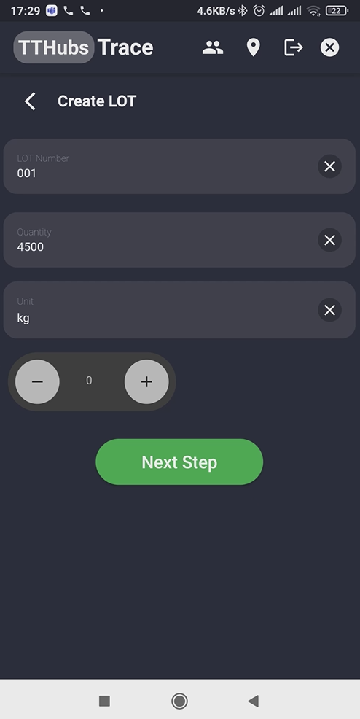
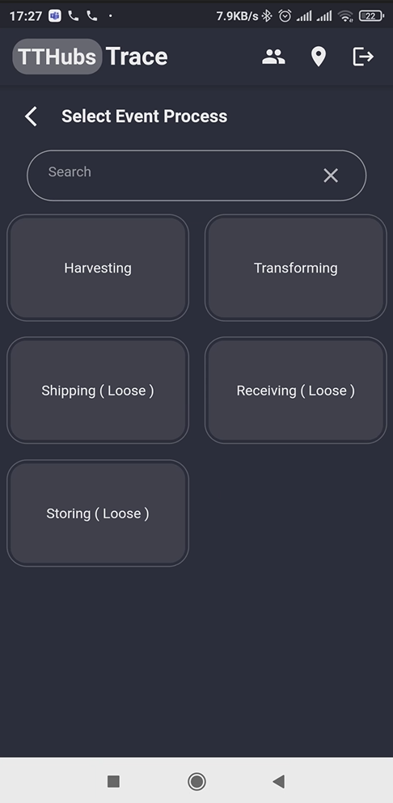
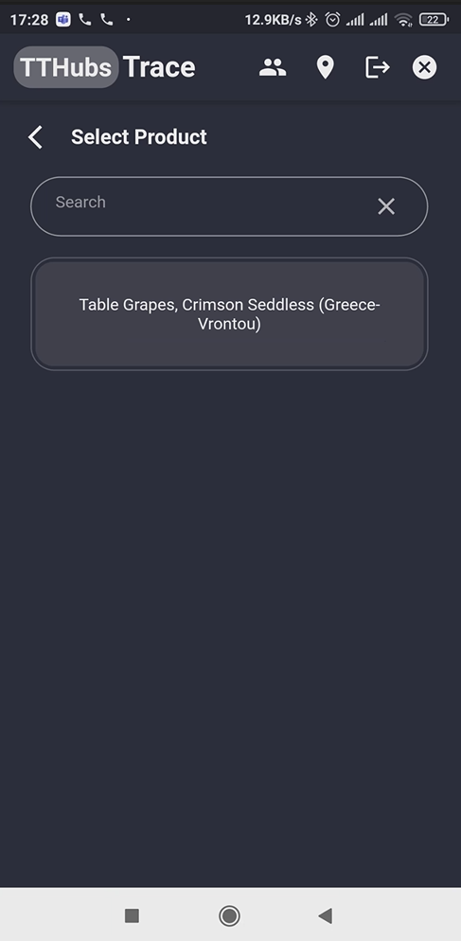
Record Events with App

Slide 21
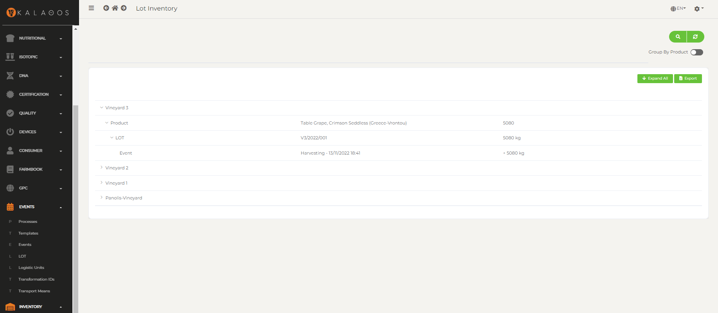
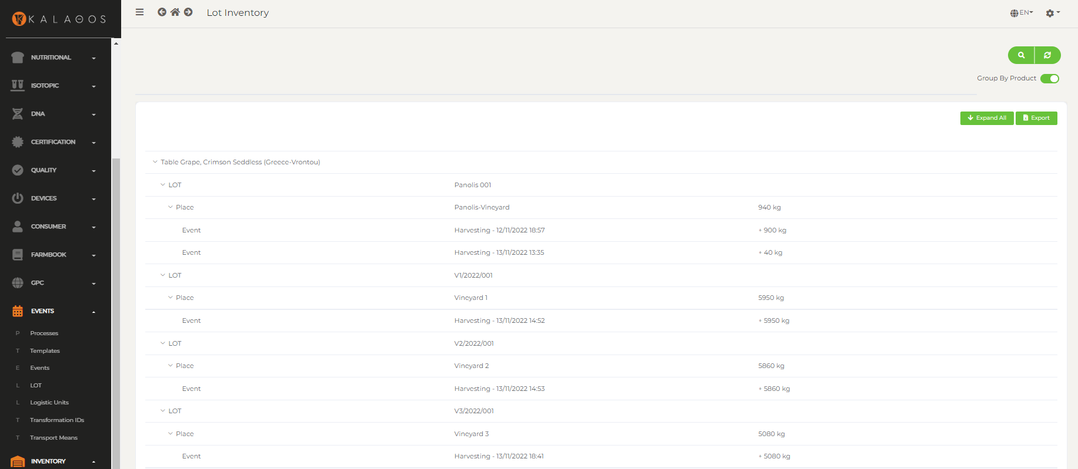
Check Inventory Level

Slide 22
The steps
Describe standard template products for specific areas [once]
(Use GS1’s GPC and attach DNA and Isotopic profile)
Register the farms + packing houses + assign products [once + update]
Create production periods – estimate yield [annual cycle]
Record events on the supply chain using EPCIS (farm → packing → distribution → retailer) – Check inventory level per LOT number and place [real time]
Monitor harvested quantities per farm [cumulative]

Slide 23
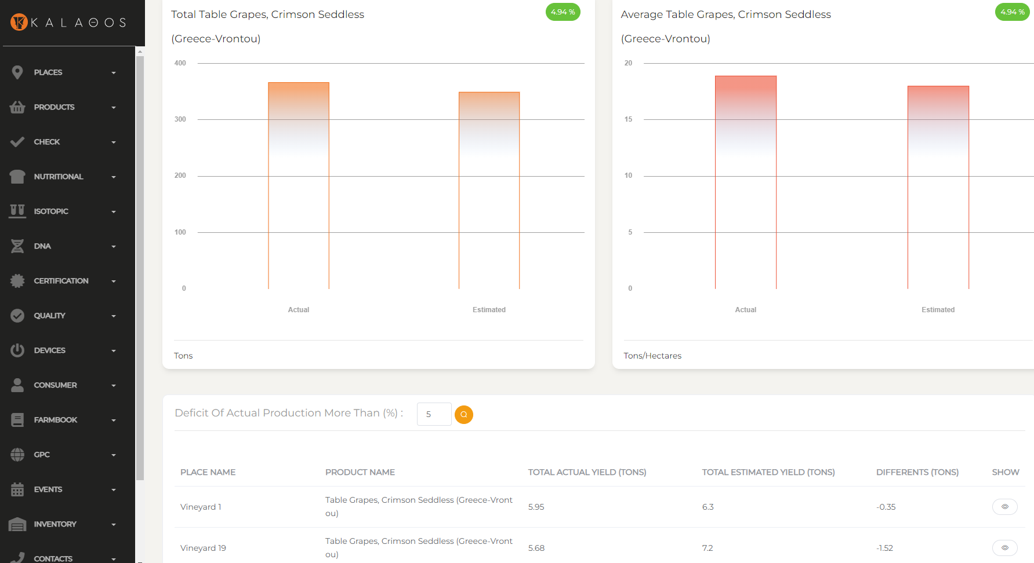
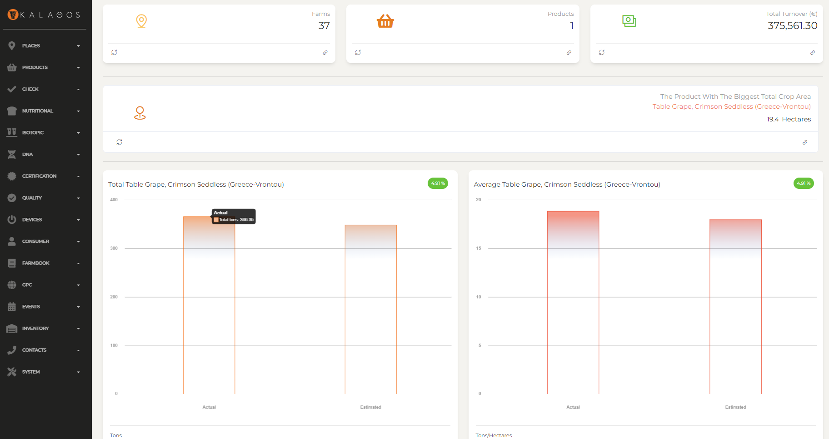
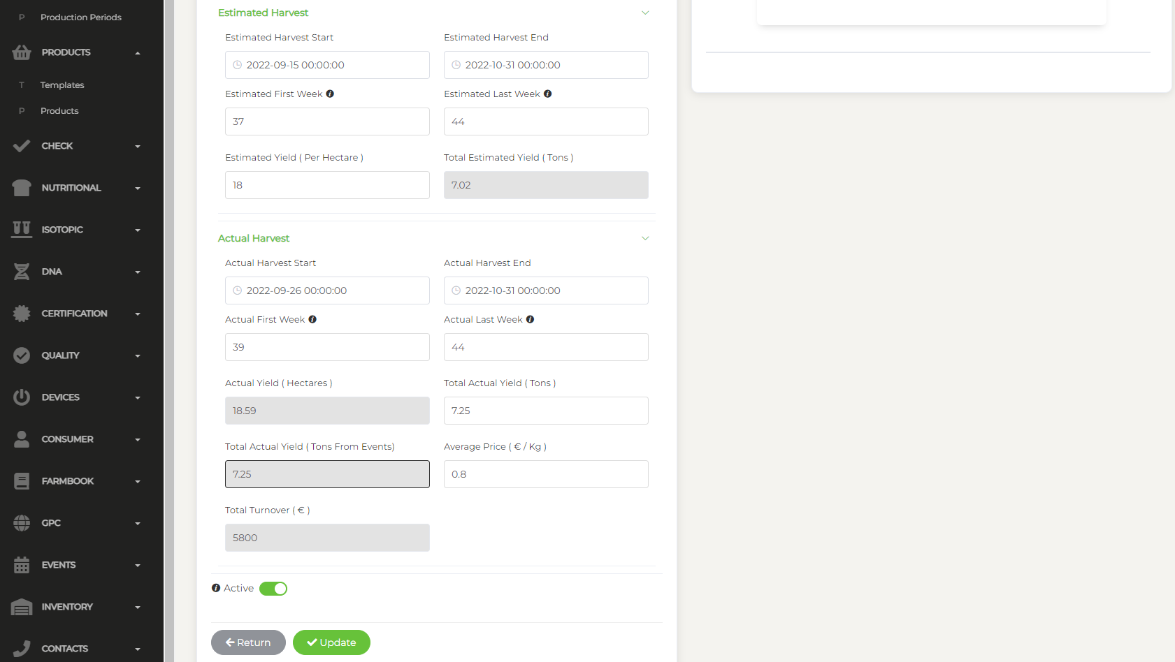
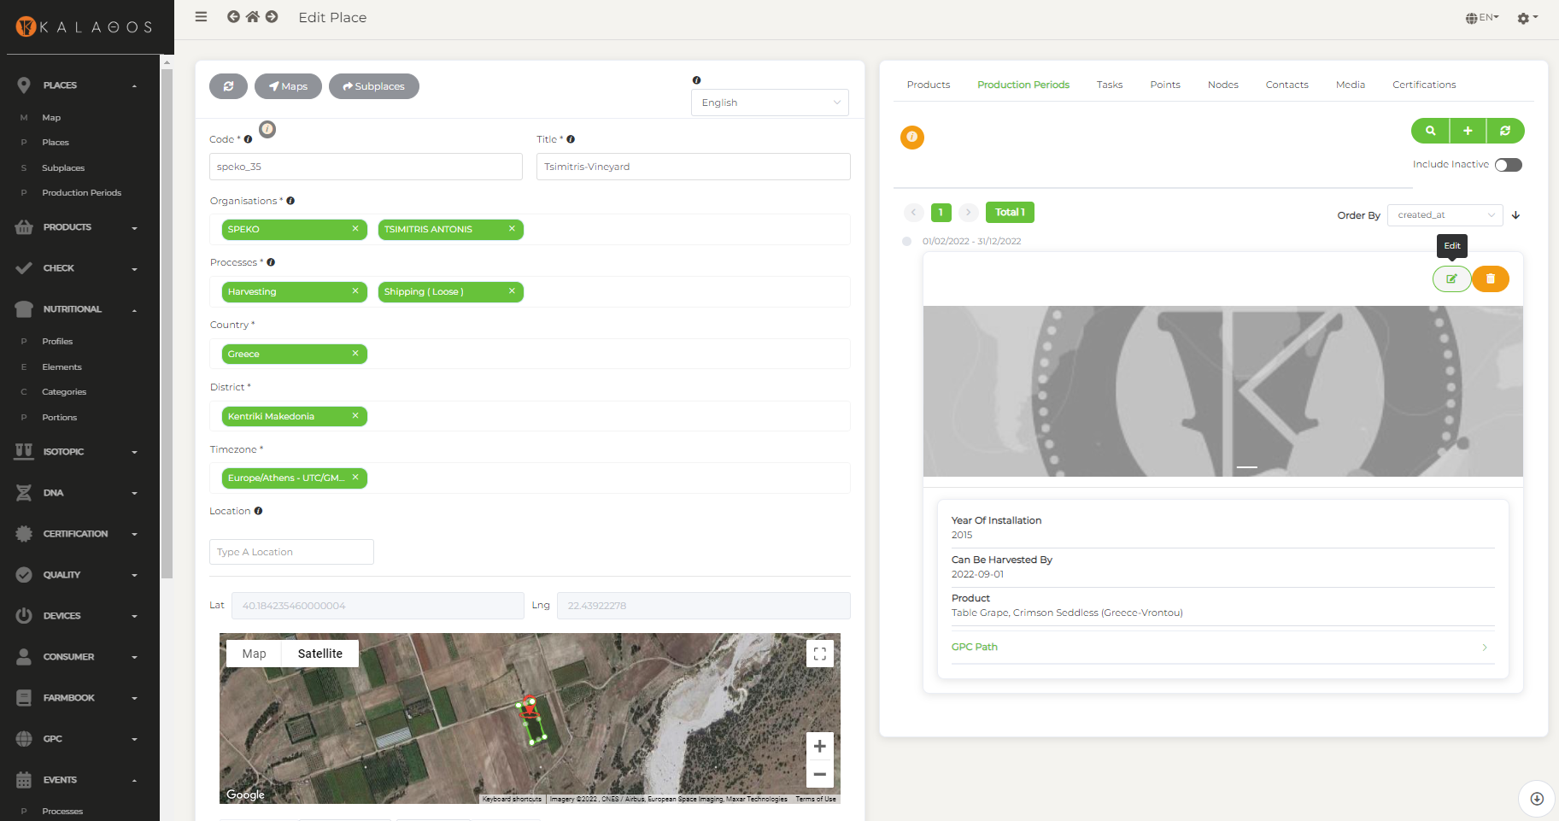
Actual Production

Slide 24
Optional steps
Record tasks per field [at regular basis]
Attach IoT devices to the farms to check conditions at the field [once]
Receive feedback [check the input data at regular basis]

Slide 25
Optional steps
Record tasks per field [at regular basis]
Attach IoT devices to the farms to check conditions at the field [once]
Receive feedback [check the input data at regular basis]

Slide 26
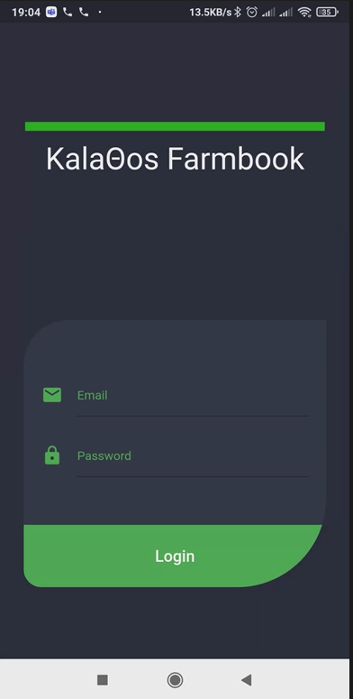
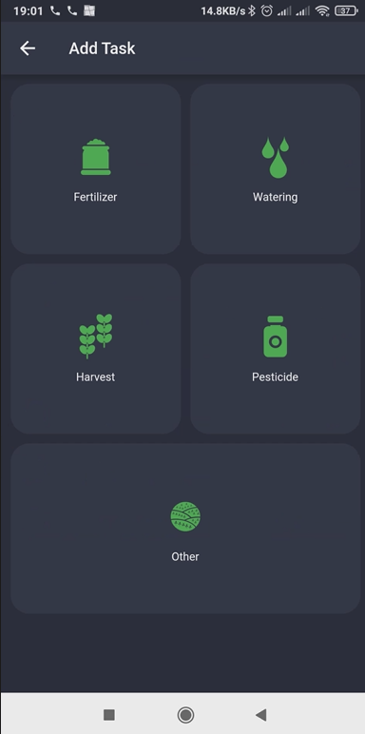


Record Tasks

Slide 27
Optional steps
Record tasks per field [at regular basis]
Attach IoT devices to the farms to check conditions at the field [once]
Receive feedback [check the input data at regular basis]

Slide 28




Attach IoT Devices and Monitor

Slide 29
Optional steps
Record tasks per field [at regular basis]
Attach IoT devices to the farms to check conditions at the field [once]
Receive feedback [check the input data at regular basis]

Slide 30
Share the real story
The real story of each product is available to each consumer just by reading the “Trace me” QR label and by Beacons (BLE) at stores.
Product full profile including personalised nutritional facts
Product’s exact route from farm to shelf.
Product origin details – using photos, videos and maps
Farm’s information

Slide 31








KalaΘos Consumer App

Slide 32






KalaΘos Consumer Web App

Slide 33




KalaΘos Food Waste Label

Slide 34
At the end…
You sahre the whole path of your product
wYou see estimated (potential availability) vs actual production level
You monitor produced volumes & transactions per farm and per packing house
For each received/distributed LOT you know the exact origin
You may correlate quality of product to conditions and actions at the field
Anti-fraud check is supported by comparing DNA and Isotopic profiles
Receive feedback from consumers around the world

Slide 35

Thank you!
www.green-porjects.gr

