Slide 1

NeuroInfant
AI-Driven multimodal decision

Slide 2


Problem
Hypoxic-ischemic encephalopathy (HIE) and early brain maturation disorders in newborns are often diagnosed too late.
Current clinical tools do not integrate multimodal data in real time.

Slide 3
The Project
Main objective:
To develop a validated AI model and a clinical decision-support system for early detection of HIE and neurodevelopmental impairment in infants aged 0–12 months.

Slide 4
Expected outcomes:
  Multimodal predictive model
  Diagnostic algorithms for early detection of abnormal brain maturation
  Telemedicine platform or device for functional brain assessment and remote monitoring
  Integrated tool for longitudinal follow-up

Slide 5
Our Vision
To develop an AI-based predictive and diagnostic model integrating:
  amplitude-integrated EEG (aEEG),
  heart rate variability (HRV),
  General Movements Assessment (GMA),
  HINE neurological assesement,
  clinical data.

Slide 6
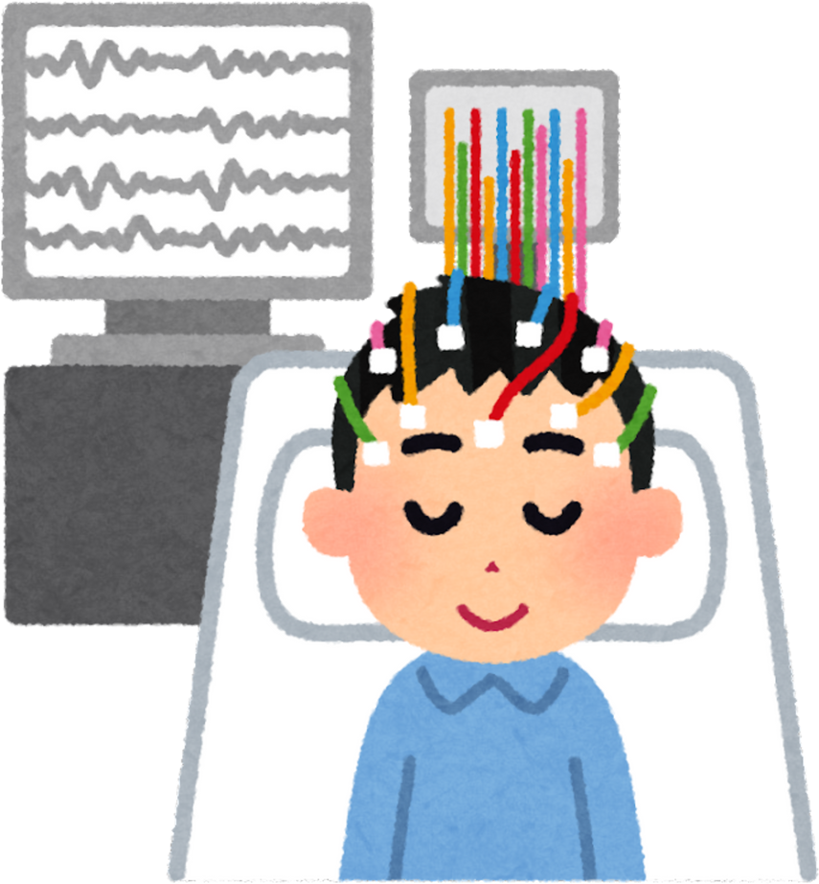
What We Have Now?
Current dataset:
  420 aEEG recordings
  370 clinical cases
  100 videos for GMA
All data are being standardized and anonymised

Slide 7

Current progress:
  Ongoing collection of clinical cases and signals
  Centralized multimodal database in development
  Collaboration with the Biomedical Engineering Department, Kyiv Politechnic University (signal processing + ML)
  Initial statistical and ML data processing has begun

Slide 8

Value
Project delivers:
  New scientific insights into early brain maturation
  A novel technological solution for neonatal care
  A digital tool for clinicians and early intervention centers
  Social impact: reduced disability and mortality, improved neurodevelopment, reduced healthcare burden

Slide 9
Technological Solution/ Ideas for discussion
Development of a portable neonatal device for data collection in hospitals and at home.
  Wearable cap/helmet for aEEG and selected EEG channels
  Chest-mounted sensor for HRV, respiration, and movements
  Digital platform / mobile app with remote access and AI analytics
  Real-time data streaming to clinicians or early-intervention specialists

