Slide 1
Marleen Och and Eike Klapper, European Commission

Slide 2
Financing Competitiveness
Notes:
Thank DK presidency

Slide 3
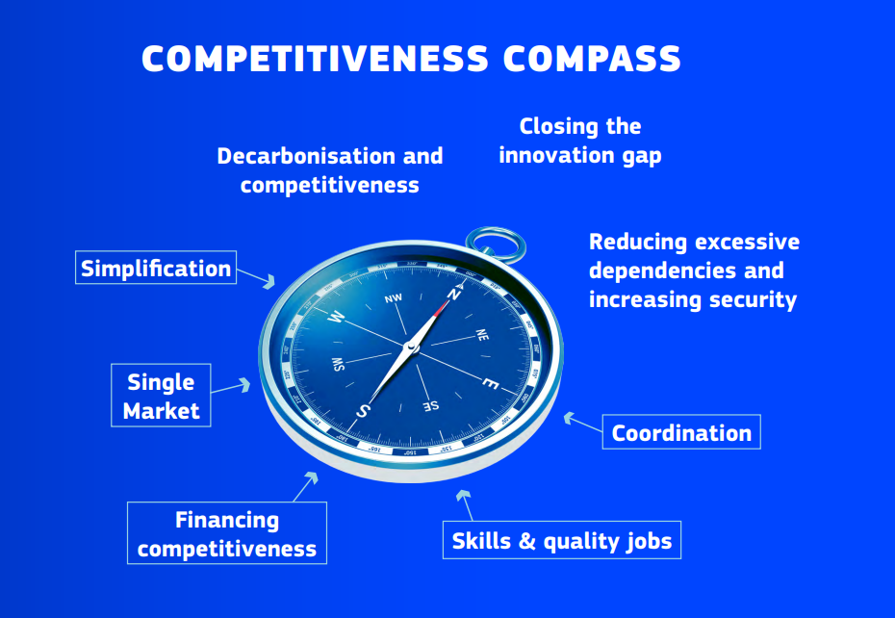
  Context
  Draghi Report → Competitiveness Compass
  Clean Industrial Deal: business plan to accelerate competitiveness and decarbonisation for European industry
  Includes: European Competitiveness Fund
  Plus: Simplification (Omnibus(es), incl. InvestEU)
Notes:
Thank DK presidency

Slide 4
Sustainable Finance
Current framework and updates on the ongoing simplification
Notes:
Thank DK presidency

Slide 5
EU Sustainable Finance Framework
  Disclosures
  Corporate Sustainability Reporting Directive (CSRD)
  Sustainable Finance Disclosure Regulation (SFDR)
  Sustainability preferences
  ESG Rating Regulation
  Tools
  European Green Bonds Standard (EuGBS)
  Climate Benchmarks
  EU Taxonomy
  Taxonomy Regulation
  Disclosures Delegated Act
  Climate and Environmental Delegated Acts
Notes:
Thank DK presidency

Slide 6



EU Sustainable Finance Framework
reporting info goes to
Large companies
publicly report
publicly report
Financial market participants
Corporate Sustainability Reporting Directive (CSRD)
Sustainable Finance Disclosures Regulation (SFDR)
EU Taxonomy
Companies report about their social, environmental and governance risks and impacts
Classification system for environmentally sustainable economic activities
Informs about the ‘taxonomy-alignment’ of a company, project or investment
Disclose information about sustainability at
Entity level
Product level
Notes:
Thank DK presidency

Slide 7
Review and Simplification
  Disclosures
  Corporate Sustainability Reporting Directive (CSRD)
  Sustainable Finance Disclosure Regulation (SFDR)
OMNIBUS
OMNIBUS
  EU Taxonomy
  Disclosures Delegated Act
  Climate and Environmental DAs
ONGOING REVIEW
ONGOING REVIEW
  Mitigation, Adaptation, Water, Circular economy, Pollution, Biodiversity
Notes:
Thank DK presidency

Slide 8
  Simplification - Current and future work around the EU Taxonomy
Disclosures - Published
Climate and Environmental DAs - Ongoing
Platform on Sustainable Finance - Upcoming
Review of Disclosures Delegated Act as part of the Omnibus package
Revisions and/or updates of existing criteria to align with technical and policy changes and improve usability
Development of additional activities and criteria
Notes:
Thank DK presidency

Slide 9
Simplification – Main elements of the Omnibus proposal for CSRD
Stop-the-clock: no phasing-in of additional companies.
Scope: limiting the scope to ‘large companies’ (over 1000 employees).
Value-chain-cap: limiting information requests for companies outside the scope.
Audit and assurance: only limited assurance required.
ESRS reporting standards: reduce datapoints and complexity.
Notes:
Thank DK presidency

Slide 10
Omnibus – State-of-play
April 2025
Council and EP adopt stop-the-clock proposal
July 2025
Commission adopts ESRS quick fix, VSME recommendations and Omnibus Taxonomy DA
October 2025
EP Plenary does not adopt position
February 2025
Commission publishes Omnibus proposal
June 2025
Council adopts its position
October 2025
EP Committee adopts its position
November 2025
EFRAG to simplify ESRS
Notes:
Thank DK presidency

Slide 11
  About InvestEU
The InvestEU Fund supports private and public investments
InvestEU Portfolio Guarantee Products
  Sustainability (next panel)
    Supports green and climate-friendly investments
    Targets SMEs and small mid-caps in the green transition
    Promotes circular economy and social inclusion
  SME Competitiveness | Innovation & Digitalisation | Microfinance & Social Entrepreneurship (Social Investment) | Skills & Education
Originally €26.2 billion EU budget guarantee
The InvestEU Fund is implemented through financial partners, including the European Investment Bank (EIB) Group and national promotional banks
As of April 2025 € 300 billion of investments mobilized (therefore: ECF)

Slide 12
  InvestEU – Omnibus
Unlocks €55B in public & private investment
Budget boost: EU guarantee increased by €2.9B (from €26.2B → €29.1B)
Drives Key EU Priorities: Competitiveness | Innovation | Decarbonisation | Social Investment
Faster, More Impactful Implementation
Streamlined reporting → saves businesses €350M
Swift rollout → quick, tangible benefits
Expanded Advisory Hub: +€40M → €440M total supporting projects in:
Defence | AI Gigafactories | Quantum Tech | Housing

Slide 13
European Competitiveness Fund
Notes:
Thank DK presidency

Slide 14
  Why ECF? – Lessons from the impact assessment
  The current offer of EU funds does not provide large-scale, seamless funding support on the entire investment journey to address market failures...
  ...with insufficient flexibility to respond to unforeseen needs...
  .. it is also insufficiently linked with other sources of public (national, regional, local) and private funding, which themselves are very fragmented...
  .. there is a financing and investment gap in the latter stages of innovation, development and scaling up of companies, in strategic sectors essential for supporting the competitiveness of the EU economy, including the “valley of death” scaling-up problem..
  (InvestEU has been a resounding success)

Slide 15
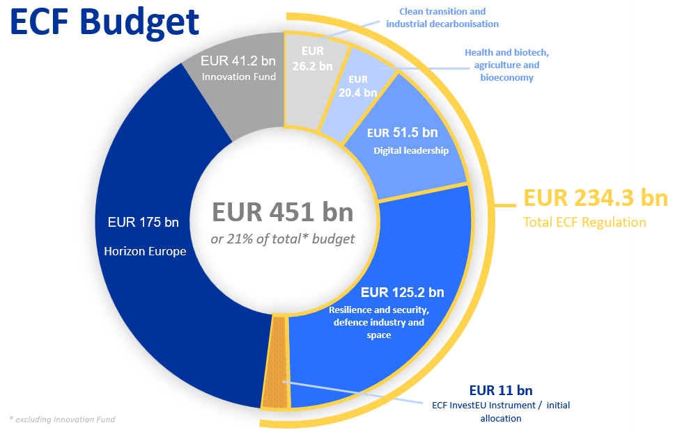

Slide 16
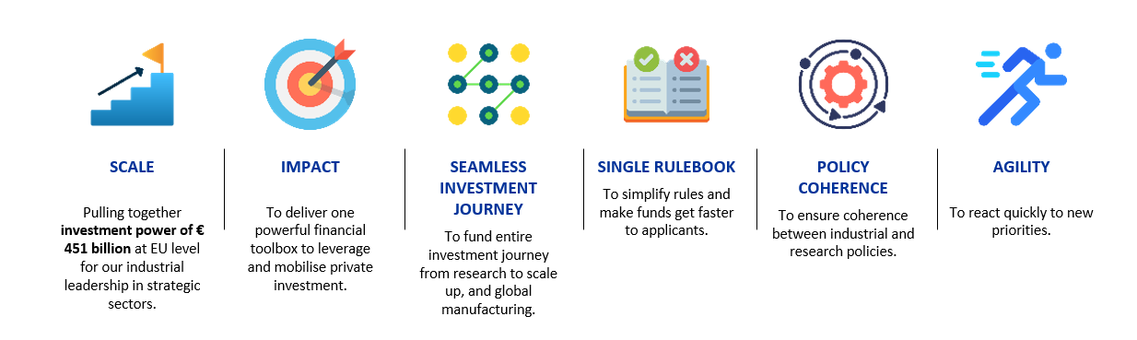
  Main features

Slide 17
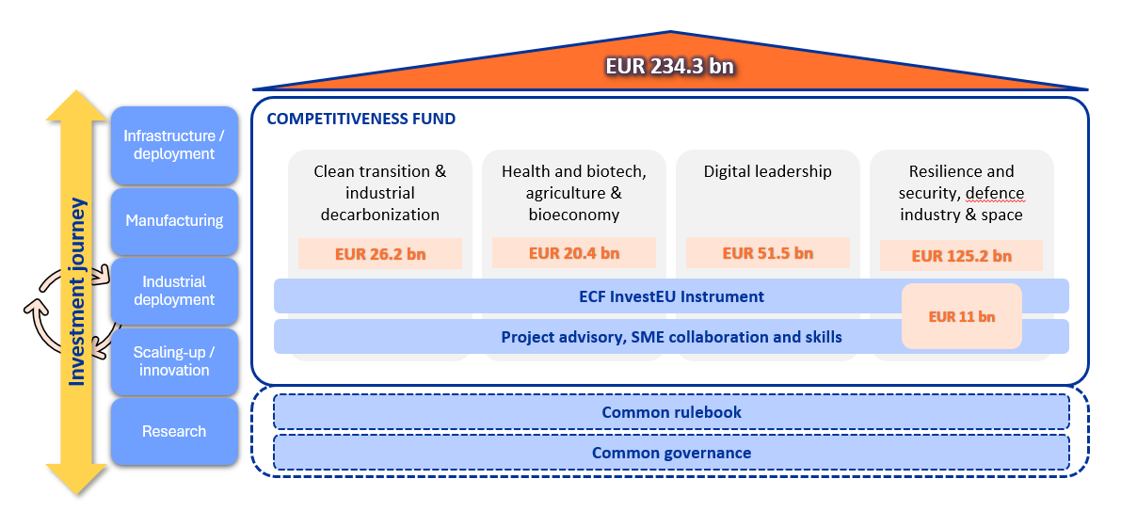
  Architecture

Slide 18
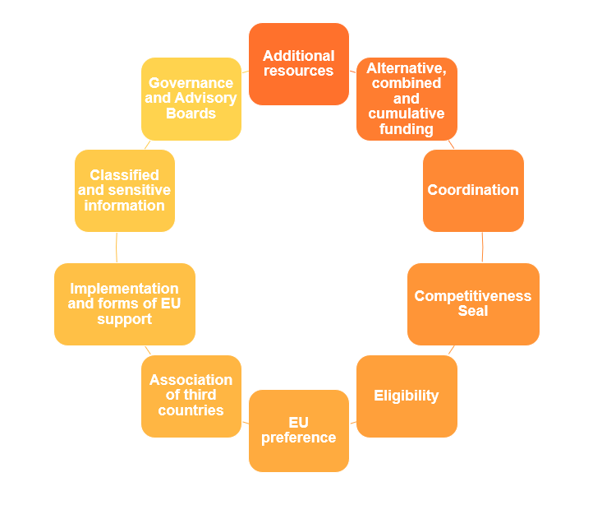
  Single rulebook

Slide 19
  Toolbox
  Grants, procurement and industrial policy coordination tools
  Work Programmes
  Accelerated and Targeted Actions for Competitiveness
  Single Market value chains builder
  EU Tech frontrunners
  Production Ramp up actions
  Top Ups for IPCEIs
  ECF InvestEU Instrument
  Budgetary guarantee
  Financial instruments
  Blending operations
  Support to start-ups and scale-ups
  EU and Member States Compartments

Slide 20
Access to Finance portal
Notes:
Thank DK presidency

Slide 21
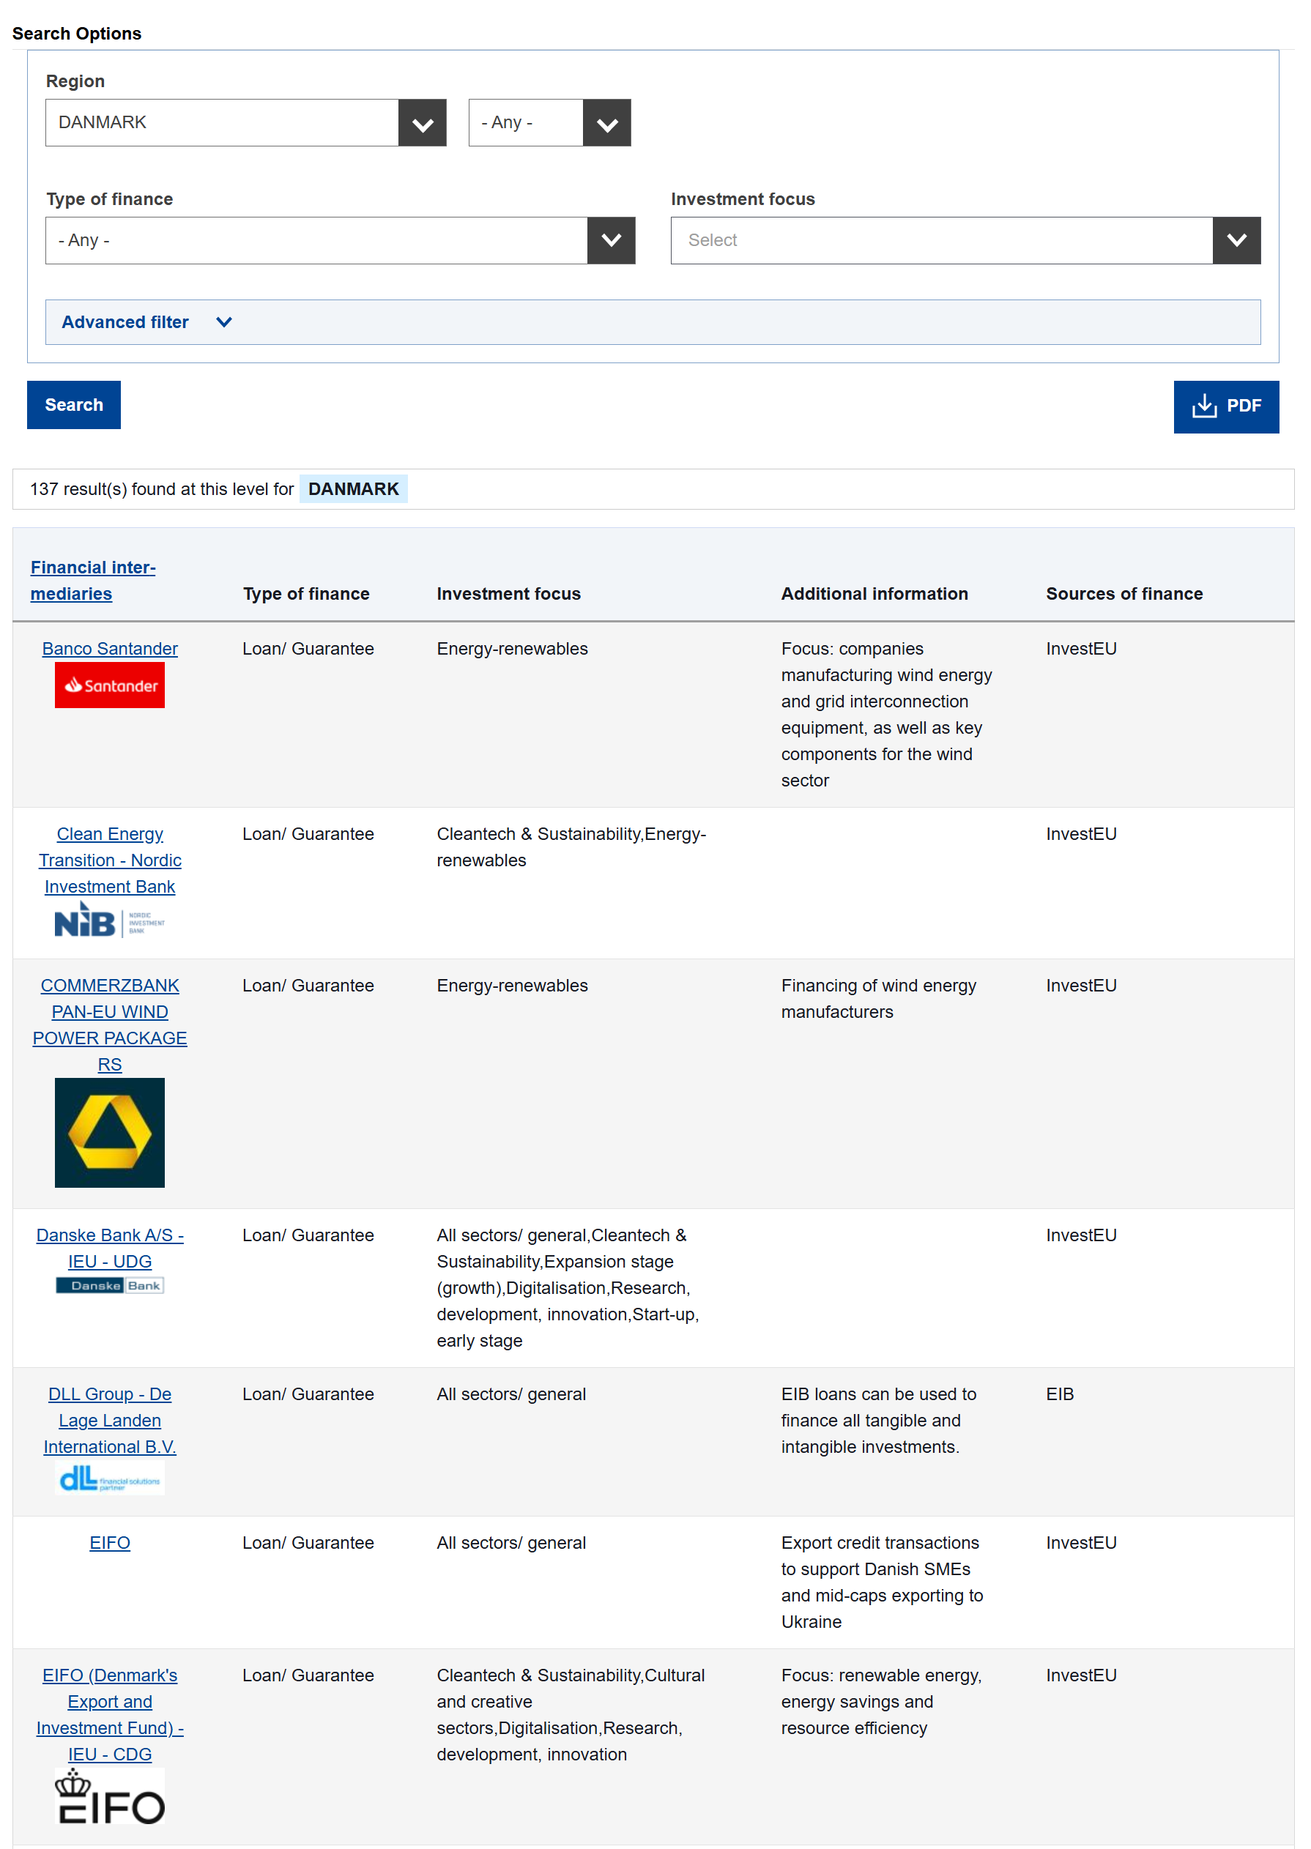
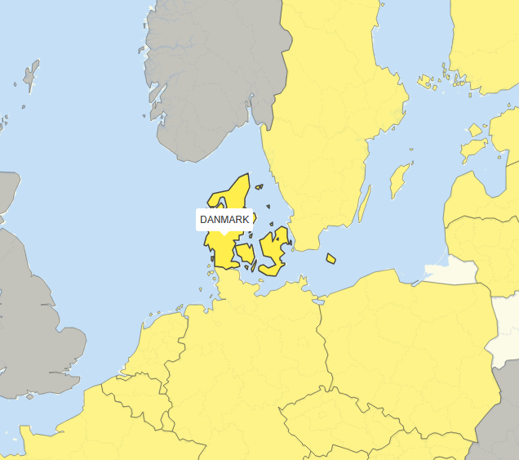

www.access2finance.eu
  Access to Finance portal (Denmark)
Notes:
Thank DK presidency

Slide 22
  Thank you for your attention!
  Questions & Answers

