Slide 1
RAISE project, Main Objectives & Directions
Evdokimos Konstantinidis
Project Coordinator of RAISE
Lab of Medical Physics and Digital Innovation, AUTH

Slide 2
Open Data
Increased transparency and accountability: Open data enables citizens to better understand how government, businesses, and other organizations are operating, and can help to hold them accountable for their actions.
Improved decision-making: Open data can provide policymakers, researchers, and businesses with valuable insights that can inform better decision-making.
Increased innovation: Open data can fuel innovation by enabling entrepreneurs and developers to create new products and services that make use of data.
Improved efficiency: Open data can reduce duplication of effort and improve efficiency by enabling organizations to share data and collaborate more effectively.
Economic growth: Open data can create new business opportunities and contribute to economic growth by enabling the development of new products and services.
Improved public services: Open data can help to improve public services by enabling governments to better understand the needs of citizens and tailor services accordingly.
Empowerment of citizens: Open data can empower citizens by enabling them to access and use data to better understand issues and make informed decisions.

Slide 3
How many of you believe in the value of open data?

Slide 4
How many of you search for available open data before you start collecting your own?

Slide 5
How many of you have collected data in the last 5 years?

Slide 6
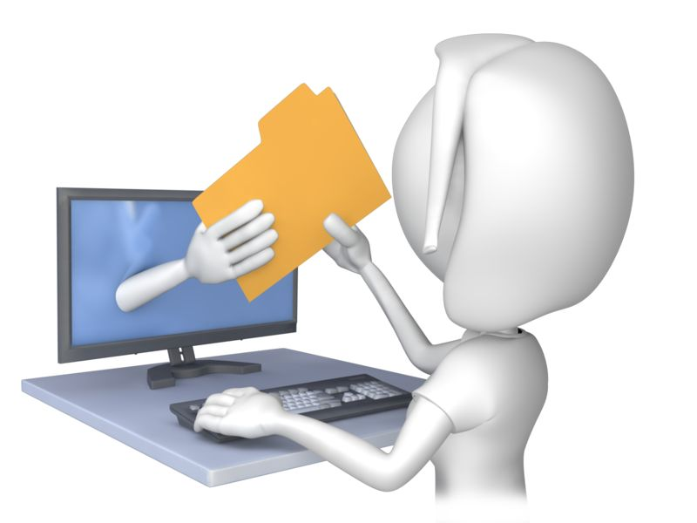
How many of you made this data open and available?

Slide 7
Is it only us??
Source: European Commission, Directorate-General for Research and Innovation, European Research Data Landscape : final report, Publications Office of the European Union, 2022, https://data.europa.eu/doi/10.2777/3648

Slide 8
Who do we share our data with?

Slide 9
What are the barriers to open data?
Legal and ethical issues: Researchers may be hesitant to share data openly due to legal and ethical concerns, such as the potential for breaching confidentiality or violating intellectual property rights.
Lack of funding and resources: Researchers may lack the necessary funding and resources to manage and share data effectively.
Data quality concerns: Researchers may be hesitant to share data openly if they are concerned about the quality or accuracy of the data, or if they fear that the data may be misinterpreted or misused.
Technical barriers: Researchers may face technical barriers in terms of the tools and infrastructure required to effectively manage and share data.
Data access and ownership: Researchers may face challenges in terms of accessing and using data, particularly if the data is owned or controlled by third parties.
Lack of incentives: Researchers may be hesitant to share data openly if they do not see a clear incentive or benefit for doing so.
Cultural and social factors: Finally, researchers may face cultural and social barriers that make it difficult to share data openly, such as a lack of awareness or understanding about the importance of open data, or a lack of trust in the data sharing process.

Slide 10
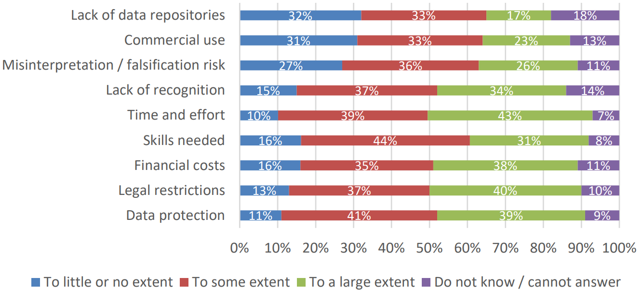
Obstacles to the management and sharing of research data
Source: European Commission, Directorate-General for Research and Innovation, European Research Data Landscape : final report, Publications Office of the European Union, 2022, https://data.europa.eu/doi/10.2777/3648

Slide 11
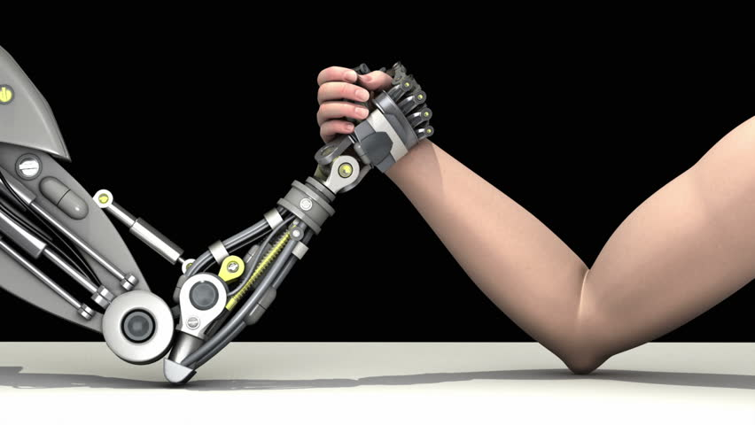
Who should change?
https://www.knowledgeidea.com/two-contradictory-view-points-for-technological-advancement

Slide 12
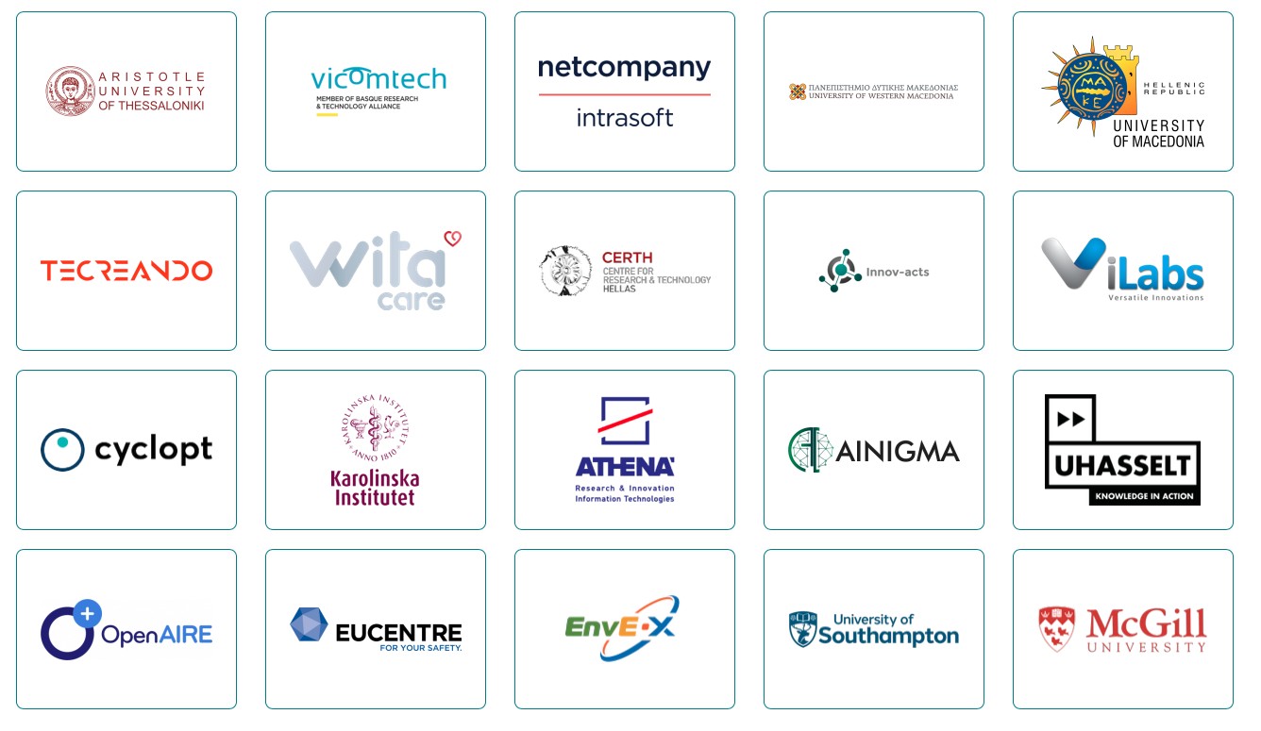
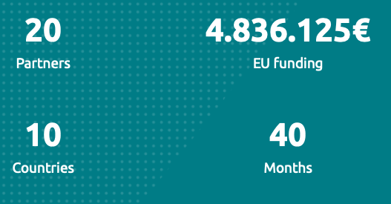
Consortium

Slide 13
Our Vision
Our VISION is the EOSC Web of FAIR Data and Services for Science is an open, fair and reliable Research Community where every researcher will be accredited for their work and all research data will be equally accessible for processing without violating data protection regulations.

Slide 14
Our Mission
In line with this vision, the mission of RAISE is to provide the infrastructure for a distributed crowdsourced data processing system, moving from open data to data open for processing.
RAISE will provide the mechanism for sending the algorithm to the dataset instead of sending the data to the algorithm.

Slide 15
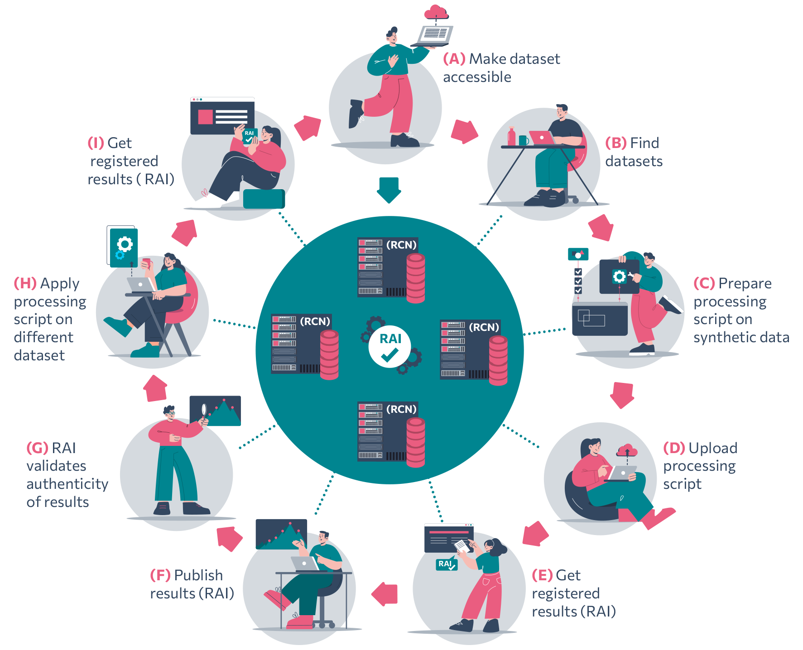
How it works

Slide 16
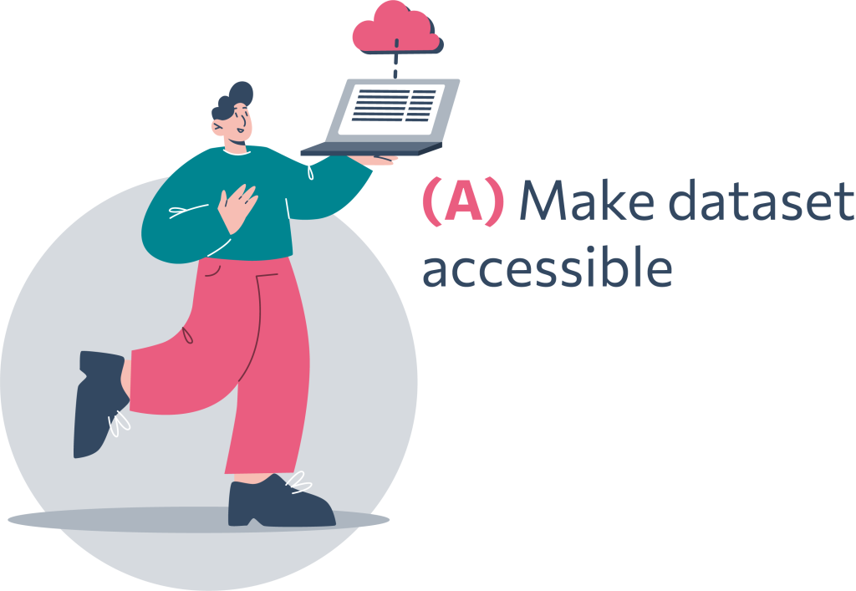
Make dataset accessible
Researchers make their data available to the research community via the RAISE research ecosystem. Researchers can upload their data on their own or any other RAI Certified Node, a trustworthy crowdsourced network offering data storing and processing resources.

Slide 17
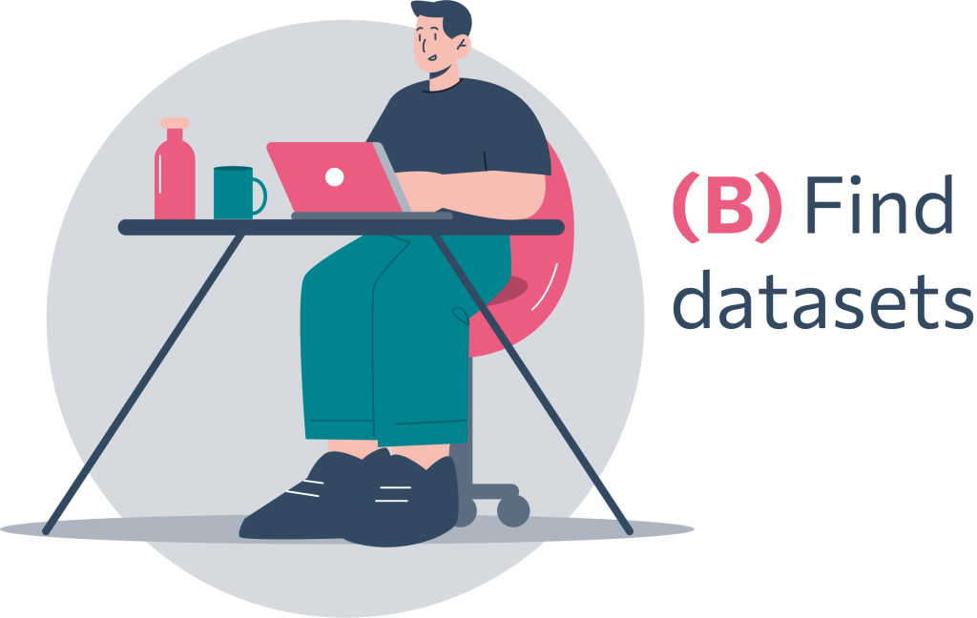
Find datasets
Any researcher can look for datasets that meet their needs for their given research question and projects. The RAI Finder Service enables them to find and access registered experiment results including the dataset and the processing algorithm’s information, or even the actual assets if the researcher has opt-in for open experiment sharing.

Slide 18
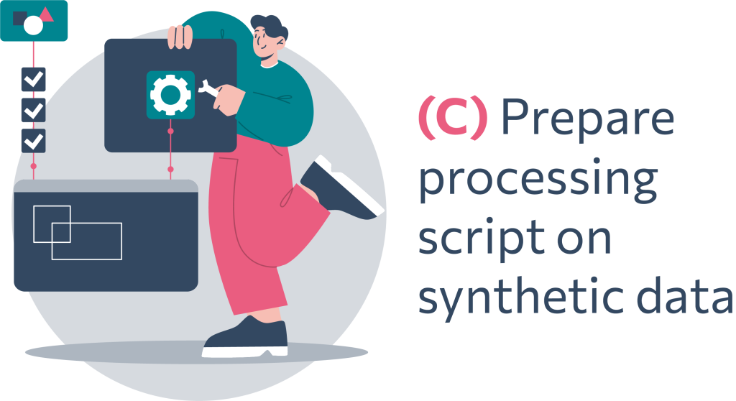
Processing script on synthetic data
The RAI Synthetic Data Generator allows the researchers to develop processing scripts by getting access to sample, small scale datasets or synthetic data which mock real data in order to protect any sensitive or personal data.

Slide 19
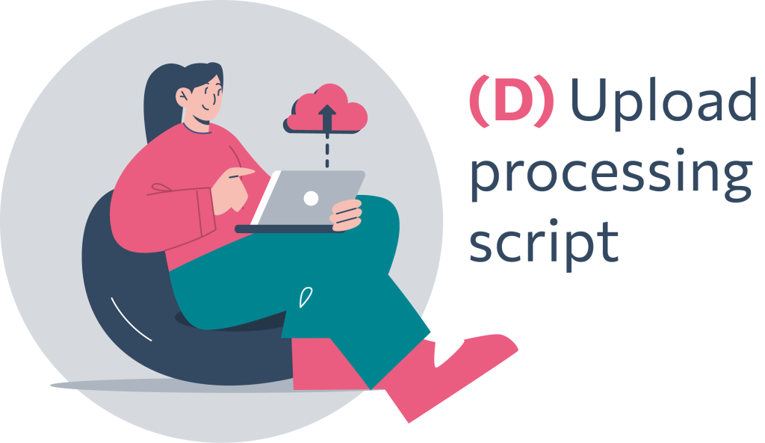
Upload processing script
The scripts/algorithms are uploaded. Researchers can load processing algorithms which will run on the remotely hosted datasets, running the algorithm without allowing the investigator to download or access them directly.

Slide 20
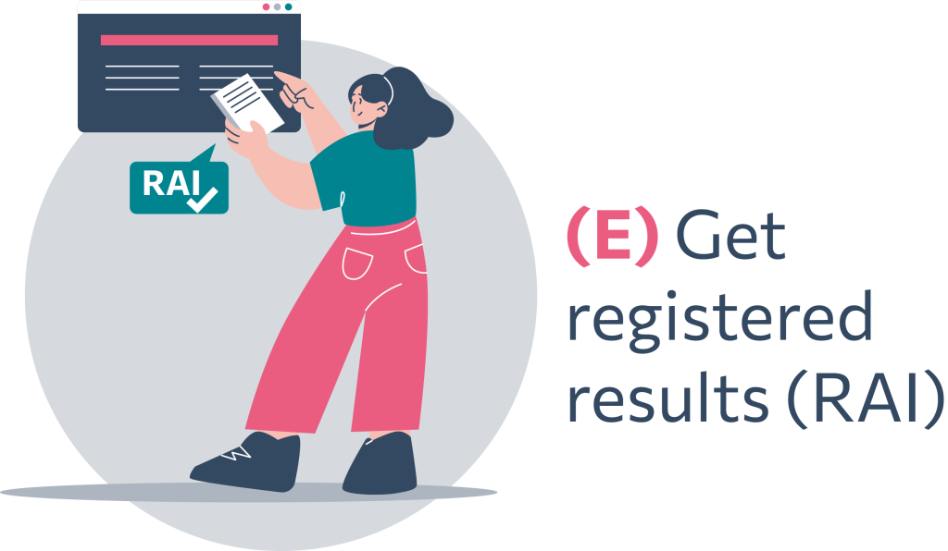
Get registered results (RAI)
The scripts and dataset pair are registered and receive the Research Analysis Identifier (RAI) persistent identifier. When the requested experiment computation is completed, the RAI Certified Node registers the results to a blockchain network through the RAI Registration Service, receiving a RAI as the outcome of the registration process.

Slide 21
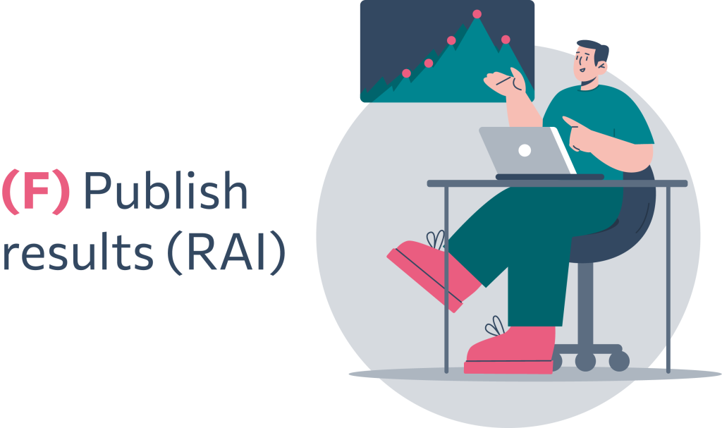
Publish results (RAI)
The results of the registration process are published and available. The RAI Central Hub will be the intermediate interface of the RAISE system and the network of the distributed Certified Nodes with the users. Any request arriving to the RAI Central Hub for processing a dataset or getting access to a sample synthetic dataset, will be addressed by the RAI Central Hub to the corresponding Certified Node.

Slide 22
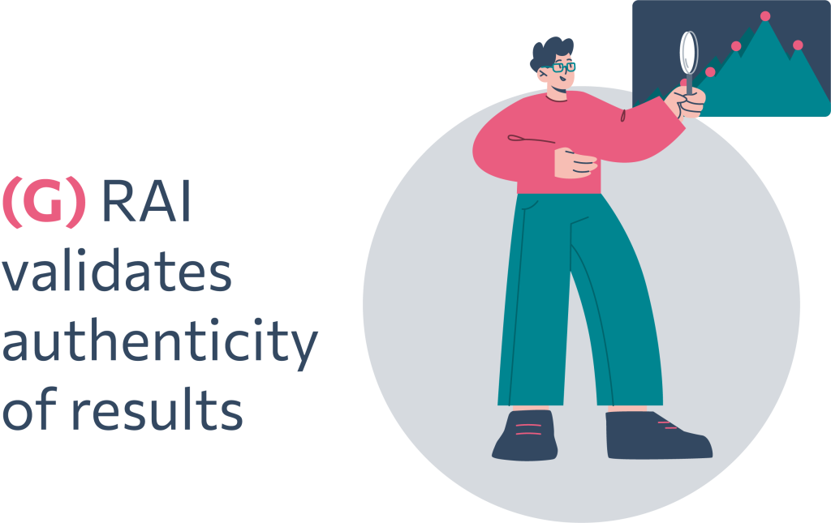
Results authenticity validation
Any researcher can validate the results through the RAI System, which enables experiment results authenticity and veracity validation. The dataset plagiarism identification and dataset proof-of-origin services add an extra layer of security by identifying similar datasets (plagiarism).

Slide 23
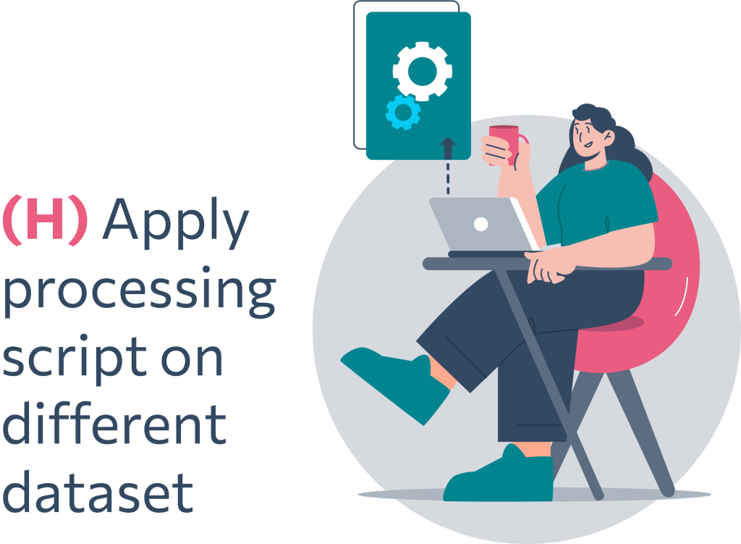
Script on a different dataset
The scripts/algorithms can be used on different datasets and contexts, such as scientific publication, patent submission or industrial IP, contract negotiation etc. in order to compare results.

Slide 24
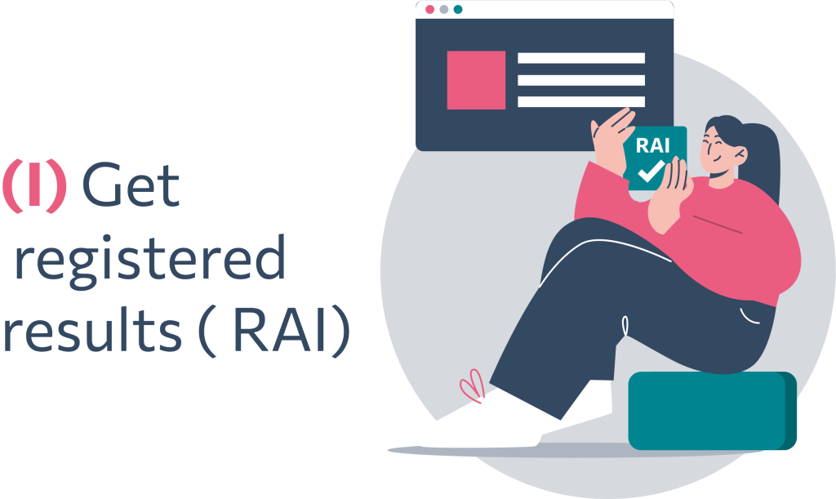
Get registered results (RAI)
The datasets are now available in RAI Cloud to be shared and processed efficiently by the research communities interested as conveniently as possible in order to reduce time-to-result and increase productivity.

Slide 25
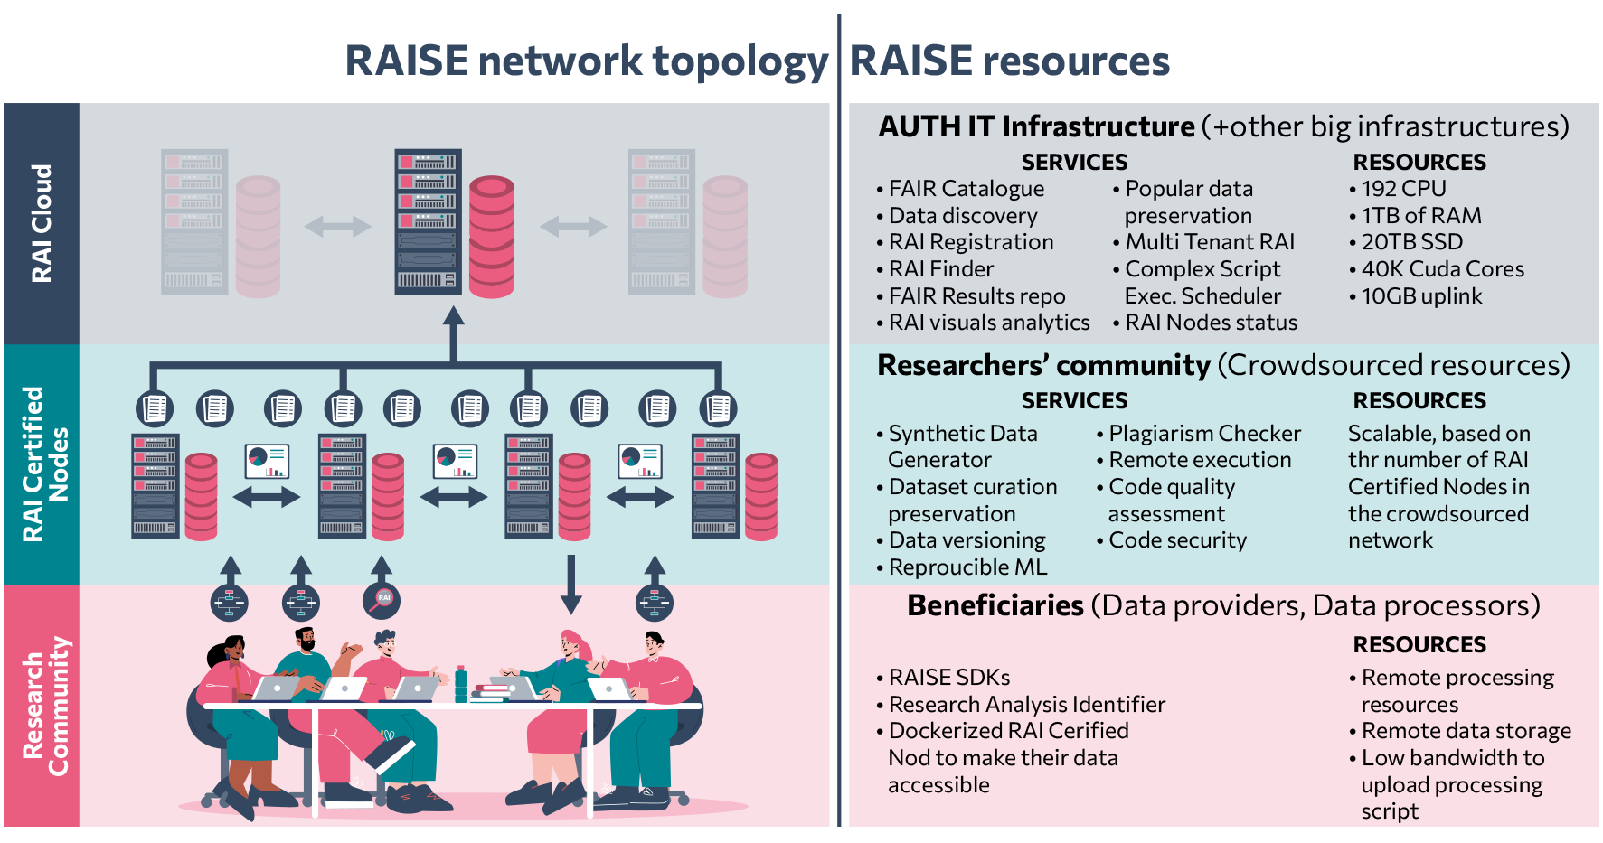

Slide 26
Application domains
Health
Mobility
Environment
Cross-disciplinary

Slide 27
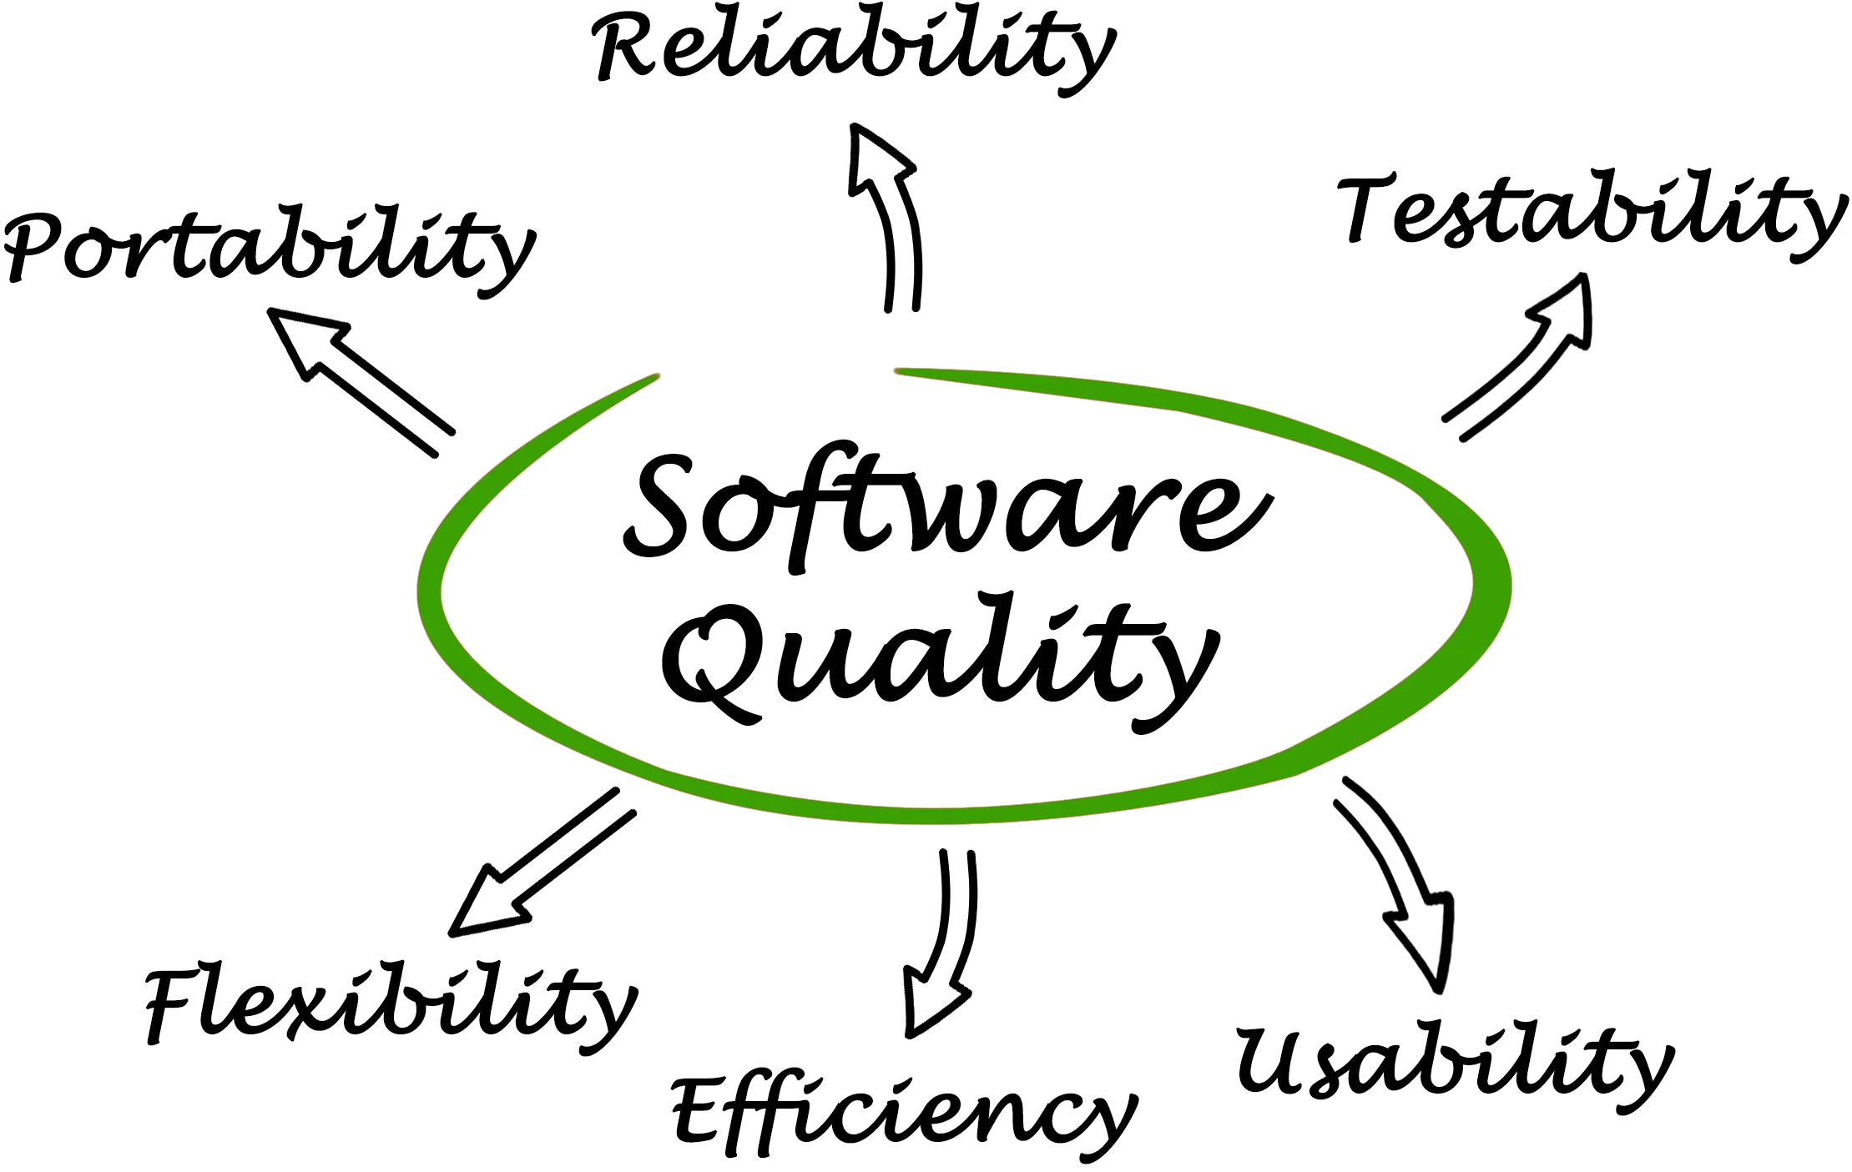
Technical consortium
11/20 Technical partners
High TRL is expected
Ready to be used by EOSC and the research community

Slide 28
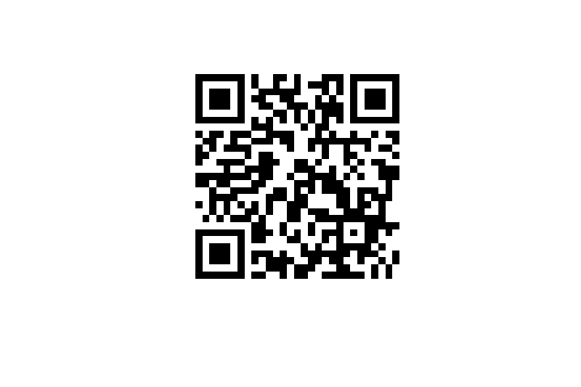
Contact Us
Evdokimos Konstantinidis Lab of Medical Physics and Digital Innovation
evdokimosk@gmail.com
Aristotle University of Thessaloniki (AUTh)
https://www.auth.gr/en/
info@raise-science.eu
Project coordinator:
Dr. Evdokimos Konstantinidis
Online presence
https://raise-science.eu/
https://twitter.com/RaiseScience
https://www.facebook.com/raise.science
https://www.linkedin.com/company/raise-science/
Subscribe to our newsletter:

