Slide 1

CoolPower
Redefining cooling for Energy-Challenged world
Efficient
Energy-Generating
Eco-Friendly

Slide 2
THE CLIMATE-COOLING CRISIS
57% Increase in global heatwaves since 2000, driving urgent demand for cooling solution
Global air conditioner stock will triple, adding 10 new units every second
HFC refrigerant leaks are up to 3,800 times more potent than CO₂ over 20 years
3x
3,800x
+57%
WMO, 2023
IEA, 2018
IPCC, AR6
⚠ The Vicious Cycle
Traditional ACs create a feedback loop: they cool indoor spaces while heating the outdoor environment and consuming massive energy, further accelerating climate change.

Slide 3
Problems with existing air coolers
Performance Limitations
Conventional systems fail to provide efficient cooling in hot and humid weather especially when temperatures exceed 50°C.
High Energy Consumption
Existing air coolers consume a massive portion of residential electricity, making up 40-60% of summer electricity costs.
Currently responsible for 4% of global CO₂ emissions, projected to reach 25% within the next 30 years.
Climate Impact
50°C+
40-60%
25%
The World Needs a Revolutionary Solution
As climate challenges intensify, traditional cooling technology is proving inadequate, expensive, and environmentally harmful. A fundamental redesign is necessary.

Slide 4
OUR REVOLUTIONARY SOLUTION
CoolPower's groundbreaking dual-function technology doesn't just cool—it generates power from the very heat it absorbs .
Cool air
Produces electricity from absorbed heat making its operating cost nearly zero
Uses eco-friendly Refrigerants with minimal impact on the environment.
Energy Generating
Green Technology
Hot air (ambient)
CoolPower's powerful cooling capabilities work in harsh climates with temperatures exceeding 50°C and humidity over 90%.
Powerful cooling
Electricity

Slide 5
Technical Validation
working priciple and technical validations

Slide 6
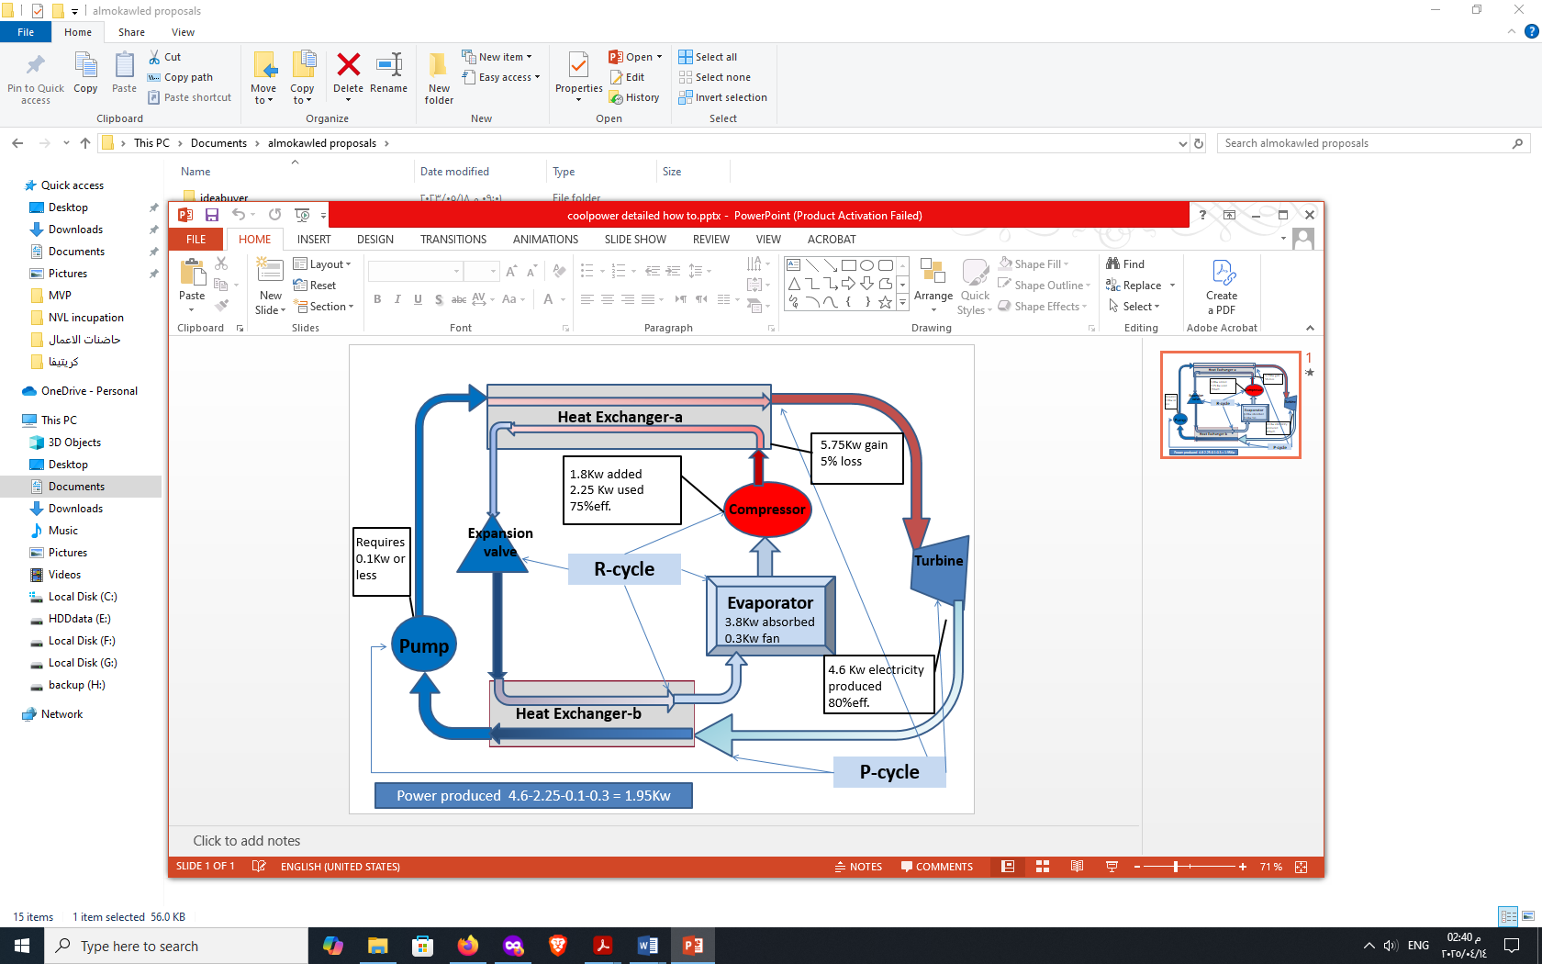
Working principle
Our hybrid refrigeration cycle (R-cycle) efficiently cools air while our energy harvesting cycle (P-cycle) convert absorbed heat into usable electricity—creating a sustainable cooling ecosystem.

Slide 7
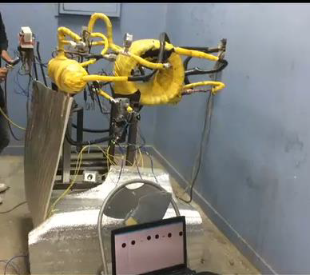
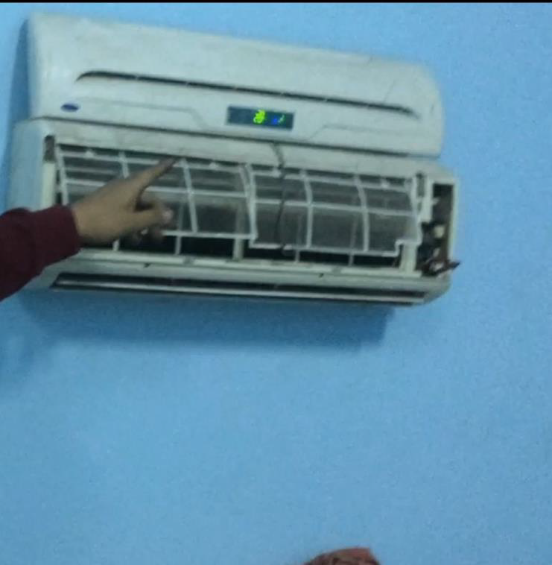
Validation progress
2018 Computational model made based on old patent (BE901144A1 / 1985)
2018/2019 feasibility study conducted at Asyut university
From the data of this study we built accurate computer model to test many refrigerant combinations
Patent application :WO2017101959 A1 (International Publication), US20190003750 A1 (US Application), with related national filings.
Figure : Setup of CoolPower's feasibility experiment

Slide 8
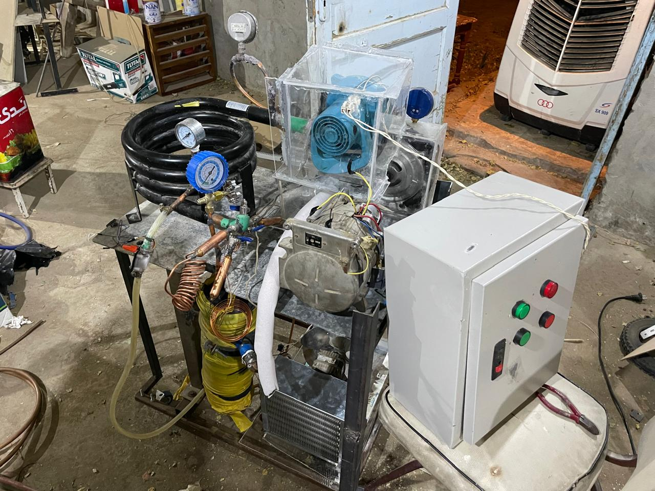
Validation progress
2023 we won Pre-incubation fund From (Nile venture lap ) NVL-incubator in Aswan university to build the prototype
12/2024 we built the prototype and won the Incubation fund from NVL to help with MVP development and Launch
Figure : Experimental setup of CoolPower's dual-function prototype

Slide 9
Market Validation

Slide 10
Over 70% of respondents indicated a willingness to pay premium for air conditioners that reduce energy bills and remain operational during blackouts.
— CoolPower Market Research, 2023

Slide 11
Competitive Comparison
Feature | Traditional AC | "Green" AC Competitors | CoolPower solution
Energy Source | Consumes electricity | Consumes electricity (efficiently) | Generates electricity
Grid Dependence | Fully dependent | Fully dependent | Independent operation (some models)
Extreme Heat Performance | Decreases efficiency above 50°C | Decreases efficiency above 50°C | Excels above 50°C
Environmental Impact | High emissions & harmful refrigerants | Reduced emissions | Zero emissions & green refrigerants

Slide 12

Market opportunities
Targeting high-growth markets with increasing demand for efficient, reliable cooling solutions
$570 M expected Market size by 2029
5.7% annual growth
20% targeted market share within 3 years of launch

Slide 13
Key Partners
Manufacturers & Suppliers
Retailers & E-Commerce Platforms
Service Providers, & technicians
Key Activities
R&D research &development
Marketing & Branding
Manufacturing
Sales & Distribution
Customer Service
Value proposition
Energy Efficiency & Production
Powerful cooling
Eco-friendly green technology
Revenue streams
Distribution Channels
Direct sales
Maintenance Contracts
Retail Outlets & Direct Sales Force
Distributors and Resellers
Online Sales
Add-ons )to enhance the utilization of the generated energy(
Extended Warranties
Business Model

Slide 14
84,000,000$
240,000 unites
20%
Expected revnue within 5 years
Estimated sales within 5 years
Estimated MENA market penetration!

Slide 15
Environmental Impact

Slide 16
17,933,000
Tons of CO₂-equivalent emissions could be avoided each year for every million units of CoolPower deployed
— CoolPower environmental impact simulation , 2022

Slide 17
ROADMAP
R&D for intial validation
Prototyping
Marketing & Branding
1
3
5
We are here
2
4
6
Market Validation
MVP
Partnership and Manufacturing

Slide 18




Our team
Dr. Mahmoud Tharwat
Co-Founder & CEO
Pharmacist – Thermodynamic and business administration studies
idea man
Dr. Mostafa Abdelfattah
Co-Founder
Ph.D in Mechanical Power Engineering
Assistant Professor at Suez University
Eng. Mohammed Abdelfattah
product developer (mechanical systems)
MSc: Mechanical engineer and responsible for cruise ships repairs
Eng. Ahmed Nady
product developer (electrical systems and control)
Master electrical engineer at national electrical grid company
Dr. Ahmed Yousef
Business administrator
Master of Business Administration
Software Pre-sales& Digital transformation expert

