Slide 1
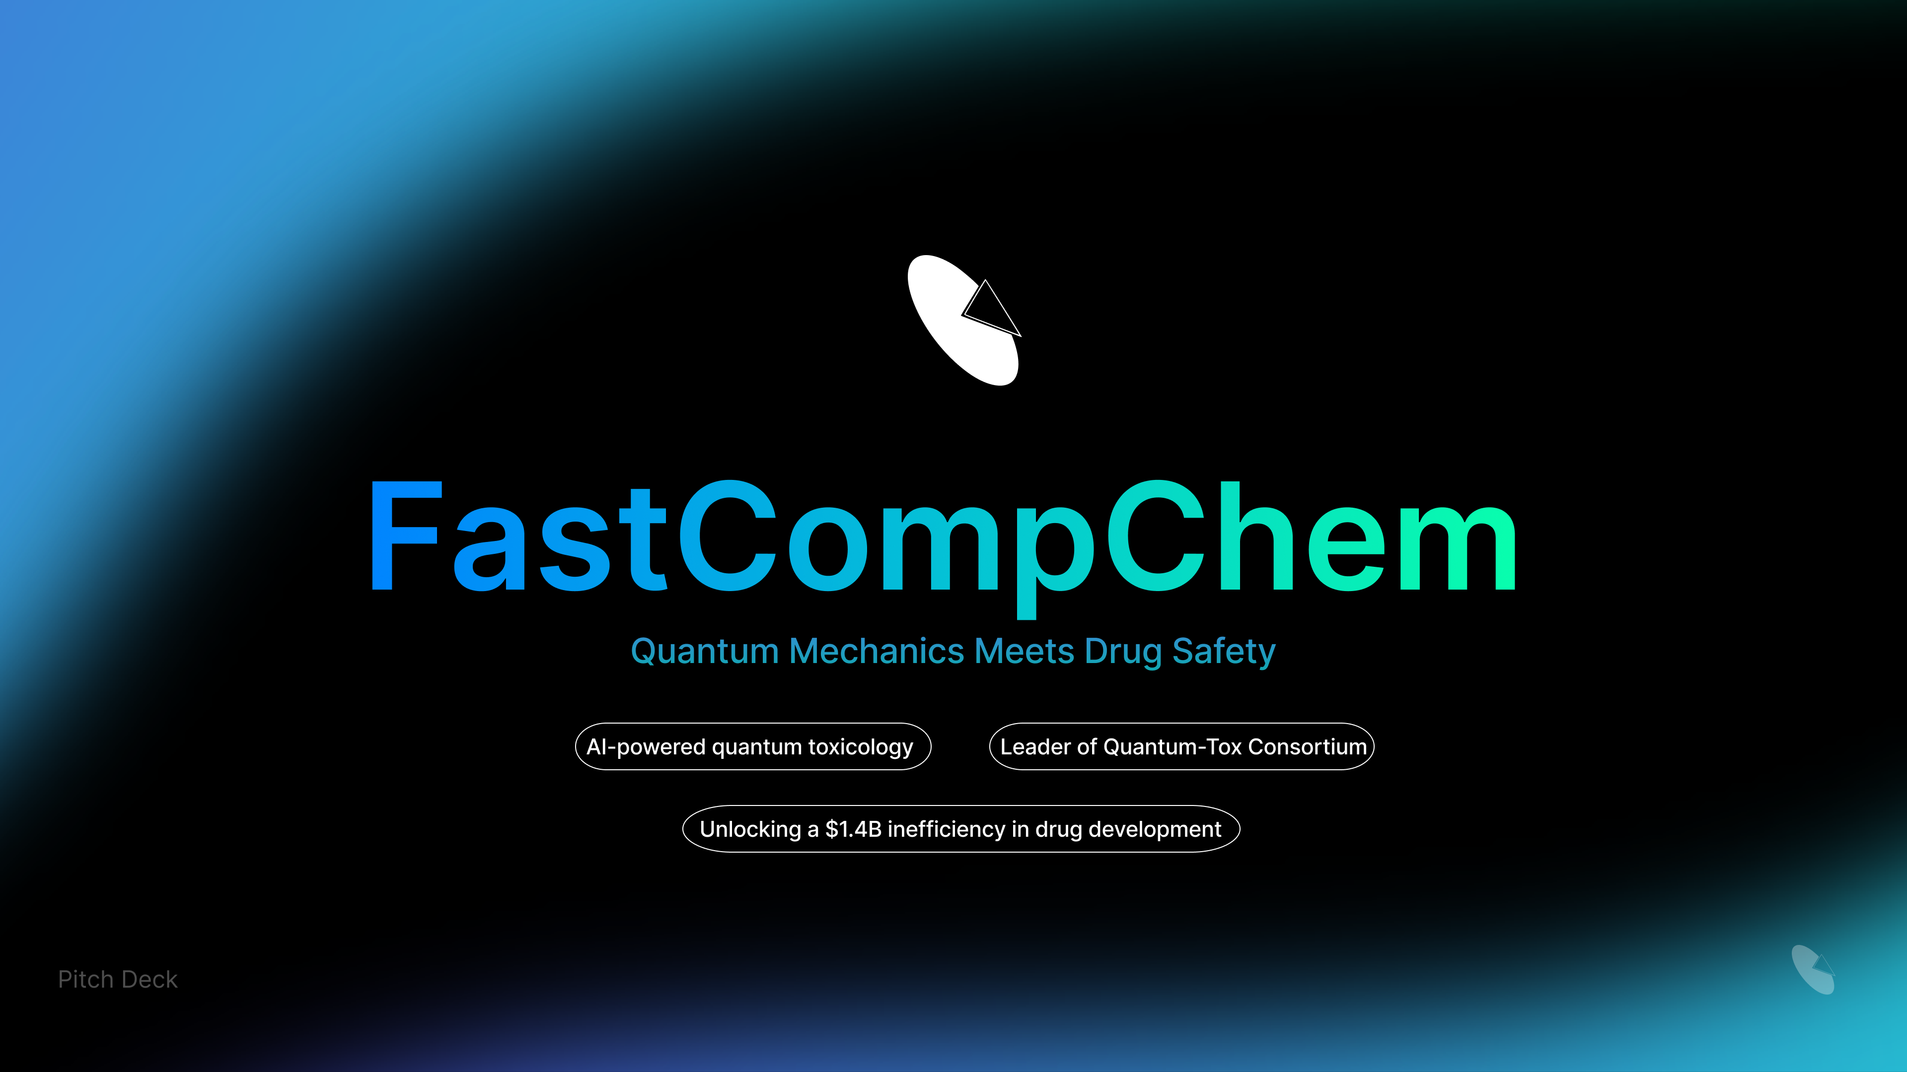

Slide 2


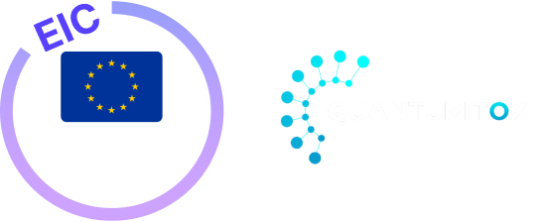
Company Context:
FastCompChem
Who we are
FastCompChem is a computational science company focused on physics-based molecular modelling.
The company operates at the intersection of quantum chemistry, toxicology, and AI, developing next-generation mechanistic descriptors.
What we do
Develop Electronic Signatures (ESigns): standardised, first-principles molecular representations derived from electronic structure.
Enable mechanism-driven toxicology that complements and strengthens NAM, AI, and in vitro strategies.
Why this matters
As chemical space becomes more novel, data-driven similarity alone no longer scales.
FastCompChem addresses this gap by grounding decisions in molecular physics.

Slide 3
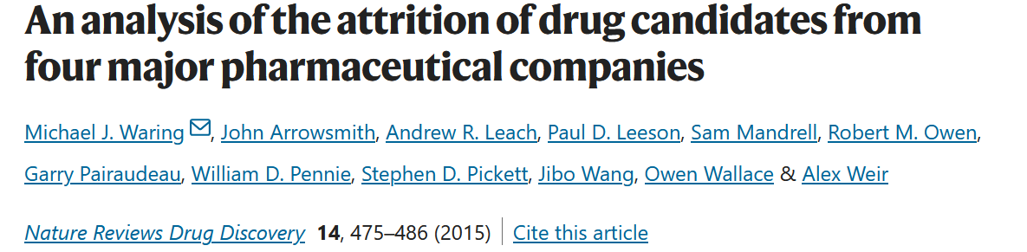

Evidence: The Toxicity Bottleneck
Waring et al. (2015)
Context
• Large retrospective analysis of pharmaceutical R&D pipelines
• One of the first systematic, industry-scale assessments of failure causes
Key findings
• Toxicity and safety issues remained the leading cause of attrition
• Failures occurred late in development, after substantial investment
• Improvements in chemistry, screening, and target biology did not remove the
problem.
Upper theoretical limit
Even under optimal discovery conditions, ~40–50% of attrition was driven
by safety.
It is a hard ceiling on R&D efficiency unless safety predictivity improves.
Implication
Toxicology is not a downstream filter — it is the rate-limiting step in modern drug discovery.

Slide 4

AI/ML in toxicology
Progress with structural limits
What AI/ML has achieved
Faster screening across multiple endpoints
Integration of in vivo, in vitro, omics, and chemistry data
Clear improvements over classical QSAR models
Structural limitations
Learning correlations rather than mechanisms
Limited extrapolation to novel chemotypes
Evidence-based conclusion
AI improves interpolation within known chemical space
The Waring ceiling remains unchanged because mechanistic causality is missing

Slide 5
Read-across today:
Indispensable, but fragile
Why read-across persists
Accepted within OECD NAM frameworks when data are limited
Pragmatic solution in data-poor scenarios
Fundamental weakness
Structural similarity ≠ mechanistic similarity
Small electronic or metabolic differences can dominate toxicity
Heavy reliance on expert judgement limits scalability
Addresses “similar” chemical space precluding extension to novel chemistries
Consequence
Read-across mitigates risk but cannot systematically lower the safety attrition ceiling identified by Waring et al.
Read-across is not the most suitable way to sustain novelty

Slide 6
Differentiation:
Electronic Signatures (ESigns)
What sets ESigns apart
ESigns encode molecules using first-principles electronic structure
Capture reactivity, polarity, redox behaviour, and interaction potential
Key differentiation
Similarity defined by mechanistic equivalence at the level of Molecular Initiating Events (MIEs), not 2D structure
Directly compatible with AOP-based toxicology reasoning
Applicable to any molecule, including novel chemical space
Why this is different
AI models learn from data
ESigns encode mechanism

Slide 7
ESigns in Conjunction with in Vitro NAMs and Organoids
Context
In vitro NAMs and organoid systems provide biologically relevant readouts.
However, they often lack:
  mechanistic specificity at the molecular level
  clear extrapolation rules across chemistry.
Role of ESigns
ESigns provide a molecular, physics-based layer upstream of assays.
Encode electronic and interaction properties directly linked to:
  Molecular Initiating Events (MIEs)
  early perturbations in AOPs.
Complementarity
ESigns do not replace assays:
  they contextualise assay outcomes
  they support interpretation and prioritisation.
Key message
ESigns connect chemistry to biology by anchoring NAM readouts in molecular mechanism.

Slide 8
Practical Integration:
ESigns + in Vitro NAM Workflows
How integration works
ESigns computed before or alongside in vitro testing.
Used to:
  prioritise compounds entering NAM pipelines
  group compounds by mechanistic similarity
  explain divergent assay responses.
Benefits
Reduced experimental burden through better triaging.
Improved confidence when interpreting:
  negative results
  borderline responses
  unexpected outcomes.
Outcome
More informative NAM workflows with lower uncertainty per experiment.

Slide 9
Why ESigns Are Suitable for Regulatory NAM Frameworks
Regulatory expectations
Transparency and explainability
Mechanistic plausibility
Defined applicability domain
Reproducibility and auditability
How ESigns support these
Derived from first-principles quantum chemistry and linked to MIE/AOP concepts
Fully deterministic, traceable, and reproducible (same inputs → same outputs)
Provide a mechanistic basis that can be used:
  directly for grouping/justification
  as inputs to AI models
Correct positioning on data dependence
ESigns do not require toxicity labels to be computed
Historical toxicity labels are used only when training or calibrating predictive models on top of ESigns.

Slide 10
From Read-Across to
Mechanistic Equivalence
ESigns as a replacement for analogue selection
Grouping driven by mechanistic equivalence (electronic structure, reactivity, interaction potential)
Reduces reliance on purely structural analogues and subjective analogue choice
Regulatory advantage
Stronger justification than structure-only similarity
Clear traceability from chemistry → mechanism → decision
AI models trained on ESign features remain evidence-based, but are grounded in mechanistic descriptors.

Slide 11
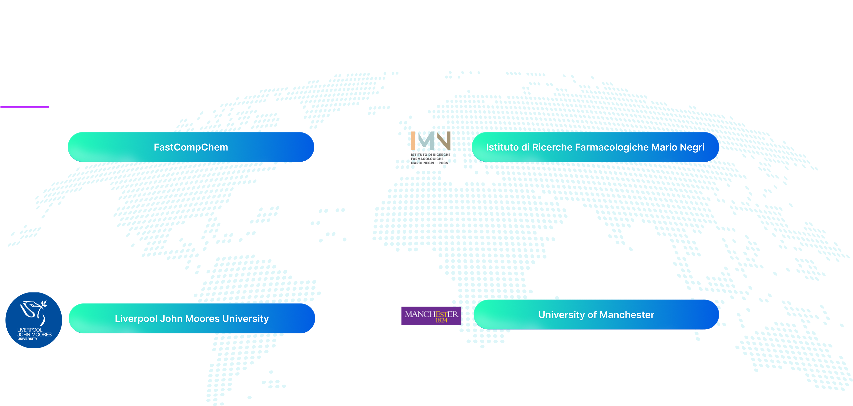
Scientific Team
& Complementary Expertise
Dr. Pedro Lopes
Quantum chemistry and molecular modelling expert; key contributor to the Drude polarizable force field (CHARMM); co-developer of CGenFF and CHARMM36
Beatriz Costa
Specialist in AI/ML, with experience applying machine learning to chemical and biological data and integrating physics-based descriptors into data-driven workflows
Dr. Emilio Benfenati
and Dr. Alessandra Roncaglioni
International leaders in computational toxicology, NAMs, and OECD read-across frameworks, with strong regulatory expertise.
Prof. Mark Cronin
Leading authority in toxicological modelling, QSAR, and NAM-based risk assessment.
Prof. Paul Popelier
World-leading expert in quantum chemical topology and electron-density analysis
Pioneer of electron-density-based descriptors for chemical understanding

Slide 12
