Slide 1




Team Up 2025
September 2, 2025
Business Model

Slide 2



Short Feedback on Exploration Proposals
Today’s Agenda
Exploration phase
What are we going to do
Next Steps and Q&A
Answering your doubts and presenting next steps

Slide 3
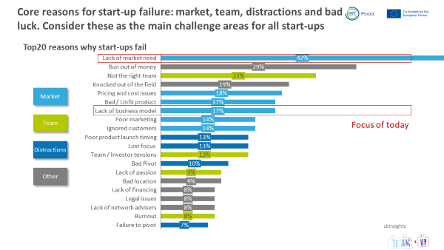
Core reasons for start-up failure: market, team, distractions and bad luck
Lack of market need
42%
Run out of money
29%
Not the right team
23%
Knocked out of the field
19%
Market
Pricing and cost issues
18%
Bad / Unfit product
17%
Lack of business model
17%
Team
Poor marketing
14%
Ignored customers
14%
Poor product launch timing
13%
Distractions
Lost focus
13%
Team / Investor tensions
13%
Bad Pivot
10%
Other
Lack of passion
9%
Bad location
9%
Lack of financing
8%
Legal issues
8%
Lack of network advisers
8%
cbinsights
Burnout
8%
Failure to pivot
7%

Slide 4
Business model
A business model describes
the rationale of how an organisation creates, delivers and captures value

Slide 5
Until you find a suitable and sustainable business model,
financing becomes a crucial part of start-up creation
Business model and financing
Product
Market
Erzeugen
Erobern
Produce
Capture
Which product / service?
What is the value?
How is it delivered?
Which market?
Which market segment?
Capital
Customer
How much turn over?
How much profit?
How is it financed?
Liefern
Which customer group?
With which frequency do customers purchase?
What do customers value?
Earn
Deliver

Slide 6
Multiple types of start-ups based on the main goals of their founders
Lifestyle Start-up
Passion
Start-up
Example: Surf shop Start-up, wandering programmer, freelancer, etc.
„Work for your passions“
repreat
Small company Start-up
Start-up
SME
Example: Barber, retailer, real estate broker, etc.
„Work to feed your family“
97% of all Start-ups
Scalable Start-up (Scaleup)
Start-up
Corporate
Example: Google, Facebook, Zalando, Salesforce.com, Genentech, etc.
„Born to be large“
Sellable Start-up
Start-up
VC
Exit
Example: WhatsApp, Tumblr, Kayak, Instagram, YouTube, etc.
„Born to be sold“
+
Corporate Start-up
Corporate
Example: Siemens Corporate Ventures, Bosch Ventures, etc.
„Space to enable innovation“
Start-up
Social Start-up
Start-up
Example: Ashoka, BioLite, Envirofit, Milaap, TerraCycle, etc.
„Born to do good things“

Slide 7

Many things need to go terribly well for a start-up to thrive, a well aligned team is key
Ingredients for a start-up
✓
A good, well aligned team
✓
An idea for a business based on a market need
✓
Enough resources (€) to demonstrate feasibility
✓
“Nerves of steel”
✓
Good timing and positive market trends
✓
Superior features than alternatives
✓
…
✓
And of course, some luck

Slide 8
Business modelling (I)
– customers and value proposition
Key
Partners
Key
Activities
Value
Proposition
Customer
Relationships
Customer Segments
What you
offer to users and paying customers
Who is paying? Who is using?
Key
Resources
Channels
Cost Structure
Revenue Streams
…

Slide 9









Customers and value proposition
    PRODUCT
    CUSTOMER
Gain Creators
6 Describe how your products
and services create
customer gains
Gains
3 Describe the benefits your customer expects, desires or would be surprised by
Products and
Services
5 List all products and services your value proposition is built around
Job to be done
2 Describe what a specific customer segment is trying
to get done
Client
Pains
4 Describe negative emotions, undesired costs, situations and risks.
Pain relievers
7 Describe how your products and
services eliminate customer pains, negative emotions or undesired costs and situations

Slide 10
Business modelling (I) – customers and value proposition
    PRODUCT
    CUSTOMER
Gain Creators
    Reliable, scalable, and innovative source of protein, solving sourcing challenges
    Access to an innovative and environmentally friendly source of protein
    Cost-efficient source of alternative protein
Gains
    Reliable source of protein
    Consistent quality
    Cost-effectiveness
    Scalable supply
    Positive environmental impact
    Differentiation in the market if they offer a novel source of protein
Job to be done
    Finding protein sources
    Evaluating their quality and cost-effectiveness
    Procuring and processing proteins
    Maintaining optimal supply chain
    Provide innovative ingredients
Products and
Services
    Insect-based protein powder
Head of sales ingredient supplier
Pain relievers
    Sourcing challenges
    High-quality standards
    Fluctuating prices
    Environmental concerns
Pains
    Unreliable sources
    Fluctuation prices
    Inconsistent quality
    Regulatory hurdles
    Lack of differentiation
Our Insect-based product helps head of sales who seek for alternative proteins to provide reliable and high-quality protein powder through innovative and environmentally friendly sources of raw material.

Slide 11
Business modelling (I) – customers and value proposition
Key
Partners
Key
Activities
Value
Proposition
Customer
Relationships
Customer Segments
high-quality insect protein powder that is nutritious, cost-effective, and innovative.
Protein ingredient suppliers
Key
Resources
Channels
We ensure a consistent supply chain and scale up according to the needs of ingredient suppliers
Cost Structure
Revenue Streams

Slide 12
Business modelling (III) – production and delivery
Key
Partners
Key
Activities
Value
Proposition
Customer
Relationships
Customer Segments
How you handle relationships
What you
offer to users and paying customers
Who is paying? Who is using?
Key
Resources
Channels
Deliver
How you deliver
Cost Structure
Revenue Streams

Slide 13
Business modelling (III) – production and delivery
Key
Partners
Key
Activities
Value
Proposition
Customer
Relationships
Customer Segments
What you do yourself
How you handle relationships
Who help you with that
What you
offer to users and paying customers
Who is paying? Who is using?
Produce
Key
Resources
Channels
What assets do you have
How you deliver
Cost Structure
Revenue Streams

Slide 14
Business modelling (III) – production and delivery
Key
Partners
Key
Activities
Value
Proposition
Customer
Relationships
Customer Segments
What you do yourself
How you handle relationships
Who help you with that
What you
offer to users and paying customers
Who is paying? Who is using?
Key
Resources
Channels
What assets do you have
How you deliver
Cost Structure
EARN
Revenue Streams
What do you have to pay for
What you get paid for

Slide 15
Business modelling
Key
Partners
Key
Activities
Value
Proposition
Customer
Relationships
Customer Segments
Larvae provider
Powder production
Long-term contracts
high-quality insect protein powder that is nutritious, cost-effective, and environmentally friendly.
Quality
Customer support
Logistics
Distribution and logistics
Protein ingredient suppliers
Marketing
Key
Resources
Channels
We ensure a consistent supply chain and scale up according to the needs of ingredient suppliers
Website
R&D
Manufacturing
Testing lab
Trade shows
Patent
Cost Structure
Revenue Streams
Raw material
HR
Marketing
Insect protein powder
Subcontracting

Slide 16
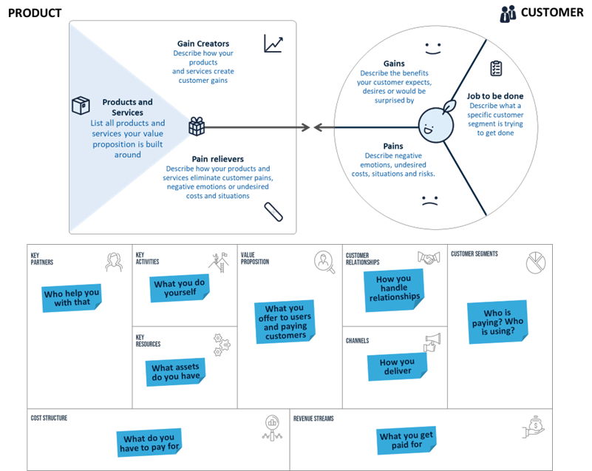
Team Work
Breakout room for each team
Return to the main session at 18:15 CET

Slide 17

Common pitfalls (basic examples)
Business Modelling
Pitfall 1
Solving an irrelevant customer job
Pitfall 2
A flawed
Business Model
To create value for your business, you need to create value for your customer
To sustainably create value for your customer, you ned to create value for your business
Pitfall 3
Neglecting external threats in
the business environment
Pitfall 4
Wait for action until you finally thought through every detail
Use market analysis as means of self-
reflection and input for the creation process
Validate and test your business model
as early as possible (Interviewing can help)

Slide 18
Sessions
August 28th
Session 6
Primary research
September 4th
Session 8
Legal issues
August 26th
Session 5
Target groups
September 2nd
Session 7
Business model
DELIVERABLE
Business model & Team Canva
8th September

Slide 19
DELIVERABLES
DELIVERABLE
DEADLINE
Team canvas +
Business Model canvas
September 8th
6-month Roadmap
September 29th
Pitch deck
October 20th

Slide 20

Next Steps
Homework
❏ Please schedule 1:1 meeting with your team before each session
❏ Reach out to coaches and schedule appointments
❏ Team work on canvas with your coaches

Slide 21
Contact Us!
Do you have any questions?
teamup@eitfood.eu

Slide 22
Business modelling – customers and value proposition
    PRODUCT
    CUSTOMER
Gain Creators
Describe how your products
and services create
customer gains
Gains
Describe the benefits your customer expects, desires or would be surprised by
Products and
Services
List all products and services your value proposition is built around
Job to be done
Describe what a specific customer segment is trying
to get done
Pains
Describe negative emotions, undesired costs, situations and risks.
Pain relievers
Describe how your products and
services eliminate customer pains, negative emotions or undesired costs and situations

Slide 23
Business modelling – production and delivery
Key
Partners
Key
Activities
Value
Proposition
Customer
Relationships
Customer Segments
What you do yourself
How you handle relationships
Who help you with that
What you
offer to users and paying customers
Who is paying? Who is using?
Key
Resources
Channels
What assets do you have
How you deliver
Cost Structure
Revenue Streams
What do you have to pay for
What you get paid for

Slide 24
Sessions
September 11th
Session 10
Start-up creation
with Juan
September 18th
Session 12
Negotiation skills (internal)
September 9th
Session 9
Intellectual Property
September 16th
Session 11
Negotiation skills (external)

Slide 25
Sessions
October 2nd
Session 14
Juan & Alex: Funding - Public
Innovative framework of EIT
October 9th
Session 16
Pitch Training
BREAK
between
Sept 22nd and Oct 1st
September 23rd
Session 13
Roadmapping
October 7th
Session 15
Private investment
DELIVERABLE
Roadmapping
29th September

Slide 26
Sessions
October 28th
Session 20
Practice your Pitch
(15 teams pitching)
October 16th
Session 18
Practice your Pitch
(7 teams pitching)
October 23rd
Session 19
Practice your Pitch
(8 teams pitching)
October 30th
Session 21
Final Pitch troubleshooting
October 14h
Session 17
How to prepare your pitch?!
DELIVERABLE
Pitch Deck
20th October

Slide 27


Graduation: Pitch competition
November 4th
Day 2 with 7 teams
November 3rd
Day 1 with 8 teams
Closing ceremony
November 12th
Next Step for winners:
Register the company

Slide 28
































Good reading recommendations

