Slide 1
Lithuania–Ukraine Business Cooperation in
Transport and Logistics
17 June 2026
Ukraine Investment Framework
Recovery - Reconstruction - Modernisation
DG ENEST D.1

Slide 2
Ukraine Facility and Ukraine Investment Framework
Ukraine Facility
Pillar II: Ukraine Investment Framework
EUR 50 billion
Ukraine Facility
EUR 9.5 bn
Ukraine Investment Framework
UIF objective
  For 2024-2027:
  Pillar I: budget support/Ukraine Plan (€38.27 billion);
  Pillar II: Ukraine Investment Framework (EUR 9.5 bn);
  Pillar III: technical assistance (EUR 4.76 bn);
  €90 billion support loan to Ukraine
  For long term: €100 billion for 2028-2034 MFF Commission Proposal (not approved yet)
  De-risking mechanisms available through International & European Financial Institutions to scale up investments and crowd in new investors;
  Investment grants to lower the cost of financing (mainly for public operations and SMEs) or to support priority groups and social inclusion objectives
  Technical assistance to support preparation and implementation of investments.
Aims to mobilise public (SOEs, municipalities) and private investments (mid and large corporates and SMEs) for the reconstruction and modernisation of Ukraine
  Total envelop of EUR 9.5 bn
  Instruments including combination of:
  - blending, grants or technical assistance for EUR 1.7 bn
  - budgetary guarantees for a capacity of EUR 7.8 bn
  Indirect management by pillar-assessed entities, i.e. Eligible Financial Institutions (EIB, KfW, AFD, BGK, etc.) and Multilateral Financial Institutions (EBRD, WB, IFC etc.).

Slide 3



Priority sectors for Ukraine Investment Framework
Potential investment opportunities (USD billion)
Key subsectors for private investments
Energy
Transport & Logistics
Strategic industries & Raw materials
Digital
Agri-food
Investportal: Private & public sector projects
Source:
UkraineInvest
Investment opportunities

Slide 4

What the Ukraine Investment Framework offers
Budgetary Guarantees/ Risk-sharing instrument to unlock more financing for investors in Ukraine and at better terms
Blended financing to reduce the cost of financing (mostly available for public sector and specific case for private)
SMEs financing from Ukrainian banks;
Equity financing through Flagship Fund.
Political Risk Insurance: through Export Credit Agencies
War Risk Insurance being developed
De-Risking component: EU guarantees
1
Possibility to benefit from:
Debt or equity funding;
Investment Grants in some specific cases;
Lower interest rates;
Longer maturities and repayment schedules;
Lower collateral requirements;
Working capital, investment, acquisition financing;
Blended finance
2

Slide 5
Ukraine Investment Framework: funds allocation up to date
UIF funds allocated and expected to be mobilised
UIF funds allocated per implementing partners
Expected mobilised
investment
Eligible Financial Institutions (EFIs) | Total | Share %
EIB | 3,242,082,000 | 38.5%
EBRD | 1,771,897,600 | 21.0%
IFC | 618,750,000 | 7.3%
BGK | 463,627,280 | 5.5%
IBRD | 441,407,500 | 5.2%
KfW | 394,862,000 | 4.7%
AFD | 276,376,000 | 3.3%
EDFI MC | 239,850,000 | 2.8%
Finnvera | 217,320,000 | 2.6%
NRB | 188,964,800 | 2.2%
Bpifrance | 163,488,000 | 1.9%
NEFCO | 109,030,000 | 1.3%
CDP & FAO | 105,300,000 | 1.3%
Eximbanka | 93,260,000 | 1.1%
Cardano Dev | 78,750,000 | 0.9%
CEB | 16,980,000 | 0.2%
TOTAL | 8,421,945,180
UIF capacity
allocated
EUR 8.6 bn
EUR 25.7 bn
3X
Multiplier
56% public
44% private
UIF funds per sectors
Public multi-sector
19%
Transport 6%
Social housing 4%
Water 2%
Dual use 4%
Social: education 1%
Energy
26%
Other 8%
Social: health 2%
Project preparation
Private multi-sector
33%
Agriculture 3%

Slide 6
Opportunities for private sector under the UIF
EFIs active in private operations
BPI France BGK Cardano Development CDP CEB EBRD | FAO Finnvera IFC KfW NRB FlagshipFund: Amber and Dragon Capital | EDFI MC (BIO, Cofides, KfW, Finnfund, FMO, IFDK, OeEB, Proparco, Swedfund, Norfund, BII, CDP, SOFID, SIFEM) EIB
Opportunities via private sector support:
International Financial Institutions (EBRD, EIB, IFC etc.)
EU National Development Banks (BGK, KfW etc.)
National Export Credit Agencies (BPI etc.)
European Commission: via the Call for Expression of Interest: EUSurvey - Survey
EU Member states: Team nationals
Opportunities via public sector support:
Companies can benefit from UIF programmes supporting public operations, via procurements opportunities generated by new public projects lead by EFIs or UA state, through:
Call for Expression of Interest from EFIs
Prozorro (UA public procurement system)
Privatisation and PPP opportunities
EFIs active in public operations
EIB AFD BGK NRB | CEB CRA EBRD Eximbanka | IBRD SAIDC NEFCO KfW
More information about available opportunities: Programmes - UIF

Slide 7
Overview of UIF programmes to support to private investment
EBRD
Hi-Bar
Ramp-up
Resilience
Ukraine Recovery and Reconstruction
Guarantee Facility (URGF)
Financial Inclusion
EDFI
Ukraine Facility Guarantee
Energy
Energy
NRB
Ukraine Recovery Guarantee
Multisector
War Risk Insurance
IFC
Better Future Programme
SMEs
BGK
Energy, Transport, Construction Investment Support
KfW
Green Lending via
the Green for Growth Fund
Lending to Micro and
Small Enterprises via EFSE Fund
National Development
Institution 4 Ukraine
Multisector
Cardano Development
Food4Impact
SMEs
Finnerva
Strategic Investment and Support for Ukraine Facility (SISU)
Dual use
BFI France
Bpifrance Ukraine Risk Mitigation & Financing Programme
EIB
EU FDI and Single Market Integration
EU4Business
Partial Portfolio Guarantee
Multisector
Energy
Multisector
Dual use
SMEs
SMEs
SMEs
War Risk Insurance

Slide 8
Financing options: equity programmes and funds
Via funds | Sector | IFC | KfW | Flagship Fund | CEB
Horizon Capital | Critical infrastructure
European Fund for Southeast Europe (EFSE), fund manager - Finance in Motion | Cross-sector for SMEs
Green for Growth Fund (GGF) | Energy, manufacturing, construction
Amber (Flagship Fund) | Consumer goods and services, healthcare, pharma, financial, agri-business, construction material Retail, tech
Dragon (Flagship Fund)
Ukraine Social Venture Fund | Cross sector for micro-entrepreneurs and SMEs
Business support programs via funds:
how does it work
EU provide contribution to funds
Funds provide equity investments to Ukrainian companies
EU contribution variations:
guarantee IFC equity in Horizon Capital;
direct contribution to EFSE and GGF, through KfW;
joint development of Flagship Fund with Amber and Dragon Capital as fund managers;
blended finance to the Ukraine Social Venture funds.
Funds provide equity and debt funding to Ukrainian companies at their discretion and under own procedures, to get more details please contact fund managers directly

Slide 9
Financing options: SME support via banks
Via banks | EBRD | BGK* | EIB/EIF
Ukreximbank | x |  | x
PrivatBank | x | x | x
Bank Lviv | x |  | x
Ukrgasbank | x
OTP Leasing/ OTP Bank
Oschadbank | x |  | x
Procredit | x |  | x
Raiffeisen | x |  | x
Ukrsibbank | x
Kredobank | x | x
Ukrgasbank | x |  | x
Credit Agricole | x
Piraeus Bank Ukraine |  |  | x
SME support programs via banks:
how does it work
EU provide guarantees to Ukrainian banks through IFIs
Ukrainian banks carry less borrowers’ risk
They are able to lend more & propose better loans conditions
Benefits to SMEs:
More lending for SMEs,
lower collateral requirements,
longer term to loan redemption.
Available grants
Smallest project size eligible: up to EUR 5 million.
Additional investment grants if priority investments or group (war-veterans, IDP, etc.)
Under EBRD programme: piloting a war damage cover for assets financed under the programme.
New programmes are negotiated with CEB, IFC, CDP, BGK.
*BGK is currently negotiating new Programmes to include more banks
Contacts of Ukrainian banks: SMEs in Ukraine

Slide 10


Financing options: Flagship Fund
  European Flagship Fund for Reconstruction of Ukraine – will be launched in June 2026 (URC, Gdansk) to mobilise over EUR 500 million equity capital
Timeline
2025-2026​
How it works
The catalytical funding available > EUR 220 m.
The 4 anchor EU MS are enacting their investment via their Development Finance Institutions.
Targets EUR 500 m (1st close)
  Announcement at Rome URC of market sounding for finding an EU/UA asset manager.
  Access to finance gap: war has impaired collateral values; commercial banks cannot lend at viable terms without risk-sharing.
  Incorporated in Luxembourg.
  Tiered structure: derisking private investors that would otherwise not invest in Ukraine with first-loss absorption. ​
  Risk diversification for shareholders thanks to geographical and sectoral spread of investments by the Fund.
  Market conform nature allows for entry of private investors already now, building crucial track record, local expertise and to be ready for mass-scale investments come peace.
  Infrastructure: Energy, transport, digital
  Private equity: consumer and goods and services, healthcare, pharma, financial, agri, construction materials, retail, tech
Implementers

Slide 11
Financing options: Export Credit Support (ECA as EFIs)
1
Direct cooperation with pillar-assessed ECAs
2
Cooperation with non-pillar-assessed ECAs
  Finnvera
  BPI France
  Eximbanka
All other EU Member states ECA
Eligible ECAs:
  UIF-supported instruments:
  Investment loans
  Buyers' credits linked to investment projects
  Investment insurance
  Available structures:
  Through EIB risk-sharing platforms (e.g., EIB EU FDI programme)
  Through pillar-assessed national development institutions (e.g. NRB, BGK)
  ECA provides origination, technical assessment, exporter outreach and national cover while EU budgetary support is channelled through the pillar-assessed partner
Cooperation opportunities:
  InvestEU Export Credit Guarantee facility
  Investment loans To support exports by EU SMEs and small mid-caps to Ukraine
  EIF & 8 EU MS ECAs: Denmark, Spain, Finland, Italy, Latvia, Romania, Slovenia and Slovakia.

Slide 12
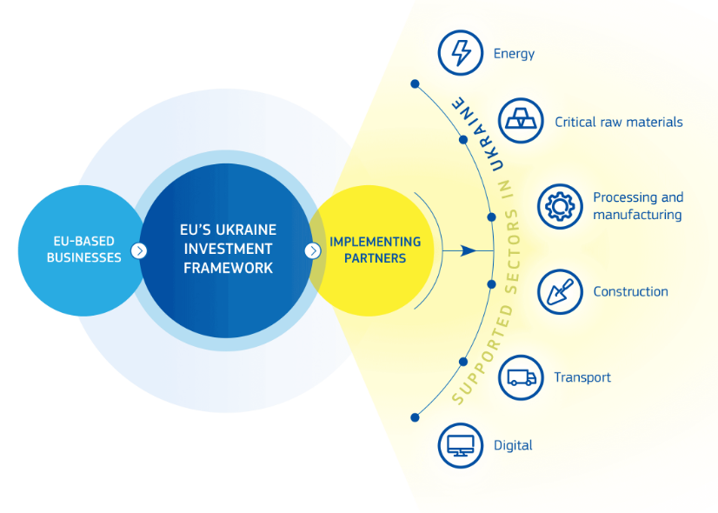
EU Call for Expression of Interest
The Call for Expressions of Interest (EoI) facilitates EU’s dialogue with Ukrainian and EU/EEA private companies on concrete investments in Ukraine. Participants may benefit from facilitated contact with EFIs for potential financial cooperation, identification of local partners, and support in engaging with the relevant Ukrainian authorities.
Calls for Expression of Interest
  Organiser: EU Commission (DG ENEST)
  Target audience: Ukrainian and EU/EEA-based mid-caps and large corporate aiming to invest in Ukraine in line with EU strategic priorities
  Objective: to identify high-priority projects and provide access to financiers under the UIF through dedicated events and workshops
  Open Call: EUSurvey - Survey
  What it doesn’t do: no direct financing (no grant), and no guarantee of financing (EFIs remain sole decision-maker on financing)

Slide 13
Ongoing Call for Expression of Interest
  EU Call for Expression of Interest for EU and Ukraine businesses, managed by the European Commission, operates on a rolling basis with no fixed deadline
Eligibility Check
Sector alignment
Preliminary Assessment
Strategic, impact + financial criteria assessed;
Priority to mature and bankable projects
Priority to EU-Ukraine JVs.
Business Engagement
Optional bilateral meetings
Matchmaking with EFIs
Bilateral and closed-door meetings participation;
Tailor-made engagement activities to facilitate project implementation.
EFI Engagement
Country of registration: EU/EEA or UA
Country of operations: UA;
Min. investment size EUR 50 m;
Min own equity participation: 30%.
Energy
Critical Raw
Materials
Processing and manufacturing
Construction
Transport
Digital
Business ready to approach EFIs
EFIs do independent due diligence and bankability check;
Outcome: Inclusion under EU Guarantee or future UIF pipeline
EFI takes autonomous decision on investment.
Evaluation: priority to the most mature projects that align with EU policy objectives and demonstrate strong integration into European industrial value and supply chains, notably through EU–Ukraine joint ventures or consortia.

Slide 14
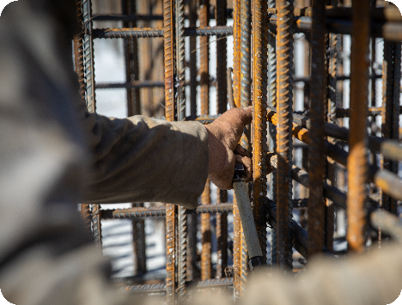
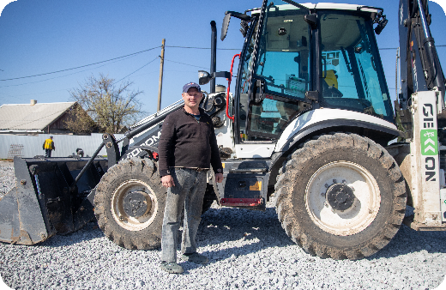
Success stories: Vivat Invest
Due to the war, the company employing over 100 people was forced to relocate part of its operations to Western Ukraine, while continuing to work in its hometown Zhaporizhia.
Financing from Kredobank has been received, enabled by EU guarantees under the EU-EBRD programme.
The company has invested in new equipment, enabling it to take on essential wartime projects — including underground schools, protective infrastructure, and other resilience-focused construction that keeps communities safe and functioning.
“Thanks to EU and EBRD support, we modernised our equipment and cut construction time signiﬁcantly,” – Volodymyr Tarasenko, Chairman of the Board, Vivat Invest.

Slide 15
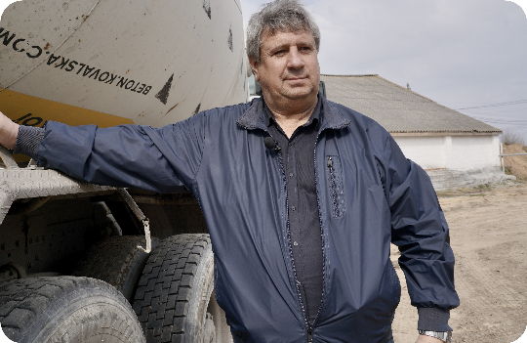

Success stories: Naporivske Farm
Aﬅer the Russian occupation in 2022, the Naporivske farm in Chernihiv was leﬅ devastated, with damaged infrastructure, lost livestock, and halted production.
With Kredobank ﬁnancing backed by EU guarantees, recovery became possible.
Now the farm has fully restored its operations, received compensation for war-related losses, and returned to proﬁtability. It has also begun developing new business lines and committing to sustainability initiatives.
“When we made the decision to rebuild our business, we knew it would take years and millions of hryvnias. Little by little, we managed to restore our farm,” – Hryhorii Tkachenko, Founder of Naporivske Farm.

Slide 16
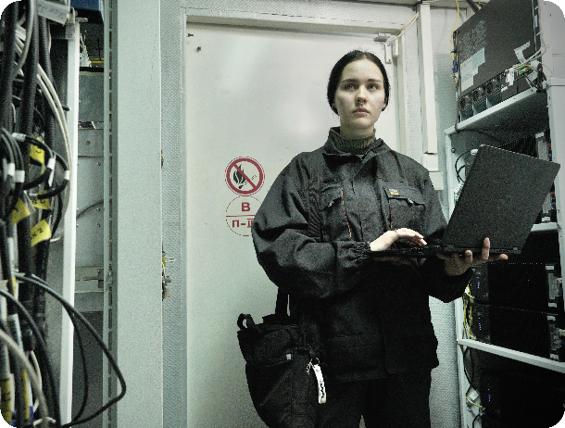
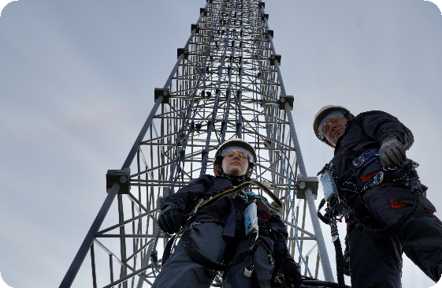
Success stories: Datagroup–Volia–Lifecell group
EU and French guarantees and ﬁnancing from the European Bank for Reconstruction and Development (EBRD) and the International Finance Corporation (IFC).
Helped unlock a major investment in Ukraine’s telecom sector. They also enabled a strategic partnership between French investor NJJ Holding and Horizon Capital, a Ukrainian private equity ﬁrm.
The investment aims to expand coverage for 10 million mobile users and deliver faster internet to 4 million homes. At a time of war, such initiatives are critical to strengthening connectivity, supporting economic resilience, and keeping communities connected.
“Our main focus was the resilience of our network so our customers can stay connected despite the challenges of the wartime,” – Mykhailo Shelemba, CEO, DVL Group.

Slide 17
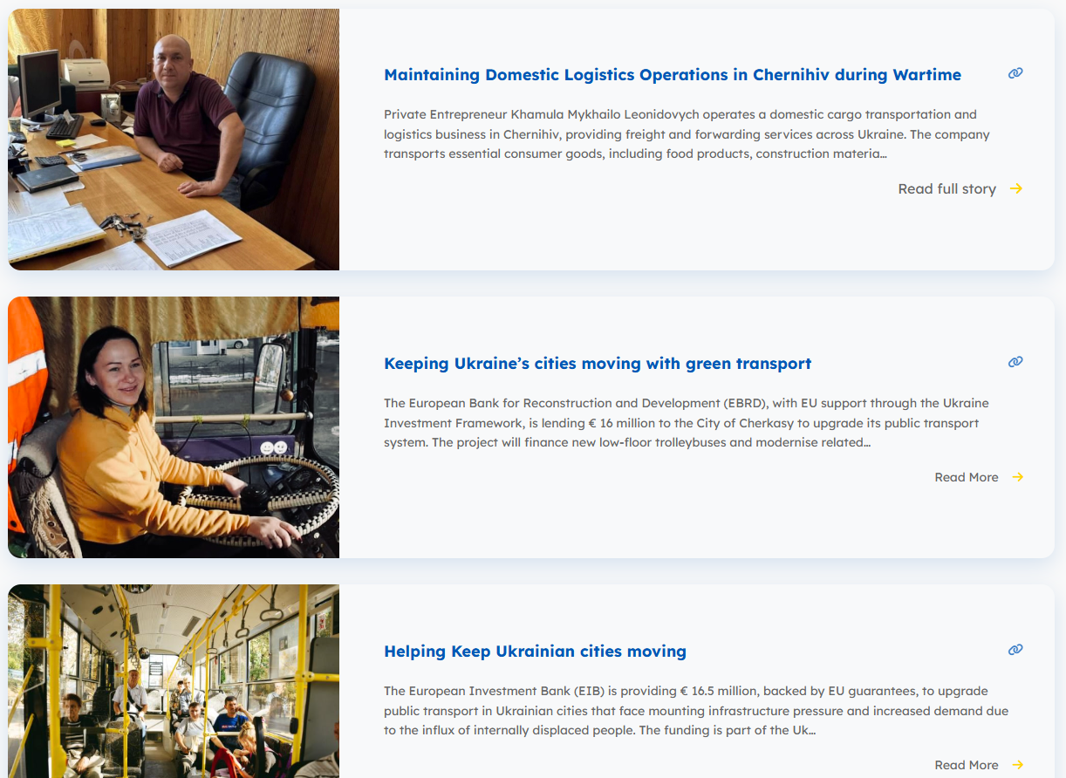
More stories online

Slide 18
Thank you for your attention
Contact: eu.ua.business.engagement@lt.ey.com enest-EU-UKRAINE-INVESTMENT-FRAMEWORK@ec.europa.eu

Slide 19
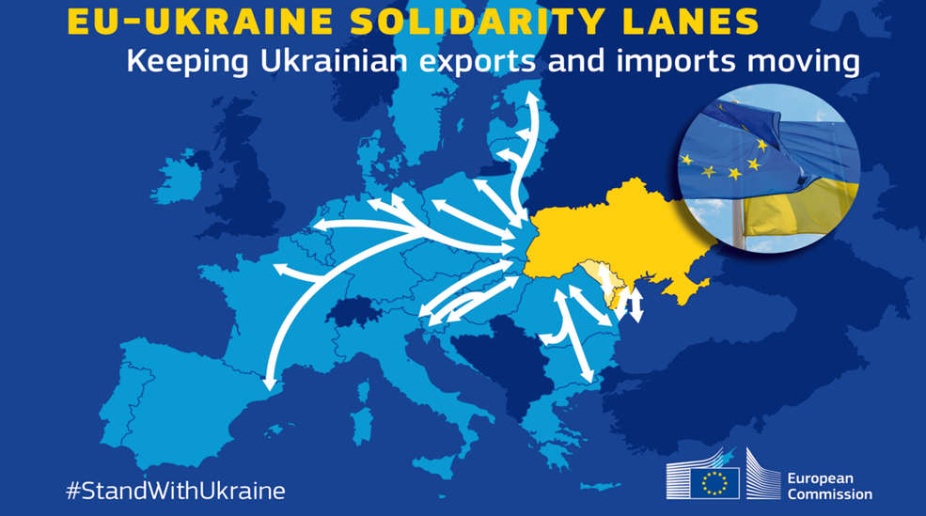

Ukraine’s transport & logistic context
Enlargement & EU Membership Candidacy
EU Acquis &
Reform agenda
TEN-T & EU Standard Gauge deployment
Reconstruction & new business opportunities

Slide 20
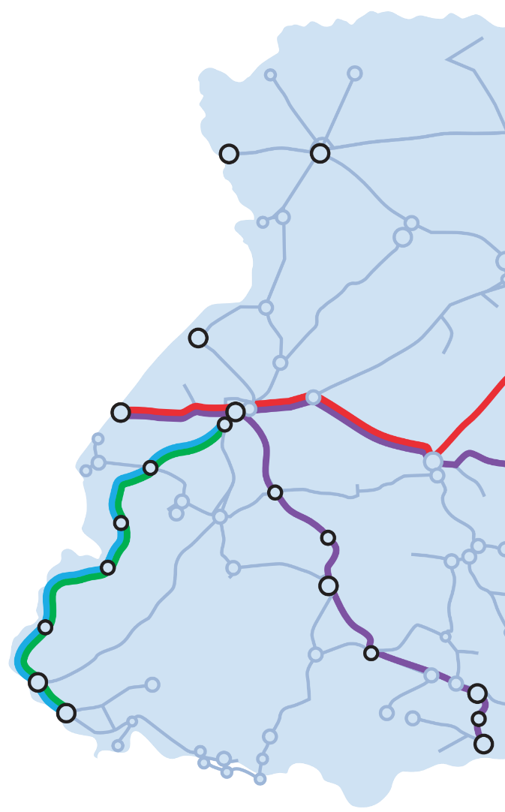
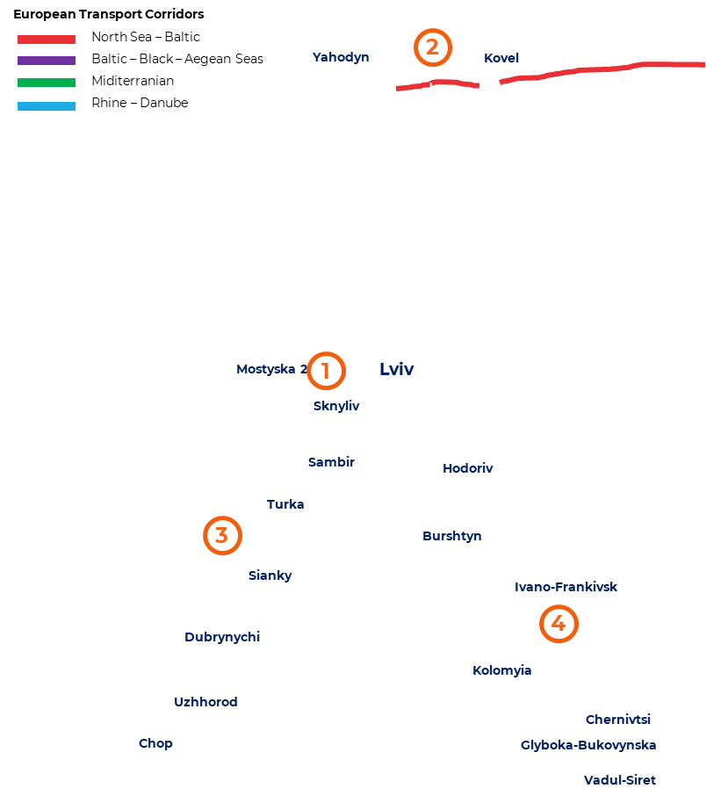
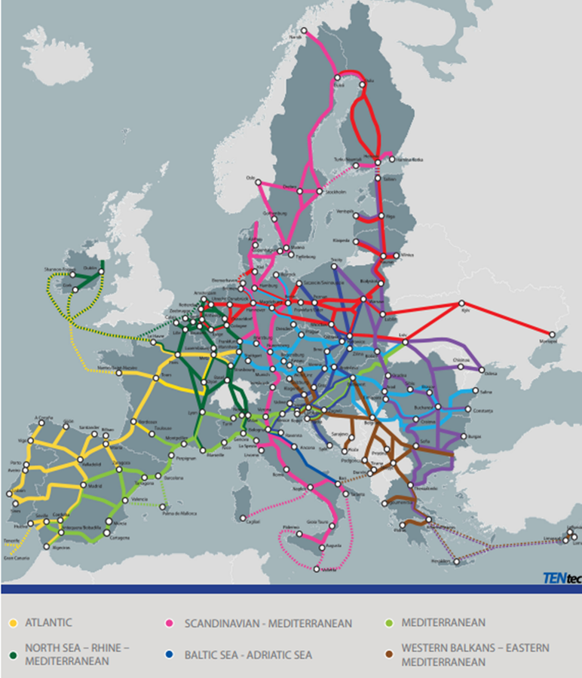

TEN-T Extension & EU Standard Gauge
e
Over EUR 2.5 billion for EU-Ukraine transport connectivity
TEN-T Regulation (EU) 2024/1679
Notes:
Remaining challenges: Security, financial sustainability and enabling conditions.

