Slide 1


A network, a brand, a dream with deadlines

Slide 2

Table of contents
1) Valueable’s target group
2) Valueable’s proposal
3) Valueable’s history
4) Something to celebrate
5) Valueable’s actors

Slide 3
(1) Valueable’s target group
5 million people

Slide 4
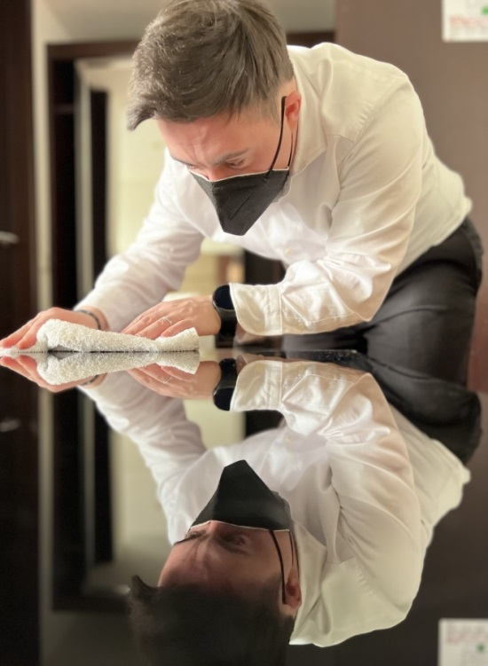
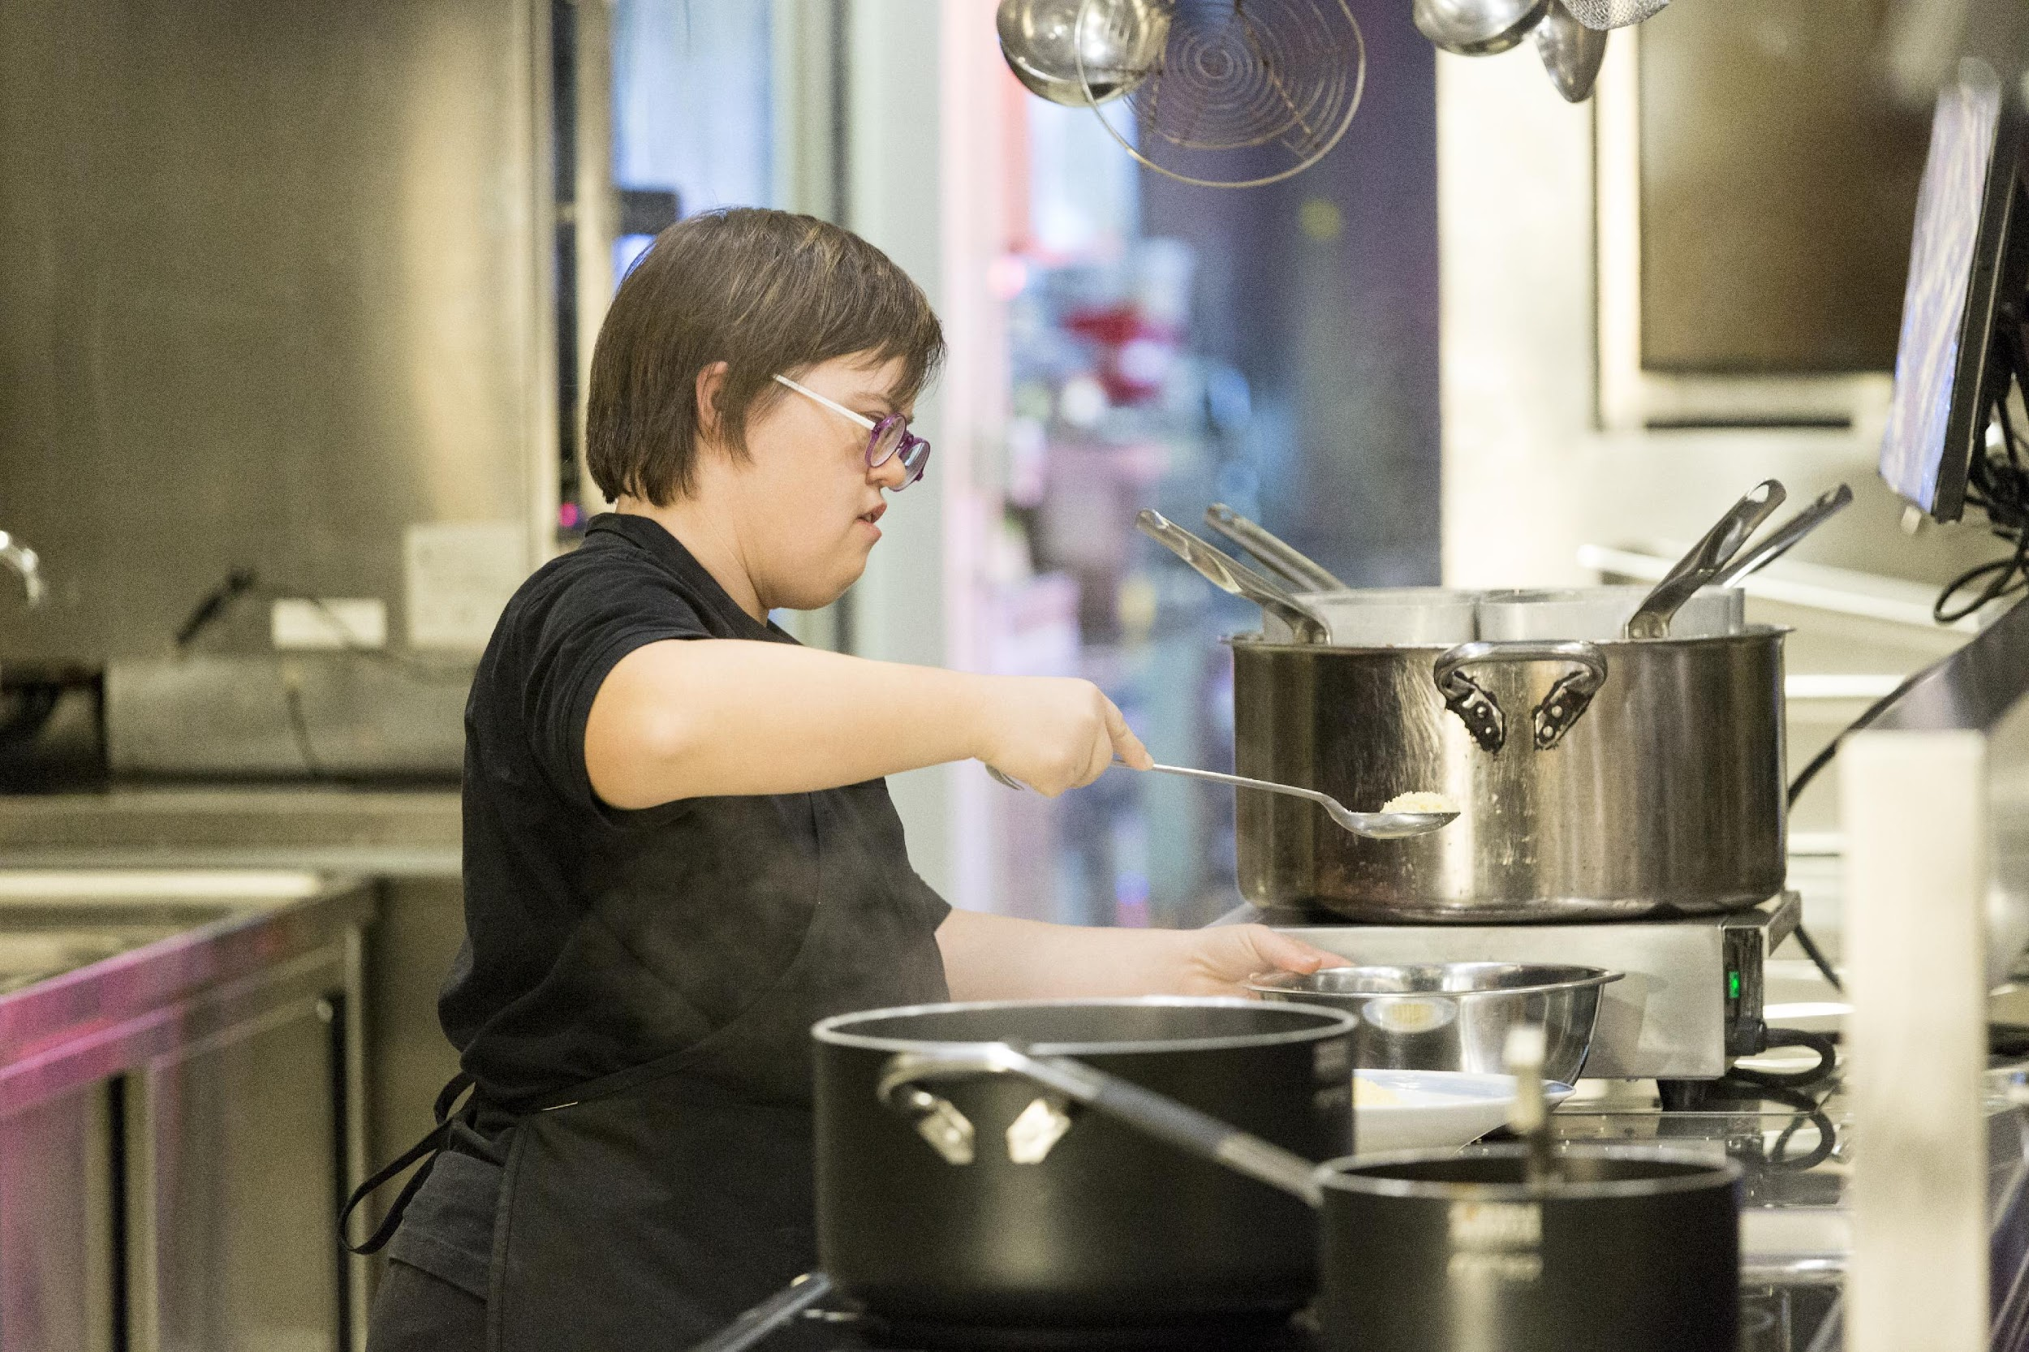
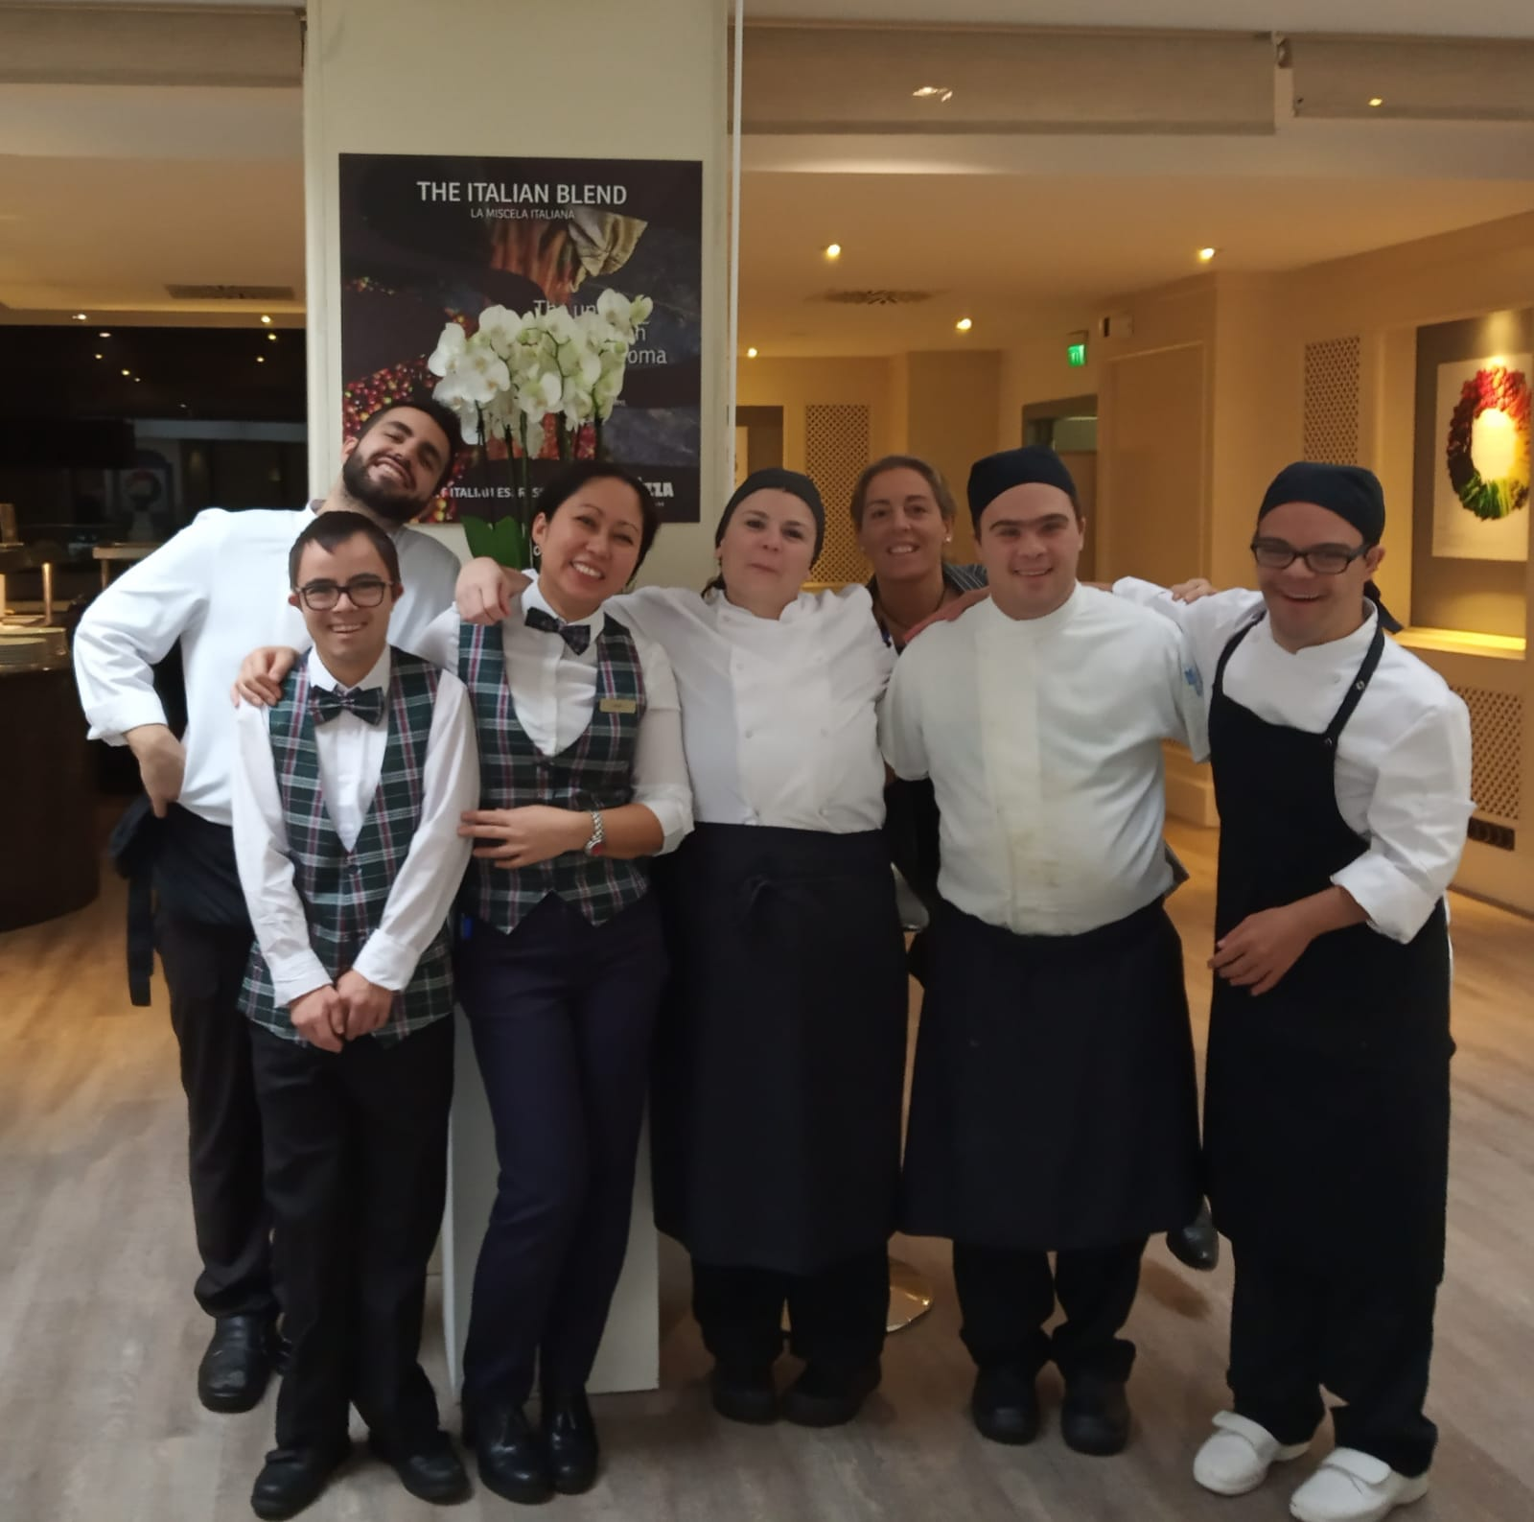
5 million Europeans with an intellectual disability
Usually, they are simply ignored.
But for them, to find a job is a matter of dignity.
We support/facilitate the empowerment of people with disabilities through meaningful and fulfilling work.

Slide 5
(2) The Valueable proposal
A systemic approach

Slide 6
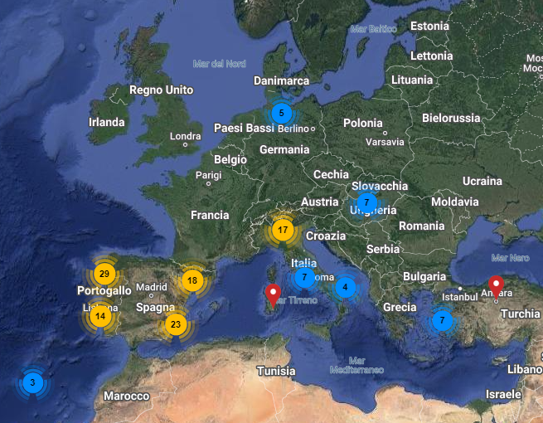
A Europe-wide network
180 hospitality companies have included /
include people with intellectual disabilities
in their work force through an internship
or a job contract.
8 Countries: Portugal, Spain, Italy,
Germany, Hungary, Croatia, Turkey.
Ireland has just joined the network.

Slide 7





Quality trademark
A quality trademark, which has been registered at the European Intellectual property office. and testifies the engagement of the employer on job inclusion without discrimination.
The bronze label is for employers who host internships.
The silver version requires a further engagement: fixed (min. 3 months) or permanent job for at least one worker with an intellectual disability.
The golden version is granted to those employers who hire at least one worker and act as ambassadors of the Valueable trademark.
These engagements are contained in a code of good practice, which is subscribed by would be members.
The label is not released as a prize but as a recognition of a long - term engagement

Slide 8
Fundamentals of the Valueable network
Long –lasting partnerships between expert training agencies and hospitality companies
Accreditation protocol for Valueable training agencies (29)
Collaboration protocol for Valueable hospitality chains (8)
Trademark and membership of the network for Valueable member companies

Slide 9
ICT tools to facilitate job inclusion
Managers
Trainee/worker with intellectual disabilities
Awareness raising course
Training agency
Course for placement
professionals
«On my own» app
HACCP course
Health &Safety course
Staff
Video tutorials
Available on Valueable’s website:www.valueablenetwork.eu

Slide 10
(3) Valueable’s history
From the «OMO»project to the Valueable network: an example of best practice

Slide 11




10 years!!!
4 projects
funded by the EU Commission
in the framework of the Erasmus +
programme
On my own…at work
2014-2017
The Valueable network(2017-2019)
Value-able
(2019-2022)
ValueS
(2022-2024)
Registration of the trademark at the European
Intellectual Property Office (2018)

Slide 12








Our road
?
Today
Final coordination meeting
AIPD
HAA
APPT21
D ALAPITVANY
DSD Turchia
Down Espana
HDSA
Axis
NH
LUMSA
Assoc: EDSA, EHMA, Marriott Budapest, AICA
2024
2022
Values
Internships abroad, training, health & safety at work
AIPD
APPT21
Univ Bologna
Univ Roma TRE/LUMSA
Adecco fondaz
Adecco italia
EDSA
Axis
Melià
EHMA
286.000€
AIPD
HAA
APPT21
D ALAPITVANY
DSD Turchia
Axis
Down Espana
LUMSA
Melià
Assoc: AICA, EDSA, EHMA
Value-able
Internships abroad, training, HACCP
United Nations - NY
2019
European Vocational Skills Week
OMO
Inclusion process, app, trademark, quality kit, etc.
167.000€
2014
325.000€
2017
AIPD
HAA
APPT21
D ALAPITVANY
DSD Turchia
Down Espana
Axis
NH
Melià
LUMSA
Assoc: EDSA, AICA, EHMA
ILO HO - Geneva
400.000€
The Valueable network
Enhancement of developed tools, internships abroad
Trademark registration

Slide 13
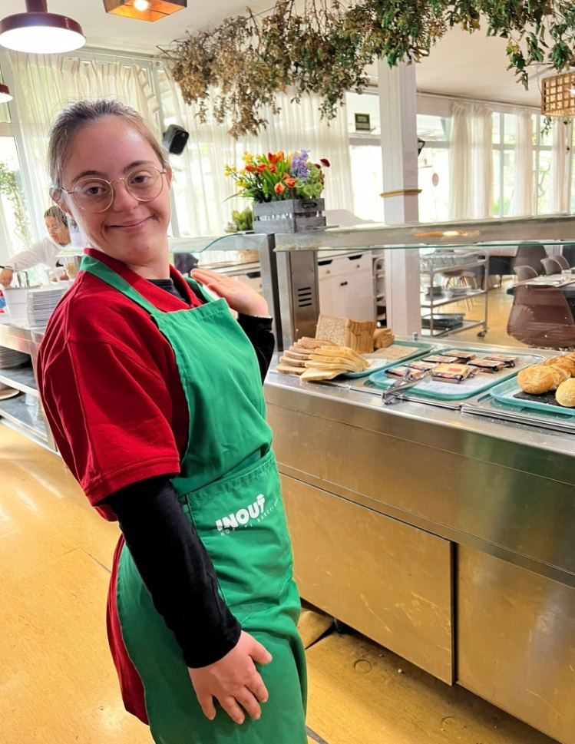
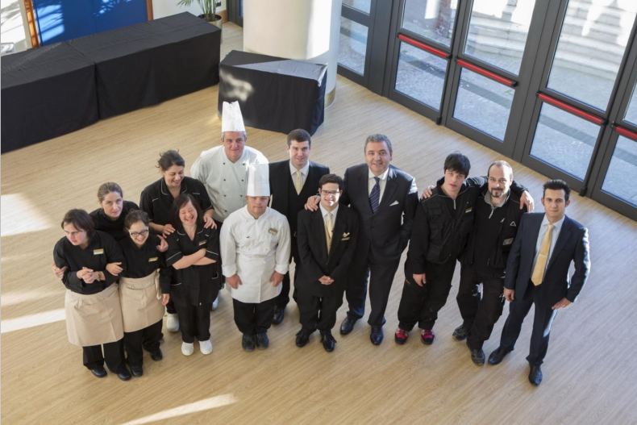
What before Erasmus +? Valueable’s ancestors
Since 2007:3-week internship of
youngsters with Down syndrome
at the In&Out Hostel in Barcelona
2014: «Hotel 6 stelle» TV docufiction. 6 people with Ds
having an internship at Melia’s hotel in Rome, followed
by TV cameras for 6 weeks.
The internship was real and lasted 4 months

Slide 14
(4) Something to celebrate
Strenghts and achievements

Slide 15
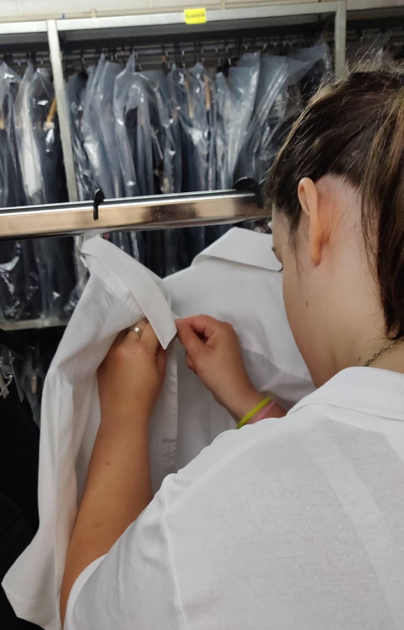
Our strenghts
Long-lasting partnerships between VET providers and hospitality companies
Accreditation of Valueable VET providers
Certification of Valueable employers.
Collaboration protocols with hospitality chains
Design, development and diffusion of facilitating tools.
Internships abroad

Slide 16
Valueable’s impact so far
Today Valueable is in : Italy, Spain, Portugal, Croatia, Germany, Hungary, Austria and Turkey and has just included Ireland .
Since 2014, almost 350 interns or workers with ID have taken a Valueable opportunity.
40 trainees have had an internship abroad.
So far,180 hospitality companies have been Valueable members.
Despite the Covid-19 pandemic which severely impacted the hospitality sector, Valueable Network has demonstrated remarkable resilience. At the moment, we count 125 members.

Slide 17
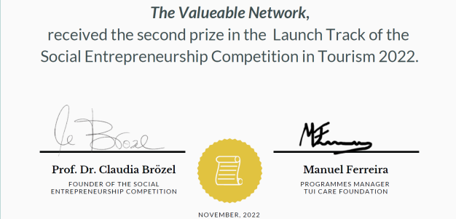



Moments of glory!
03/2018 Presented at the United Nations in New York as the best European example of job inclusion of people with Down syndrome
12/ 2019Presented as an example of good practice at the “Technical workshop on decent work for persons with disabilities in the tourism sector ILO HQ, Geneva”
11/2020 Valueable invited by the EU Commission at the European Vocational Skills Week 2020, as an example of Inclusive excellence
11/2020, among the 7 winners of the .eu web awards
2020, Included in the EU Commission #EUvsDiscrimination publication on “How to put reasonable accommodation into practice. Guide of promising practices.
11/ 2022: 2nd winner at Social Entrepreneurship Competition in Tourism, by the Eberswalde University for Sustainable Development (Berlin)
04/2024. Highly commended at the Disability Smart Awards, promoted by the UK Business Disability Forum.
2019
.
.
2020
2022
2019
2018
2020
2024

Slide 18
Valueable from 2016 to 2024

Slide 19
A Valueable image
Social media presence on Instagram, Facebook and LinkedIn to raise awareness about the importance of disability inclusion in the hospitality industry.
Website: www.valueablenetwork.eu - an easy to navigate platform where anyone can access our tools and keep updated on our latest news.
Public events — we are invited regularly to speak at natiomal and international seminars and roundtables, to contribute to conversations about breaking barriers and the benefits of inclusive employment.
Media coverage: articles on paper and online press on both social and business magazines.

Slide 20
(5) Valueable actors
Partners, accredited agencies, signatories, member companies

Slide 21















Valueable supporters
Disability associations as training and placement agencies
European Down syndrome Association
Hospitality chains
(Partners and protocol signatories)
One Italian University
The Italian Hospitality employers’ association

Slide 22












Pursuing the same objective: job inclusion
Accredited training agencies
Protocol for chains’ signatories

Slide 23


«Happy are those who dream dreams
and are ready to pay the price
to make them come true»
L. J. Suenens
Come and join our dream!

