Slide 1
March 2024

Slide 2

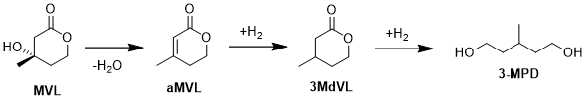
Mevaldi’s unique and patented building block is Nuvone© :
3 Methyl delta Valero Lactone - 3MdVL
Product 1
Nuvone ©️
Product 2
Nuvonext ©️
biomass
Fermentation
Down Stream Processing
  Nuvone©️ and Nuvonext©️ can be made out of a wide range of sustainable Cellulose feedstocks like woodscrap, straw or beetrootpulp through a combined fermentation and chemical process
Private and Confidential 2023

Slide 3
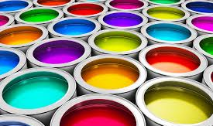
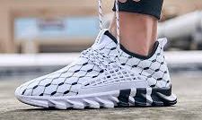
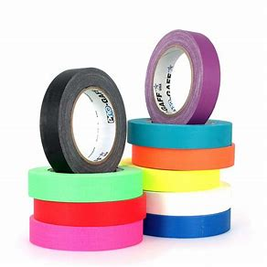
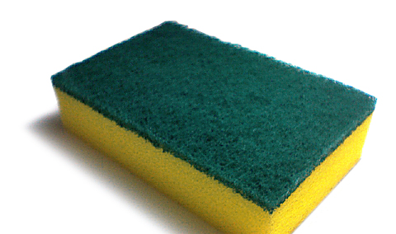
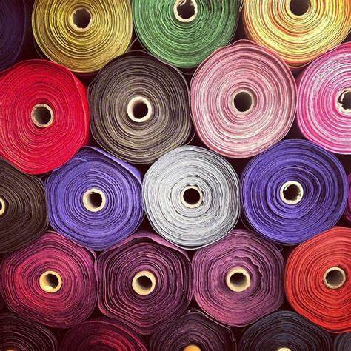
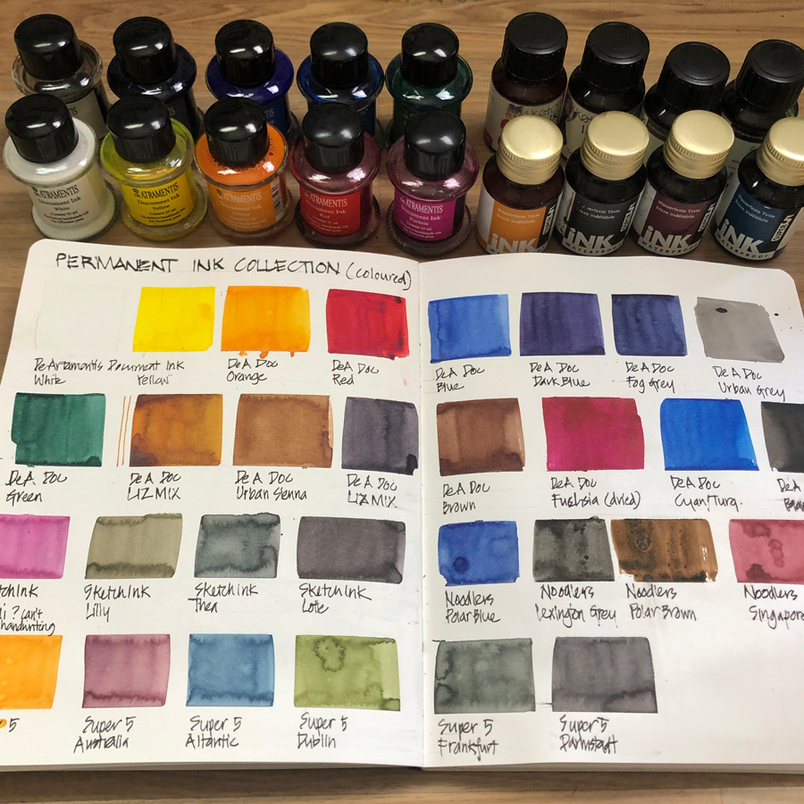
Mevaldi is producing a bio-based building block for new bio-polymers and recyclable Polyurethanes (PUR)
Coatings
Apparel
Adhesives
Label
PUR foams
Textiles
Specialty inks
Private and Confidential 2023

Slide 4
