Slide 1
STUDY VISIT
& MATCHMAKING

Slide 2
General info
1.Prepare short 4-minutes presentation (max. 3-5 slides, max. 5MB) on this graphical pattern with the guideline for its contents.
2. Send your presentation by the September 7 via e-mail to:
icphealth@port.lukasiewicz.gov.pl
3. You will receive an email with a confirmation of participation in the pitching session.

Slide 3
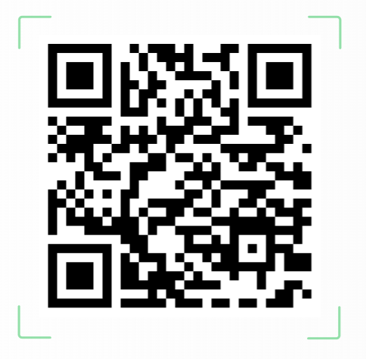
Intro (1 slide)
Guidelines for participants
Organisation unit/name:
Organisation type
Contact person name
Qr code with contact details or linkedin profile of contact person required
Institution website
Contact:
contact@brandname.pl

Slide 4
Slide about organization (1 slide)
…
…
(our experience in international Projects…)

Slide 5
Our research support asset
…
…

Slide 6
Calls of interest
(to be selected from cluster 1 and 4 – calls for 2027):
https://research-and-innovation.ec.europa.eu/funding/funding-opportunities/funding-programmes-and-open-calls/horizon-europe/horizon-europe-work-programmes_en
…

Slide 7
Project idea / expertise offer / collaboration (1-2 slides)
Introduce your experience/collaboratios?
Scope of the project
Who/what is needed
Where to apply (e.g. Horizon Europe open calls, European Institute for Innovation and Technology (EIT) calls, calls organized by the European Partnerships)

Slide 8
Thank you

