Slide 1

Belavista Trend Montenegro d.o.o.
Travel agency Trend Travel
Herceg Stjepan Square No. 4
Belavista, Old Town
Herceg Novi, Montenegro
Tour operator license No.109
License for transportation in international road traffic No. MKI343
Limo service license No. MSP012-L/1

Slide 2
Travel agency Trend Travel operates within the company Belavista Trend Montenegro d.o.o. founded in April 2007 with headquarters at Herceg Stjepan Square No. 4, Old Town, Herceg Novi. The second open office that operates throughout the year started in 2011 and is located across the street from the main bus station in Herceg Novi at the address Orjenski bataljon No. 3.
During the tourist season from 1st May until 31st October, the travel agency Trend Travel operates through 4 branches at the following addresses:
  Obala Nikole Kovačevića No. 46, Igalo
  Promenade Pet Danica No. 2, Topla
  Promenade Pet Danica bb, Topla
  Save Kovačevića No. 77A, Savina
Business decisions and activities aimed at achieving long-term performances travel agency Trend Travel achieves with the professional teamwork of more than 20 employees throughout the year, as well as the same number of additional staff engaged during the summer tourist season.
All these years of it’s existence, the image of the business resulted in becoming a reliable partner and an agency of creative contribution to tourism. The best ratio of price and quality of service, many years of experience in organizing different types of travel, as well as a significant number of partners, fully justify the epithet of one of the leading agencies in the region.

Slide 3
For its work so far, the travel agency Trend Travel has won a number of domestic and international awards and certificates, which confirms the vision of business with the goal of uncompromising quality.
The tourist offer of the Trend Travel agency was shaped through business segments:
  Airport transfers
  Limo service
  VIP tours
  Group and individual tours in the country and abroad
  Boat tours
  Active vacation
  Cruises
  Airline tickets
  Guide services
  Reservation of private and hotel accommodation
  Rent a car, boat, bike

Slide 4
Travel agency Trend Travel organizes one-day tours in the form of group or individual visits:
Herceg Novi tour
Jeep safari on Orjen
An evening of national cuisine and folklore in the stone village
The bay of Kotor
Mini Montenegro
Skadar lake
Bar and Ulcinj
The monastery of Ostrog
Montenegro tour
Lipa cave and wine route Plantaže
Montenegro canyons
Zip line over the deepest canyon in Europe
Tara river rafting
Dubrovnik
Trebinje
Mostar
Medjugorje and Kravica waterfall
Shkoder (Albania)

Slide 5
According to the client's needs and wishes, the Trend Travel agency organizes individual and group transfers from/to the airports (Tivat, Podgorica, Dubrovnik, Split, Sarajevo, Belgrade, Tirana...), as well as a transfer service from bus and train stations, shipping ports or any other place of departure upon request.
The travel agency Trend Travel is recognizable by its own fleet of high tourist class vehicles with a capacity of 4 to 51 passenger seats with air conditioning, audio/DVD equipment, microphone, navigation, panoramic windows, comfortable tourist movable seats with tables and armrests, as well as safety belts, safety and child seats.
As an attached transport vehicle, the travel agency Trend Travel also owns a professional BOX trailer for the needs of transporting groups with a large amount of luggage.

Slide 6
The vehicles have a license for international and domestic passenger transport, a certificate of compliance with the conditions for the transport of children, technical and traffic permits, insurance policies for passengers and belongings, insurance towards third parties.
Vehicle fleet stucture:
  Passenger vehicles
  Minivans
  Minibuses
  Buses
  Trailers
According to the needs of the market in Montenegro, Western Europe and Russia, as well as the requests of clients, the vehicle fleet is continuously complemented and renewed based on organizational and territorial needs.
The company has its own parking space of 1345 m².

Slide 7
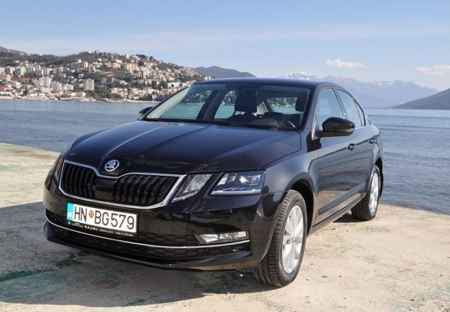
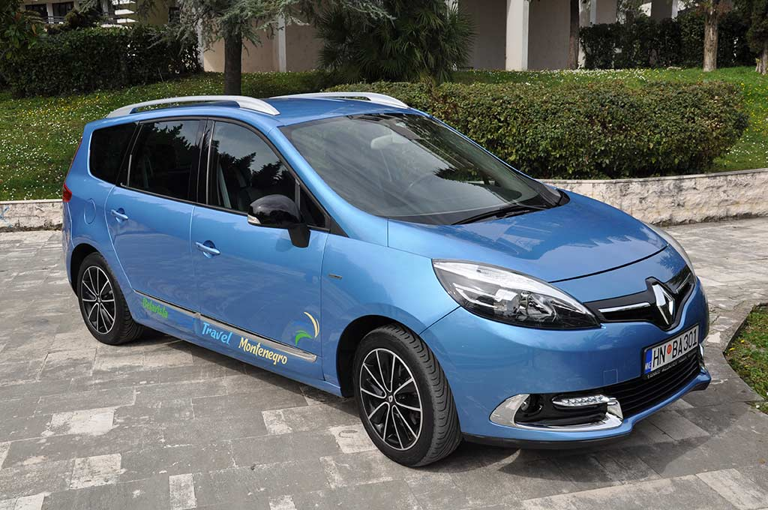
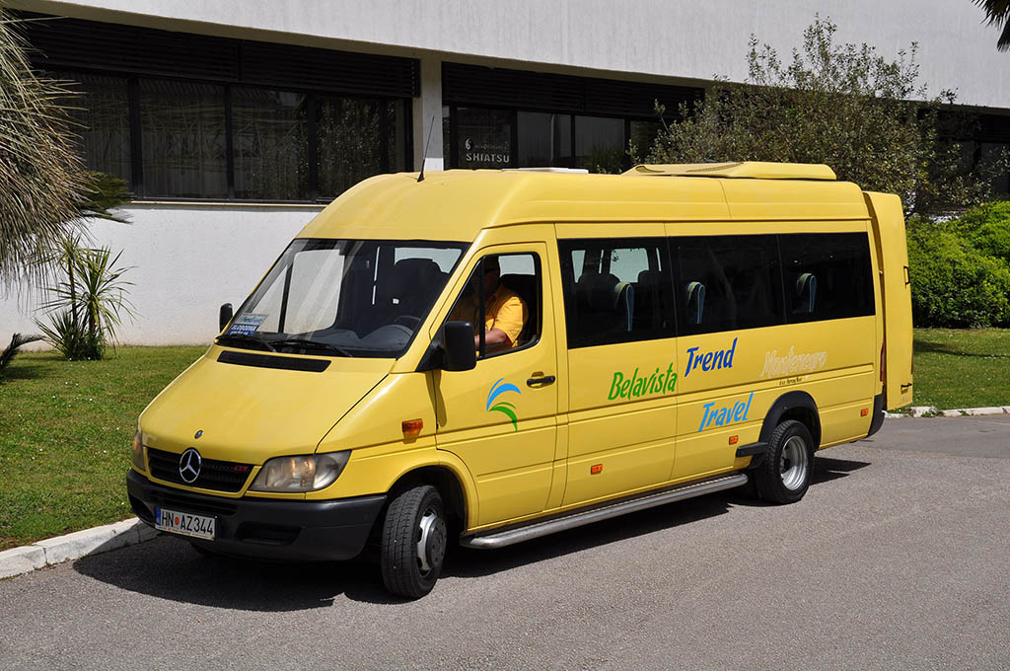
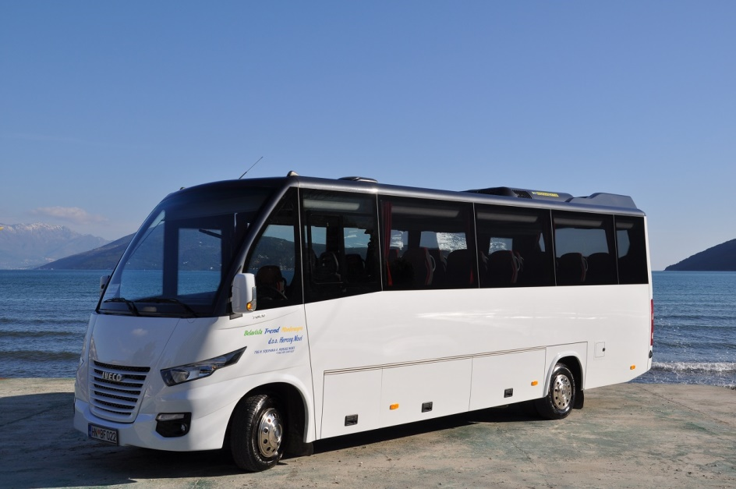

Slide 8
