Slide 1
“Model to Cure”
Accelerating the discovery
of novel medicine with
EXSCALATE

Slide 2
Pull architectures are request driven: the researcher ask a specific question , and the server responds accordingly.
Other Platforms

Slide 3
See Different.

Slide 4
is an event driven architecture: the platform pushes relevant data to researcher with a holistic approach
EXSCALATE

Slide 5
To enable a holistic approach, Exscalate Combines Computer simulations with Machine Learning to expand the existing experimental knowledge with high quality synthetic data
EXSCALATE

Slide 6



Exscalate
5 Pillars
The EXSCALATE platform can support the entire process up to clinical candidate identification
CTTD
LiGen
TCS
ProfhEX
KEX
KnowledgEX
20K+ 3D Models
260K+ annotations of 3D functional domain (SHAPEx)
100K+ pockets ready to virtual screen (GENEOnet)
6.5K mol/Sec/GPU
Autotuning
AI Pose Selector Predictor
Absolute Binding Free Energy
>2T synthesizable molecules
150+ curated chemical reactions
Reaction Driven Generative chemistry
8 AI Models of Tox
Based on 52 Targets
610 AI powered ligand-based models
600 Metabolic reactions mapped
Tox Alerts
Database Architecture & Data Structure
Knowledge Graphs
GNN Neural Network implementation

Slide 7
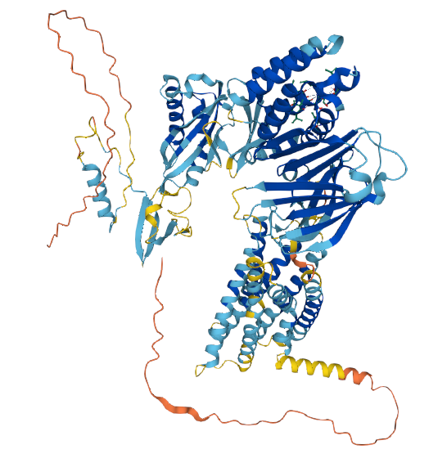
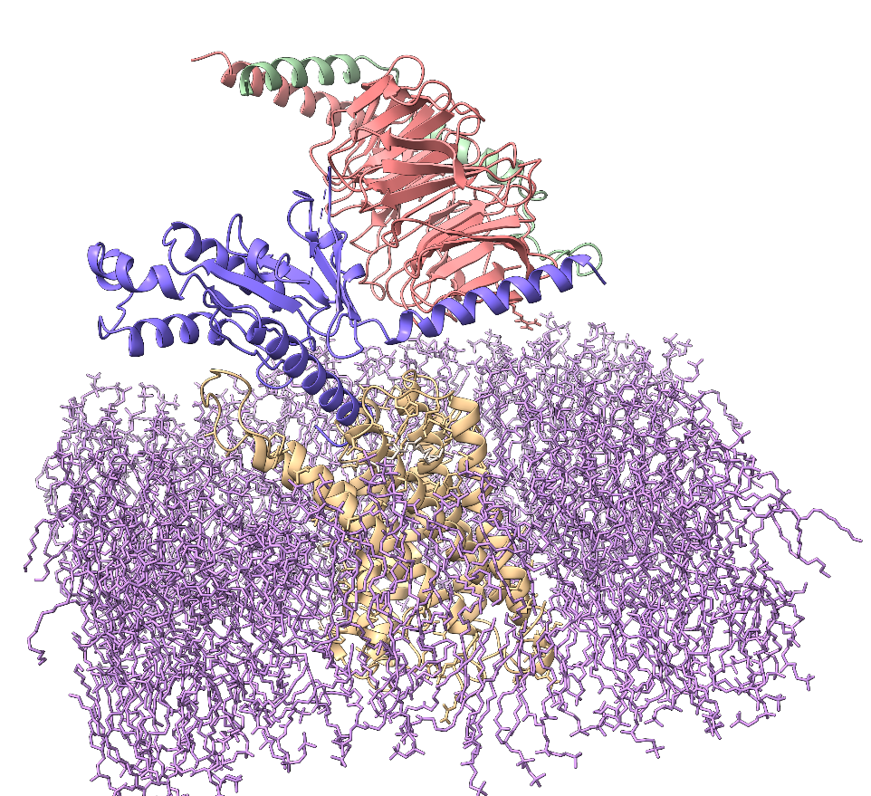

EXSCALATE: Comprehensive Therapeutic Target Database
Proteins are dynamics systems
EXSCALATE collects more than 20K high quality 3D structures of the most relevant Therapeutic Targets, considering the environment and the ensemble of pharmacologically relevant conformations, bound and abound with ligands. All the generated structures are thermalized with molecular dynamics simulation to study the dynamic behavior of proteins. CTTD is designed to compare orthologues and paralogues for selectivity and cross species reactivity.
Alphafold 2.0
EXSCALATE
GPR110
Adhesion G-protein coupled receptor F1

Slide 8


EXSCALATE: Comprehensive Therapeutic Target Database
proteome-wide knowledgebase for functional biology
CTTD has been built to be an integrated environment that combines database, dynamic 3D models and extended protein annotations.
3D Protein Models
>20K 3D models
Dynamics Simulations
Essential Dynamics
APO, HOLO
100+ nSec MD simulations
Active, Inactive
100K+ Ligands Binding Sites
Pocketome
260K+ Novel Protein Functions
Functional Annotations
Structural Biology Validation

Slide 9
Ligen™ is an exa-scale Structure Based Virtual Screening Tool
Combining Artificial Intelligence & Molecular simulation (AIMS)
Structure based virtual screening tool designed for supercomputer centers*, powered with AI to generate the highest quality predictions. Parallel screen of more than 100 targets in multiple conformations
Secure Platform as a Services
CTTD
Compounds
GPU Accelerated
Molecular Docking Engine
AI
Pose
Selection
ML
Scoring
Function
Free Energy
Perturbation
Energy
Scoring Function
EXSCALATE: An Extreme-Scale Virtual Screening Platform for Drug Discovery Targeting Polypharmacology to Fight SARS-CoV-2
https://www.computer.org/csdl/journal/ec/2023/01/09817028/1EMV96xHxnO
EXSCALATE: An extreme-scale in-silico virtual screening platform to evaluate 1 trillion compounds in 60 hours on 81 PFLOPS supercomputers
https://arxiv.org/abs/2110.11644

Slide 10

“AI-based platform for small molecules features estimation”
Suite of machine learning models for large-scale estimation of:
  Drug liabilities and adverse events
  Poly Pharmacology
  PhysChem & ADMET
  Metabolites

Slide 11
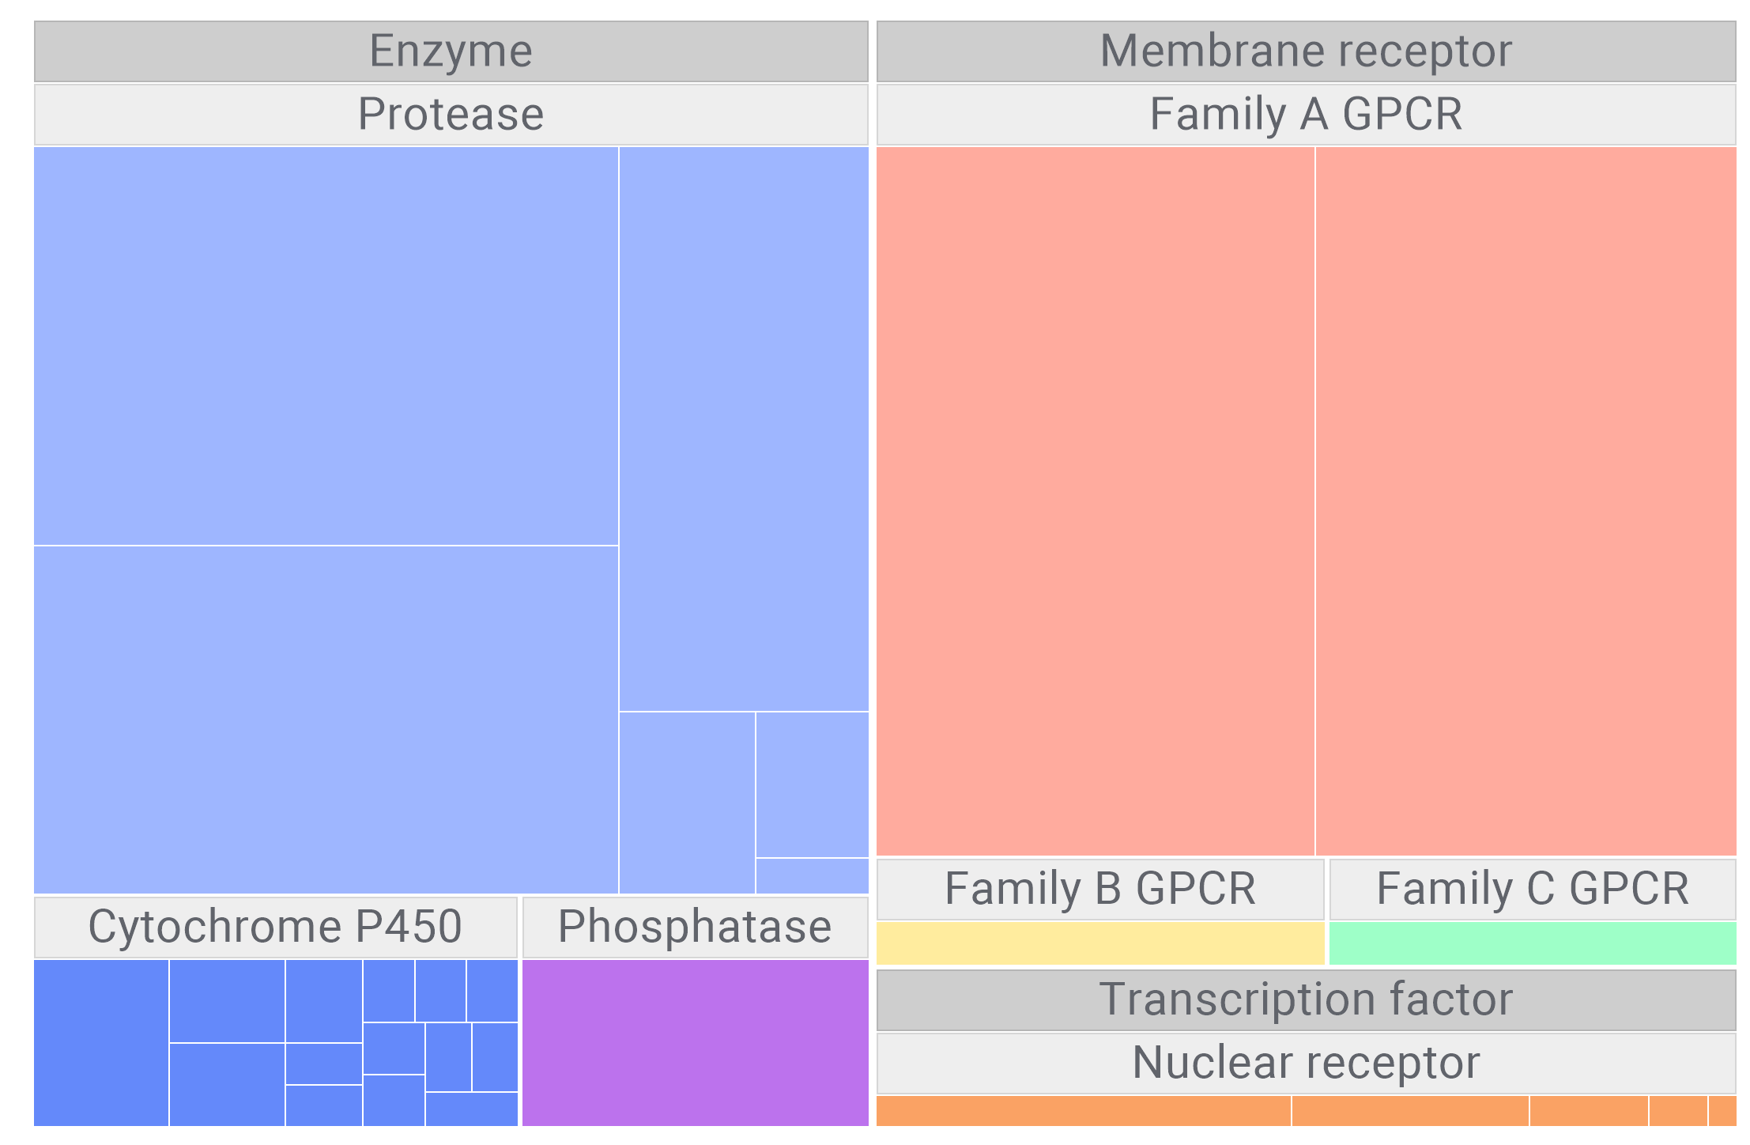
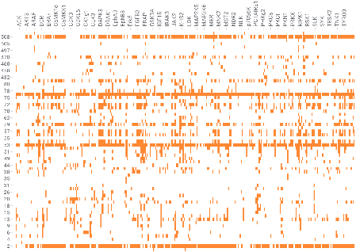
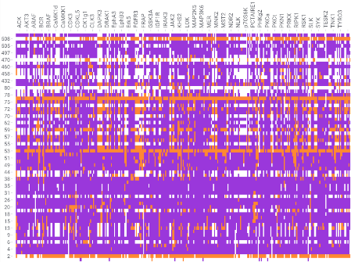
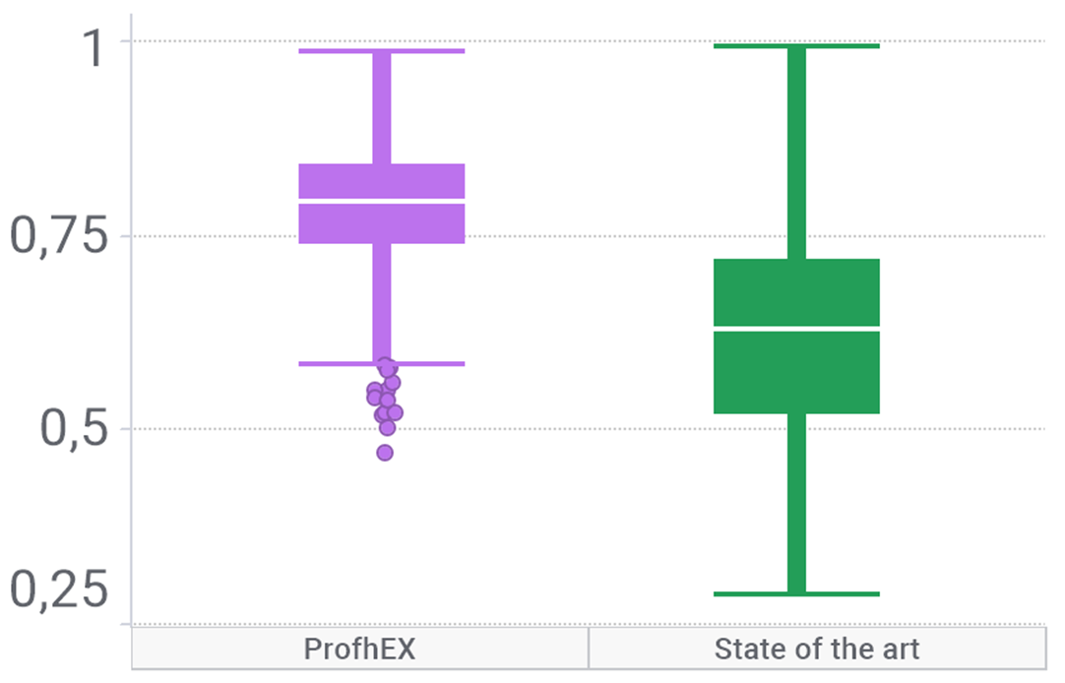
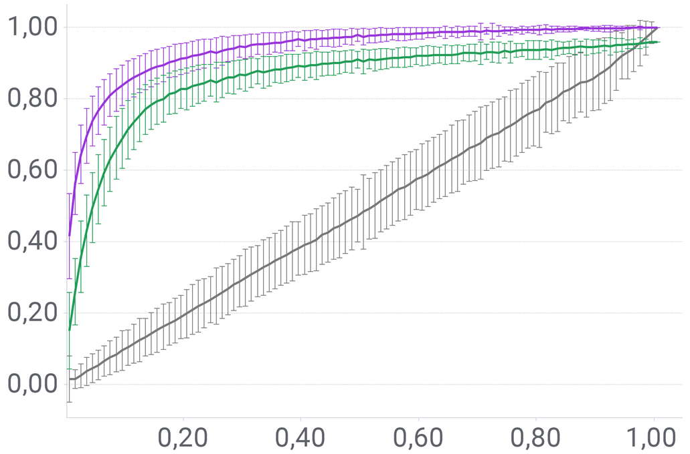
ProfhEX: Ligand Based Virtual Screening
Ligand Based Virtual Screening
AI derived synthetic data extends the Drug’s polypharmacological profile
suggesting novel applications
High quality models
Data gap and polypharmacology
Kinases
>60 % simulated data
>600 models* over the main protein families
325 kinases
190 GPCRs
Experimental
ProfhEX-augmented
ProfhEX
Non-AI models
ProfhEX: AI-based platform for small molecules liability profiling - https://jcheminf.biomedcentral.com/articles/10.1186/s13321-023-00728-6

Slide 12
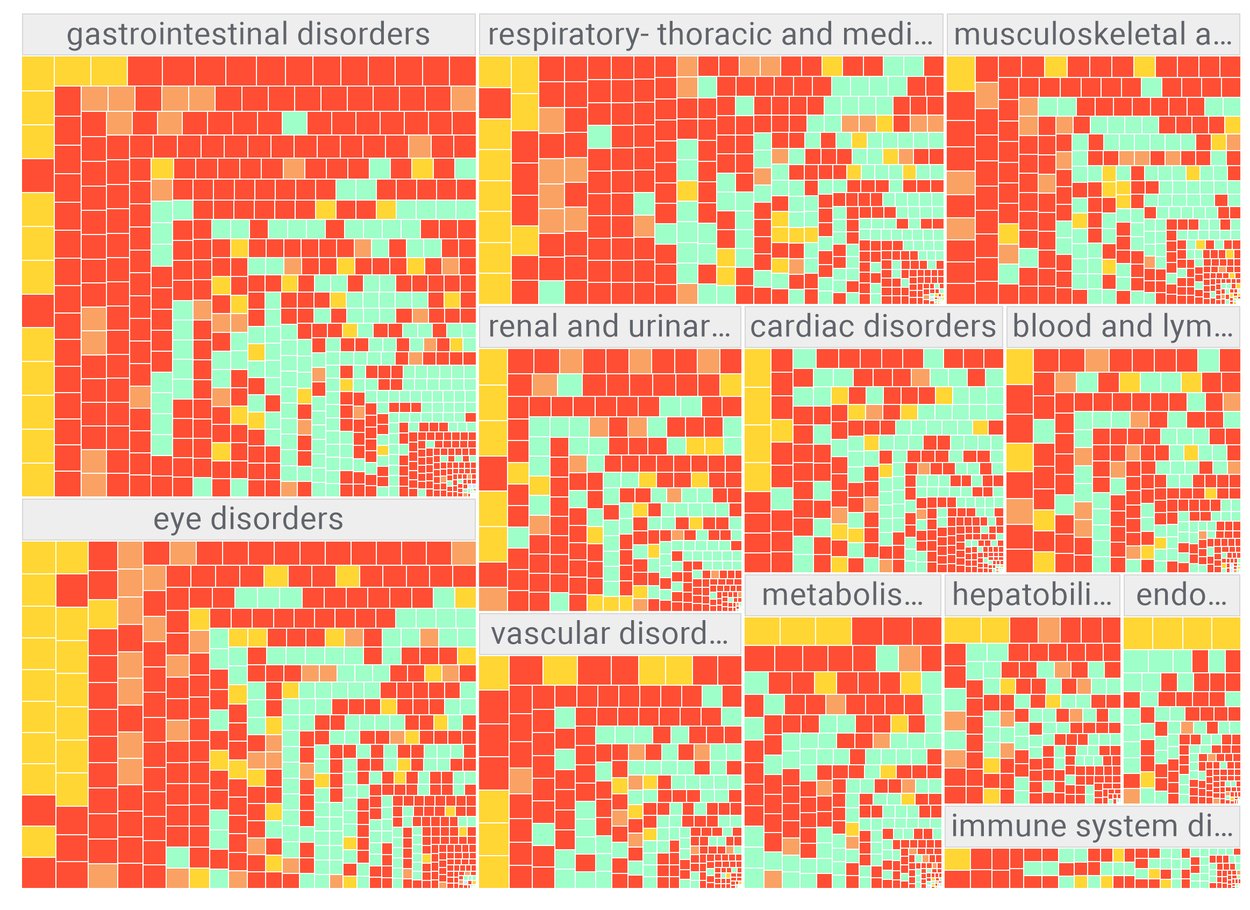
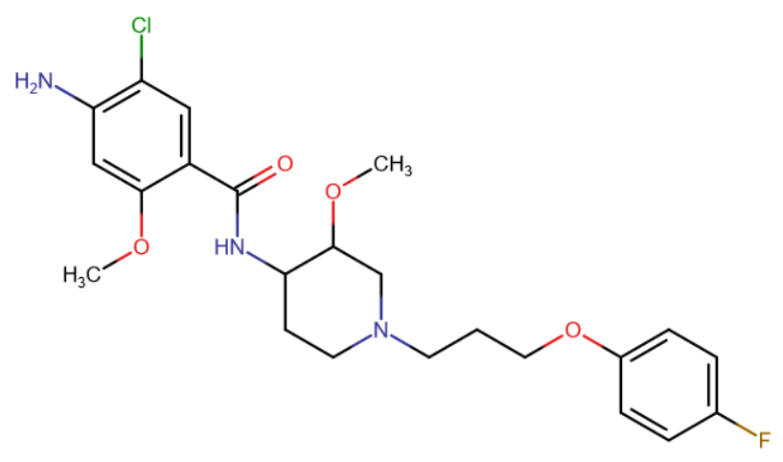
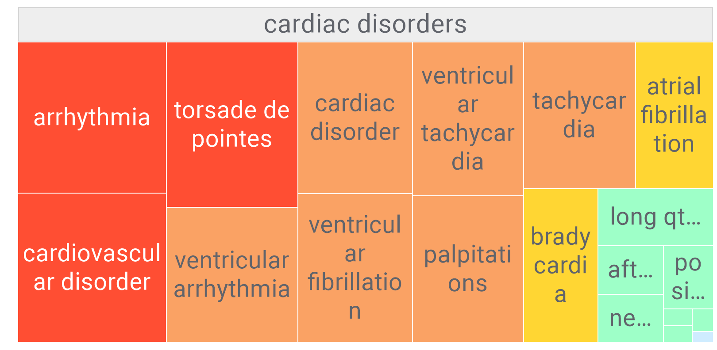
ProfhEX: Adverse Drug Reactions
Adverse Drug Reactions
Off-targets prediction suggests ADR’s mechanistic interpretation.
ADRs can be used to validate novel predicted activities
>1M side effects data
From ADR to Polypharmacology
Cisapride
Withdrawn due to cardiotoxicity
>20
ADR Models
Ion channels activation
ProfhEX activity profiling
SIDER DB

Slide 13


EXSCALATE: Artificial Intelligence (AI) and Molecular Simulation (MS)
Combine complementary approaches to maximize the success
Molecular Docking
Ligand Based VS
Pocketome Similarity
Adverse Drug Reactions
Interactome
Metabolism
Notes:
Collect the information and apply AI based on Machine learning approaches and scoring functions

Slide 14
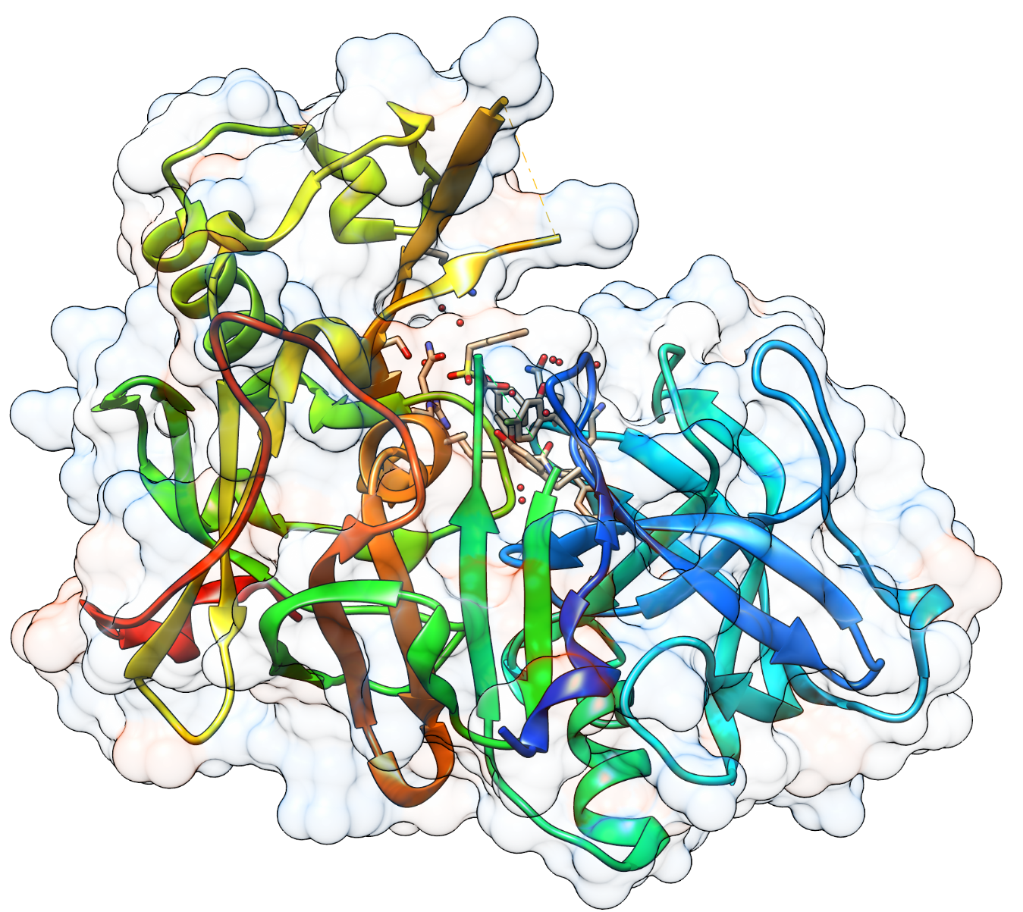
EXSCALATE
Thank you very much for your kind attention

Slide 15
CTTD references
Proprietary Binding Site Mapping tool:
GENEOnet: A new machine learning paradigm based on Group Equivariant Non-Expansive Operators. An application to protein pocket detection. https://arxiv.org/abs/2202.00451
Towards a topological–geometrical theory of group equivariant non-expansive operators for data analysis and machine learning. Nature Machine Intelligence, https://doi.org/10.1038/s42256-019-0087-3
Molecular dynamics and Multiple Receptor Conformations approach:
Combining Molecular Dynamics and Docking Simulations to Develop Targeted Protocols for Performing Optimized Virtual Screening Campaigns on the hTRPM8 Channel, Int. J. Mol. Sci., https://doi.org/10.3390/ijms21072265
Extensive Sampling of Molecular Dynamics Simulations to Identify Reliable Protein Structures for Optimized Virtual Screening Studies: The Case of the hTRPM8 Channel, Int. J. Mol. Sci., https://doi.org/10.3390/ijms23147558
Structure of human TRPM8 channel, https://doi.org/10.1101/2022.10.19.512915
ShapEx:
The SARS-CoV-2 spike protein binds and modulates estrogen receptors. Science Advances, https://www.science.org/doi/full/10.1126/sciadv.add4150
Relevance of Spike/Estrogen Receptor-α interaction for endothelial-based coagulopathy induced by SARS-CoV-2. on Signal Transduction and Targeted Therapy

Slide 16
LiGen references
Proprietary Structure-based virtual screening software:
EXSCALATE: An Extreme-Scale Virtual Screening Platform for Drug Discovery Targeting Polypharmacology to Fight SARS-CoV-2. IEEE Transactions on Emerging Topics in Computing, https://ieeexplore.ieee.org/abstract/document/9817028
Tunable approximations to control time-to-solution in an HPC molecular docking Mini-App. The Journal of Supercomputing, https://link.springer.com/article/10.1007/s11227-020-03295-x
Tunable and Portable Extreme-Scale Drug Discovery Platform at Exascale: the LIGATE Approach, https://arxiv.org/abs/2304.09953

Slide 17
Other high impact references:
X-ray screening identifies active site and allosteric inhibitors of SARS-CoV-2 main protease, Science, DOI: 10.1126/science.abf7945
Exscalate4CoV High-Performance Computing for COVID Drug Discovery, Book, https://link.springer.com/book/10.1007/978-3-031-30691-4
LIGATE: The game changer in drug discovery, https://www.ligateproject.eu/. Accessed 7 June 2022
A review on parallel virtual screening softwares for high-performance computers. Pharmaceuticals 15(1), 63 (2022)
S. Markidis, D. Gadioli, E. Vitali, G. Palermo, Understanding the I/O impact on the performance of high-throughput molecular docking, in Proceedings of the IEEE/ACM Sixth International Parallel Data Systems Workshop (PDSW), St. Louis, MO (2021), pp. 9–14
Dompe Farmaceutici. Spike mutants, https://spikemutants.exscalate4cov.eu/. Accessed 8 Dec 2022
I. Romeo, I.G. Prandi, E. Giombini, C.E.M. Gruber, D. Pietrucci, S. Borocci et al., The Spike Mutants website: a worldwide used resource against SARS-CoV-2. Int. J. Mol. Sci. 23(21), 13082 (2022)
European Commission. High performance computing used to develop new drugs against the Zika virus, https://digital-strategy.ec.europa.eu/en/news/high-performance-computing-used-develop-new-drugs-against-zika-virus. Accessed 7 June 2022
REMEDi4ALL: Repurposing of medicines 4All, https://remedi4all.org/. Accessed 7 June 2022

