Slide 1
Maximizing Human Potential
Donna Bungard
Indeed
United States of America
Digital training platforms and ecosystem building in inclusive employment
March 5th, 11:00 am
Notes:
Good morning. Wow you picked us over Jenny - on behalf of myself and the panel, we’re flattered!
My name is Donna Bungard, Director of Accessibility at Indeed.
Welcome to Digital training platforms and ecosystem building in an inclusive environment.
First, let’s talk about something fundamental: maximizing human potential. Specifically, how we can intentionally build a better world of work by focusing on skills-first hiring and equitable skills development."

Slide 2

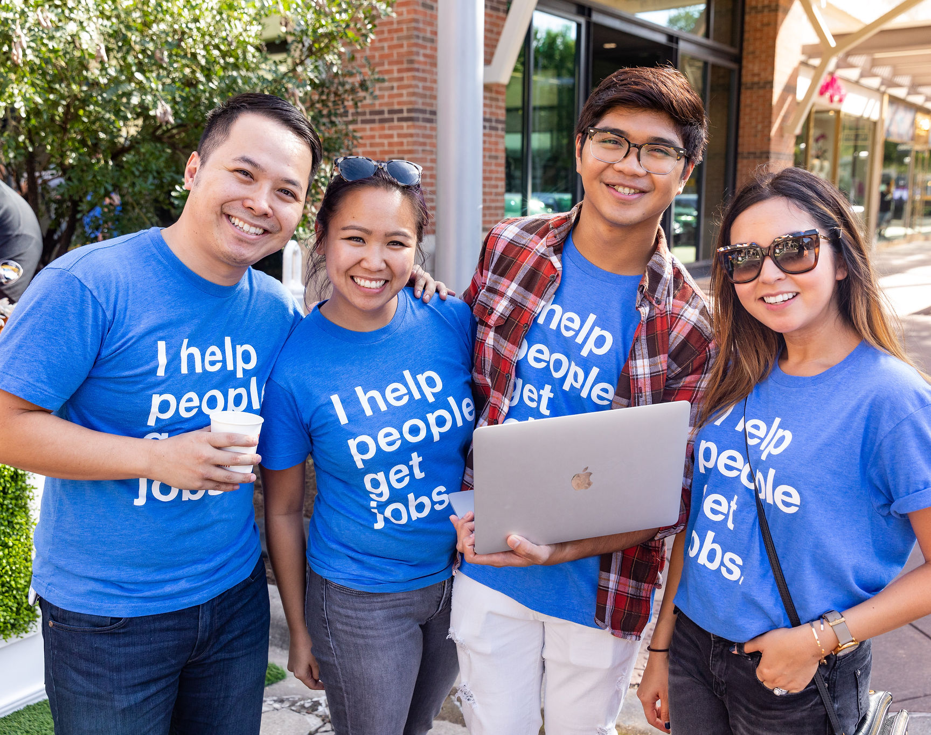
At Indeed,
we help people get jobs.
Notes:
At Indeed, our mission is simple but powerful: we help people get jobs. But to truly make this mission a reality for everyone, we must be intentional about how we create opportunities and set people up for success.

Slide 3

Global workforce is changing
Rapid technological shifts
New skill requirements emerging
Demographic shifts impacting employment
Notes:
The world of work is changing. Technology is evolving, skill requirements are shifting, and demographic changes are reshaping the labor market. The question is: Are we preparing our community for success in this changing landscape?

Slide 4
Traditional hiring often focuses on:
Rigid degree requirements
Overemphasis on prior job titles
Limited opportunities for non-traditional candidates
Notes:
Most hiring systems prioritizes degrees over skills, connections over capability, and past experience over potential. This approach excludes talented individuals and limits economic mobility.

Slide 5
A skills-first approach
The Solution
What is skills-first hiring?
Hiring based on skills & competencies
Recognizing diverse learning pathways
Promoting equitable access to opportunities
Notes:
For too long the Disability Community has been defined but limitations, not potential. Skills-first hiring focuses on what a person can do, rather than barriers that are not of their own making. It’s about removing artificial barriers and opening doors for people based on their abilities, not their social identities.

Slide 6
Maximizing human potential means:
Notes:
So, what does maximizing human potential mean?

Slide 7
Maximizing human potential means:
01
Investing in people’s skills
Notes:
Investing in people, our community

Slide 8
Maximizing human potential means:
01
02
Investing in people’s skills
Expanding access to growth
Notes:
expanding opportunities for growth

Slide 9
Maximizing human potential means:
01
02
03
Investing in people’s skills
Expanding access to growth
Removing systemic barriers to employment
Notes:
And removing systemic barriers to employment
Everyone has the potential to learn, grow, and contribute.
Our responsibility is to ensure they have the opportunity to do so.

Slide 10
The global talent shortage
Total global labor deficit as a percentage of workforce
2020
3%
6%
2030
2025
11%
Workforce
Labor deficit
97%
94%
89%
Unrealized output
$2.1 trillion
Unrealized output
$3.8 trillion
Unrealized output
$8.5 trillion
Graph from Korn Ferry illustrating the growth of the global labor deficit as a percentage of the workforce, rising from 3% in 2020 to an estimated 6% in 2025 and an estimated 11% by 2030.
Notes:
It’s been estimated that by 2030, the global labor deficit is predicted to reach more than 80 million workers. If we fail to tap into all available talent, businesses will struggle to innovate, and economies will suffer.

Slide 11
How skills-first hiring solves the talent crisis
A skills-first approach helps:
Bridge labor shortages
Expand economic participation
Drive innovation and growth
Notes:
Skills-first hiring isn’t just about fairness or even being equitable—it’s about business resilience and economic sustainability. When we hire based on skills, we create stronger, more adaptive workforces.

Slide 12
Unlocking potential
Skills-first hiring elevates disabled talent
Celebrates diverse ways of thinking and working
Highlights unique problem-solving skills
Values adaptability and innovation
Appreciates lived experience
Notes:
Skills-first hiring doesn’t just remove barriers—it elevates all of our talents. Disabled workers bring unique perspectives and strengths—like creative problem-solving, adaptability, and innovation. By focusing on skills, we’re not just including disabled workers; we’re leveraging their strengths to drive business success.

Slide 13

Embedding accessibility in learning & development
Accessible learning unlocks potential
Skills development must be designed for all learners
Accessibility must be built into training systems, not added later
Adaptive learning benefits everyone, not just disabled employees
Notes:
If we are committed to a skills-first approach and supporting the disability community benefiting from that approach, we need to ensure learning systems are accessible by design. That means ensuring training platforms, upskilling opportunities, and professional development programs are inclusive from the start—because when accessibility is embedded, everyone benefits.

Slide 14

How organizations can lead
Rethink job descriptions
Expand skill-based learning programs
Measure success through skills-based metrics
Notes:
We need to maximize human potential so we need to move beyond intent and into action. That starts with rethinking hiring, expanding skill development, and ensuring everyone has the tools to succeed, especially those who have been historically excluded.

Slide 15
At Indeed,
we help all people get jobs.
Notes:
At Indeed, we believe that all people deserve the opportunity to contribute, grow, and thrive. That’s why we’re committed to advancing skills-first hiring.

Slide 16




Now is the time to build a better world of work together.
Notes:
It’s time to build a better world of work together.

Slide 17
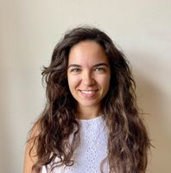
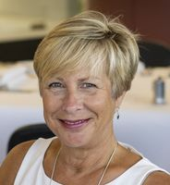
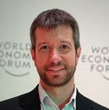
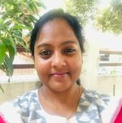
Today’s
Panel
Evangelia-Christina Andreadi
Project Manager, MARGARITA
Jane Hatton
Founder/CEO, Evenbreak
Gabriel Marcolongo
CEO, Incluyeme.com
Jyothi Bezawada
Lead Technical Project Manager,
SwarajAbility/Youth4Jobs
Notes:
Now, let’s hear from today’s panelists—awardees who are actively shaping a more inclusive workforce. They’ll share insights on how their organizations are making skills development for people with disabilities happen now.

Slide 18
Today’s
Panel
Evangelia-Christina Andreadi
Project Manager, MARGARITA
Jane Hatton
Founder/CEO, Evenbreak
Gabriel Marcolongo
CEO, Incluyeme.com
Jyothi Bezawada
Lead Technical Project Manager,
SwarajAbility/Youth4Jobs
Notes:
Evangelia Christina Andreadi (it's pronounced as it is written, the accents go as Evangelía Christína Andreádi).
MARGARITA is an association providing services to people with neurodevelopmental disorders in Athens. MARGARITA has created the first Supported Employment Department in Greece, and the first accessible greek platform for connecting people with neurodevelopmental disorders who are seeking for a job and employers, named Ergasiamou (ergasíamu).

Slide 19
Today’s
Panel
Evangelia-Christina Andreadi
Project Manager, MARGARITA
Jane Hatton
Founder/CEO, Evenbreak
Gabriel Marcolongo
CEO, Incluyeme.com
Jyothi Bezawada
Lead Technical Project Manager,
SwarajAbility/Youth4Jobs
Notes:
Jane Hatton (Jain Hat-un)
Evenbreak (Ee-vun brake) Evenbreak aims to eliminate the disability employment gap through educating employers about inclusion and accessibility, supporting candidates to navigate around disabling barriers, and helping the two groups find each other on a global disability job board. All services are designed and delivered by people with lived experience of disability.

Slide 20
Today’s
Panel
Evangelia-Christina Andreadi
Project Manager, MARGARITA
Jane Hatton
Founder/CEO, Evenbreak
Gabriel Marcolongo
CEO, Incluyeme.com
Jyothi Bezawada
Lead Technical Project Manager,
SwarajAbility/Youth4Jobs
Notes:
Gabriel Marcolongo (pronounced Gah-bree-el Mar-co-lon-go)
CEO & Founder of Incluyeme.com (In-cloo-yeh-me dot com), a social organization dedicated to promoting the socio-labor inclusion of people with disabilities across Latin America. They have built the region’s largest network, with over 240,000 people with disabilities registered on our platform. Through partnerships with more than 700 companies, they connect this vibrant community with training and employment opportunities, driving transformative change toward inclusive workplaces.

Slide 21
Today’s
Panel
Evangelia-Christina Andreadi
Project Manager, MARGARITA
Jane Hatton
Founder/CEO, Evenbreak
Gabriel Marcolongo
CEO, Incluyeme.com
Jyothi Bezawada
Lead Technical Project Manager,
SwarajAbility/Youth4Jobs
Notes:
Jyothi Bezawada ( Jyoh-thee )
Youth4Jobs ( Youth-Four-Jobs ) SwarajAbility - Youth4Jobs Foundation is a pioneering NGO from India committed to empowering Persons with Disabilities by fostering sustainable jobs and livelihoods. We collaborate with governments, businesses, and civil society in India. Swaraj Ability (pronounced as spelt) is India's first fully accessible AI Triggered Jobs and Livelihoods platform specifically for Persons with Disabilities.

Slide 22
Let’s begin
Notes:
Let’s get started! Evangelia are you ready to go first?

