Slide 1
Building a business case in the media industry
Ms Emily Flores (Cripple Media, USA)
Mr Lukas Burnar (andererseits, Austria)
Mr Nick Herd (L’Arche, Canada)
Dr Irmgarda Kasinskaite-Buddeberg (UNESCO)
6 March 2025 and 16:00 – 17:00
Notes:
Please add your notes here.
Title; First name, last name of speaker(s); Name of Organization, Name of Country, Name of Session (as written in Agenda)
#ZeroCon24
Day and Time of Session

Slide 2
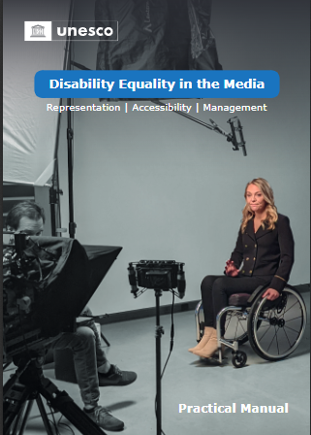
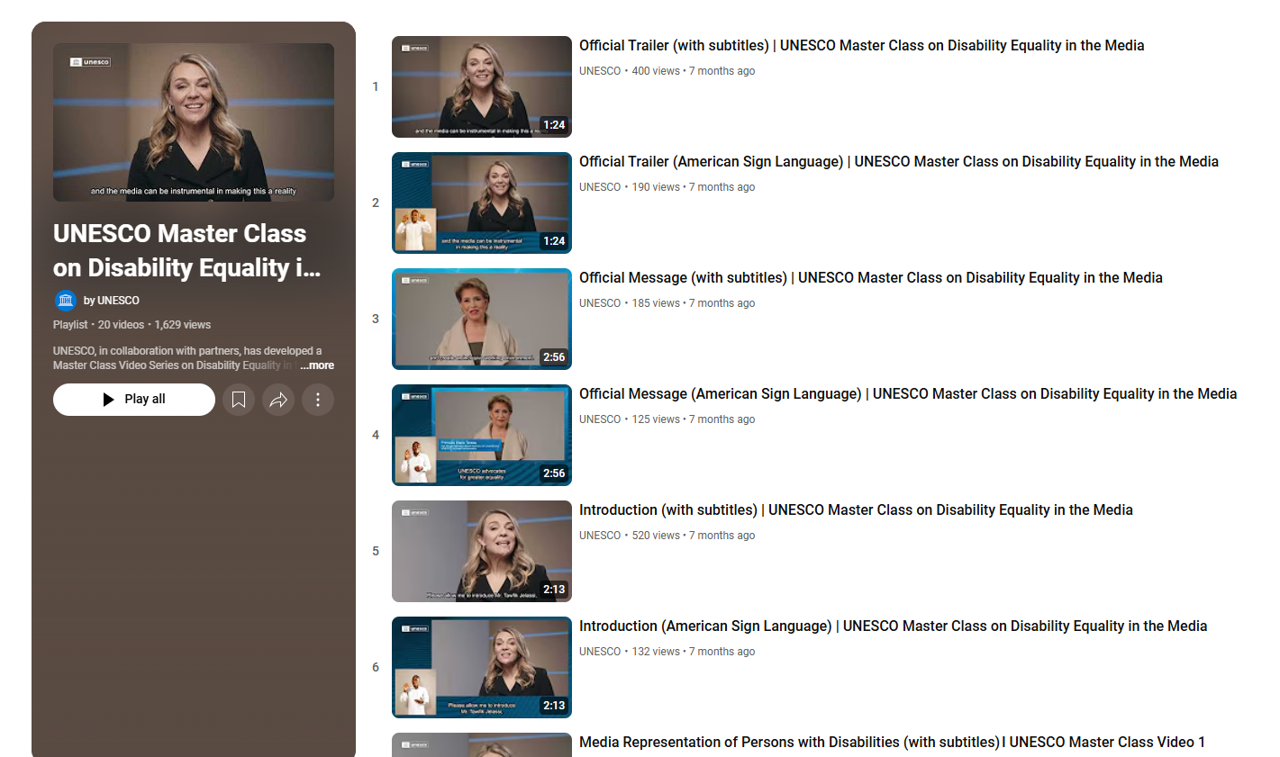
Available in English, Ukrainian, Khmer and Mongolian
Coming soon in Arabic, French, Spanish and Russian
Notes:
Practical Manual (link) - https://www.unesco.org/en/media-pluralism-diversity/media-diversity/disability-equality-media
Master Class (link) – YouTube https://www.youtube.com/playlist?list=PLWuYED1WVJIMZBOnVYyfkNo-Q20DbUvLU

Slide 3
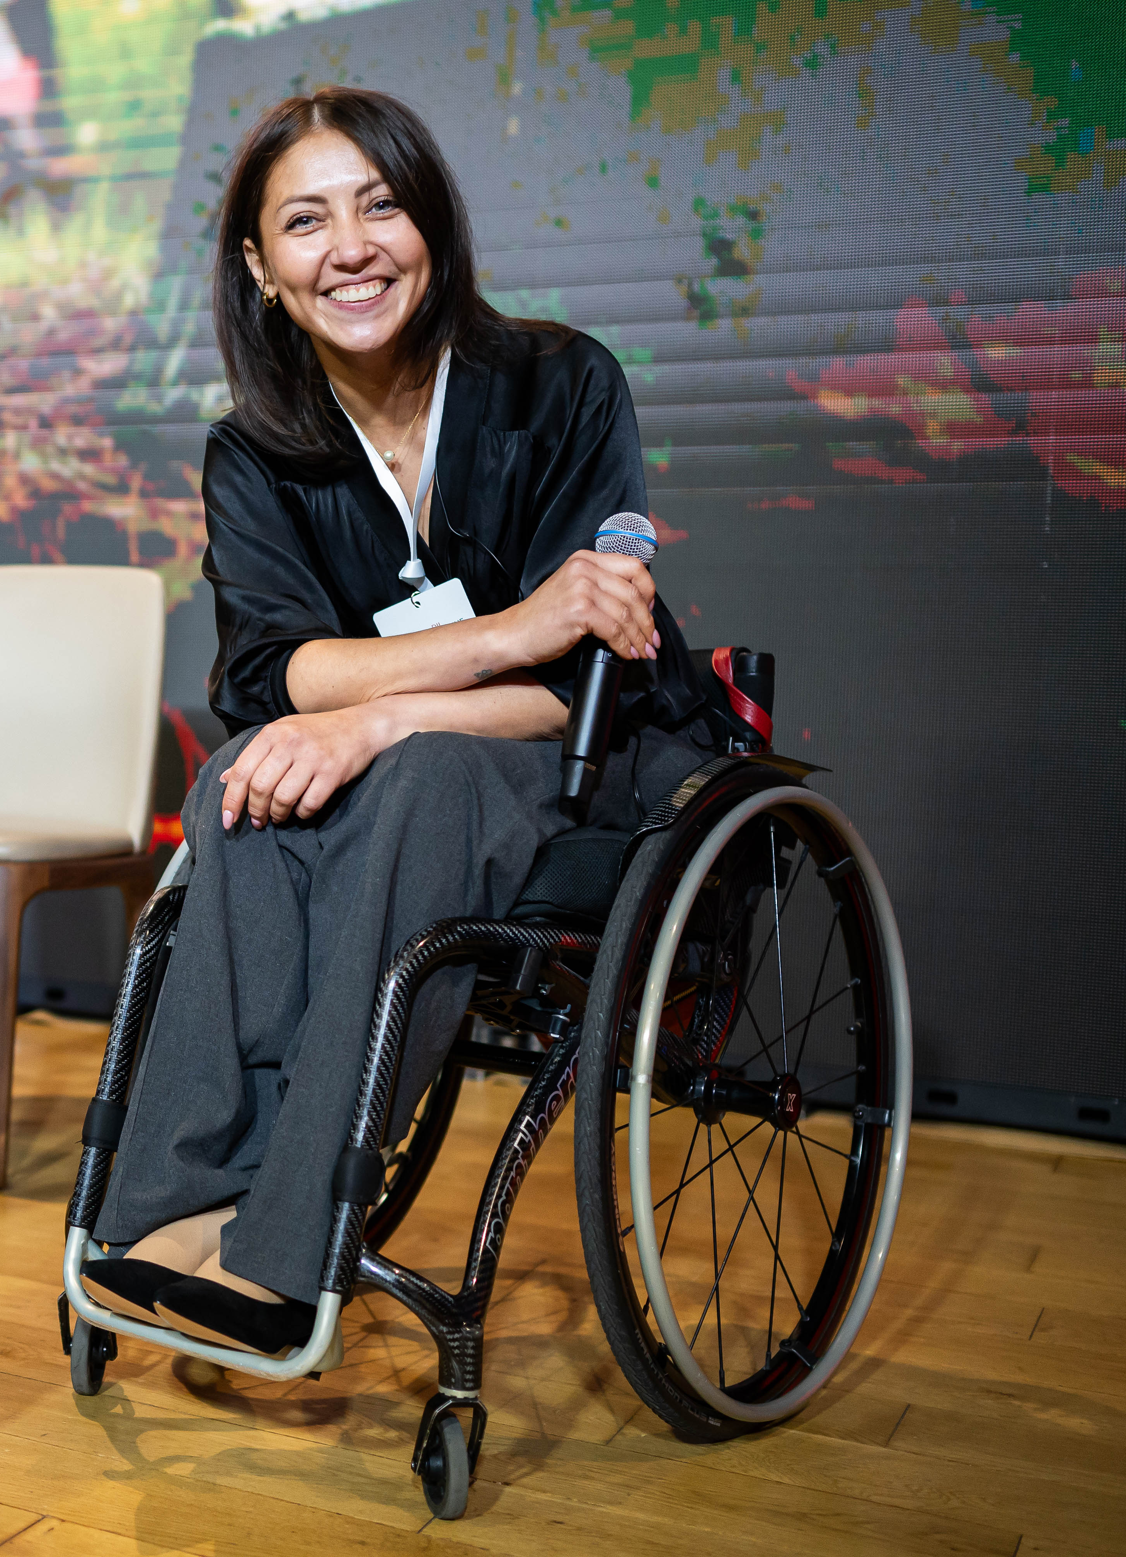
Editorial content and
equitable media programming
“By adopting inclusive editorial policies and providing equitable media programming, the media will improve their ability to serve diverse audiences, especially those who are still underserved and underrepresented”.
UNESCO (2024) Practical Manual on Disability Equality in the Media: Representation, Accessibility and Management
#ZeroCon25

Slide 4
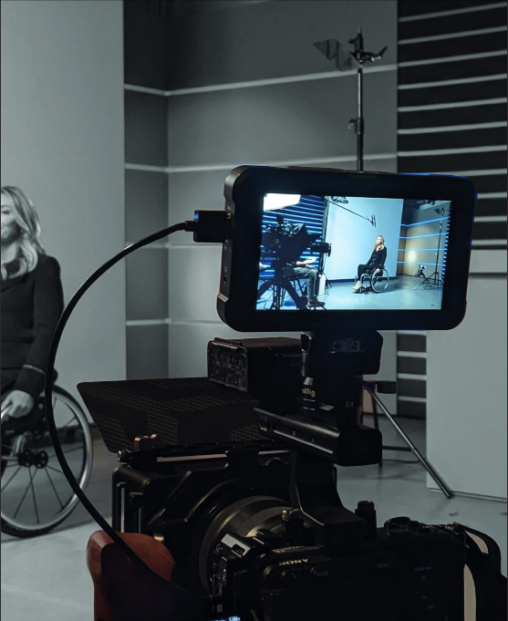
Making media content and operations accessible
“Producing quality content for and about persons with disabilities in a fair, non-discriminatory, and impartial manner is only half of the road —media content also needs to be accessible to them…Accommodation often includes, but is not limited to, captioning, signing, audio description and easily understandable menu navigation for audiences with disabilities”.
UNESCO (2024) Practical Manual on Disability Equality in the Media: Representation, Accessibility and Management
#ZeroCon25
Notes:
https://unesdoc.unesco.org/ark:/48223/pf0000391032/PDF/391032eng.pdf.multi

Slide 5
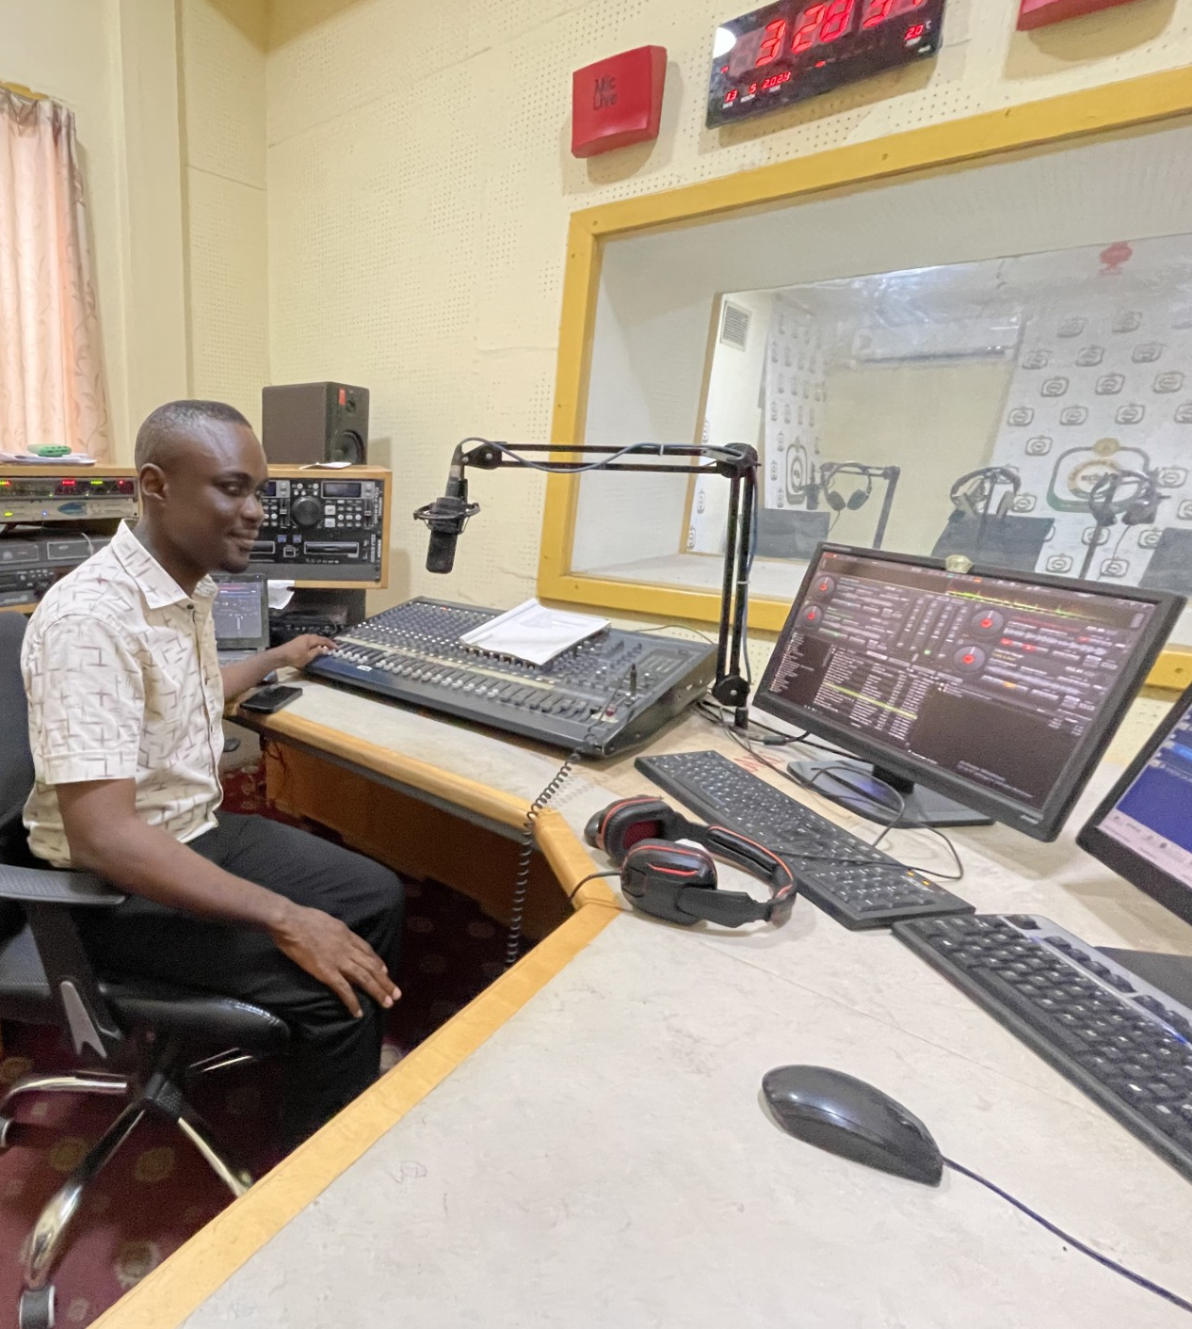
Inclusive management practices in media industry
“Media organizations, like any other employer, have a legal obligation to provide decent working conditions and apply non-discriminatory practices according to existing laws and conventions, including those relating to the rights of workers with disabilities”.
UNESCO (2024) Practical Manual on Disability Equality in the Media: Representation, Accessibility and Management
Selasie Sikanku, Radio journalist,
Ghana Broadcasting Corporation
#ZeroCon25
Notes:
https://unesdoc.unesco.org/ark:/48223/pf0000391032

Slide 6
Examples few activities

Slide 7
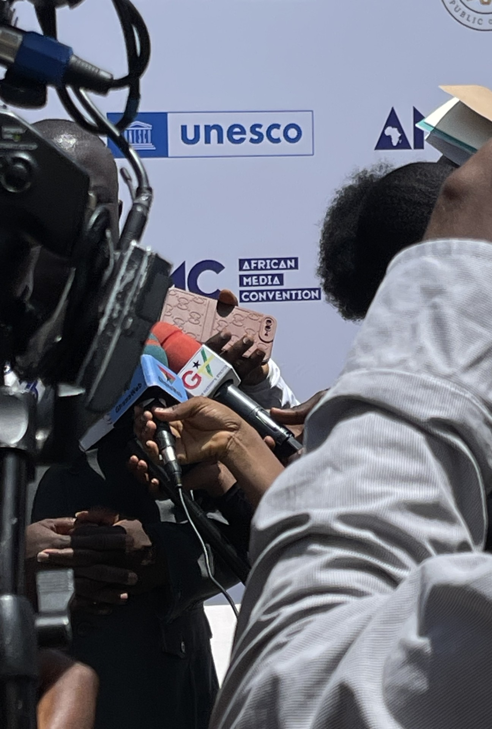
Promoting Disability Equality: Enhanced diversity in African Media
2024
3rd African Media Convention
Training of 12 media organisations across 10 African countries (Burundi, Ethiopia, Ivory Coast, Kenya, Mozambique, Rwanda, South Africa, Uganda, Zambia, and Zimbabwe).
Tanzania
Development of Standard Operating Procedures (SOPs) for gender
and disability inclusion in 7 media organisations.
ACTIVITIES ARE PLANNED FOR 2025 IN TANZANIA AND ZAMBIA
Notes:
UNESCO promotes disability equality in African media by collaborating with broadcast executives, community media, media associations and regulators ahead of the 3rd African Media Convention in Accra, Ghana.
The workshop on 14 May 2024 was attended by representatives from the public broadcasters of Ethiopia, Ghana, Kenya, Zambia, Zimbabwe, and community media and media regulators organizations in Ethiopia, Ivory Coast, Kenya, Mozambique, Namibia, South African and Uganda, as well as civil society organizations of persons with disabilities in Ghana.
During the full-day meeting on the eve of Africa’s most important media convention, the senior executives and managers, including editors, regulators, and broadcasters, discussed and explored how enhanced diversity improves press coverage and representation, as well as increases editorial independence and professionalism. It also opens up new revenue streams, for example through providing news content and services for consumers using assistive technologies when accessing information.
Persons with disabilities are seldom seen as credible sources, potential customers and users of media content and services, as their needs and preferences are rarely fully understood, nor are technological solutions explored in newsrooms, production studios and management boards.
The delegates of the 3rd African Media Convention recalled in their outcome document “Accra Declaration 2024” that:
“The integration of disability and diversity inclusion into media employment practices and content generation through guidelines and frameworks on gender equality and social inclusion, ensuring that all voices are represented and heard within the African Media landscape”.
For more information on UNESCO’s work on Diversity in Media, please visit: www.unesco.org/en/media-pluralism-diversity/media-diversity

Slide 8
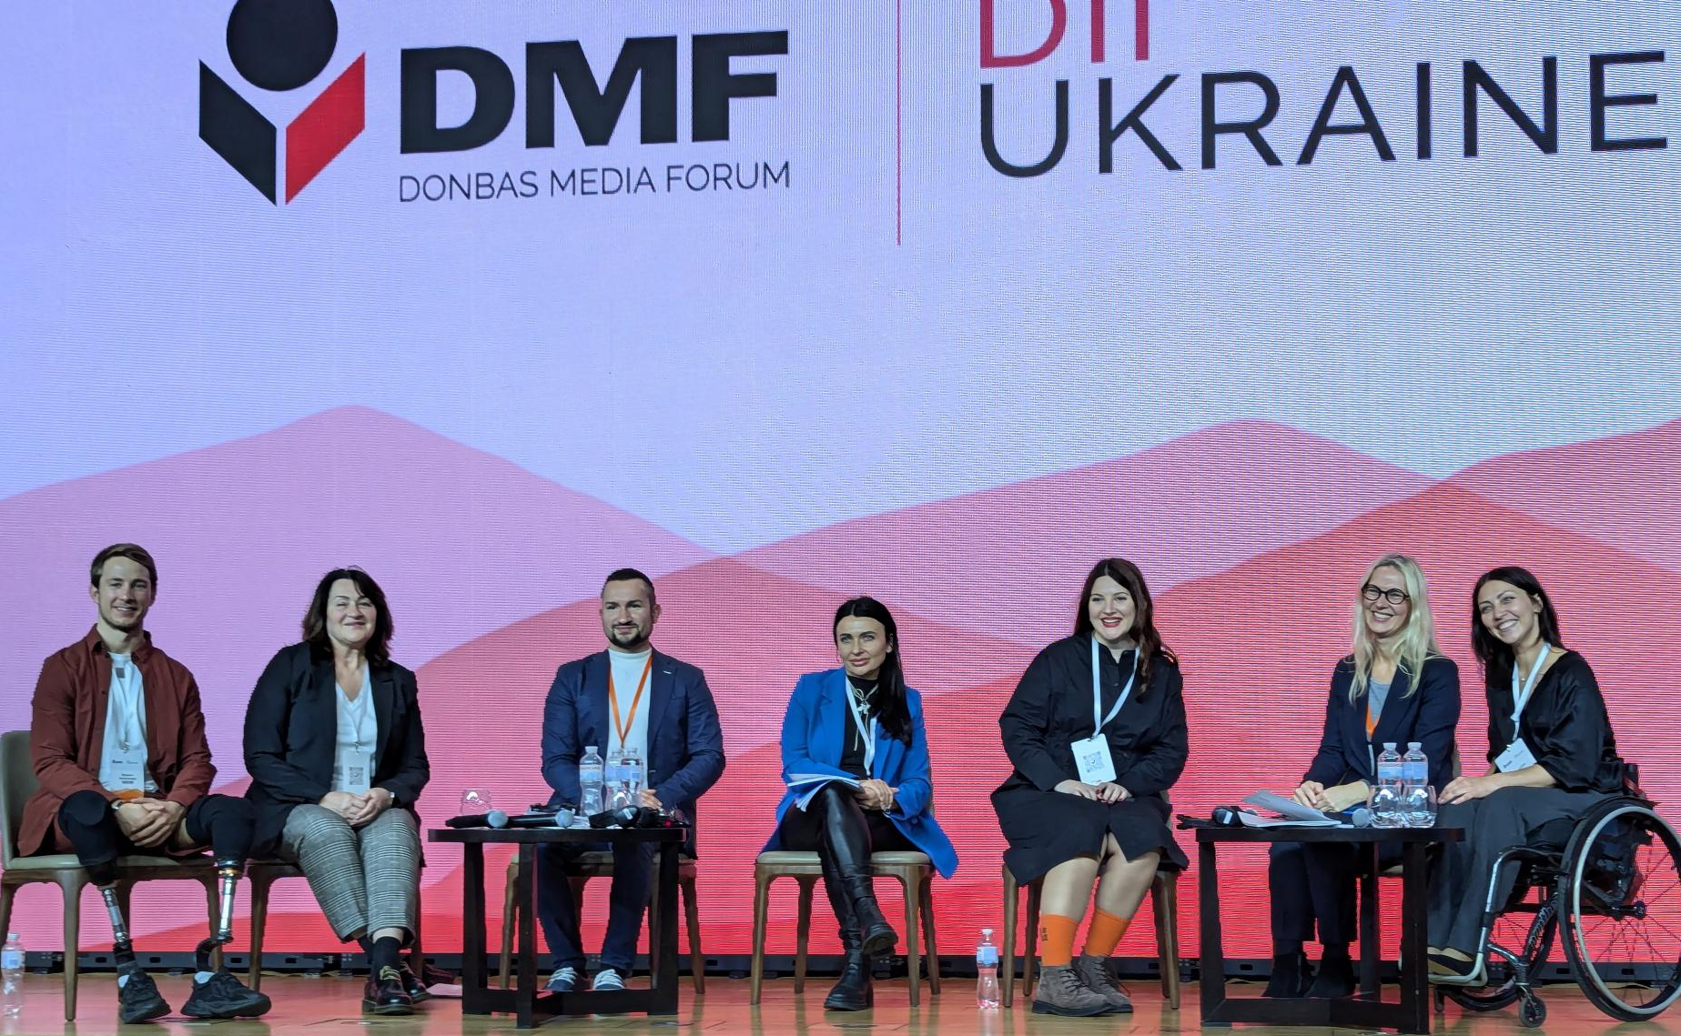
Disability equality for Ukraine’s recovery and reconstruction
Training of 17 media organisations from central and front-line areas to ensure equitable coverage on disability issues, produce accessible media content, and implement inclusive practices for media professionals with disabilities during the ongoing armed conflict.
Notes:
https://www.unesco.org/en/articles/unesco-supports-disability-equality-ukraines-recovery-and-reconstruction
Around the 2024 Donbas Media Forum (DMF) held in Kyiv on 18 and 19 October 2024, senior editors, media regulators, and managers engaged in a dedicated training and panel discussion led by UNESCO. These events focused on developing inclusive editorial policies, creating accessible content for individuals using assistive devices, and ensuring equitable opportunities within media organizations. Participants also examined how such transformative changes are crucial to Ukraine’s recovery and reconstruction process.
The war’s toll on Ukraine’s media landscape is profound. Many outlets - newspapers, radio stations, and news websites – have ceased operations, depriving citizens of reliable and life-saving information.
This disruption particularly impacts people with disabilities, a social group already facing barriers to accessing information, media content and services. According to Ukraine's Ministry of Social Policy, over 3 million Ukrainians have one or more disabilities, and this number is expected to increase by 17,000 each month, largely due to the ongoing war.
To address such challenges, UNESCO launched the Ukrainian version of its Practical Manual on Disability Equality in the Media during a training course organized for 17 senior media professionals from central and rural areas, including those working from front lines. The manual provides actional guidance on how to include persons with disabilities as part of the media audience and workforce. It also encourages media outlets to adapt their content and practices to support accessibility, a key step as Ukraine transitions to a more digital and inclusive media environment.
For nearly 10 years, the Forum has provided a national platform for safe dialogue between media workers. As a partner of the forum, UNESCO led this year a panel titled “Diversity, equality and inclusion in the media as an imperative for Ukraine's recovery and reconstruction process”, with the presence of hundreds of media professionals from the country.

Slide 9
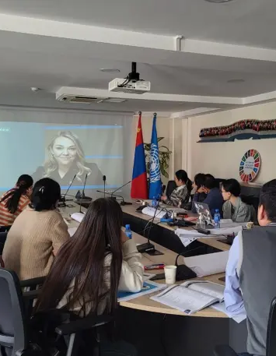
Promoting Disability Equality: Enhanced diversity
in Asian Media
Mongolia
Training of 5 media organisations on creating inclusive content and adopting disability-sensitive editorial practices. As a result, 15 pieces of disability-inclusive content were produced and disseminated
ACTIVITIES ARE PLANNED FOR 2025 IN BANGLADESH

Slide 10
