Slide 1
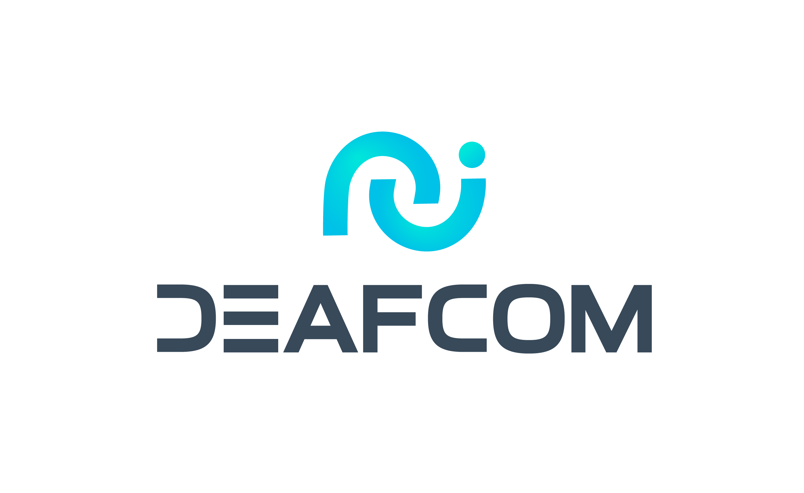
Michal, Obložinský
Šárka Humlová
Deafcom
Czech republic
Employment and ICT
6th March 15:00 – 16:00
Notes:
First slide, introduction of company:
Deafcom: accessibility for the Deaf
Michal Obložinský, Šárka Humlová; Deafcom, Czech republic, Employment and ICT
#ZeroCon25
6th March 15:00 – 16:00

Slide 2
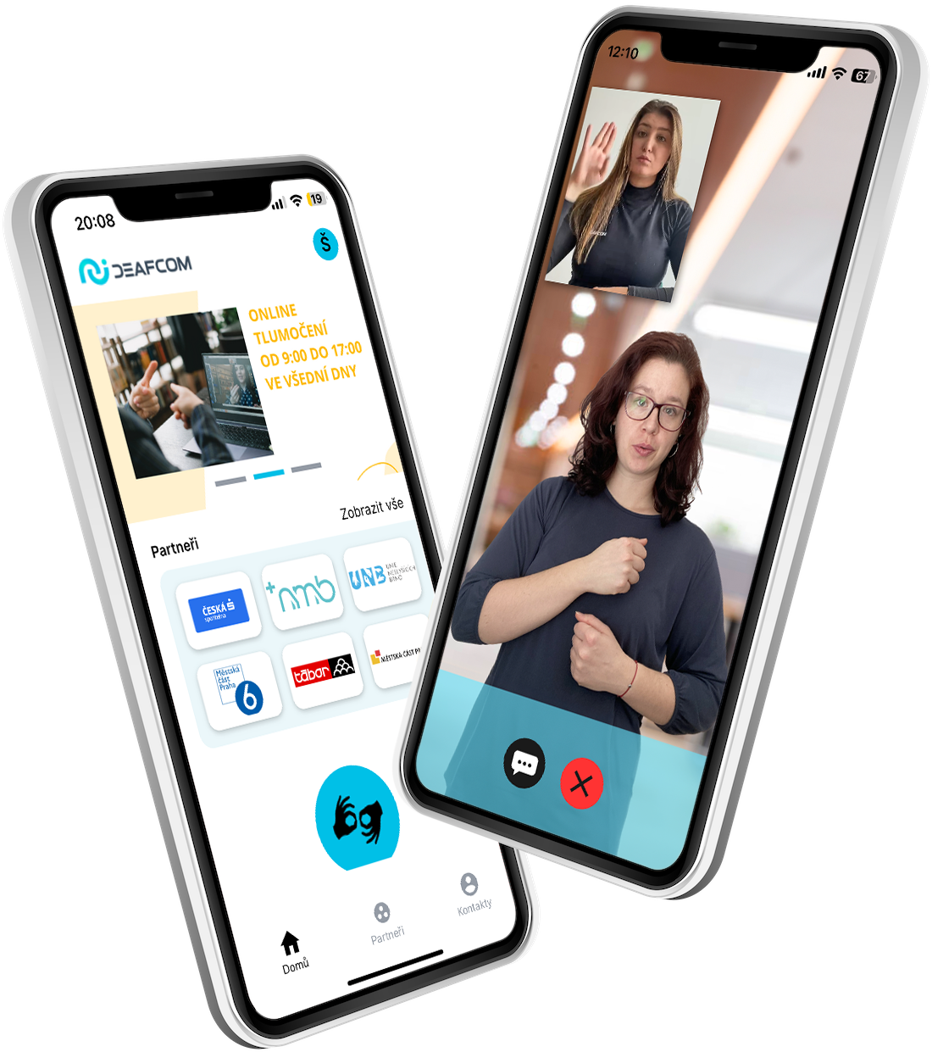
Deafcom
Provider of accessible communication services for the Deaf and Hard of Hearing
Developer of a SW for video remote service (VRS), video remote interpretation (VRI) and Text Relay Service (TRS)
Handling 100,000+ interpretations and growing
Notes:
Title: Deafcom:
Deafcom is a provider of accessible communication services for the Deaf and Hard of Hearing. To address their unique needs, we have developed a comprehensive software solution for Video Relay Service (VRS), Video Remote Interpretation (VRI), and Text Relay Service (TRS), ensuring seamless and effective communication.
What sets us apart is our deep collaboration with Deaf communities across the EU, allowing us to design solutions that are precisely tailored to their specific requirements.
Our services are trusted by governments, as well as public and private organizations, to ensure accessibility for the Dead and Hard of Hearing. We seamlessly integrate with existing processes, ensuring minimal disruption.
Currently, we handle over 100,000 interpretations and are expanding our services to meet the increasing demand for accessible communication solutions.

Slide 3


Deafcom: our services
  1. Operating our own interpreter call center
Based in the Czech republic (our home country)
Most important partner: Česká spořitelna, a member of Erste Group
Project: Accessible hospitals financed by the Czech Ministry of Health
Notes:
Title: Deafcom – our services
Interpreter Call Center - In our home country, the Czech Republic, we operate our own interpreter call center. Our largest partner is Česká spořitelna, a member of the Erste Group, where we support accessible communication for their Deaf clients. Additionally, we are participating in the Accessible Hospitals project, which is funded by the Ministry of Health. This project enables hospitals to remain accessible 24/7 for the Deaf community, ensuring seamless communication in critical settings.

Slide 4








Deafcom: our services
  2. Providing specialized SW
Specialized Software solution for VRS, VRI, TRS
All-in-one solution for the Deaf, Interpreter interface, Administration, and accessible contact points
Operating in 9 countries across Europe:
Estonia
Portugal
Iceland
Slovakia
Lithuania
Czech republic
Bulgaria
Germany
Notes:
Title: Deafcom: our services
2. Specialized Software - We offer specialized software for Video Relay Service (VRS), Video Remote Interpreting (VRI), and Text Relay Services (TRS). Currently used in 9 EU countries, our solution helps local organizations efficiently manage interpreter capacity and workload. It includes unique features tailored to the needs of Deaf users, interpreters, administrators, and organizations aiming for accessibility for the Deaf and Hard of Hearing.

Slide 5
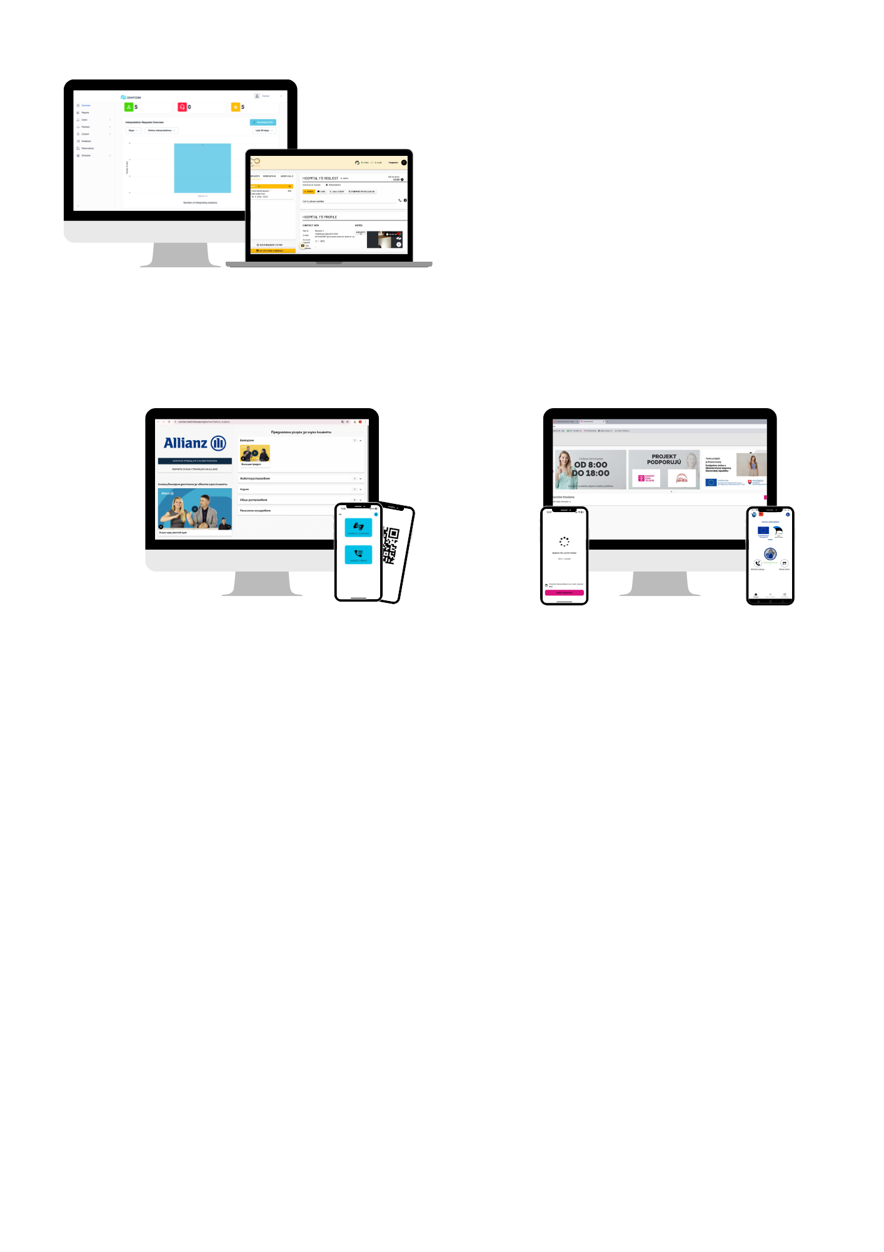
Our product: Complex SW for VRS,VRI,TRS
Mobile and web app for Deaf user
Accessible contact points
Interpreter interface & administration
Notes:
Title: Our product
1) Mobile and web app for Deaf user
VRS, VRI, Text relay - Available for all kind of services
Possibility to choose interpreter - Deaf users can choose from currently available interpreters
Interpreter name upfront - Name of the interpreter before interpretation starts
Waiting time - Deaf users see their number in a queue
Making calls - Deaf users can call any number through interpreter
Feedback, reservations, contact list, etc.
CALL BACK – detailed on next slide
2) Accessible institutions – contact points
QR codes - Registration free access to sign language interpreter from any institution
Interface for institutions - 2 buttons app for institutional client
Easy implementation - Implementation takes up to 5 minutes (place QR codes or install the app)
Prioritization - Possibility to prioritize requests from selected institutions (e.g., hospitals)
Reporting tool - Report of number of interpretations for every institution
Accounts administration - Accounts and reports easily manageable from admin
3) Interpreter interface & administration
Shift scheduling - Create and manage shifts for your interpreter
Automatic reporting - Automatically generated data about interpretation
Reservations list - All or closest reservations upfront
List of requests - List of all active requests for interpretation sorted by priority
Notes about interpretation upfront - Information related to the interpretation upfront
Dialing from our system - Calls to requested numbers by one click directly from our system

Slide 6





Key drivers of success
Strategic Investments
National Recognition
Impactful Projects
Further development
Notes:
Title: Key drivers of success
Strategic Investments: Secured funding from two Czech venture capital funds to kickstart the development of our innovative IT solutions.
National Recognition: We actively participate in national tenders, providing our specialized software solutions. In Lithuania and Estonia, we serve as the national provider of accessible services for the Deaf and Hard of Hearing. In Slovakia, we are the sole provider of online interpreting services. Our involvement in these initiatives continuously drives the development and enhancement of our solutions.
Impactful Projects: We participate in initiatives like the Accessible Hospitals project in Czechia, supported by the Ministry of Health. Through this project, we enable over 40 hospitals to provide 24/7 accessibility for Deaf patients, ensuring equal access to healthcare services.
Further development: We are currently working on making the 112 emergency line accessible for Deaf and Hard of Hearing individuals at a European level.

Slide 7
The future
2025
2030
Interpreted sessions
100,000+
1,000,000+
Countries of operation
11
15
Accessible contact points
1,000+
13,500+
Notes:
Title: The Future
Over the next year, we plan to increase facilitated interpretation calls from tens of thousands to hundreds of thousands, expand our presence from 9 to 11 countries, launch emergency lines, and grow our accessible solutions from 400 to over 1000 accessible contact points.
Looking ahead to 2030, we aim to reach 1 million facilitated interpretation calls, extend our reach to 15 countries, and scale our accessible solutions to more than 13,500 contact points.

Slide 8
Notes:
Thank you for your attention.

