Slide 1
Making neurodiversity work at work
Kurt Schöffer
auticon
Germany
Inklusive Beschäftigung – ein globales Thema das uns alle beschäftigt!
Friday, 7 March 2025, 10:00 – 11:00
Notes:
Please add your notes here.
Title; First name, last name of speaker(s); Name of Organization, Name of Country, Name of Session (as written in Agenda)
#ZeroCon24
Day and Time of Session

Slide 2

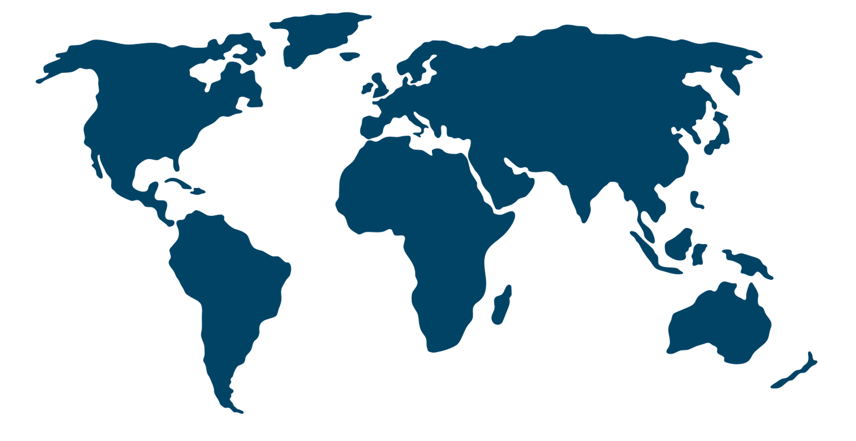

Who we are
575
employees
3
continents
76%
autistic
15
countries
80%
neurodivergent
Notes:
auticon is a global consultancy firm operating in 15 countries worldwide. Our service portfolio helps organisations make sustainable changes to become authentically neuroinclusive. 80 percent of the global auticon team is neurodivergent. We are the largest social enterprise with an autistic majority workforce. We actively live neurodiversity every day and have a unique culture.
Our vision is to build a more inclusive world. Our mission is to address the inequalities in employment for neurodivergent adults and showcase the strengths of neurodiversity in society.

Slide 3
About us
Our vision:
A more inclusive world
Our mission:
Equal career opportunities and conditions for neurodivergent
Showcase the strengths of neurodiversity in society
Notes:
auticon is a global consultancy firm operating in 15 countries worldwide. Our service portfolio helps organisations make sustainable changes to become authentically neuroinclusive. 80 percent of the global auticon team is neurodivergent. We are the largest social enterprise with an autistic majority workforce. We actively live neurodiversity every day and have a unique culture.
Our vision is to build a more inclusive world. Our mission is to address the inequalities in employment for neurodivergent adults and showcase the strengths of neurodiversity in society.

Slide 4
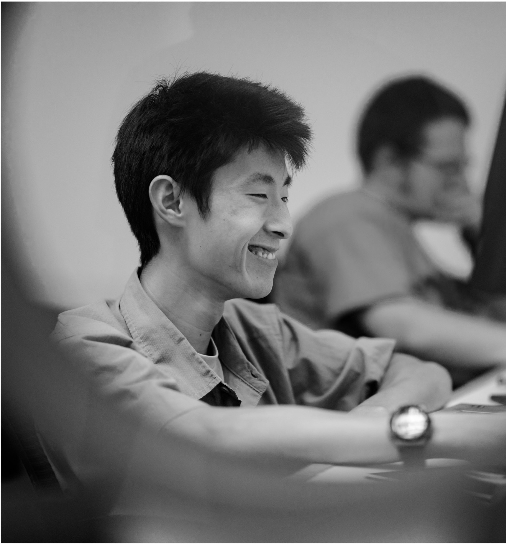
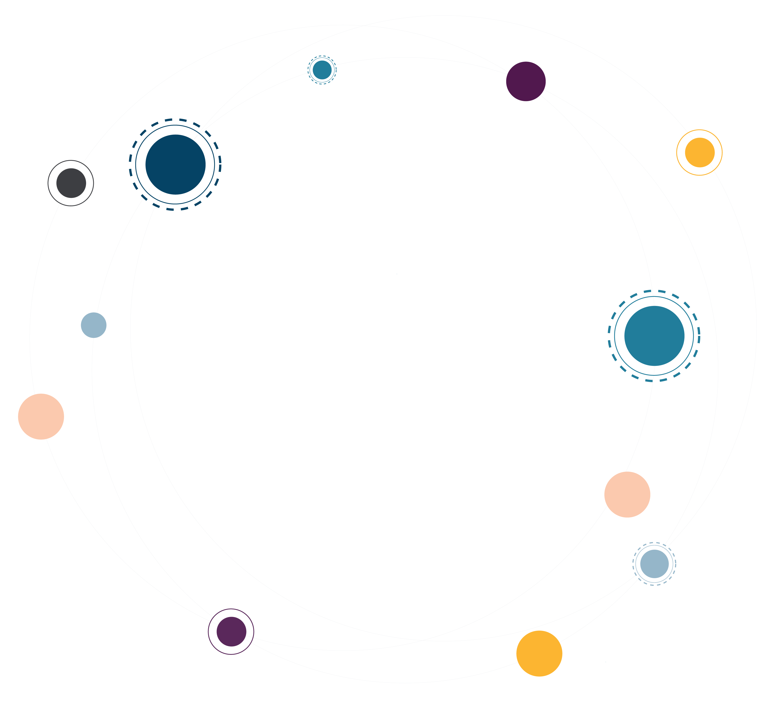
What makes us different
We are a Social Enterprise
We exclusively hire autistic IT specialists
We show companies the business benefits of neurodiversity
We share our expertise and enable other organizations to become neurodiverse
Notes:
Our IT Services and Neuroinclusion consulting business is the basis for our social engagement and our special business model. We can finance ourselves through customer projects and are profitable. Thus, we can employ autistic IT specialists, give them the support they need and offer them the same career opportunities, salaries and conditions that are a matter of course for non-autistic people.
We show companies the business benefits of neurodiversity and prove, that there is a Return on Investment from including neurodivergent people in their projects. And we pass on our more than 13 years of knowledge and experience to companies that want to become attractive employers for these valuable qualified specialists.

Slide 5
Scalable business model
Berlin, Nov. 2011: Foundation, supported by Social Venture Fund
Since 2011 and ongoing: Growing Tech Service Portfolio
2016: Expansion to Great Britain and France
2018: Canada, USA, Switzerland, Italy and Australia (2019)
2023: Joining forces with Unicus: Scandinavia, Netherlands, Poland
Since 2022 and ongoing: Neuroinclusion Services
Notes:
Our model for inclusion has proven to be scalable. In the first five years, auticon established six offices in Germany. From 2016 on, we have been constantly expanding and adapting our inclusion model to other markets.
All services for technology consulting that we added over the years fit to autistic strength. In 2022, we started our neuroinclusion consulting, training and coaching.

Slide 6
Proving the value of neurodiversity
Organisations
looking to support their data workforce with talent that brings a new perspective
IT Services
Quality Assurance & Testing, Software Development, Data Analysis, Processes, Cyber Security, AI…
Organisations
ready to be neuroinclusive
Neuroinclusion Services
Advisory, Maturity Assessments, Trainings & eLearning, Coaching…
Organisations
wanting to address specific issues regarding neurodiversity in the workplace
Notes:
auticon's clients are well-known international corporations and mid-sized companies that either look for IT support or for more internal awareness and knowledge on neurodiversity and how to support neurodivergent colleagues. Often, clients of our IT consulting become clients for neuroinclusion services and vice versa.

Slide 7
How we make it work at work
The secret source: Support from Job Coaches and Project Managers
Job Coaches
Develop tailor-made and suitable working environments for our autistic employees
Educate clients around autism and neurodiversity
Are specialists for all neurodivsersity-related matters
Project Managers
Point of contact for clients and auticon IT-specialists for technical and other professional matters
Task assignments taking into account and aligning to individual autistic strengths and professional skills
Notes:
The job coaches support our autistic colleagues socially and communicatively. Customers are informed about the consultants’ autism from the outset. This relieves our employees of the burden of decision and the stress of either explaining themselves or “masking” and hiding their autism.
Our project managers provide technical support for IT projects and are our customers' point of contact. Briefings for client teams, targeted onboarding and constant collaboration with our job coaches and project managers allow our clients to experience inclusion in a positive way.

Slide 8

Our Impact on Employees
70% of autists working for auticon were either previously unemployed our worked in temporary jobs – about half of them over a period longer than three years. Internal surveys highlight sustainability of our model:
75%
82%
84%
83%
have become more self-confident by working for auticon
confirm improved well-being
feel valued and can be authentic at work
improved technical and cognitive skills
Notes:
The impact our business model has on our neurodivergent employees is measurable. Yearly impact surveys show that the autistic IT specialists gain more self confidence, imporive their mental health and can develop their professional skills and cognitive strength.

Slide 9

Our Impact on clients
96%
said that auticon consultants made valuable professional contributions to their projects
85%
say they have a greater understanding of neurodiversity as a result of working with auticon
96%
said that auticon consultants made valuable professional contributions to their projects such as greater accuracy,
alternative perspective / ideas, and innovative approach
Notes:
SOURCES:
auticon Global Impact Report (2023)

Slide 10
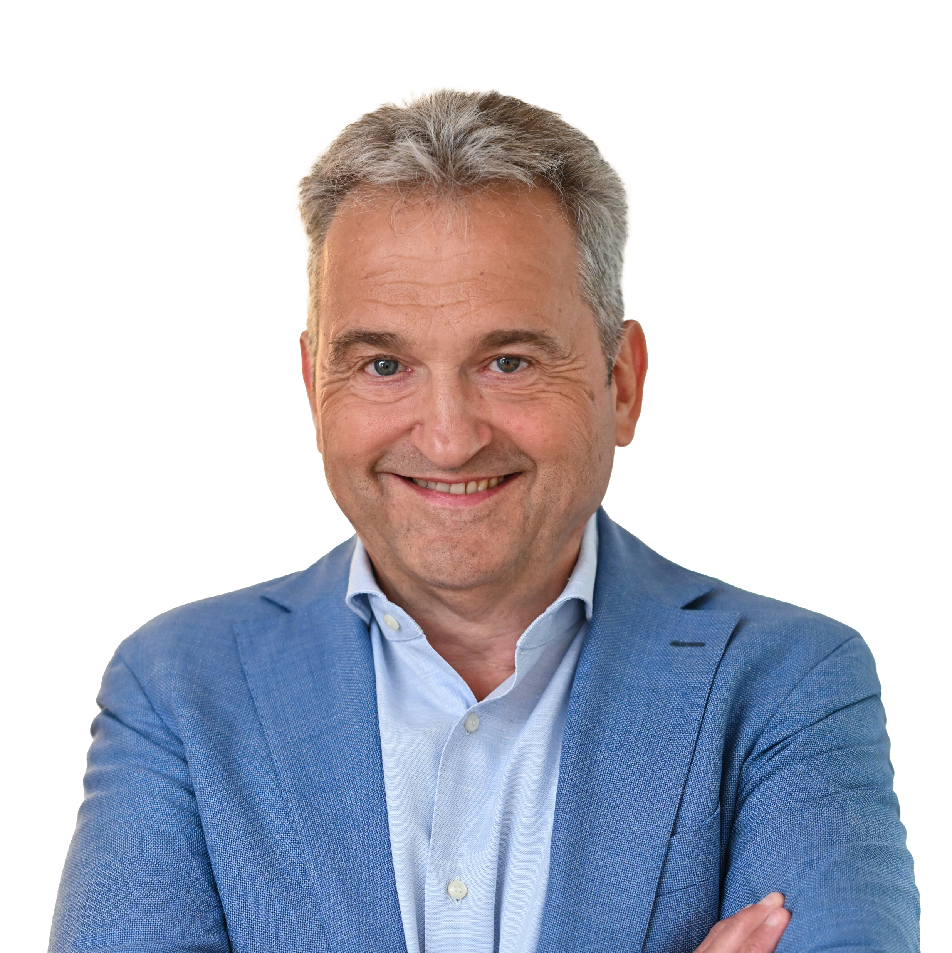
Contact – Kurt Schöffer
auticon
Kurt Schöffer
CEO
Kurt.schoeffer@auticon.com

Slide 11
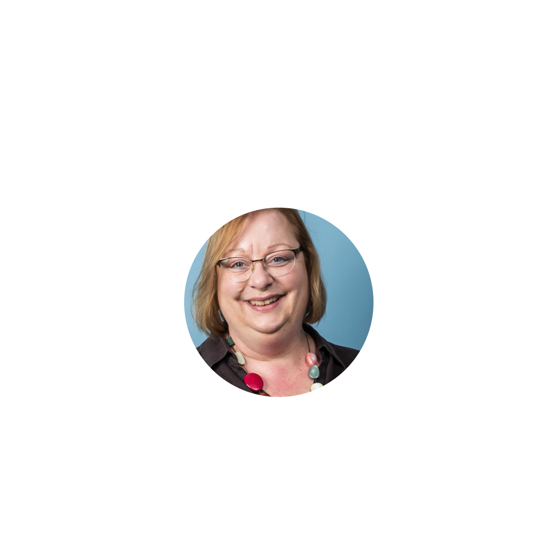
Contact – Ursula Schemm
auticon
Ursula Schemm
Marketing Manager Germany
Ursula.schemm@auticon.de

