Slide 1


Welcome to MRT IT PEAKS LIMITED

Slide 2



ABOUT US
MRT IT Peaks Limited is a Ugandan based organization that provides IT, data
and analytics solutions that enable electronic data driven insights and
informed business decisions that triggers business and company
productivity.
VISION
We envision a world in which all individuals have the opportunity to reach their highest potential through making use of data and IT systems
MISSION
To improve decision making and project implementation in organizations using IT systems and electronic data.

Slide 3

OUR CORE VALUES
1
Integrity
2
Teamwork
3
Innovativeness
4
Ethics & Respect

Slide 4






OUR SERVICES
Database design and development
Networking
Data analytics
Data management, analysis and IT skills training
IT consulting services
Data management and entry
Cyber security
Research
Software Development
Business Intelligence
System maintenance

Slide 5




OUR PRODUCTS
01
02
03
04
CVAS (Computer Vision and Sonification device)
Info Agric
Digital menu and hotel management system
Retail and Wholesale Business Management System
This is an advanced AI-powered smart device designed to enhance the mobility, independence and spatial awareness of individuals who are totally or partially visually impaired.
A mobile application that connects farmers directly with buyers, wholesalers , experts and sellers of genuine farm inputs and providing them with information.
A digital platform for managing and displaying menus, including food, beverages, and services. It manages various aspects of hotel operations including room assignments, guest management, ordering, inventory management, accounting, among others
This is a comprehensive Point of Sale software solution designed to streamline and automate the operations of retail and wholesale businesses

Slide 6

OUR AIM
Our commitment to excellence is evident in our stringent focus on quality, security, and scalability:
Quality
We implement thorough testing protocols, including unit, integration, and end-to-end tests, to ensure our software meets the highest standards. Code reviews and pair programming are integral to our quality assurance process.
Security
We adopt a security-first mindset, incorporating best practices such as code analysis, penetration testing, and regular security audits to protect against vulnerabilities.
Scalability
Our architecture is designed to scale seamlessly with user growth and evolving business needs. By utilizing microservices and cloud-native technologies, we ensure our solutions are resilient and capable of handling increasing loads.

Slide 7
ADVANCED TOOLS AND TECHNOLOGIES APPLIED
Version control
Git for robusta
source code
management.
CI/CD pipelines
GitHub Actions for
automated testing
and deployment.
1
Collaboration platforms
Jira for efficient project management
2
Containerization
Docker and
Kubernetes for
Consistence.
3
Development frameworks
Backend and frontend
4
5

Slide 8
MILESTONE
01
Compliance:
Registered by NITA
Compliant with Company’s Act 2012.
Customer satisfaction:
Our services received a rating of 4.8 out of 5 from our clients.
02
Market Expansion: We have been able to expand to international markets such as Kenya, England and others.
03
04
Eight successful Projects completed in the field of Palliative care and Health.

Slide 9
OUR MOST RECENT SUCCESSFUL PROJECTS
Project name: APCA MER Platform
Client: African Palliative Care Association (APCA)
The M&E, reporting and strategic dashboard supports entry, analysis, aggregation and visualization of data for APCA indicators.
Project name: End of life care MIS
Client: African Palliative Care Association (APCA)
The end-of-life information system provides for capture of data for patients and bereaved care givers and provides a real time dashboard used to monitor and manage patient and caregiver records during end of life and bereavement process.
Project name: Palliative Care service providers Geo map
Client: WHO, APCA, IAHPC, icpcn, St Jude Global, PallCHASE.
Geo Mapping of palliative care service providers in the Eastern Mediterranean Region.
Project name: KEHPCA MER Platform
Client: Kenya Hospices and Palliative Care Association (KEHPCA).
A digital monitoring, evaluation and reporting platform for Kenya Hospices and Palliative Care Association strategic indicators.
Project name: mPallCare
Client: University of Leeds UK
A palliative care digital platform encompassing a mobile and web application for palliative care service delivery in Uganda and a wider African region.

Slide 10
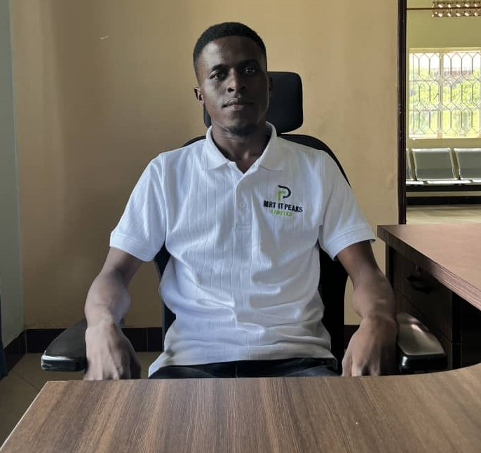
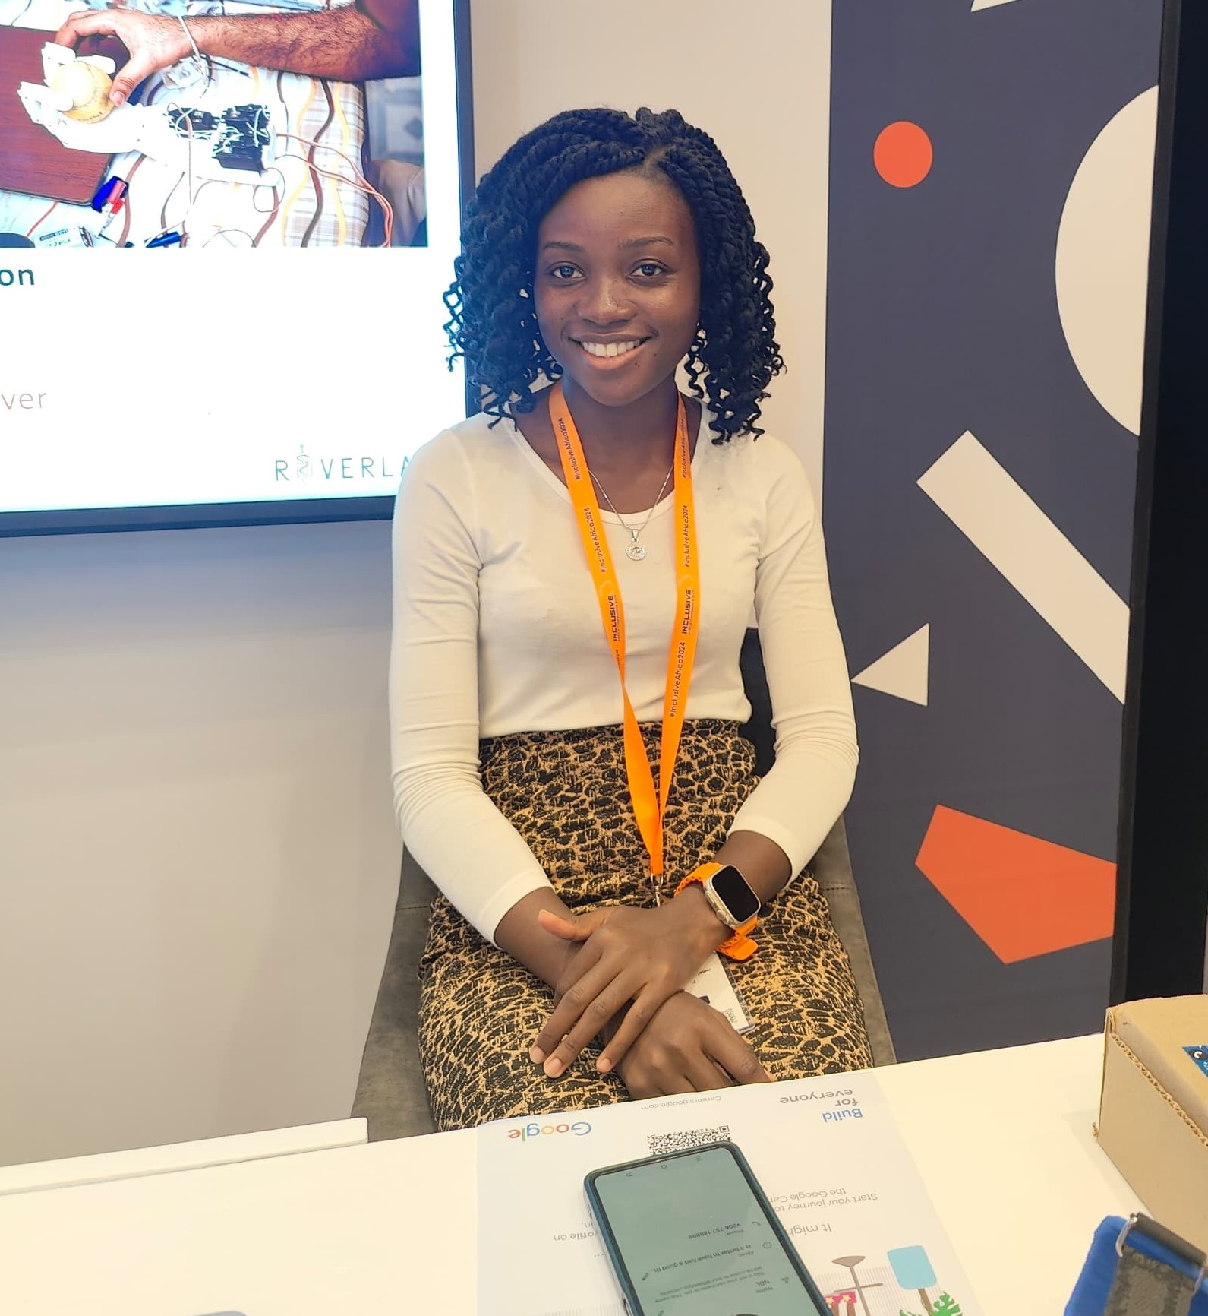
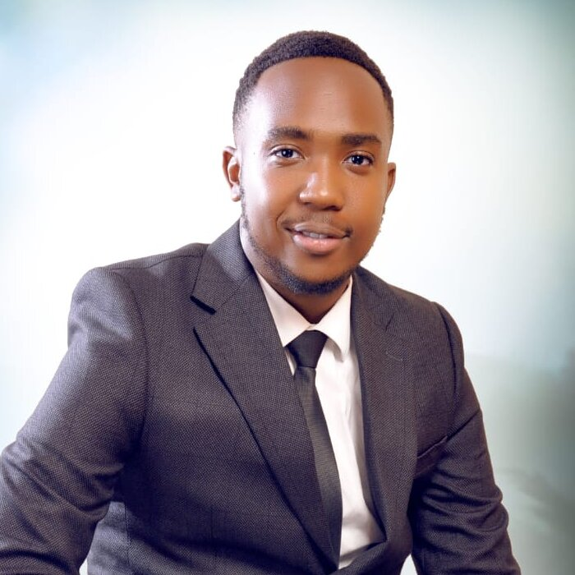
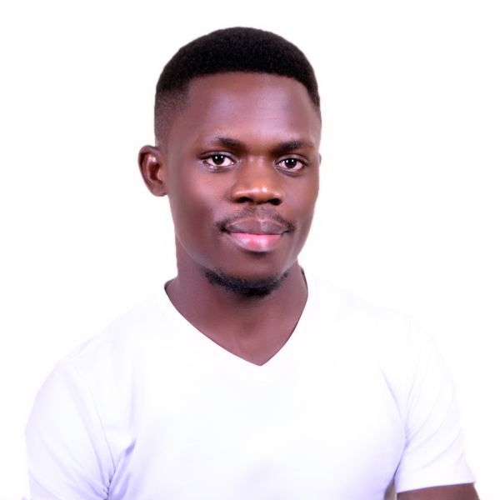
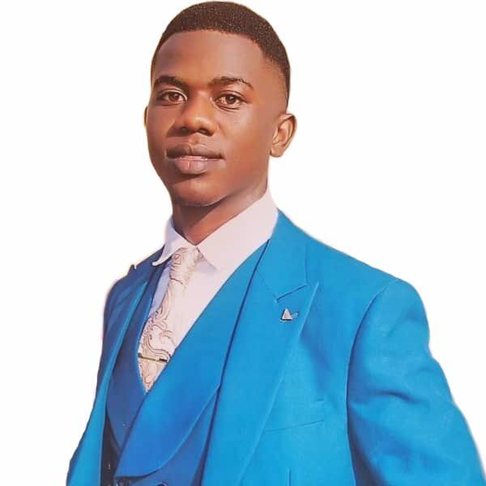
OUR TEAM
Ssemirembe Ronald
CEO
Nabunje Diana
Project Manager
Kitenda Patrick
CHRO
Mayanja Adrian
CTO
Ndawula Micheal
CFO
Extensive knowledge in Financial strategic development, Budget and forecasting, financial reporting and analysis, Risk management
With vast experience in monitoring and evaluation specifically in the health sector for 5 years.
Extensive experience in Strategic planning, Operations management, Process Optimization and others.
Extensive knowledge and skills in Recruitment and management of human resource.
Proficient in both frontend and backend programming languages and technologies.

Slide 11

MPALLCARE
Description
“mPallCare” is a digital health platform that is used to support care delivery for people with life limiting illnesses and inform policy maker decision making in Uganda and the wider African region.
Objective
“mPallCare” aims at;
Improving preparedness and resource targeting for the management of palliative care patients and prevalent diseases,
Improved access to and use of routine patient data and improved symptom management primarily in Uganda, Kenya, South Africa and Malawi.

Slide 12






FUNCTIONS OF THE DIFFERENT FEATURES OF THE PLATFORM
Mobile Application
1.Patients and VHT use the mobile application to submit patient data
2.VHT use the mobile application to register patients
1.Patients get self management content about their conditions using the mobile applications
Web Application
The web application is used by clinicians and administrators for monitoring patient data
It is used by facility administrators to monitor health workers’ performance.
The web application is used for disseminating data to policy makers and researchers through the dashboard.

Slide 13




WHY CHOOSE US?
01
Expertise
02
Passion
03
Client centricity
04
Experience
Our team is composed of highly competent individuals with vast experience in various fields including but not limited to IT, M&E, Finance and Project Management.
We are passionate about health and inclusion of underserved populations through advanced IT solutions
We actively engage our clients in stages of product development so as to ensure that we fulfill their goals.
We have more than eight successful palliative care projects with 95% meeting clients’ planned schedule.

Slide 14



SOME OF OUR CLIENTS IN HEALTH AND PALLIATIVE CARE

