Slide 1


INCLUSION IN THE DNA OF CHARM-EU
From value-based approach to meaningful implementation
Ágnes Sarolta Fazekas-Vinkovits, PhD
CHARM-EU Alliance, Spain & partner countries (Home | CHARM-EU)
Session: Inclusive Practices in Universities and Higher Education Institutions
Wednesday, February 21, 2024; 14:00 – 15:20 CET
Notes:
Please add your notes here.
Title; First name, last name of speaker(s); Name of Organization, Name of Country, Name of Session (as written in Agenda)
#ZeroCon24
Day and Time of Session

Slide 2

THE CURRENT HIGHER EDUCATION LANDSCAPE
The student and staff population has become more diverse in the global higher education landscape of the 21st century (UNESCO World Conference on Higher Education, 2009).
Structural barriers, such as barriers in teaching and learning environments, still fail to respond to the diverse needs of individuals and hinder their educational aspirations, access to and full participation.

Slide 3

ENHANCING INCLUSIVE EDUCATION FOR ALL
A GLOBAL CAUSE
During this panel and over the years, across the ZeroProject I am delighted to observe innovative inclusive solutions, and out of box thinking that follow a holistic, intersectional and human rights based approach
Our practices are not singular actions; they are interlinked and contribute to a more inclusive, just education and societies globally.
The keyword I would like to start and connect to colleagues at our panel discussion is INTERLINKAGE.

Slide 4
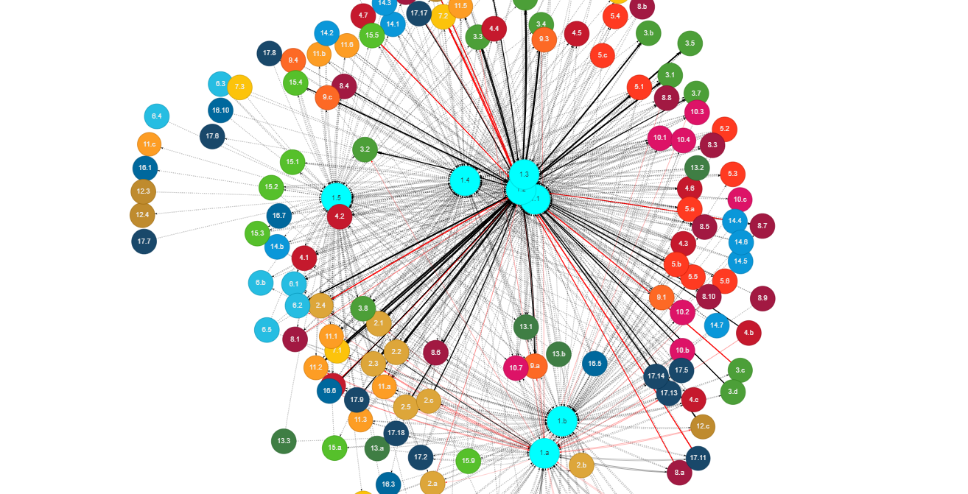
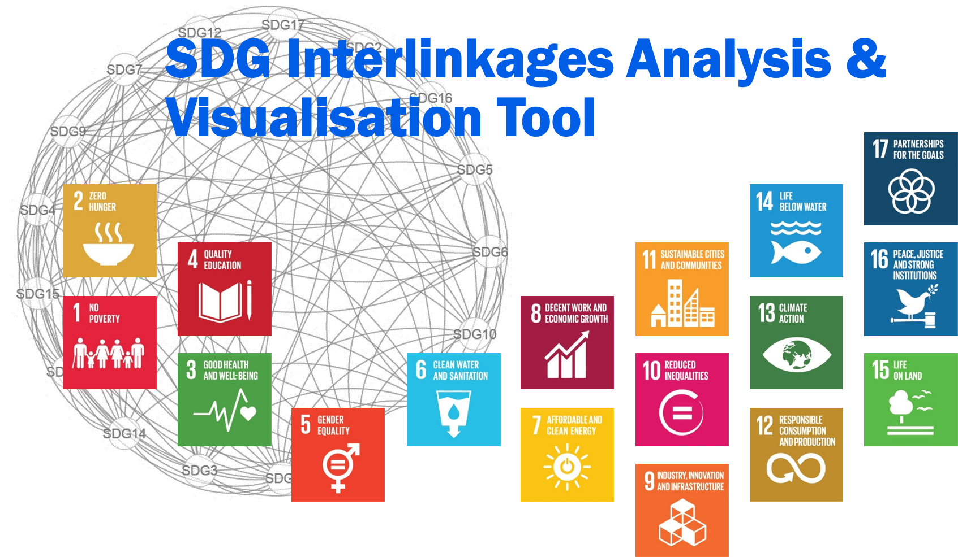
IN ADDITION I SHARE WITH YOU A RELEVANT TOOL THAT MIGHT BE RELEVANT TO IN YOUR VARIOUS ACTIONS
SDG Interlinkages Web Tool (iges.jp)
Like, a spider network,
the visualisation of
SDG Interlinkages Web Tool (iges.jp)

Slide 5

ONE OF THE CORE VALUES OF CHARM-EU ARE: INCLUSIVENESS
CHARM-EU: CHallenge-driven, Accessible, Research- based, Mobile European University
Core Values | CHARM-EU We see it as our social responsibility to foster an open, welcoming, and safe environment grounded in inclusivity, compassion and mutual respect, where individuals from all backgrounds, lived experiences, circumstances and access needs can collaboratively learn, work and serve.
We are committed to creating excellence in teaching and learning by providing the appropriate structures and services that remove barriers to success and support student and staff access and participation needs.
Applying a holistic, intersectional, human rights-based approach to inclusion and diversity within CHARM-EU.

Slide 6

FROM VALUE-BASED APPROACH TO MEANINGFUL IMPLEMENTATION (1)
(KEY HIGHLIGHTS, NON-EXHAUSTIVE LIST)
Co-creating with the CHARM-EU Community | Draw on best practices & influence new inclusive practices within our partner universities and CHARM-EU
Inclusion Measures | Master’s Programme An inclusive program | CHARM-EU.​
Minimasing financial barriers CHARM-EU Grant | Master’s Programme Tuition fees | CHARM-EU

Slide 7
FROM VALUE-BASED APPROACH TO MEANINGFUL IMPLEMENTATION (2)
(KEY HIGHLIGHTS, NON-EXHAUSTIVE LIST)
Needs Assessment | Master’s Programme Inclusivity plan review and key findings | CHARM-EU
Professional Development Sessions and Tools| Inclusivity tips for CHARM-EU educators to support academic staff in creating an inclusive teaching and learning environment Inclusivity tips for CHARM-EU educators | CHARM-EU
Call for Action and joining global Awareness-Raising | i.e. CHARM-EU joins the celebration of the International Day of Persons with Disabilities! | CHARM-EU

Slide 8
TESTIMONIAL BY MAUD SLANGEN, CHARM-EU MASTER’S STUDENT
"I am a 25-year CHARM-EU student in the master program Global Challenges for Sustainability. In particular as a person on the spectrum, I faced many challenges within this Master’s program. Therefore, I was very glad to learn about the inclusivity Team and the Needs Assessment. This made it more feasible for me to attend the program in an alternative way that suited better for me. Even though there is definitely still room for improvements, very positive changes are happening as well. Personally was very happily surprised by the way the Inclusivity Team dealt with my personal concern regarding a two week project based at one of the institutions abroad. I was afraid the program would be too overwhelming. However after sharing my concern, the inclusivity Team as well as the CHARM staff dealt with my situation in a very understanding way and provided me with solutions that worked out very well. My overall experience with the inclusivity Team is positive and I hope they can grow and achieve a more inclusive and accessible education in the future.”

Slide 9

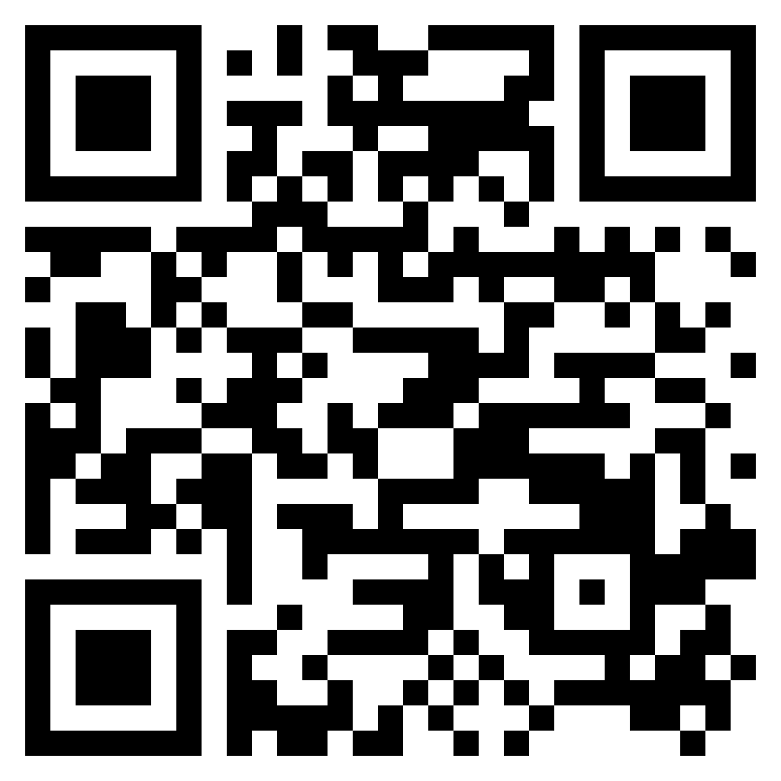
THANK YOU!
FEEL FREE TO CONTACT ME WITH ANY QUESTIONS
Agnes Sarolta Fazekas-Vinkovits, PhD (she/her)
Assistant Professor, ELTE, Eötvös Loránd University, Bárczi Gusztáv Faculty of Special Needs Education, Institute for Disability and Social Participation
Email: fazekas.agnes.sarolta@barczi.elte.hu
CHARM-EU Inclusiveness Leader (2019-2022); (2023-)
Twitter: Agnes Sarolta Fazekas-Vinkovits, PhD (@agnessarolta) / Twitter
LinkedIn: Agnes Sarolta Fazekas-Vinkovits, PhD

Slide 10
RESOURCES & FURTHER READINGS
Center for Applied Special Technology CAST (2018). Universal Design for Learning Guidelines version 2.2. Wakefield, MA: CAST Retrieved from: Retrieved from http://udlguidelines.cast.org
Fazekas, Á.S. (2018). Felsőoktatáshoz történő hozzáférés és a felsőoktatásban való részvétel vizsgálata a fogyatékossággal élő személyek vonatkozásában. Doktori disszertáció. ELTE Eötvös Loránd Tudományegyetem Társadalomtudományi Kar Szociológia Doktori Iskola Szociálpolitika Doktori Program. Budapest. (offline upon request)
Fazekas, Á. S. (2019). The journey towards Universal Design in the Teaching and Learning Environment in Hungarian Higher Education. THE AHEAD JOURNAL No. 9 A Review of Inclusive Education & Employment Practices Dublin: AHEAD Educational Press ISSN 2009-8286 Retrieved from: https://www.ahead.ie/journal/The-journey-towards-Universal-Design-in-the-Teaching-and-Learning-Environment-in-Hungarian-Higher-Education

Slide 11
RESOURCES & FURTHER READINGS
Fazekas, Á. S. & Csalagovits, Z. (2019). A step-by-step Guide for making your Erasmus+ Projects inclusive. Budapest: Te is Alapítvány Retrieved from: https://www.dropbox.com/s/9i17h7bbxnu2y64/Step_by_Step_Guide_ErasmusACCESS_print.pdf?dl=0
UNESCO World Conference on Higher Education, 2009: https://unesdoc.unesco.org/ark:/48223/pf0000189242.locale=en

