Slide 1

Unlocking Possibilities
Francesca Cesa Bianchi
Vice President
Global Initiative for Inclusive Information and Communication Technologies (G3ict)
Global Disability Conferences in 2025: Call to Action
Thursday, March 6, 2025 (16:00 to 17:00)
Notes:
M-Enabling Summit
Unlocking Possibilities
Francesca Cesa Bianchi
Vice President
Global Initiative for Inclusive Information and Communication Technologies (G3ict)
Global Disability Conferences in 2025: Call to Action
Thursday, March 6, 2025 (16:00 to 17:00)

Slide 2
About the M-Enabling Summit
What: Global conference to facilitate collaboration and networking among industry leaders, policymakers, advocates, and accessibility experts to promote accessible and assistive digital technologies. Hosts the annual forum the International Association of Accessibility Professionals (IAAP).
Who: Independent and self-funded since its inception in 2011, the Summit is organized by G3ict, the Global Initiative for Inclusive Information and Communication Technologies, a nonprofit established in 2006 with the support of the United Nations (UNDESA), and the Secretariat of the CRPD.
Where: Crystal Gateway Marriott, Washington, D.C., United States.
When: The summit is held annually in the Fall. This year: October 6-8, 2025.
Notes:
About the M-Enabling Summit
What: Global conference to facilitate collaboration and networking among industry leaders, policymakers, advocates, and accessibility experts to promote accessible and assistive digital technologies. Hosts the annual forum the International Association of Accessibility Professionals (IAAP).
Who: Independent and self-funded since its inception in 2011, the Summit is organized by G3ict, the Global Initiative for Inclusive Information and Communication Technologies, a nonprofit established in 2006 with the support of the United Nations (UNDESA), and the Secretariat of the CRPD.
Where: Crystal Gateway Marriott, Washington, D.C., United States.
When: The summit is held annually in the Fall. This year: October 6-8, 2025.

Slide 3
A Global Hub to Advance Digital Accessibility.
Opportunities for Collaboration for:
Advocates: accessibility, innovation-driven agenda, network, and collaborations with key government and business leaders.
Executives: peer networking and curated list of hot topics and speakers developed with a multi-stakeholder Program Advisory Committee.
Accessibility Professionals: peer-to-peer structured sharing of experience.
Sponsors and Exhibitors: networking opportunities with decision-makers.
International Editions: held in Sydney (Australia), Milan (Italy), Moscow (Russian Federation), Dusseldorf (Germany), and in San Francisco (USA) with GSMA.
Virtual opportunities: Tenth of thousands of users over the years of its livestreaming and post-show on-demand offerings.
Notes:
A Global Hub to Advance Digital Accessibility.
Opportunity for Collaboration:
Advocates appreciate the venue’s accessibility, its innovation driven agenda, and the many opportunities to network with key government and business leaders.
Executives appreciate the curated list of topics and speakers developed with their input and G3ict’s research findings.
Accessibility Professionals enjoy sharing in-person peer-to-peer experiences in implementing digital accessibility.
Sponsors and Exhibitors enjoy networking opportunities with thought leaders in digital accessibility.
International Editions: held in Sydney (Australia), Milan (Italy), Moscow (Russian Federation), Dusseldorf (Germany), and in San Francisco (USA) with GSMA.
Virtual participants: Tenth of thousands of users over the years of its livestreaming and post-show on-demand offerings.

Slide 4
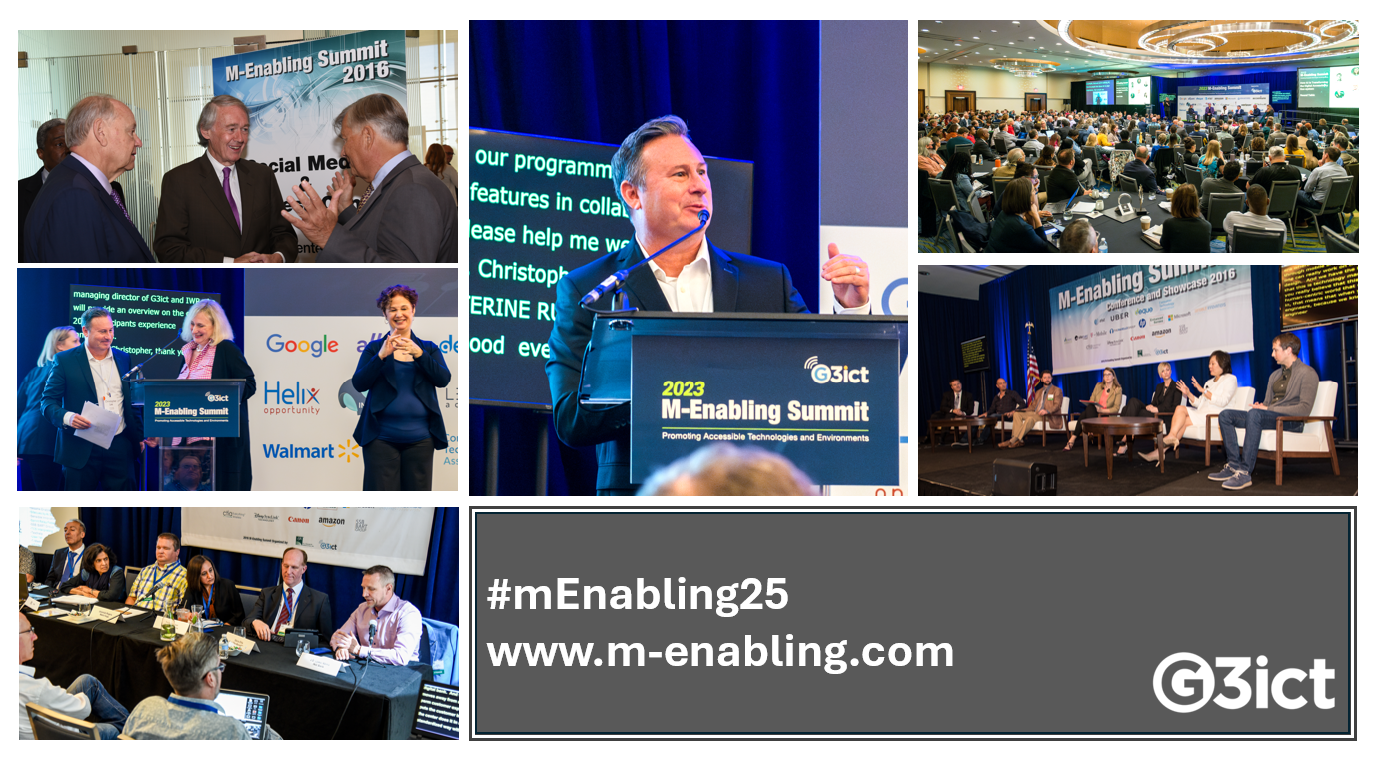
14 Years M-Enabling Summit: Advocating for Digital Accessibility Innovation on a Global Scale. Join Us!
Washington, D.C., October 6-8, 2025
Notes:
14 Years M-Enabling Summit: Advocating for Digital Accessibility Innovation on a Global Scale. Join Us!
M-Enabling Summit, Washington, D.C., October 6-8, 2025
Photos from M-Enabling Summit throughout the years, including keynote speaker, Senator Ed Markey; G3ict President, Christopher Lee and Vice President, Francesca Cesa Bianchi.

