Slide 1
It’s Time We #EnableEveryone.
Varun Chandak
Access to Success
Canada
Funding and accelerating assistive technologies
Thursday, 6 March 2025, 10:00 AM - 11:00 AM
Notes:
Varun Chandak, Access to Success, Canada.
Funding and accelerating assistive technologies
#ZeroCon24
Thursday, 6 March 2025, 10:00 AM - 11:00 AM
How many of you are innovators or entrepreneurs?

Slide 2

How many of you have been told your innovation is not scalable?

Slide 3
ATS Labs is a free, global accelerator for accessibility startups.
Notes:
Everything we do is designed to help accessibility innovations scale.

Slide 4


Designed for All Disabilities
A 3-month virtual accelerator for disability tech.
Programming – Focus on Inclusive Design
Resources – Accessibility Investments Database
Network – Inclusive Innovation Network
Funding – Cash and In-Kind Grants

Slide 5
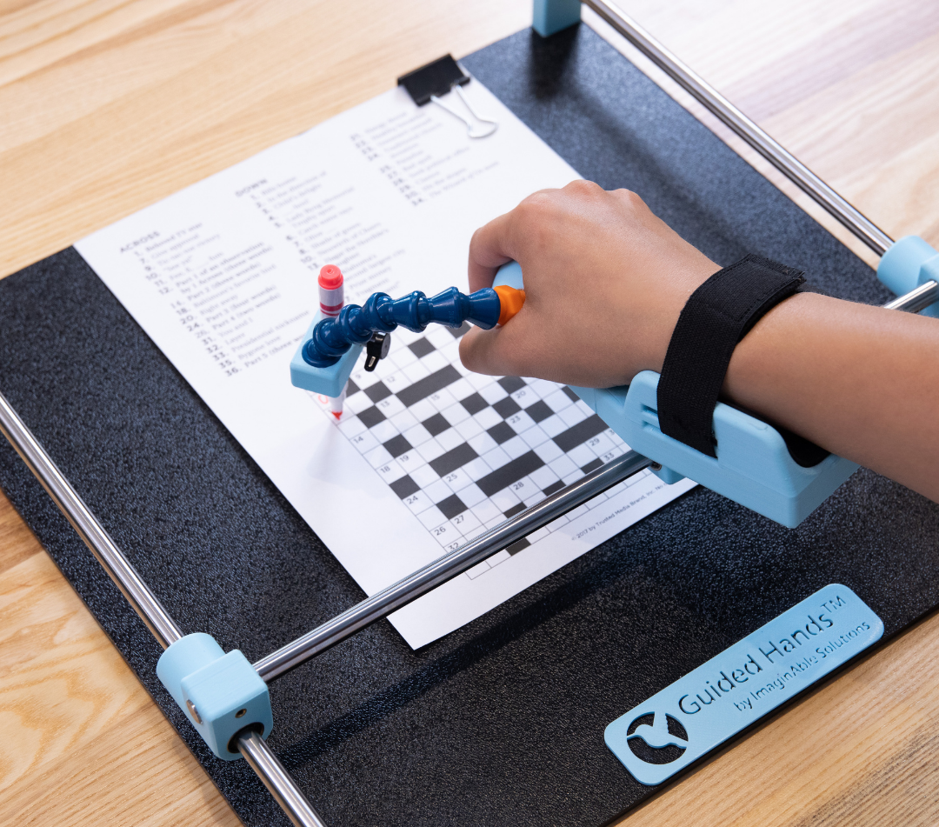
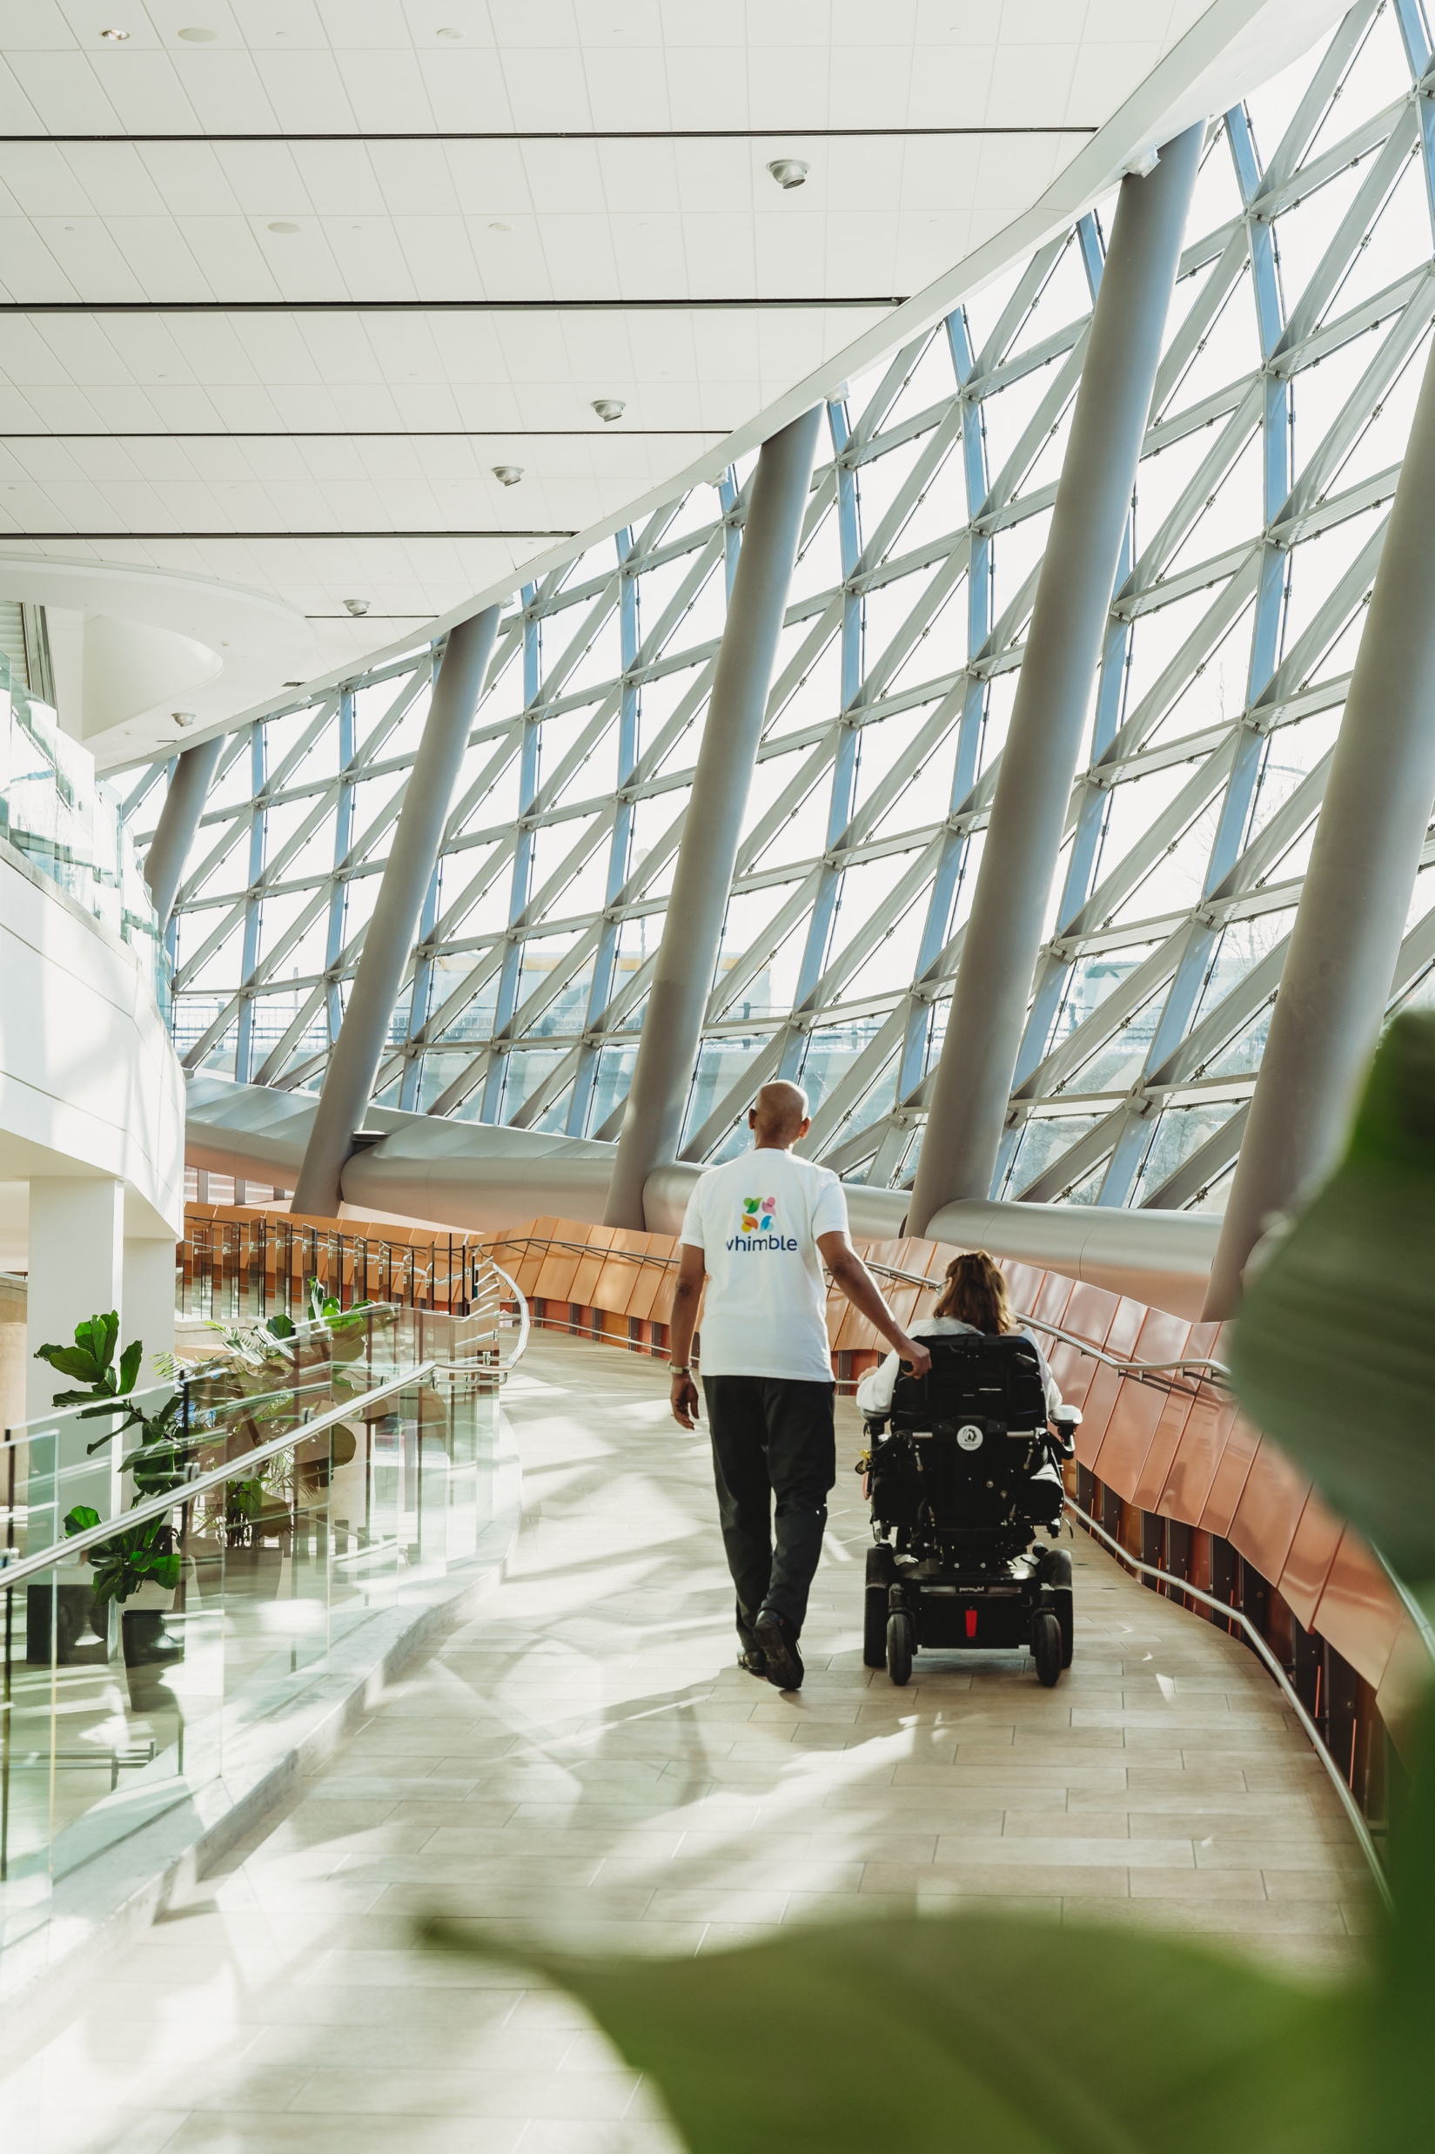

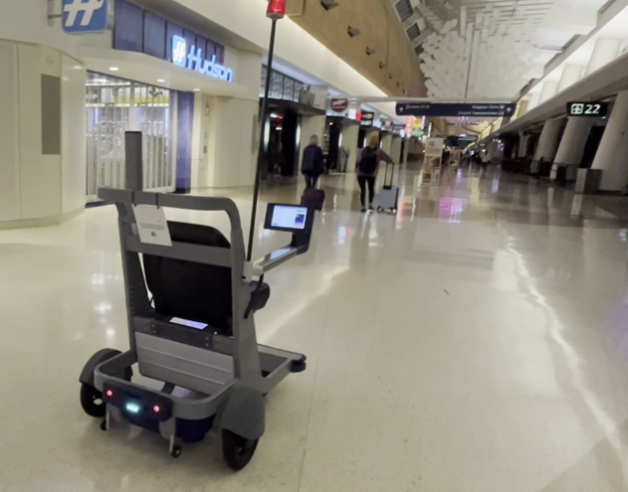
Designed to Scale
ImaginAble Solutions
Whimble
Good Trouble
Games
Blueberry Technologies

Slide 6


Meaningful Resources and Networks
Cities with Most Repeat Accessibility Investors
accesstosuccess.ca/AID

Slide 7
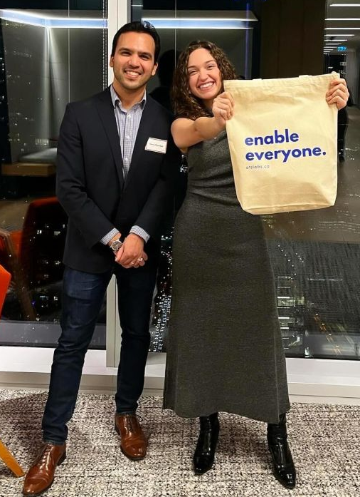
On a Mission to #EnableEveryone
5
60
Cohorts since 2019
Startups served
6
$35M
Countries represented
Funding raised
200+
200+
Hours of programming
Mentors and speakers
1 million people with disabilities benefitted to date.

Slide 8
Join us on our journey to Enable Everyone.
accesstosuccess.ca

