Slide 1

UNIFIED CHAMPION SCHOOLS
Emanuelle Dutra and Jesús Arenas
Brazil/Panama
Special Olympics Latin America
Inclusive Sports and Quality Education
Wednesday, 21 February 2024,
15:20-16:20 CET
Notes:
Thank you very much, Daniela and Zero Project for recognizing the innovative and integral work that Special Olympics Latin America on behalf of Special Olympics does as a contribution to the educational inclusion of people with intellectual disabilities, thanks to the Unified Champion Schools program.

Slide 2
1
Provide year-round sports training and athletic competition in a variety of Olympic-type sports for children and adults with intellectual disabilities, giving them continuing opportunities to develop physical fitness, demonstrate courage, experience joy and participate in a sharing of gifts, skills and friendship with their families, other Special Olympics athletes and the community.
9
6
8
Notes:
Since 1968, Special Olympics has the mission to provide year-round sports training and athletic competition in a variety of Olympic-type sports for children and adults with intellectual disabilities, giving them continuing opportunities to develop physical fitness, demonstrate courage, experience joy and participate in a sharing of gifts, skills and friendship with their families, other Special Olympics athletes and the community.

Slide 3
1
Provide year-round sports training and athletic competition in a variety of Olympic-type sports for children and adults with intellectual disabilities, giving them continuing opportunities to develop physical fitness, demonstrate courage, experience joy and participate in a sharing of gifts, skills and friendship with their families, other Special Olympics athletes and the community.
9
6
8

Slide 4

STIGMA
Notes:
And the programmatic offer of Unified Champion Schools is based on this mission, however, as a changing and constantly improving Organization in a changing world, we also frame our efforts to continue reducing the stigma of exclusion and marginalization

Slide 5
EXCLUSION
STIGMA
Notes:
of exclusion

Slide 6
MARGINALIZATION
STIGMA
EXCLUSION
Notes:
and marginalization

Slide 7
SUSTAINABLE
DEVELOPMENT
GOALS
STIGMA
EXCLUSION
MARGINALIZATION
Notes:
by adopting global agreements such as the Sustainable Development Goals, specifically:

Slide 8








SDGs related with the program Unified Schools
To advocate and educate
Social and leadership skills that support careers
Physical and mental health
To empower women
Strong communities through local programming
Inclusion of people with ID
To achieve collaboration and partnerships
justice for people with disabilities
Notes:
by adopting global agreements such as the Sustainable Development Goals, specifically:
GOAL 3: To improve physical and mental health via Health programming
GOAL 4: To advocate and educate through Unified Champion Schools.
GOAL 5: To empower women through sport, health, youth and leadership programs
GOAL 8: To increase social and leadership skills that support careers
GOAL 10: To promote the inclusion of people with Intellectual Disabilities
GOAL 11: To strengthen communities through local programming
GOAL 16: To create social justice for people with disabilities, leveraging major invents to foster goodwill
GOAL 17: To achieve collaboration and partnerships around the SDGS

Slide 9




Special Olimpics areas of intervention
INCLUSIVE SPORTS
INCLUSIVE
HEALTH
INCLUSIVE LEADERSHIP
INCLUSIVE
EDUCATION
Notes:
These actions are focused at the organizational level, through four pillars: Sports, Health, Inclusive Leadership and Education.

Slide 10
PHYSICAL
INCLUSION
Notes:
From the age of two, that is, from early childhood, we support children in Latin America to experience something beyond simple physical inclusion,

Slide 11
SOCIAL
INCLUSION
Notes:
this being a social inclusion thanks to the three components of Unified Champion Schools:

Slide 12
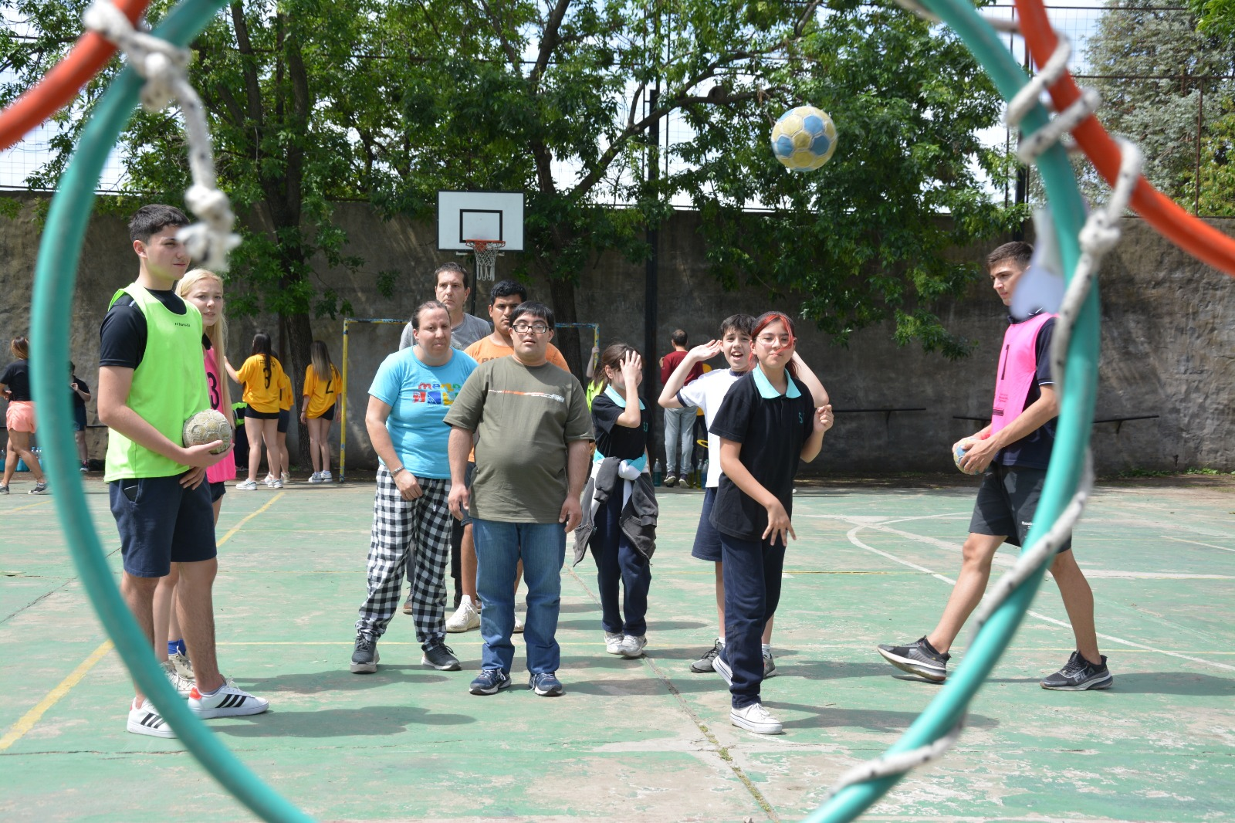
UNIFIED SPORTS
(ADAPTATIVE SPORTS)
Notes:
Unified Sports (Adaptive Sports) – to be enjoyed by everyone.

Slide 13
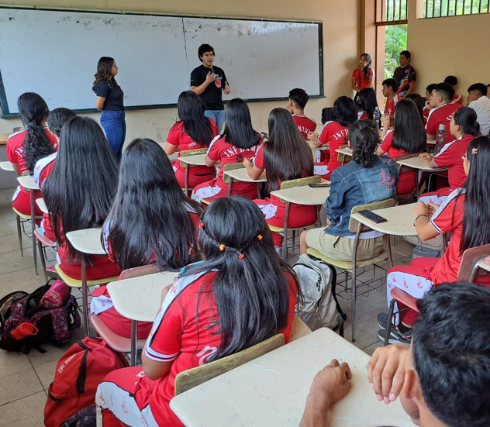
WHOLE SCHOOL ENGAGEMENT (CAPACITY-BUILDING)
Notes:
Whole School Engagement (Capacity-building) - to create inclusive educational environments.

Slide 14
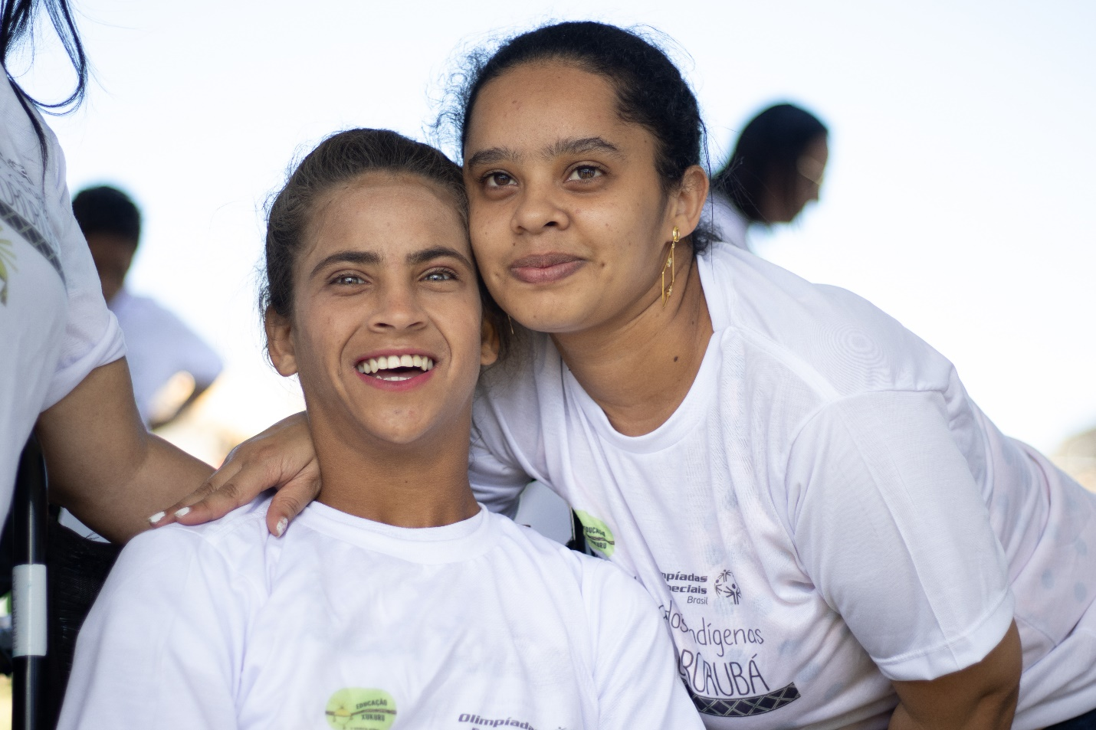
INCLUSIVE YOUTH LEADERSHIP
(UNIFIED EXPERIENCES)
Notes:
Inclusive Youth Leadership (Unified experiences) – to promote shared spaces among peers and with people in the community by the development and celebration of sports events and community projects.

Slide 15
Social network in the unified schools
STUDENTS
TEAMMATES
FRIENDS
Notes:
With these offer we spread a simple message: Everyone can become, in addition to students, teammates or even friends.

Slide 16
IF WE TEACH CHILDREN TO PLAY TOGETHER, THEY CAN LEARN AND LIVE TOGETHER
STUDENTS
TEAMMATES
FRIENDS
Notes:
If we teach children to play together, they can learn and live together.
But this will continue happening if we allow the participation of people of all abilities.

Slide 17



Partners for the Unified School Project
Notes:
Unified Champion Schools is a program that is developed throughout the Latin American region, however, thanks to global partners (SNF and MBZ),

Slide 18
Countries where the Project has been implemented
CHILE
MEXICO
BRAZIL
PARAGUAY
ARGENTINA
EL SALVADOR
DOMINICAN REPUBLIC
Notes:
7 countries (Mexico, Chile, Paraguay, Argentina, El Salvador, Dominican Republic and Brazil)

Slide 19
Stakeholders for the social inclusion
EDUCATIONAL INSTITUTIONS
FAMILIES
SOCIAL INCLUSION NETWORK
COMMUNITIES
GOVERNMENTS
Notes:
implement this programming with a structure that has contributed to the construction of a social inclusion network that transcends educational institutions and involves entire families, communities and now local and national governments

Slide 20
GLOBAL COALITION FOR INCLUSION
Notes:
through what we call the GLOBAL COALITION FOR INCLUSION (which Christo will surely expand on this topic),

Slide 21




GLOBAL COALITION FOR INCLUSION
PLAYING GAMES
EXCHANGING OPINIONS
PRACTICING SPORTS
INTERGENERATIONAL DIALOGUE
Notes:
have joined forces to provide the rights we all deserve through simple actions such as playing games, practicing sports, providing spaces for exchanging opinions and promoting intergenerational dialogue.

Slide 22
INVITE YOU TO CONTINUE EXPANDING OUR LIFE CHANGING IMPACT
Notes:
And we are here to invite you to continue expanding our life changing impact that so far has reached in Latin America:

Slide 23
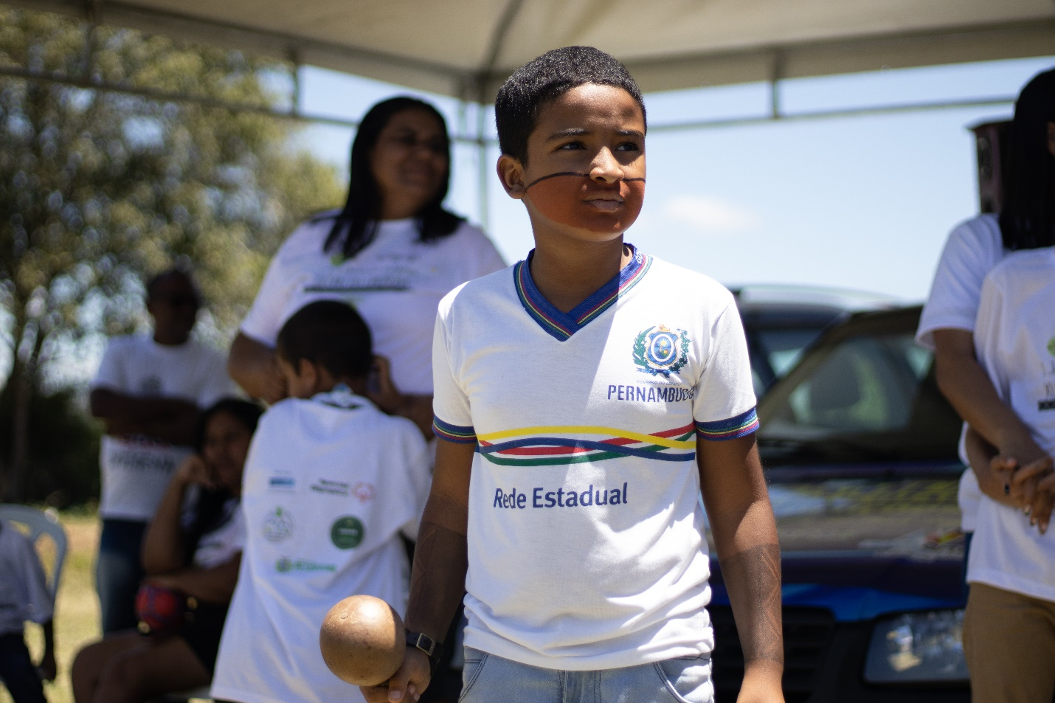
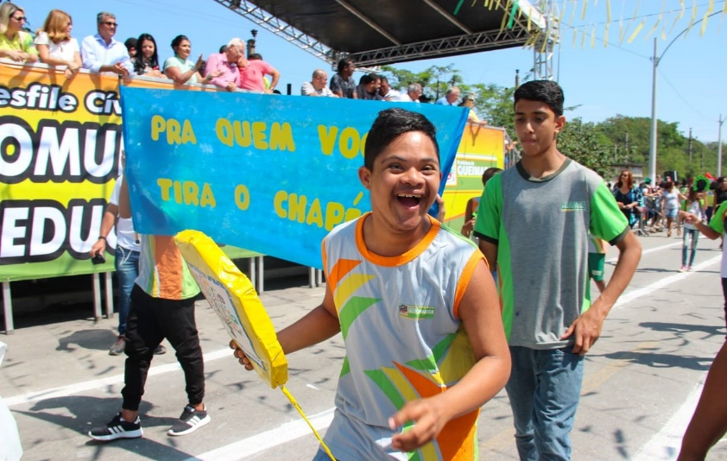
+ 16,000 YOUTH WITH AND WITHOUT ID
Notes:
+ 16,000 youth with and without ID

Slide 24
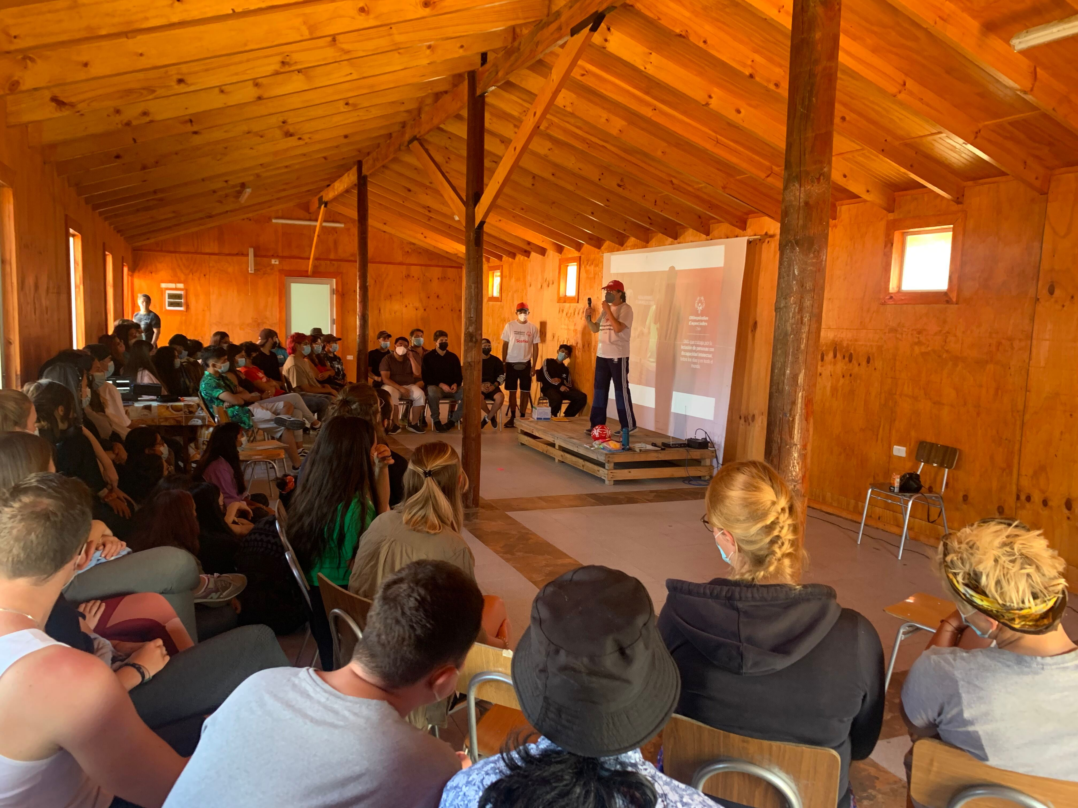
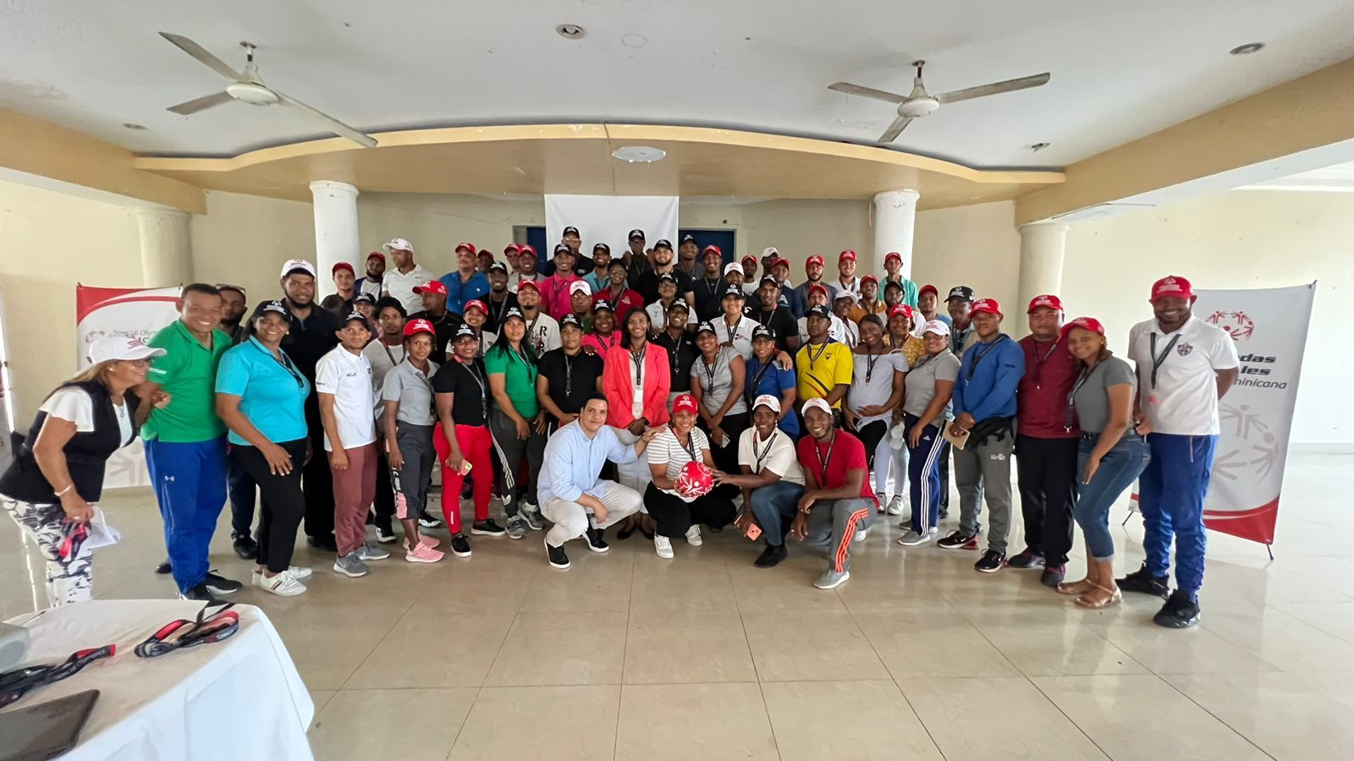
+ 11,000 EDUCATORS
Notes:
+ 11,000 educators

Slide 25
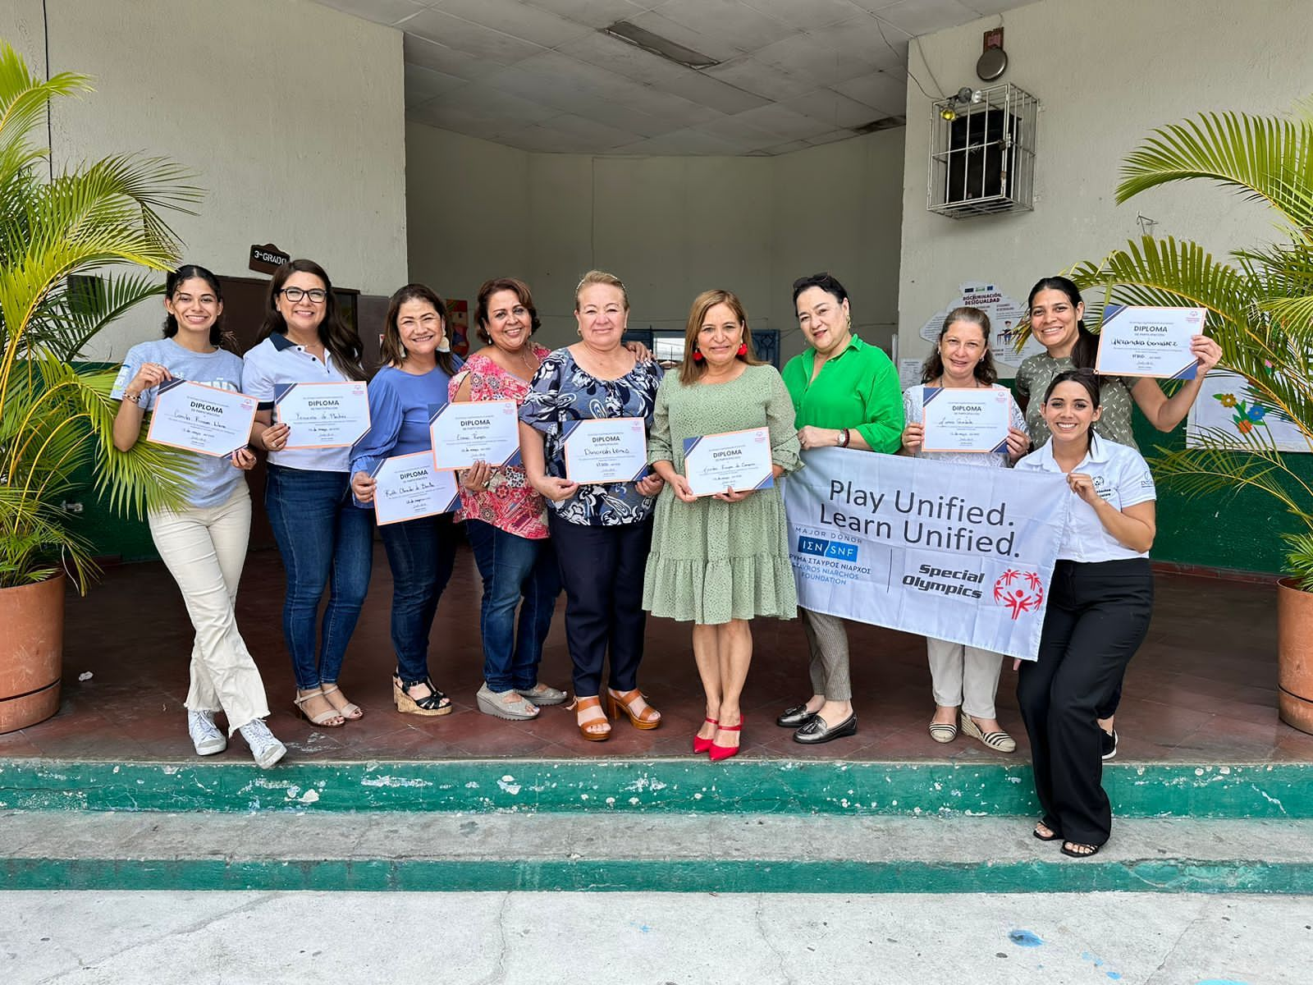
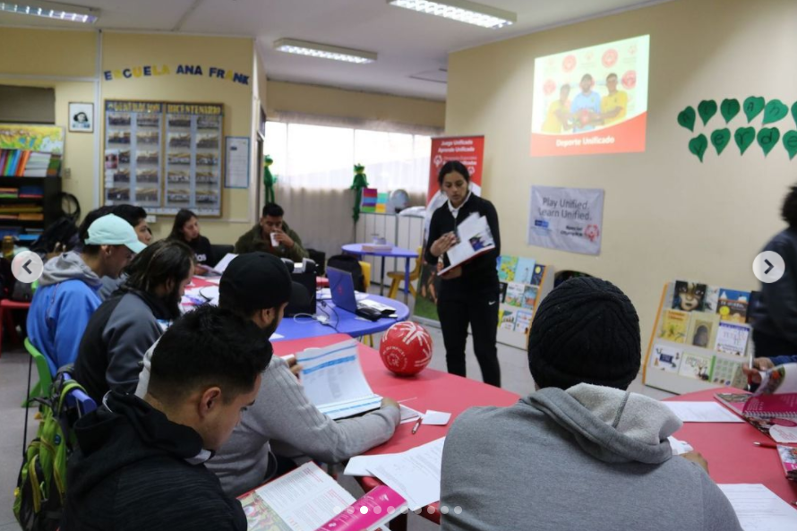
+1,000 schools
334 of these schools were added during 2023 alone
Notes:
+1,000 schools, of this total, 334 of these schools were added during 2023 alone.

Slide 26
Inclusive Mindset
UNIVERSAL
DIGNITY
EMPATHY & PERSPECTIVE TAKING
COURAGEOUS ACTION
KNOWLEDGE
SKILLS
EXPERIENCES
INDIVIDUAL
SOCIAL
COMMUNITY
VALUES
COMPETENCIES
CHARACTER
Notes:
As a result of the implementation of the Unified Schools, we develop inclusive mindsets based on 3 pillars:
Universal Dignity: That refers to what we value, means recognizing that everyone is worthy of respect.
Empathy & Perspective Taking: That refers to what we understand about other people’s feelings and ideas.
And Courageous Action: That refers to what we do, a willingness to speak up when something is wrong or harmful.
This mindset develops knowledge, skills, and experiences in individuals like me, our schoolmates and all of you who are part of the community.
Manu’ story:
My experience in school was not an inclusive one, it was not until I joined Special Olympics and started playing Unified Football that I started to be less shy, express myself better and have fun playing with others. Even some of my teammates changed their attitudes and perspectives towards people like me and now we have become a family.
This is what opportunities like Unified School are about, to change society’s view when it comes to inclusion in a natural and fun way. I would love to have had this opportunity before in my early school years, I could have made more friends, and I could have had teachers that didn’t think I was “crazy” for just being who I am.
I always think about how many people are struggling in schools and are isolated from others. I know how it is, I have been there. I invite you all to make a difference to me in helping others to not feel like they are not important, and that they don’t belong anywhere.
When we work together today, a better society is being developed not only for the future but for everyday starting now. I don’t want to talk about inclusion for the rest of my life and I don’t want the next generation to talk about inclusion, what I want is for all of us to live inclusion, but we have to act now.

Slide 27

CHOOSE TO INCLUDE,
THANK YOU!

