Slide 1
Count Me In: Improving nutrition and feeding of children with disabilities
Kate Miller, MS, CCC-SLP, CLC
Carolyn Moore, MPH
SPOON
United States of America
Early childhood interventions tailored for low-income and rural settings
21 February, Wednesday, 13:20-14:40
Notes:
Count Me In: Improving nutrition and feeding of children with disabilities
Kate Miller & Carolyn Moore, SPOON
United States of America
Early childhood interventions tailored for low-income and rural settings
21 February, 13:20
#ZeroCon24

Slide 2
Nutrition, feeding, and disability
Children with disabilities experience high rates of malnutrition
Estimated 30-80% of children with disabilities experience feeding difficulties
Eating and drinking are developmental skills
Nutrition links to rights to participation and family care
Children with disabilities are often excluded from nutrition policies, programs, and investments
Notes:
Children with disabilities 3 times more likely to be malnourished, twice as likely to die from malnutrition.
Up to 80% of children with disabilities have feeding difficulties.
Malnutrition and lack of services are major drivers of institutionalization and improving nutrition can facilitate children being able to fulfill their rights
Often excluded from nutrition policies, programs, and investments.

Slide 3
SPOON and the project
Global nonprofit focused on feeding and nutrition of children with disabilities
Our model combines training, tools, and advocacy to maximize impact
Supports children, families, service providers, and policy makers
Implemented in partnership with civil society and governments
Notes:
SPOON is focused on improving feeding and nutrition for children with disabilities, including children without family care, who often have feeding difficulties (such as choking or coughing during feeding) and malnutrition. We combine training, a digital health app, and advocacy in a system-wide approach to reduce malnutrition. Implemented in partnership with civil society and governments.

Slide 4
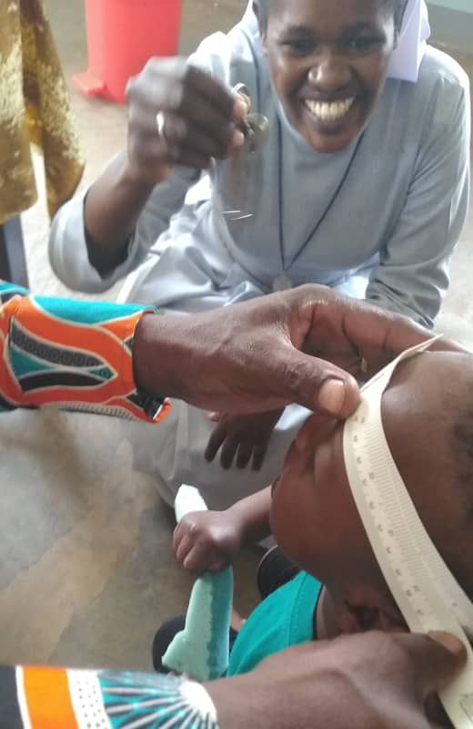
Training
Equips service providers in health, child care, and social work sectors
Service providers use training to support families and caregivers
Skills-based
Digital and in-person curriculum
Topics include Developmental Feeding Skills, Best Practices for Mealtime, and Counseling Caregivers on Nutrition & Feeding
Notes:
We train service providers to build skills in nutrition, feeding, disability, and child development. Service providers use training to coach and support families and caregivers.
Trainees acquire skills through practice and application of knowledge.
Training covers topics such as Developmental Feeding Skills, Best Practices for Mealtime, and Counseling Caregivers on Nutrition & Feeding, to name a few.

Slide 5
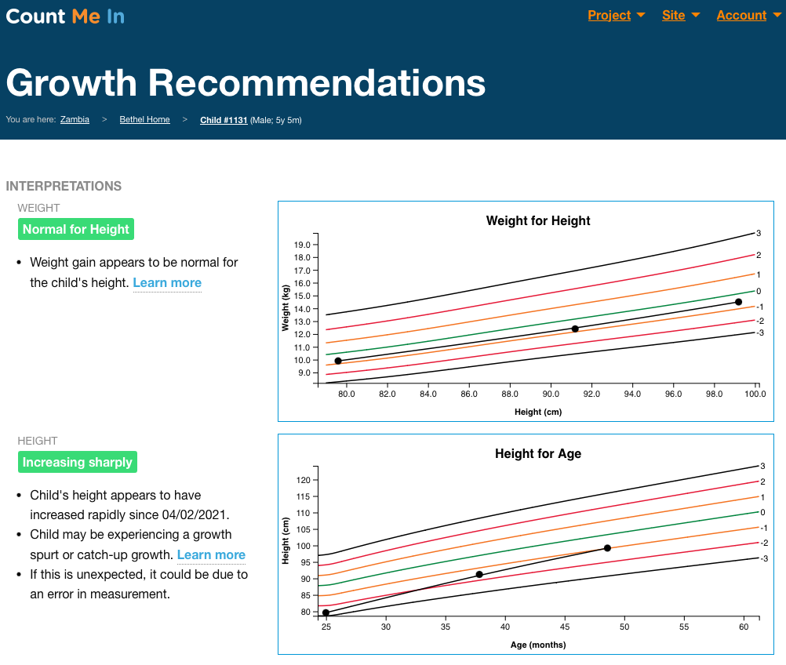
Count Me In app
SPOON’s digital health app: Count Me In
Modules on growth, anemia, feeding, and developmental screening
Reminders and resources to put training into practice
Facilitates assessments and monitoring
Individualized recommendations for caregivers and care plans for each child
Notes:
Count Me In, a web-based app, bridges training with practice to strengthen nutrition care delivery and generate data.
Four modules: growth, anemia, mealtime, and developmental screening.
The app guides the user to assess and monitor children’s status and generates individualized care plans used to counsel caregivers.
Generates data and easy-to-read reports to aid decision-making.
Screenshots show pages found in Count Me In.

Slide 6
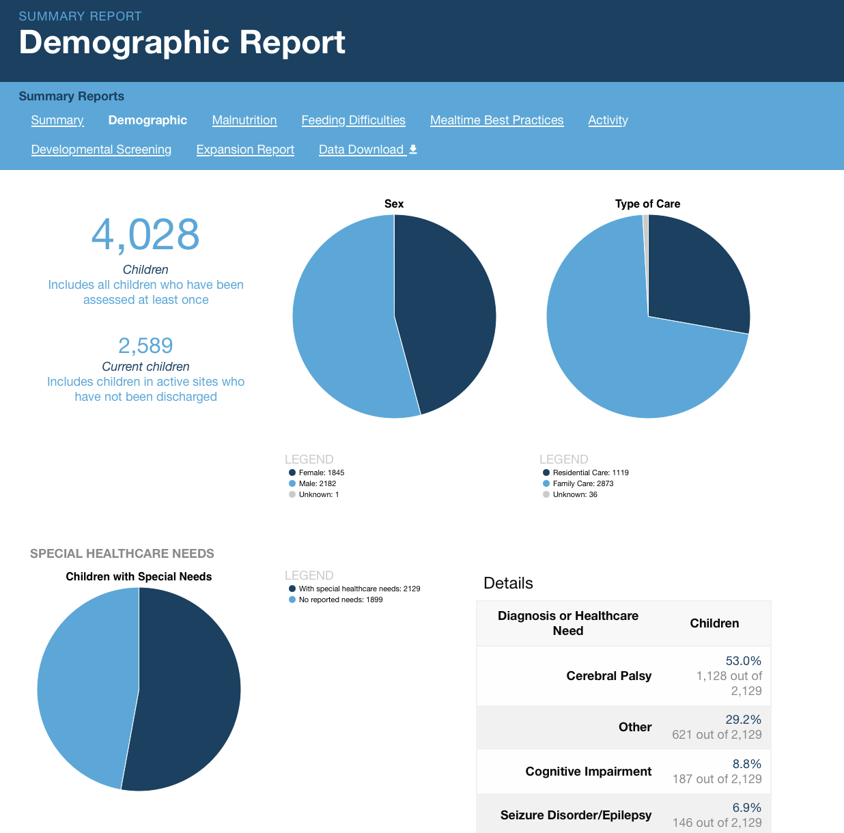
Advocacy
Count Me In generates data and reports on nutrition and feeding status of children with disabilities
Used to inform outreach and technical support for policies, strategies, guidelines, and tools
Outreach to practitioners and funders
Global and national coalitions
Notes:
We don’t just replicate our successful programs, we leverage our data to reach as many children as possible through advocacy. Data collected provides insight into the needs of children with disabilities and demonstrate changes over time. We work to ensure that the evidence our programs generate is shared with decision makers and used to increase focus on this population. Screenshots show sample report from Count Me In.

Slide 7
Impact
In 2022, trained nearly 600 people in 9 countries
More than 4,000 children assessed in Count Me In
Reductions in key indicators of malnutrition
Contributed to advocacy priorities in Lesotho, Zambia, and Uganda
Improving nutrition has long-ranging benefits for children
Notes:
We have had success reducing key indicators of malnutrition and ensuring that children with disabilities are fed in a safe, responsive manner. This work has contributed to advocacy priorities in Lesotho, Zambia, and Uganda. We estimate that millions of children will also benefit from inclusive policies. Improving nutrition also has long-ranging benefits for children. Proper nutrition and safe and nurturing feeding environments support long-term health and development.

Slide 8
Program Examples
Zambia: Incorporating nutrition into programs and policies serving families of children with disabilities
Lesotho: Linking developmental screening and nutrition screening in preschools and health centers
Uganda: Integrating nutrition and feeding into family care and deinstitutionalization, and improving data on nutrition and feeding status of children with disabilities
Notes:
Zambia: Incorporating nutrition into programs and policies that serve
Lesotho: Linking developmental screening and nutrition screening in preschools and health centers
Uganda: Integrating nutrition and feeding into family care and deinstitutionalization, and improving data on nutrition and feeding status

Slide 9
Recommendations and next steps
Recommendations:
  Incorporate nutrition into programs serving children with disabilities
  Prioritize disability inclusion in nutrition systems
  Link training, tools, and advocacy for impact
  Improve data and accountability
Next steps:
  Developing Count Me In Plus
  Assess and track the feeding and nutrition of 10,000 children
  Use data and partnerships to advocate for inclusive policies, investments, and services
Notes:
Recommendations:
Incorporate nutrition into all programs serving children with disabilities
Prioritize disability inclusion in nutrition systems
Link training, tools, and advocacy
Importance of partnerships and coalitions
Improve data and accountability
Up next, SPOON is developing a new version of the app to provide a mobile-first experience, offline functionality, and expanded functionality. We aim to assess 10,000 children, and use that data for advocacy.

Slide 10
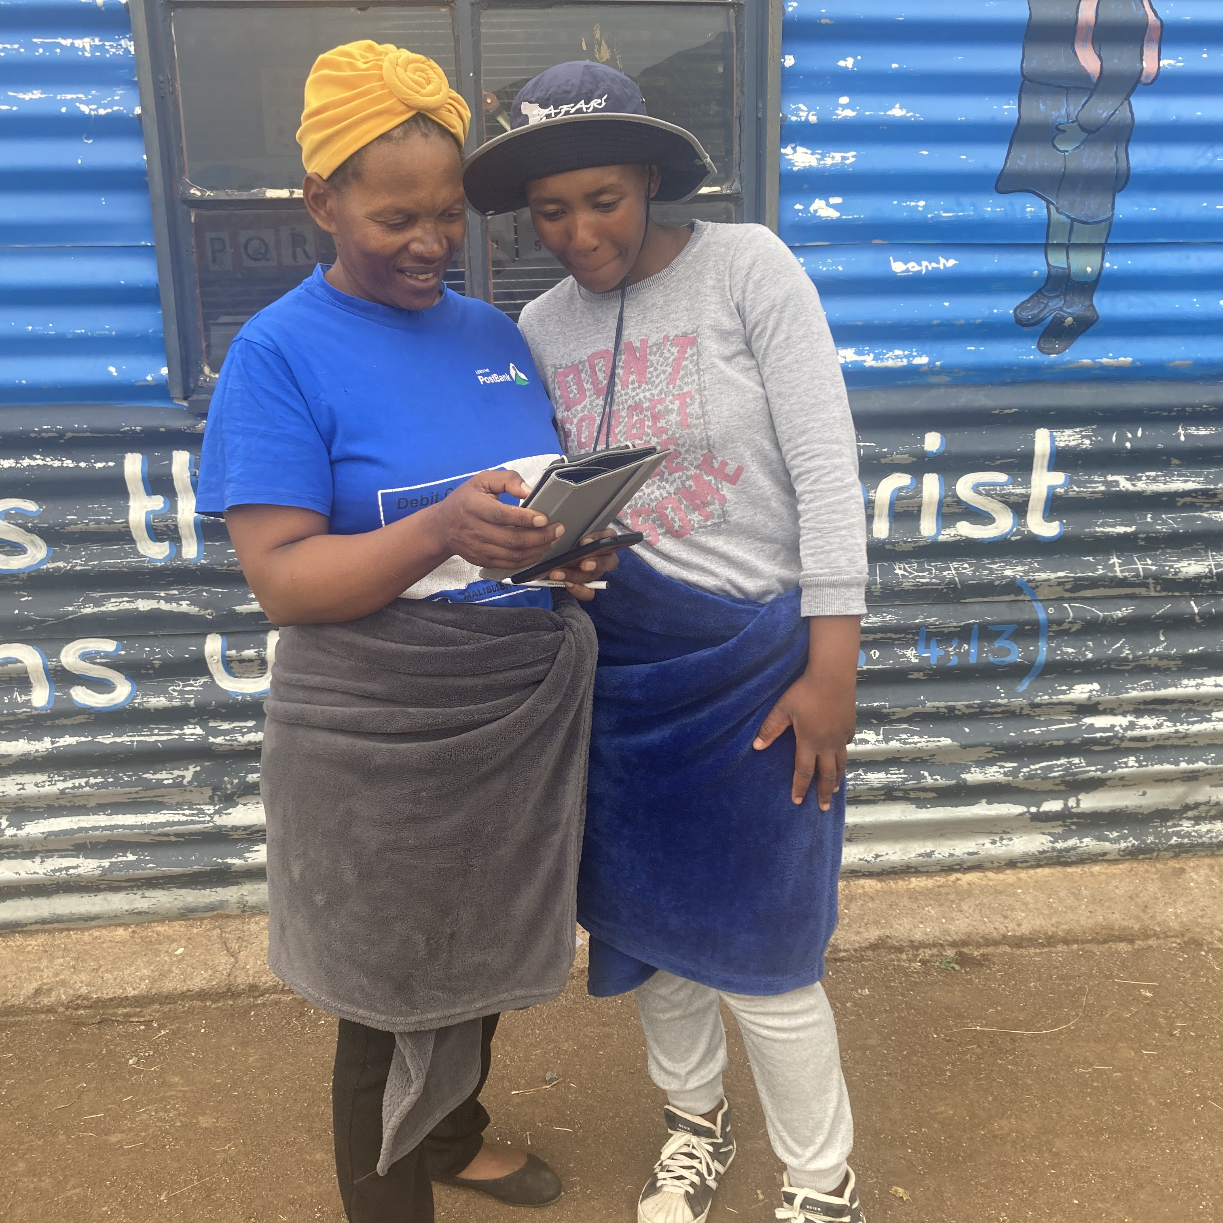
Sustainability
Replicated across countries, translated into six languages
Customization in partnership with TAGs
Aligned with guidelines, best practices, customs and contextual factors
Country-specific advocacy goals
Thank you!
katem@spoonfoundation.org
Notes:
Programs replicated and customized within and across countries.
Training curriculum used in more than 10 countries.
Count Me In translated into six languages and adopted in eight countries
Supported different advocacy goals in each country
Components of the work have been adopted in others
This work and implementation of Count Me In is funded through grants and donations from foundations, individuals, and corporations, both to SPOON and our partners.
Thank you!

