Slide 1
Upskilling and Matching Academy for Employment of Disabled Professionals
Mike Hess
Blind Institute of Technology (BIT)
USA (with global presence)
ICT Solutions Supporting the Blind and Visually Impaired
Wednesday 5 March 2025, 17:00-18:00
#ZeroCon25
Notes:
Please add your notes here.
Title; First name, last name of speaker(s); Name of Organization, Name of Country, Name of Session (as written in Agenda)
#ZeroCon24
Day and Time of Session

Slide 2
Empowering Disabled Professionals Through Accessible IT Training
Blind Institute of Technology (BIT), a U.S.-based NGO, has developed an innovative IT training and upskilling programme for disabled professionals, equipping them with the technical skills needed to compete in today’s workforce. Offered fully online, the programme is designed with accessibility in mind.
BIT collaborates with employers to secure competitive jobs for graduates, with starting salaries ranging from $40,000 to six figures. In the most recent 18 months, 251 students completed the programme, with many securing employment in tech roles. The initiative is officially recognized by the U.S. Department of Labor.
Driven by this success, BIT expanded internationally and is launching its programme in the EU, further advancing digital inclusion on a global scale.

Slide 3
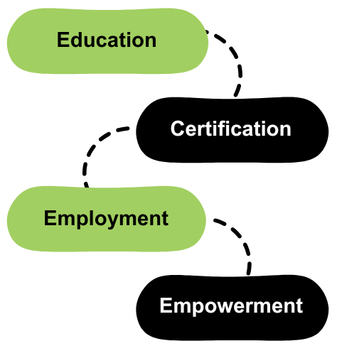
Breaking Barriers with Accessible Training and Employment
BIT’s three-phased approach:
Education: Accessible online courses tailored for
professionals with disabilities.
Certification: Industry-recognized credentials: Salesforce
Administrator and CPACC.
Opportunity: Job placements through partnerships with
employers and apprenticeship programs.
BIT is the only Salesforce-approved training provider for
people with disabilities, offering complimentary globally accessible courses.
Notes:
Sample Slide: presenting three points on our project and the relationship to this year’s theme of the Zero Project Conference. Point 1; Point 2; Point 3 connect together in this way.

Slide 4

Impact, Success, and the Future
Success Factors:
  Strong partnerships with corporations like Salesforce and Randstad.
  Complimentary training eliminates financial barriers for participants.
  Graduates enter competitive industries ready to succeed.
Future Vision:
  Replicate the BIT model in additional countries.
  Develop additional courses to meet emerging industry needs.
  Developing future-ready curricula to meet evolving industry demands.

