Slide 1

Accessibility Map - a nationwide platform with a search tool for medical facilities and specialist clinics adapted to the needs of people with disabilities
Kamil Zięba
Fundacja Avalon
Poland
Professionals with disabilities in health-care careers
Thursday 6 March 2025 | 10:20 - 11:20
Notes:
Please add your notes here.
Title; First name, last name of speaker(s); Name of Organization, Name of Country, Name of Session (as written in Agenda)
#ZeroCon24
Day and Time of Session

Slide 2
Who are we?
Avalon Foundation:
A nationwide non-governmental organization, at the front of Polish organizations for persons with disabilities.
Established in 2006.
Supports people with disabilities and chronically ill people so that they can lead an active life.
High-quality services, including fundraising, rehabilitation, promoting sports activities, and education.
Notes:
Avalon Foundation – is a nationwide non-governmental organization established in 2006.
Thanks to efficient management and ensuring high quality of services provided, we have been at the forefront of Polish non-governmental organizations dealing with the issue of disability for years.
We support people with disabilities and chronically ill people so that they can be active. We help in raising funds, rehabilitate, promote sports activity, and educate.
We believe that a person with a disability can be independent and active in every sphere of their life. We are committed to changing the perception of disability and of people with disabilities in the eyes of society.

Slide 3
Our vision
We believe a person with a disability can be independent and active in every sphere of their life.
We are committed to changing the perception of disability and of people with disabilities in the eyes of society.
Notes:
Avalon Foundation – is a nationwide non-governmental organization established in 2006.
Thanks to efficient management and ensuring high quality of services provided, we have been at the forefront of Polish non-governmental organizations dealing with the issue of disability for years.
We support people with disabilities and chronically ill people so that they can be active. We help in raising funds, rehabilitate, promote sports activity, and educate.
We believe that a person with a disability can be independent and active in every sphere of their life. We are committed to changing the perception of disability and of people with disabilities in the eyes of society.

Slide 4
Accessibility Map
An interactive map of accessible services.
A search tool, for medical facilities adapted to needs of patients with disabilities, as well as healthcare professionals with experience in admitting such patients.
Over 350 medical entities.
Since the website was launched, 21.752 people have used it.
Thanks to the Accessibility Map, we enable people with disabilities equal access to medical care and the opportunity to use healthcare services in the most independent way possible.
Notes:
Foundation's Accessibillty Map is an interactive map of accessible services, which doubles as a search tool, thanks to which people with disabilities can find a medical facility adapted to their needs, as well as doctors and specialists with experience in admitting patients with disabilities. This is an innovative project in Poland where people with disabilities can search for an appropriate medical office based on specific, very detailed requirements and doctors of all specializations.
The tool is still being improved, currently the database of medical entities includes over 350. Since the website was launched, 21,752 people have used it. Thanks to the Accessibility Map, we enable people with disabilities equal access to medical care and the opportunity to use the services of e specialist the most i independent and independent way possible. People with physical disabilities, people with sensory disabilities and neurodivergent people can find an appropriately adapted facility.

Slide 5
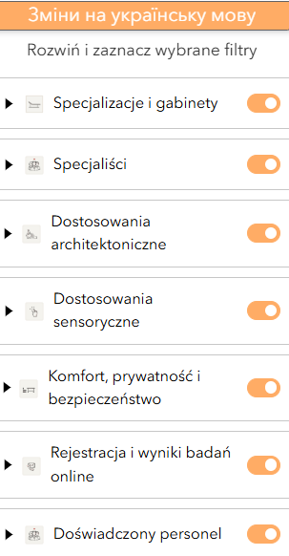
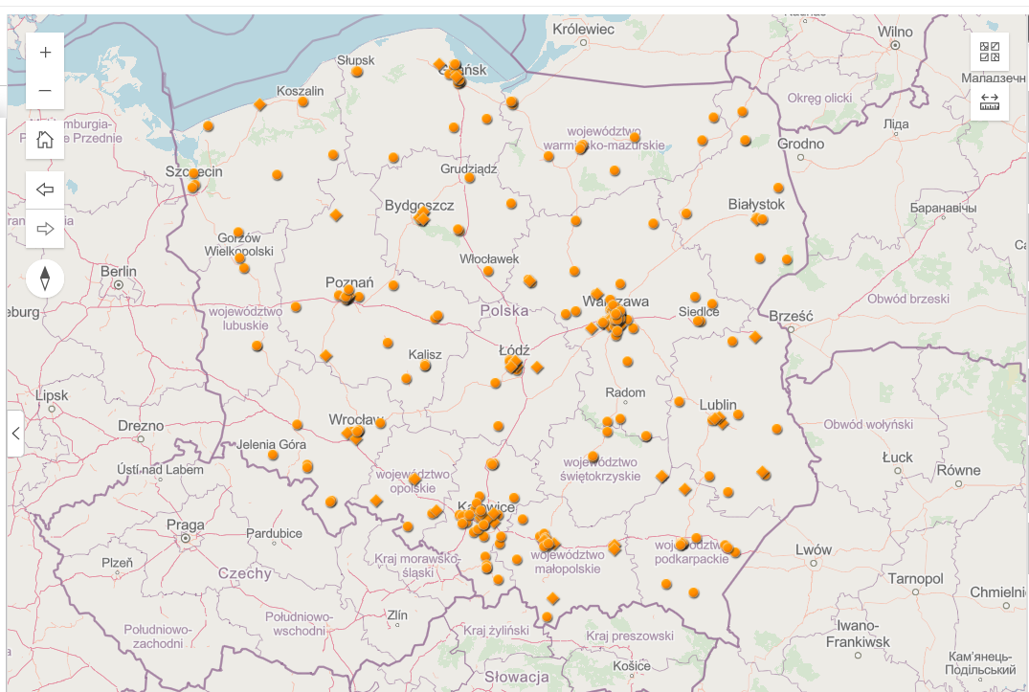
Home Page
Notes:
You can now see the Accessibility Map home page and some of the filters.
Available facilities are marked as points on the Map of Poland.
We divide the search filters into architectural adjustments, sensory adjustments, ensuring the comfort of privacy and security, staff experience and the form of registering the visit and receiving test results. The patient can also indicate the need for a personal assistant or check the possibility of extending the visit.
We have also more detailed filters. For example, according to architectural adaptations, these include:
1. Ability to reach the office using a wheelchair,
2. Horizontal markings for the blind,
3. Automatic doors,
4. Elevator,
5. Toilet for people with disabilities,
6. Adjustable gynaecological chair,
7. Lift for transferring people with mobility disabilities.
You can also check whether the facility has an alternative option to make an appointment or collect results and check the experience of medical and administrative Staff in working and communicating with patients with disabilities.

Slide 6
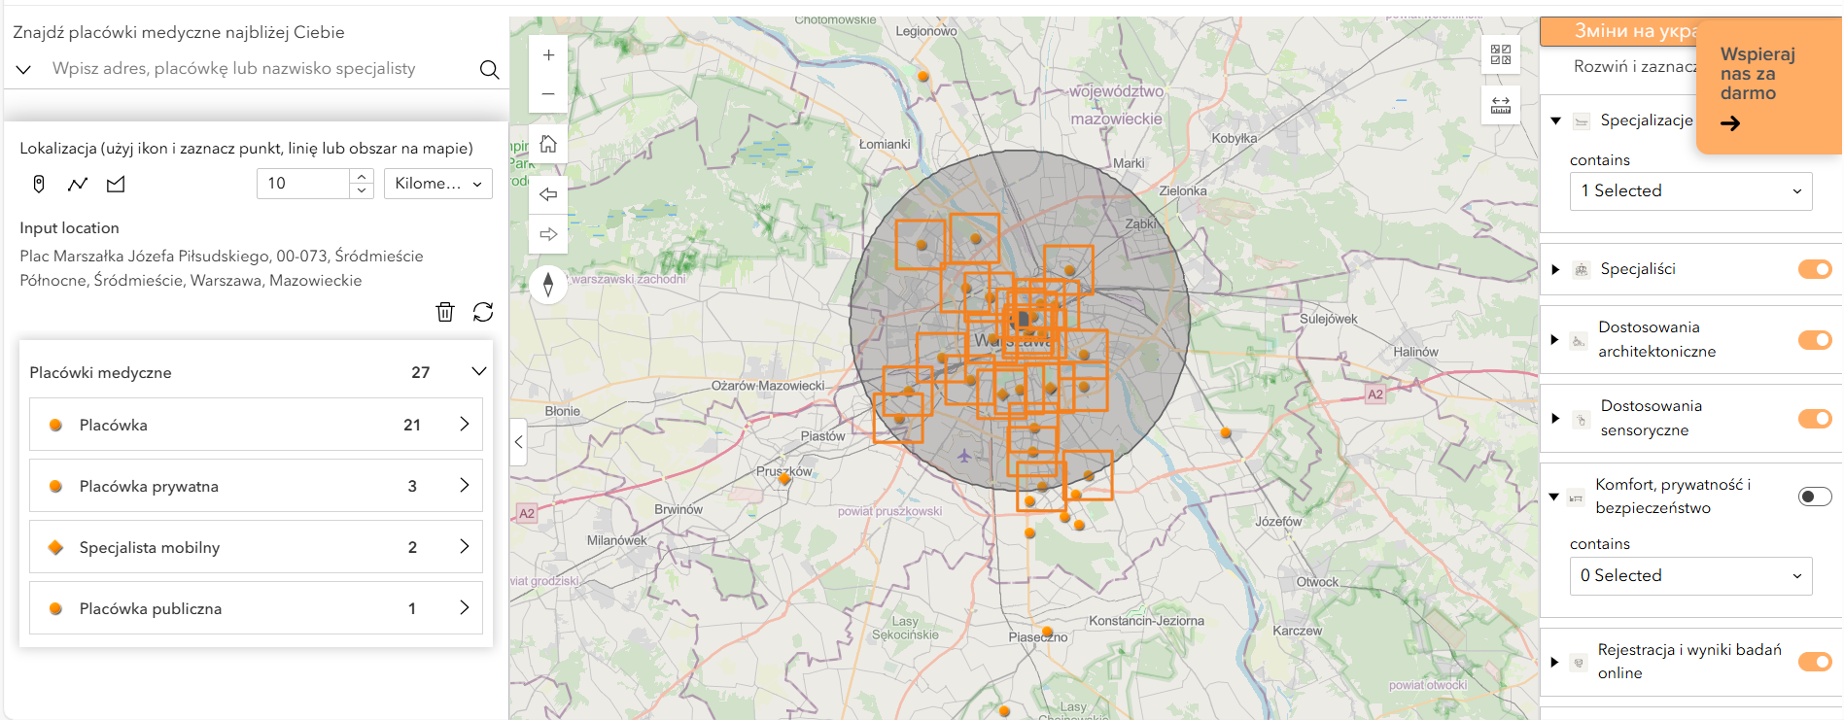
Functions and capabilities
Notes:
This an example of using the filters to find a facility that is in a 10 km radius of a chosen spot on the map.
Among the provided information are the availability of the healthcare professional to do house visits and if it’s a private practice or public.
We inform patients whether they can use the services free of charge through the National Health Fund or whether they have to pay for them themselves.
Thanks to the advanced geolocation function, you can find a suitable place in their area or by entering a specific address.
It’s adjustable, and you can enable or disable more filters to find the facility that suits the patient's needs best.

Slide 7
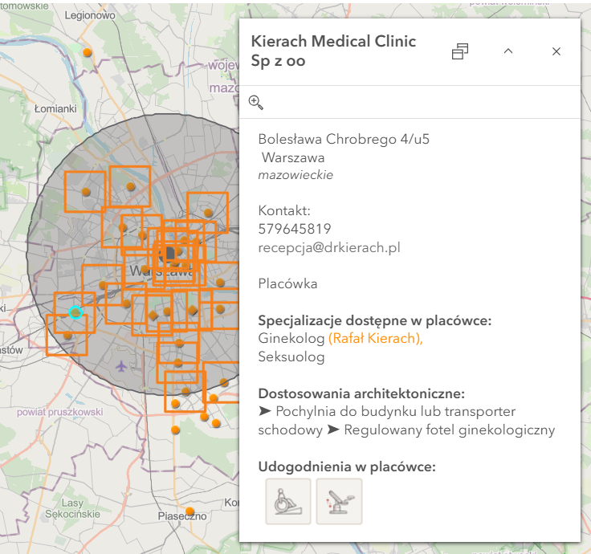
Functions and capabilities - example
Here is an example of the chosen facility, that displays the profile with the basic infomation in the database.
On the profile of each facility, you will find contact details and directions, what healthcare professionals you will find there (also the name of the doctor), and the adaptations and accessibility measures – not only in written form but also through symbols.
Notes:
On the profile of each facility, you will find detailed contact details and details on how to get to the facility. We inform whether the patient can use the services free of charge through the National Health Fund or whether they have to pay for it themselves.
We present what type of healthcare professionals work in this place.
Thanks to the advanced geolocation function, a patient can find a suitable place in their area or by entering a specific address, street or city

Slide 8
Accessibility adjustments
A real-life example of why the map is needed:
  A twenty-five-year-old larger-bodied girl who used a wheelchair was unable to undergo a gynecological examination.
  Lack of a suitable clinic in the entire province.
  No access to information.
The Accessibility map is a solution:
  The entire package of information: the adaptation of facilities, requirements and support needs in one place
  Multiple languages –so it will be accessible to even more persons
Notes:
I was deeply moved by the story of a twenty-five-year-old larger-bodied girl who used a wheelchair and was unable to undergo a gynecological examination due to the lack of a suitable clinic in the entire province. In addition to the lack of available facilities, access to information was also a problem. I spent many hours trying to find a suitable facility in her area. Thanks to our Accessibility Map, the entire package of information about adapting facilities to the requirements of people with different needs is easily accessible and concentrated in one place.
At the moment, our website works in Polish and Ukrainian. We are working on making it possible to use it in English.

Slide 9
Next steps
Easily to implement and replicate both in the database development scheme of various entities in a given country and internationally
Combine the Accessibility Map with another initiative run by the Avalon Extreme department - a map of accessible sports facilities
Our goal is to create a comprehensive platform that covers all accessible places in Poland.
In the future, we plan to create databases of adapted cultural institutions (museums, theaters, community centers), database of educational institutions, and a database of public entities such as city offices, banks, post offices, etc.).
Notes:
The ACCESSIBILITY MAP can be easily implemented and copied both in the database development scheme of various entities in a given country and internationally as the MAP of offers of each subsequent country interested in creating an inclusive an equal society that does not exclude due to access to reliable information about accessibility.
We are currently preparing to combine the Accessibility Map with another initiative run by the Avalon Extreme department - a map of accessible sports facilities, such as gyms and other places of physical activity adapted to the needs of people with disabilities. Our goal is to create a single, comprehensive platform that will cover all accessible places in Poland - In the future, we plan to create databases of adapted cultural institutions (museums, theaters, community centers), database of educational institutions, and database of public entities such as city offices, banks, post offices, etc.).

Slide 10
Thank you!
Notes:
Thank you for your attention and on behalf of the entire Avalon Foundation, we thank you for this wonderful award. Being here opens the door for us to share our solution with organizations and experts from all over the world and inspire others to create even more accessible spaces and services. I am sure that each of us, as we develop technologies and tools adapted to the needs of people with disabilities, will contribute to building a world where accessibility and equal opportunities become a matter of course.

